Slide 1
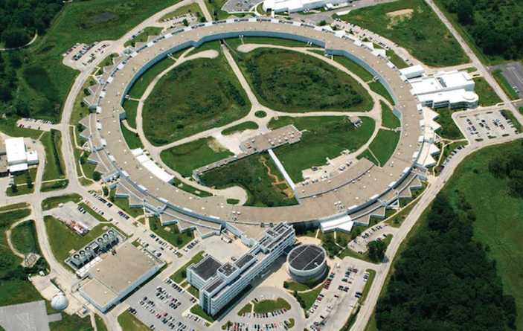
Data Management at the Advanced Photon source (APS)
RDA-PanSig Workshop on Interoperability
drhgfdjhngngfmhgmghmghjmghfmf
Nicholas Schwarz
Principal Computer Scientist, Group Leader
Scientific Software Engineering & Data Management
X-ray Science Division
Advanced Photon Source
3 - 4 April 2017
ALBA

Slide 2
Data Policy
Current APS Data Policy
The APS is committed to providing our users with their data in a timely and convenient fashion
Users are responsible for meeting their data management obligations (usually dictated by their funding agencies)
The APS does not guarantee long-term data archiving or management
Each beamline has its own data management plan
https://www1.aps.anl.gov/Users-Information/Help-Reference/Data-Management-Retrieval-Practices
DOE Statements
Not all data needs to be shared or preserved; cost/benefit should be considered
PI funded to collect data should comply with respective funding agency requirements for a data management plan, which should address how to validate results using preserved data, or how results may be reproduced without preserving data
http://science.energy.gov/funding-opportunities/digital-data-management

Slide 3

Data Storage Systems
Argonne Leadership Computing Facility (ALCF) prototypes
Petrel (Online Now)
IBM ESS (Elastic Storage Server) GL6
2 x POWER8 servers
  GPFS Native RAID
6 JBODS
  58 x 6 TB drives each
  2 x 400 GB SSD each (metadata)
  2 PB raw storage / 1.5 PB usable storage
Extrepid (Provisioning)
Data Direct Networks (DDN) S2A9900
  4 racks
  10 drawers of 60 drives per rack
  48 1TB and 12 3TB SATA drives in each drawer
  3 PB raw storage / 1.5 PB usable storage
Tape Backup
Utilize ALCF tape backup systems (via GPFS) when needed
Contact: Mike Papka, William Allcock, Ian Foster, Rachana Ananthakrishnan, Roger Sersted, Dave Wallis, Ken Sidorowicz, et al.

Slide 4
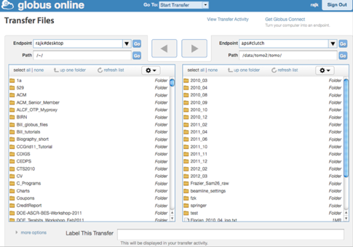
Data Management & Distribution
Globus Services
Collaborating closely with Globus Services team (www.globus.org) to leverage best-in-class tools for automating data transfer, file sharing, and maintaining data ownership / permissions.
Integration with orchid is being planned for both APS and ALCF.
Contact: Ian Foster, Rachana Ananthakrishnan, Mike Papka, William Allcock, Roger Sersted, Dave Wallis, Ken Sidorowicz, et al.

Slide 5
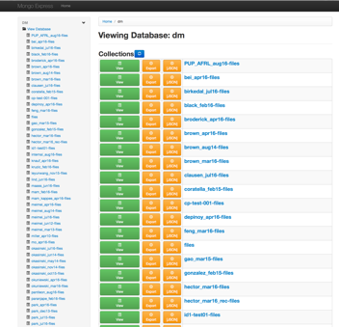
Data Management & Distribution
Storage Automation
Some beamlines have written their own tools for automating data transfer to storage systems using the Globus command line tools: 2-BM and 32-ID-C
Other beamlines are using a set of tools developed to aid in this process: 1-ID, 6-ID, 7-ID, 8-ID, 33-ID, and 34-ID
# Add a new experiment
> dm-add-experiment --experiment=s1id-data01 --name=s1id-data01
# Add users and roles
> dm-add-user-experiment-role --experiment=s1id-data01 --username=d12345 --role=User
# Start experiment
> dm-start-experiment --experiment=s1id-data01
# Monitor a directory for new files and transfer data to storage system
> dm-start-daq --experiment=s1id-data01 --data-directory=/local/s1id-data01
# Alternatively, data files may be uploaded after acquisition
> dm-upload --experiment=s1id-data01 --data-directory=/local/s1id-data01
# Other commands, such as dm-get-daq-info and dm-get-upload-info for checking status, and dm-stop-daq and dm-stop-experiment for stopping monitoring.
https://confluence.aps.anl.gov/display/DMGT/
~750 TB of data stored since October 2015
Contact: Rachana Ananthakrishnan, Francesco De Carlo, Ian Foster, Barbara Frosik, Sinisa Veseli, et al.

Slide 6
Next Steps
APS supports a variety of data formats: TIFFs, custom ASCII spec files, HDF5 (NeXuS, Data Exchange, others)
Both a database and an archival format
Exploration
BNL/NSLS-II’s BlueSky
  Next generation data acquisition system (long-term alternative to spec?)
  Metadata catalog – format agnostic
  NoSQL database is very flexible
ICAT
Materials Data Facility, Citrine, Invenio, PDB
US Collaborations: ExFaC; CAMERA; APS – NSLS-II analysis collaboration

Slide 7
Thank You

Slide 8
The submitted manuscript has been created by UChicago Argonne, LLC, Operator of Argonne National Laboratory (“Argonne”). Argonne, a U.S. Department of Energy Office of Science laboratory, is operated under Contract No. DE-AC02-06CH11357. The U.S. Government retains for itself, and others acting on its behalf, a paid-up nonexclusive, irrevocable worldwide license in said article to reproduce, prepare derivative works, distribute copies to the public, and perform publicly and display publicly, by or on behalf of the Government. The Department of Energy will provide public access to these results of federally sponsored research in accordance with the DOE Public Access Plan. http://energy.gov/downloads/doe-public-access-plan.

