Slide 1
Nexus Usage at SOLEIL
Common Data Model Access
A generic data access layer
Majid Ounsy: Software Development Manager, SOLEIL
Notes:
I will start with the genesis of the cdma project
-
Then I' will respond to this fondamental question : what is...
-
I'll present next the concepts of the CDMA
-
and finally I'll conclude with the current status and the planned roadmap

Slide 2
Agenda
Genesis
What is the CDMA?
Key concepts
Current status & Road map
Notes:
I will start with the genesis of the cdma project
-
Then I' will respond to this fondamental question : what is...
-
I'll present next the concepts of the CDMA
-
and finally I'll conclude with the current status and the planned roadmap

Slide 3
Genesis
What is the CDMA?
Key concepts
Current status & Road map

Slide 4
Genesis
About file formats
  Up to the 90' scientific data was recorded into ASCII text files and binary files for images (TIFF,...)
  The scientists used to develop their own data reduction application
  In the early 90', binary file formats like HDF were introduced in order to allow the recording of various kinds of data into the same container and to deal with big data arrays
      Scientists have less control on data format and on the read/write tools
      Needs of new tools to access the data (an HDF5 file content is not readable with simple text editors or showable with image viewer)
Notes:
A few words about file formats history in the synchrotron community
1-
2-
3-
the adoption of such a format implies :
-
-

Slide 5
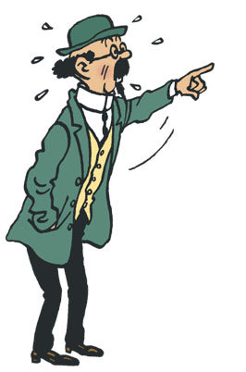

Genesis
Immediate consequence
Don't worry!
Two solutions exist:
- adapting your reduction tool
- extracting data into old formats
I can no longer
read my data!!
Your NeXus format
is boring me.
I just want my data!!
Notes:
Clics :
- Don't worry
- Your Nexus
As an immediate consequence, the scientist are in trouble with such a change.
clic - Of course the software engineers will propose a way to not prevent the scientist from accessing their files
clic – And (in most of the cases) the scientist will answer : 'I just want to access my data'

Slide 6
Genesis
The SOLEIL choice
  SOLEIL choose NeXus/HDF5 (in early 2005) and developed a the extracting tool in order to produce ASCII files (and also bmp/jpeg for images).
    Pro:
      Using NeXus/HDF5 format is therefore transparent for scientists
      Less resistance to the deploying of NeXus/HDF5 based acquisition tools
    Cons:
      Scientists don't see the added value of NeXus/HDF5
      It don't push to develop/adapt data reduction applications able to read such files
Notes:
SOLEIL choose NeXus/hdf5 and we have developed a extracting. This was easier than redevelop all the data reductions tools used by our scientists
--
The advantages are :
-
-
The disadvantages are :
-
-

Slide 7
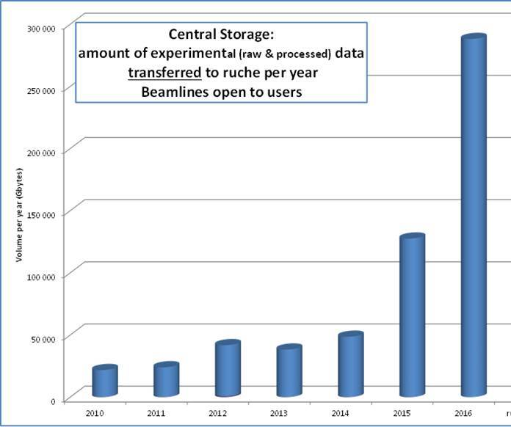
Genesis
On the acquisition side
  NeXus/HDF5 data format is the “standard” on all our beamlines since the beginning of operations at SOLEIL
  We developed a set of tools (above our Tango control system) in order to write experimental data and metadata
  NeXus is used on
  all the beamlines
  millions of files
  All is fine !
Notes:
To perform the data recording we have developed a set of tools based on the Tango bus.
NeXus is ...
We already have more than 2 millions NeXus files
So we are happy guys !

Slide 8
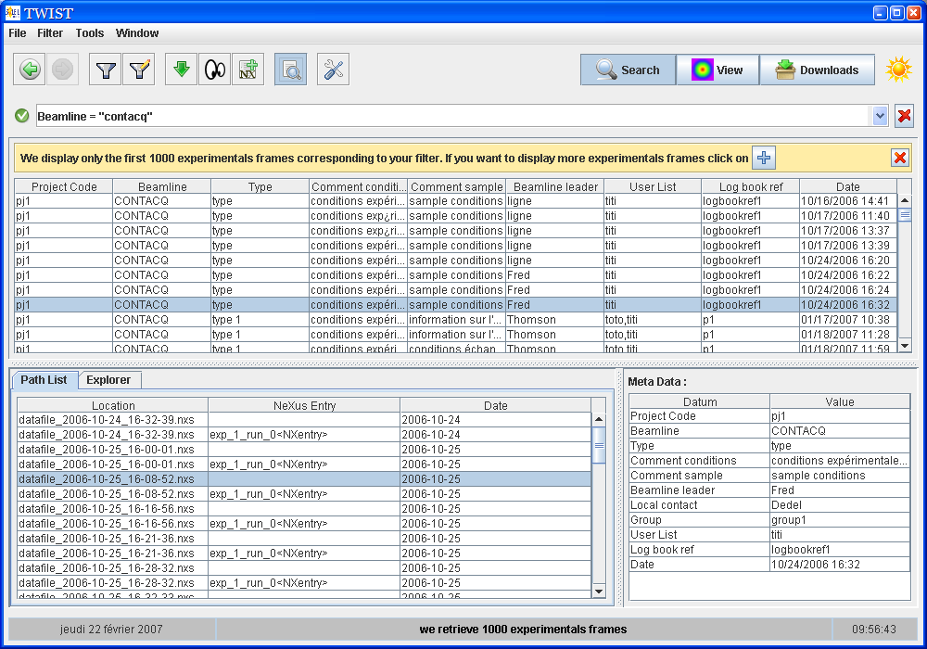
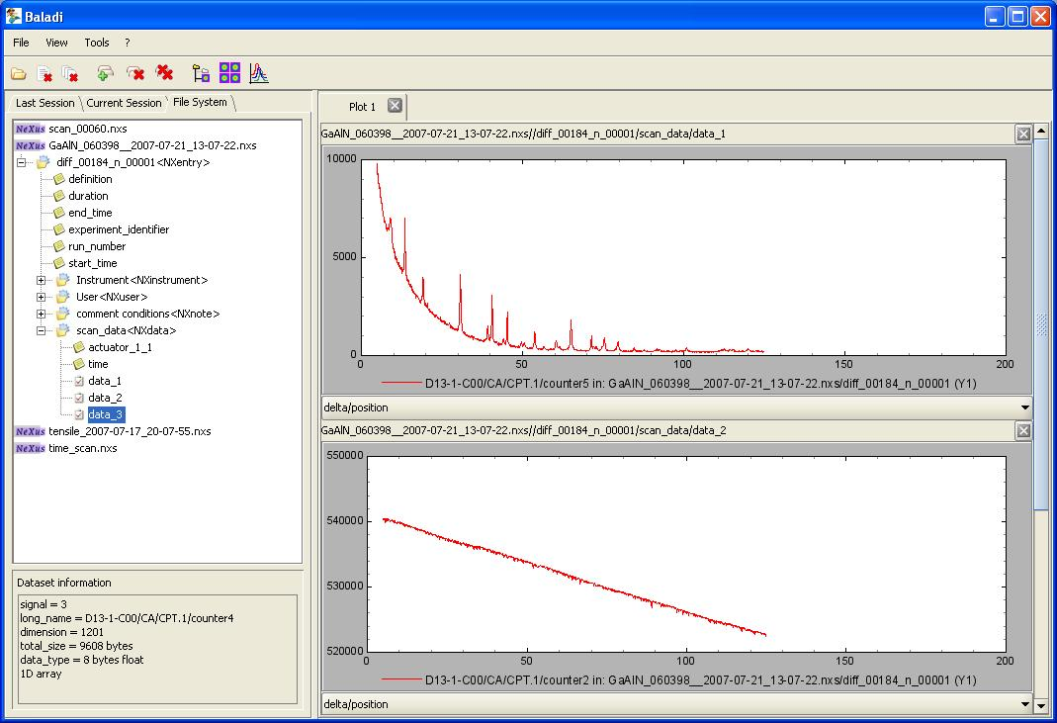
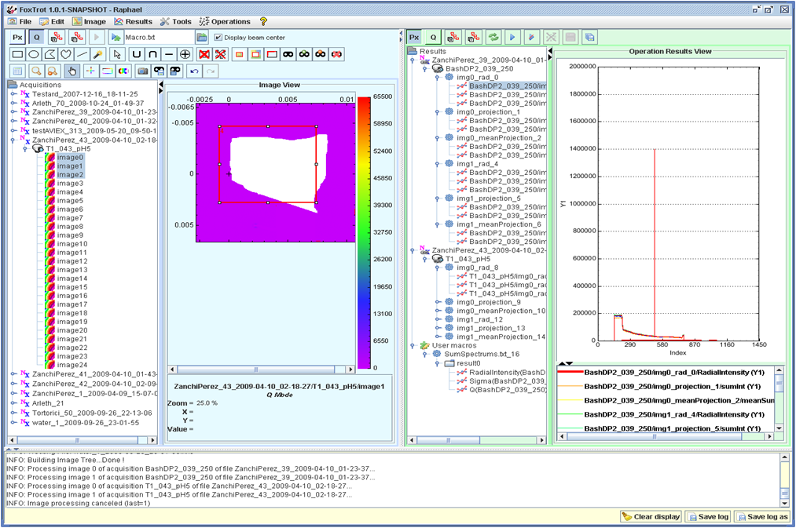

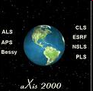
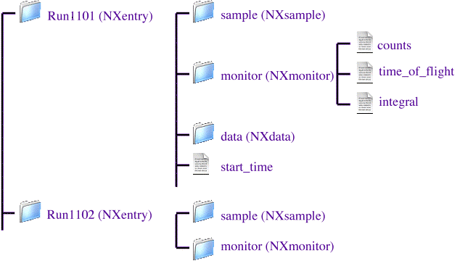

Genesis
How to exchange data and applications?
Data Analysis
application B
Data Analysis
application C
File retrieval
File browsing
SAXS Data Analysis app
NeXus API
SOLEIL NeXus Files
ANSTO Files
DESY Files
Notes:
On the other side, the data reduction, things are a bit more difficult
We developed tools to access our own data: file retreival, file browser and a first data reduction application for our first SAX beamline (SWING)
-
But when we start to thinking about exchanging data, we were not so confident :
- data analysis application developped byu other institutes are not aware about our NeXus file
- our data reduction tools for the SAX beamline is also not aware about data produced in other institutes

Slide 9

Genesis
How to exchange data and applications?
Even worse, we were blocked even before exchanging data with other institutes!!
SAXS data
application
At this point we concluded that we needed a higher level of abstraction
NeXus API
On SWING beamline, data organisation had been fixed by a « SAXS oriented » data acquisition sequence
On CRISTAL beamline, data organisation inside the NeXus file had been fixed by a «Powder diffraction oriented » data acquisition sequence
Soleil NeXus file created on CRISTAL
Soleil NeXus file created on SWING
Notes:
Even worse, when we tried to use Foxtrot on data produced by an other beamline at SOLEIL: it simply crash!
just because the data structure of neux s files produce by this other beramline is slightly different than for the SAX beamline!
clic – We conclude that...

Slide 10
Genesis
20,000 km far from SOLEIL, a new hope:
The GumTree project
    Started from the mid 2000's at ANSTO. This Java project provides:
      A GUI (GumTree Workbench)
      a middleware system (GumTree Server)
      a source code framework (GumTree Framework)
      see http://gumtree.codehaus.org/ for mode information
    Its data access layer, called GumTree Data Model, is the first implementation of the level of abstraction we need:
      It's based on a a generic interface and a plug-in mechanism which encapsulate data formats support
      the first plug-in was for the netCDF format
Notes:
Before we came to this conclusion, far away from SOLEIL, some people was already aware about this issue.
-
The ANSTO institute (a Neutron source) started the developement of GUMTree near 2005, a Java project aimed to read and process data
-
The data access layer of GUMTree implements the required level of abstraction we needed.
-
Basically it uses a plug-in mechanism that encapsulate support of different data files format
-
ANSTO uses the netCDF/HDF5 format so they developped first a netCDF plugin and, later, a NeXus plugin.

Slide 11
Genesis
First steps
  The CDMA project was officially born during ICALEP 2009 when ANSTO (T. Lam, N. Hauser) meet SOLEIL (A. buteau, M. Ounsy)
  Actually, the CDMA is a evolution of the GumTree Data Model
  January, 2011: The first official release (Java)
  June, 2011: First release (1.0) of the C++ port
Notes:
During ICALEPS 2009, some people from SOLEIL had met people from ANSTO. Then the CDMA project was born.

Slide 12
Genesis
What is the CDMA?
Key concepts
Current status & Road map

Slide 13
What is the CDMA?
  A API aimed to provide to programmers a data access layer that is independent of the scientific datasets format.
  Key points:
    A plug-in system that allows support of various data sources
    An abstract interface for navigation through data sets
      Concrete classes are provided by data plug-ins
    A dictionary mechanism to retrieve measurements and technical values independently of the data structures
  It is intended to be the data access layer of data reduction applications.
Notes:
It's a API...

Slide 14
Genesis
What is the CDMA?
Key concepts
Current status & Road map
Notes:
Now I'll explain the key concepts

Slide 15
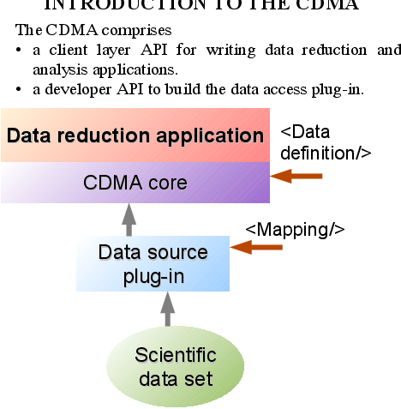
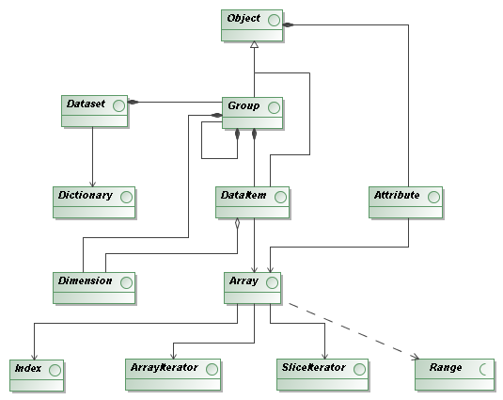
Key concepts
The model - simple
  2 API’s
      Reduction developer
      Plug-in developer
  Separation of concern!
Notes:
The data model is very simple hierarchy :
a dataset contains the data of a whole experiment
--
it contains a groups hierarchy
each group contains dataitem (array or scalar value) comming with attributes that describes them (units, description string, timestamps, and so on...)
--
The API is divide in two parts :
- one for engine and plug-in developers
- and the other for client applications
--
Thus we propose a clear separation of concern between raw data access and data analysis

Slide 16
Key concepts
Plug-ins system
    A CDMA plug-in is a piece of code that adds the support for the data produced by a institute (SOLEIL, DESY, ANSTO,...)
      It may use one or more 'data format engine' which provide support of specific data file format (e.g. NeXus, netCDF, Spec,...)
    Plug-ins are loaded at run-time
    A client application can load simultanously two (or more) files that required different plug-ins
    Available plug-ins: NeXus (SOLEIL), netCDF (ANSTO), EDF (ESRF)

Slide 17
Key concepts
// Get a handle to the data structure
IDataset aDataset = Factory.openDataset(“{data file location}”);
…
// Get a reference to the root group
IGroup rootGroup = aDataset.getRootGroup();
// Go into sub groups
IGroup instrumentGroup = rootGroup.getGroup("instrument");
IGroup monochromatorGroup = instrumentGroup.getGroup("monochromator");
// Get a data item
IDataItem energyData = rootGroup.getDataItem(“energy”);
…
Physical navigation interface
    The CDMA abstracts file formats structures using a simple hierarchy
      A dataset (IDataset object interface) refers to a whole experiment
      Data is logically accessed through a hierarchy of group & data items (IGroup and IDataItem objects)
    Code sample

Slide 18
Key concepts
The dictionary mechanism
    The CDMA was originally developed to allow data analysis applications to not care about file formats.
    We think it's not sufficient. Applications developers don't have to care about data structures.
    A dictionary is mainly a list of commonly accepted physical concepts.
      Each concept has a label (a keyword) and, optionally, some synonyms
      It's equivalent to a CIF dictionary.

Slide 19
CDMA concepts
The dictionary mechanism
    The dictionary mechanism uses:
      A list of concepts (equivalent to the CIF dictionary).
      A data definition document: it's the client point of view on the data.
      A mapping document between keywords defined in the data definition and the physical structure.
    Each institute that contribute to this project have to provide:
      A plug-in for the experimental data it produces
      One or several mapping documents

Slide 20
Key concepts
// Getting a handle to the data structure
IDataset dataset = Factory.openDataset(“{data file location}”);
…
// Getting a reference to the root logical group, indicating we use the dictionary API
ILogicalGroup root = dataset.getLogicalRootGroup();
// Getting some data from a keyword
IDataItem energy = root.getDataItem(“monochromator_energy”);
// Getting experimental data
IDataItem diffrn_images = root.getDataItem(“diffrn_images”);
…
Using the dictionary mechanism
  Let the data analysis application developer just focus on data analysis!

Slide 21
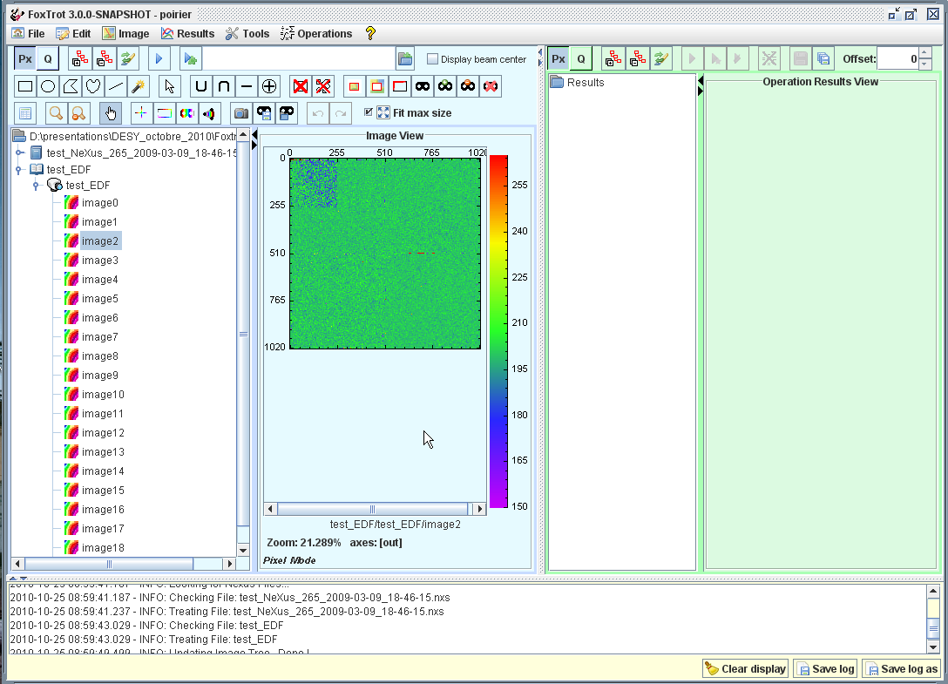

Key concepts
<data-def name="Experiment name"> <!-- ex: EXAFS, SAXS,... →
<item key="mono_energy">
<item key="mono_type">
</data-def>
CDM
Files format plugin
<map-def name="Experiment name">
<!-- ex: EXAFS, SAXS,... -->
<item key="mono_energy">
<path>path/to/user/mono/energy</path>
</item>
<item key="mono_type">
<path>path/to/user/mono/type</path>
</item>
...
</map-def>

Slide 22
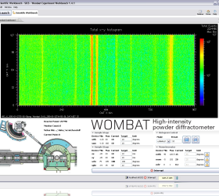
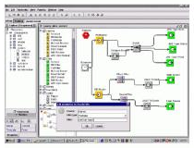
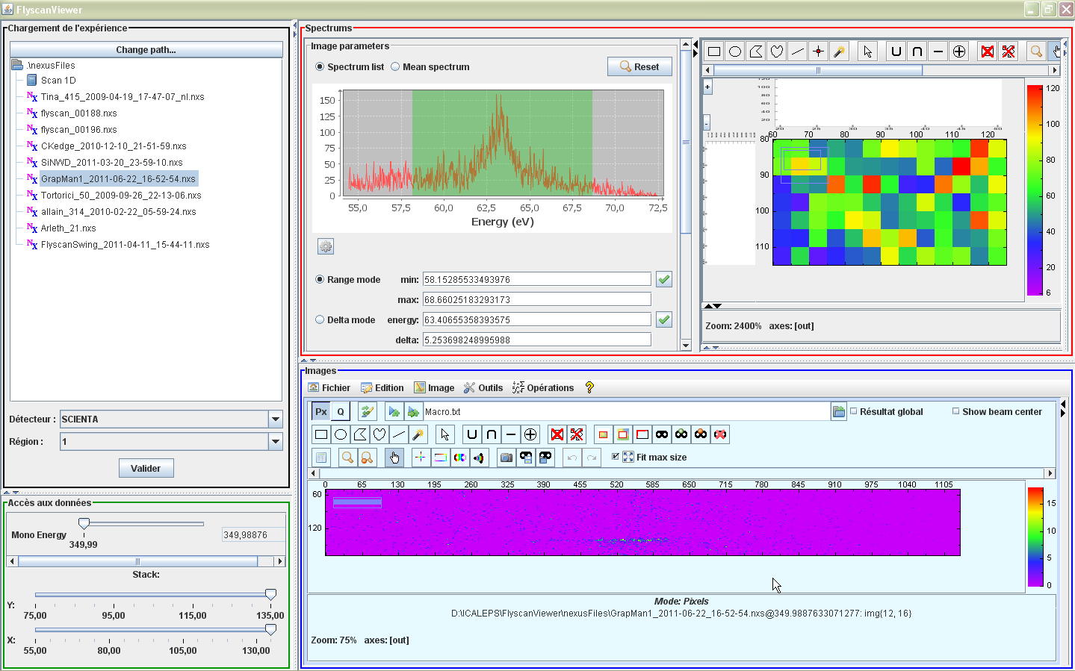
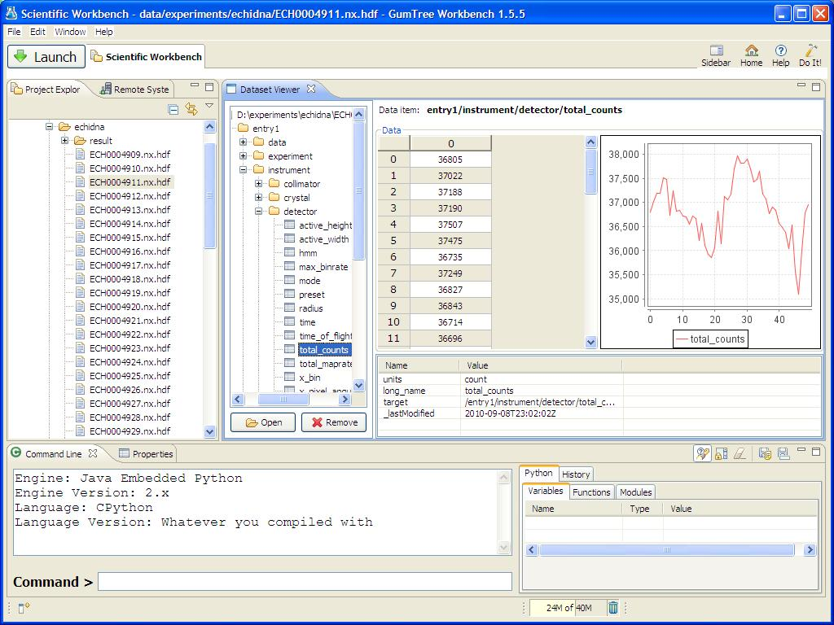


Key concepts
Passerelle Wokflow Enginer
SOLEIL Data reduction
GumTree ANSTO
Databrowser
?
CDMA
?
EDF
netCDF
Data storage
Archiving System

Slide 23


