Slide 1

Tanja Ducic
MIRAS In-house Research Program
8th of November 2021
Notes:
-Not centering on theoretical aspects of MX but on explaining you but how does MX looks like at ALBA.

Slide 2
IH Research Program 2017-2021 Figures
MIRAS
3 BL-Sci.
1 PDoc
1 external Marie Curie PDoc
1 Joint PhD
Scientific record
IH biological research @ MIRAS (2017-2021)
IH = 11-13% of total beamtime
Scientific records obtained in collaboration with:
Synchrotrons: Diamond, APS, Elettra
University: Paris, Belgrade, North Western, UAB
Hospitals: Göttingen, Himac, Bellvitge, Hospital del Mar, Tortosa.
Average IF 4.7
2

Slide 3
IH Research activities
Inhouse Research Areas of Interest (last 5 years)
2021-2024 IHR mission
Promote multimodal projects on 3D cells culture among scientific community.
Integrative In-house Projects
Collaborative IH research:
Twinning and COSTS EU projects on degenerative diseases (both MS in preparation), and Union for International Cancer Control's Grant (Ducic et al., Analyst 2017)
3
Notes:
This talk can be outlined in the following points:
1) First, an introduction to MX-BL XALOC, including:
- a description of the BL Layout
- some details of the type of samples that can host the BL
- an overview of the BL software
- the newest developments
- some illustrative examples
2) And finally, a brief glimpse of the new microfocus BL (presently in construction)

Slide 4
What do we do at MIRAS?
Preparing samples for bio µFTIR
Follow bio-macromolecular changes (e.g. protein aggregation, lipids peroxidation, carbonylation etc.)
Statistical evaluating of cellular chemical changes
Searching for biomarkers in cells/tissues in different diseases.
workflow
FTIR spectroscopy and microscopy and correlation
with other techniques (VIS, XRF, SXT).
Andjus et al., Eur. Biophys. J. 2019
4
Notes:
What we can not do now?
Resolution!

Slide 5
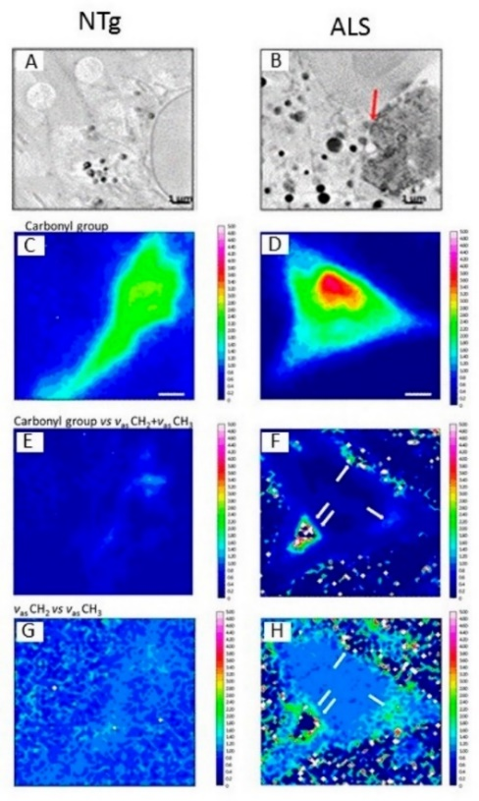
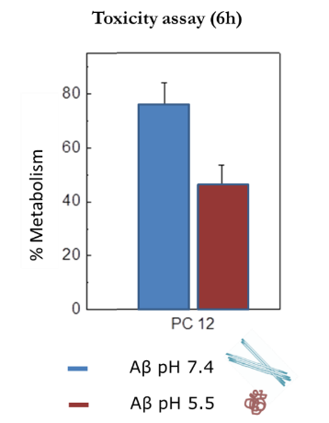
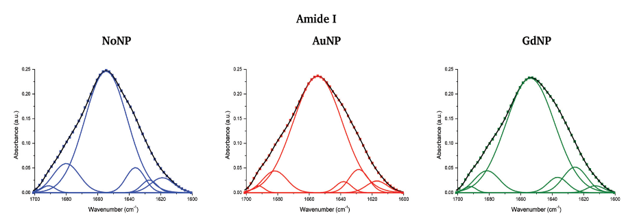
Examples of IH research @MIRAS
1) Development of innovative radiotherapy approaches: getting new insights into the tumour response at the cellular and molecular levels through FTIR
2) Synchrotron-Based FTIR on the Effect of Alzheimer’s Aβ Amorphous and Fibrillar Aggregates on PC12 Cells
3) Characterization of neurons in amyotrophic lateral sclerosis: Multimodal approach combining FTIR, hard and soft X-ray microscopy
Martínez-Rovira et al., Analyst 2016
Granullar non fibrillar aggregates are more toxic to cells than fibrils.
Benseny-Cases et al., Anal. Chem. 2018
Towards synergetic effort of multimodal synchrotron techniques
5
Ducic et al, Anal. Chem. 2019

Slide 6
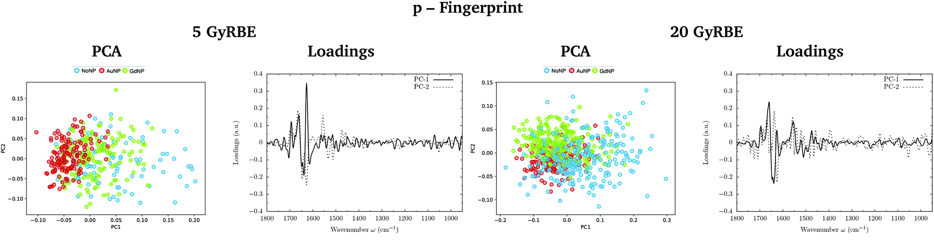
1. IH scientific project:
Study of the intracellular nanoparticle-based radiosensitization mechanisms in F98 glioma cells treated with charged particle therapy
SR-FTIR is a useful and precise technique for assessing cell response to innovative radiotherapy approaches.
Several NP-induced induced cellular modifications as conformational changes of protein, lipid and DNA.
Martínez-Rovira et al., Analyst 2020
6

Slide 7
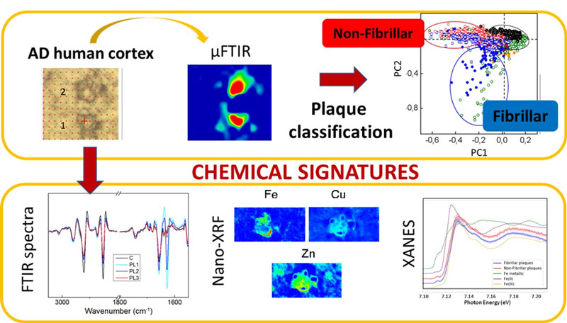
2. IH scientific project:
Multimodal approach on Alzheimer disease
Distinguish non-fibrillary and fibrillary plaques (FTIR)
Fe³⁺ in the fibrillary plaques (XANES)
Synchrotron X-ray Fluorescence and FTIR signatures for Amyloid Fibrillary and non-fibrillary Plaques.
Álvarez-Marimon et al., ACS Chem. Neurosci. 2021
7

Slide 8
3. IH scientific project:
Correlative synchrotron-based X-ray and infrared imaging
Lipids status and copper in a single astrocyte of the rat model for amyotrophic lateral sclerosis evaluated.
ALS cells contained more Cu, colocalized with total lipids, carbonyl groups and oxidized lipids.
Cu min: 0 max: 0.012µg/cm²
C
Lipids min: 0 max: 3 a.u.
Correlation of VIS, XRF, FTIR imaging
Carbonyl groups min: 0 max: 8 a.u.
Kreuzer et al.,
J. Biophotonics 2020
8
Proteins min: 0 max: 13 a.u.

Slide 9
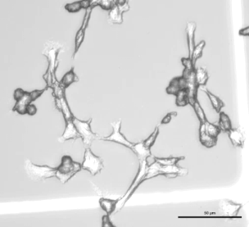
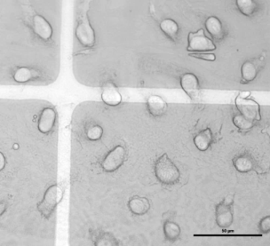
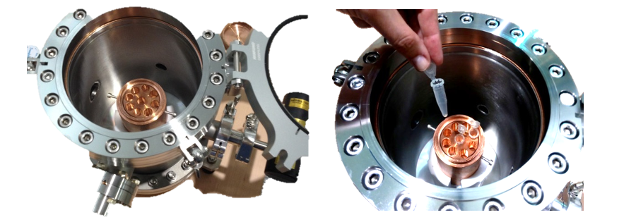
IH BL Development projects:
Sample preparation for multimodal experiments:
Freeze drier:
-Freeze-drying allows the direct sublimation of ice to the gas phase
for the preparation of water-free samples.
-Completely sealed system, using high vacuum and low temperature
developed in the ALBA in-house project.
formaldehyde fixed and freeze dried glioma cells
In-house 2018, T. Ducic & M. Kreuzer
9

Slide 10
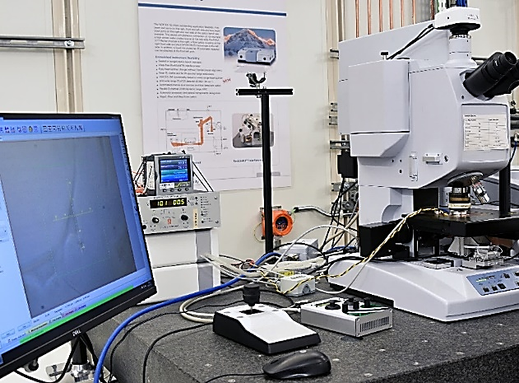
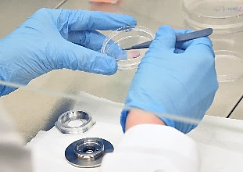
IH BL Sample environment projects:
  Live-Cell Imaging Set-up
-Live cells setup for FTIR evaluation of metabolic compounds in the single cells
-Drug treatment evaluation
Ducic et al,
Manuscript submitted
Project in collaboration with SISSI BL @ ELETTRA
10

Slide 11
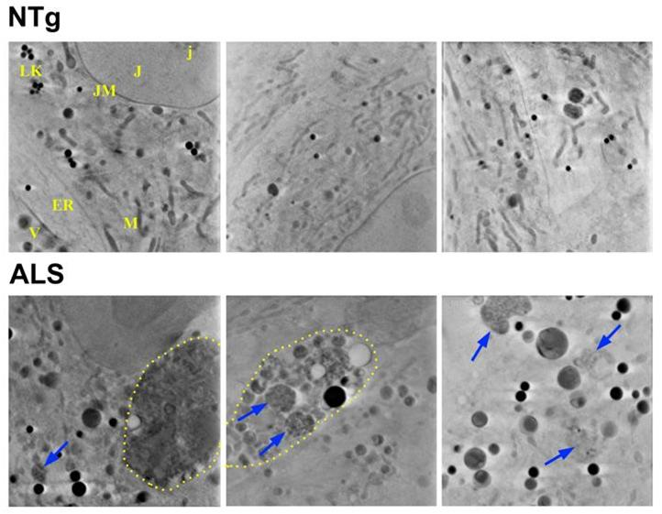
Towards integrative IH projects
Correlative imaging by using synchrotron light for illuminating molecular disorders
Scientific pilot projects
Collaborations
Sample environments techniques
Soft X-ray tomography
X-ray
Fluorescence /
XANES
FTIR
Invited talk to Microscopy and Microanalysis 2021
organized by Microscopy Society of America
Ducic et al., Microscopy and Microanalysis 2021
doi:10.1017/S1431927621000982
11
Notes:
+CT +cryo 3D SIM

