Slide 1
Proposed capabilities in Cell and Tissue Biology in the path to ALBA-II
Judith Juanhuix
9.11.2021

Slide 2
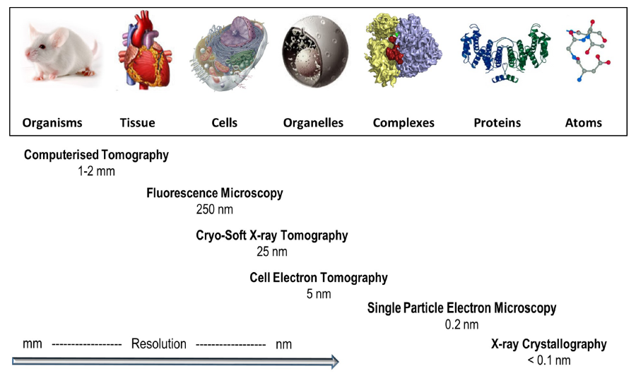
New tools to fill in the gaps
New tools based on different probes required: XR, visible light, electrons, IR
Aim for multi-modal, multi-scale and correlative experiments
ALBA embedded within their strategic partners provides leading capabilities
FAXTOR
STXM
BioSAXS
MIRAS
MISTRAL
XAIRA
XALOC
Cryo3D-SIM
150 nm
CryoEM-SPA
BioSAXS
1 nm
Cryo-ET
5 nm
FTIR
3 μm
Computational Biology
Cryo-nanoXRF
50 nm
From Harkiolaki et al. DOI:10.1042/ETLS20170086 ; CC BY 4.0 modified

Slide 3
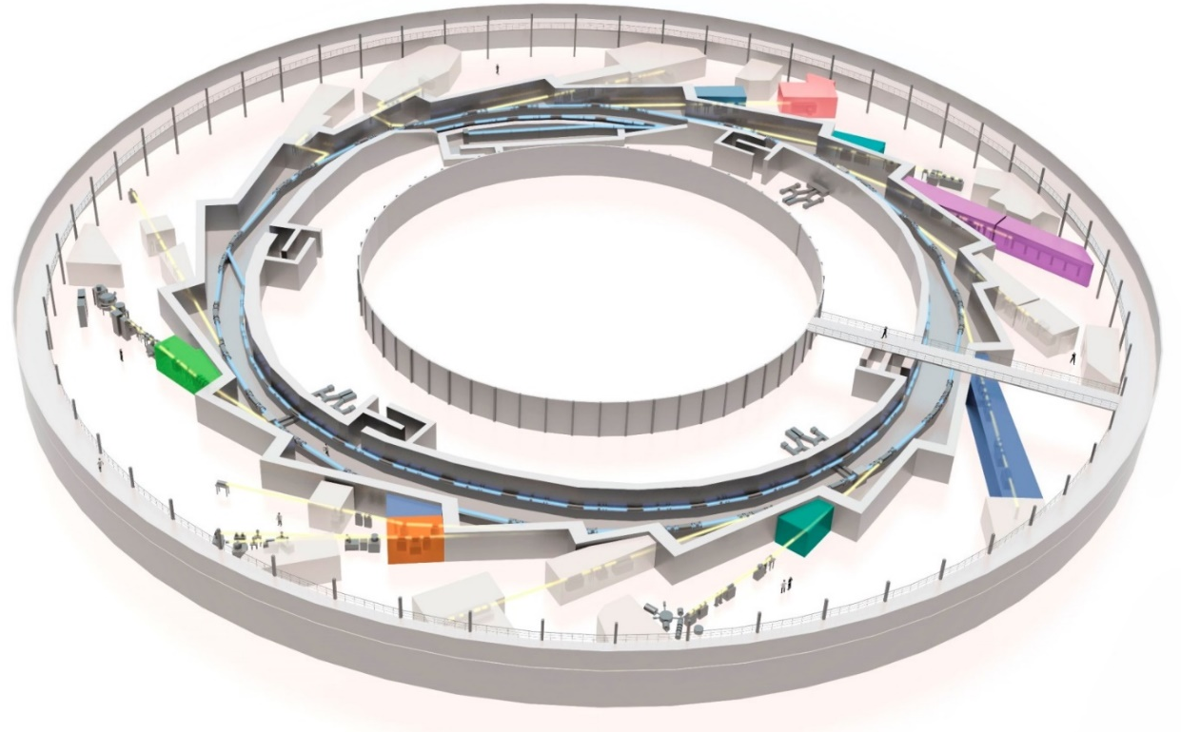
Proposed tools in Structural Cell and Tissue Biology
New tools proposed in Cell and Tissue Biology:
Cryo-nanoXRF (STXM) BL
Expanded FTIR techniques
Sub-μm CT BL/branch
Correlative microscopies
Sample prep (incl. CryoFIB-SEM)
THz,raman, nanoIR
Cryo nanofocus 3D
(fluo+phase contrast)
MISTRAL (SXT)
CryoFIB-SEM
MIRAS (FTIR)
Cryo3D-SIM
BioLabs
sub-μm CT
FAXTOR (HXT)
Existing
tools
Proposed
tools

Slide 4
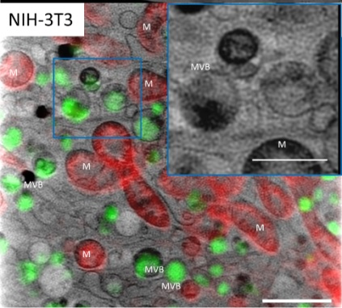
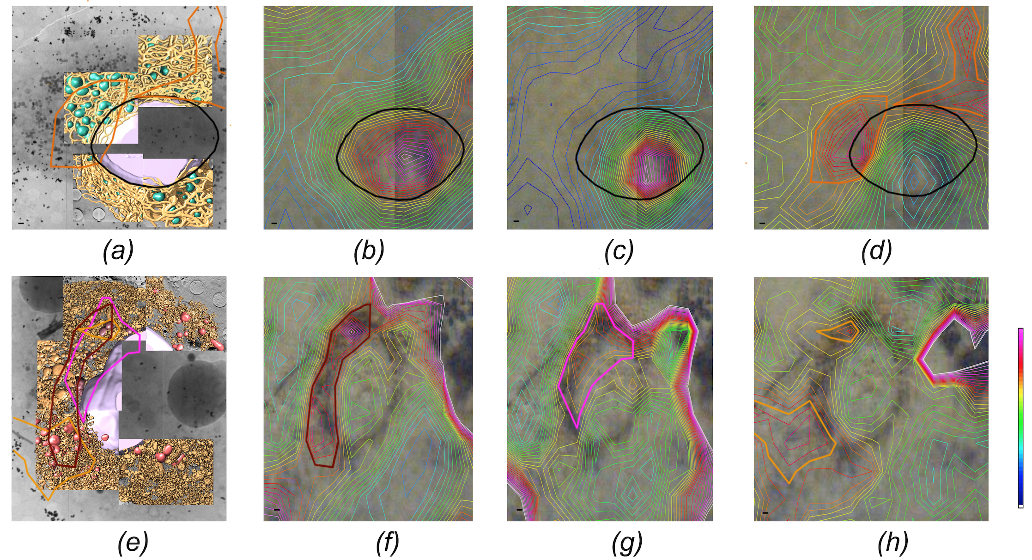
MISTRAL - Cryo-SXT
MISTRAL complete refurbishment to reach the limits of the technique
Computing methods (e.g. automated data alignment) to access non-expert users
Establish as a regular user service the correlative microscopies (in particular Cryo-3DSIM)
Develop methods to additional multimodal approaches
Proof of concept of
cryo 3D-SIM/cryo-SXT
Groen et al. Chem. Sc. (2021)
Example of cryo-SXT
correlated to SR-µFTIR
Pérez-Berná et al. (in press)

Slide 5
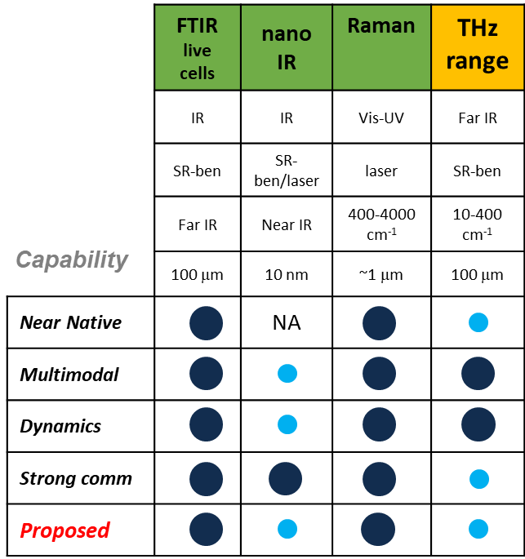
FTIR Program
Key tool to relate chemistry and structure.
FTIR on live cells is set as maximum priority.
Raman technique is low hanging fruit.
Extension to THz-range:
  Accessing to secondary structure signatures
  But: needs in-vacuum environment, dehydrated samples
  Possible depending on the ALBA-II design
Nano-FTIR:
  Accessed either through SR BL or laser source
  High resolution (10nm) on organelles from lysed cells
  More difficult experiments, but EU large community

Slide 6
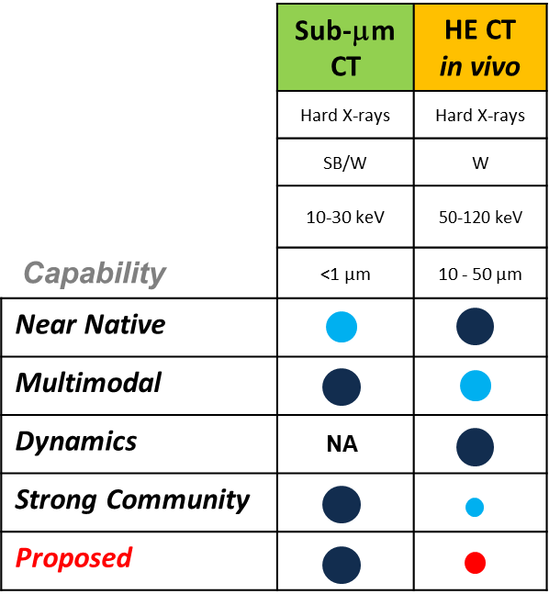
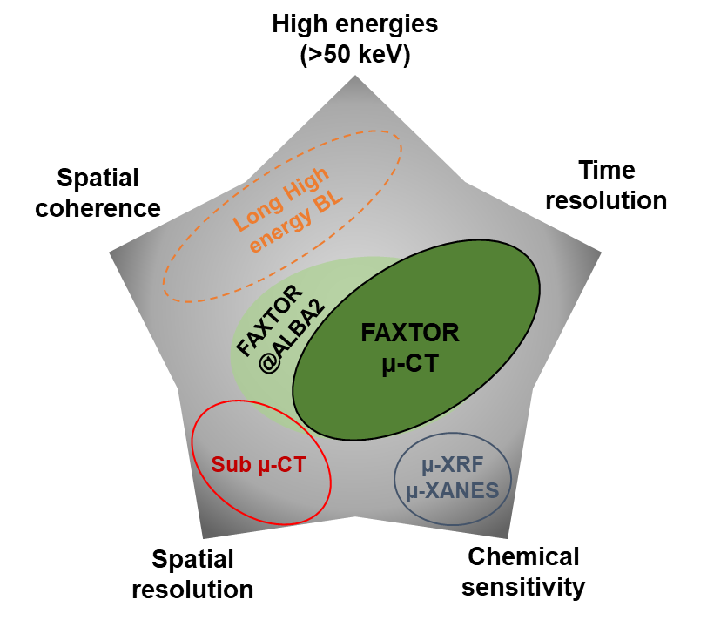
Hard X-ray Computed tomography
User community to be built upon FAXTOR coming into operation in 2024.
HE-CT in vivo capabilities (i.e. biomedical BL) are disregarded
Focus on sub-micron resolution imaging:
  To increase multimodal capabilities: link to FTIR, Cryo-SXT, STXM.
  Applications on 2D and tomography of cells and tissues.
  With μ-XANES capabilities
  To be built as a new branch of FAXTOR BL (or as a separate BL).
@Alberto Mittone

Slide 7
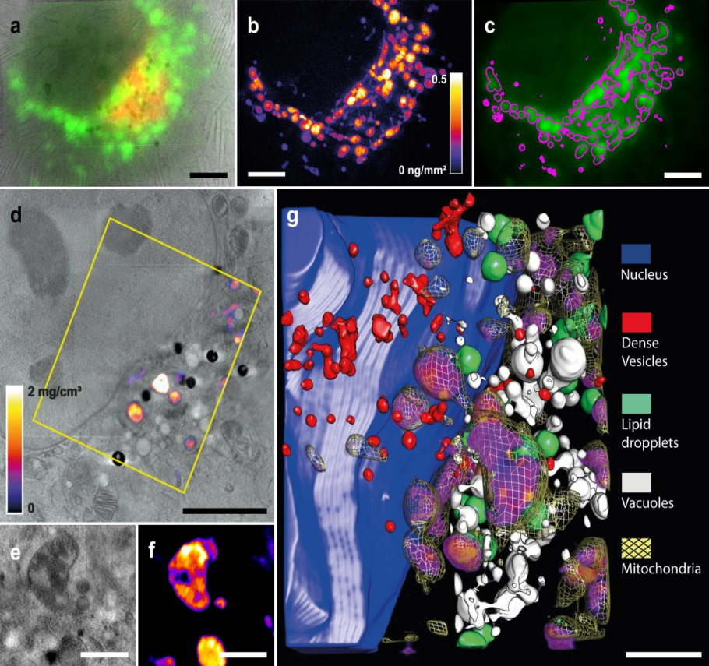
Cryo-nano X-Ray Fluorescence and phase-contrast imaging
Nanofocus (~50 nm, stable) beamline with a scanning transmission X-ray cryo-microscope
  Nanofluorescence: quantification of trace endo- and exogenous elements at high-sensitivity.
  Phase contrast-based imaging: 2D and tomography of cells.
Addressed community: Cell Biology, Metallobiology, drug delivery, nanomedicine, applied nanomaterials, new therapeutic agents, genetic recessive diseases, viral infections, biocatalysis.
Example of cryo-SXT correlated to 3D cryo XRF
epifluo
Ir
5 µm
5 µm
Similar beamlines: ID16A@ESRF, I14@Diamond, P06@DESY (cryogenic condition to be installed), Nanoscopium@SOLEIL, NanoMAX@MAXIV (no cryogenic conditions)
1 µm
2 µm
Ir-organometallic drug highly specific, may substitute cis-Platinum
J.J Conesa et al. Angew. Chem. 59, 1270-1278 (2020)

Slide 8
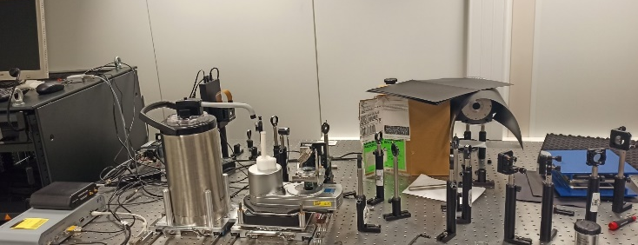
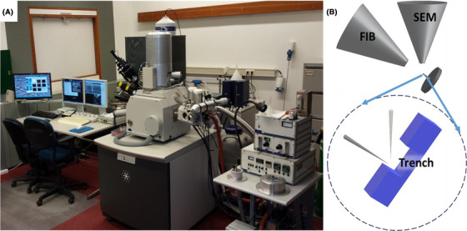
Non-SR Microscopies
Key to correlate optical techniques from external groups to the data from SR-based techniques
Cryo-3DSIM
Used as a preferred correlative microscopy for SR techniques
Only 2 units worldwide: Diamond and ALBA
Sample preparation lab required
BSL 2 required.
CryoFIB-SEM
Imaging of cryo-sectioned cells and tissues
Resolution down to 30nm
Long acquisition time, destructive
Specialized for sample preparation and characterization
MF Hayles, DAM de Winter, DOI: 10.1111/jmi.12951

Slide 9
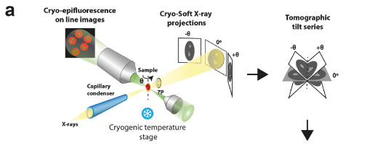
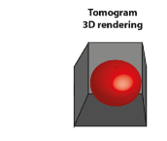

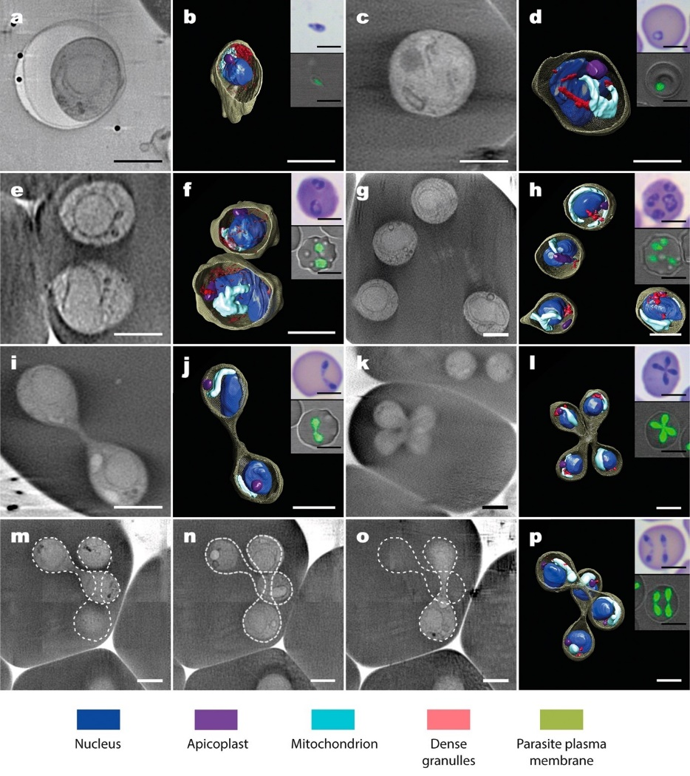
Cryo-Electron Tomography
Suitable for visualizing organelles and cell ultrastructure in situ, including mixed populations
Bridges the gap between structural molecular and cellular biology
Requires
  Sample preparation lab and screening electron microscopes
  Correlative cryo super-resolution microscopies for best results
National Facility on Biological Electron Microscopy (CNB, Madrid) already existing
  CNB is focused on CryoET and cryoFIB-SEM, and well integrated into network
  ALBA and CNB are already collaborating
  Partnership to be studied
  The needs of the growing community to be monitored

Slide 10
Proposed instruments
3D structure
cryo-ET
cryo FIB-SEM
In vivo CT
cryo-SXT
μPCXT
cryo-3D-SIM
cryo epifluo
cryo
nano-XANES
SR-µFTIR
μXANES
μXRF
specific localization
nano-FTIR
chemical information
cryo
nano-XRF
elemental
quantification
(ppm)
operational
in development
not currently at Alba
new

Slide 11
The Conclusion
 | FTIR live cells | Nano IR | Raman | THz range | Cryo SXT | Cryo nanoXRF | Cryo ET | Cryo 3D-SIM | (cryo) FIB-SEM | Sub-μm CT | HE CT in vivo
 | IR | IR | Vis-UV | Far IR | Soft X-rays | Hard X-rays | Electrons | Visible | Electrons | Hard X-rays | Hard X-rays
 | SR-ben | SR-ben /laser | laser | SR-ben | SR-ben | SR-IVU |  | - | - | SB/W | W
 | 400-4000 cm⁻¹ | Mid/Near IR | 400-4000 cm⁻¹ | 10-400 cm⁻¹ | 280-3000 eV | 10-25 keV | (300 kV) | - | - | 10-30 keV | 50-120 keV
 | 100 μm | 10 nm | ~1 μm | 100 μm | 30nm | <100nm | - | - | samp prep | <1 µm | 10-50 μm
Near Native |  | NA
Multimodal
Dynamics |  |  |  |  |  |  |  |  |  | NA
Strong comm
Proposed
Capability
3th generation upgrade
4th generation upgrade
Essential tool
Desirable tool
Disregarded tool

