Slide 1
Industrial Program Overview
Structural Cell and Tissue Biology
Núria Valls
9-11-2021

Slide 2
MISSION of the ALBA industrial program
  The mission of the industrial program is to promote and to make available to the industrial sector all the potential of the synchrotron services and developments to boost the innovation capabilities and the competitiveness of the industry and of the society
  In the SCTB industrial program, the mission is:
  To boost satisfaction of our customers to the highest level achievable by offering state of the art services and new advanced synchrotron light techniques to industry
  To enlarge our portfolio of customers by rising awareness towards industry of the innovation and competitive advantage of using synchrotron light techniques

Slide 3

ILO: Industrial Liaison Office
ORGANIZATION
Office reporting to the Director
Four people (1 @20%)
ACTIVITIES OF THE ILO: outreach, beamtime access, lab access, intellectual property protections and technological transfer to the industry, EU and national funding for companies....
SINGLE ENTRY POINT FOR INDUSTRIAL USERS
PROPRIETARY ACCESS FOR INDUSTRIAL USERS:
to ensure confidentiality and property of the results,
cost covering fee

Slide 4
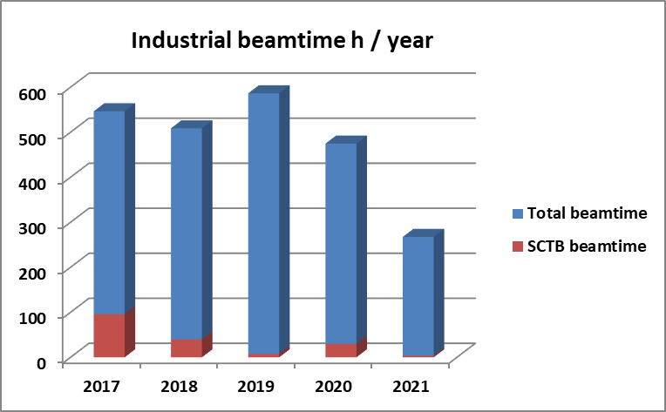
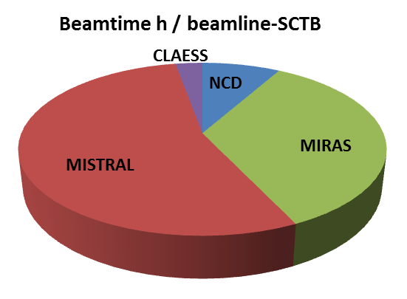
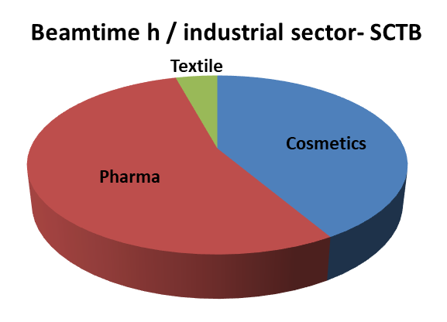
Industrial Beamtime-SCTB
SCTB industrial services started in 2017
5 companies
7.5 % of overall industrial beamtime
Industrial sectors: Cosmetics, Textile and Pharma
BL: MIRAS, MISTRAL, NCD, CLAESS

Slide 5
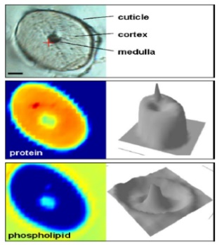
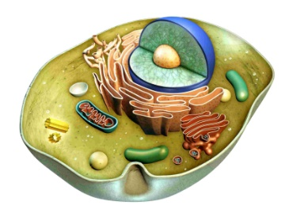
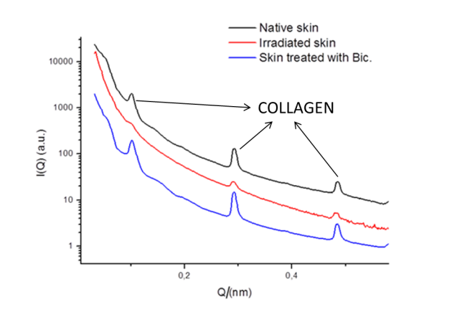

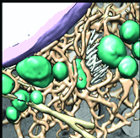
Services provided in SCTB section
Pharma
Structural effects of drugs at cellular level
Textile
Leather collagen orientation upon treatments
Cosmetics
Hair: biochemical effects of cosmetics on hair and S analysis
Skin: Efficacy of products at cellular level, collagen structure and product penetration studies
@ MISTRAL
@ MIRAS, NCD, CLAESS
@ NCD
Multiple techniques can be used for skin studies (MIRAS+NCD)

Slide 6
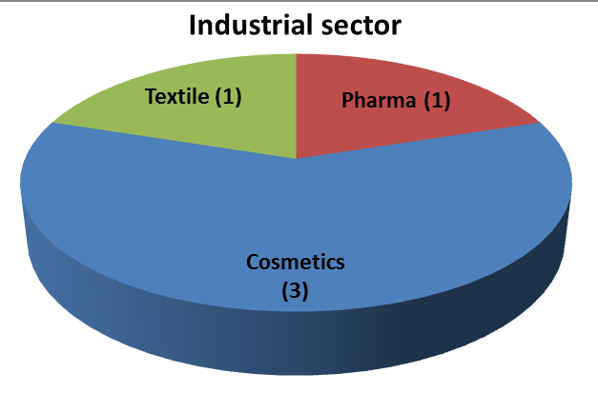
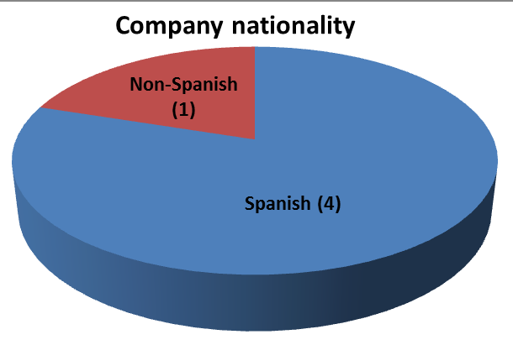
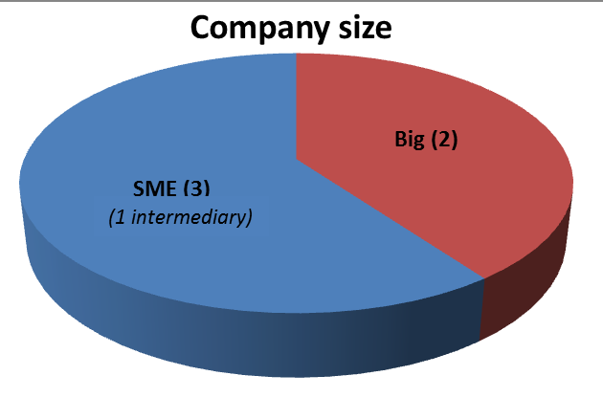
Companies profiles and their needs
  For COSMETICS:
    Scientific evidence for efficacy of the products is now requested for cosmetic products
    Synthetic skin may open the door to more routine measurements
    Contacts with research group for offering a more complete service (IQAC-skin research)

Slide 7
Companies profiles and their needs
In general, for SCTB services:
Different types of companies with similar needs: full service is required
Sample preparation and data analysis is crucial
Pharma and Cosmetics: important sectors in the local area
Consolidation of cosmetic services is foreseen
Pharma and other fields and services will be further explored

Slide 8

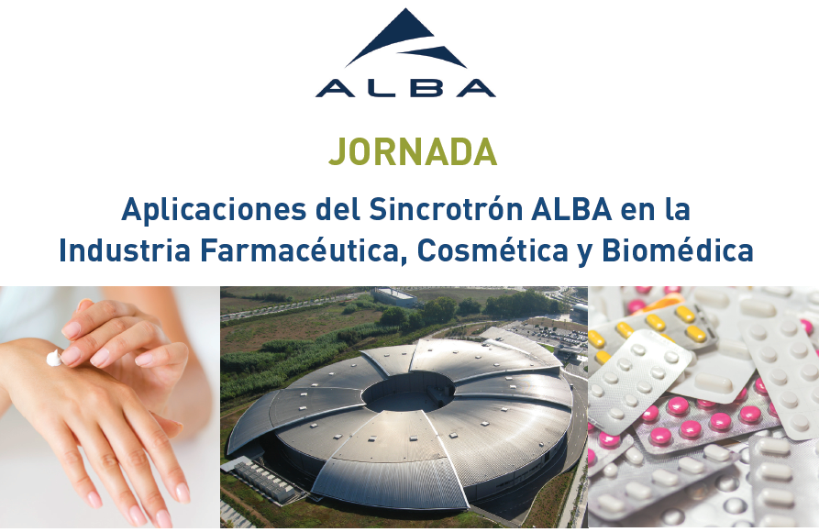



Outreach industrial program in SCTB
  Industrial workshop organized to target pharmaceutical and cosmetic local companies
  Contacts with Beauty Cluster- cosmetic, the Spanish Society of Cosmetics
  Participation in conferences
  Support from European Projects for outreach activities
  Other sectors to be further explored: implants, textile, agrifood
We have focused on cosmetics and pharma and we will explore other fields
Aiming to promote ALBA capabilities and attract new companies

Slide 9


Looking for specific funds
Some specific funds are available for industrial projects:
  National funds: CDTI (Spanish Industrial Agency), ACCIO (Catalan industrial Agency...)
  EU funds: CALIPSOplus and LEAPS-INNOV projects
    Funds for SMEs, short experiments and networking
    TamaTA & TamaTA-INNOV, leaded by ALBA, access to the main European synchrotrons and XFEL
9 experiments of SMEs have been granted at ALBA under TamaTA project, 4 for cosmetics and Spanish companies

Slide 10
Summary- Industrial SCTB program
Strengths
Weaknesses
  Network with industrial associations, scientists related to companies that can eventually become customers
  Reliability of the BLs and the photon source
  Network with other groups/institutions to provide a joint service in cosmetics
  Lack of knowledge on X-ray techniques by the relevant industrial sectors
  Need to provide assistance/training on sample preparation and on data analysis, offering full service requires human resources
  Intensive human resources needed to provide services to some companies
  Low number of companies using SCTB section services
  Industry beamtime requires fast allocation
Opportunities
  Build-up community:
    Cosmetics and Pharmaceutical sectors very important in the local area
    More fields to explore: implants, textile, agrifood
  Increase of the portfolio of industrial services: cryo nano X ray flourescence + phase cont. imaging , Hard X ray full field for phase contrast imaging. ALBA II will allow to increase the industrial services
  Implementation of remote access and higher throughput
  External funds
  Dark periods of other synchrotrons
Threats
  Industry is very demanding: technically, in terms of cost-effectiveness and timing
  Maintain excellent performances to provide top-services
  Competitive services in other synchrotrons
Notes:
Message: upgrade is worth it!

