Slide 1

Status and perspectives of cryo-electron microscopy tools in bioimaging
Jose Javier Conesa Muñoz
jj.conesa@cnb.csic.es
Department of Macromolecular Structures, CNB-CSIC
ALBA Synchrotron, 8th Nov. 2021

Slide 2

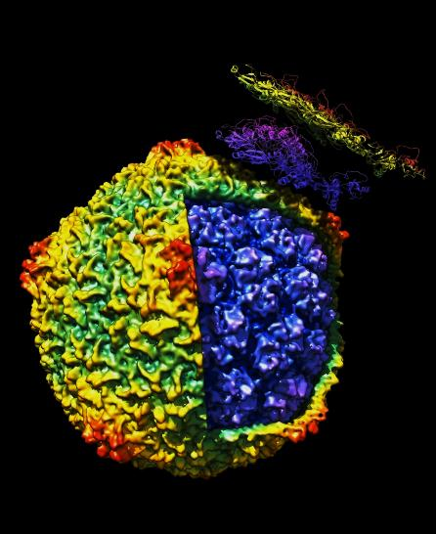
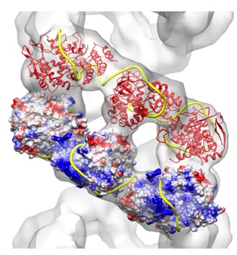
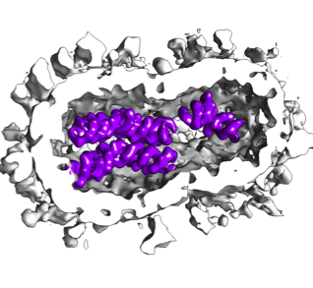
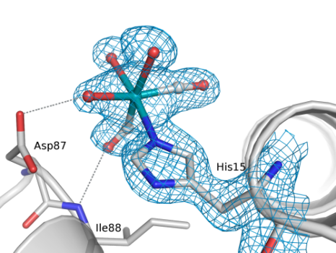
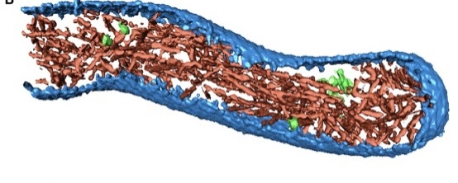
Structural Biology
resolution
Super-resolution VLM
Cryo SXT
Cryo-FIB-SEM
ELECTRON TOMOGRAPHY
ELECTRON MICROSCOPY
X-RAY DIFFRACTION
NMR
Visible Light microscopy
Integration at cellular level
Topology and interaction
Macromolecular complex structure
Protein structure
Cellular Biology Interactomics Structural Proteomics

Slide 3

Severo Ochoa Bioimaging Initiatiative at CNB
Service access to users to be implemented (2022)
Access through:
iNEXT
INSTRUCT
Fee charge per session
Bioimaging
initiative
Optical microscopy
Sylvia Gutiérrez
(http://www.cnb.csic.es/index.php/es/
investigacion/
Scientific-/light-microscopy)
Electron Microscopy
Cristina Patiño
(http://www.cnb.csic.es/index.php/es/
investigacion/
servicios-cientificos/
microscopia-electronica)
Single Molecule
Optical and Force
Spectroscopy
José Requejo-isidro
(on going development)
Correlative
Microscopy
Javier Conesa
(on going development)
Instruct Cryoimage
Processing Center
José M. Carazo
Carlos O. Sánchez Sorzano
(http://www.i2pc.es)
Image Analysis
Carlos O. Sánchez Sorzano
(on going development)
Cryoelectron Microscopy
Rocío Arranz
(http://www.cnb.csic.es/index.php/es/investigacion/servicios-cientificos/microscopia-crioelectronica)

Slide 4
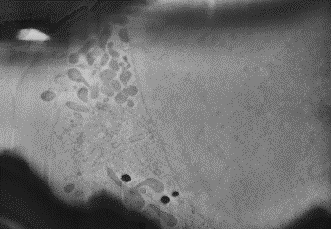
Cryocorrelative fluorescence electron tomography
A
B
D
Resolution, potentialy
to the protein
complex level
Protein/events Targetting
C
Whole cell architecture
at the level of organelle

Slide 5
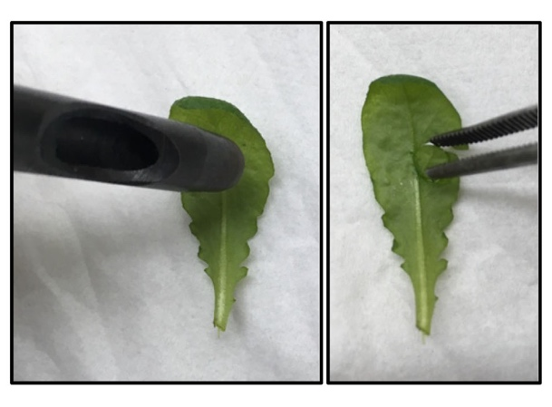
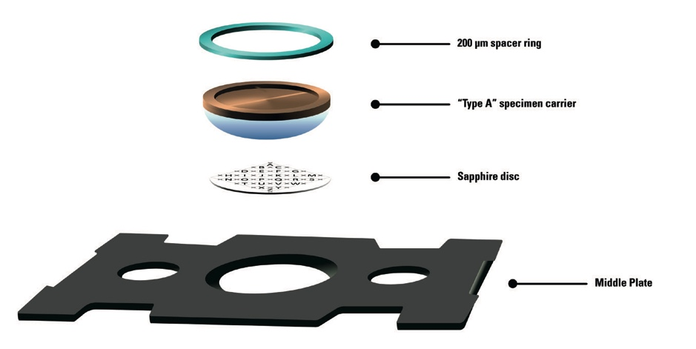
Cryocorrelative fluorescence electron tomography
Sample preparation
PLUNGE FREEZING
HIGH PRESSURE FREEZING
Cell monolayers
Purified samples
Tissue

Slide 6
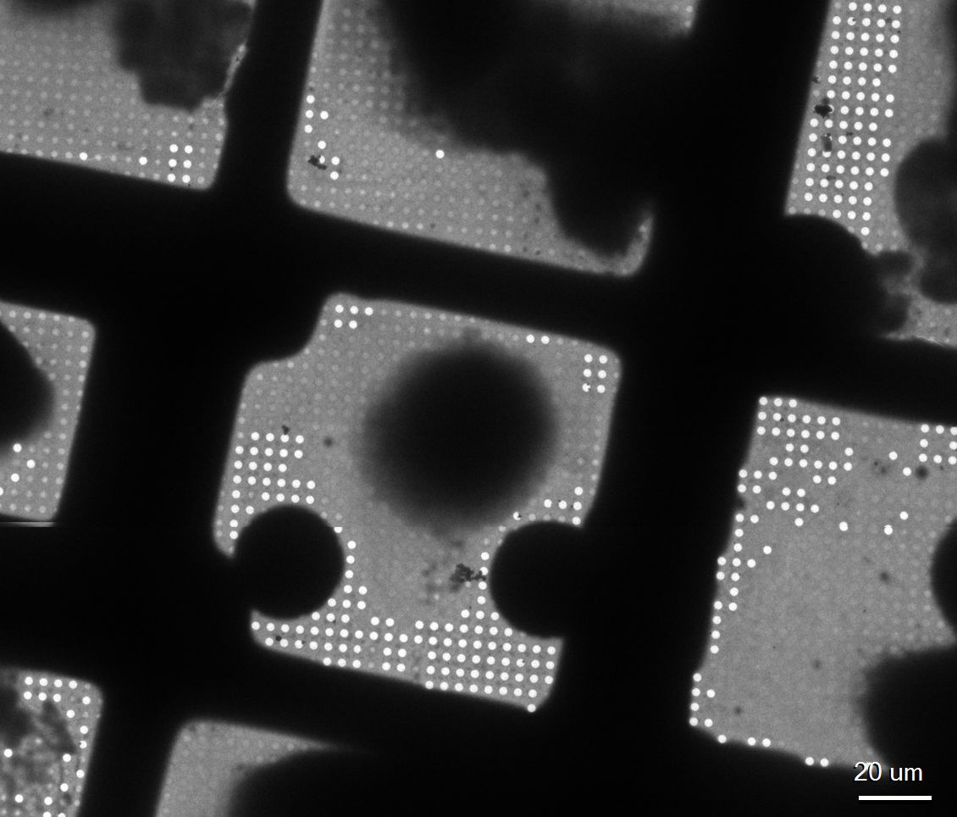
Sample quality control
Cryo-TEM image 200 kV
Cryo-fluorescence microscopy
10 um

Slide 7
Cryo FIB-SEM tomography
Zeiss Crossbeam 550
FIB (Ion Beam)
SEM (Electron Beam)

Slide 8
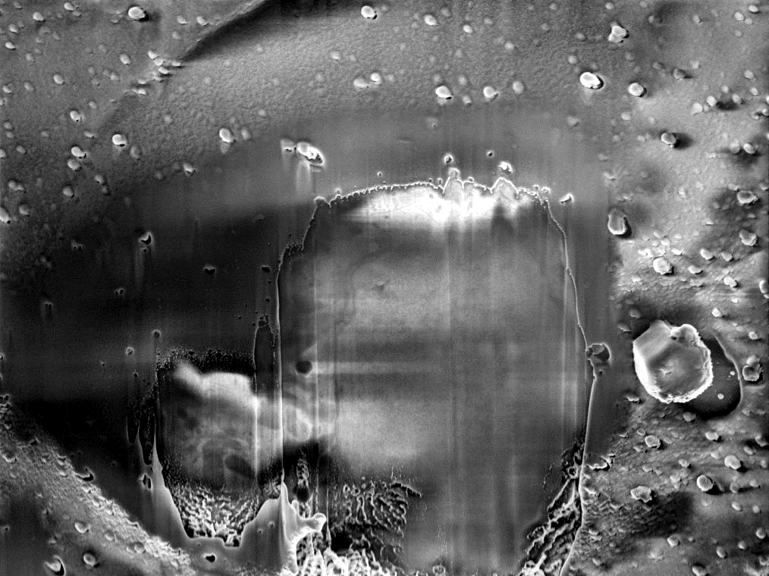
Cryo FIB-SEM tomography

Slide 9
Cryo FIB-SEM lamella preparation
FIB (Ion Beam)
SEM (Electron Beam)

Slide 10
Cryoelectron Tomography

Slide 11
Cryoelectron Tomography
Subtomogram averaging
From Matinez-Sanchez et al., 2020, Nature Methods

Slide 12
Cryocorrelative fluorescence electron tomography
*1 modified from From Weber et al., 2019 Cells; *2 modified fromMatinez-Sanchez et al., 2020, Nature Methods; *3 Modified from Weber et al., 2019 Cells; *4 Modified from Weber et al., 2019 Cells

Slide 13
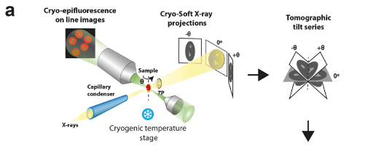
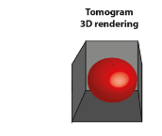

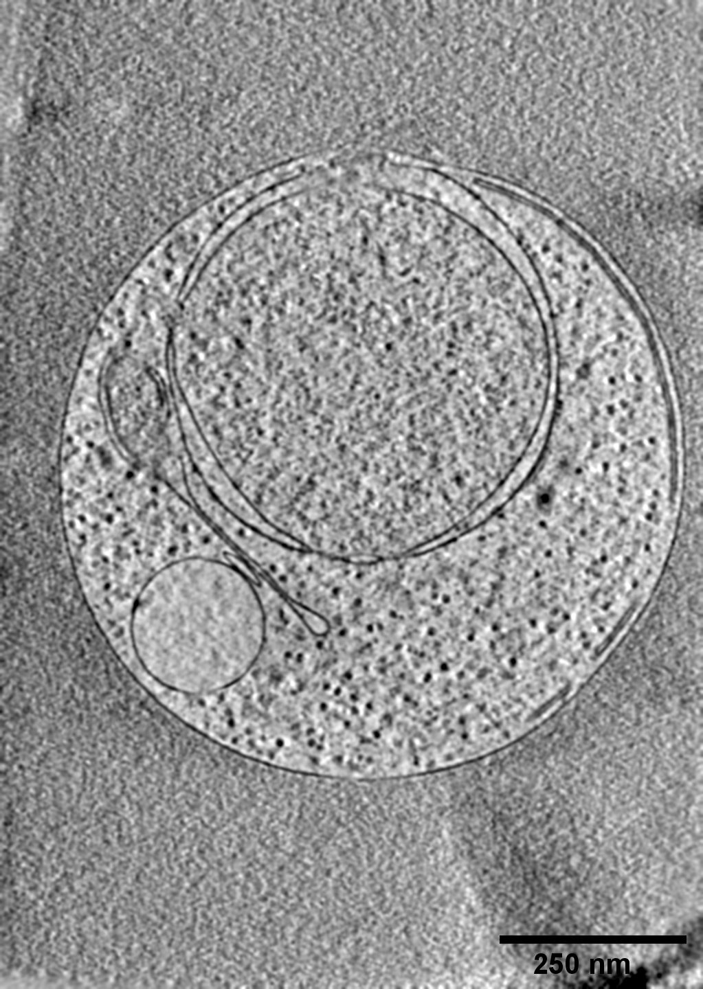
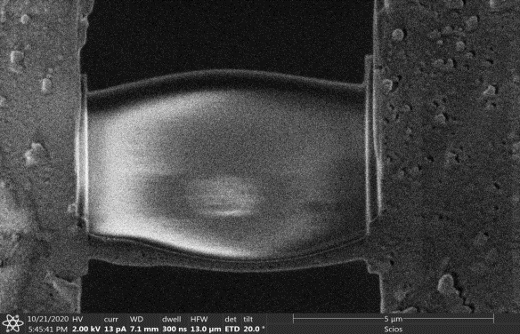
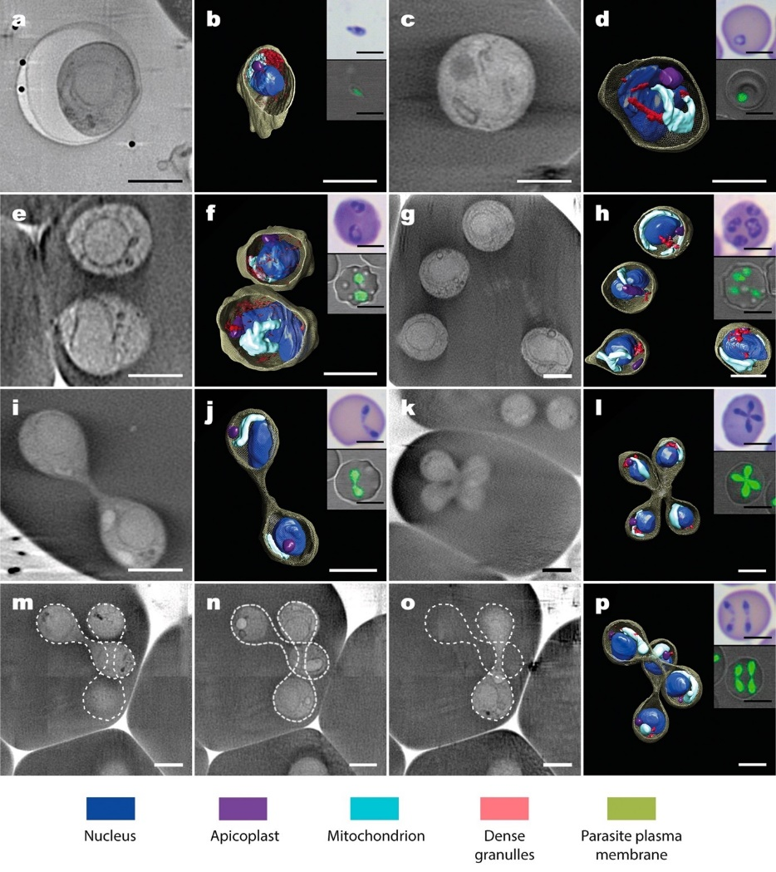
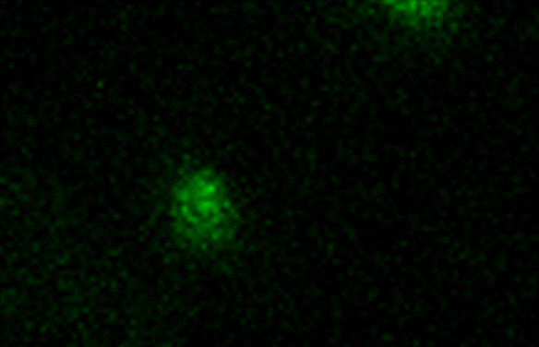
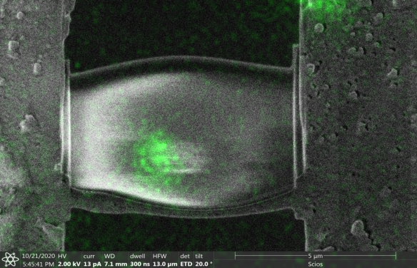
Cryocorrelative microscopy: Babesia divergens asexual cycle

Slide 14
Perspectives: cryo-correlative workflows
Cryo-SXT | FIB-SEM + cryoET
Resolution to the level of cell organelle | Resolution potentially to the atomic level
High throughput (hundreds of tomograms per session) | Around 20 lamellae preparation per sesión
Non destructive, possible to combine with other methodologies after at whole cell level | Destructive, not posible to combine with other methods after at whole cell level
Spectroscopy capabilities
Cryo-Soft X-ray Tomography + cryo-FIB-SEM + cryoET
FIB (Ion Beam)
SEM (Electron Beam)
Not stablished yet
Feasible, same sample prep and compatible supports
Possible method development to be implemented in collaboration between ALBA and CNB
Possibility to correlate cryo-ET with other synchrotron techniques (STXM, microCT) to be studied

Slide 15

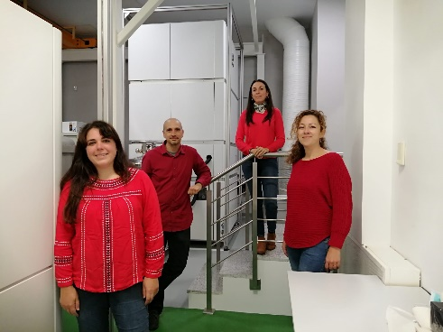

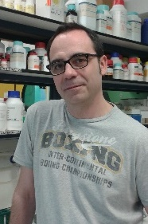
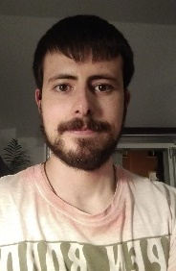
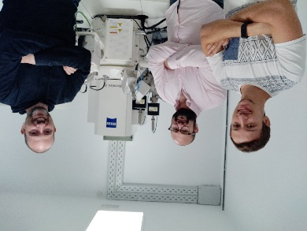

Acknowledgements
CNB, Madrid
José María Valpuesta
Cryo-EM Facility
Rocío Arranz
Fco. Javier Chichón
María Teresa Bueno
Noelia Zamarreño
Javier Collado
César Santiago
Unidad de Biocomputación
Jose María Carazo
Carlos Oscar Sánchez Sorzano
MISTRAL beamline
Eva Pereiro
Andrea Sorrentino
Ana J. Pérez-Berná
Ricardo Valcárcel
Jan Groen
Centro Nacional de Microbiología
Daniel Luque
Estrella Montero
Luis Miguel Gonzalez
Elena Sevilla
Carmen Terrón
Francisco Sanchez Madrid
Noa Martín
Thanks for your attention!
David Delgado
Jonathan Piccirillo

Slide 17
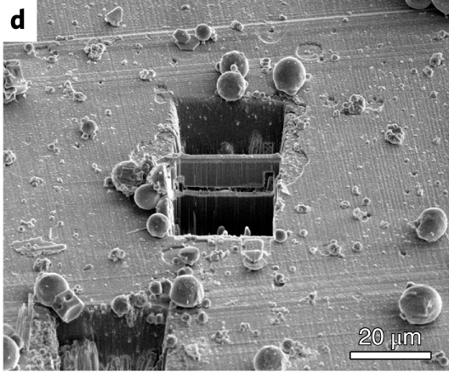
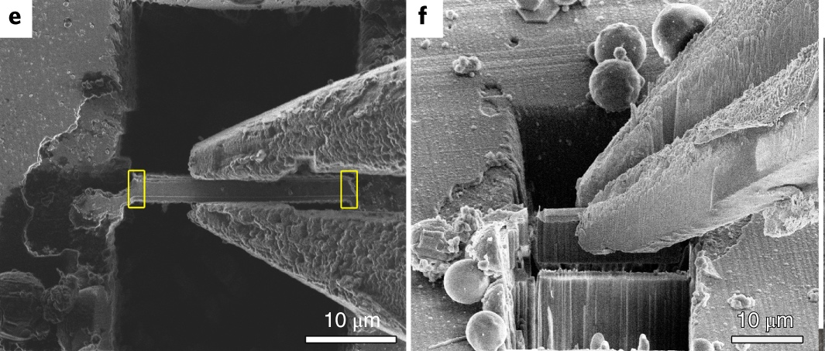
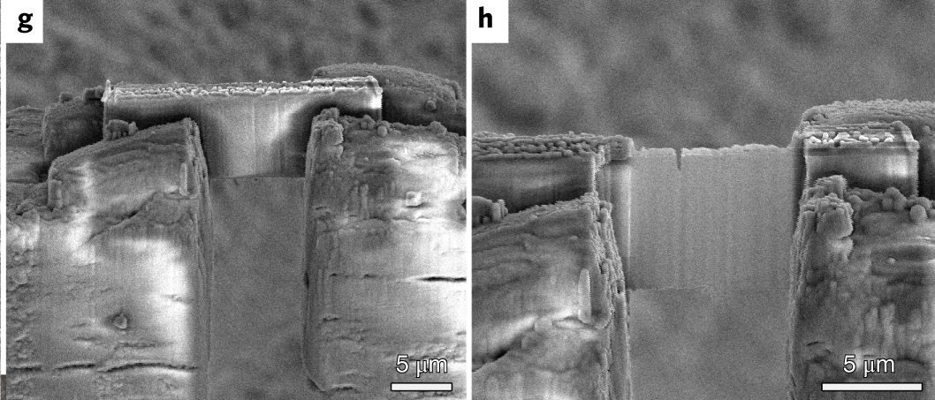
Cryo FIB-SEM lamella preparation
Tissue (thick samples)
FIB (Ion Beam)
SEM (Electron Beam)
Modified from Weber et al., 2019 Cells

Slide 18
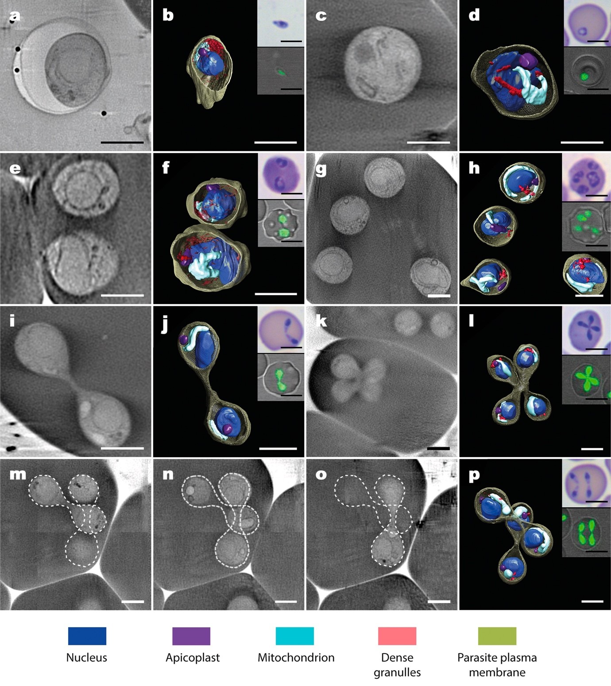
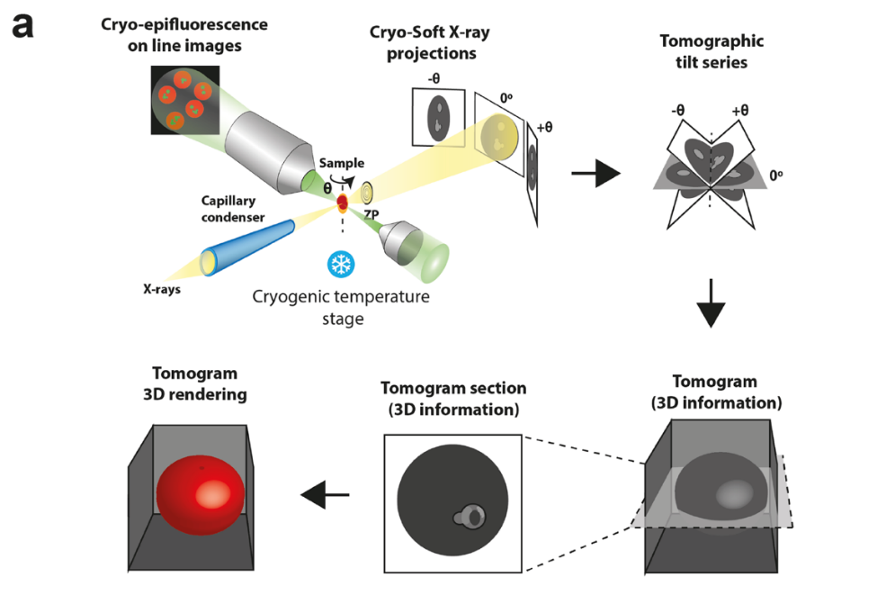

Slide 19
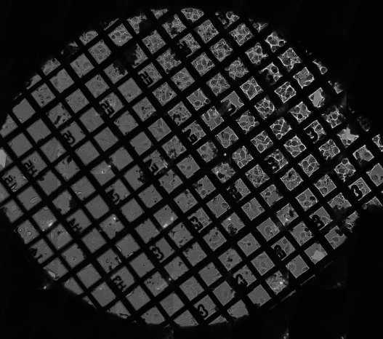
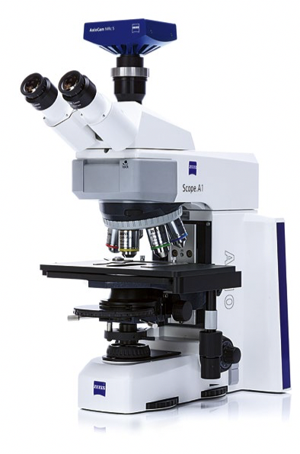
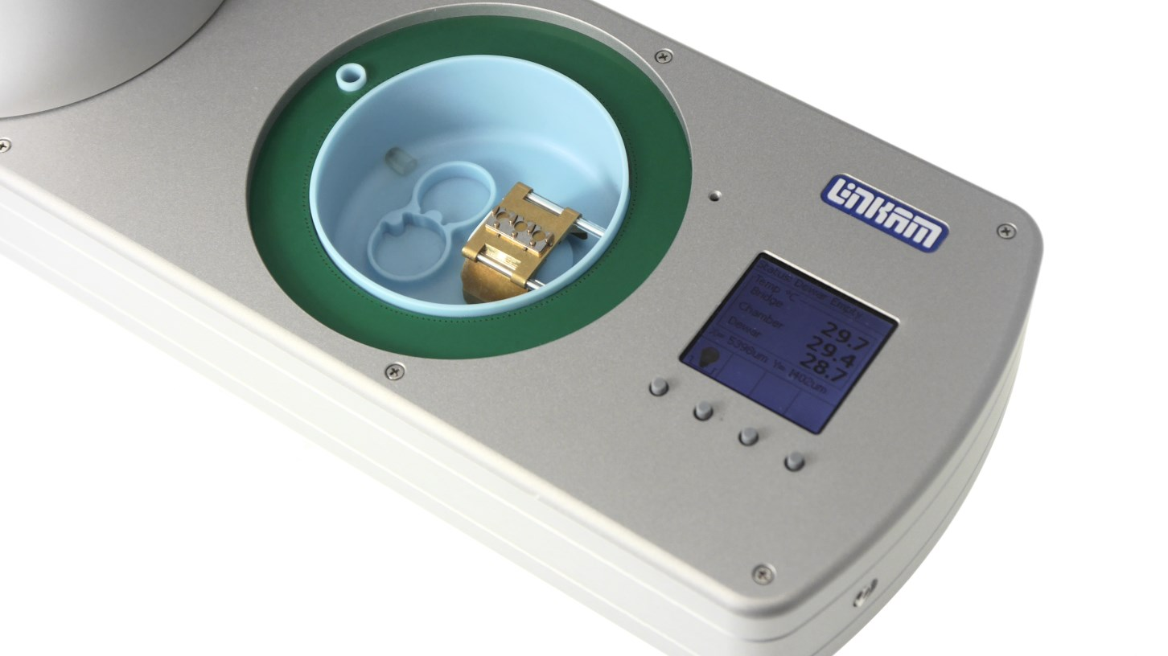
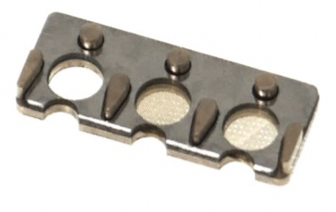
Cryofluorescence microscopy
WIDEFIELD
AXIOSCOPE A1
CONFOCAL
LSM 900
AIRYSCAN2 detector
500 um
Linkam Stage
CMS196
10 um

