Slide 1
µCT at ALBA: status and vision
Structural Cell and Tissue Section Review
The Existing Tools
Alberto Mittone
8/9.11.2021
Notes:
FAXTOR is a new beamline dedicated to fast hard x-ray computed tomography imaging currently under construction at ALBA.

Slide 2
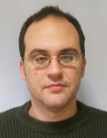
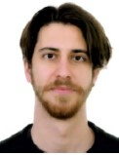
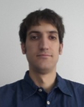


FAXTOR - BL31 Staff
Foreseen position plan:
4 “structural positions” (long term guaranteed).
  3 scientists
  1 post doc position
“Matrix” staff:
?
Current FAXTOR staff:
Alberto Mittone (BL responsible)
Since Feb 2019 – X-ray imaging/Bio/software
Alessandra Patera (BL scientist)
Starting date January 2022
X-ray imaging/Mat science
To be HIRED ~ 2022 (BL scientist)
To be HIRED ~ 2024 (Post-doc)
Llibert Ribó
Mechanical engineer
TBR
Controls engineer
Álvaro Baucells
Electronic engineer
+ work package managers (Infrastructure, ID, FE, Vacuum, Computing…)
?
?
Joint efforts with MX beamline (XAIRA) to establish a High throughput data infrastructure
Commissioning starts – mid 2023
Notes:
Consider NANO branch in triangle and its position
High energy mark -
Add triangle / energy / time resolution / energy resolution + keyword application
Access higher
Moving into the GAP analysis, specific know-how and the development of equipment will be required for in-situ/in-operando studies but this can be achieved through in-house projects and external partnerships. The complex scientific projects can be sustained by coupling them with new services and structure techniques. Heavy computation services will be required, so a close collaboration with data analysis services is required. The limitations in spatial coherence can be smoothed by implementing at ALVA of a mini-beta section and in the future with the ALBA2 storage ring upgrade. The last point is linked to the limited multi-scale capabilities, however this gap can be filled if it is considered in the framework of ALBA2 a physical extension of the beamline or the construction of a complementary long high energy imaging beamline.

Slide 3

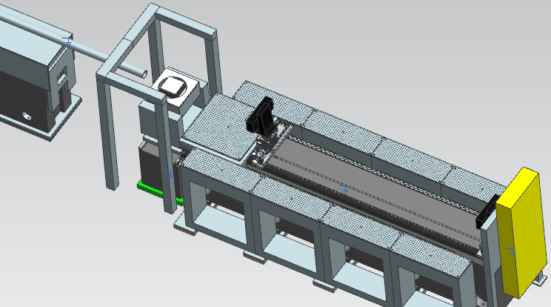
FAXTOR - Beamline and instrumentation
In construction
10-50 keV
18 m
DMM
Detector
CT-stage
Filters
ID Source: Multi-pole wiggler
2.5 T peak field/5 poles/In vacuum
Energy range: 10 – 70 keV
Max beam size @sample: 35x12 mm² (HxV)
Flux: ~6*10¹³ ph/s/0.1%BW - 30 keV/250 mA
MPW54
20 m
36-40 m
36 m
Temporal resolution:
100 ms - 1000 s (CT)
100 µs - 1 s (Radiography)
FAXTOR
End-station
Spatial resolution
Two detection stages
@ENDSTATION: Filtered white beam or Double Multilayer Monochromator ΔE/E ~ [2,5]% beam
Pixel size: 1-10 µm
Field of view: few mm to few cm
Operational to users - Beginning 2024
Notes:
The beamline is fed by a short in-vacuum multipole wiggler, currently under construction. This provides a broad energy spectrum, ranging between 10 keV and 70 keV (in filtered white beam). The main Optical element of the beamline is a Double Multilayer Monochromator, providing an energy bandwidth comprised between 2% and 5% in range between 8 keV and 50 keV.

Slide 4
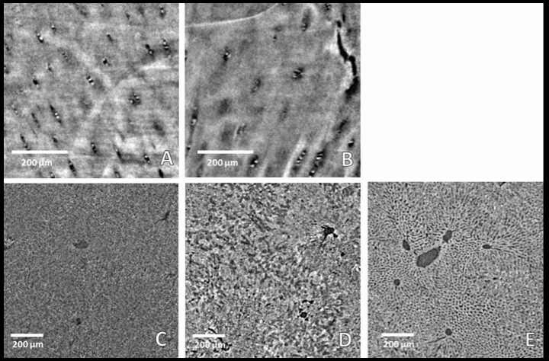
FAXTOR - Techniques and science
Rat brains
Available techniques:
Propagation based imaging. (1-5 µm, 10-40 keV)
X-ray absorption imaging. (1-10 µm, 10-70 keV)
Time resolved radiography.
µ-Computed tomography (3D/4D).
µCT/µXRF/SAXS/WAXS
Romano M. et al. Cancers, 2021.
+ Combination with external stimuli
Neuroimaging – spinal cords
Cartilage imaging (human plugs)
Rat livers
Stroebel J. et al. Sci. Rep, 2020.
Mittone A. et Al, JSR 2020.
land
Rack A. et al. Instruments, 2020.
Notes:
As techniques propagation based X-ray phase-contrast and absorption-based imaging will be used on a daily basis. Future extensions including differential phase-contrast imaging can be also foreseen. Different acquisition protocols will be available, from time resolved projection imaging, to static and time resolved computed tomography.

Slide 5
SWOT
Strengths
Weaknesses
Flexible End-station (in-situ/in-operando capabilities).
Broad energy range with Tunable spectrum.
Broad time resolution.
No in-vivo measurements capabilities (small animals).
Limited sensitivity in phase-contrast (Spatial coherence).
Limited spatial multi-scale capabilities.
Not yet established users community.
Threats
Opportunities
ALBA2 long shutdown during possible ramping up of user community.
Competing communities at the beamline (Bio / Mat. science).
Competitive environment in Europe.
Reduced horizontal electron beam size with ALBA2.
IT Infrastructure upgrade, creation of computing and data analysis unit.
Long shutdown (machines upgrade) in other facilities.
Notes:
Check shutdown/list of competitors (last point of opportunity)
Easy setup change (mono/filtered white beam):
Concerning the SWOT analysis, the identified beamline strengths are a flexible end-station, easy change of the setups and broad energy range. As weaknesses the BL is currently in construction and in Europe a competitive environment is present in the field. In addition, strong computation requirements are required and currently optimal commercially available solution of high speed streaming CMOS camera are lacking. One last issue is linked to the limited of spatial coherence achievable. The main threats are linked to possible lack of computing resources, the evolution of competing imaging techniques and technical upgrades of existing beamlines and storage rings. As opportunities we will take advantage of the IT infrastructure upgrades, and the performance improvement expected from the ALBA 2 machine. In addition, a strong industrial interested arose around FAXTOR is present.
THREATS:
ALTERNATIVE TECHNIQUES: SHANEL - OPTICAL CLEARING
Conventional source developments -> larger photon fluxes

Slide 6
GAP analysis
Gap
Mitigation
Heavy computational services Required.
Coupling with Data Analysis Services. IT infrastructure upgrades.
Ongoing tests on the implementation of a mini-beta section/ALBA2 machine.
Implementation of differential phase-contrast imaging setups.
Limited phase-contrast sensitivity.
Not yet established users community.
Early dissemination/establishing collaborations.
Limited multimodal capabilities.
Implementation of new instruments enabling multimodal approaches.

Slide 7
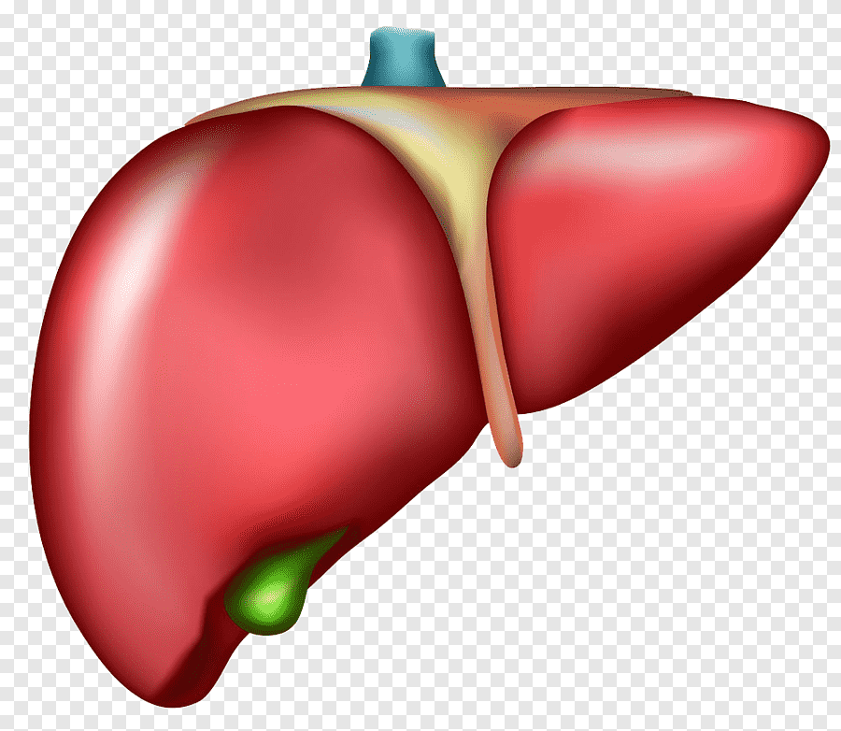
Integrating µCT into multimodal experiments
FTIR
Cryo-SXT
LeNaour F. Anal Chem, 2012.
µCT
Brandlhuber M. Inv Rad, 2016.
Pérez-Berná A. et al, acsNANO, 2016.
10 µm
5 µm
1 µm
50 µm
100 nm
Pixel size
>10 cm
~ 2 cm
~ 200 µm
Sample size

Slide 8
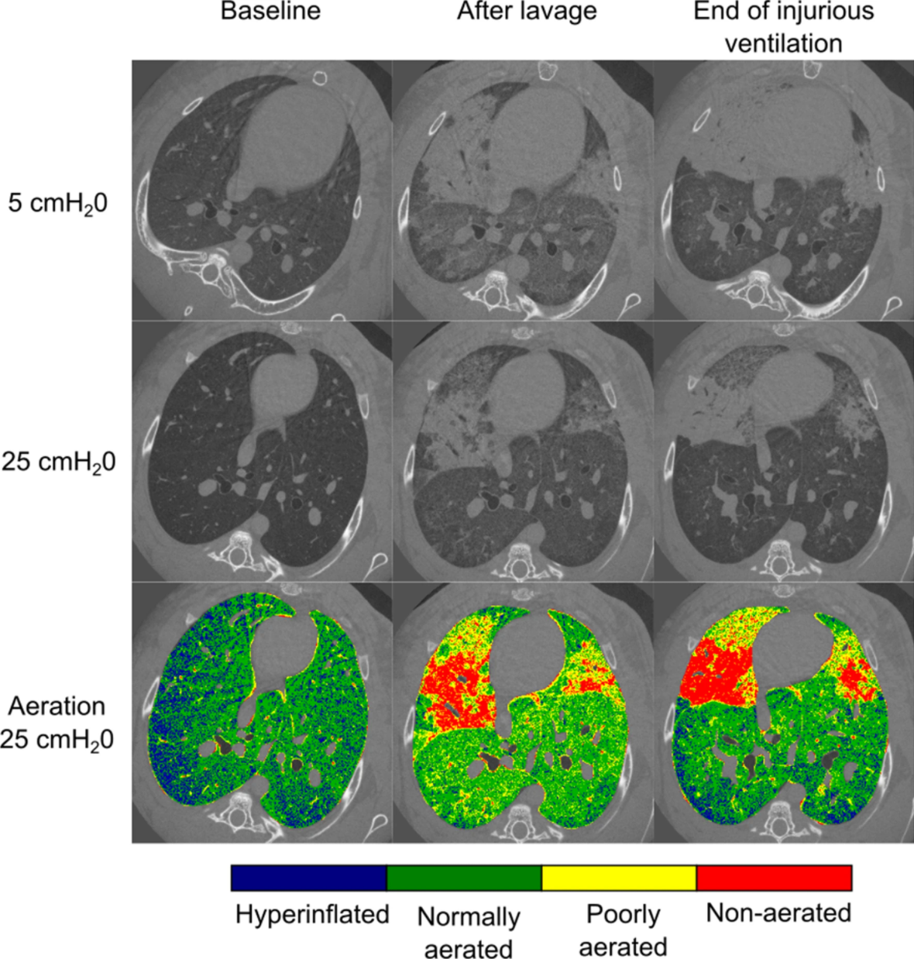
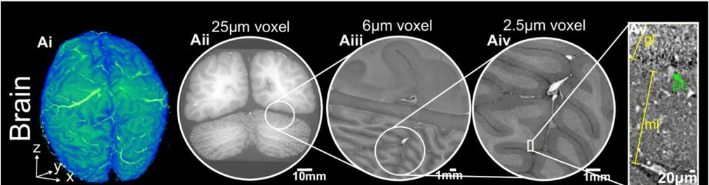
Towards high energies?
Larger/denser samples.
Low dose/in-vivo applications.
Ex-vivo Breast imaging
In-vivo lung imaging
Full human knee joint
Gasilov S. et al. BOE, 2013.
A. Horng et al. Inv Rad, 2014.
Walsh C. et al. Nature Met, 2021.
Multiscale imaging of organs
L. Fardin et al. Sci Rep, 2021.
Requires ID source.
ALBA disadvantage compared to High Energy machines.
In-vivo user community is limited.

Slide 9
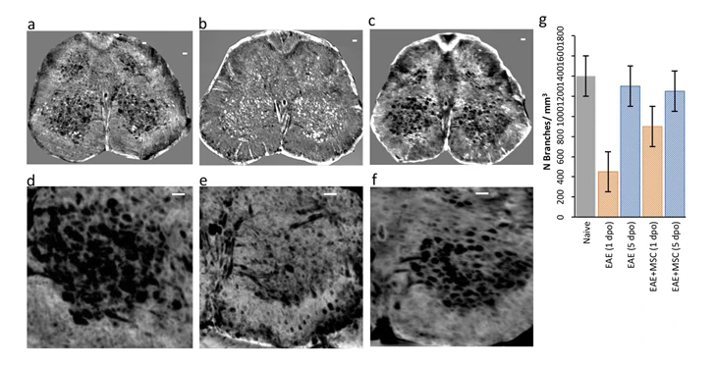
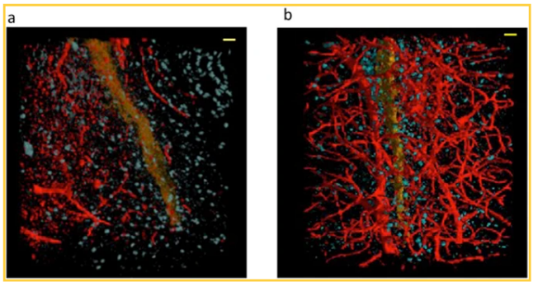
Mind the gap!
Expanding multi-scale capabilities - sub-µm CT (spatial resolution)
A. Horng et al. Multiscale X-ray phase contrast imaging of human cartilage for investigating osteoarthritis formation. J. Biomed. Sci, 2021.
µCT
Sub µCT
µCT
Sub µCT
A. Cedola et al. X-Ray Phase Contrast Tomography Reveals Early Vascular Alterations and Neuronal Loss in a Multiple Sclerosis Model. Sci. Rep. 2017.
I. Bukreeva et al. Quantitative 3D investigation of Neuronal network in mouse spinal cord model. Sci. Rep. 2017.

Slide 10
Hard X-ray CT Vision
 | Sub-μm CT | HE CT in vivo
 | Hard X-rays | Hard X-rays
 | SB/W | W
 | 10-30 keV | 50-120 keV
 | <1 µm | 10 - 50 µm
Near Native
Multimodal
Dynamics
Strong Community
Proposed
High energies (>50 keV)
!
Spatial coherence
Time resolution
Long High energy BL
Capability
FAXTOR @ALBA2
FAXTOR
µ-CT
NA
Sub µ-CT
µ-XRF
µ-XANES
Essential tool
Desirable tool
Disregarded tool
Spatial resolution
Chemical
sensitivity
3th generation upgrade
4th generation upgrade

Slide 11
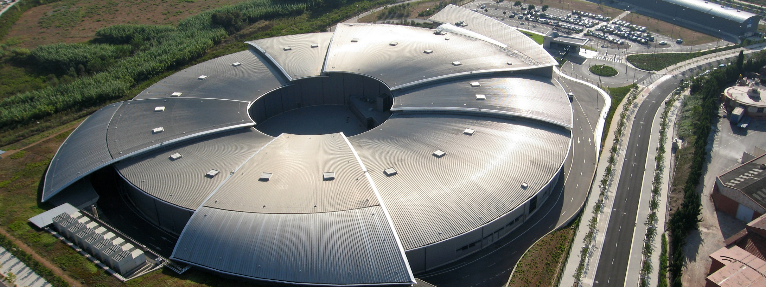
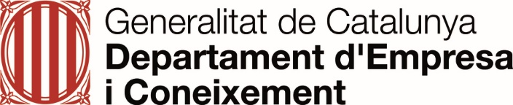

Thank you for your attention!

