Slide 1
Vision of the FTIR program at ALBA
Tanja Ducic
8/11/21

Slide 2
MIRAS mission and vision in life science field
Characterization and visualization of the macromolecular composition in different diseases and after treatments at the cellular, tissue, and small organism (model system) level, linking different chemical and structural information.
Contribution on macromolecular conformational changes in synergetic multimodal approaches to fully exploit and connect all possible information of biological processes and health challenges.

Slide 3
GAP analysis
Gap
Mitigation
Dependency on basic instruments limits the throughput and growth of the program.
Lack of complementary vibrational analysis.
Unstable users demand and long publication cycle.
Sophisticated sample preparation.
Extraction of IR light from 4th generation.
Rapid and significant development of conventional IR sources that compete with the IR synchrotron source.
Competitive European environment.
Build dedicated bio- end-stations allowed by the optical design.
Implement additional setup (Raman, THz and nano-FTIR).
High throughput and easier access to other techniques (other tools at ALBA).
Bio-lab support.
Looking (exploration) for new sources.
Bring them to the synchrotron.
Multimodal multiscale approach and collaborations.
How to get there
Instrumentation upgrade
Multimodal approach

Slide 4
Proposed instruments and methods
What do we aim? How?
Further multi-length scale and multi-modality (chemical and structural) with other techniques
Live cells µFTIR for users
Extract more information in chemical and structural interaction:
  in order to follow bio-macromolecular changes and interaction (e.g. protein higher order movement, epigenetic studies) (chemical)
  Higher special resolution (structural)
Integrating novel sample preparation (3D cell culture and tissue on chip) and methods (Raman, Mass- spectrometry).
Live cell microfluidic setup
Implement new techniques:
  Terahertz spectroscopy
  Nano-FTIR for spectroscopy and imaging
Priority

Slide 5
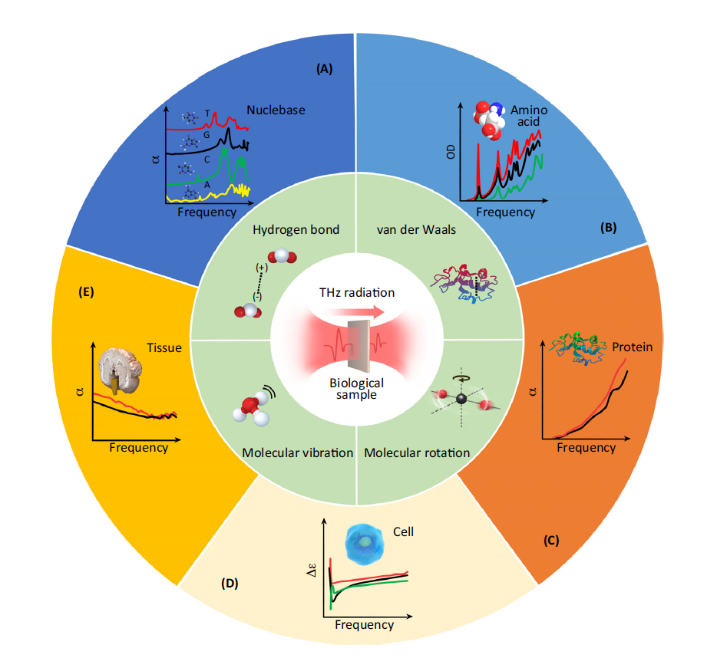
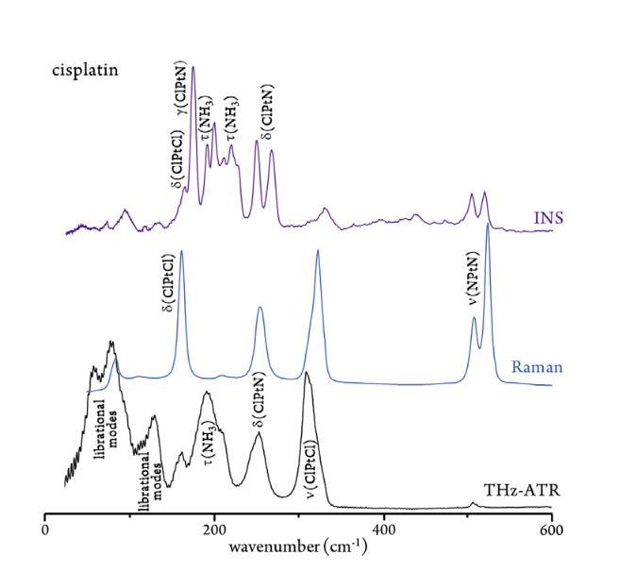
Proposed instrument:
Terahertz (THz) Spectroscope
The THz range is sensitive to hydrogen bonds, van der Waals and hydrophobic interactions.
Noninvasive and nonionizing radiation (1–10 meV) - suitable for in vivo real-time without causing damage (but high water absorption).
Possible by synchrotron light - synergy with the material science group
Need in-vacuum spectrometer.
Demanding sample preparation.
Spectral Fingerprint
Yung et al., Trends in Biotechnology, 2016
Near-Field Nanoscopic Terahertz Imaging of Single Proteins
Yang et al., Small 2021
Batista de Carvalho, et al., 2021 Biophysical J.
5

Slide 6
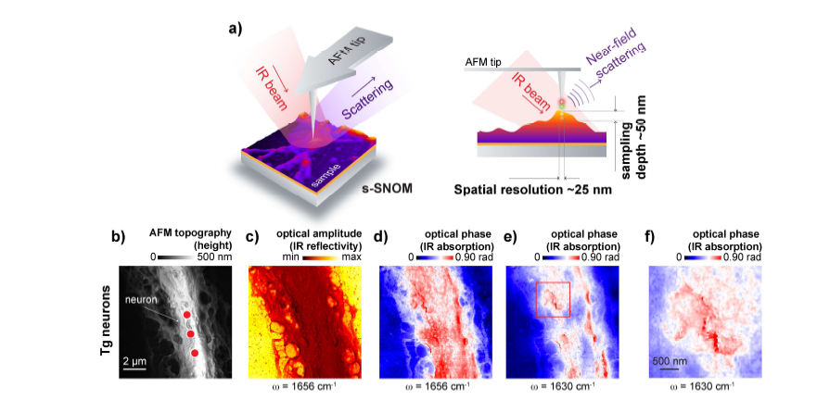
Proposed instrument: nano-FTIR spectroscopy
Not intact cells measurements: studies on single fibrils, viruses, individual protein complexes, membranes and protein aggregates…
Sample preparation and technique are challenging.
Mapping with ~10-30 nm lateral resolution.
Benefit for hospital, clinical research.
TEM, AFM, FTIR, and Raman characterization of SARS-CoV-2 virus. (Wood et al., 2021, Angewandte Chemie)
Freitas et al., Cells 2021
6

Slide 7
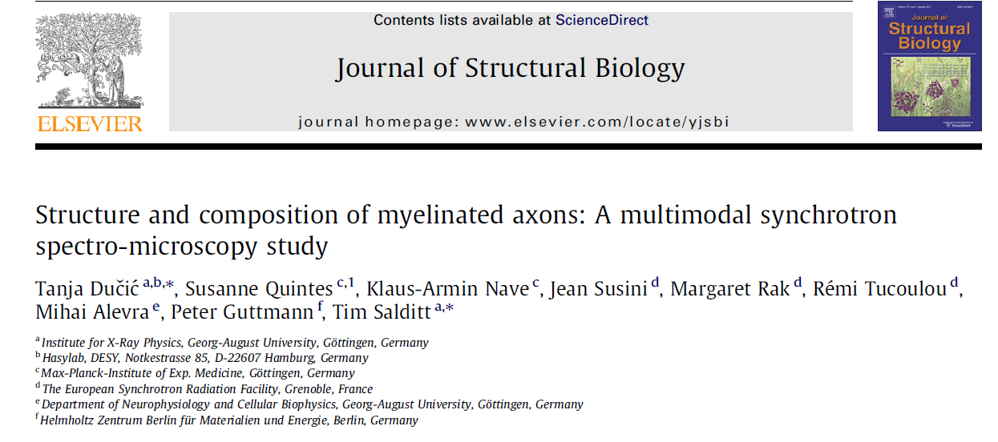
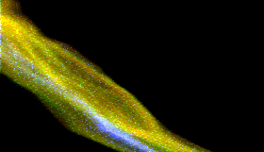
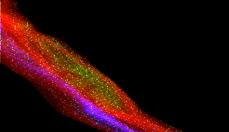
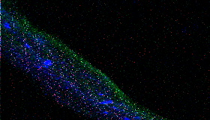
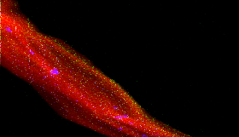
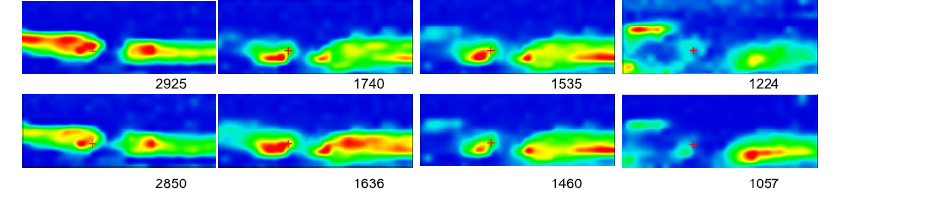
Know-how on the multimodal approach
Example on combining FTIR, and different X-ray microscopies on intact cells
Our long term experience in multimodal approach
Cryo TEM
Single axon XRF cryo-measurement
AFM
Multimodal application of synchrotron radiation based FTIR in combination with:
-SXT (cryo)
-X-ray fluorescence (cryo and freeze dried),
-XANES (cryo)
-FE TEM (cryo),
-In vivo MRI & ex vivo MRI,
-AFM (in vivo),
-confocal fluorescence microscopy (fixed cells)
-histological analysis
(Ducic et al., J. Struct Biol. 2011)
Cryo TXM
Mn- red, Cu- green, Fe- blue
P- red, Na- green, Fe- blue
SR-FTIR
LIPIDS ESTER PROTEINS PHOSPHATES

Slide 8
Know-how on the multimodal approach
Multimodal synchrotron radiation microscopy of intact astrocytes from the hSOD1 G93A rat model of amyotrophic lateral sclerosis:
Combining FTIR, hard and soft X-ray microscopy on single cell
Ducic et al, Analytical Chemistry 2019

Slide 9
Collaboration between beam-lines for correlative research
Cryo-ET
BioSAXS
(structure of macromolecular complexes s vs
nano-FTIR)
Nano - XRF
XANES
MIRAS
(FTIR)
MISTRAL
(Live cells
vs cryo)
(tomography of organoids)
FAXTOR
BioLab
(advanced
sample preparation)
In-house program on new technique as 3D cells culture, organoids or tissue on chip.
Sample preparation and innovative project are foreseen, and the bio-lab support is needed.
Increasing usage of correlative microscopies (IR, X-ray microscopies and VIS)

Slide 10
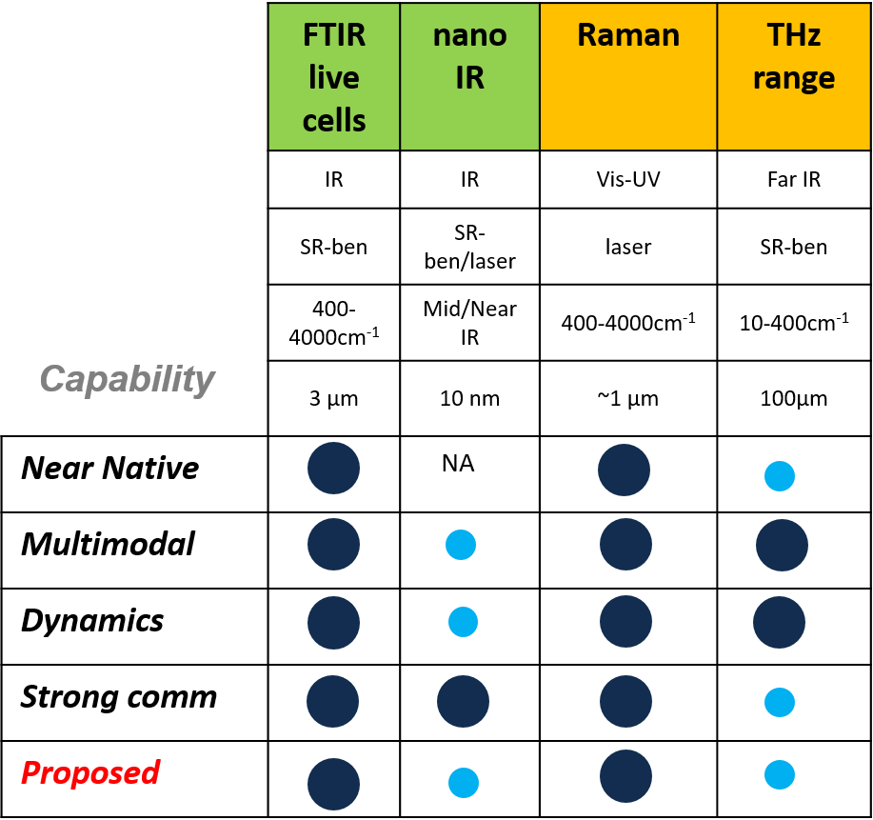
Proposed upgrade of the FTIR program
benefits for the life science investigation community
Live cells multimodal approach and new sample preparation techniques will collect more crucial information in close to native (physiological) conditions (enlarging the user’s programs and interests).
Additional techniques (THz, Raman and nano-FTIR) will provide new chemical information and increase close collaboration in the life-science users’ community.
Optimization IR sources driven by science:
  synchrotron BL coupled with for current mid-IR application on live-cell setup,
  synchrotron BL coupled with in-vacuum spectrometer for THz,
  lasers for nano-FTIR.
essential tool
3th generation upgrade
desirable tool
4th generation upgrade

