Slide 1
MISTRAL BL vision
Eva Pereiro
08/11/21

Slide 2
MISTRAL role and vision
Visualization of the near-to-native cellular environment is paramount to understand
cellular processes (e.g. pathogen infections, evaluation of drug treatments at cellular
level, morphological changes in genetic recessive diseases, revealing intercellular
structures or locating specific structures or molecules).
Ultimately, the goal is to link structure with function and chemical
information and elemental quantification in 3D.

Slide 3
SWOT
Strengths
Weaknesses
Few competitors.
Complementarity to other microscopies.
High throughput (cells population statistics).
Staff dedication.
Good publications IF.
New user groups accessing the technique.
Major BL upgrade required due to aging.
No reproducible sample preparation.
Difficult sample quality control.
Manual data processing required.
Lack of bio-users expertise in tomography.
Threats
Opportunities
Cryo 3D CLXT is mandatory to keep competitiveness.
Productivity loss if delayed BL upgrade
Proprietary TXM software
Lack of support staff for sample preparation and cryo-3D-SIM.
Arising of competing laboratory techniques
Integrating cryo 3D CLXT into the program.
BL upgrade and methodology can improve significantly experiment conditions
Higher data throughput by implementing reliable fiducialess alignment.
Growing user community.
Notes:
Message: BL and TXM upgrades are necessary
more support in sample prep and software is necessary
SAY: there was no community.
ET: electron tomography
CLXM: Correlative Light-X ray microscorpsocy
Most productive soft TXM in the world (with Bessy).
Fine tuning of mirror curvature with beam

Slide 4
GAP analysis
GAP
Aging instrumentation
Integration of cryo 3D CLXT to keep competitiveness
Automated data alignment for increased throughput
Improved methodology
Sub-100 nm cryo rotation run-out in 3D
Mitigation
BL optics upgrade (nanobenders)
Cryo 3D-SIM in development; sub-100 nm cryo SR?
Fiducialess alignment
Cone beam tomography & partial coherent
image formation model
Major TXM upgrade

Slide 5
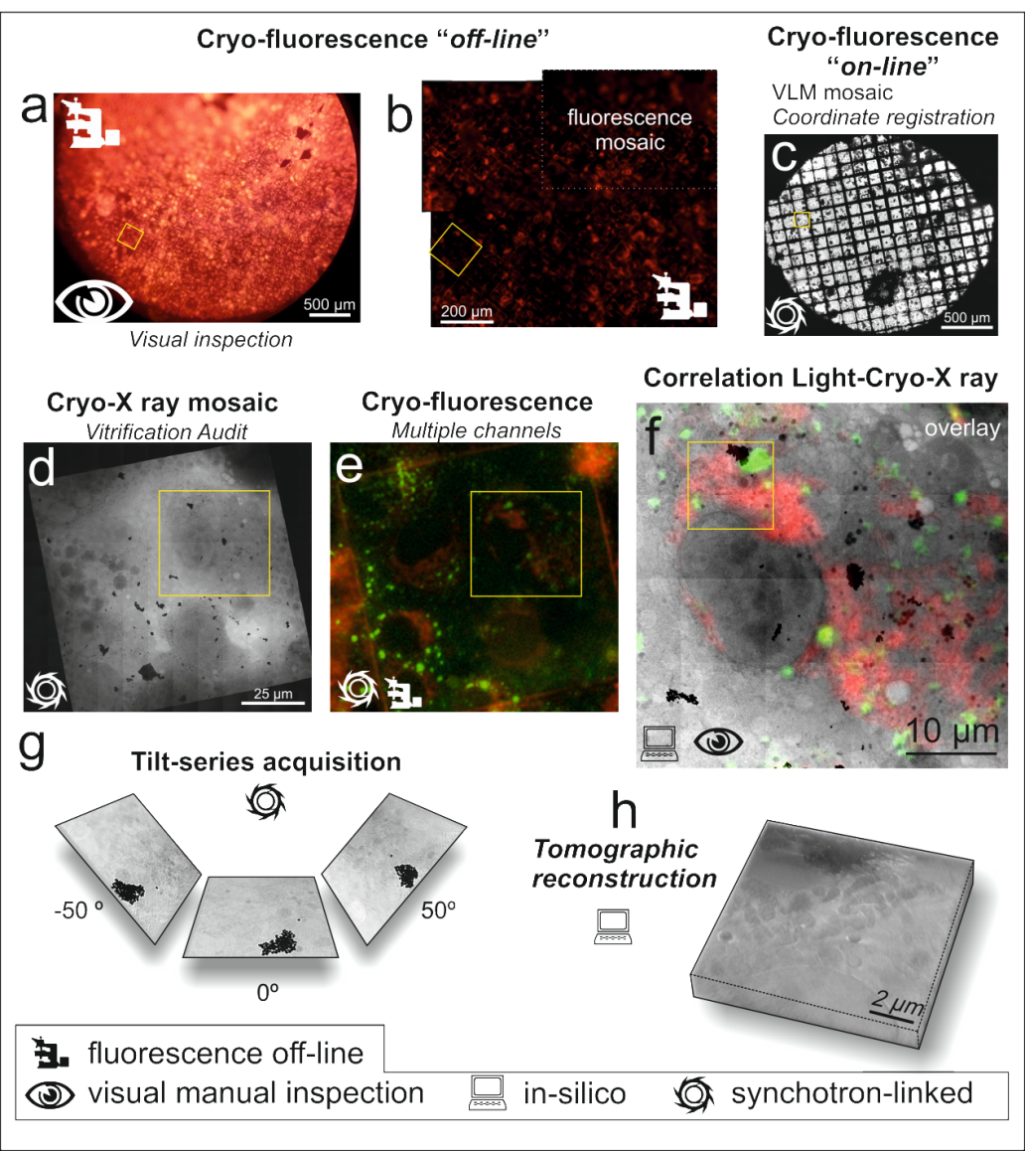
workflow
What we do now
Identifying specific cellular structures
Follow processes
Evaluating cellular morphological changes
only 2D low resolution VLM
correlation in cryo!

Slide 6
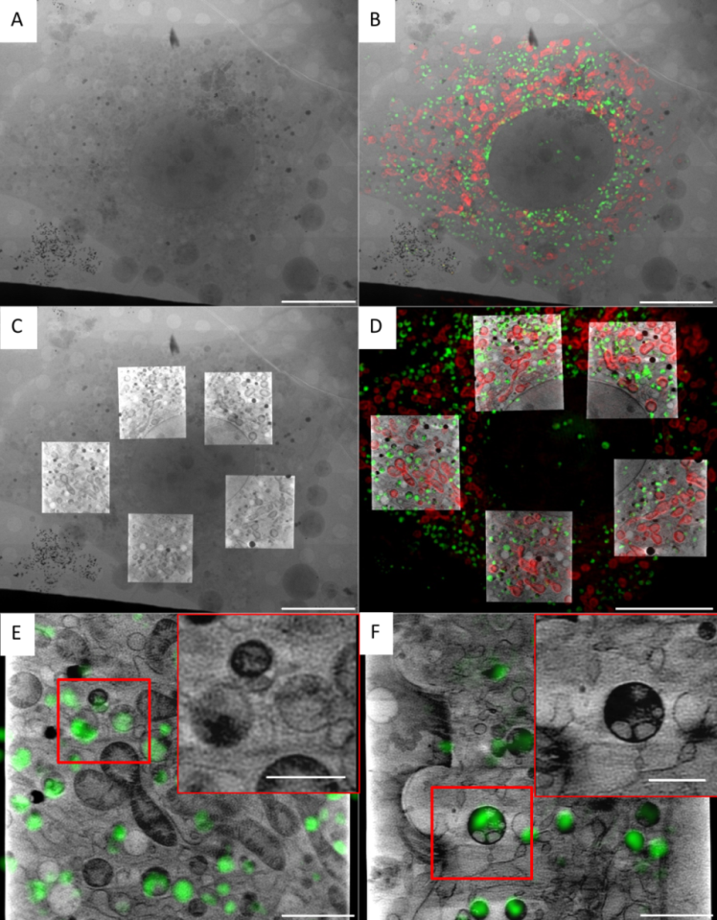
What we’ll be doing soon: 3D cryo CLXM
Identifying specific cellular structures
Follow processes
Evaluating cellular morphological changes
2D X-ray mosaic
2D mosaic & 2D SIM
2D X-ray mosaic & SXT
3D SIM & SXT
cryo 3D-SIM correlated to cryo-SXT
All users groups will benefit!
NIH-3T3 cells
primary fibroblats
Groen et al. Chemical Science 2021
Providing cryo 3D-SIM to users in a day to day basis will require an extra FTE.

Slide 7


Mitigation
Upgrade phase 1 (2022- 2024)
Instrumentation
  3D CLXT for users in 2022: cryo 3D-SIM in development
  towards increasing resolution: decrease Cu braids wobbling to ∼1 µm (irreproducible)
covered
in development
needed
Methodology
  towards automatic 3D CLXT (1 FTE from EU project for 24 months)
  accounting for real TXM geometry: cone beam tomography
  automatic data alignment for users: fiducialess alignment
  accounting for real optical system: partially coherent image formation model
Notes:
Red: capital investments and resources

Slide 8
Mitigation
covered
in development
needed
Upgrade phase 2 (2024- 2028)
Instrumentation
    towards high resolution raw data collection: 3D wobbling <100 nm with active correction
    increase BL performance: nanobenders in all elliptical cylinder mirrors
    3D CLXT matching resolution: sub-100 nm 3D cryo super resolution

Slide 9
Mistral vision
Cryo correlative approaches to link structure, function and chemical information in 3D.
Structure information
operational
in development
not currently at Alba
cryo-SXT
µPCXT
nano-PCXT
Exploiting all possible information!
SR-µFTIR
3D cryo SIM
cryo-ET
3D cryo-XRF
SR-µFTIR
cryo XANES (soft)
3D cryo XRF
Chemical info & element quantification (ppm)
Location of specific molecules
or structures

Slide 10
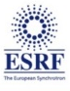

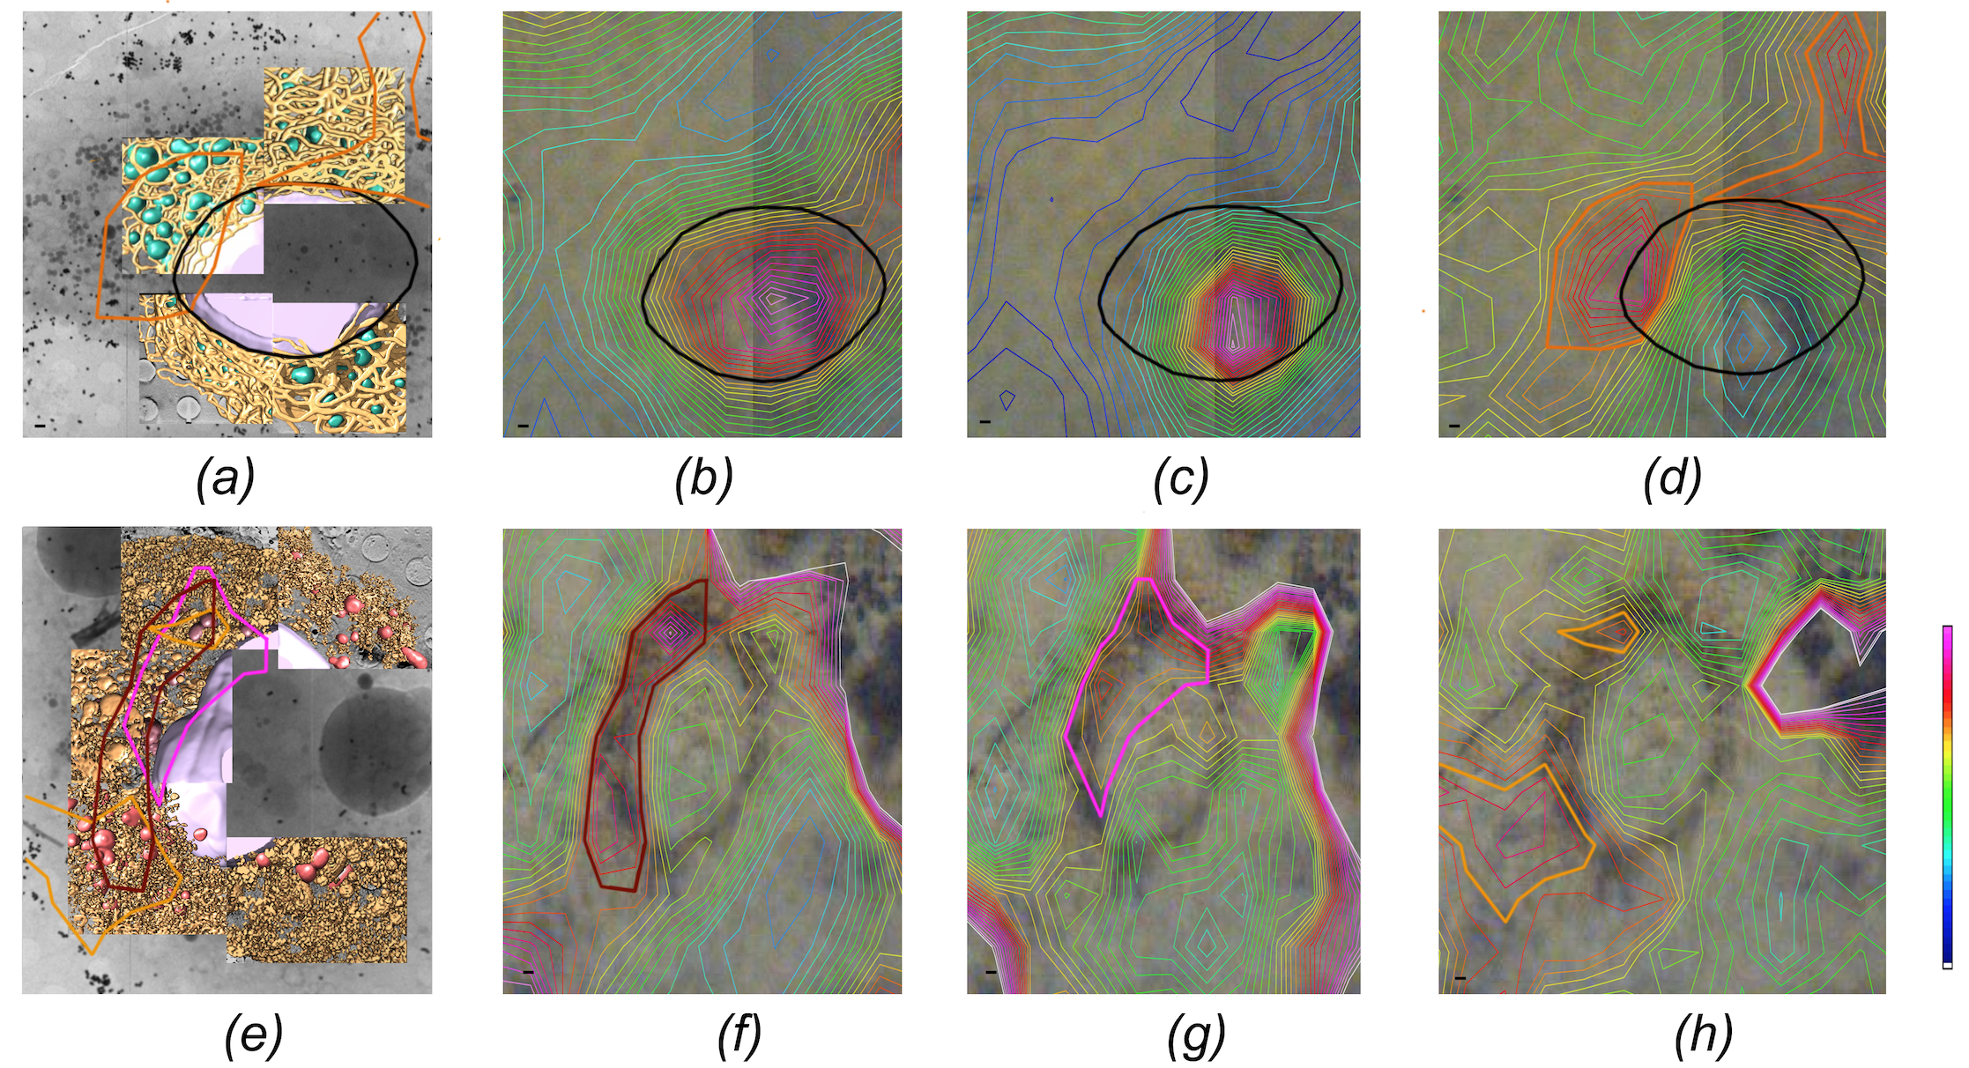
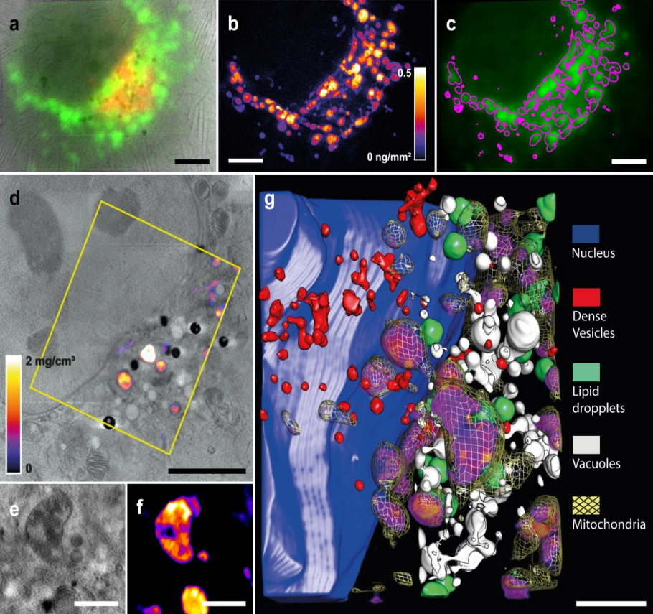
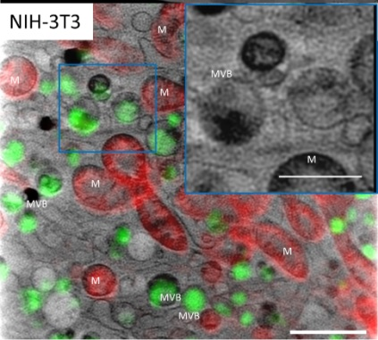
Example of
cryo-SXT correlated to
3D cryo XRF
Example of cryo-SXT correlated to SR-µFTIR
cryo-SXT
lipids
amide I
oxidation
control
5 µm
HCV replicating cells
Pérez-Berná et al. (in press)
5 µm
1 µm
2 µm
Example of cryo 3D-SIM/cryo-SXT
J.J Conesa et al. Angew. Chem. 59, 1270-1278 (2020)
Groen et al. Chem. Sc. (2021)

Slide 11
Towards exploiting all
possible information on the same cell
3D cryo super resolution for users in a day-to-day basis
cryo 3D X-ray Fluorescence with sub-100nm resolution for elemental quantification
cryo-ET & cryo-FIB SEM (+HPF)

Slide 12
Upgrade benefits for the user community
Instrumention upgrade will produce better data and keep competitiveness.
Automated data alignment allows accessibility to non-expert users.
3D cryo CLXT will produce more complete information and expand the user community.
Expanding portfolio to additional multimodal correlative approaches will
  benefit from already existing protocols (cryo-SXT/cryo-XRF & cryo-SXT/μFTIR)

