Slide 1
MISTRAL user support and inhouse research
Ana J Perez-Berna
14th October 2021

Slide 2
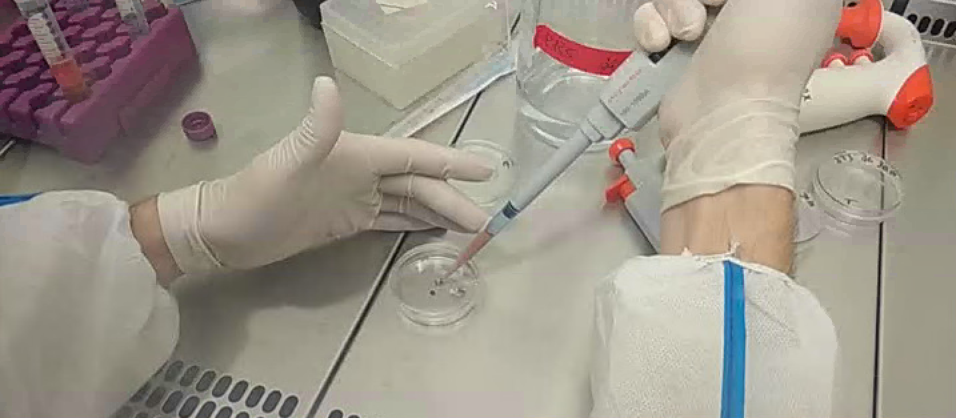
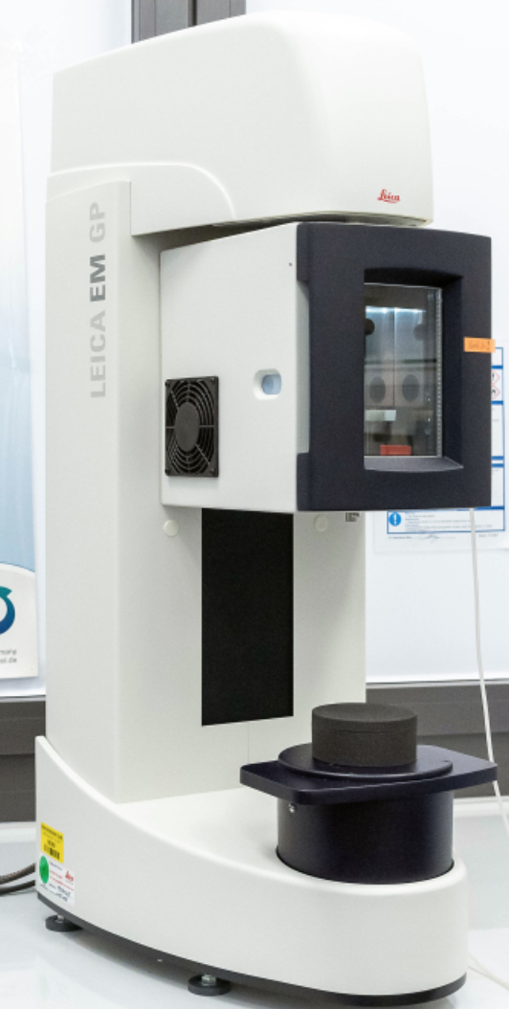
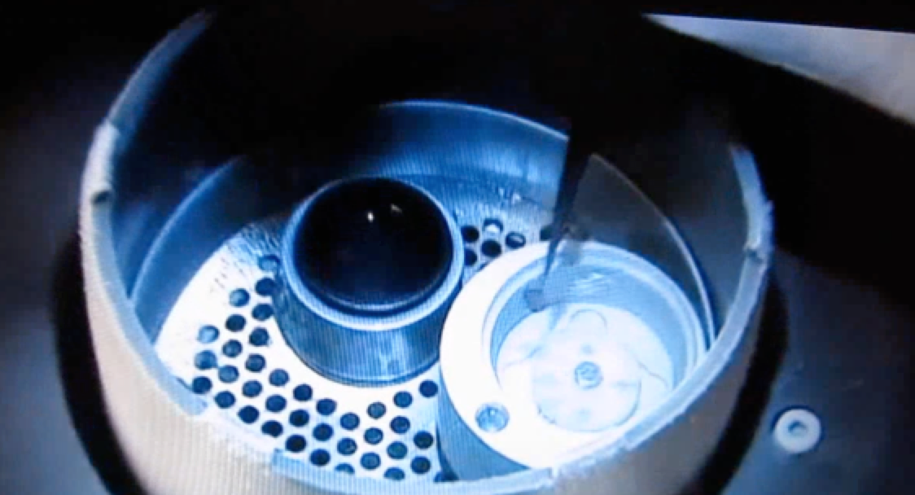
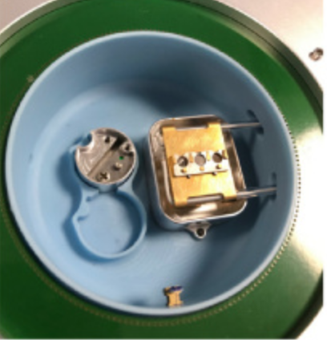
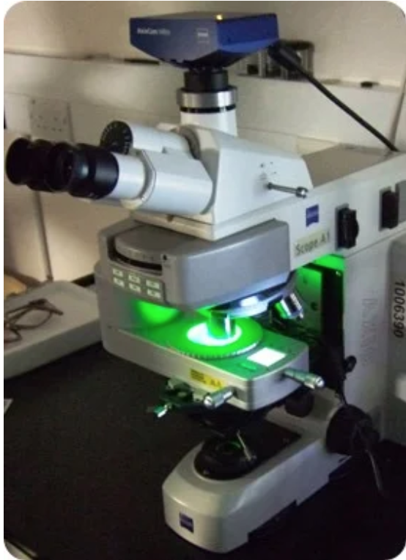
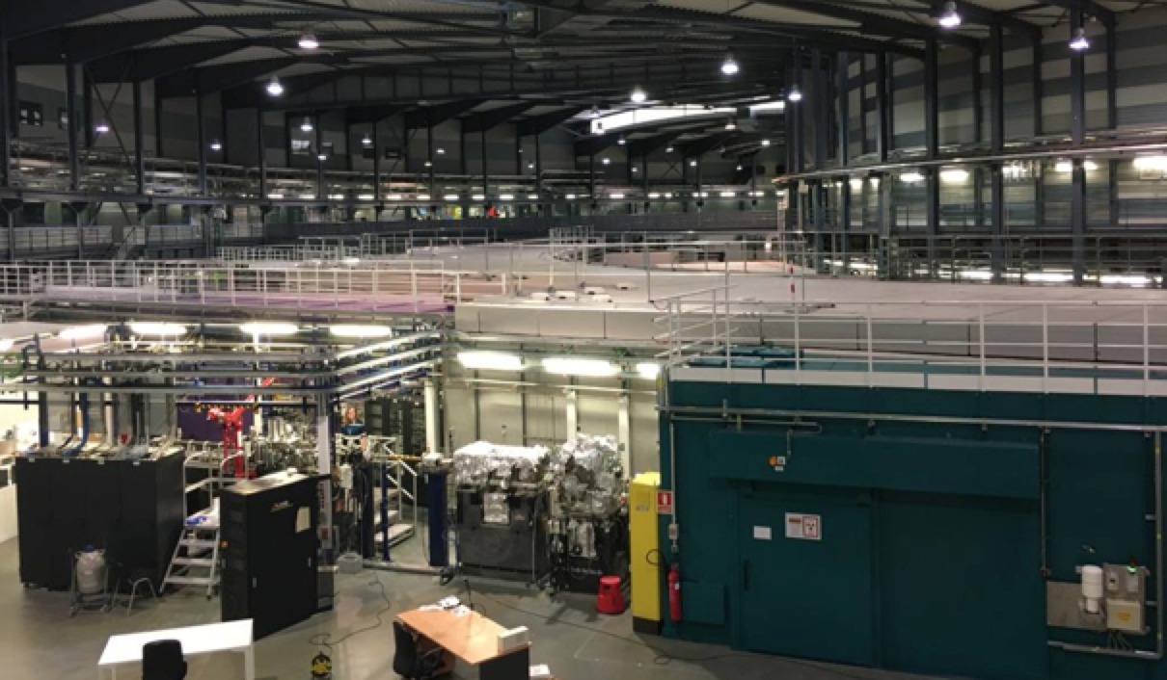
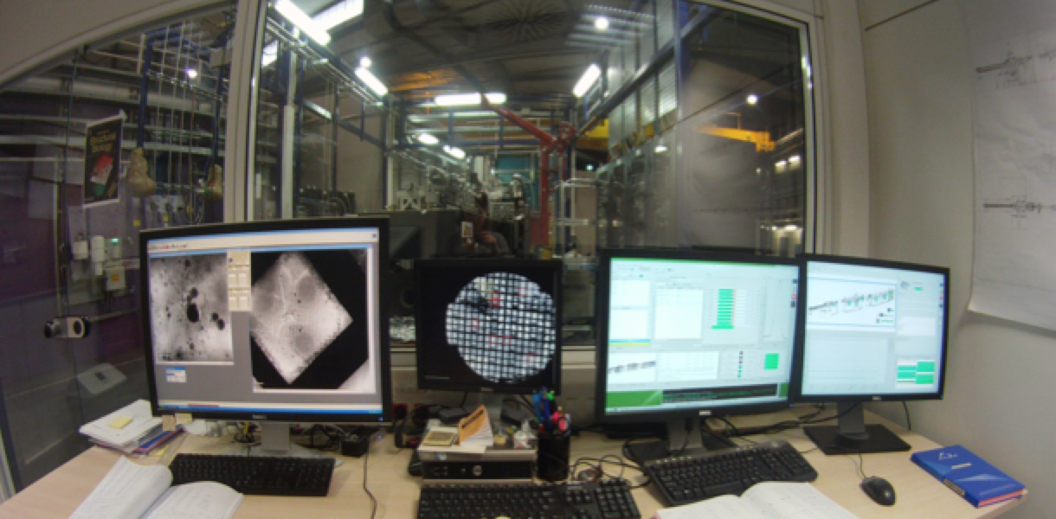
MISTRAL User support
General steps of the MISTRAL user support
Cell culture Platform
Vitrification Platform
Sample screening at cryo
MISTRAL BEAMTIME
Data Processing support
1-15 days
4-5 hours
4-5 hours
Asistance to the user during the beamtime from 8:00 to 20:00
Notes:
The idea is to expand the capabilities of this services

Slide 3
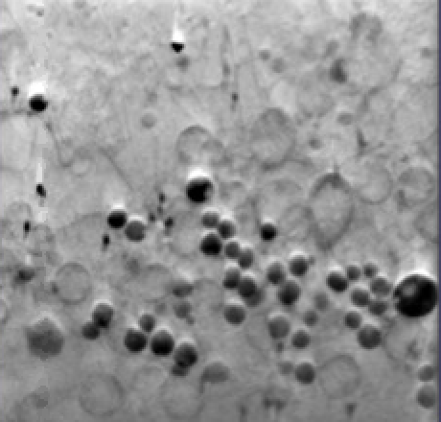
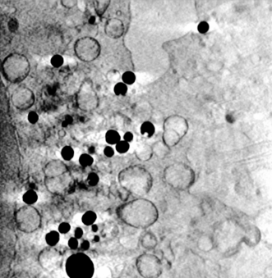
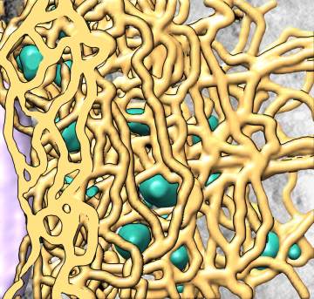
Data Processing support
All dataset are automatically reconstructed by the MISTRAL staff
First step for the selection of the best tomograms
Auto-training for user:
The MISTRAL staff provide detailed Instruction for
Manual alignments
Webinar for Alignment
Auto-training for user:
The MISTRAL staff provide detailed Instruction for
Segmentation of the dataset
Webinar for segmentation
AMIRA
Personalized Guidance:
Advice + Support
The users are not familiar with the software: Difficulties + Problems

Slide 4
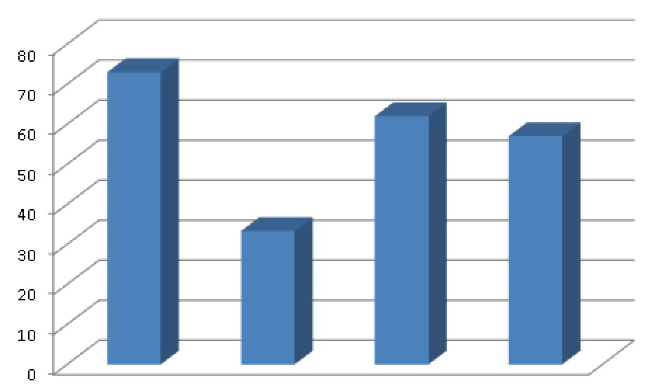
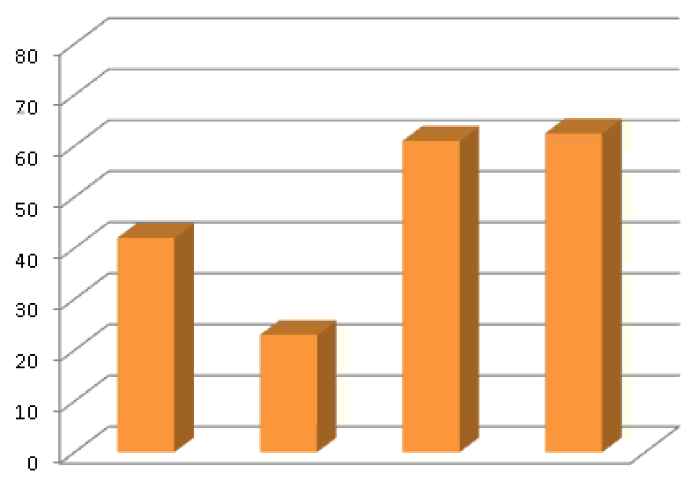
MISTRAL User support Conclusion
User support is a high time-consuming task for the MISTRAL staff due to several reasons:
• The cryo-tools (Plunge-freezing and linkam cryostage) for the cryo sample environment is an uncommon equipment for a normal biolaboratory. Since they are not familiar with them, only MISTRAL staff is able to prepare the samples for the 60% of the Bioproposal.
MISTRAL staff provides:
Production of Samples for MISTRAL staff
Production of user samples (academic/industrial)
100% Screening of the samples with cryoepifluorescence
Training of the Users.
Data Processing support
Sample preparation support
2 BL staff
2 BL staff
% Allocated Biological Proposal
% Allocated Biological Proposal
2018 2019 2020 2021
2018 2019 2020 2021
Averaging: 59.3 % Of the allocated biological proposal
Averaging: 48.3 % Of the allocated biological proposal
No staff is assigned to the Biolaboratory for sample preparation support. Done by MISTRAL scientist
Notes:
ALBA is a reference infrastructure in Spain with a vocation to provide services to users based on the criterion of scientific excellence.
Due to its unique characteristics, ALBA is a strategic place to locate a hub of advanced BIO services to users in the same way that we offer photons. These complementary services related with structural biology, microscopy or drug discovery could generate a large number of potential users throughout Spain
In this sense, the development of the services that the Biolab offers to users is fully justified on its own.
ALBA II as a fourth generation synchrotron and ASTIP gives even more powerful arguments to develop this BIO services in ALBA as a consequence of the powerful synergies with the groups and institutions members of ASTIP.
Implementation of BIO services on a large scale to users would be very useful for the Spanish community but requires a strong investment in human resources.

Slide 5
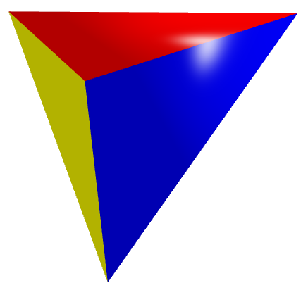
Current in-house program and perspectives
Towards correlative imaging in 3D & exploring intercellular connections
Structure information
Cryo-SXT
BEAMLINE GOAL:
Obtain the 3D structure of a whole cell without sectioning or any addition of chemical compounds for fixation or staining to link with
function
and chemical information .
Chemical information
CryoXANES
3D Cryo XRF
FTIR spectroscopy
Location of specific molecules
Fluorescence microscopy
3D CryoSIM

Slide 6
Current in-house program and perspectives
Major purpose of the in-house program is to develop:
A proof of concept to perform multimodal correlation with other techniques
Establish the protocol for the experiment for the future users.
Structure information
Cryo-SXT
BEAMLINE GOAL:
Obtain the 3D structure of a whole cell without sectioning or any addition of chemical compounds for fixation or staining to link with
function
and chemical information .
Chemical information
CryoXANES
3D Cryo XRF
FTIR spectroscopy
Location of specific molecules
Fluorescence microscopy
3D CryoSIM

Slide 7
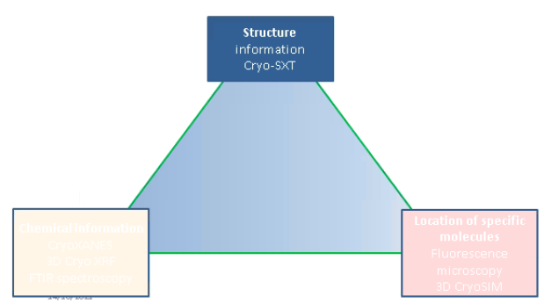
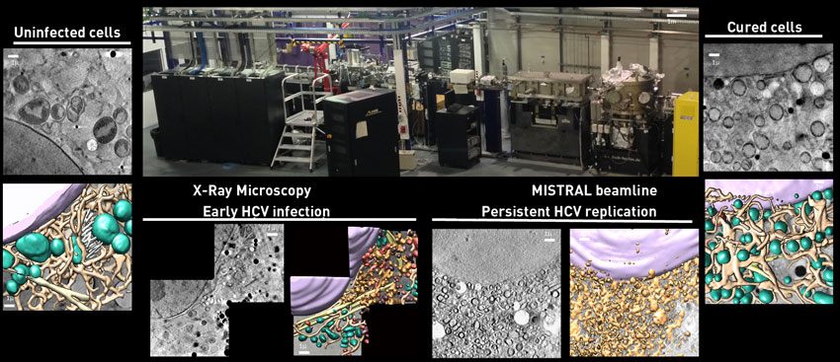
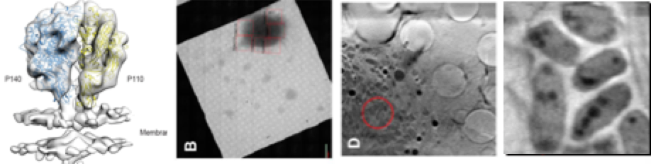
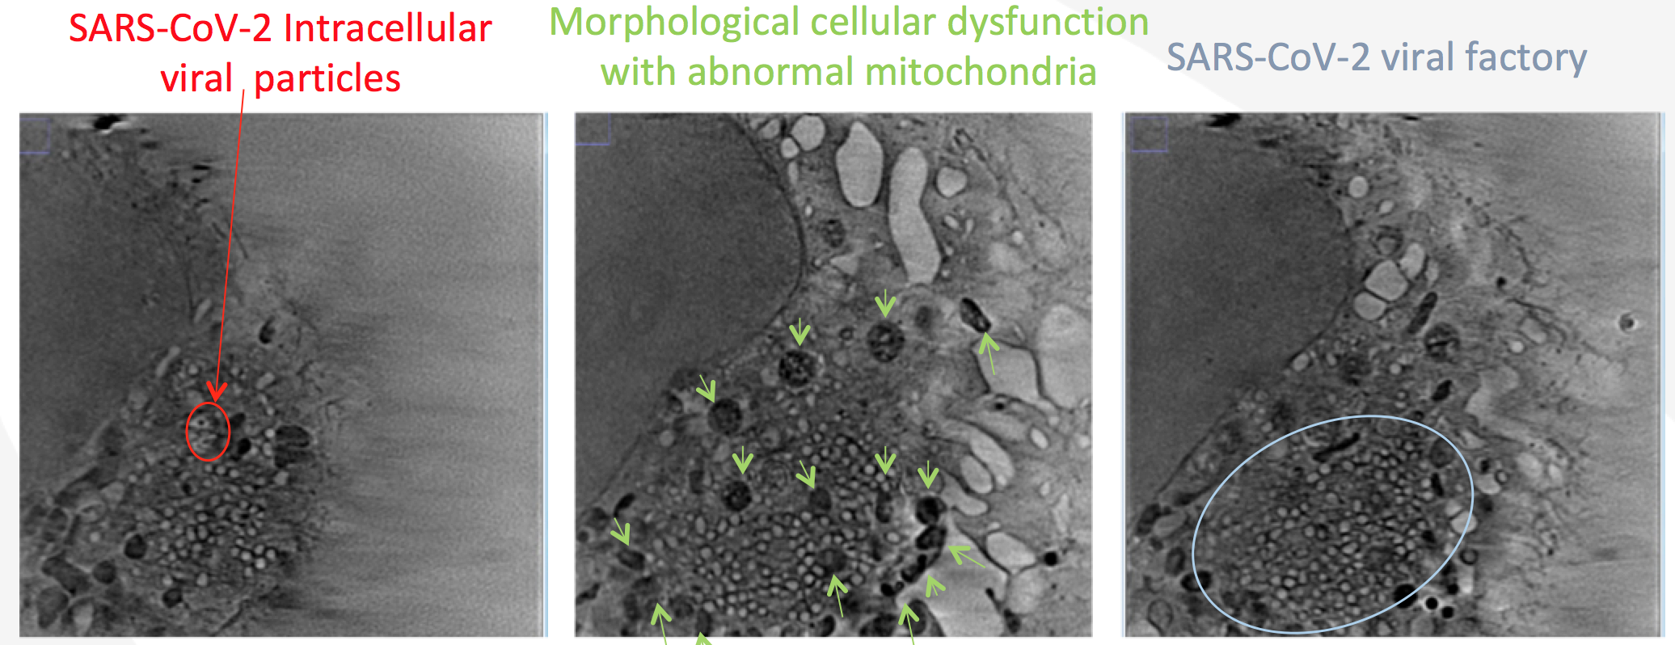
Current in-house program
Structure information
Hepatitis C infection
Multimodal experiment for reversion of the infection by antiviral drugs
MISTRAL+MIRAS beamline
Sample preparation strategies for efficient correlation of cryo 3D-SIM and cryo-SXT
Multi-scale collaboration with MX: Xaira + Xaloc
Characterisation of structural alterations induced by Zika virus
Integrated Structural Biology Study of Mycoplasmas
Study of SARS-CoV-2 infection and therapy causing intracellular membrane alterations

Slide 8
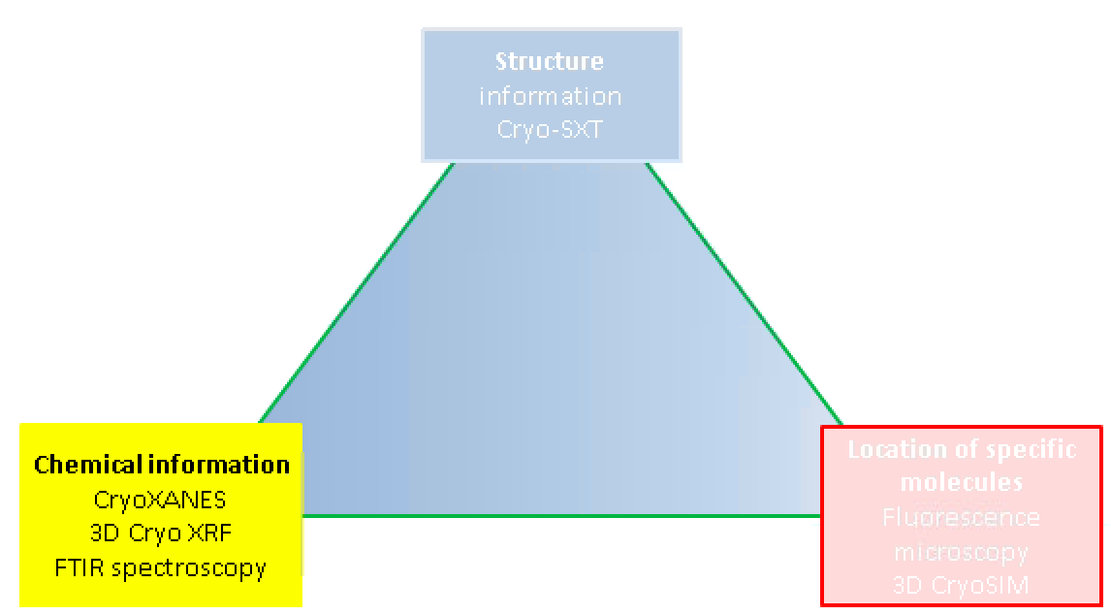
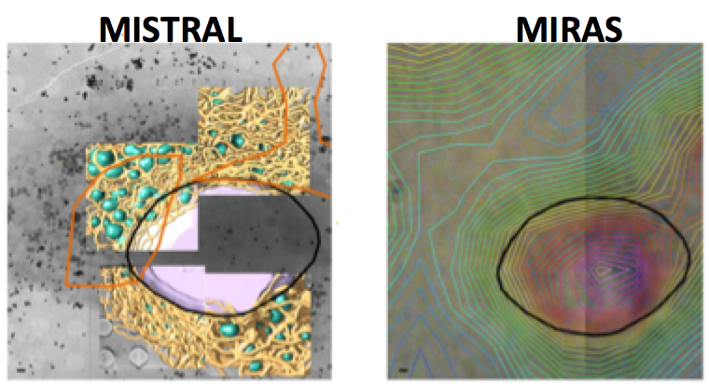
Current in-house program
Chemical information
CryoXANES
3D Cryo XRF
FTIR spectroscopy
Correlation with X-Ray Fluorescence
Correlation with cryo-XANES microscopy
Correlation with FTIR spectroscopy
Intracellular Localization and Quantification of a Ions:
Iridium Anticancer Compound.
Bio mineralization
Cholesterol
Atherosclerosis
Calcium
Algae
Sea urchin embryos
Hydroxyapatite
Human Bone-Marrow Mesenchymal Stem Cells
Multiscale study for Identification of the chemical composition of the viral structures and the cellular oxidation for drug treatments HCV
Intracellular Ion deregulation in in stress condition for viral infection

Slide 9
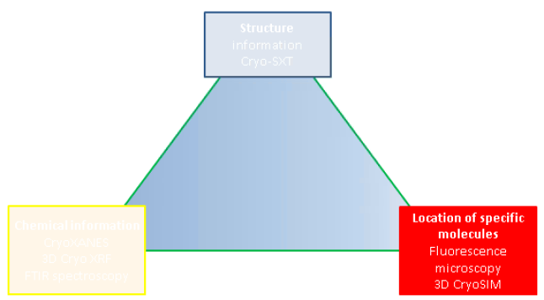
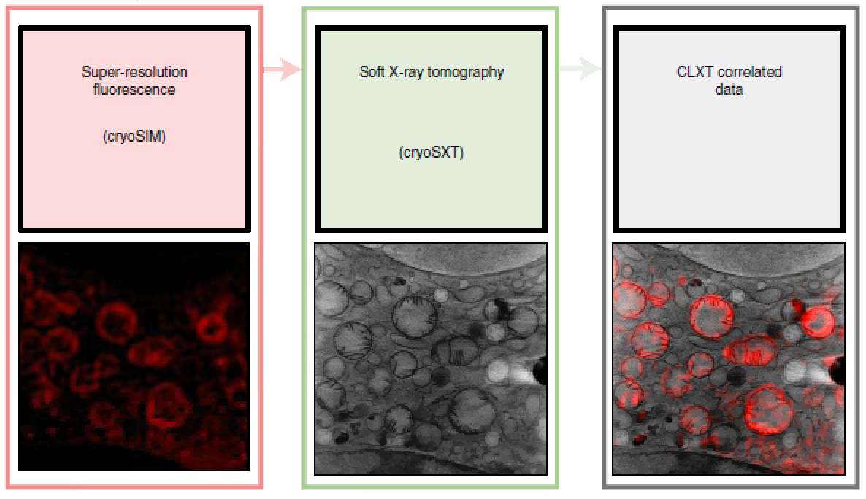
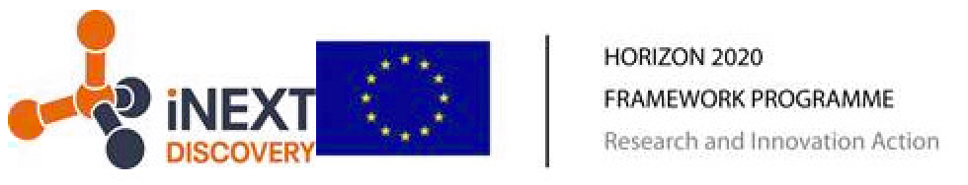
Current in-house program EU project
Location of specific molecules
Fluorescence microscopy
Cryo 3D-SIM
  Given the constant demand for easily accessible and user-friendly methodologies, we are working in development of correlation for fluorescent light and X-ray tomography imaging
  Microscope for cryo 3D super-resolution fluorescence cryo-imaging at 200 nm resolution using structured illumination microscopy.
All optical parts are controlled by acquisition software GUI
In development:
At temporary location
At part time by ALBA staff
EU iNext Discovery FTE Joaquín Otón
Develop automatic 3D correlation
script for CLXM
  There are 2 cryo 3D-SIM in the world: Diamond and ALBA Strategic tool to locate a hub of advanced BIO services for users. These complementary services generate a large number of users at national and international level.
MISTRAL inhouse research and user support
Nat Protoc 16(6): 2851-2885 . (2021)

Slide 10
User support perspectives
• The 60% of the users have NO experience in the sample manipulation or software data analysis.
• There was NO community for cryo-SXT, MISTRAL is creating the user community 2013 : High number of new users for year.
Soft-Xray cryo tomography is a single experiment for understanding the biological system of the users, so when they resolve the cellular structure of their system, the necessity of access of MISTRAL finish.
User schedule:
Sample preparation
Cryo 3D-SIM
4 days
MISTRAL Beamtime
5 Days
Data analysis
Sample preparation
Cryo 3D-SIM
4 days
MISTRAL Beamtime
5 Days
Next user
• If cryo 3D-SIM available to users, an extra Full Time Equivalent needed.

