Slide 1
Mistral: Status and Current User Program
Andrea Sorrentino
8.11.2021

Slide 2
Role of Mistral within the Life Science Section
Life Science Section mission:
Make accessible effective, state-of-the-art scientific services and instruments dedicated to solving societal challenges related to life sciences such as health and environment.
Act as a catalyst for scientific collaborations addressing societal challenges for which life sciences may provide solutions.
Mistral’s role:
  Visualization of the near native cellular structure to understand cellular processes by providing cryo-tomography and eventually cryo-spectromicroscopy on frozen hydrated whole biological cells.

Slide 3

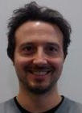

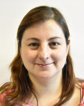
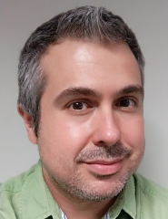
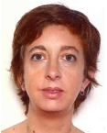
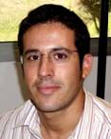
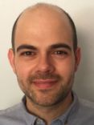
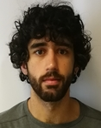

Staff
Eva Pereiro: BL responsible
Cryo soft x-ray tomography
Correlative approaches for cellular biology
Andrea Sorrentino: BL scientist
Cryo soft x-ray tomography
Spectromicroscopy
Externally funded
BL09-MISTRAL
(currently)
Jan Groen (2021/22): Biolab technician
CoCID EU project
Ana J. Pérez-Berná: BL scientist
Cryo soft x-ray tomography
Viral infections
Joaquín Otón (2021-23): Postdoc
iNext-Discovery EU project Cryo-CLXM scripts
Lucía Aballe (since 2020): BL scientist
Magnetic imaging
  BL Technician:
  Ricardo Valcarcel (50%)
  Electronics engineer:
  Xavi Serra (15%), Borja Revuelta (15%)
  Floor coordinator:
  Robert Oliete (10%)
  Mechanical engineer:
  NA
  Controls engineer:
  vacant
Support

Slide 4
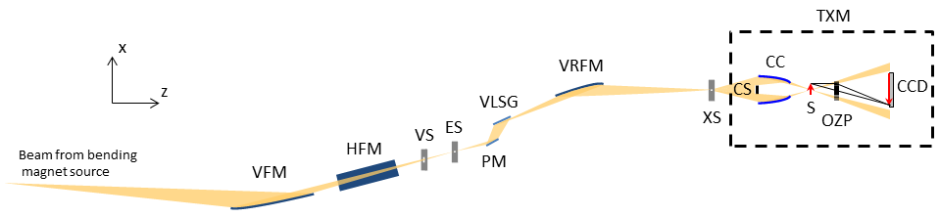
Overview of current instrumentation
Beamline
Beamline Optics
Transmission X-ray Microscope (TXM)
  Beam from Bending Magnet Source
  (critical energy 8.5 keV)
Sample
Measured beam properties at sample:
  Energy range: 300 eV – 1200 eV
  Flux: ≈ 2 x 10¹⁰ ph/s/100mA @ 520 eV.
  Beamline is optimized for cryo-Tomography on biological cells in the water window energy range.
The beamline was designed to provide full illumination of the TXM condenser lens for the whole energy range with maximum photon flux.

Slide 5

Overview of current instrumentation
TXM
CCD
capillary condenser lens
sample
central stop
objective zone plate lens
(40 nm and 25 nm ZP)
Microscope capabilities (it was bought from Zeiss as a prototype ):
  2D Measured Spatial Resolution ≈ 30 nm half pitch.
  Detector effective Pixel size 8 nm – 16 nm, Field of view 8x8 µm² - 16x16 µm².
  Cryo environment ( ≈ 110 K).
  On-line visible light epifluorescence microscope for correlative low resolution 2D imaging.
Available techniques for bio-samples (with 30 nm spatial resolution):
  Cryo – soft X-ray Tomography (± 70◦ max angular range, typical acquisition time ≈ 5 -10 min.).
  Cryo – soft X-ray Spectromicroscopy (from Ca L – edge).

Slide 6
Current User Program in biology
Bio-shifts
oversubscription (%)
number of shifts
accumulated new users
New users
number of users
Change of awarded beamtime policy
(proportional share to the submitted shifts) .
- 2 staff.
- SARS-CoV2
- 3 staff
Bio-shifts over-subscription stable from 2018.
80% total beamtime for bio-science.
International user community.
Growing user community.
High Impact Factor Publications.
Publications (average IF = 7.6)

Slide 7
Current User Program in biology
Cryo -Tomography
+ correlative (EM, VLM, hard XF)
Cryo -Tomography
+ cryo - Spectromicroscopy
Cryo -Tomography
+ correlative

Slide 8
Overview of current available Software
Automatic
Tomography
alignment
OK!
Tomography reconstruction
(Tomo3D)
Delivery to users!
normalized-deconvolved absorbance tilt stack
Data Pre-Processing
Homemade Automatic Online pipelines
BL Control System
Data Acquisition
TXM Control System

Slide 9
Overview of current available Software
Data Processing
(NO homemade
software)
Manual Tomography alignment (IMOD)
Tomography reconstruction
(Tomo3D)
Automatic
Tomography
alignment
OK!
Tomography reconstruction
(Tomo3D)
NOT OK!
Teaching and tutorials
normalized-deconvolved absorbance tilt stack
Delivery to users!
Data Pre-Processing
Homemade Automatic Online pipelines
BL Control System
Data Acquisition
TXM Control System

Slide 10
Overview of current available Software
Data Processing
(NO homemade
software)
Data Analysis (we assist no-expert users)
Manual Tomography alignment (IMOD)
Segmentation i.e. 3D rendering (Amira, Chimera)
Spectro-Microscopy
(TXMWizard, matlab, Origin)
Tomography reconstruction
(Tomo3D)
Automatic
Tomography
alignment
OK!
Tomography reconstruction
(Tomo3D)
NOT OK!
Teaching and tutorials
normalized-deconvolved absorbance tilt stack
Data Pre-Processing
Homemade Automatic Online pipelines
BL Control System
Data Acquisition
TXM Control System

Slide 11
Overview of current limitations
(follow up provided in the vision talk)
Beamline Optics:
  BL performance very sensitive to perfect optical alignment.
TXM:
  Axial rotation run-out is of the same order of ZPs depth of field (~ 1.5 µm) and not reproducible.
Software
  No automated fiducialess alignment requires manual data processing.
Sample preparation
  No dedicated technician often requires scientific staff dedication.

Slide 12
SWOT
Strengths
Weaknesses
Few competitors.
Complementarity to other microscopies.
High throughput (cells population statistics).
Staff dedication.
Good publications IF.
New user groups accessing the technique.
Major BL upgrades required because of aging.
No reproducible sample preparation.
Difficult sample quality control.
Manual data alignment required.
Lack of bio-users expertise in tomography.
Threats
Opportunities
Cryo 3D CLXT is mandatory to keep competitiveness.
Productivity loss if delayed BL upgrades.
Proprietary TXM software.
Lack of support staff for sample preparation and cryo-3D-SIM.
Arising of competing laboratory techniques.
Integrating cryo 3D CLXT into the program.
BL upgrades can improve significantly experiment conditions.
Higher data throughput by implementing reliable fiducialess alignment.
Growing user community.

