Slide 1
Perspectives on imaging of biological samples
Eva Pereiro
04/11/21

Slide 2
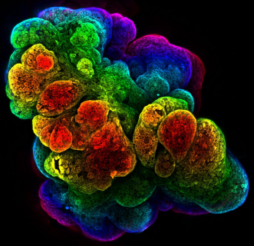
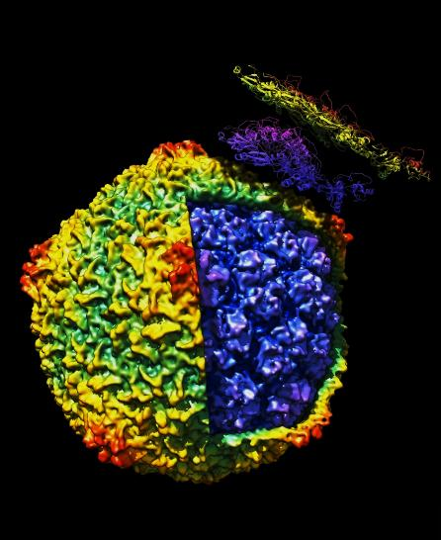
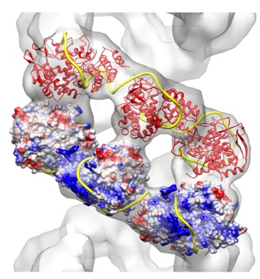
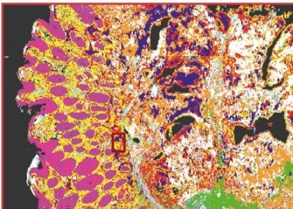
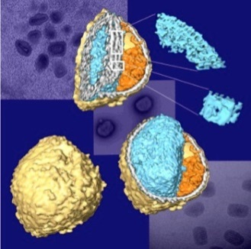
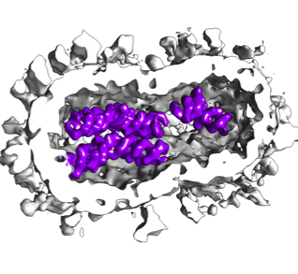
Biological imaging techniques today
operational
in development
currently not at Alba
5 µm
500 nm
30 nm
5 nm
1 Å
resolution
sub-μPCXT
sub-μXRF
NMR
µPCXT
µFTIR
BioSAXS
cryo-3DSIM
nanoXRF
cryo-ET
MX
cryo-SXT
cryo FIB-SEM
VLM
nanoPCXT
cryo-SR
Single Particle
ptychotomo
sample dimensions
Tissue
Organoids
Cellular Biology Interactomics Macromolecules
Multimodal imaging across resolution scales is essential to understand biological mechanisms.
Notes:
Lab-grown mouse mammary gland imaged by 3D confocal (Dr. Harris Univ. Cambridge)

Slide 3
Synchrotron-based imaging at 3rd and
4th generation sources
3D structure
cyo-SXT (5 min/cell)
cryo holotomo (4h/sample)#*
cryo ptychotomo (30h/sample)#*
sub-µPCXT (min/sample)
µPCXT (min/sample)
chemical info
cyo-nanoXANES* (30 min/cell)
cryo edge-enhanced tomo
µFTIR
µXANES
µXRF
elemental
quantification (ppm)
cryo-nano 2D XRF
cryo-nano 3D XRF(17h/cell)
cells
30 nm
100 nm
500 nm
t i s s u e
5 µm
operational
in development
not currently at Alba
* dose limitation + difficult for users # sample shrinking in the beam

Slide 4
Synchrotron-based imaging at 4th generation sources
No new techniques but
  enables faster data acquisition in particular for slow techniques (3D XRF, ptychotomo)
Many challenges ahead!
  BL stability
  sample stability in the beam
  very fast data acquisition needed for statistics keeping stability (×100 faster)
  data management
Notes:
Many challenges to fully exploit the flux/coherence gain

Slide 5
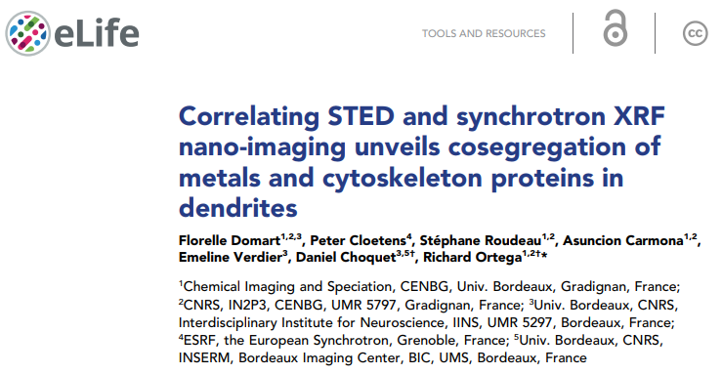
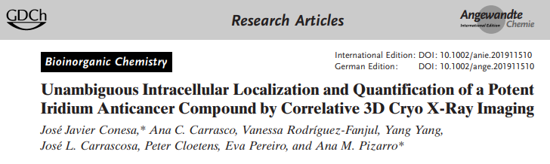
Correlative microscopies
Facing the complexity of biological systems requires correlative approaches.
The ultimate goal is to link structure, function, chemical information
and elemental quantification in 3D.
Notes:
Co-localization of zinc and tubilin in dendrites with a molecular ratio of about one zinc atom per tubulin-αβ dimer
More and more publications require correlative approaches to tackle complex problems!

Slide 6
Correlative microscopies
Goal obtain complementary information on the same sample
Requirements
  non-destructive techniques
  correlative approaches at similar resolution with same sample support
  registration/fiducialisation of datasets needed in 2D and 3D
  automatic pipelines for data registration in 2D and 3D
  cryo temperature capabilities required at resolution <1μm
Notes:
A talk on correlative microscopies will come later

Slide 7
Status of multimodal correlative approaches
at ALBA… and perspectives
3D structure
cryo-ET
cryo FIB-SEM
In vivo CT
?
μPCXT
cryo-SXT
cryo-3D-SIM
cryo epifluo
cryo
nano-XANES
μXANES
μXRF
SR-µFTIR
specific localization
nano-FTIR
chemical information
cryo
nano-XRF
elemental
quantification
(ppm)
BioSAXS
operational
in development
not currently at Alba
new
Correlative protocols demonstrated by staff on model systems

Slide 8
Perspectives on imaging biological samples
Efforts required to exploit all possible multimodal and multiscale
information by correlative approaches.
Available techniques should act as seeds to grow correlative strategies.
Future generation facilities should provide correlative microscopy
capabilities to users.

