Slide 1
Current Status of the Tools in Cell and Tissue Biology
Judith Juanhuix
8.11.2021

Slide 2
Life Sciences Mission, focus on cells and tissues
2021-2024
ALBA
mission
Contribute to the improvement of well-being and progress of society as a whole through provision of scientific instruments dedicated to solving societal challenges such as health, environment, energy and communication.
Act as a catalyst for regional and national collaborations addressing overarching societal challenges.
Be a center of excellence in synchrotron radiation (SR) science and technology at European level and consolidate the status of CELLS as a recognized world class facility in its field.
2017-2021
2021-2024
Life Sci
mission
Make accessible effective, state-of-the-art scientific services and instruments dedicated to solving societal challenges related to life sciences such as health and environment.
Act as a catalyst for regional and national collaborations addressing societal challenges for which life sciences may provide solutions.
Notes:
forget about “photons”

Slide 3
Challenges
Diagnosing and planning the future scientific strategy, with clear priorities.
Implementation of multi-modal and multi-scale projects.
Designing and building state-of-the-art instruments, some of them out of confort (photon) zone.
Operating the instruments in the experiment and measurement mode.
Providing integrated services to scientific and proprietary research.
Integrating ALBA in the European network of excellence.
Disseminating the ALBA capabilities.
Develop a clear career path for ALBA staff.

Slide 4
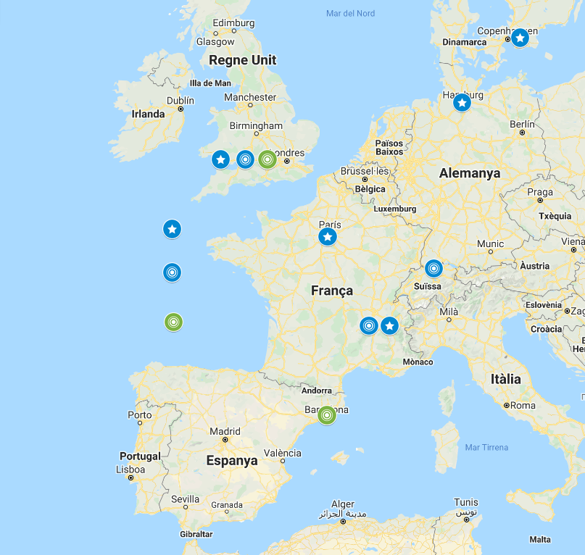
European Context
The Structural Cell and Tissue Life Sciences community is well-connected in Europe (and worldwide) through programs, projects and human mobility
The groups are mostly specialized in particular techniques.
Strong push for tackling complex challenges/issues/problems in a multi-disciplinary, multi-scale approach
BUT : Gaps exist between communities and collaborative partners
nanoXRF
nanoPCXT
cryo-SXT
Beamlines dedicated to cell biology in Europe

Slide 5
Branding
ALBA is to be established as an international reference center and enabler.
Focus in specific topics (branding), approached in an holistic way, while servicing the entire community
Multi-length Scale Approach To Understand Behavior Of Biological Systems
      using a suite of techniques and services enabling the catalytic role of ALBA
Focused on scientific fields
Techniques
Services
Health
Cell and tissue ultrastructure
Pathogen infections
Cancer and diseases
Drug delivery
Full-field Tomography (SX, CT)
nanoXRF, nanoPCXT imaging (STXM)
Cryo-3DSIM and other correlative microscopies
FTIR
Cryo-FIB-SEM
Cryo-ET
Tailored to objectives and community
Filling the gap between groups and facility
From collaborator-based to user-based approach
Notes:
INCLUDE PARNERSHIP, COLLABORATION, NETWORK in the branding
we have a buch a tools, now collaborator-based approach, we need to go to the user program

Slide 6
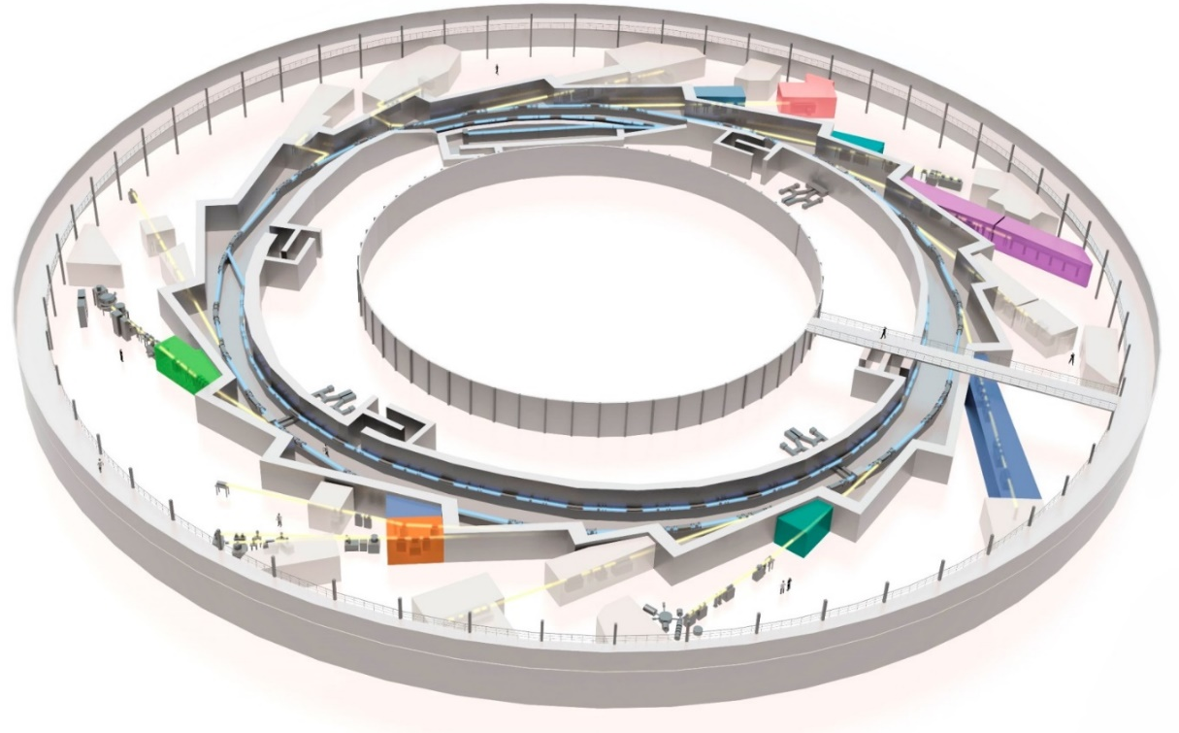
Current tools in Structural Cellular and Tissue Biology at ALBA
FAXTOR (HXT)
MIRAS (IR)
XAIRA (μMX)
MISTRAL (TXM)
Current beamlines in Structural
Cell and Tissue Biology:
MIRAS (FTIR)
MISTRAL (cryo-SXTomo)
FAXTOR (CTomo)
CryoEM-SPA (200kV)
BioLabs
NCD-SWEET
(SAXS)
Fully
dedicated
XALOC (MX)
Partially
dedicated
Residual
use
In
construction
Molecular
Biology
CLAESS (XANES)

Slide 7
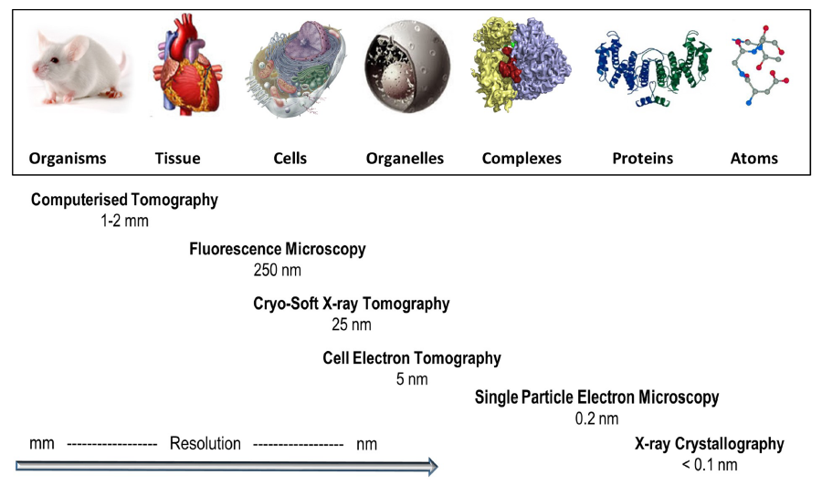
Current status of the Life Sciences tools
There is a resolution gap between molecular and cell biology to be filled
To become “catalist for health and environment” requires more tools and services
FAXTOR
MISTRAL
XAIRA
XALOC
MIRAS
SAXS
1 nm
FTIR
3 μm
From Harkiolaki et al. DOI:10.1042/ETLS20170086 ; CC BY 4.0 modified

Slide 8




Current Collaborations and Leadership
Partnerships
iNEXT-Discovery EU project (H2020).
CoCID (Compact Cell Imaging Device) EU project (H2020)
COST Actions: CUMULIS, Bioneca
Leading roles
Leader in WP29 Joint Research Activity in iNEXT-Discovery
Membership in the Executive Board of iNEXT-Discovery (5 members)
Scientific collaborations
FTIR+μXRF: BioNanoProbe@APS, Institut Curie
TXM+μXRF: ID16A@ESRF, BL24@Diamond

Slide 9
Towards correlation between existing program tools
Cell and Tissue imaging
Macromolecular structure
FAXTOR
(HXR Tomo)
Resolution
Cryo-EM
(Single Particle)
XAIRA
(μMX)
MIRAS
(FTIR)
MISTRAL
(SXR Transmission Tomo)
NCD-SWEET
(bioSAXS)
XALOC
(HT MX)
Biolab
Mammal cell lab
BioLab
Sample prep (P2)
BioLab
Proteomics
in operation
In-house MX program is now expanding to cellular biology (TXM, Mistral BL), but limited by tools and facilities
Increasing pressure for correlative microscopies (only cryo 2D epifluorescence available, need for cryo3D techniques)
Sample preparation and user assistance at ALBA biolabs are critical for success
in construction
not optimized

Slide 10
Our strategy at a glance
ALBA to provide X-ray and electron-based tools and “missing links”
Aiming at a continuous path from genotype to fenotype structural studies
ALBA embedded within their strategic partners provides leading capabilities
FAXTOR
STXM
BioSAXS
MIRAS
MISTRAL
XAIRA
XALOC
CryoEM-SPA
BioSAXS
1 nm
FTIR
3 μm
CryoFIB-SEM
20 nm
Computational Biology
Cryo-ET
5 nm
From Harkiolaki et al. DOI:10.1042/ETLS20170086 ; CC BY 4.0 modified

