Slide 1
Introduction to the mission
Klaus Attenkofer
8.11.2021

Slide 2
The Context: ALBA II
ALBA upgrade decision to a 4th generation synchrotron was granted in December 2020; the goal of the upgrade is:
  Bringing all facilities of ALBA to a modern, state-of-the-art standard guaranteeing stable and effective operation for the next 20-25 years.
  Significantly strengthening the microscopic capabilities.
  Providing high throughput capabilities and integrating big data approaches in the research portfolio.
  Strengthening the operando and in-situ capabilities.

Slide 3
The Context: ALBA’s Mission
ALBA is dedicated to provide robust highly productive user operation for a broad user community.
In addition, we will provide full services in three focus areas:
  Health.
  Energy.
  Information technology.
Full services mean:
  Provide all sample preparation and computational tools necessary to enable the user to answer key questions and grand challenges of the field.
  And develop methodologies using multimodal approaches.
  Add additional characterization tools (mainly microscopic tools like Electron Microscopy) to reach atomic and subatomic resolution or add additional contrast mechanisms.
  Team up with strategic partners to fill resource gaps and still provide full services.

Slide 4
The Context: ALBA II at a Glance
Beamlines at ALBA II:
13 ID BLs
8 super bend BLs
4 (?) BM Bls
1 IR BL (?)
2 Straights for RF
1 Straight for injection
Beamlines at ALBA:
currenly committed or operated ports:
Potential for new beamlines at ALBA II:
9 ID BLs
3 BM Bls
1 IR BL
2 ID BLs (long; low beta-function)
1 ID BLs (long; high beta-function)
1 ID BL (short; low beta-function)
8 super bend BLs

Slide 5
The Context: Upgrades and new Beamlines
New beamlines
Upgrades for existing beamlines (4.Generation standards)
Upgrades for existing beamlines (3.Generation standards)
Timing:
Full scientific case and “rough” preliminary design available end of 2022: Strategy Document (end of 2023 including 4th gen upgrades)
One beamline has to be selected begining of 2022.
(most likely short or high-beta long)
2 long beamlines need to be selected in 2022.
Concept of BM, super-bend, ID has to be defined 2022
Re-evaluating of current beamline program: end of 2022.
Evaluation of upgrade level:end of 2023.
PID for selected BLs: End of 2025.
Project start: 2024.
Re-evaluating of current beamline program: end of 2022.
PID of individual projects: end of 2026.
Start with first investments beginning 2022.

Slide 6
The Context of the Section Review
The Section
Reviews
Workshops &
Colloquium
Call for
New Instruments
Goal:
  Mission verification.
  Strategy review.
  Gap Analysis.
  Service review.
Stakeholders:
  International experts.
  National user community representatives.
  SAC expert.
Goal:
  Identification of grand challenges.
  Identification of needs.
  Creating awareness in community.
  Organizing community.
Stakeholders:
  Spanish community.
  International experts.
  ALBA employees.
  AUSE.
Goal:
  Identification of instruments and services
  Grouping key-players around proposed instruments.
Stakeholders:
  Spanish and international community.
  ALBA employees.
  AUSE.

Slide 7
The Context: The Scientific Case & Strategy Document
The Section
Reviews
Call for
New Instruments
Mission & Strategy
Documentation:
  Review report.
  Review documentation.
Interest of User Community.
Forming of Beamline Team and Key user Community
Documentation:
  Feasibility study.
  Risk analysis.
  Scientific case.
ALBA team
Strategy Document
Instrument Review Panel
ALBA Director
Full Proposal and PDR

Slide 8
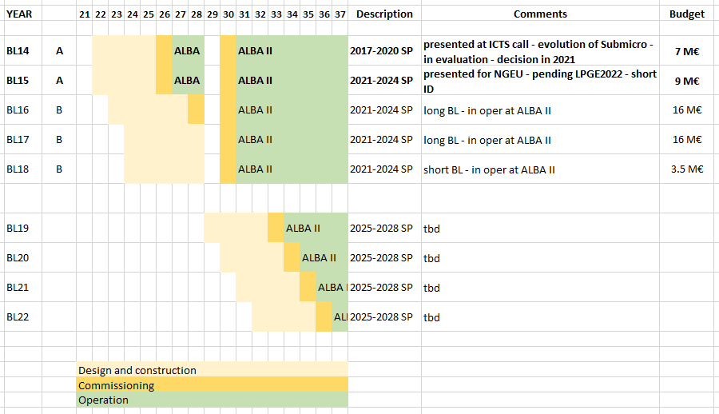
Long Term New Beamline Development Program
(As spelt out in strategic plan & current funding expectations)
Operational at ALBA
And to be decided in 2021
Operational at ALBA II
And to be decided in 2022+

Slide 9
ALBA II process during 2021
Scientific case
ON GOING
Workshops
ALBA II Colloquia
ON GOING
- Section Reviews
BL proposals
FINISHED
From ALBA staff
ALBA II Day (30.6.21)
ON GOING
From ALBA Users
Workshops in preparation:
Catalysis I (grand challenges)
Battery
SAC
Mai
June
July
August
September
October
November
December
January
February
2D Materials
WS
Spintronics
WS
Time resolved
WS
Catalysis II
First version
of science case
With gap analysis
Catalysis III
Macromolecular
stractural biology
Review
Material Science
and Chemistry
Review
Magnetism and
Electronic Material
and Device
Review
SructuralCellular
and Tissue Biology
Review
Science case
SAC evaluation of
Science case and beamline
selection
Start of Beamline 14
ALBA II Day
(workshop)
Definition of proposal
and preselection for
projects compatible with BL14
Selected proposal
development
External review
and rating
Internal Call for
BL Concepts
Internal presentation
of call results
User Community Call for
BL Concepts
User Community Call for
BL Concepts Deadline
BL proposal

Slide 10
ALBA II process during 2022
Scientific case
PLANNED
Workshops
ALBA II Colloquia
BL proposals
PLANNED
- From ALBA Users
SAC
March
April
May
June
July
August
September
October
November
December
Science case
SAC evaluation of
Science case and beamline
selection
External review
and rating
Definition of ALBA II BLs
Analysis of BL concepts
(by ALBA) –
choice of # of them
User Community Call for
BL Proposals
ALBA II Day
(workshop)
Definition of proposal
and preselection for
Projects for ALBA II BLs
Selected proposal
development
BL proposal

Slide 11
The Review Goals:
General goals of the review:
  Provides ownership to the section team by creating mission and strategy in a bottom up approach.
  Is there a clear defined vision for the reviewed area which
    Brands ALBA giving it a unique role within the competitors.
    Matches the societal needs of the next 2 decades.
    Reflects the expected needs of the Spanish community.
  Are the risks understood and is the strategy appropriate to fulfil the mission?
Specific goals in the S Review:
  Is the definition of the mission focused enough to achieve the goals with reasonable efforts and is the mission broad enough to address the challenges of the next 20 years.
  Is the suite of proposed tools and services appropriate to achieve the mission.
  Is the the approach of integrating the cryo-TEM tomography by a strategic partner appropriate.
  Is the effort put on the right areas to achieve the mission.
  Is the strategy of the industrial program sound?

Slide 12
The Review Format:
Four Blocks:
  The structure will follow:
    Defining mission and presenting the existing program overview.
    Presenting the status quo with SWOT and gap analysis (in respect to the mission) of all instruments
    The proposed strategy (Vision) with new tools.
    The strategic partnerships: where do we stand and what is our philosophy.
  Format of each block:
    Individual talks are kept below 15min. Most are only 12.
    We try to give everybody a “say”.
    To not disrupt the flow we suggest to make a long discussion after each block. We have some time for short questions for clarification after each talk but this should be kept to 1-2minutes.
  Any additional requests for info can be done today and Judith and myself will try to provide the info tomorrow.

Slide 13
The Start:
Thanks a lot!

