Slide 2

Projects STATUs: POST UPGRADE News FROM THE ESRF
first-of-a-kind, low-emittance, high-energy synchrotron light source

Slide 3
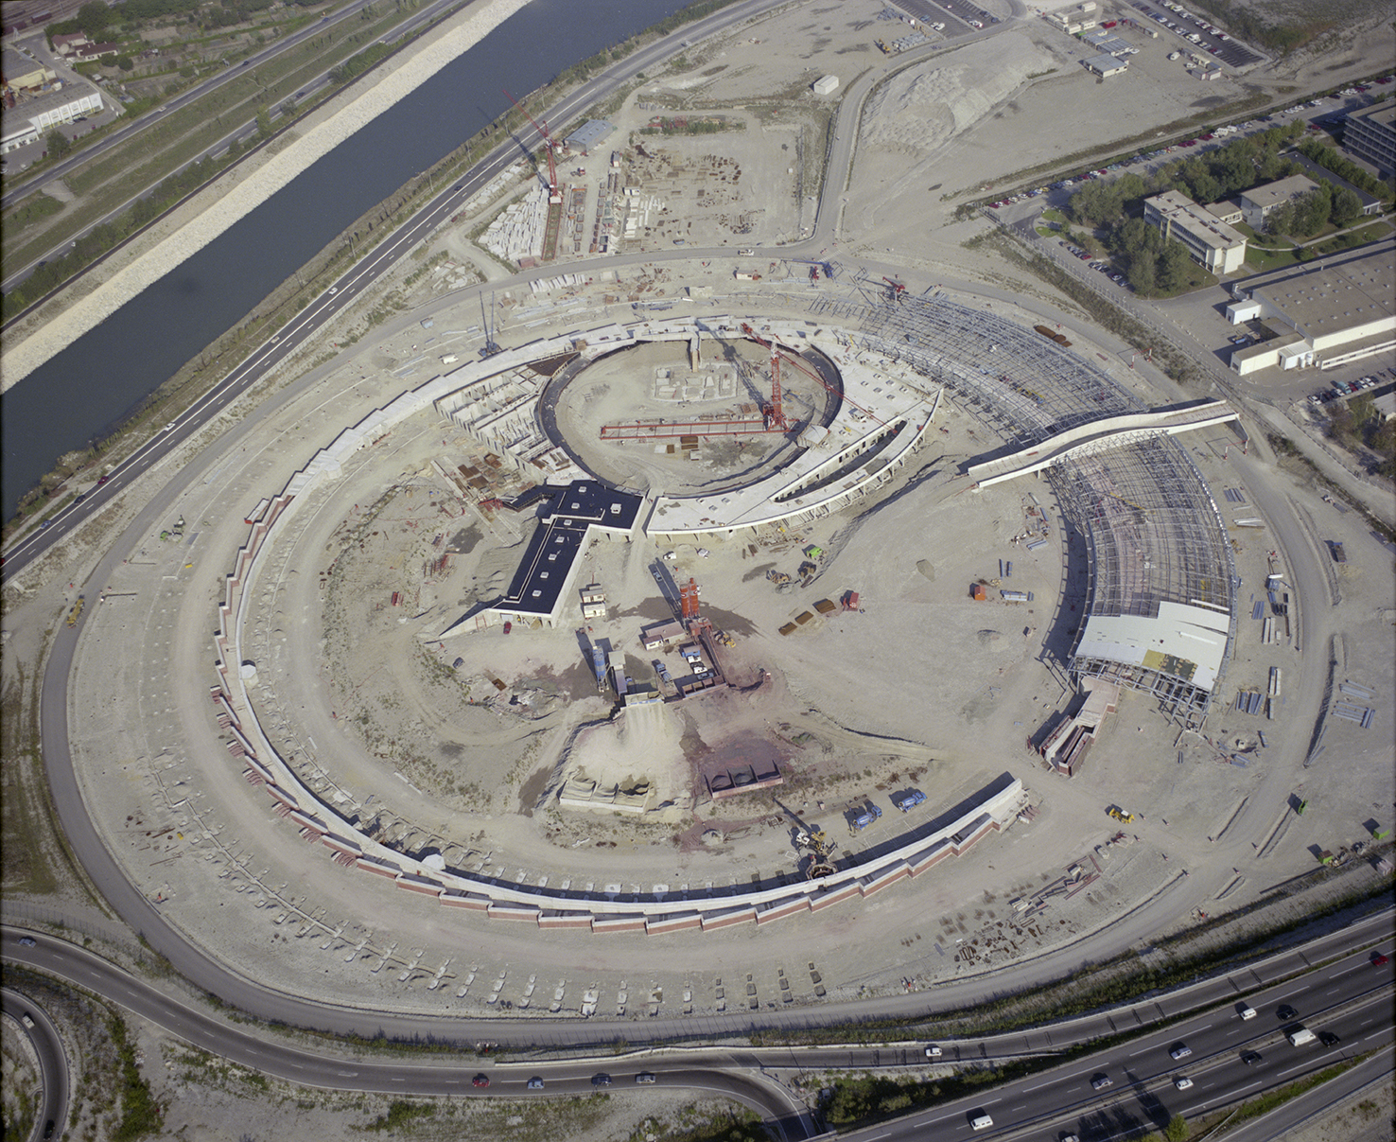
About the ESRF
European Synchrotron Radiation Facility
      photon factory from science - matter studies
        light/matter interaction → knowledge (i.e., light as a probe)
        photon source → (43) beamlines → experiments → knowledge
      ESRF first beam in 92 – full user mode operation in 94
        almost 30 years of state-of-the-art X-ray experimental science
        science & knowledge progress → new needs
        a new machine to align with science expectations & challenges

Slide 4
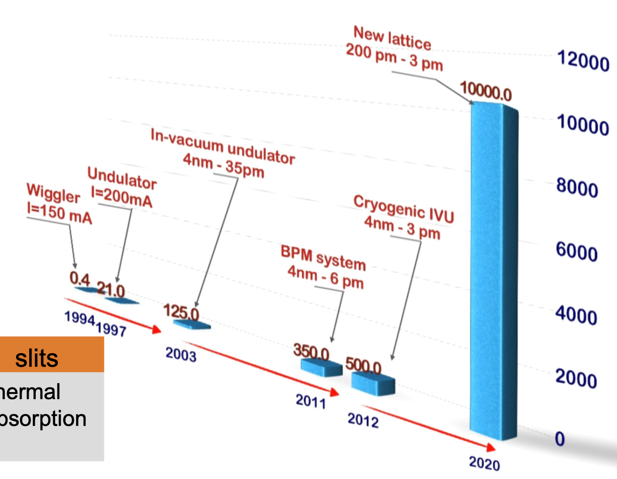
About the ESRF (& synchrotron FALCILITIES)
The ESRF upgrade program
      the low emittance / high brilliance quest
        ~ smaller beam size + higher photon density
        a.k.a. transition from 3rd to 4th generation machines
        smaller scale matter studies, faster data-acquisition (cross section = const, but higher photon flux)
        expected EBS gain: x100 (in terms of nb. photons per unit time per unit surface for monochromatic beam)
      an end-to-end upgrade program
        150 M€ spread over 4 components from 2015 to 2022
        a new machine (EBS) – new SR + adapted transfer line & booster – open to users in 2020
        4 new (flagship) beamlines + 14 refurbished beamlines + 29 unchanged = 47 beamlines in 2022
        a new X-ray detectors program – faster readout + higher resolution → data deluge (tens of TB/day)
        a new data strategy – advanced data analysis - (HPC + AI)-based services for users

Slide 5
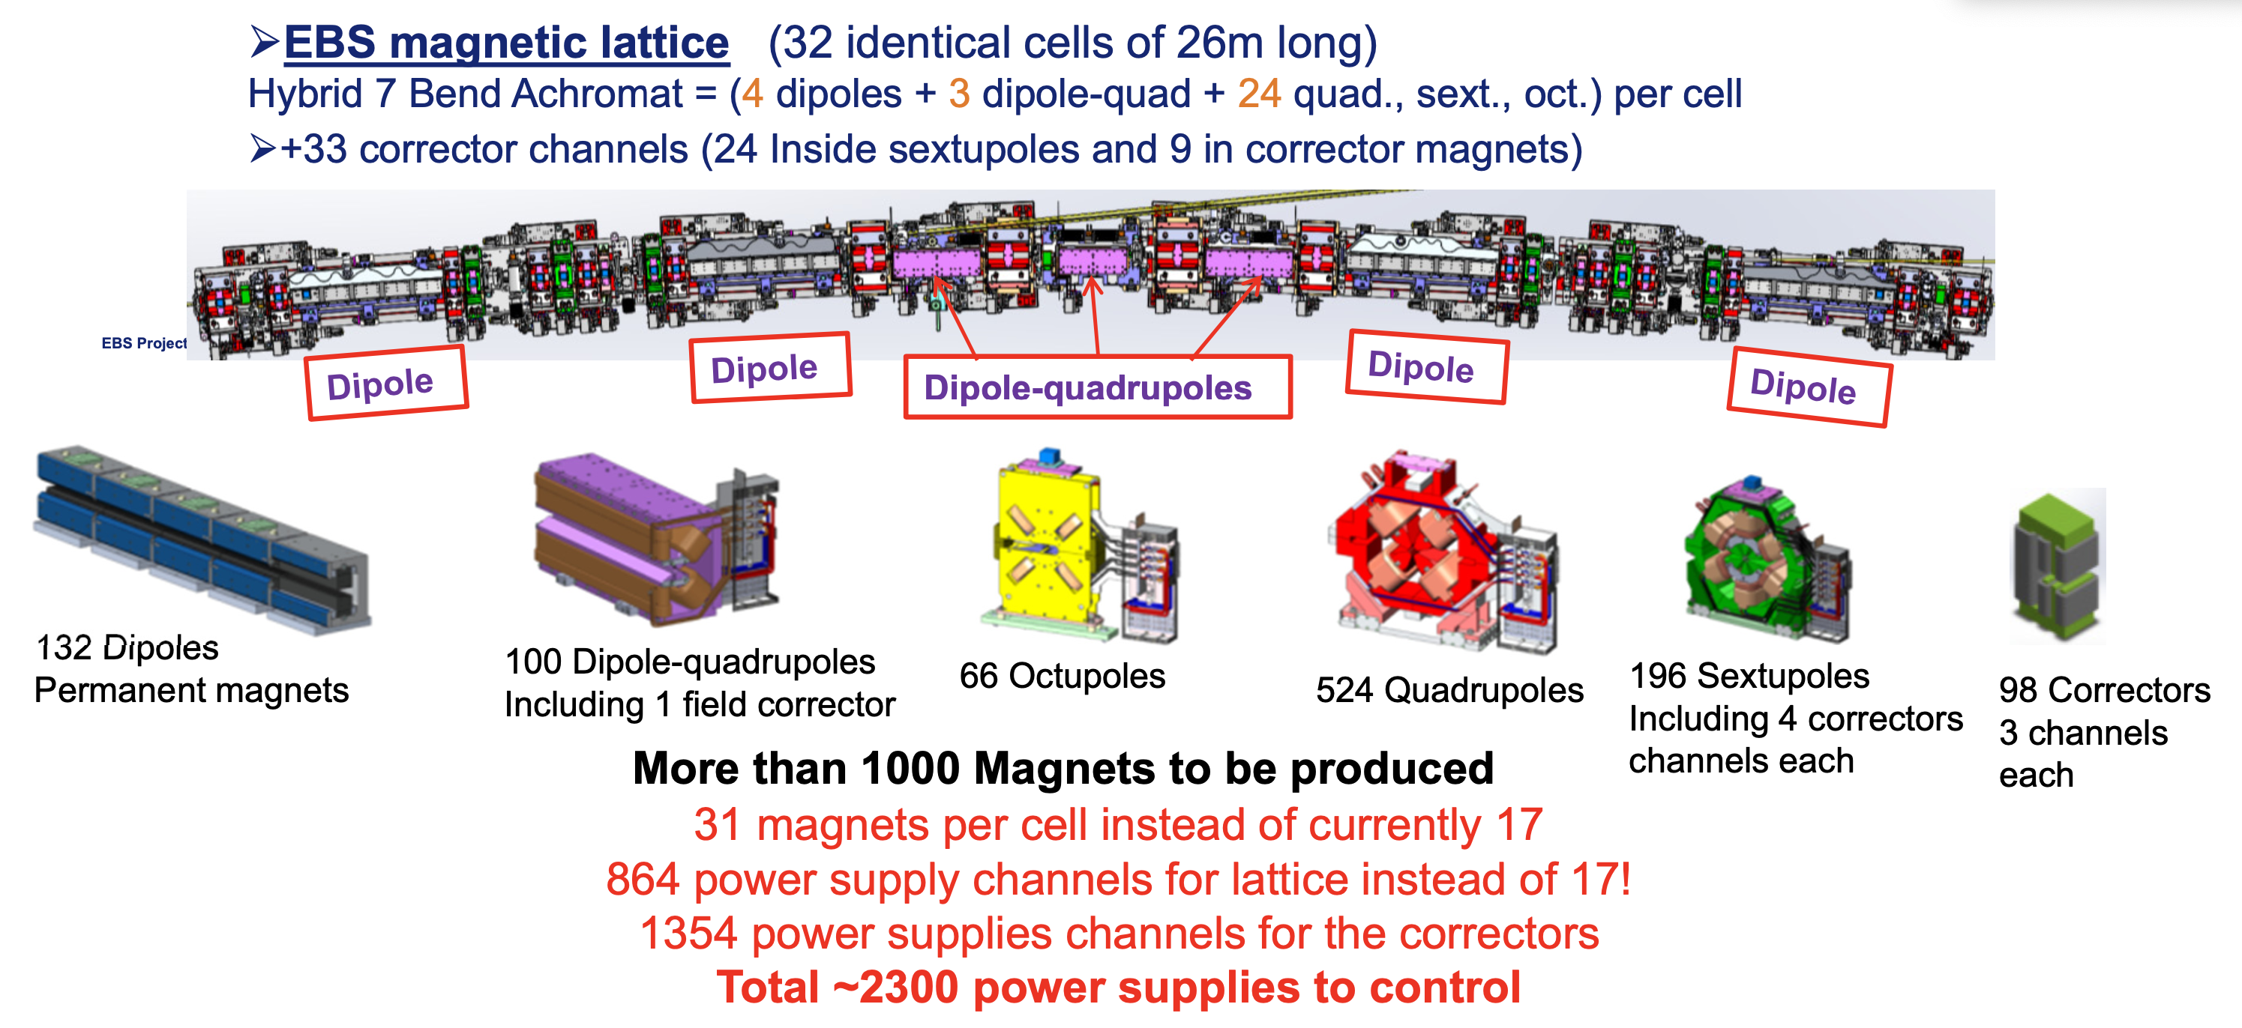
New Machine Components: Magnets

Slide 6
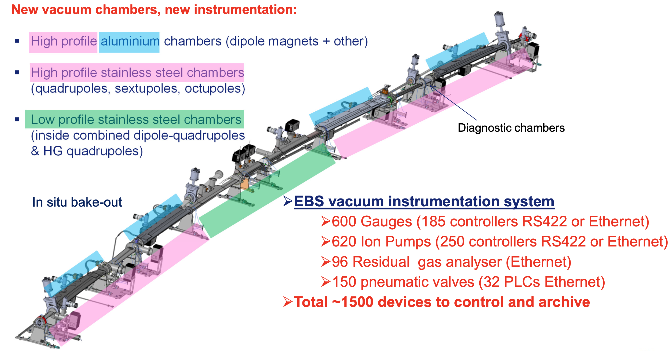
New Machine Components: Vacuum SYSTEM

Slide 7
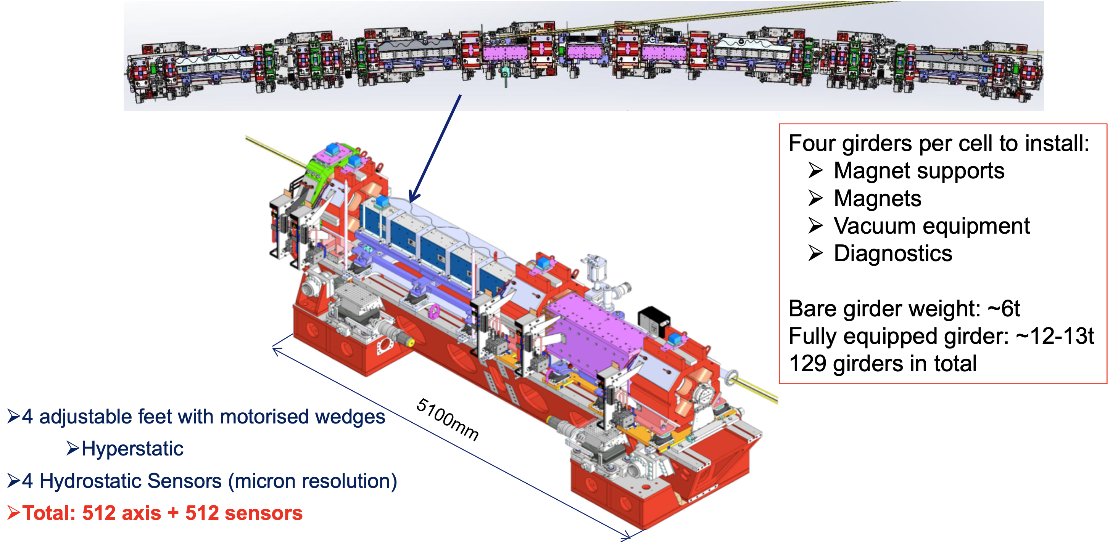
New Machine Components: Girders

Slide 8
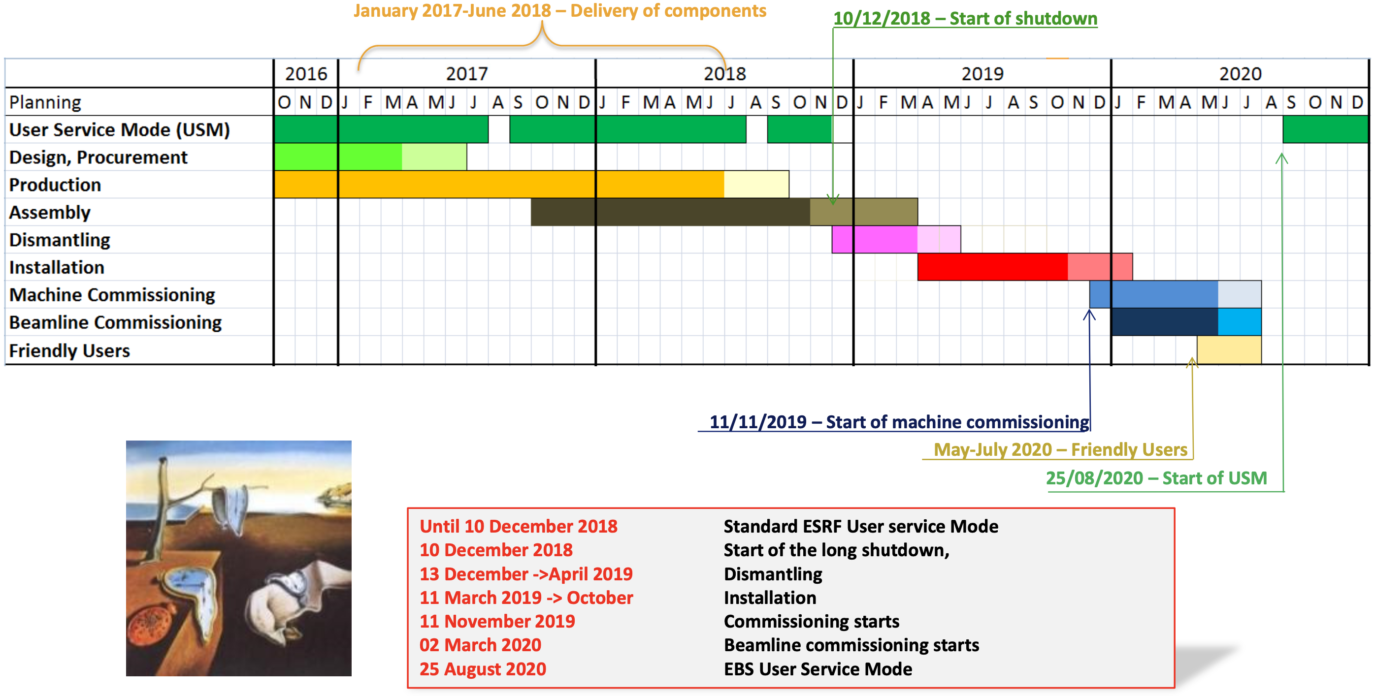
INITIAL Project schedule
The ESRF upgrade program
      main constraint/challenge:
        do the job while minimizing machine (& beamlines) downtime!
        project management challenge: dismantle, mount, commission, (re)open a full SR… in only 20 months!
        test/validate each component: from the lowest machine part to the highest level control room GUI

Slide 9
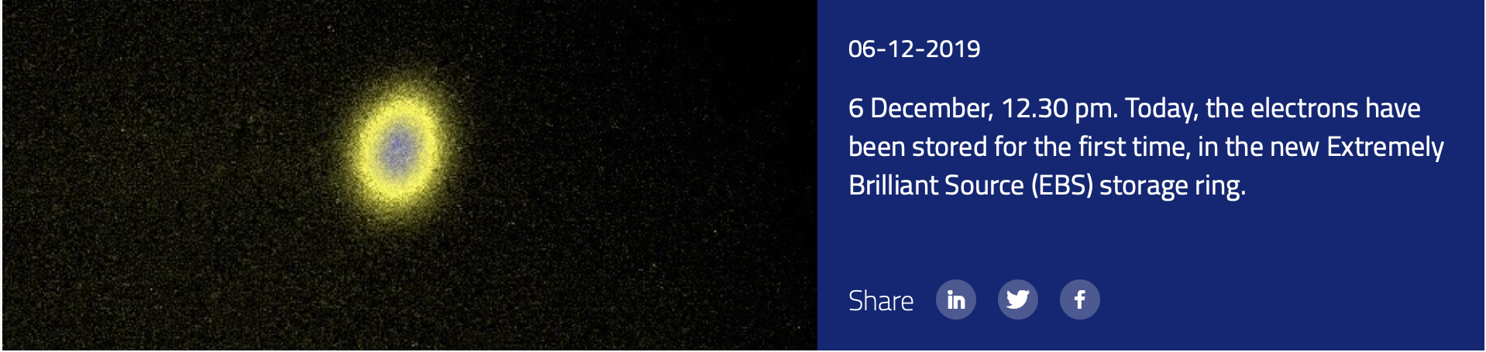
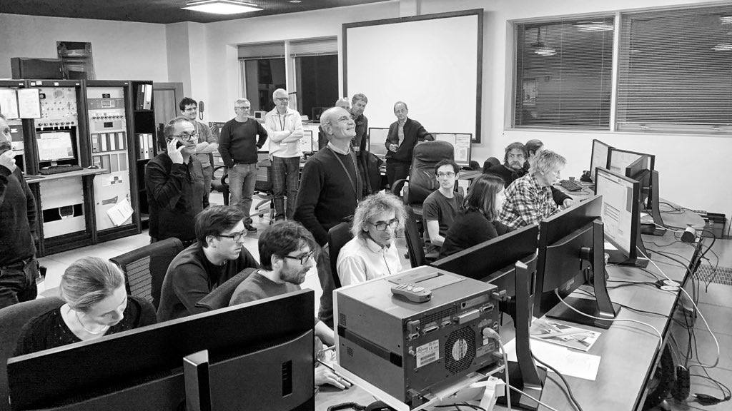
INITIAL Project schedule

Slide 10
The UPGRADE FROM THE Control UNIT POINT OF VIEW
The ESRF upgrade program
      impact of the upgrade on the control system?
        new machine design → more/new equipments → more/new Tango devices
        main components: girders, magnets → power-supplies, vacuum
        old & new hardware/software components must coexist within the same control system
        globally, machine upgrade → partial upgrade/rescale of the CS
        integrate new hardware
        adapt or fully rewrite control for some subsystems (e.g., slow & fast orbit feedback)
        adapt or fully rewrite some GUIs
        good opportunity to upgrade obsolete hardware and/or software (TACO finally disappeared!)
        time constraint → be ready for day one of the commissioning
        offline validation → simulation → EBS-Simulator (pyAT + Tango servers & clients)
        same behavior as real CS, clearly boosted the commissioning phase
        development, validation, sandbox platform → still heavily used on a daily basis (3 EBSS instances)

Slide 11
After ONE YEARE of EBS
The ESRF upgrade program
      some feedback after 1 year of EBS operation (full user mode resumption in January 2021)
        simulation REALLY helps to be on time and to deliver reliable operation tools from day one of the restart
        validate backwards compatibility
        notably in terms of communication between old and new equipments
        e.g., old embedded IP stacks don’t like modern switches
        e.g., POE negotiation
        don’t trust AI evangelists!
        you don’t need AI to restart the machine and deliver beam
        however, ultimate performances could be difficult to obtain with aggressive machine designs
        restart your machine then optimize (if required)
        ESRF-EBS: expected emittance, beam lifetime better than expected (with pure Organic Intelligence)
        potential AI applications for EBS:
        transfer efficiency (Bayesian Optimization)
        feedback loops (Reinforcement Learning)
        see https://sites.google.com/view/owle/home (AI for particle accelerators)

Slide 12
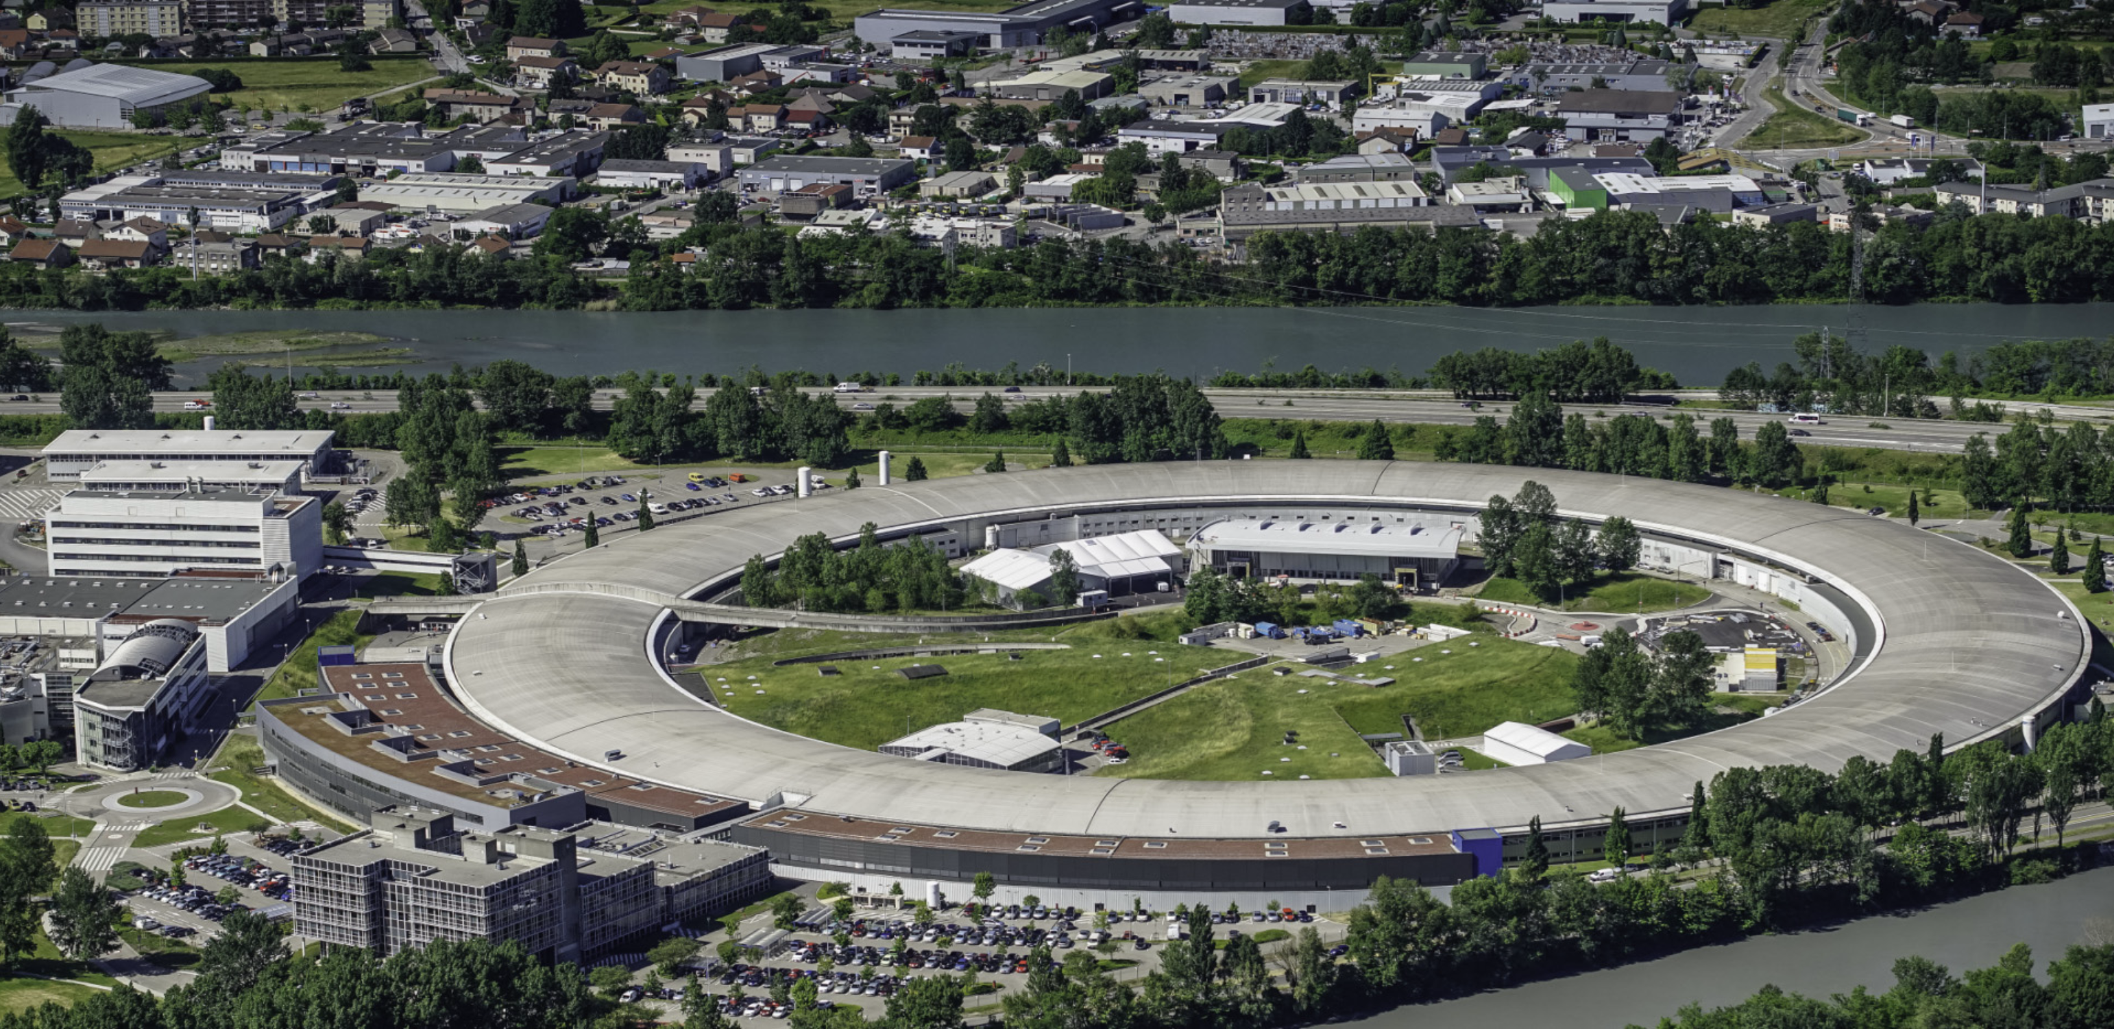
Thanks!

