Slide 1


Status of IC@MS
Mateusz Nabywaniec, Michał Gandor, Lukasz Zytniak
Tango Community Meeting, ESRF/Zoom, 14-15.09.2021

Slide 2

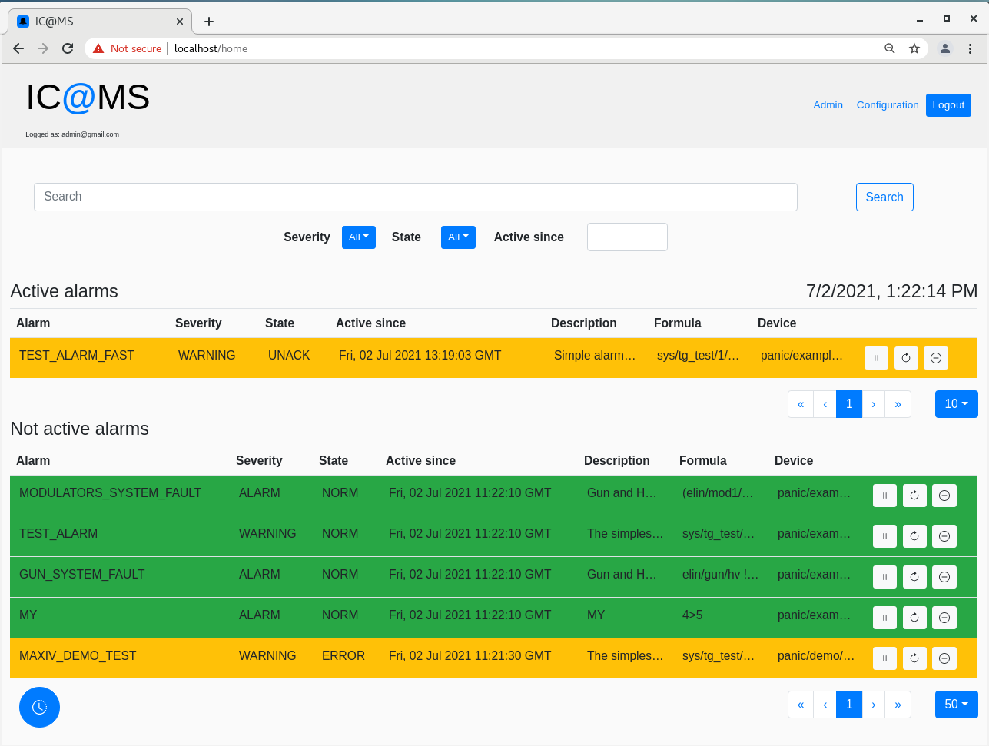
IC@MS - Integrated, Cloud ready @larm Management System
C@MS
CLOUD BASED alarm Management System
  Shortened of downtimes,
  Increased company efficiency,
  Reduction of personnel stress:
    Alarms handling streamlined,
    Increased situation awareness,
    Integration of production and infrastructure,
  Non-typical situations monitored thanks to runtime alarming formulas definition

Slide 3

Demo - plan
How to edit existing alarm?
How to trigger the alarm using Jive?
How to add new alarm?
  Datasources
  Composers
How to find single alarm history?
How to find all available history (snap & pyalarm)?
How to filter by state?
How to search (by name, tag and description)?
How to check API (Swagger)

Slide 4
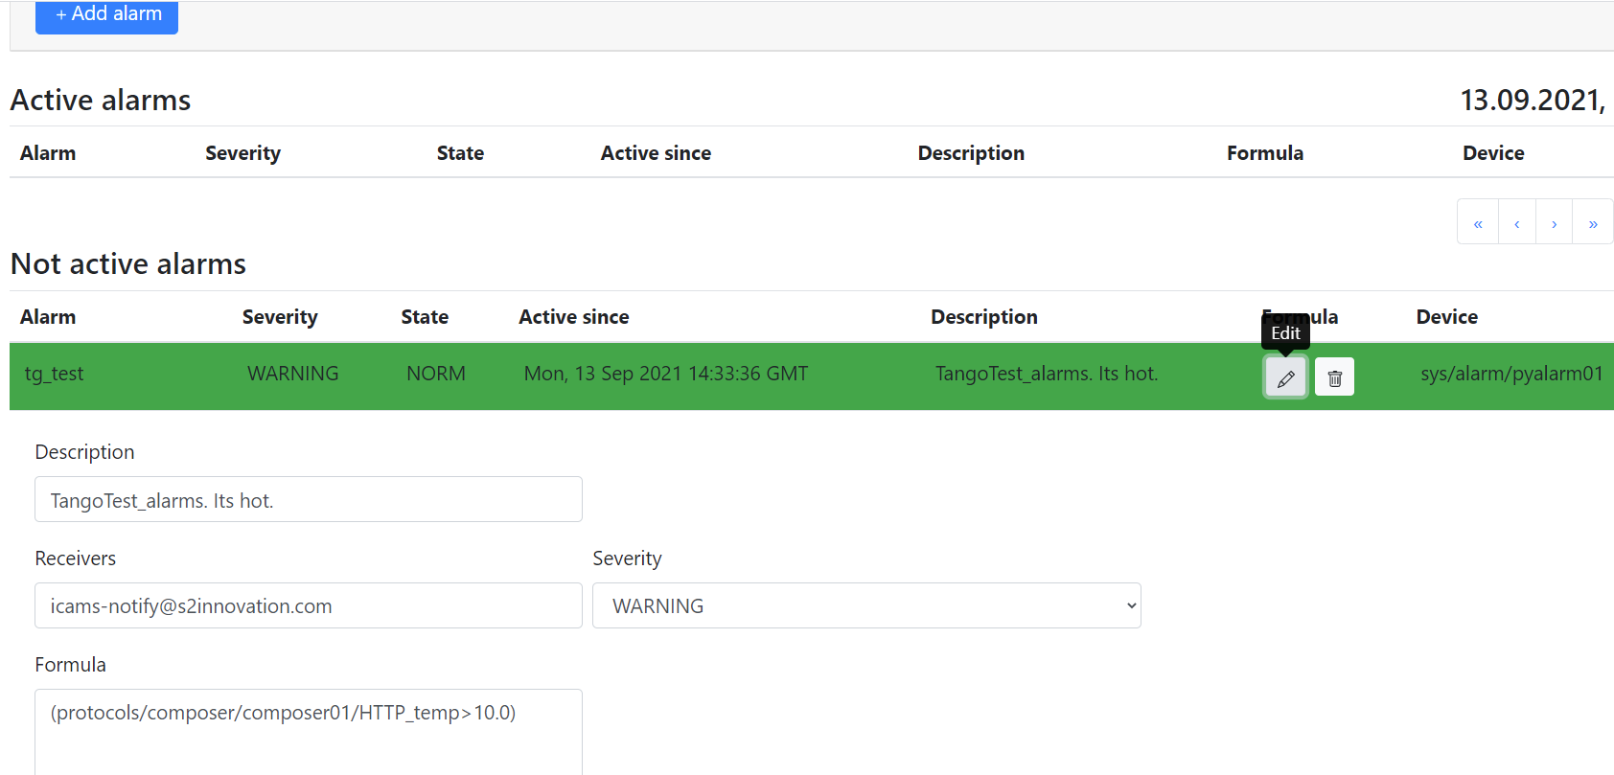
How to edit existing alarm?

Slide 5
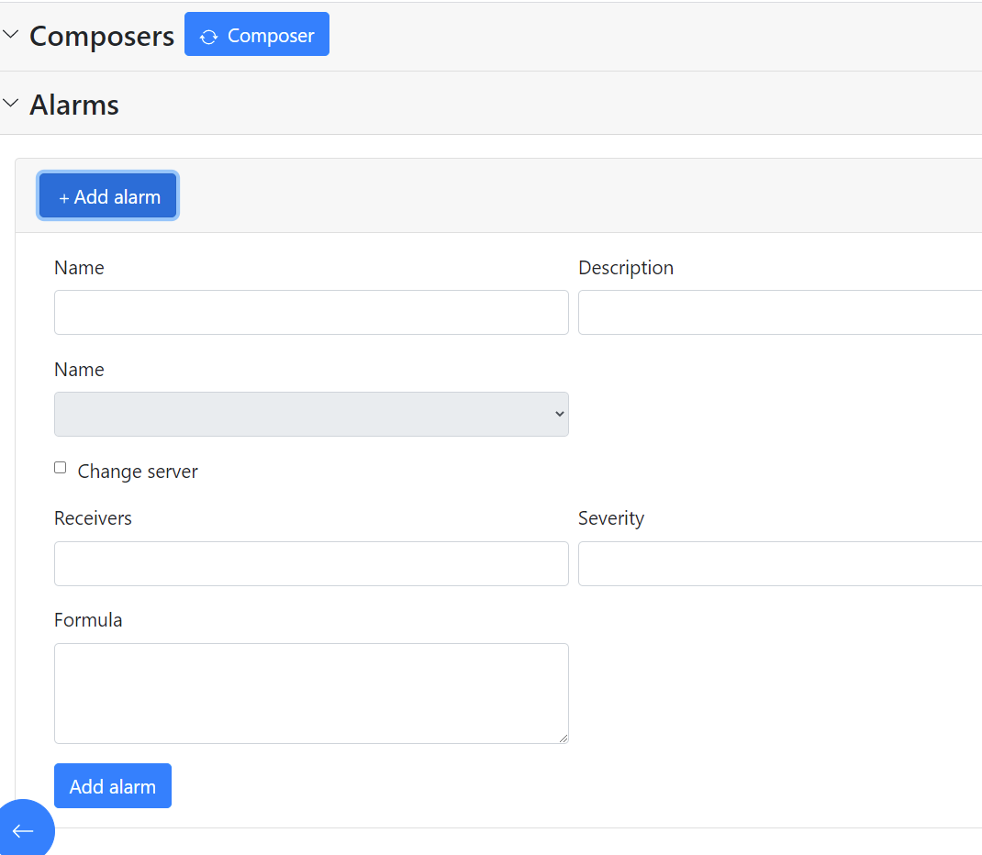
How to add new alarm?

Slide 6
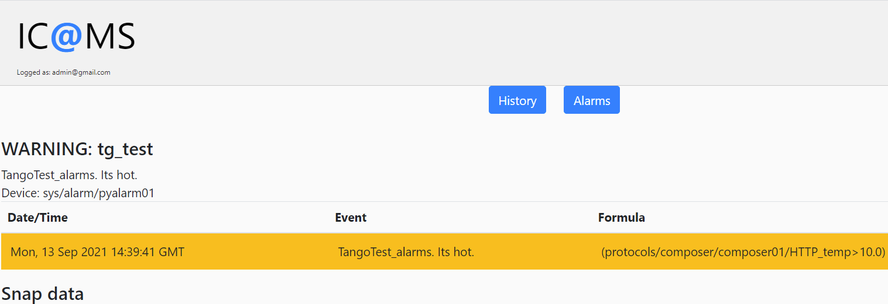
How to find single alarm history?

Slide 7
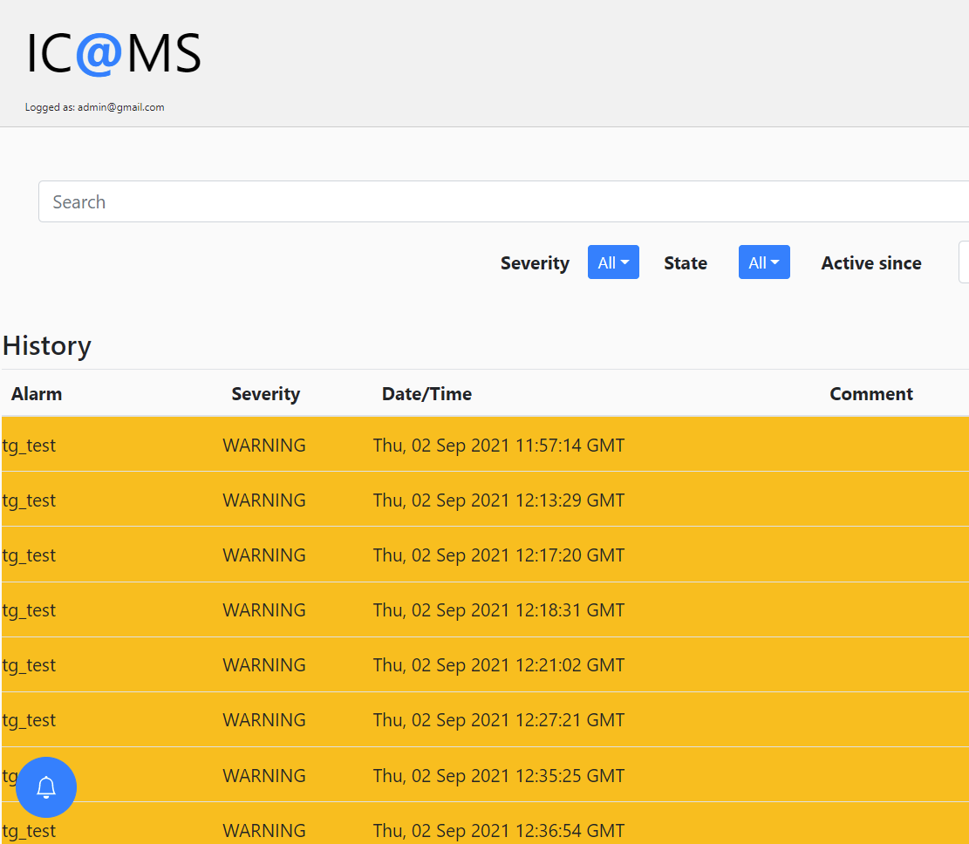
How to find all available history?

Slide 8
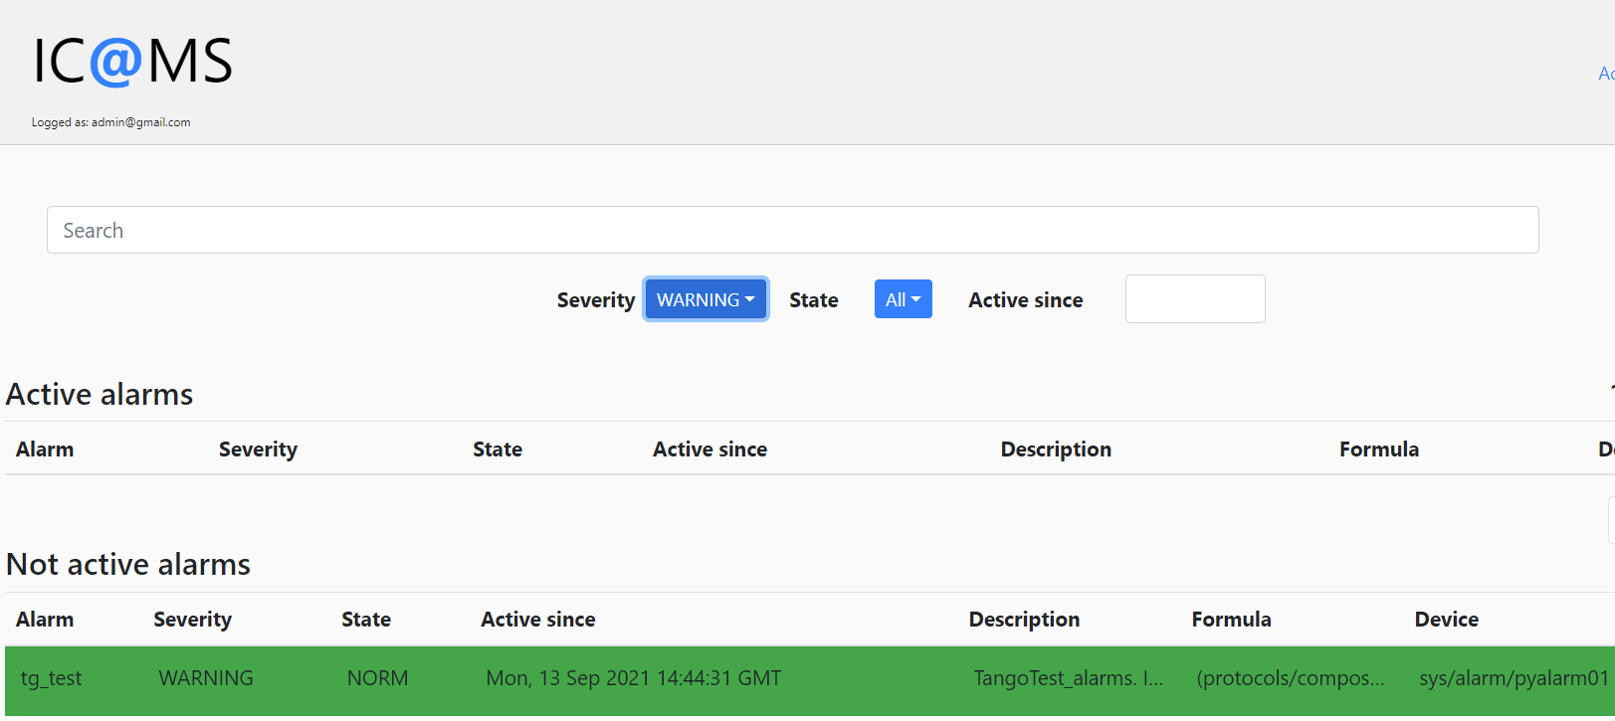
How to filter by severity or state?

Slide 9
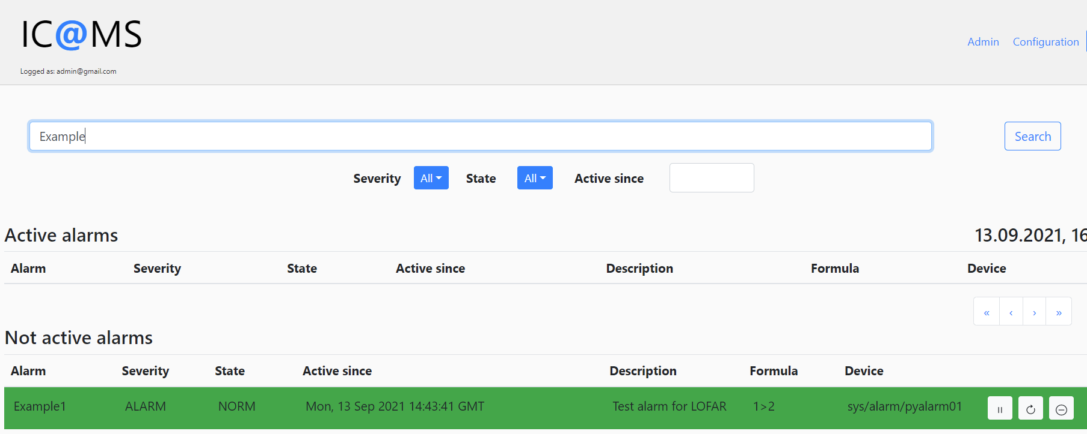
How to search?

Slide 10
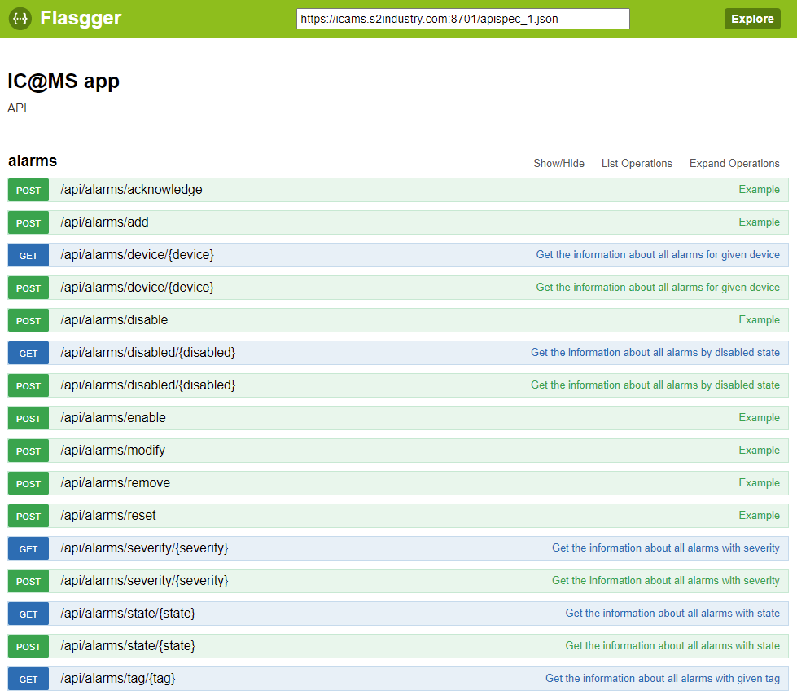
IC@MS API (Swagger)

Slide 11

IC@MS at ALBA Synchrotron
Water cooling systems group is testing IC@MS,
IC@MS is working fine with over 200 alarms.
Planned improvements:
Close sessions when restarting
Improve navigation
Sorting of ACTIV alarms
  Priority
  Date
Sorting of Not ACTIVE
  State
  Name of alarm
Bug in Panic:
  ERROR and OOSRV & SHLVD and DSUPR are different states

Slide 12
Thank you!
S2INNOVATION Sp. z o. o. [ltd.]
Podole 60 Street,
30-394 Kraków, Poland
(+48) 795 794 004
contact@s2innovation.com

