Slide 1

https://www.tango-controls.org
C++ Kernel Status
Reynald Bourtembourg – ESRF
Thomas Braun - ( ) byte physics
Michal Liszcz - S2INNOVATION

Slide 2
Overview
Migration to Gitlab.com
Tango Kernel Webinars
cppTango Status
    9.3.x
    cppTango 9.4
Packages
Community Life

Slide 3


Migration to Gitlab
https://github.com/tango-controls/cppTango
https://gitlab.com/tango-controls/cppTango
Archived:
Read Only
No longer updated

Slide 4
Migration to GitLab
Main motivations:
Travis CI change of policy and ambiguity. No longer free for Open Source projects. Broken promise.
Use GitLab CI/CD as alternative to Travis CI
Many institutes in the Tango Community are used to GitLab (many institutes are running a GitLab self-hosted instance)
Gitlab is free software while GitHub is not
Free of Charge Gitlab Gold License granted by gitlab.com
Warning: some features available thanks to the Gold license are using proprietary SW from Gitlab.
Migration was relatively straight forward

Slide 5
Migration to GitLab
Consequences:
Travis CI jobs -> GitLab CI jobs
Dropped SonarCloud support
SonarCould -> clang-tidy and clang-analyzer jobs
ABI-API compliance checker: GitHub action -> GitLab CI job
Still using Appveyor for Windows CI
  Move to GitLab CI/CD is also considered (#731)
tango-9-lts branch renamed to main

Slide 6

Tango Kernel Webinars
Goals
Share the knowledge on the Kernel Code
Help/Guide first contributors to the Kernel Code
https://tenor.com/view/nod-beard-pai-mei-gif-5470798

Slide 7
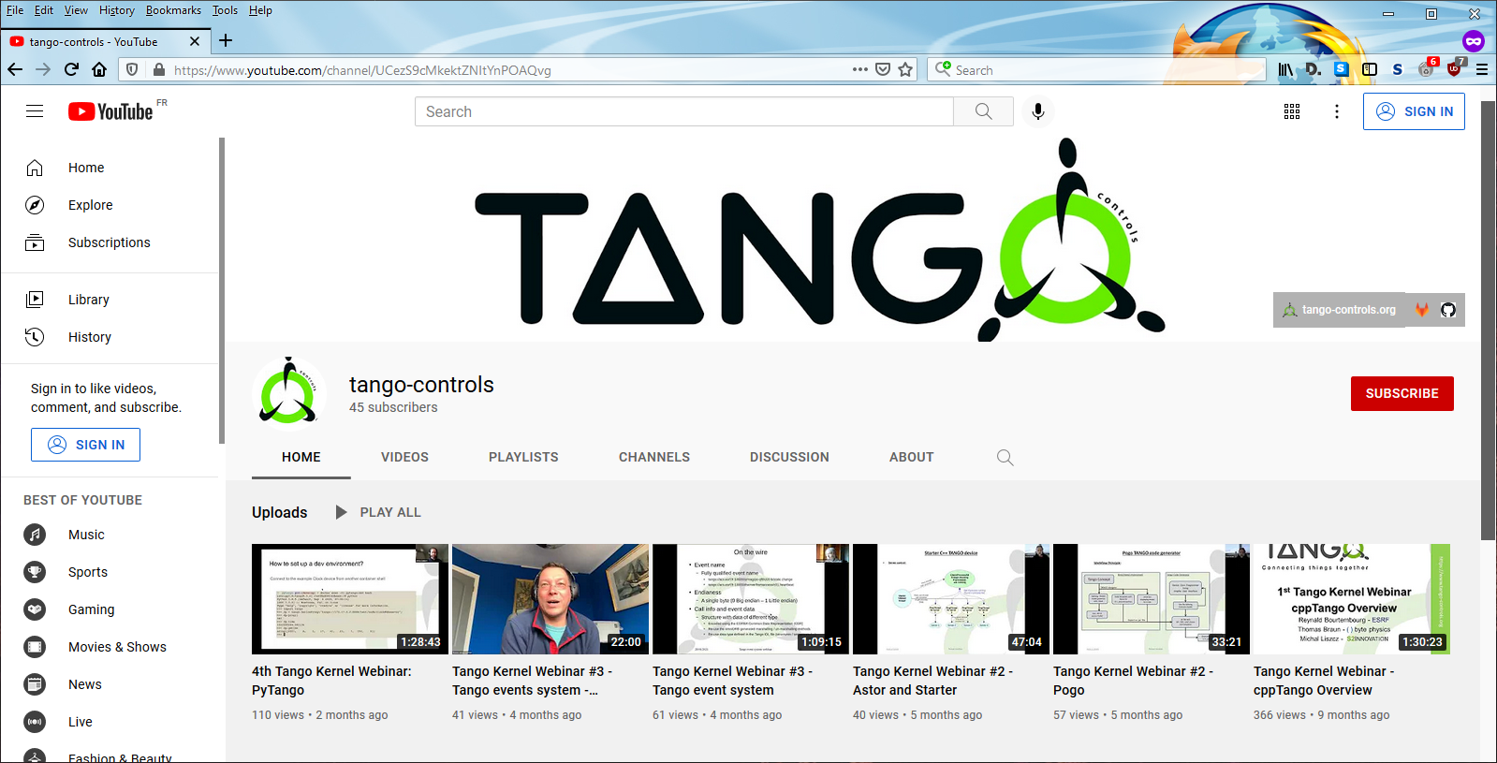
Tango Kernel Webinars
Video records available on tango-controls YouTube channel:
https://www.youtube.com/channel/UCezS9cMkektZNItYnPOAQvg

Slide 8
Development branches
main | 9.3-backports
Future cppTango 9.4 | (9.3.x development branch)
Requires C++14 at least | Does not require C++11 (Can be compiled on old compilers but might need a more recent CMake version)
Not binary compatible with cppTango 9.3.x | Binary compatible with cppTango 9.3.x
Gitlab CI: Latest LLVM (12.0.1) Latest GCC (10.2.0, soon 11.1.0) Ubuntu 20.04 Debian 8, 9 and 10 clang-tidy clang-analyzer | Gitlab CI: Debian 7, 8, 9 , and 10
Appveyor: win32 msvc14 and msvc 15 x64 msvc14 and msvc15 | Appveyor: win32 msvc9, msvc10, msvc12, msvc14 and msvc 15 x64 msvc9, msvc10, msvc12, msvc14 and msvc 15
Support for Debian 8 will be dropped soon.
Notes:
We will drop support for Debian 8 in the main branch (consequence of the C++14 requirement decision

Slide 9
cppTango changes (main)
!746 Event unsubscription from DeviceProxy destructor
!745 .travis/gcc-latest/Dockerfile: Update to 10.2.0
!748 Correct PCH compile definitions in Release mode
!753 Doxyfile.in: Upgrade for doxygen 1.8.19
!752 Remove conditional constexpr define
!755 Bugfix/fix abi checking
!757 Replace sprintf with snprintf
!775 INSTALL.md: Add missing cmake options
!770 Fix and document windows build
!758 Allow turning shared library building off

Slide 10
cppTango changes (main)
!776 Add more classes to documentation
!777 .travis/llvm-latest: Upgrade to llvm 11.0
!779 Include dependencies as SYSTEM libraries
!783 Remove calling GCC internal functions
!782 CMakeLists.txt: Remove bogus omniidl check
!803 event_lock.cpp: Make it compile on 32-bit linux
!800 Revise developer documentation
!808 Search docker for tests
!813 Fix sonar scanner usage
!811 Travis: Use sonar cache

Slide 11
cppTango changes (main)
!817 Fix API_EventTimeOut
!820 Gitlab CI migration
!832 Don't install unnecessary omniORB stub for MSVC
!831 Support clang-tidy
!790 CMakeLists.txt: Enforce a minimum libzmq version
!836 Bugfix/zmq try compile with custom path
!837 Update for new branch names
!835 Add clang-analyzer CI job
!843 Move server_init_hook to Util::server_init

Slide 12
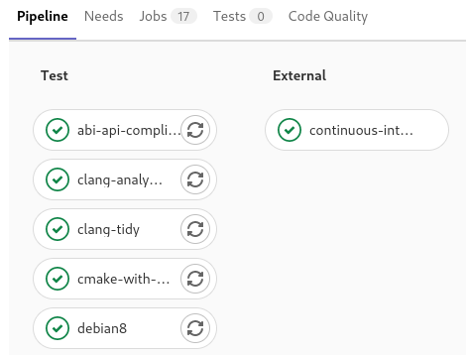
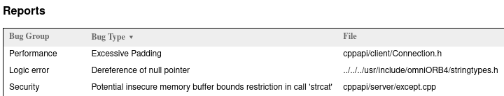
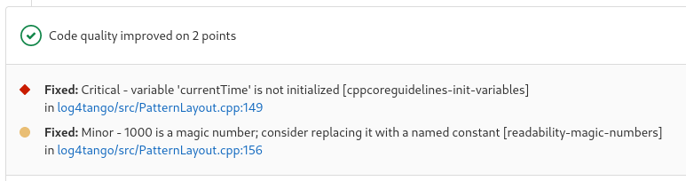
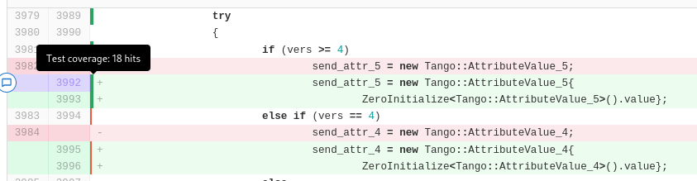
cppTango CI pipeline
Regression test & code quality CI jobs
Clang Static Analyzer reports
Clang-Tidy code quality for MRs/diffs
Test coverage visualization

Slide 13
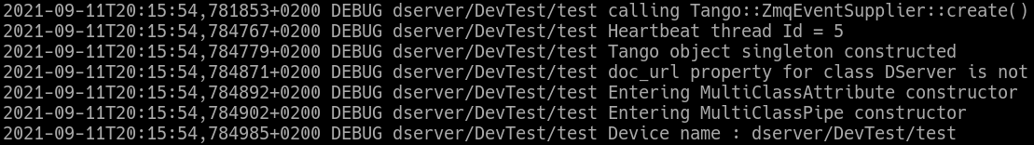
cppTango changes (main)
!845 Change logging default layout
!848 CODEOWNERS: Add Nicolas Leclercq
!846 ./travis/llvm-latest/Dockerfile: Upgrade to v12
!794 Use chrono to represent log4tango timestamps
!853 CMakeLists.txt: Default USE_PCH to ON
!766 Keep source tree clean and use more targets
!759 Cleanup log4tango

Slide 14
cppTango upcoming changes
!787 Musl fixes – Support for musl libc (Alpine Linux)
!851 Doxyfile.in: Add log4tango classes
!856 Make compatible with cmake 3.7 again
!850 Add git revision to LIBRARY_VERSION
!857 Support CMAKE_BUILD_TYPE RelWithDebInfo
!855 Add debian bullseye – Debian 11 CI job
!862 Remove outdated build files from cppapi
!864 Add support for sanitizers – ASAN, UBSAN, TSAN in CI
!859 Remove code forked from libjpeg – optional libjpeg-turbo dependency for JPEG encoding/decoding
… and many bugfixes

Slide 15
cppTango 9.4
Reminder from Nov 2020. Slides courtesy of Thomas Braun.

Slide 16
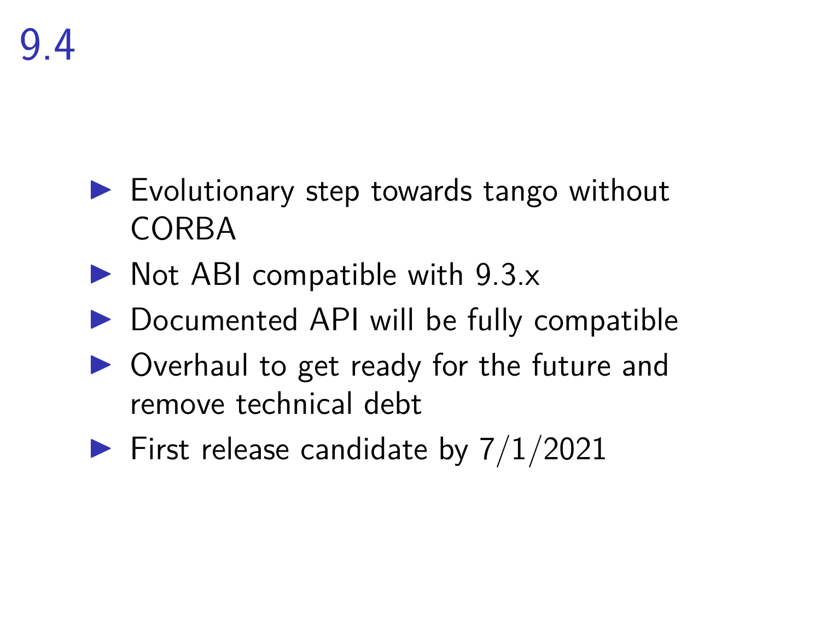
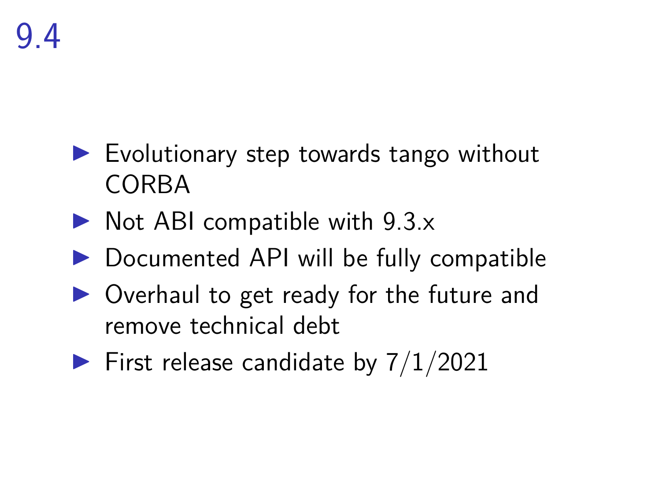
– Missed

Slide 17
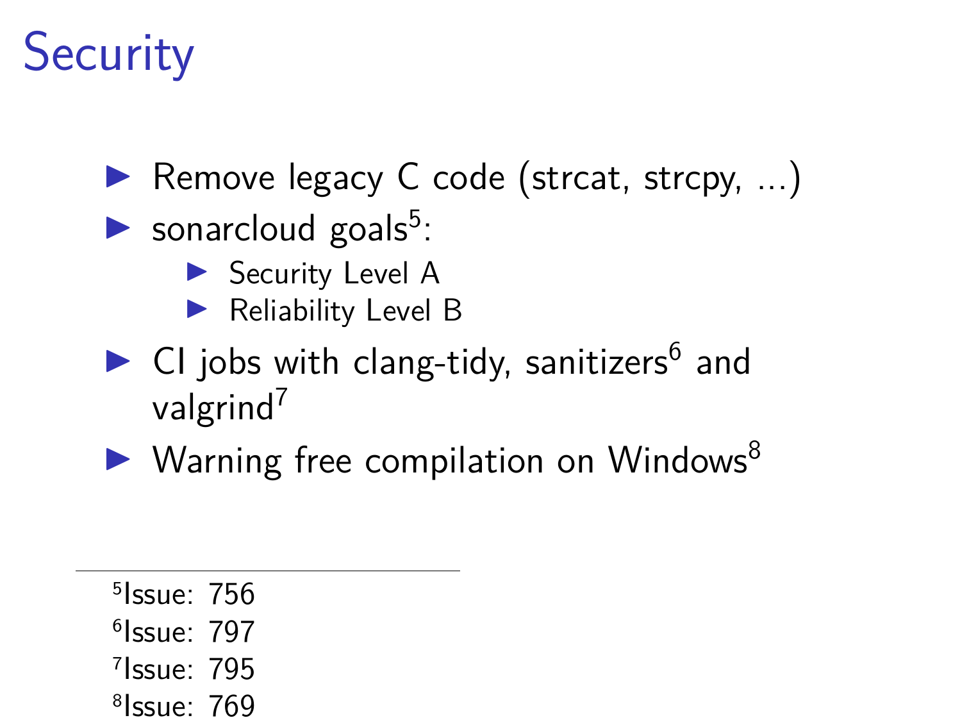
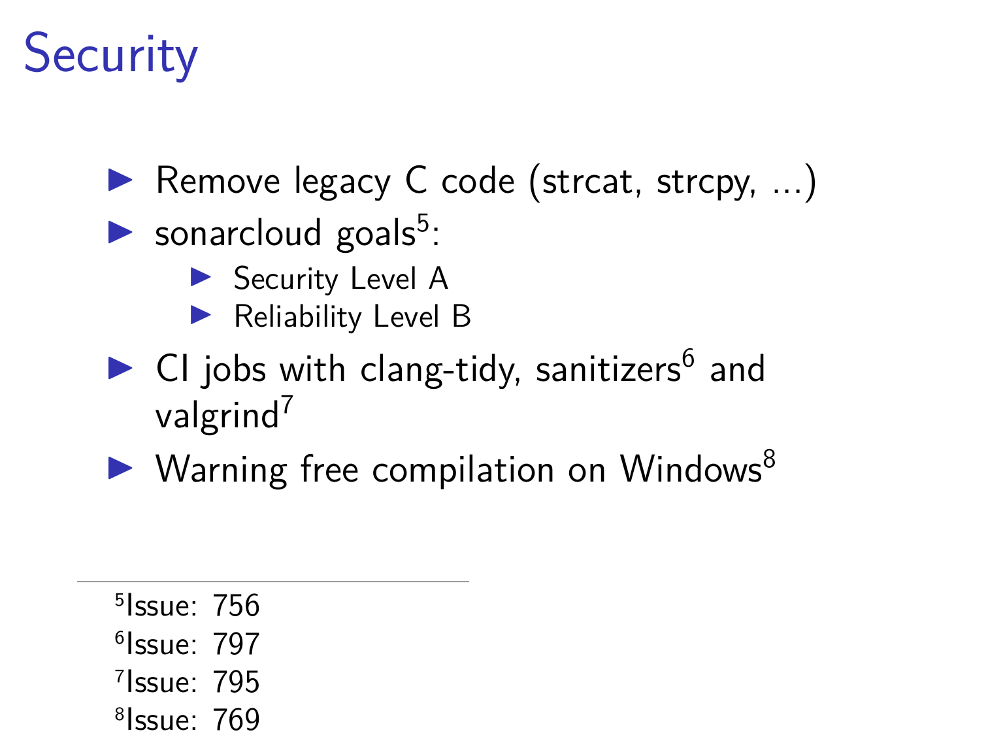
– WIP
– Tracked by clang-tidy job now
– WIP

Slide 18
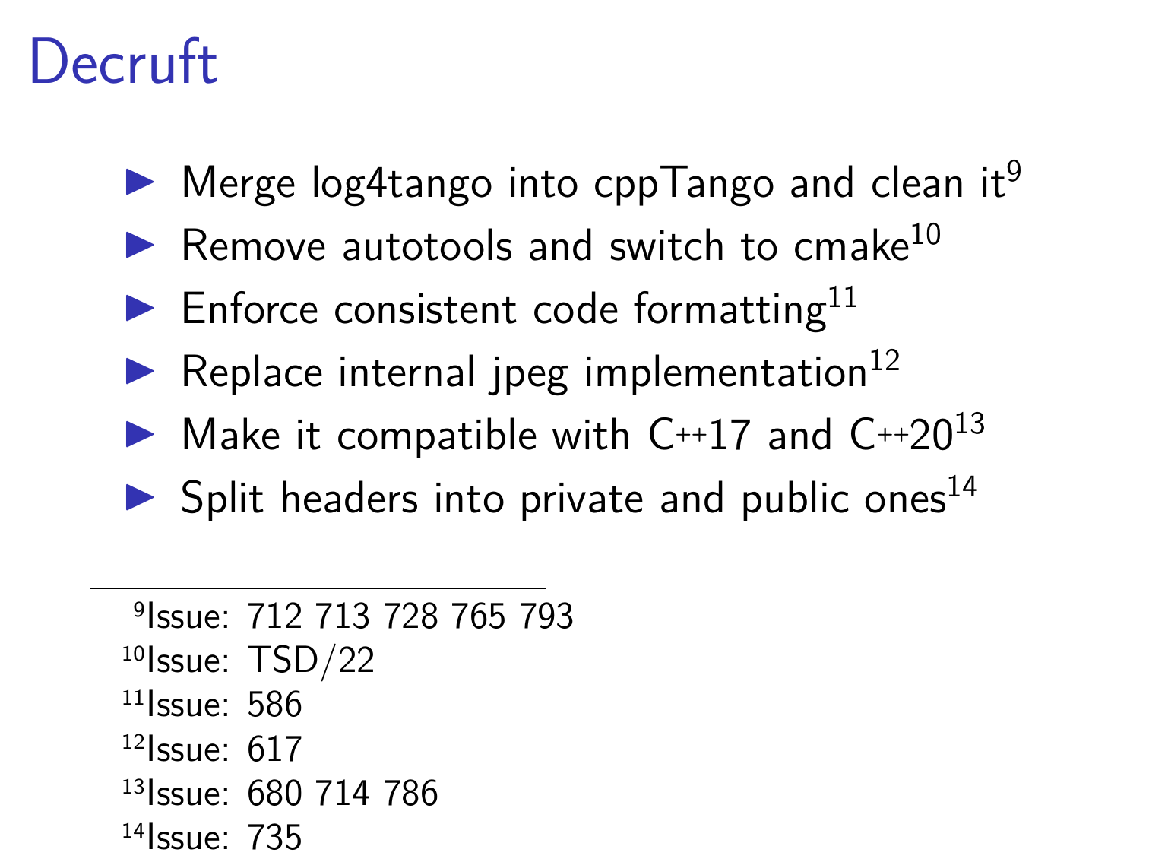
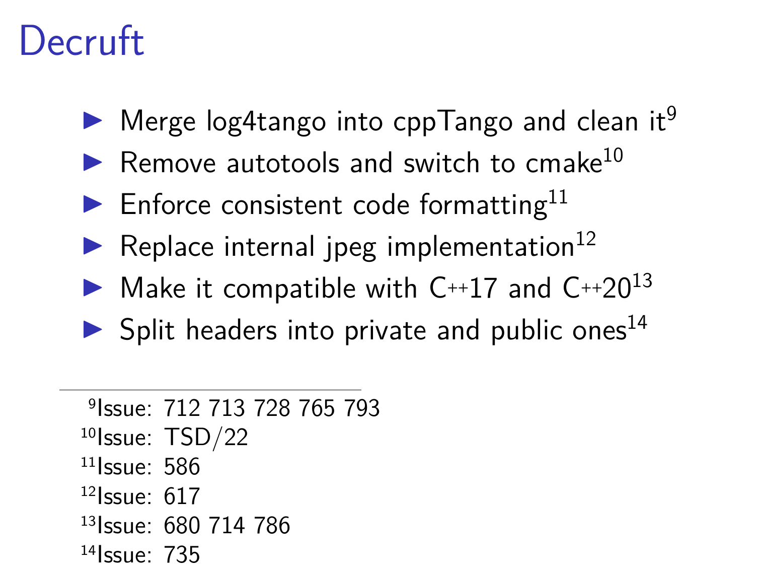
– Done
– WIP
– WIP

Slide 19
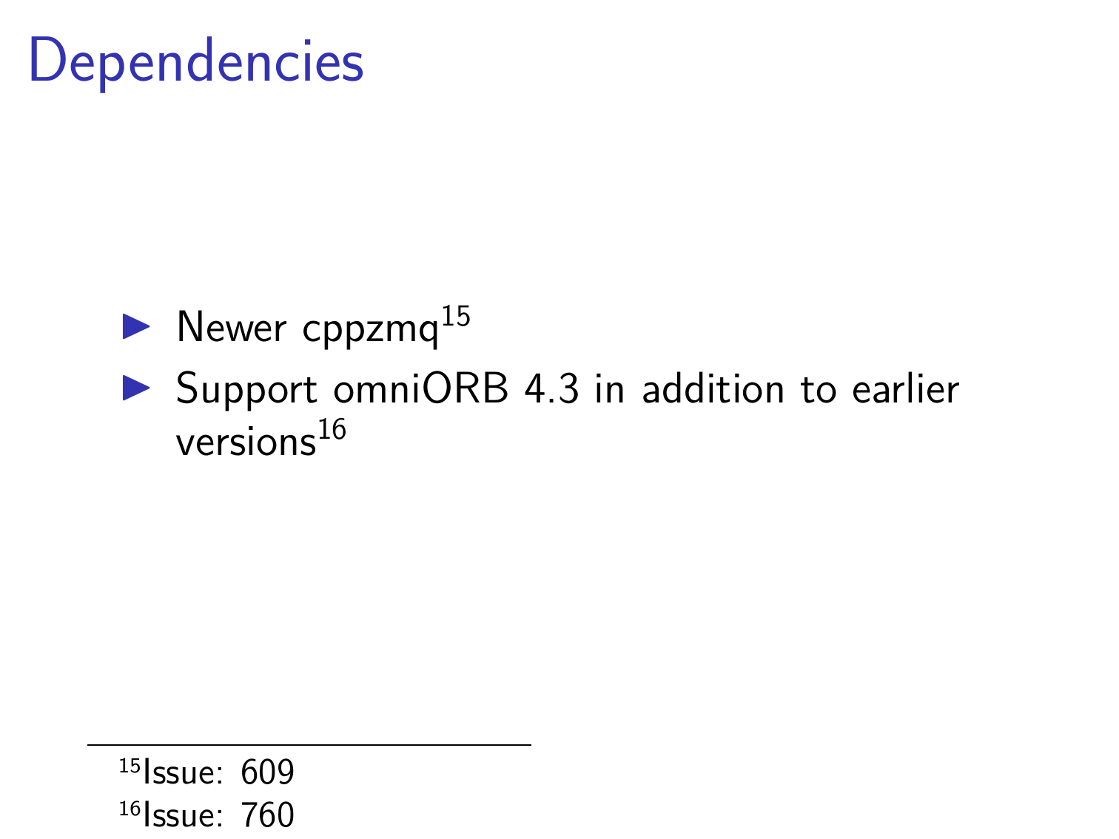
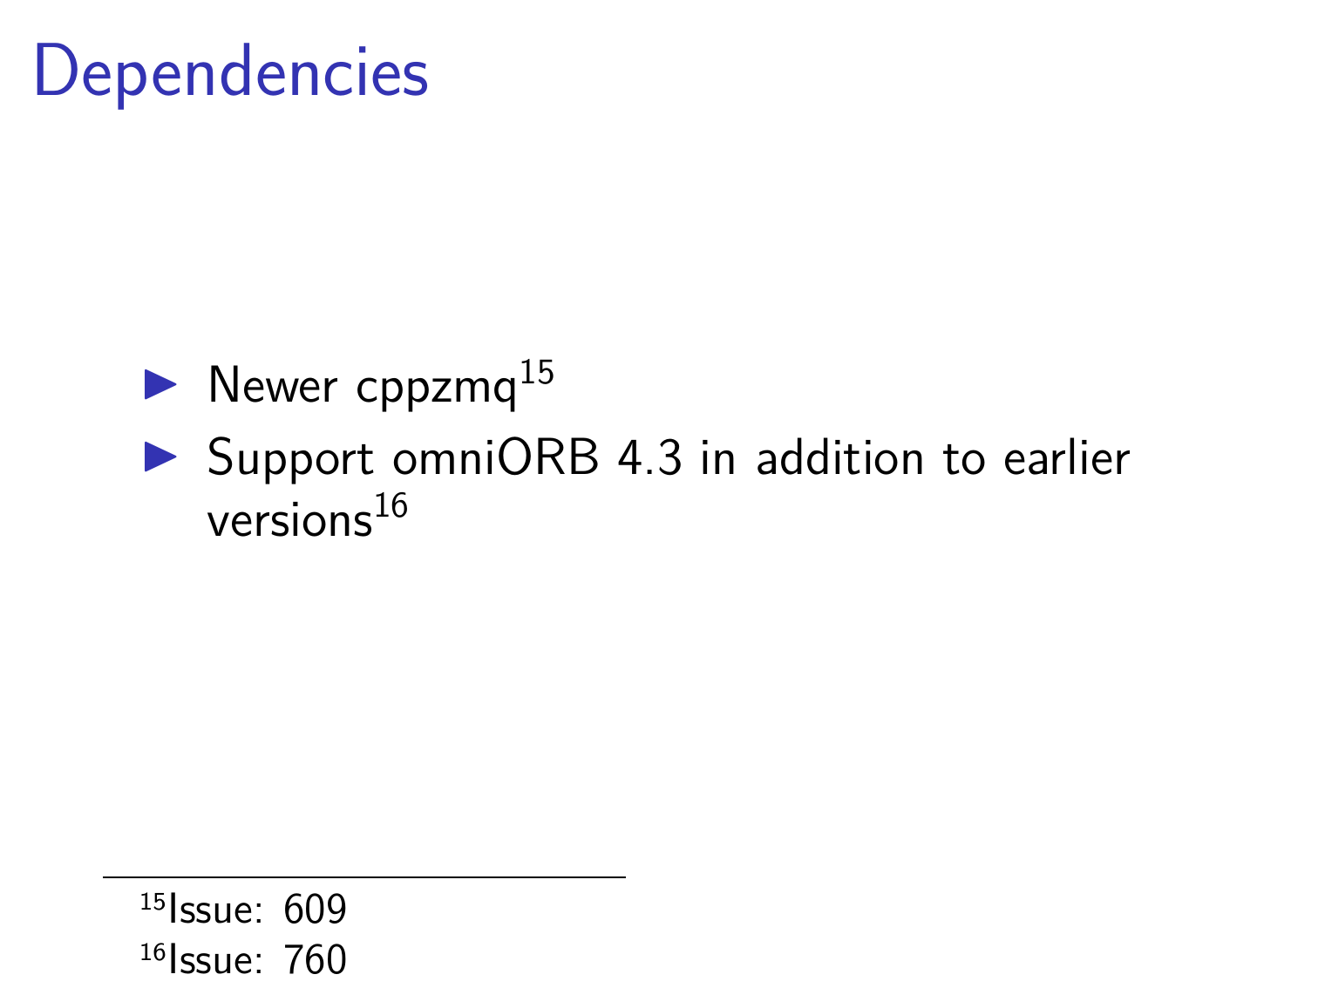
– WIP

Slide 20
Conda Packages
Tango Conda packages now available on conda-forge channel:
  tango-idl
  cpptango
  itango
  pytango
  tango-admin
  tango-test
  tango-database
  tango-starter (WIP)
Many thanks to Benjamin Bertrand (Max IV)

Slide 21

Community Life

Slide 22

Tango Kernel Teleconf Meetings
https://www.artstation.com/artwork/nQOEko

Slide 23
Tango Kernel Teleconf Meetings
https://www.artstation.com/artwork/nQOEko

Slide 24
Tango Kernel Teleconf Meetings
On 2nd and 4th Thursday of the month at 15:00 (Paris time)
Agenda and minutes available on Github:
  https://github.com/tango-controls/tango-kernel-followup
Status of recent development (cppTango, JTango, pyTango, POGO, RFCs, …)
Technical discussions
Define priorities

Slide 25
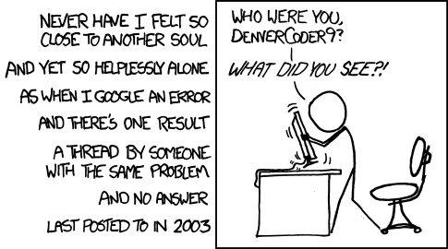
Tango-Controls forum
https://www.tango-controls.org/community/forum
https://xkcd.com/979

Slide 26
Thank you!
Any questions?
Acknowledgement:
Alexander Senchenko, Andy Goetz, Anton Joubert, Benjamin Bertrand, Carlos Pascual, Dmitry Egorov, Emmanuel Taurel, Frédéric Picca, Geoff Mant, Giacomo Strangolino, Graziano Scalamera, Guifré Cuni, Hélder Ribeiro, Igor Khokhriakov, Jairo Moldes, Jean-Luc Pons, Johan Venter, Katarzyna Rzęsikowska, Lorenzo Pivetta, Marius Elvert, Michal Liszcz, Michał Gandor, Nicolas Leclercq, Nicolas Tappret, Pascal Verdier, Piotr Goryl, Reynald Bourtembourg, Sergi Rubio, Sébastien Gara, Thomas Braun, Tiago Coutinho, Zbigniew Reszela and so many others for their contributions (PR, bug reports, code reviews, comments, …)
https://www.gitlab.com/tango-controls/cppTango/issues
https://www.gitlab.com/tango-controls/TangoSourceDistribution/issues

