Slide 1
Magnet Power Supply
POCPA 2016
Briant Lam
May 24-26, 2016

Slide 2
Outline
  Overview
  Technical Requirements
  Power Supply Designs
  Power Supply Stability
  Schedule
  Summary

Slide 3
Overview – LCLS-II Status
The LCLS-II project will provide expansion and enhancement of the existing LCLS facility.
  A high repetition rate injector system located at Sector 0 of the SLAC linac
  Replacement of the existing linac (Sector 0-10) with a superconducting linac
  Two new undulator systems, producing independently tunable x-ray beams
  Systems for transport, diagnostics and optical manipulation of the x-ray beams
  Modifications/upgrades to experimental stations
Department of Energy (DOE) Critical Decision (CD) 2/3
  Approval received in March 2016
  CD-2 Performance baseline
  CD-3 Start of construction
Final design review of magnet power supplies approved May 2016
  Magnet power supply designs complete and approved
  Authorized to begin procurement and fabrication
Notes:
Include description of what work is being done
Show screen shots of beam line
Refer to specific work to be done in screen shots as you describe the scope of work

Slide 4
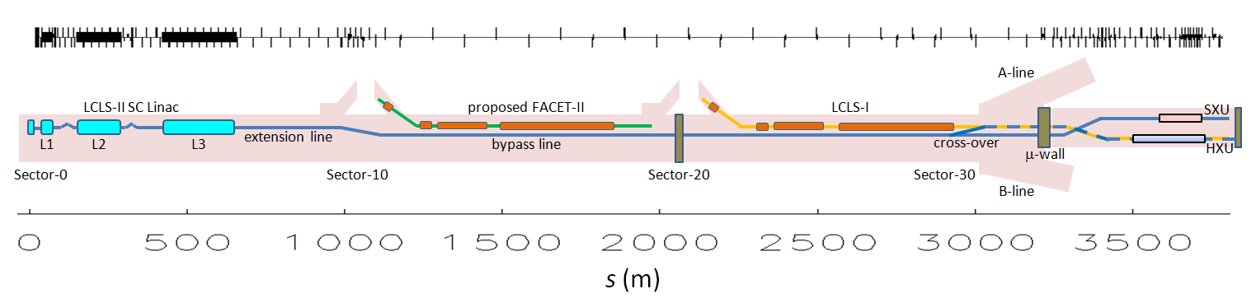
Overview – LCLS-I and LCLS-II Performance Measures
Performance Measure | Threshold | Objective
Variable gap undulators | 2 (soft and hard x‑ray) | 2 (soft and hard x‑ray)
Superconducting linac-based FEL system (New LCLS-II)
Superconducting linac electron beam energy | 3.5 GeV | ≥ 4 GeV
Electron bunch repetition rate | 93 kHz | 929 kHz
Superconducting linac charge per bunch | 0.02 nC | 0.1 nC
Photon beam energy range | 250–3,800 eV | 200–5,000 eV
High repetition rate capable end stations | ≥ 1 | ≥ 2
FEL photon quantity (10⁻³ BW) | 5x10⁸ (10x spontaneous @2,500 eV) | > 10¹¹ @ 3,800 eV
Normal conducting linac-based system (Existing LCLS-I)
Normal conducting linac electron beam energy | 13.6 GeV | 15 GeV
Electron bunch repetition rate | 120 Hz | 120 Hz
Normal conducting linac charge per bunch | 0.1 nC | 0.25 nC
Photon beam energy range | 1,000–15,000 eV | 1,000–25,000 eV
Low repetition rate capable end stations | ≥ 2 | ≥ 3
FEL photon quantity (10⁻³ BWª) | 10¹⁰ (lasing @ 15,000 eV) | > 10¹² @ 15,000 eV

Slide 5
Technical Requirements – LCLS-II Magnets and PS
Magnets by Type
Magnet Type | Magnet Qty | PS Qty
BEND (16 types) | 110 | 69
QUADRUPOLE (15 types) | 236 | 196
SOLENOID (2 types) | 3 | 3
XCOR/YCOR (10 types) | 420 | 420
Grand Total | 769 | 688
Power Supplies by Type
Voltage | Current | Magnet Qty | PS Qty
Kepco BOP 100W |  | 105 | 105
5 | 20 | 105 | 105
Genesys 1.5kW |  | 27 | 18
30 | 50 | 19 | 16
50 | 30 | 8 | 2
Genesys 10/15kW |  | 123 | 51
40 | 250 | 3 | 2
40 | 375 | 6 | 3
50 | 200 | 49 | 30
60 | 250 | 31 | 9
80 | 187.5 | 22 | 6
200 | 50 | 12 | 1
Analogic 232HC 12kW |  | 26 | 26
100 | 120 | 26 | 26
MCOR 40-1500W |  | 488 | 488
40 | 1 | 85 | 85
40 | 2 | 86 | 86
40 | 6 | 281 | 281
40 | 12 | 23 | 23
50 | 30 | 13 | 13
Grand Total |  | 769 | 688
Notes:
Populate table with Typed, Doc#, Title, Status

Slide 6
Technical Requirements – Stability
Field Stability Requirements | Value | Units
Bends | 30-100 | ppm (RMS w.r.t. max field)
Bend Trims | 100-200 | ppm (RMS w.r.t. max field)
Quadrupoles | 100-300 | ppm (RMS w.r.t. max field)
Correctors | 100-200 | ppm (RMS w.r.t. max field)
Field stability is equal current stability, ΔB/B_{max} = ΔI/I_{max}
Stability must be met for Klystron Gallery temperature swings of ±15 °C
  Exception: Corrector long term stability is “much larger, ~0.1% rms”
Notes:
Populate table with Typed, Doc#, Title, Status

Slide 7
Power Supply - Types
Intermediate type power supplies
  SLAC-designed PI-based Ethernet power supply controller (EPSC), 2006
  Controls off the shelf power supplies, unipolar and bipolar
  Regulates using off the shelf current transducers
  Used for warm and superconducting magnets
Trim type power supplies (MCOR)
  SLAC-designed bipolar power supply, 1995
  Recent upgrade to the power amplifier for lower noise
  Recent design of an Ethernet controller with embedded IOC
  Used for trims, correctors and small quadrupoles

Slide 8
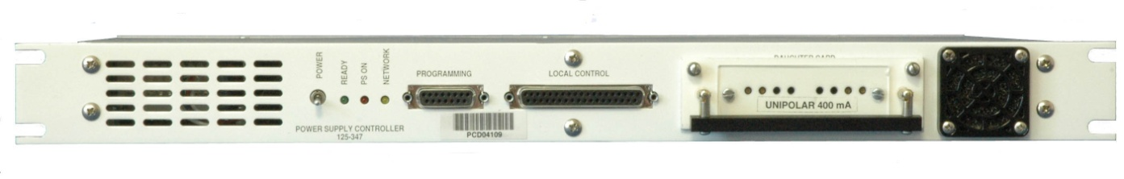
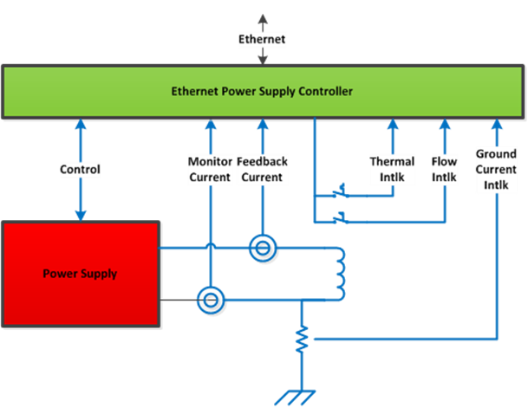
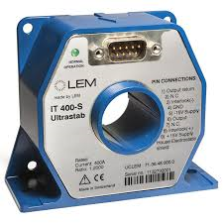
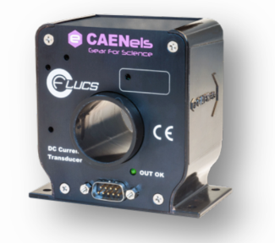
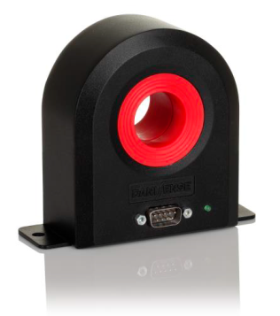
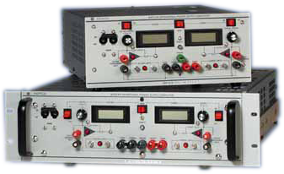
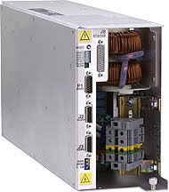
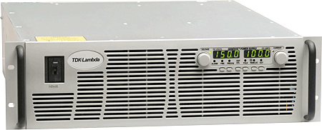
Power Supply – Intermediate
Notes:
List key interfaces with neighboring mechanical systems, IS, others
Talk about how these are being managed

Slide 9
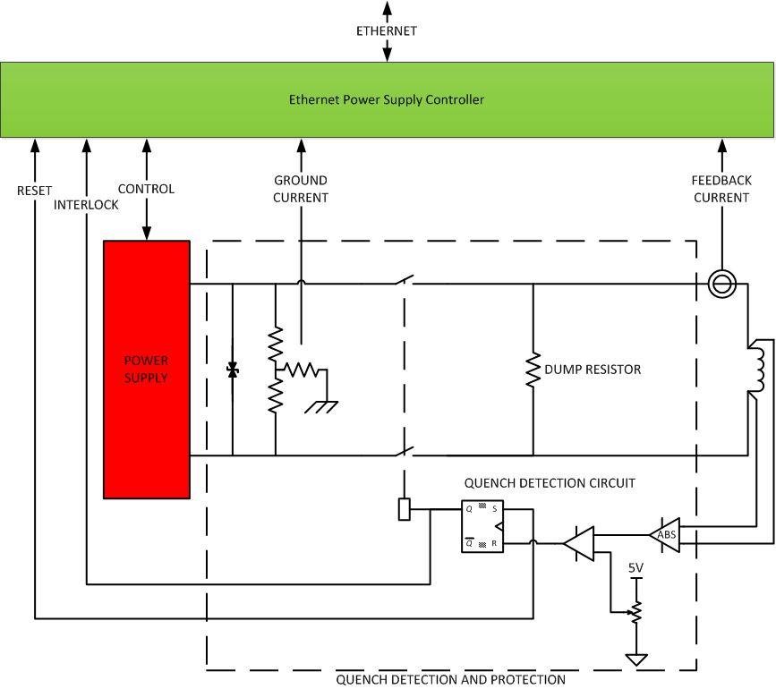
Power Supply – Intermediate Superconducting
Superconducting magnet power supply uses Intermediate topology but with added quench detection and protection circuit
Notes:
List key interfaces with neighboring mechanical systems, IS, others
Talk about how these are being managed

Slide 10
Power Supply – Ethernet Power Supply Controller
EPSC Specification | Value | Units
DAC/ADC Stability (provided by oven stabilized zener, LM399A) | < ± 0.25 | ppm/°C
Transducer Stability (off the shelf) | < ± 1 | ppm/°C
Burden Resistor Stability (Resistor TC individually characterized) | ~ ± 1 | ppm/°C
Overall Stability (typical worst case) | < ± 2.25 | ppm/°C
Error over ±15°C | 68 | ppm
Absolute error | 0.05 | %
Bandwidth (typical) | 10 | Hz
Resolution (effective) | 20 | Bits
Used where stability requirement is better than 0.01%
Typically for bends and larger quadrupoles
Higher stability requirements satisfied by:
  Controlling ambient temperature
  Select components with lower temperature coefficient
Notes:
Populate table with Typed, Doc#, Title, Status

Slide 11
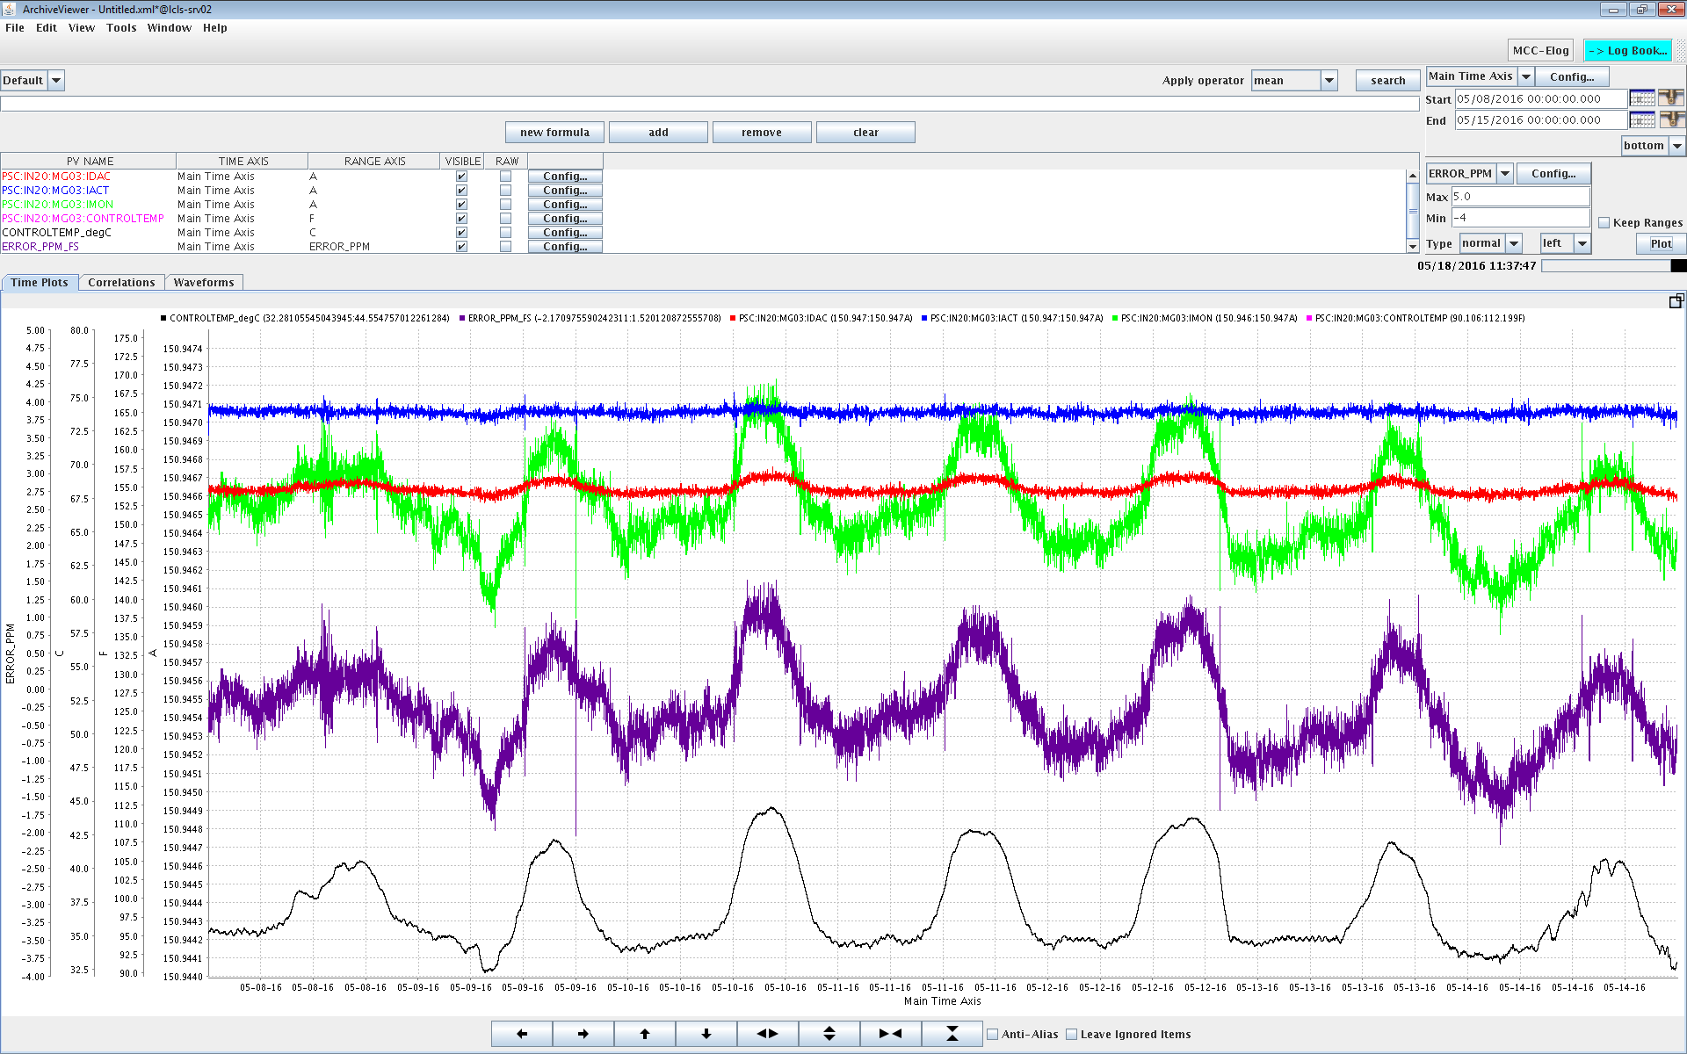
EPSC Stability – Dogleg Bend 0.3 ppm/°C (WRT FS)
I_REG
I_DAC
I_AUX
3.7 ppm
ERROR
13.3 °C
ΔT

Slide 12
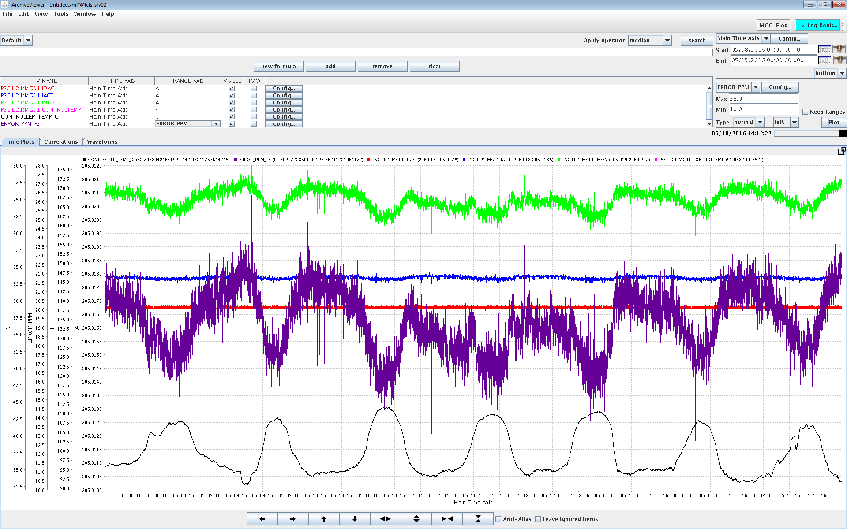
EPSC Stability – BC1 -1.2 ppm/°C (WRT FS)
I_REG
I_DAC
I_AUX
13.7 ppm
ERROR
11.4 °C
ΔT

Slide 13
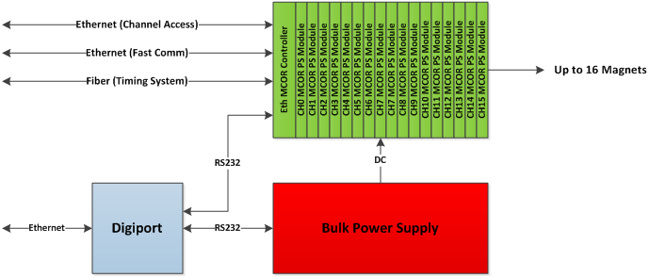
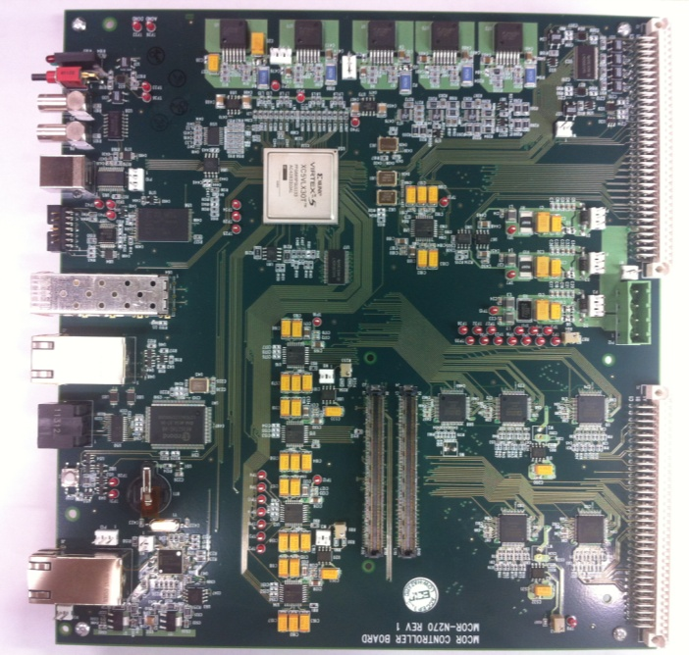
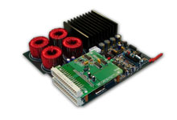
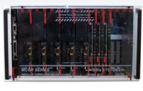
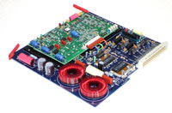
Power Supply – Trim (MCOR)
Crate Controller MCOR30 MCOR12/6/2/1
Notes:
List key interfaces with neighboring mechanical systems, IS, others
Talk about how these are being managed

Slide 14
Power Supply – MCOR Specifications
MCOR Specification | Value | Units
Stability (dominated by regulating shunt resistor) | 15 | ppm/°C
Error over ±15°C | 450 | ppm
Absolute error | 0.1 | %
Bandwidth (typical) | 10 | Hz
Bandwidth (fast feedback) | 120 | Hz
Voltage | 30-50 | V
Current | 1, 2, 6, 12, 30 | A
Resolution | 16 | bits
Used long term stability requirement is 1000 ppm, diurnal drift
Meets 100 ppm short term stability
Typically used for trims, correctors and small quadrupoles requiring power < 1.5 kW
Notes:
Populate table with Typed, Doc#, Title, Status

Slide 15
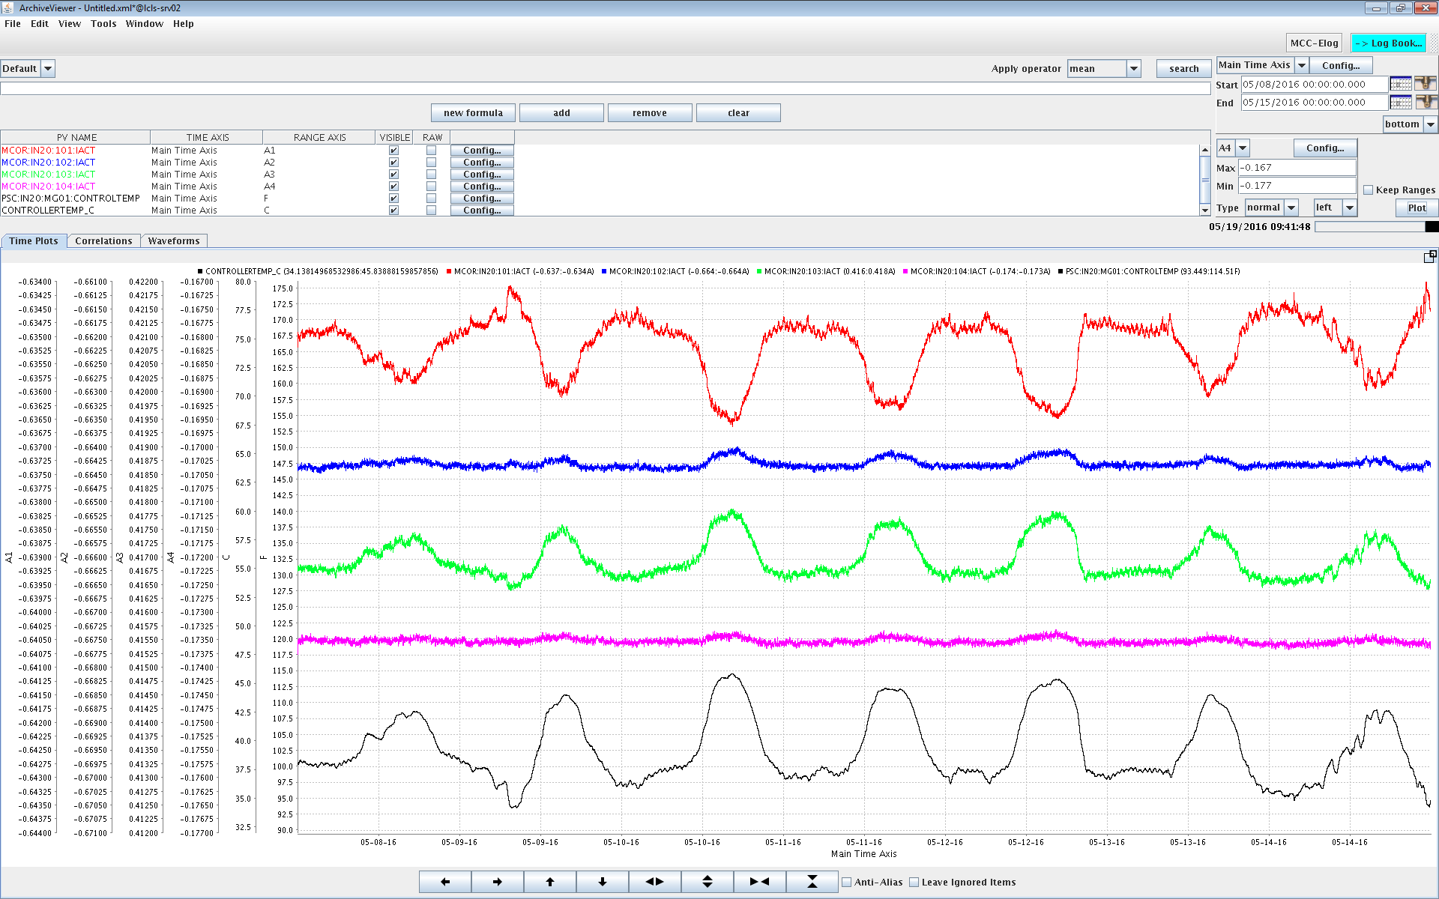
MCOR12 Stability – 1.7 to 21 ppm/°C (WRT FS)
250 ppm
21 ppm/°C
40 ppm
3.4 ppm/°C
166 ppm
13 ppm/°C
20 ppm
1.7 ppm/°C
11.7 °C
ΔT

Slide 16
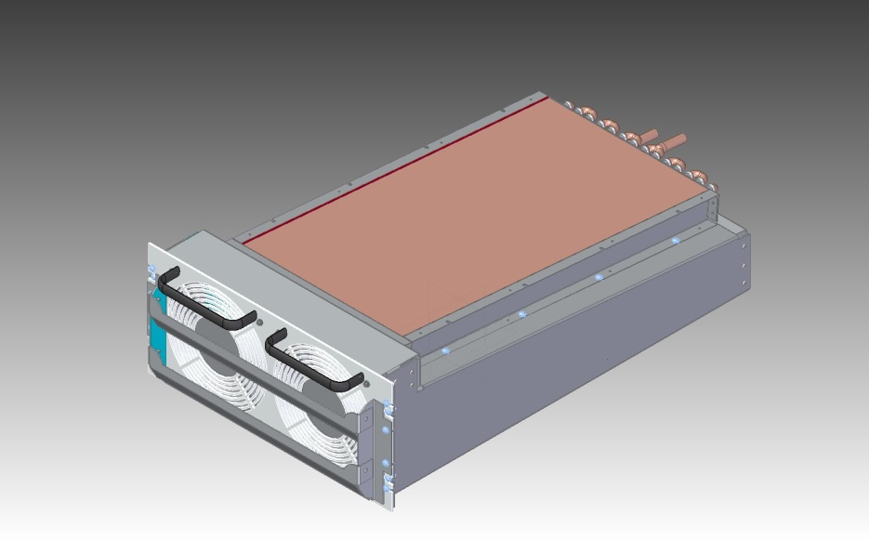
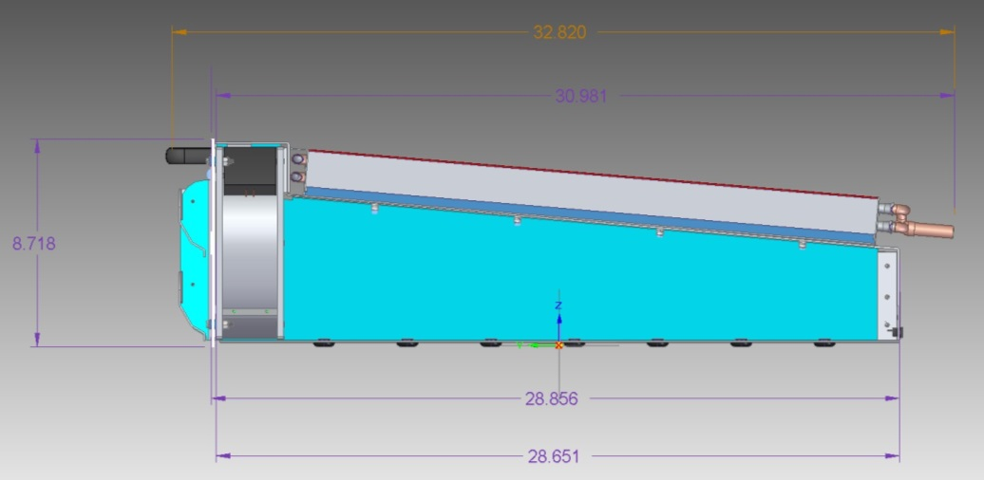
Power Supply Design – Rack Heat Exchanger
Racks in the LINAC will use sealed water cooled racks to keep equipment clean. Heat exchanger designed and tested to remove 3kW.

Slide 17
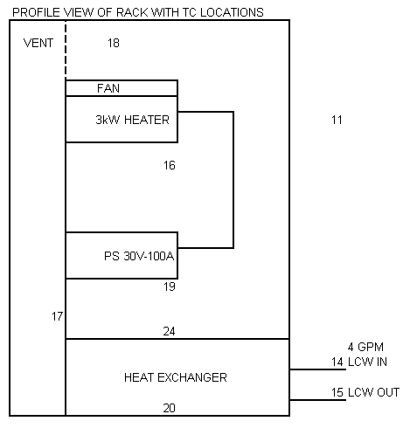
Power Supply – Rack Heat Exchanger Test
 | Ambient | Supply LCW | Return LCW | Inside HX Box | Front Bottom | Inside Top | Inside Heater | Inside Middle | Inside Bottom
TC Channel | 11 | 14 | 15 | 20 | 17 | 18 | 16 | 19 | 24
Avg Temp °C | 26.6 | 30.4 | 33.1 | 34.2 | 35.3 | 35.0 | 50.2 | 35.8 | 46.6
Water flow rate | 4 gpm
Water deltaT | 2.71 °C
Water Power | 2857 W
Heater Power | 3000 W
Efficiency | 95%
Heat Exchanger dT | 12.4 °C

Slide 18
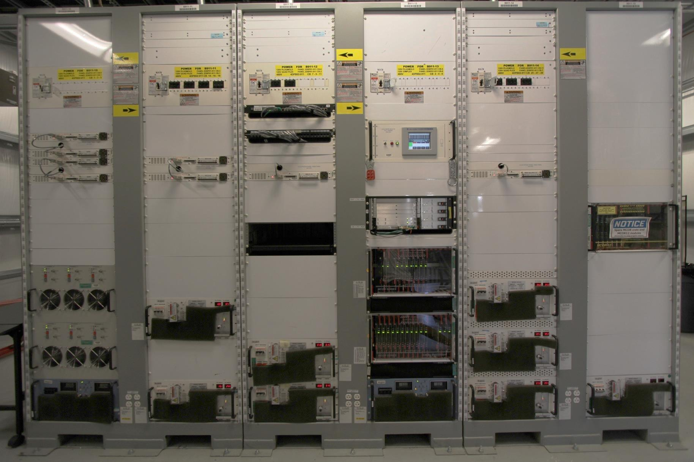
Power Supply – Existing Installation LCLS-I

Slide 19
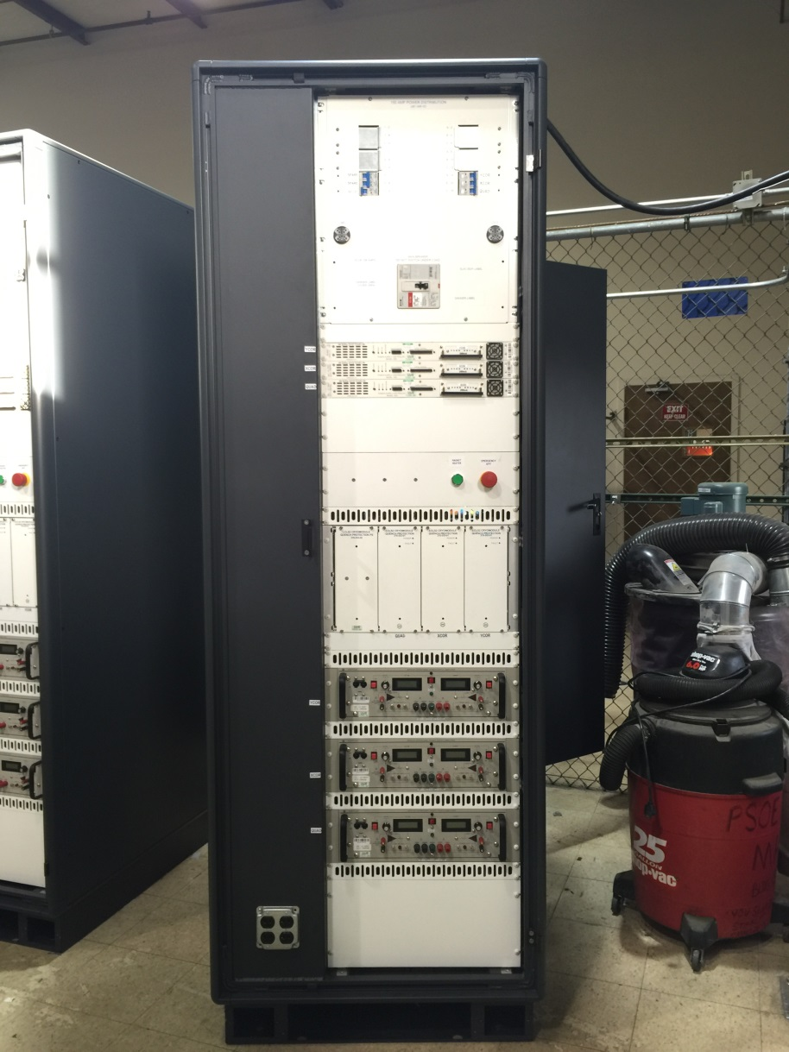
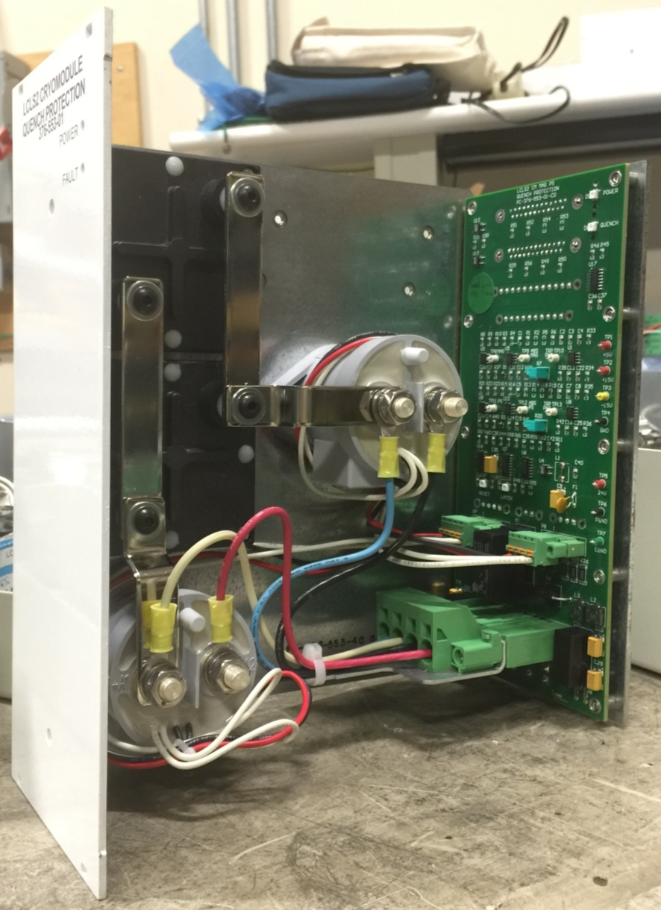
Power Supply Design - Superconducting
Notes:
List key interfaces with neighboring mechanical systems, IS, others
Talk about how these are being managed

Slide 20
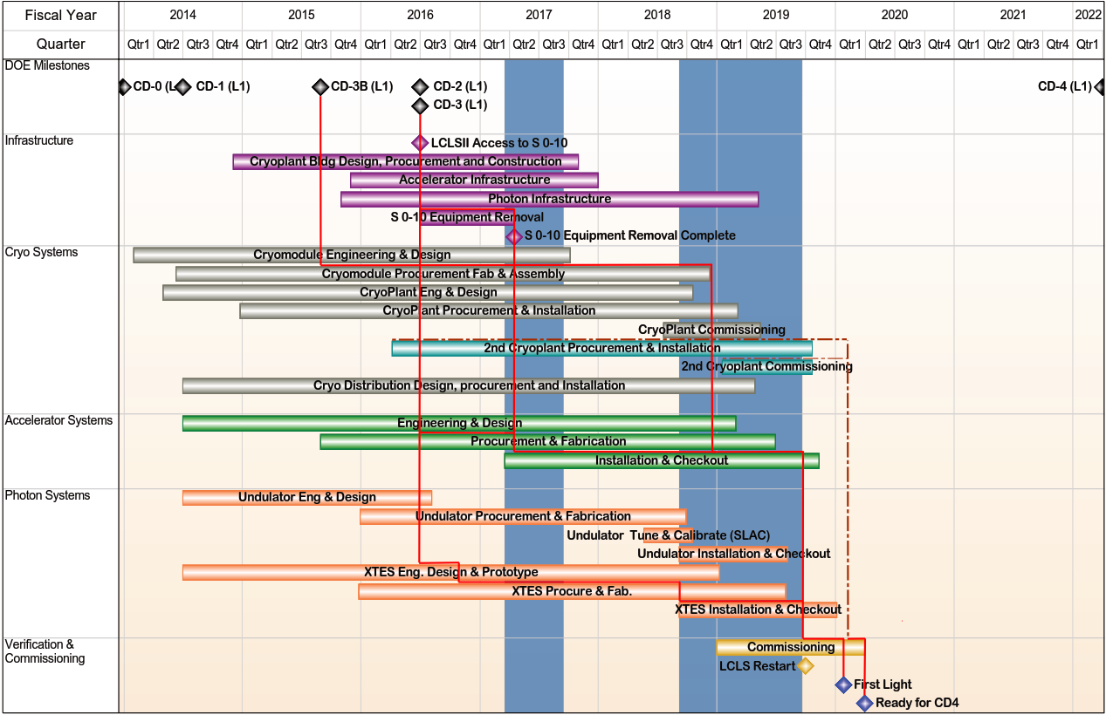
LCLS-II Summary Schedule and Critical Path
Notes:
Cu linac turn-on

Slide 21
Summary
Magnet power supply designs for LCLS-II
Performance satisfies LCLS-II requirements
  Ethernet Power Supply Controller (EPSC) used where stability is more demanding and for higher power magnets
  MCORs used where stability is less demanding and for low power magnets
Procurement has begun
Installation begins June 2018
First Light in October 2019
Notes:
List and elaborate on applicable lessons learned

Slide 22
End

Slide 23
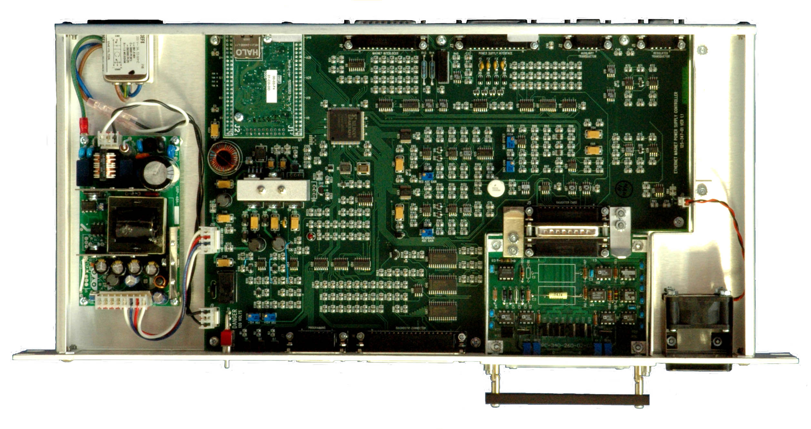
Power Supply Design – Intermediate EPSC

Slide 24
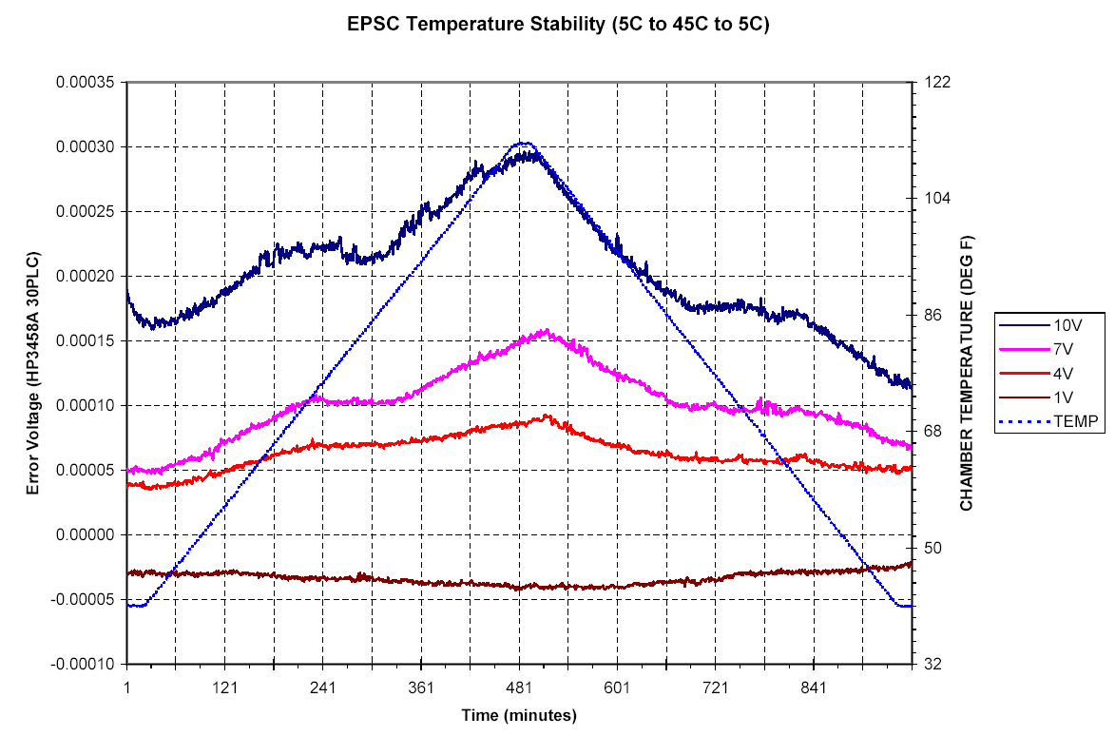

Slide 25
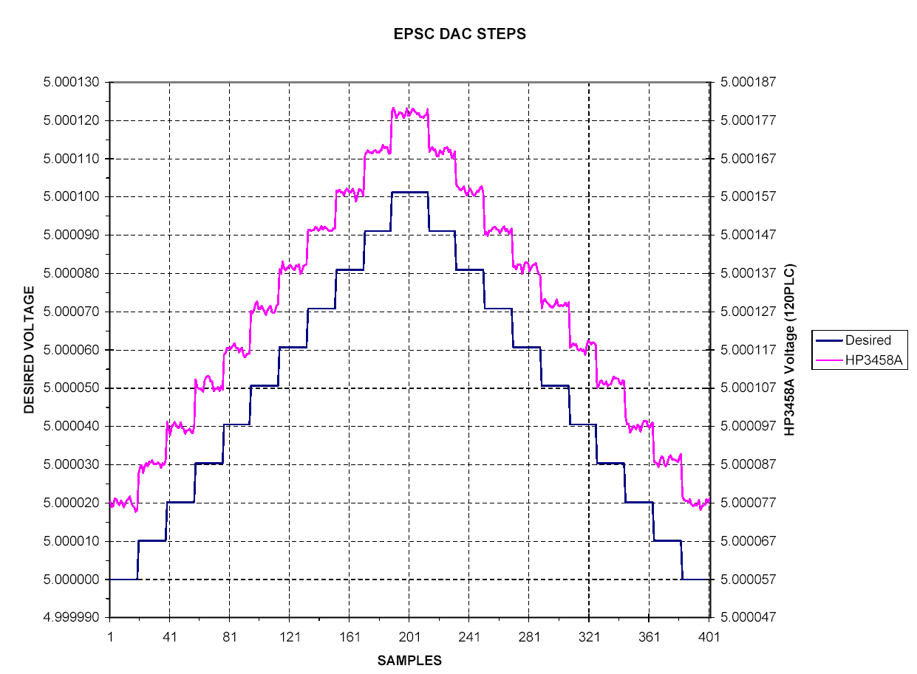

Slide 26
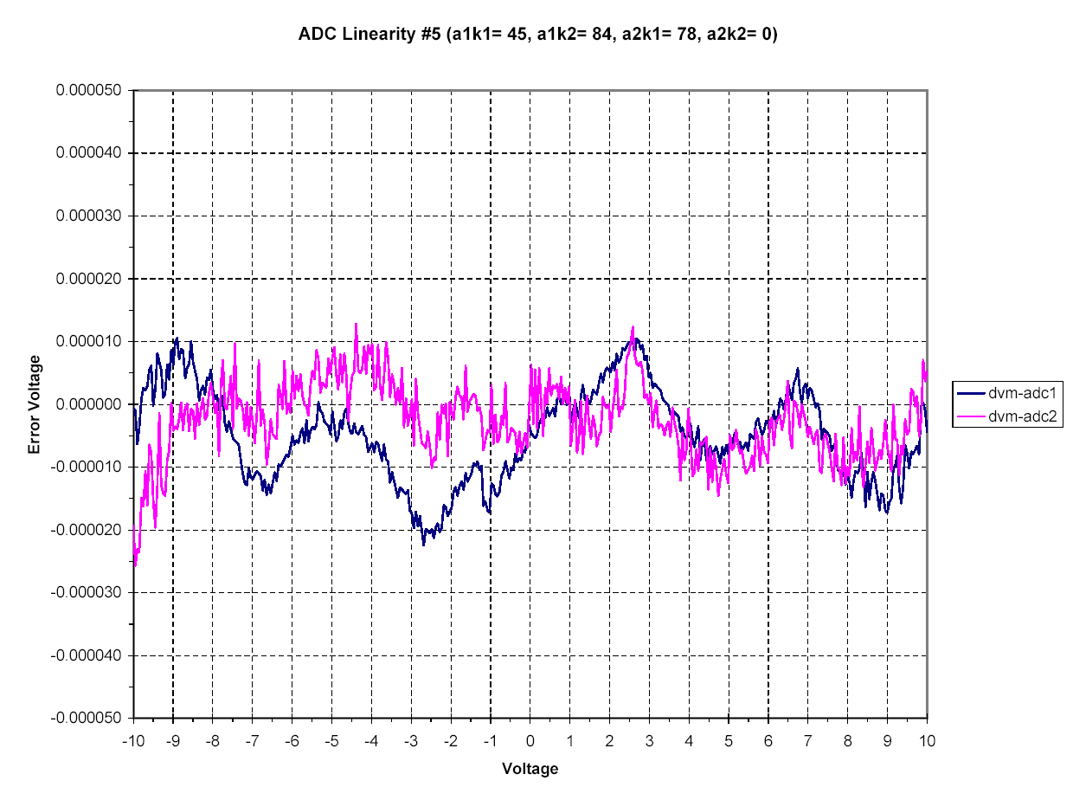

Slide 27
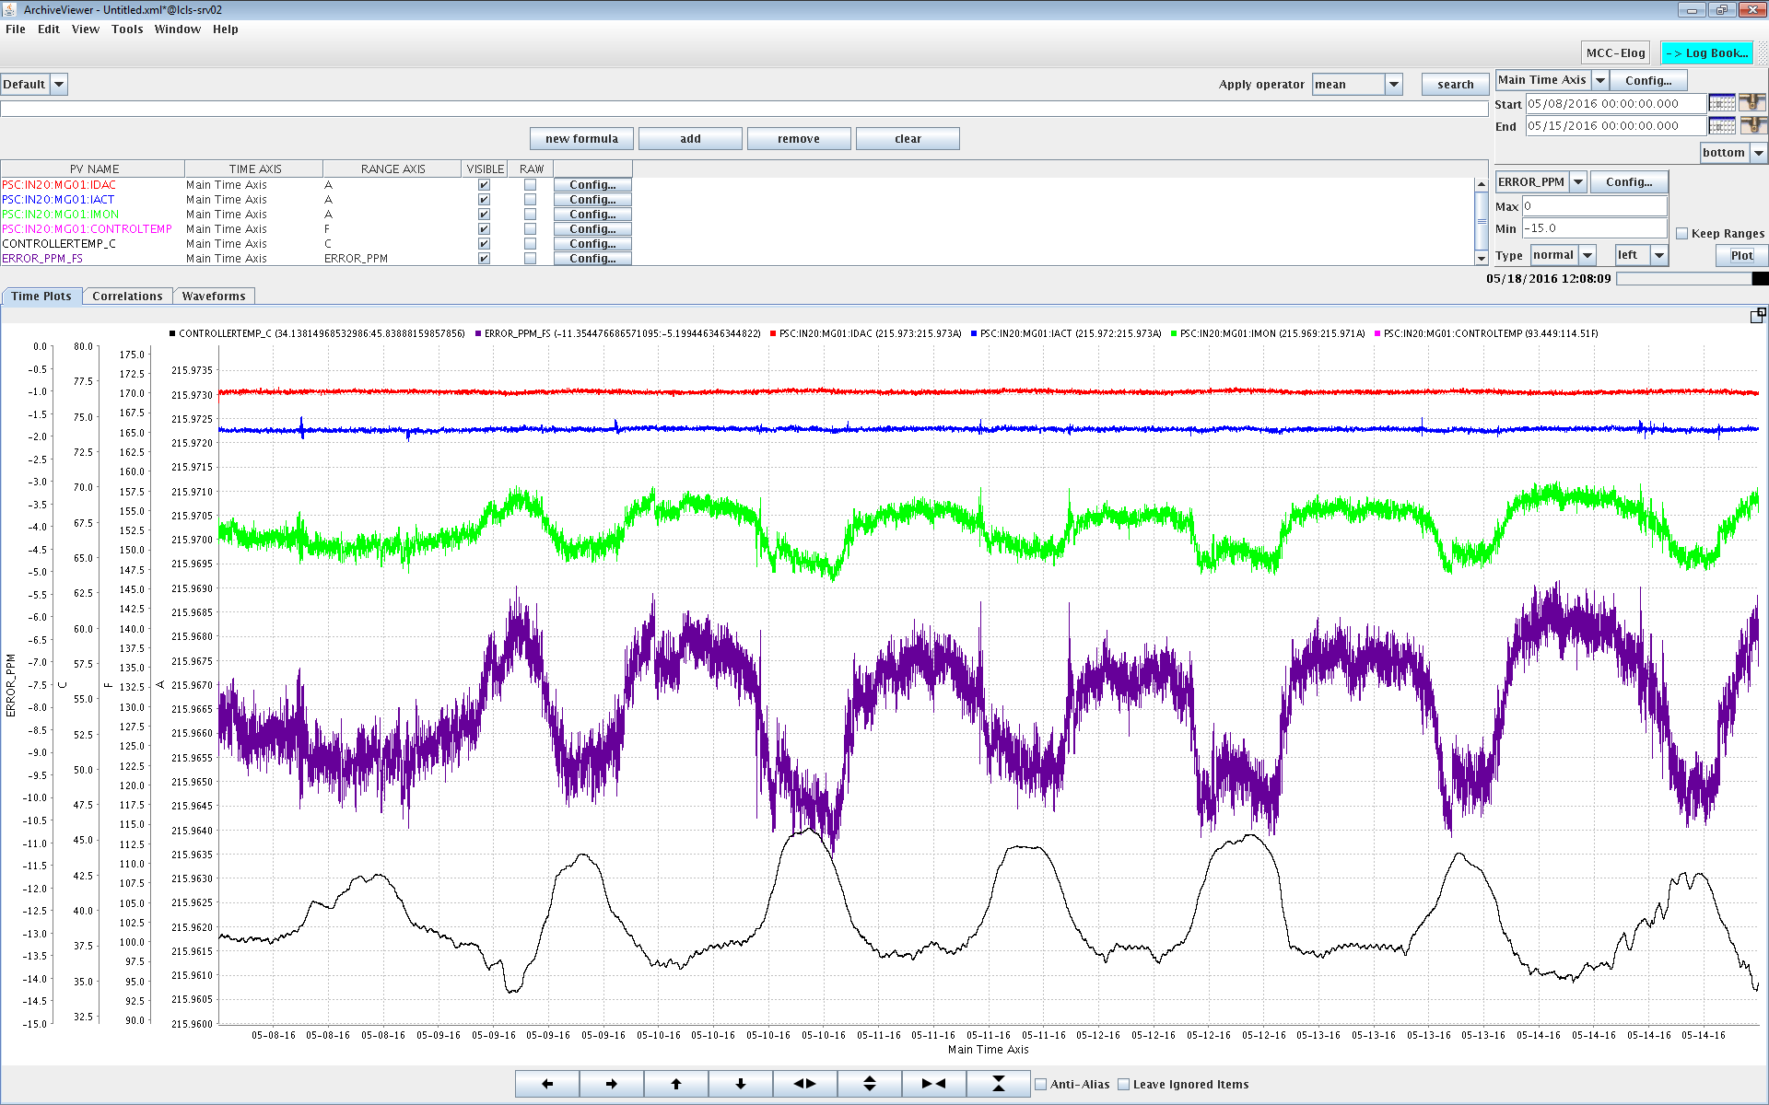
EPSC Stability – LH Chicane 0.5 ppm/°C (WRT FS)
I_REG
I_DAC
I_AUX
6.2 ppm
ERROR
11.7 °C
ΔT

Slide 28
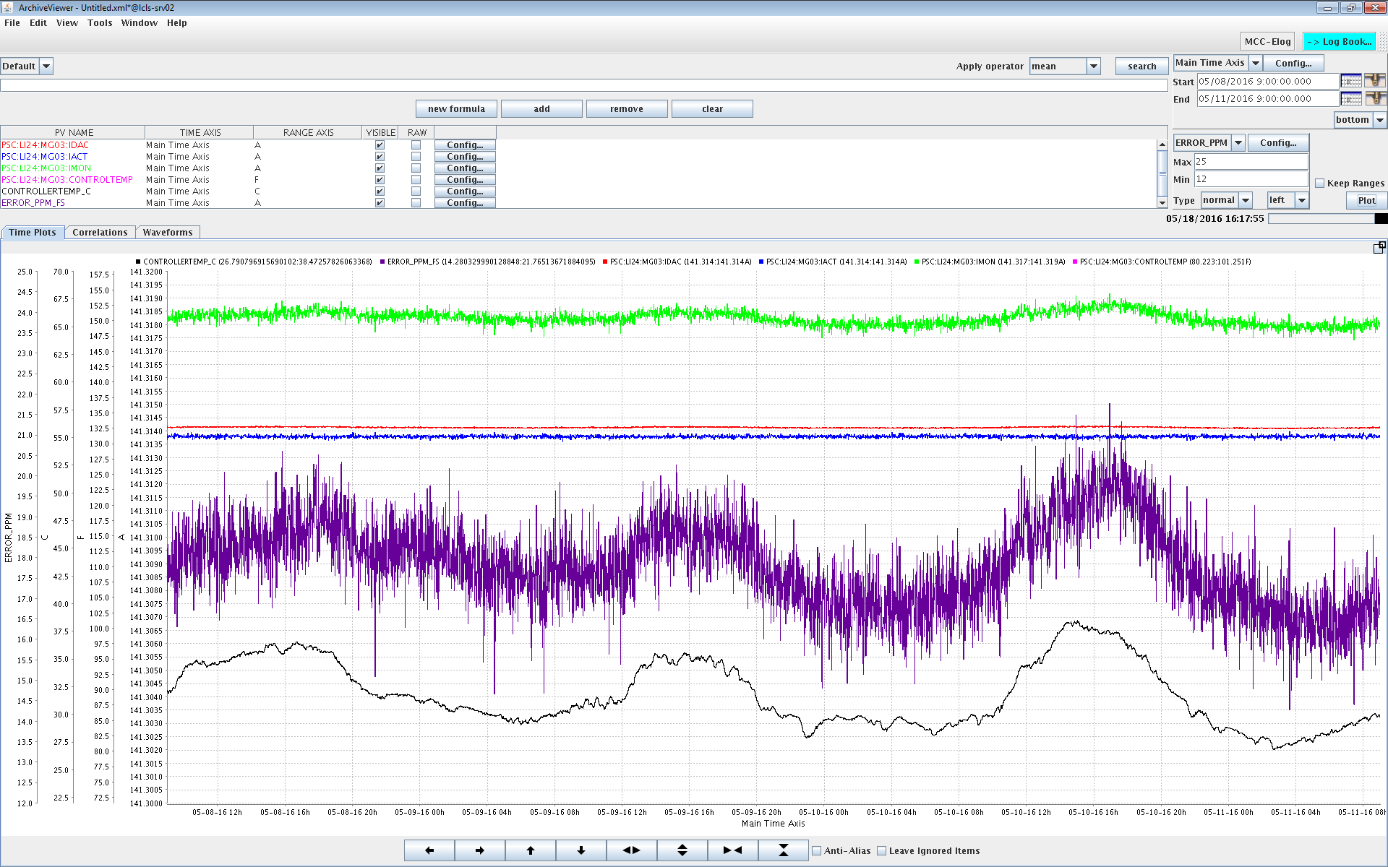
EPSC Stability – BC2 0.6 ppm/°C (WRT FS)
I_REG
I_DAC
I_AUX
7.5 ppm
ERROR
11.7 °C
ΔT

Slide 29
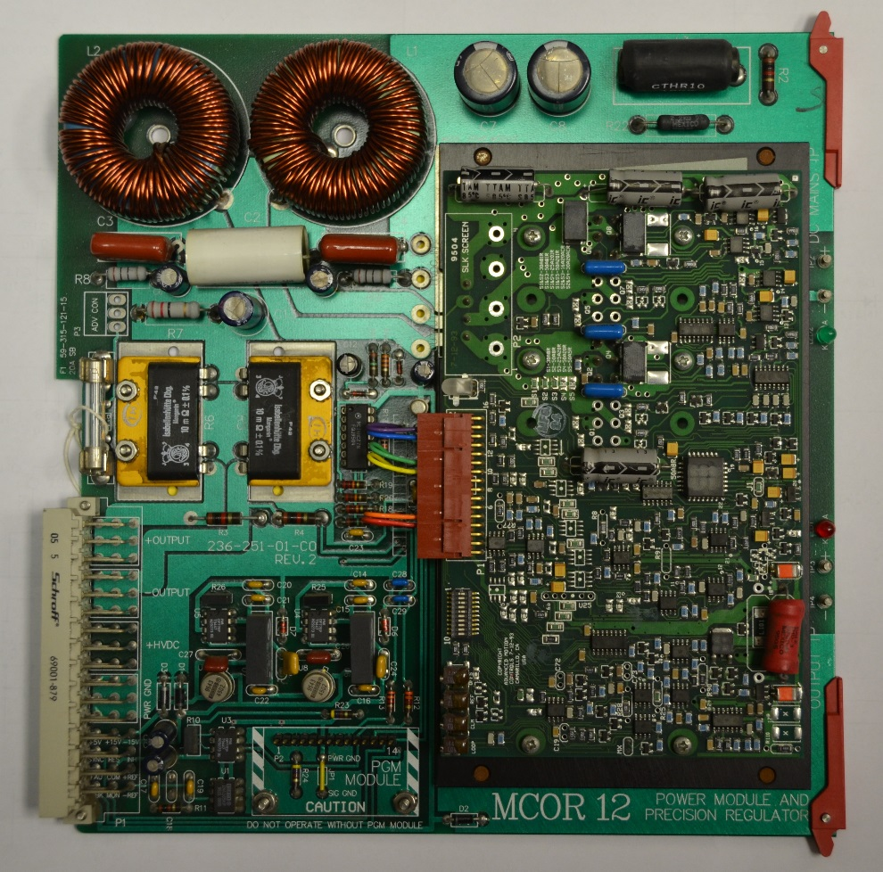
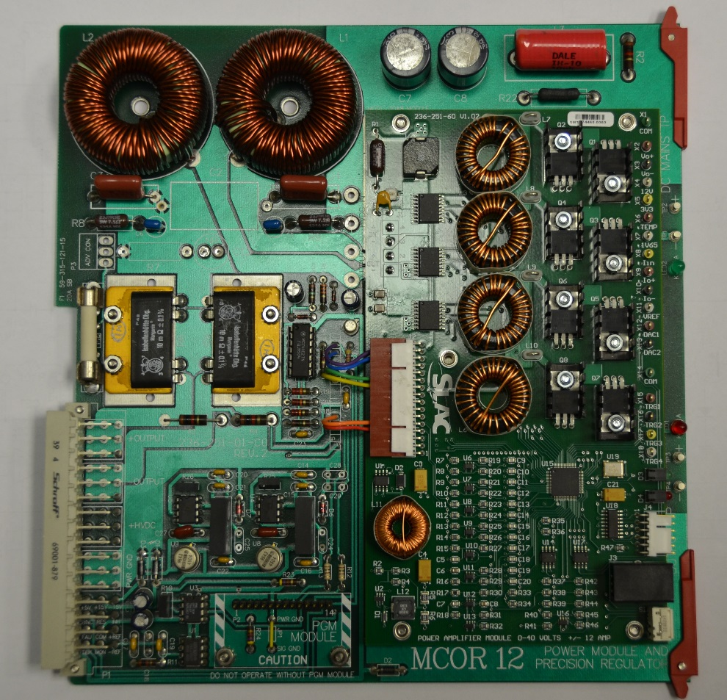
Power Supply – MCOR Old and New
With new Power Amplifier
And Modified Output Filter
MCOR 12 Module

Slide 30
Power Supply – MCOR 120 Hz
Fast Feedback
Step Response
106 mH Load Inductance
Stainless Steel Beam Pipe
480 mA Step
Settles in 6 milliseconds
Switch = 9 (no attenuation)
Custom Daughterboard
Blue Output Current 120 mA/div
Red Output Voltage 5 Volt/div
Green Coil in SS beam pipe

Slide 31
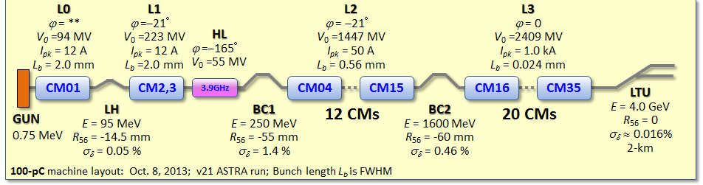
Overview – LCLS-II Layout
proposed
FACET-II
LCLS-I Linac
2.5-15 GeV
LCLS-II Linac
0.2-1.3 keV (1 MHz)
Sec. 11-20
Sec. 21-30
SXU
SCRF
HXU
4 GeV
1-25 keV (120 Hz)
1-5 keV (1 MHz)

