Slide 1
New active filter for COSY dipole power converter
May 29, 2016 | Markus Retzlaff & Christian Ehrlich
Many thanks for the support of the IKP-4 Members, FZJ BoD and the HGF Members

Slide 2
Summery
Power converter overview
Interaction between thyristor- & parallel feeding- stage
Development steps for the new parallel feeding, by Markus Retzlaff & Christian Ehrlich
Development of the new transistor driver, by Christian Ehrlich
Development of the new linear stage, by Markus Retzlaff

Slide 3
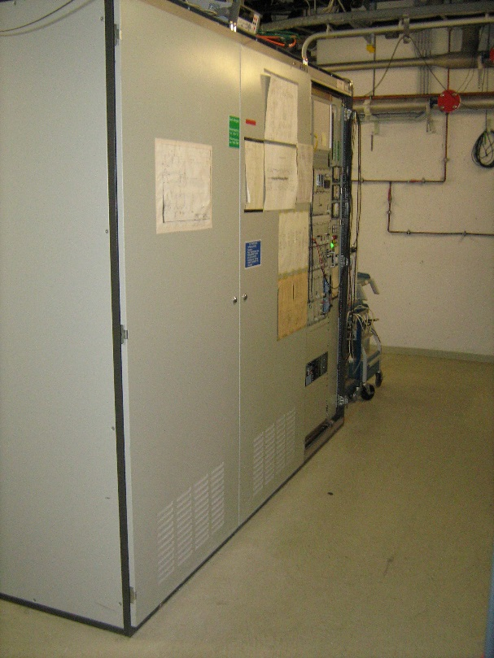
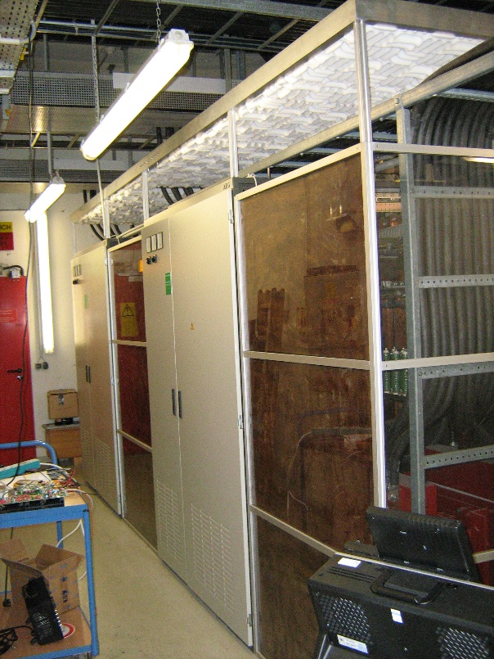
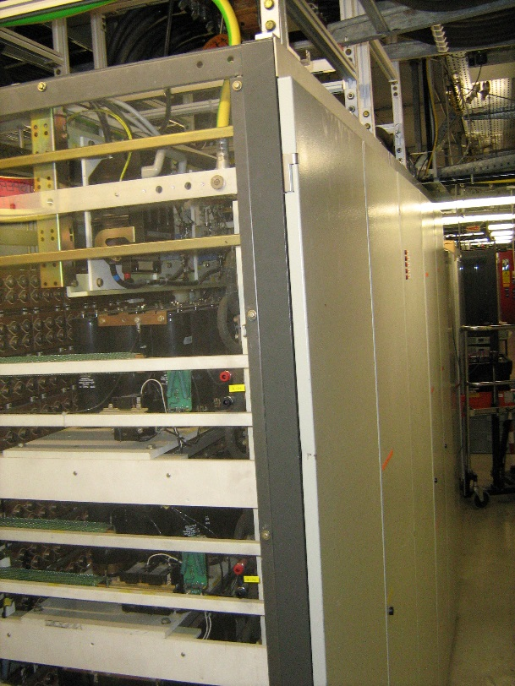
Power converter overview
control cabinet thyristor cabinet parallel feeding
2600 x 2200 x 850 mm 5200 x 2200 x 1200 mm 3000 x 2200 x 900 mm

Slide 4
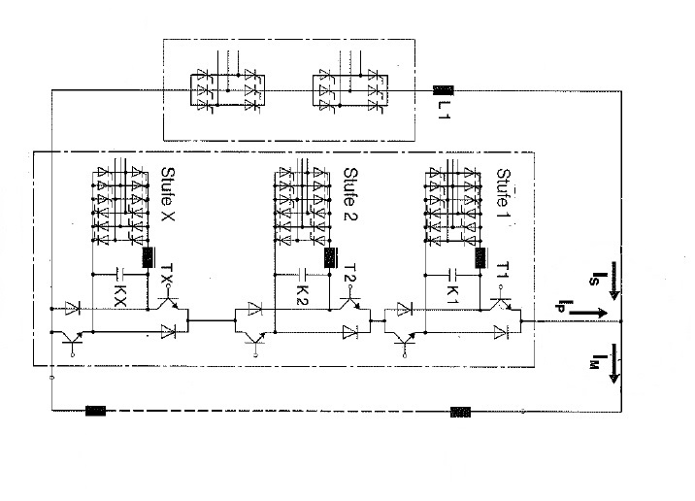
Power converter overview
output current 5000 A (20ppm), output voltage 1250 V, 6.25 MW
Thyrister
stage
Parallel feeding
COSY dipole magnets 24 (25)

Slide 5
Power converter overview
Interaction between thyristor- & parallel feeding- stage
Development steps for the new parallel feeding, by Markus Retzlaff & Christian Ehrlich
Development of the new transistor driver, by Christian Ehrlich
Development of the new linear stage, by Markus Retzlaff

Slide 6
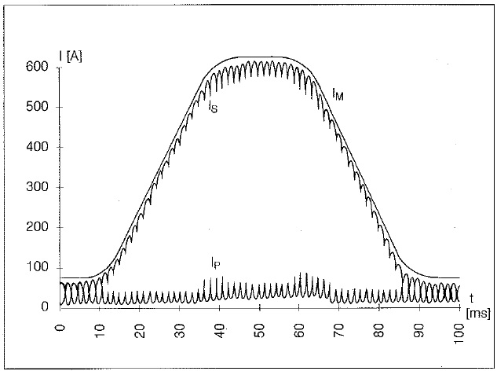
Interaction between thyristor- & parallel feeding- stage
Main Current
IM = IS + IP
Thyristor Current
IS
Prallel feeding Current
IP

Slide 7
Power converter overview
Interaction between thyristor- & parallel feeding- stage
Development steps for the new parallel feeding, by Markus Retzlaff & Christian Ehrlich
Development of the new transistor driver, by Christian Ehrlich
Development of the new linear stage, by Markus Retzlaff

Slide 8
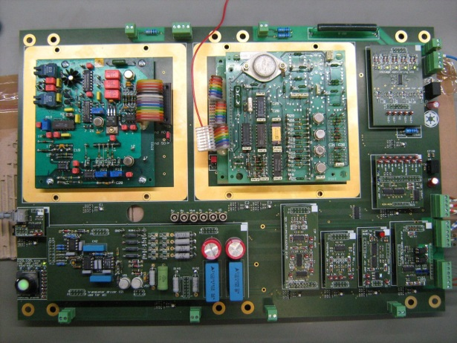
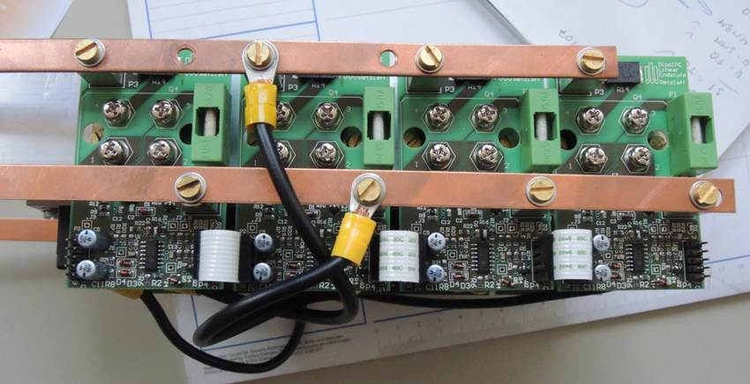
Development steps for the new parallel feeding
by Christian Ehrlich
Extension for the new linear stage
New transistor gate driver
by Markus Retzlaff
New linear stage
New active filter structure

Slide 9
Power converter overview
Interaction between thyristor- & parallel feeding- stage
Development steps for the new parallel feeding, by Markus Retzlaff & Christian Ehrlich
Development of the new transistor driver, by Christian Ehrlich
Development of the new linear stage, by Markus Retzlaff

Slide 10
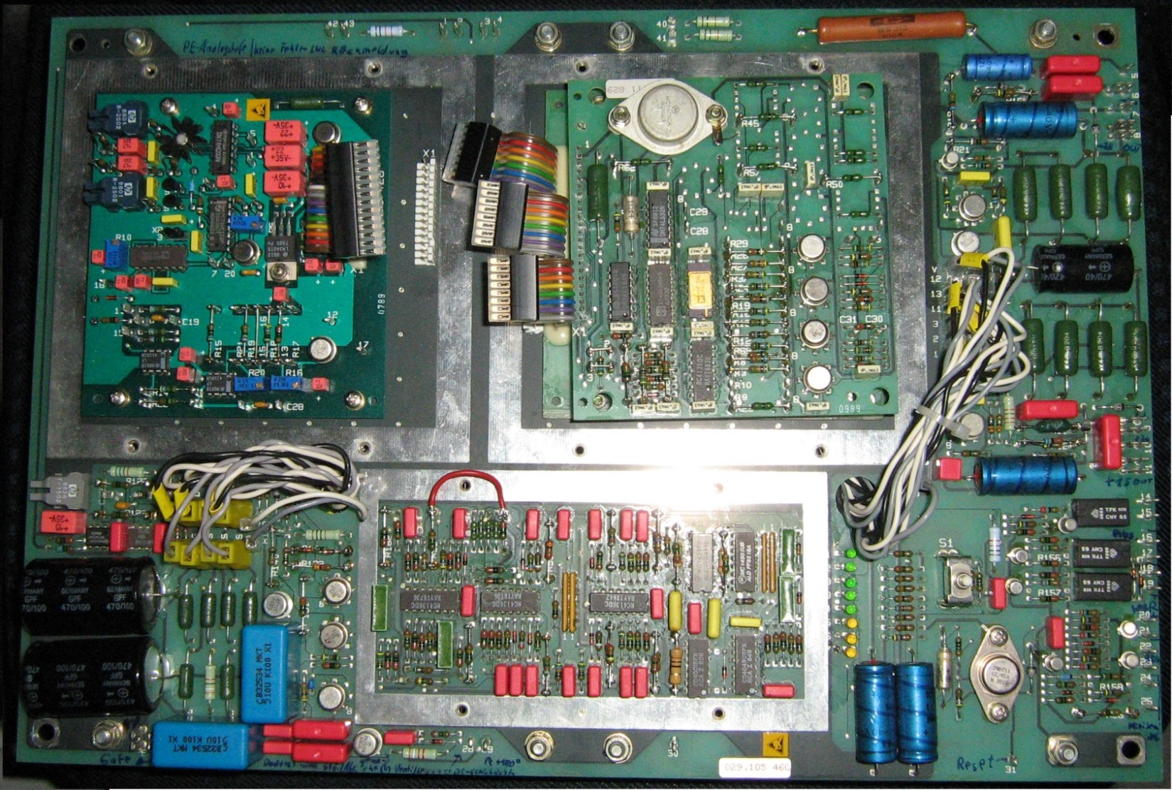
The old transistor driver from 1988
Four versions: 029.105.454 (switch stage „oben“), 029.105.546 (switch stage „unten“), 029.105.458 (analog stage „oben“), 029.105.460 (analog stage „unten“)

Slide 11

The new transistor driver
One Mainboard for all versions. Setting with selector switch

Slide 12
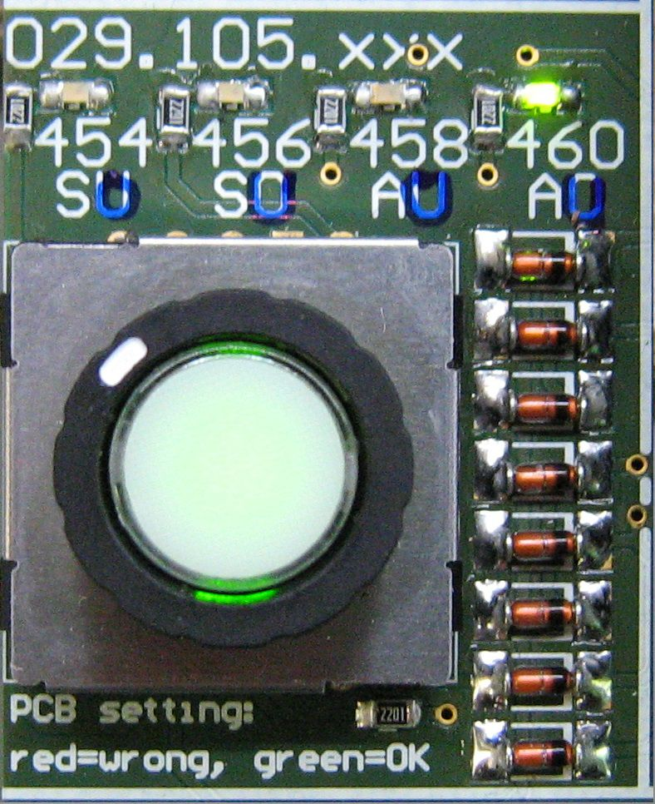
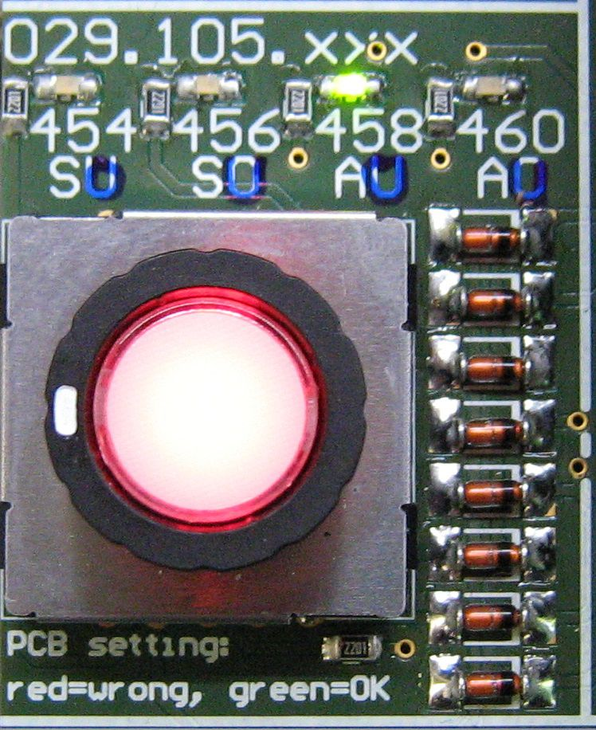
Global pcb setting indicator & switch
PCB setting idicator
PCB setting switch (one Mainboard for all four old versions)

Slide 13
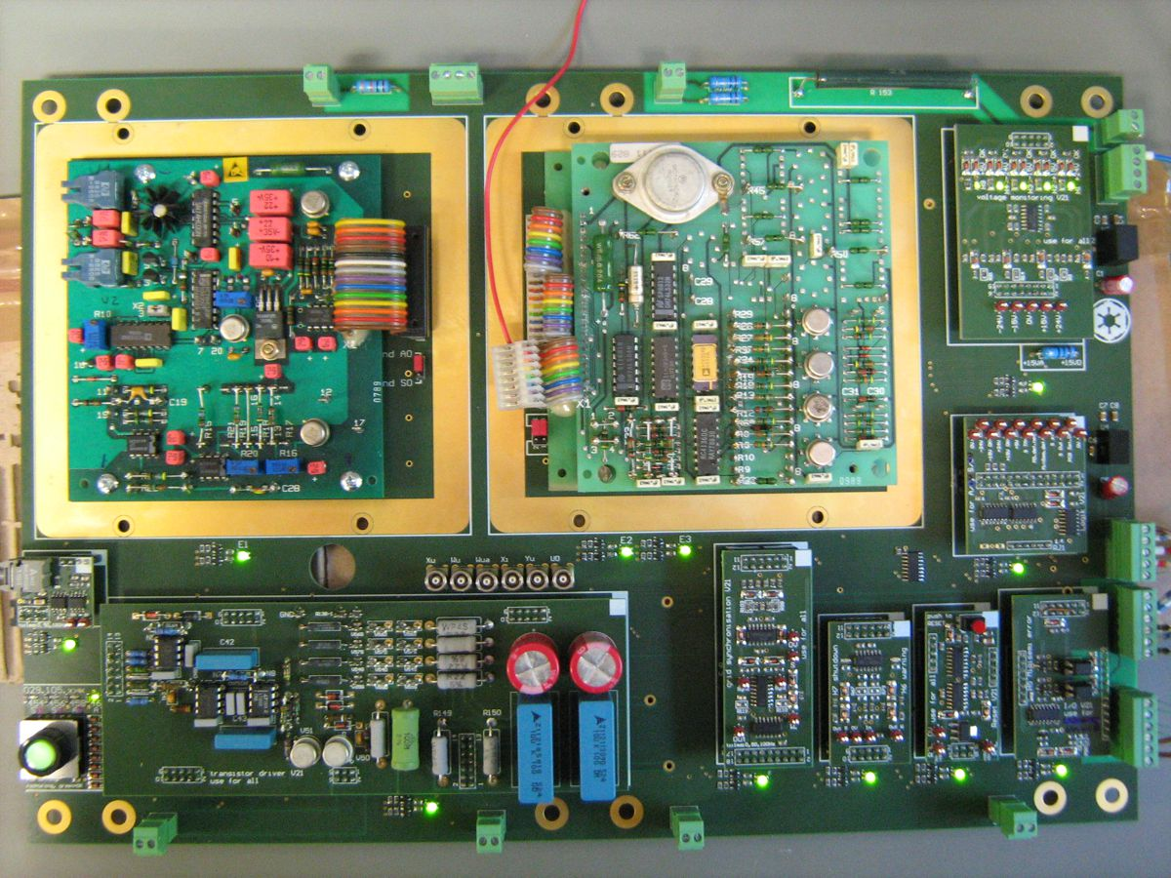
Single pcb setting idicator, „OK“

Slide 14
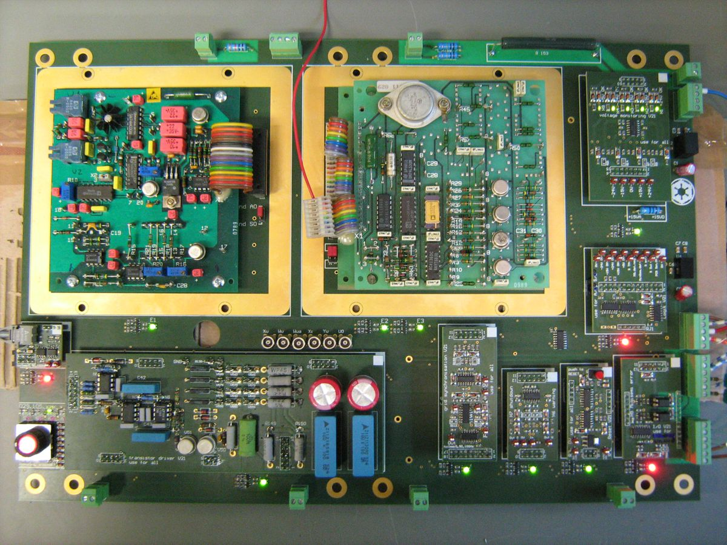
Single pcb setting idicator, „wrong“

Slide 15
Major functions
The new transistor driver must have the same seven major functions:
Voltage monitoring
Grid synchronisation
Fiber optic communication
IO-Ports
Transistor monitoring
Reset driver
Transistor gate driver (BUZ45)
Logic for interlocks

Slide 16
Module functions
Voltage monitoring
Grid synchronisation
Fiber optic communication
IO-Ports
Transistor gate driver (BUZ45)
Transistor monitoring
Reset driver
Logic for interlocks

Slide 17
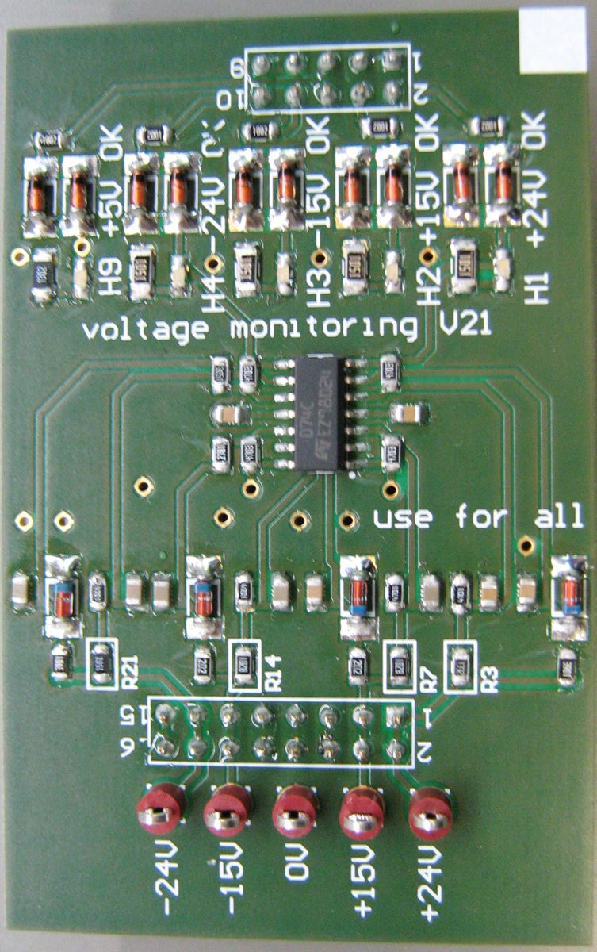
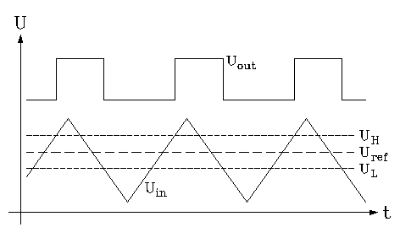
Voltage monitor
Status display
Measuring points

Slide 18
Module functions
Voltage monitoring
Grid synchronisation
Fiber optic communication
IO-Ports
Transistor gate driver (BUZ45)
Transistor monitoring
Reset driver
Logic for interlocks

Slide 19
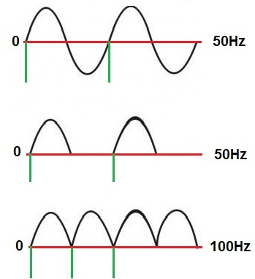
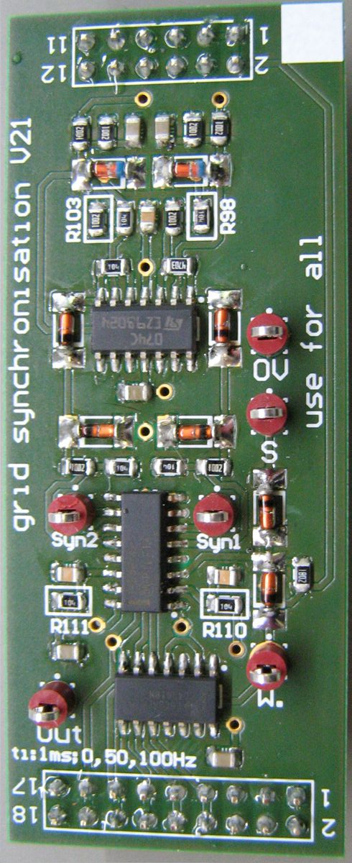
Grid synchronisation
20ms
warning
10ms
10ms
normal operation

Slide 20
Module functions
Voltage monitoring
Grid synchronisation
Fiber optic communication
IO-Ports
Transistor gate driver (BUZ45)
Transistor monitoring
Reset driver
Logic for interlocks

Slide 21
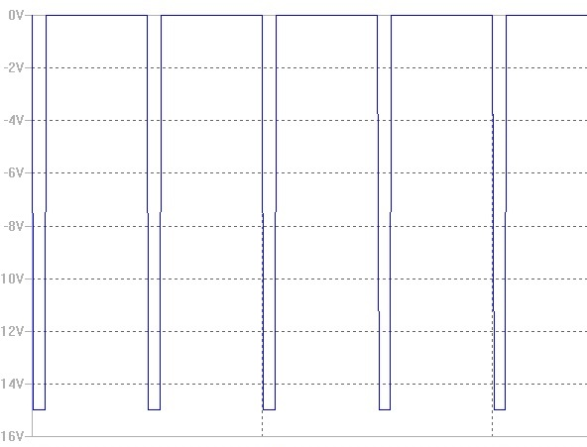
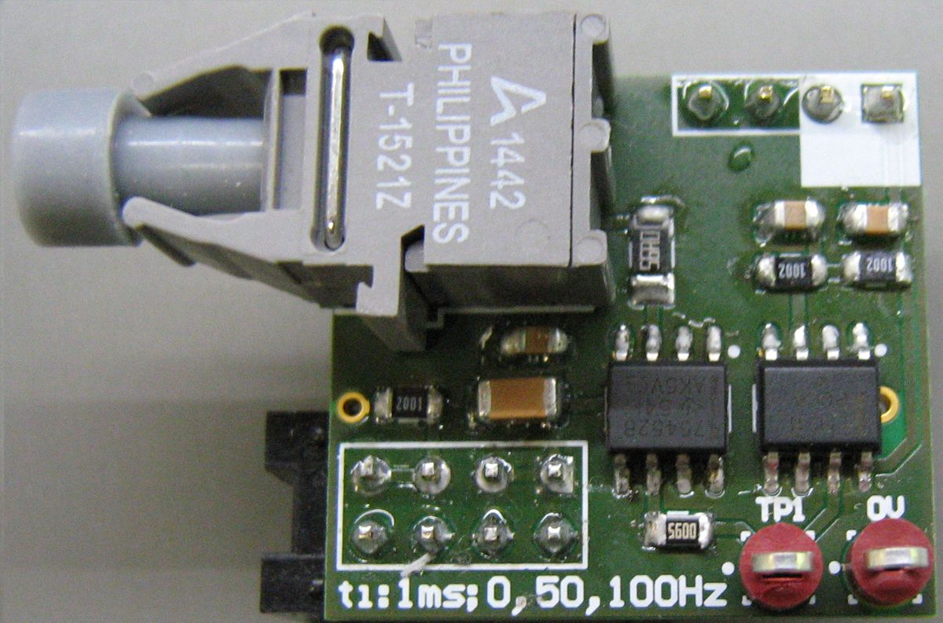
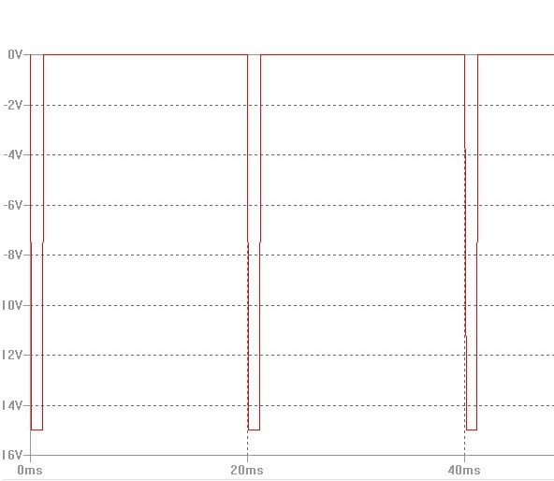
Fiber optic communication
10ms = normal operation
LWL
20ms = warning
Testpoints
> 20ms = shutdown

Slide 22
Module functions
Voltage monitoring
Grid synchronisation
Fiber optic communication
IO-Ports
Transistor gate driver (BUZ45)
Transistor monitoring
Reset driver
Logic for interlocks

Slide 23
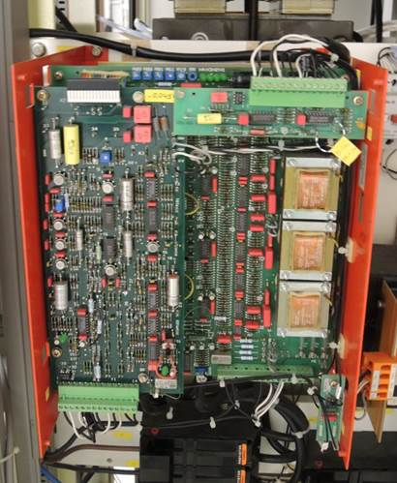
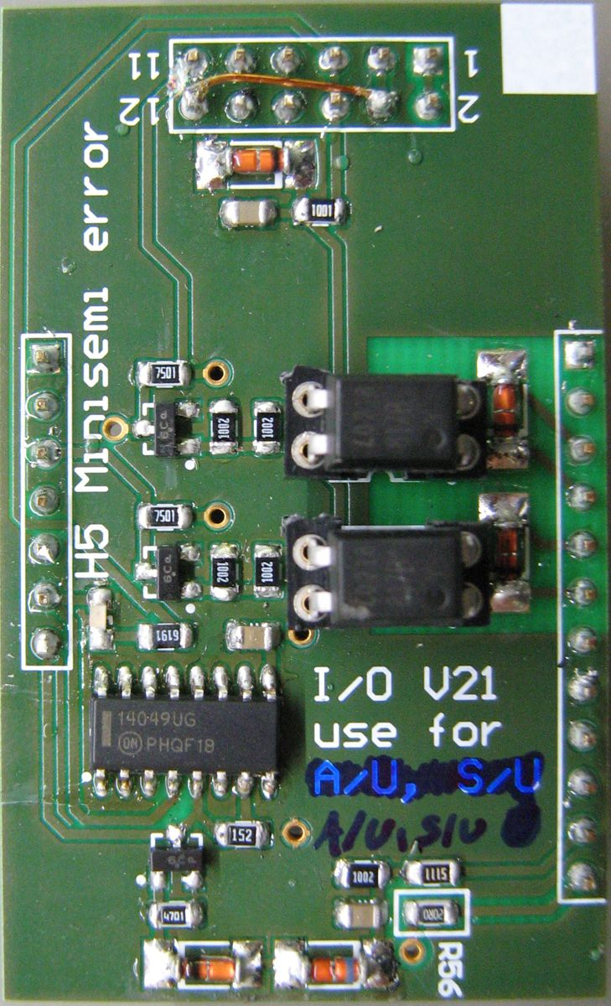
Input ports and MiniSemi monitoring
Version „unten“ (down)
MiniSemi for the intermediate circuit

Slide 24
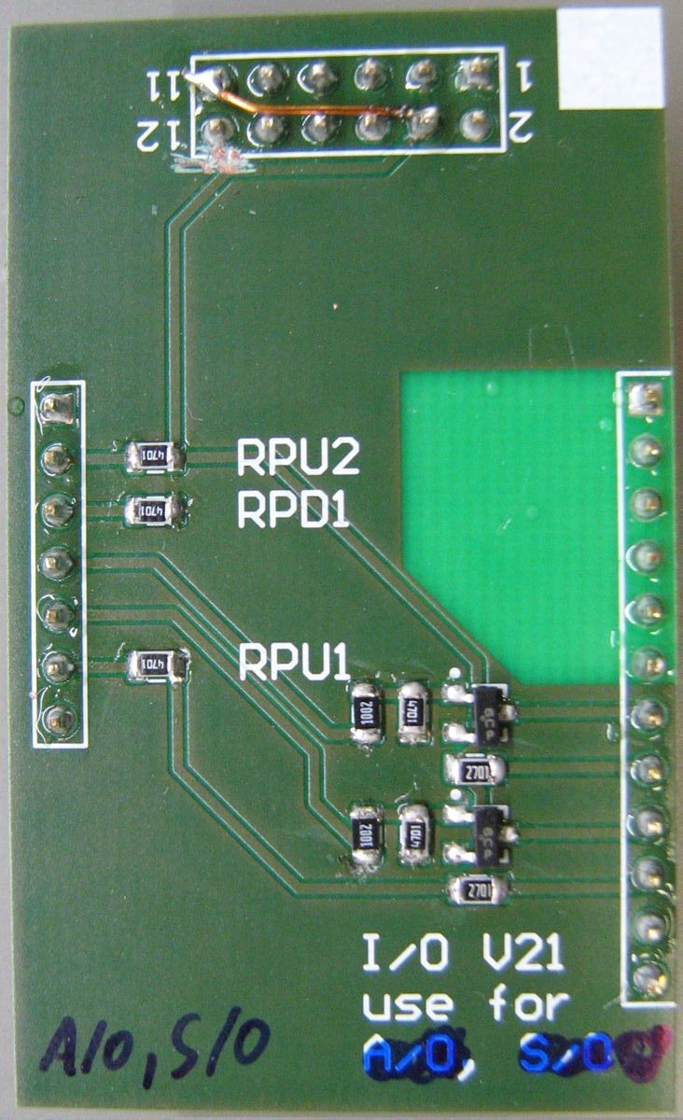
Output ports
Version „oben“ (up)
LWL
wire
warning
shutdown
Transistor gate driver „unten“
Transistor gate driver „oben“
Warning output
Shutdown output

Slide 25
Module functions
Voltage monitoring
Grid synchronisation
Fiber optic communication
IO-Ports
Transistor gate driver (BUZ45)
Transistor monitoring
Reset driver
Logic for interlocks

Slide 26
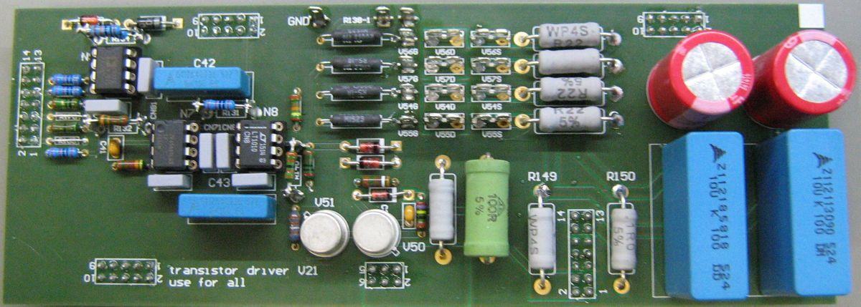
Transistor gate driver
Gate connection to 384 BUZ45 transistors

Slide 27
Module functions
Voltage monitoring
Grid synchronisation
Fiber optic communication
IO-Ports
Transistor gate driver (BUZ45)
Transistor monitoring
Reset driver
Logic for interlocks

Slide 28
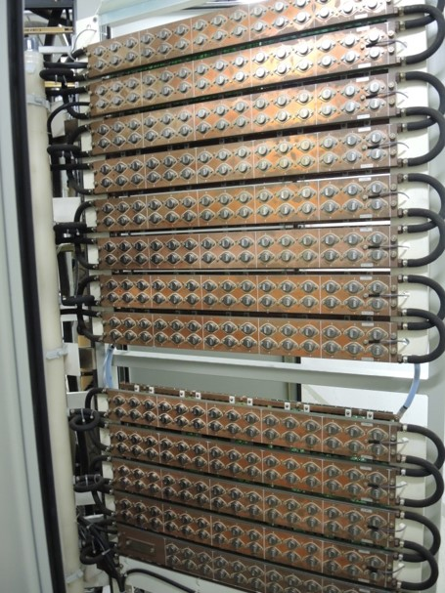
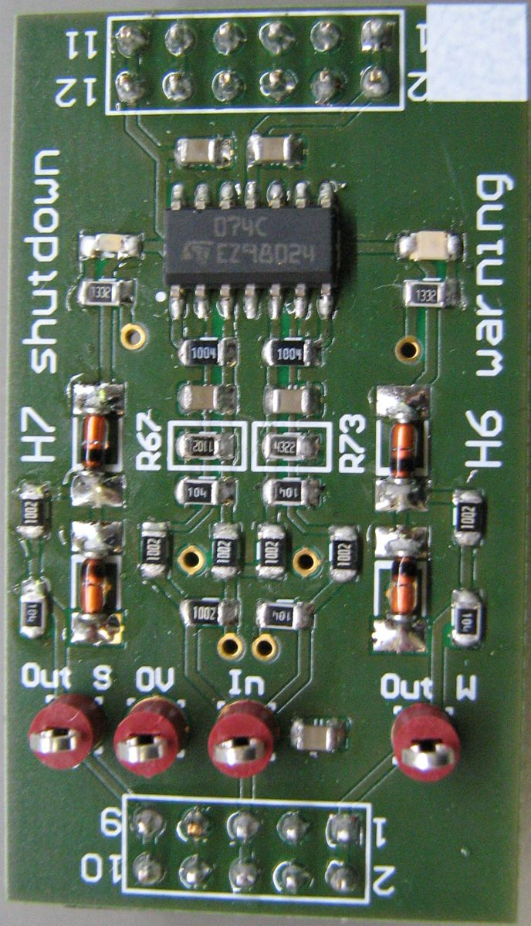
Transistor monitoring
One of the transistor holders
384 BUZ45 Transistors
128 transistor groups (6 in each group)
shutdown =
3 groups failure
warning =
1 group failure
1750 mm
1100 mm

Slide 29
Module functions
Voltage monitoring
Grid synchronisation
Fiber optic communication
IO-Ports
Transistor gate driver (BUZ45)
Transistor monitoring
Reset driver
Logic for interlocks

Slide 30
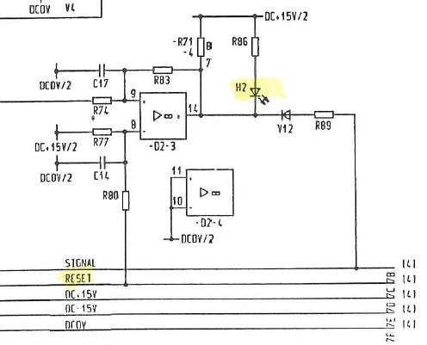
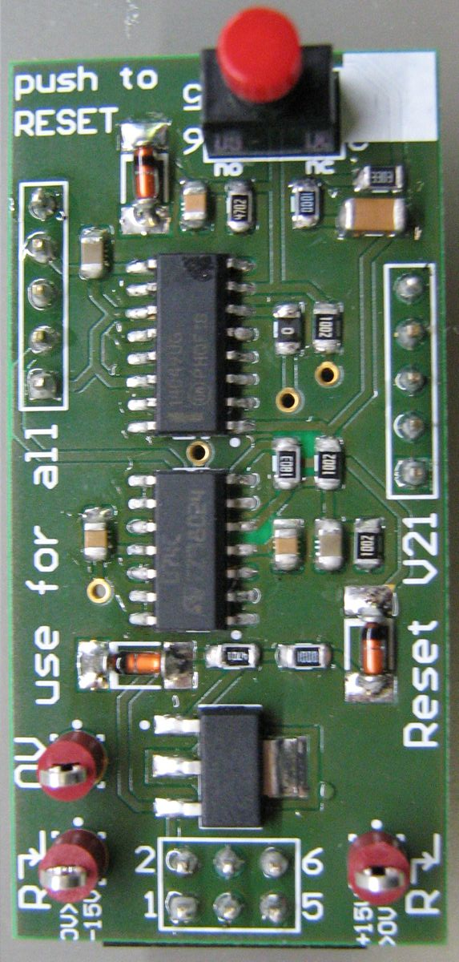
Reset driver
Single transistor group monitoring
error memory

Slide 31
Module functions
Voltage monitoring
Grid synchronisation
Fiber optic communication
IO-Ports
Transistor gate driver (BUZ45)
Transistor monitoring
Reset driver
Logic for interlocks

Slide 32
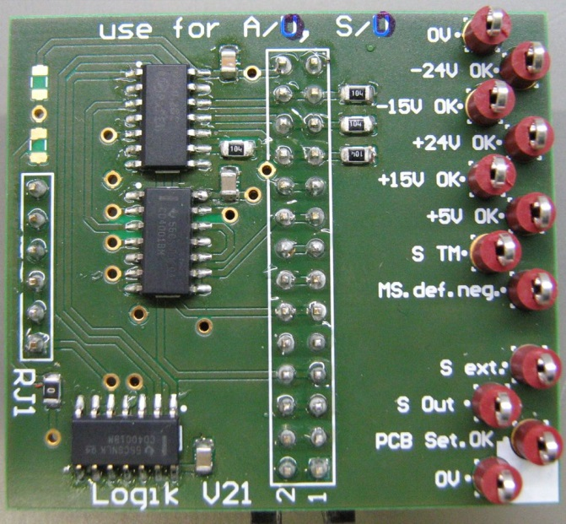
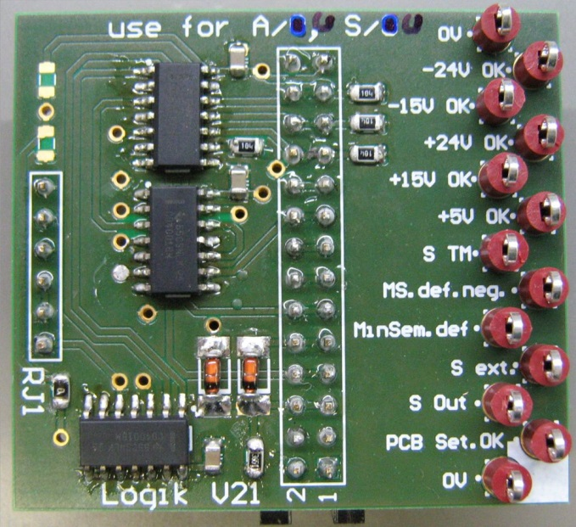
Logic for interlocks, „oben“ & „unten“
Every signal on testpoints
No software used, only gatter logic

Slide 33
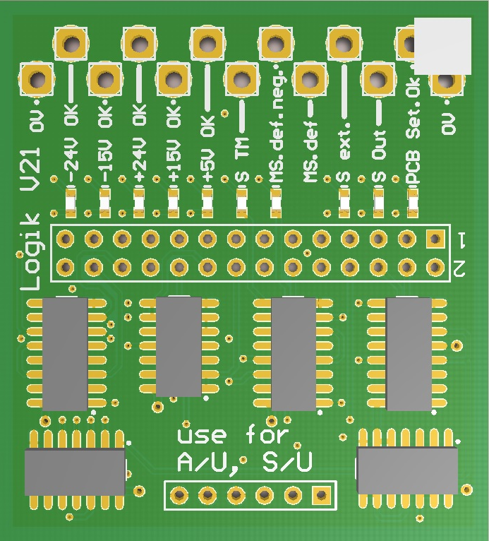
Logic for interlocks, version „unten“
Every signal on testpoints
Error memory
with LED
No software used, only gatter logic

Slide 34
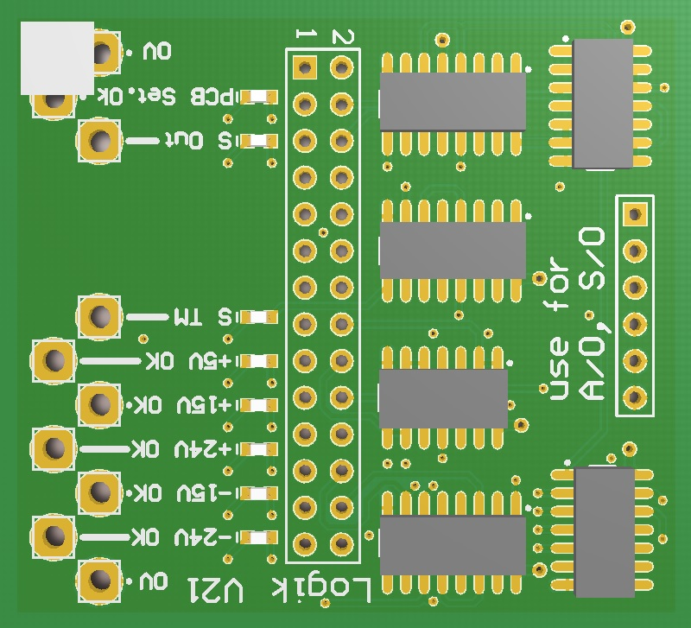
Logic for interlocks, version „oben“
Every signal on testpoints
Error memory
with LED
No software used, only gatter logic

Slide 35
Old mainboard had to be calibrated after repair, in case of an error

Slide 36
The new mainboard is balanced in itself, by calibration of the function modules

Slide 37

Every spare parts are calibrated with the external testing bench
Resistors for calibration

Slide 38


Repair without special knowledge about the dipol power converter is possible
defect pcb out
tested pcb in

Slide 39
Maintenance time is much shorter
All terminals of the mainboard are pluggable
All function blocks are modular
All spare parts are calibrated
One mainboard for all four old versions
„siri-function“ for PCB setting control
All important signals are fed directly to LEMO sockets or test points
Compatible with old upper boards E1-E3
No special knowledge of the activ filter required, all components are coded and clearly labeled

Slide 40
Necessary modifications and difficulties in developing
Current connection must be changed to terminal blocks
No further mechanical work necessary, because the entire mechanism and terminal positioning is equal to the old version
Difficulties during planning and development:
Measuring of the dipol electronics only during maintenance possible
Incomplete documentation
Subtle differences in the old version
Handmade connections on the old pcb

Slide 41
Power converter overview
Interaction between thyristor- & parallel feeding- stage
Development steps for the new parallel feeding, by Markus Retzlaff & Christian Ehrlich
Development of the new transistor driver, by Christian Ehrlich
Development of the new linear stage, by Markus Retzlaff

Slide 42
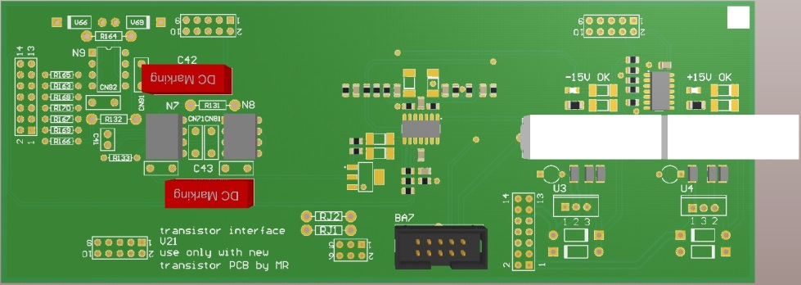
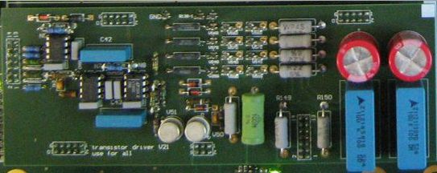
Interface for the new linear stage
Same connection from the mainboard to the interface

Slide 43
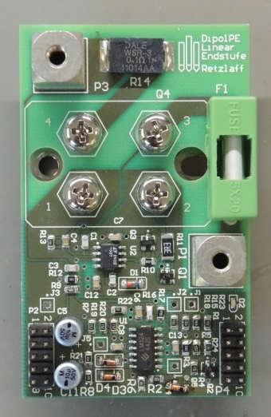



Interface for the new linear stage
Same Reset- and Transistormonitoring signals

Slide 44
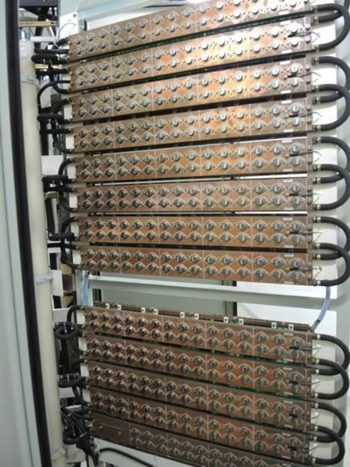
The old linear stage
MOSFETS are connected in parallel, with drain resistors.
No controlled symmetry, so we have to rely on the symmetery of the transistors themselfs
Groups of six transistors are supervized, to detect drifts or broken ones
Modern versions of the MOSFETs (BUZ45A) have enormous drifts, so we cannot use them in parallel connection. Or we have to select them with great discard.

Slide 45

The new linear stage
Each MOSFET has ist own regulation, for better symmetry
Each MOSFET has ist own failure detection
MOSFET from IXYS specially designed for linear regulation
SOT-227 case instead of TO-3

Slide 46
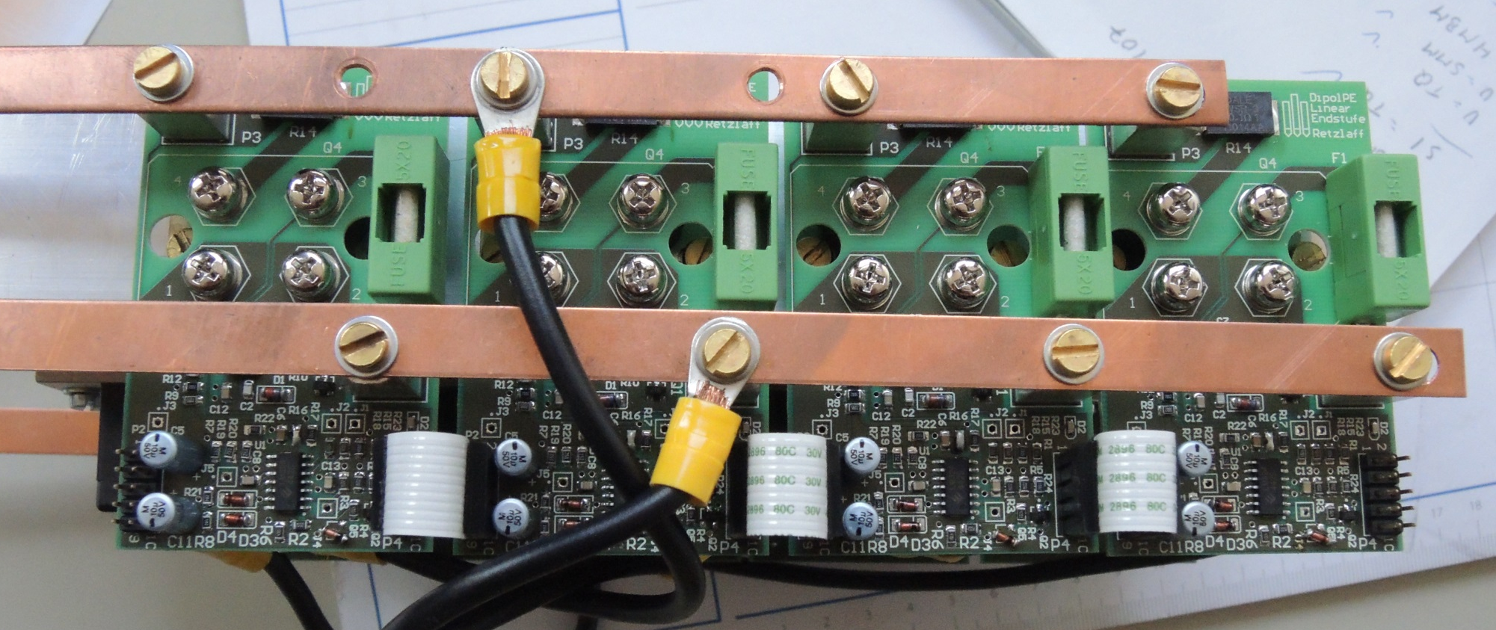
The new linear stage
Easy daisy chain connection of the regulation boards with FFC and bus bars

Slide 47
Outlook for the linear stage
In the future, the intermediate circuit will be dynamic, instead of the static system from now. This would dramatically reduce the power loss of the linear stage, and we can also reduce the number of transistors.
This will be realized with a source- / sink power converter, to be able, to feed the energy back into the mains, during discharging the magnets.

Slide 48

Thanks for your attention

