Slide 1
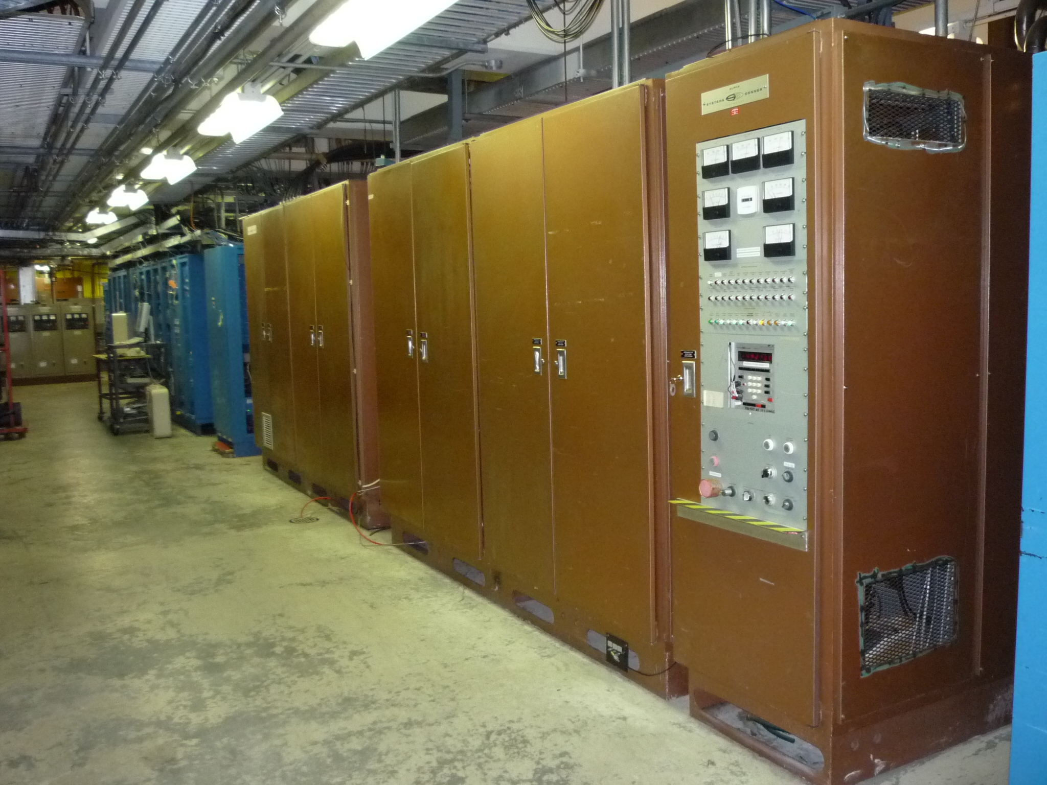
2.9 MW Cyclotron Main Magnet Power Supply
Dan Louie | TRIUMF

Slide 2
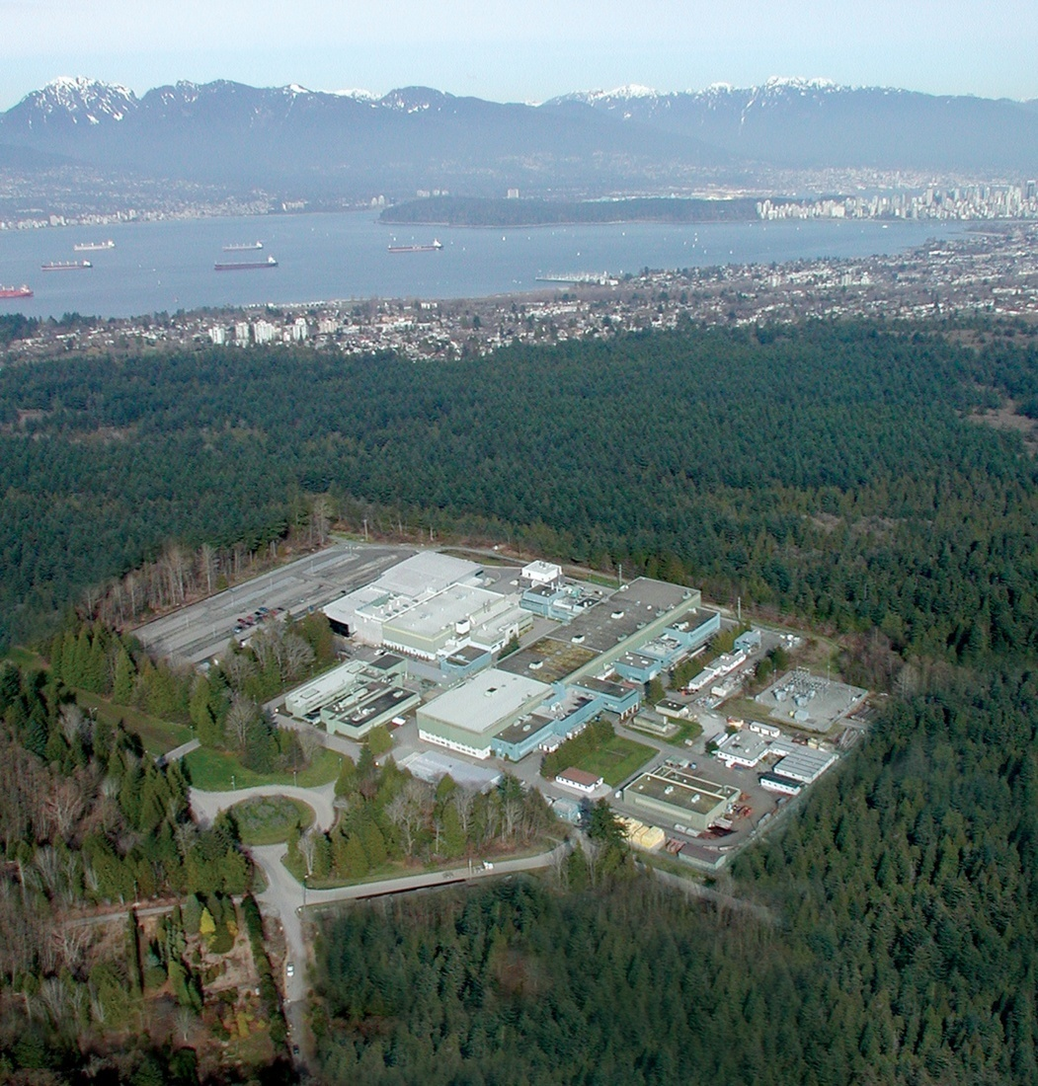
TRIUMF stands for TRI University Meson Facility
Founded by University of British Columbia, Simon Fraser University, University of Victoria 43 Years Ago
Full Members:
Carleton University
University of Guelph
Queen’s University
Simon Fraser University
University of Alberta
University of BC
University of Manitoba
Université de Montréal
University of Toronto
University of Victoria
York University
Associate Members:
University of Calgary
McMaster University
Saint Mary’s University
University of Regina

Slide 3

TRIUMF is located on the campus of University of British Columbia.

Slide 4
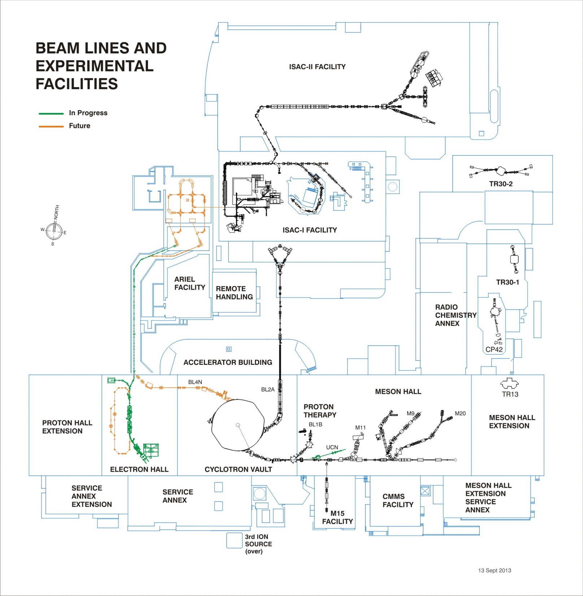

TRIUMF Accelerators
  500MeV H⁻ cyclotron since 1974
  ISAC-I accelerates rare-isotopes 2001
  ISAC-II first experiment 2007
  ARIEL (e-Linac) begins 2010
ISAC-II
SRF Linac
DTL
RFQ
ARIEL Facility
ISAC-I
ISAC Targets
ISAC: Isotope Separator and Accelerator
ARIEL: Advanced Rare IsotopE Laboratory
50 MeV Electron Linac
500 MeV Cyclotron

Slide 5
TRIUMF Power Supplies Distribution
Proton Accelerators
Cyclotron: Trim Coils, 5kW, (max. 85 Amperes) 88
Harmonic Coils, 5kW, (max. 85 Amperes) 22
Main Magnet, 2.9MW, (max. 26700 Amperes) 1
Beamlines: Dipoles, 100kW, (max. 1250 Amperes) 30
Quadrupoles, 100kW, (max. 1000 Amperes) 225
Steerers, 1.5kW, (max. 30 Amperes) 183
Total: 549
Electron Linac
Beamlines: Dipoles, 20kW, (max. 400 Amperes) 10
Quadrupoles, 1.6kW, (max. 60 Amperes) 54
Steerers, 50W, (max. 5 Amperes) 126 Total: 190

Slide 6
Cyclotron Facts
Function :
Accelerates H- ion beam.
Average beam current 350 uA, up to 520 MeV
Vacuum Tank:
Diameter: about 18 meters
Pressure achieved: less than 5 X 10-8 Torr
Main Magnet:
Type : Sector-focussed electro-magnet
Configuration : " Pinwheel " , 6-sectors trailing CCW looking from top (see TRIUMF logo)
Pole diameter: ~18 meters
Weight: 4000 Tons
Coils: 30 turns (15 upper and 15 lower)
Characteristics: 0.004 ohm, 0.12 H
Normal Operating Power: 18400 Amperes at 75 Vdc.
Field : 5608 Gauss (normal operation)

Slide 7
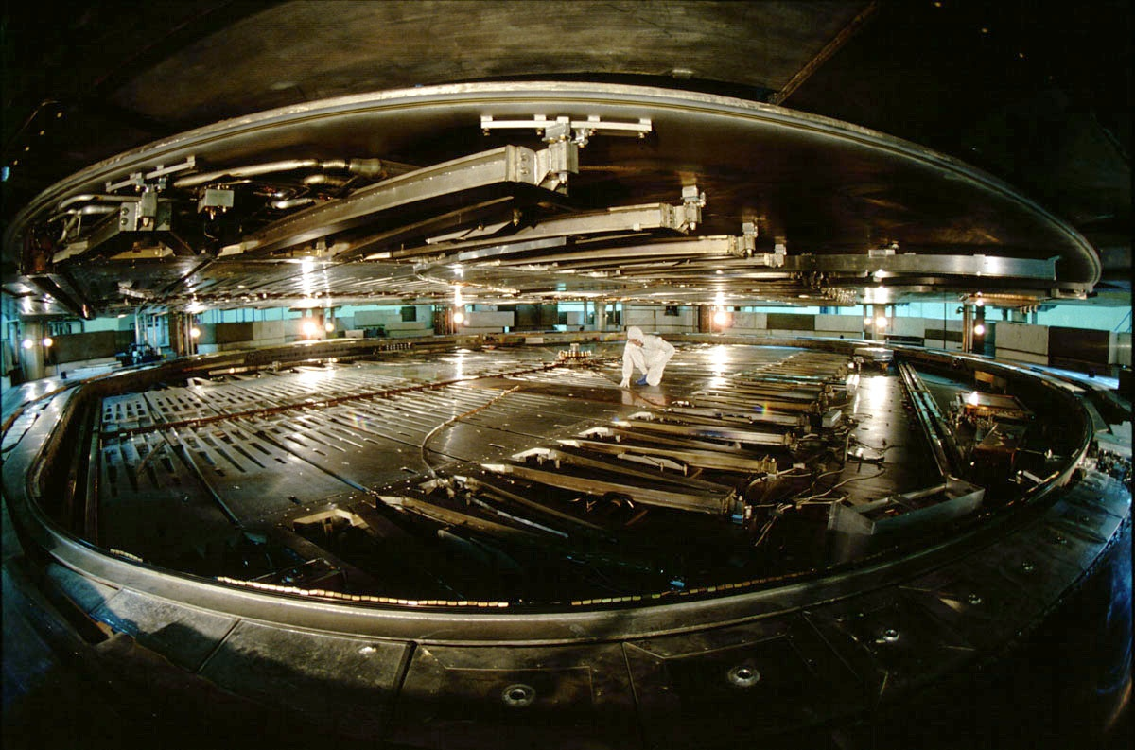

Slide 8
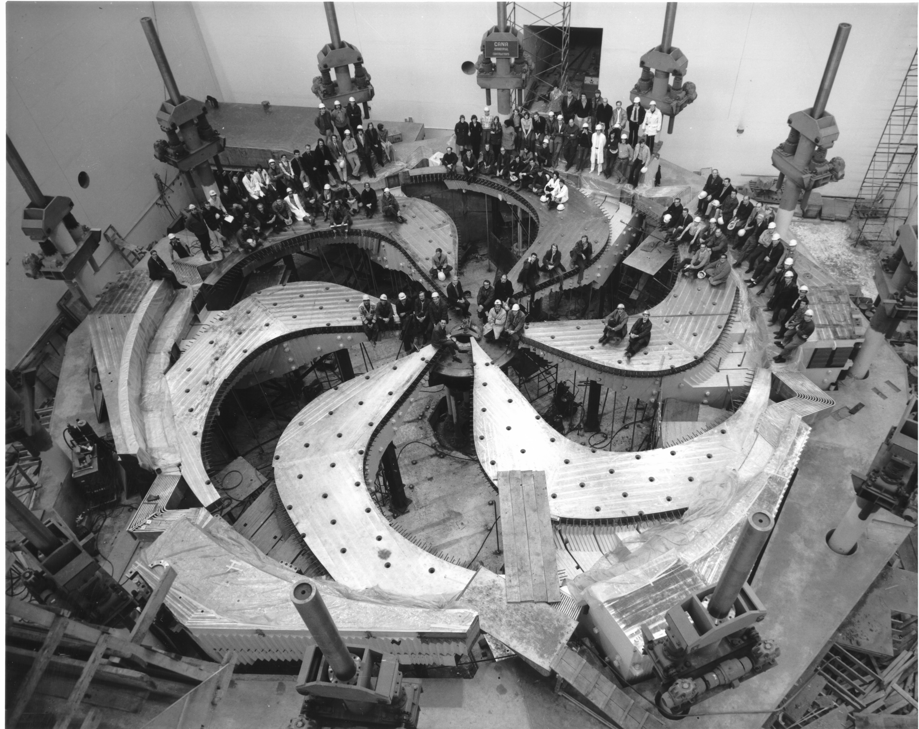
Cyclotron Magnet
Bottom half of main magnet poles and coil

Slide 9
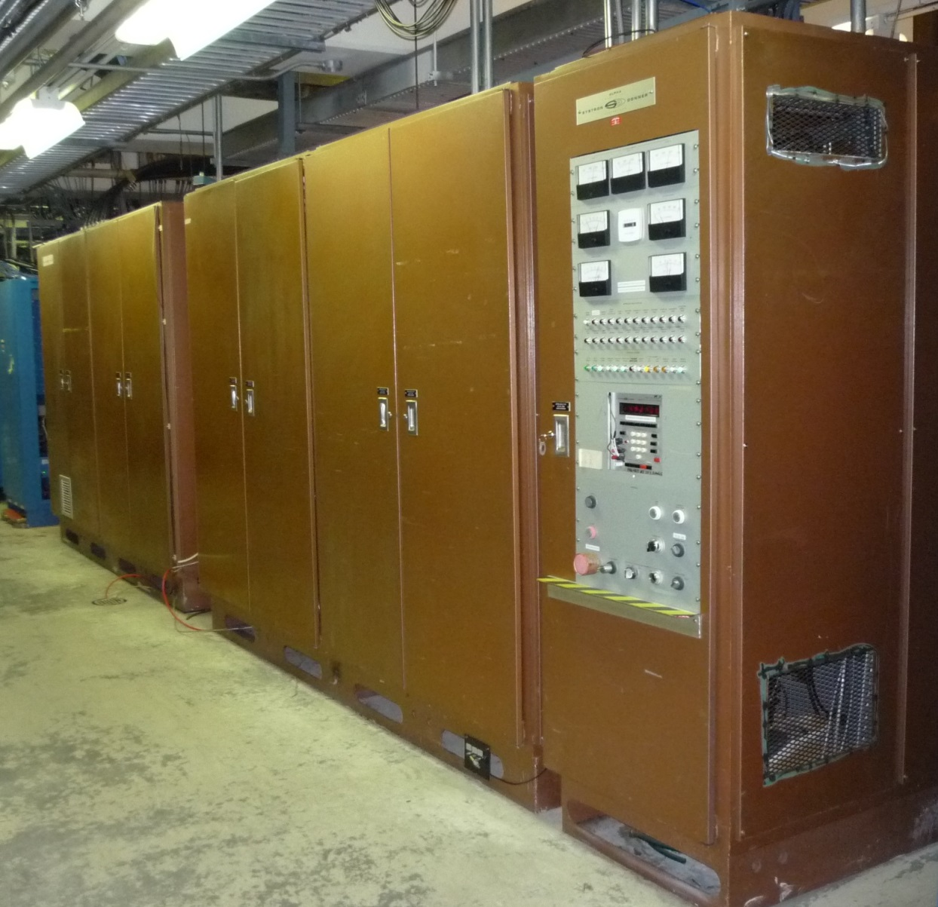
Cyclotron Magnet Power Supply
Linear, Series Pass Regulator
Max Output Voltage: 110Vdc
Max Output Current: 26,700 Amps
Max Output Power: ~2.9 MW
Current Stability: 2 ppm
Magnetic Field Stability: ~1 ppm with external field compensation
In operation since: 1974
Made by Alpha Scientific, California, USA

Slide 10
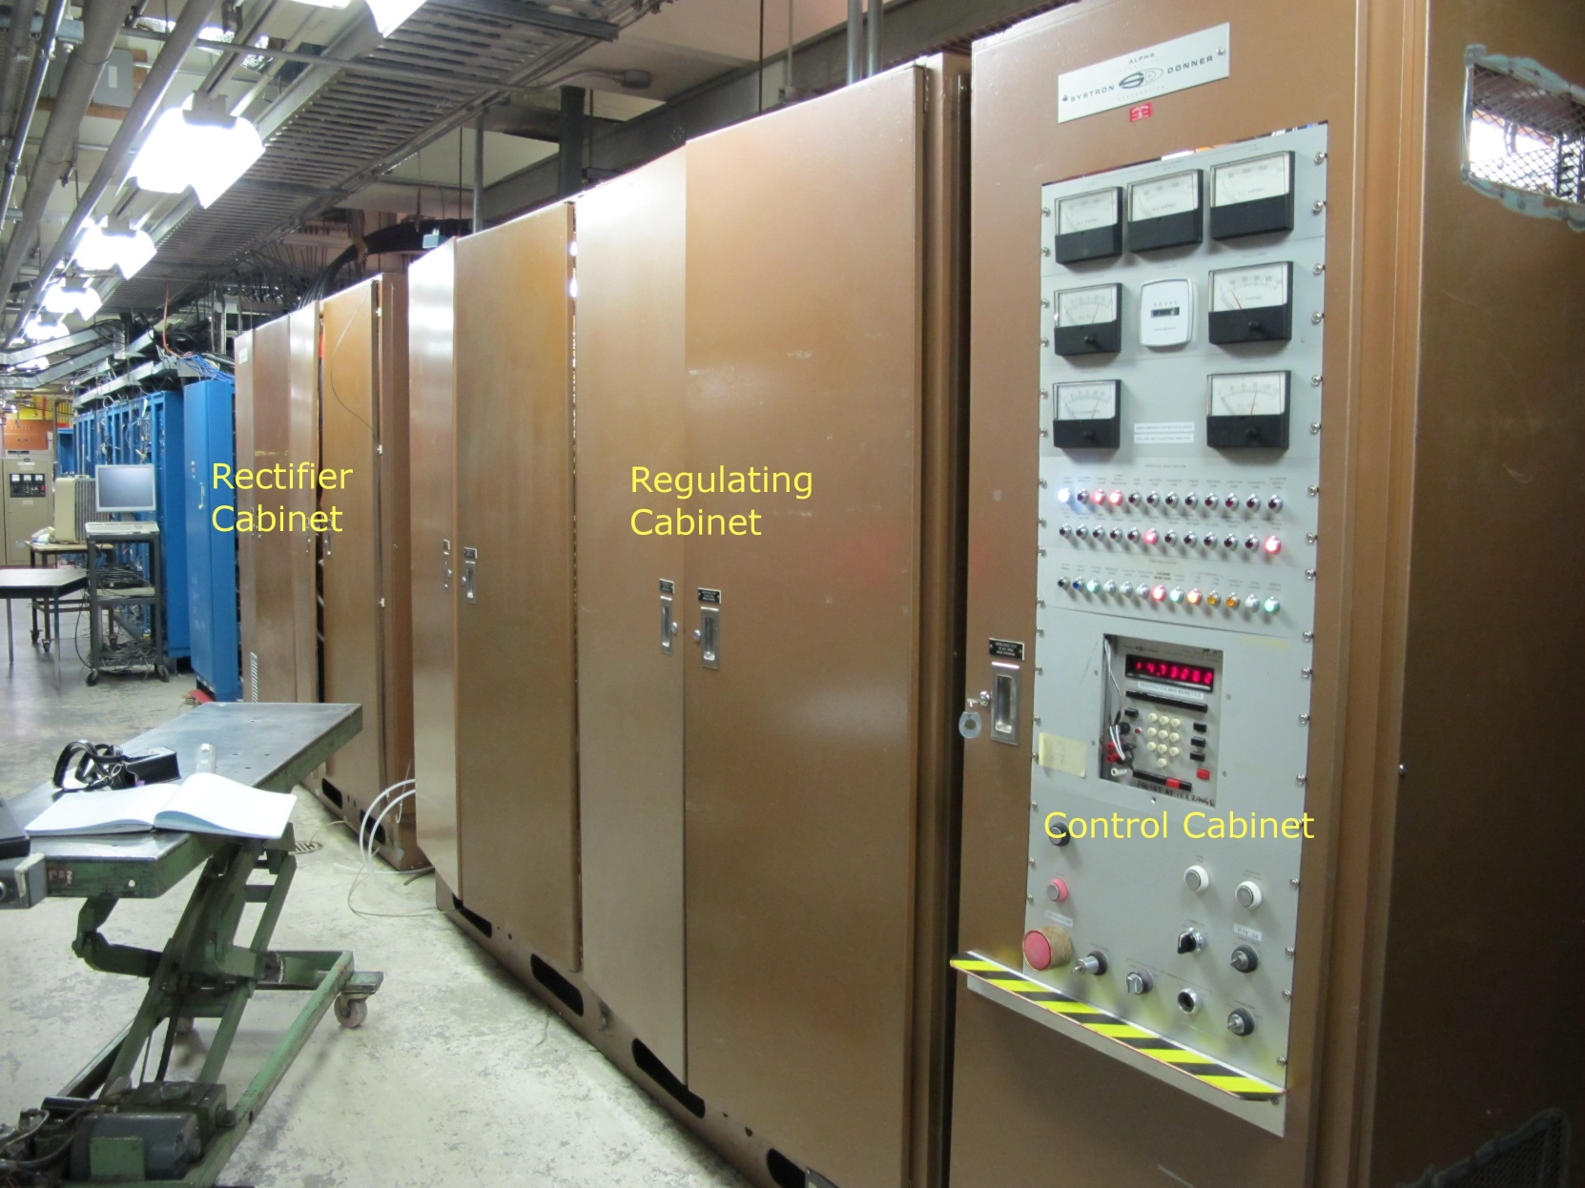
Cyclotron Magnet Power Supply

Slide 11
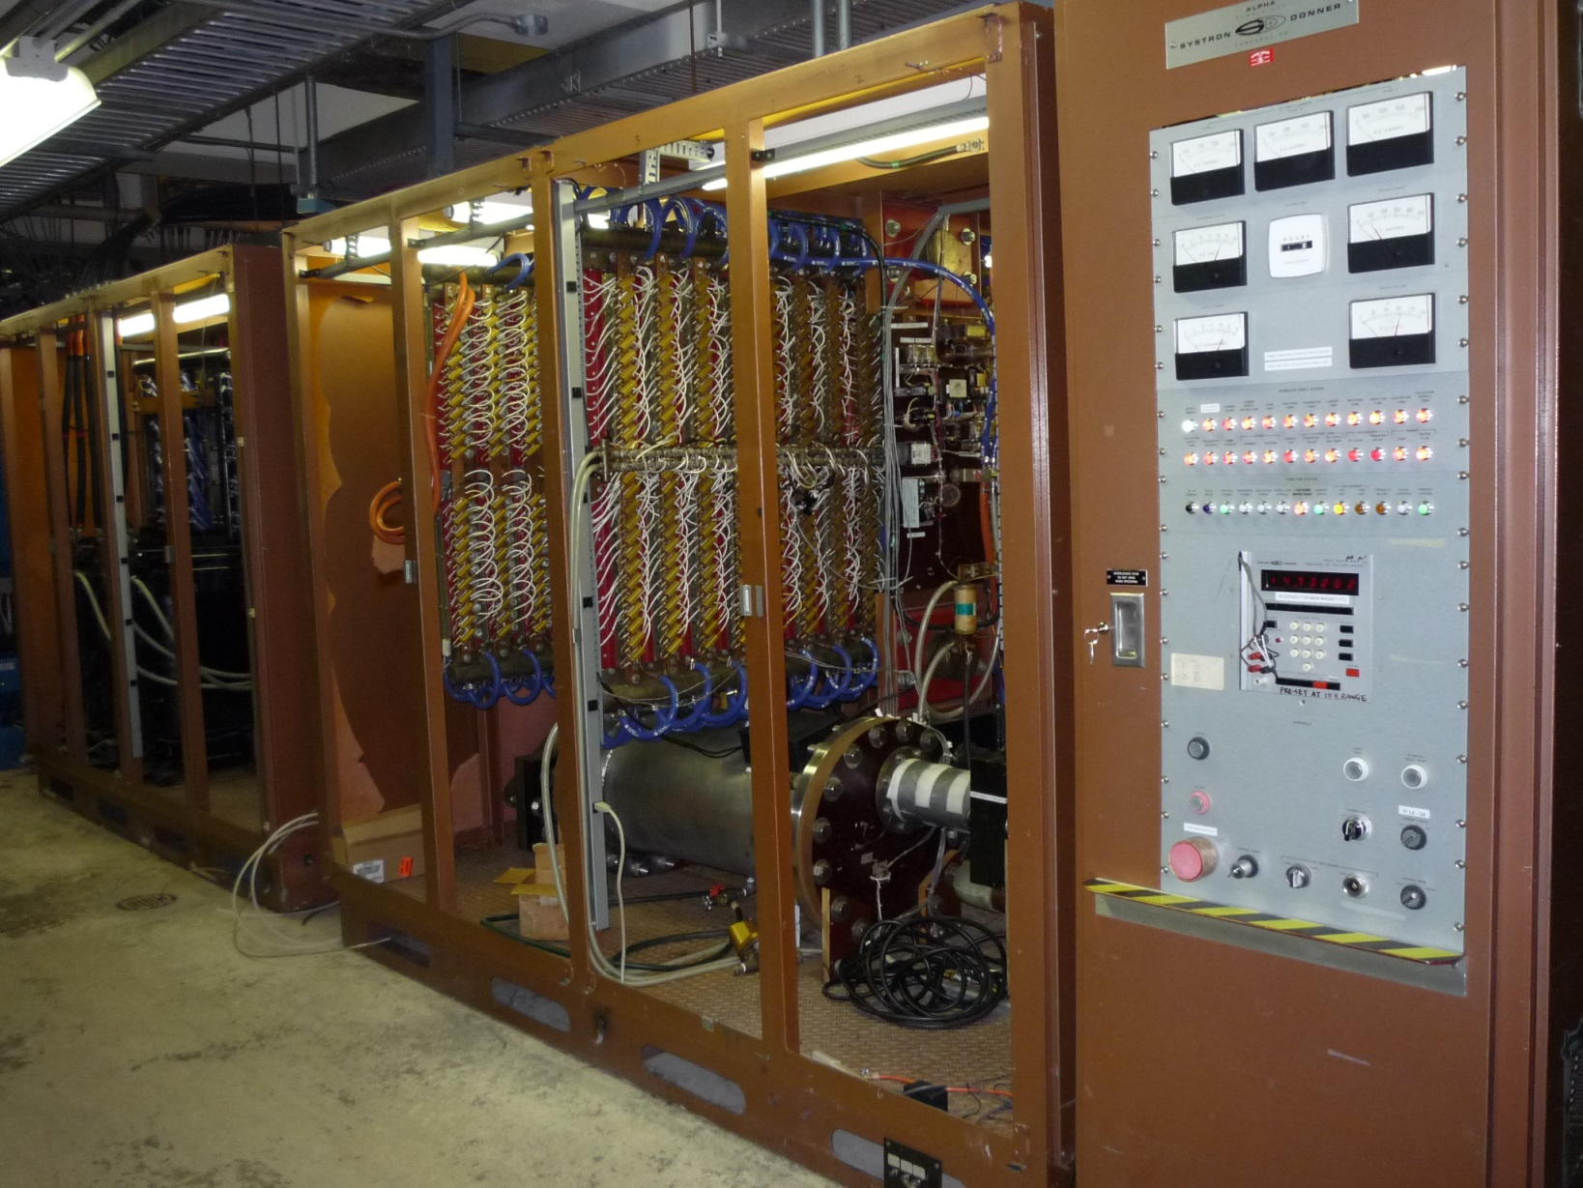
Cyclotron Magnet Power Supply

Slide 12
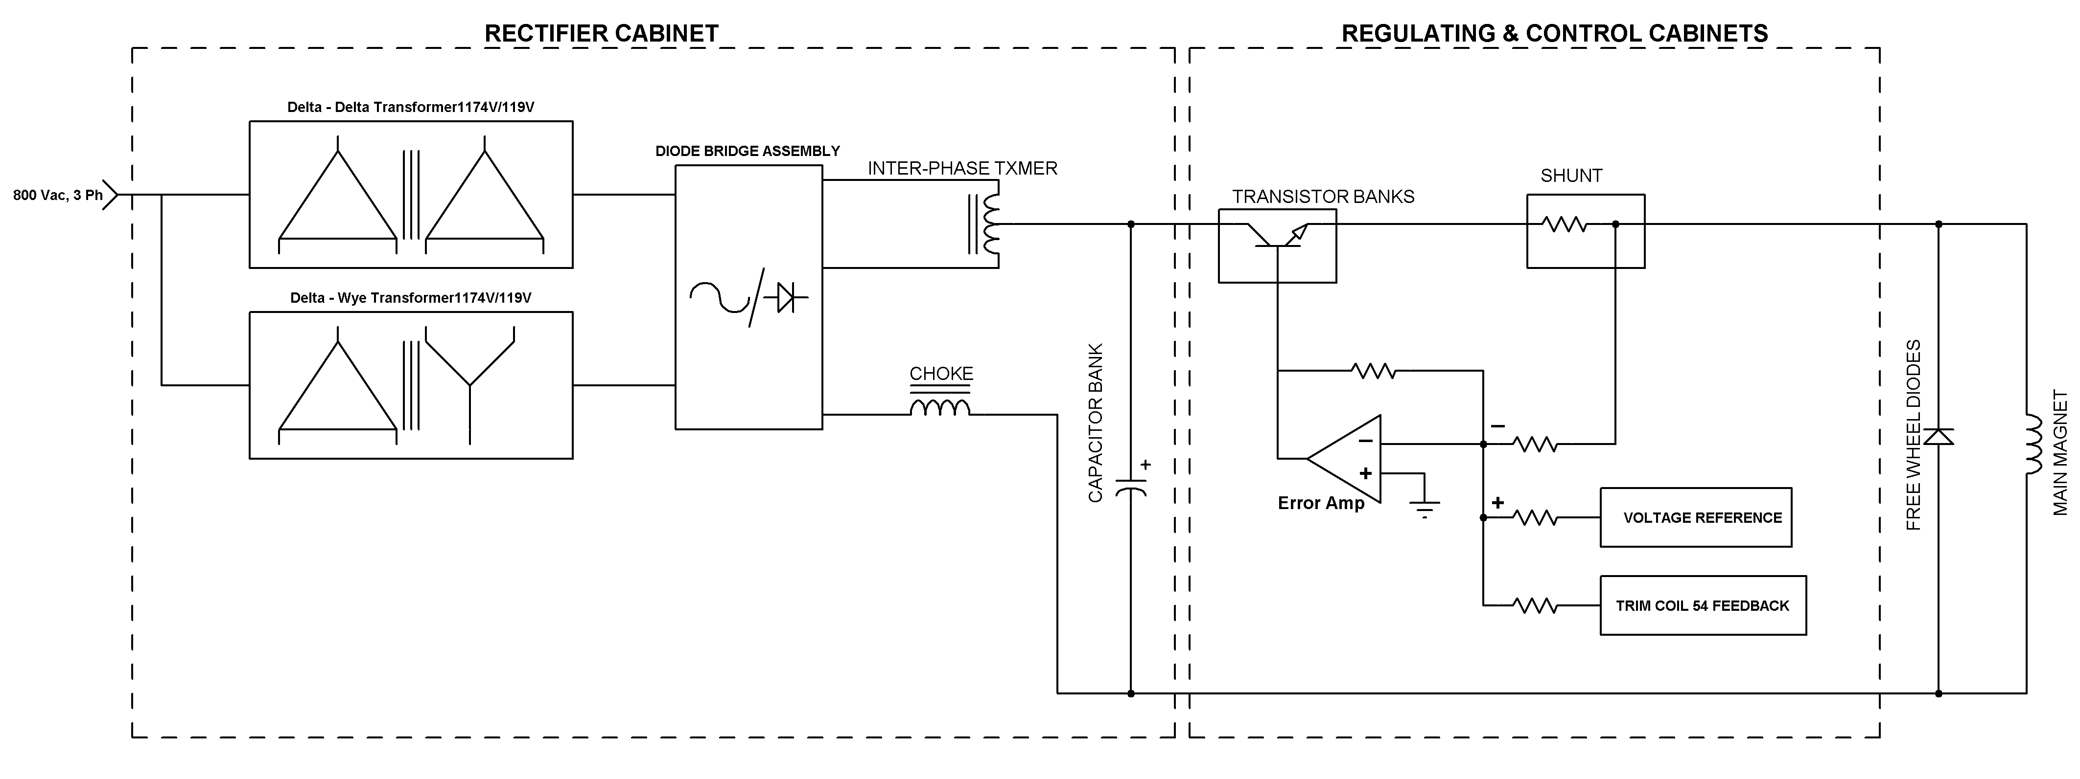
Cyclotron Magnet Power Supply – Major Components

Slide 13
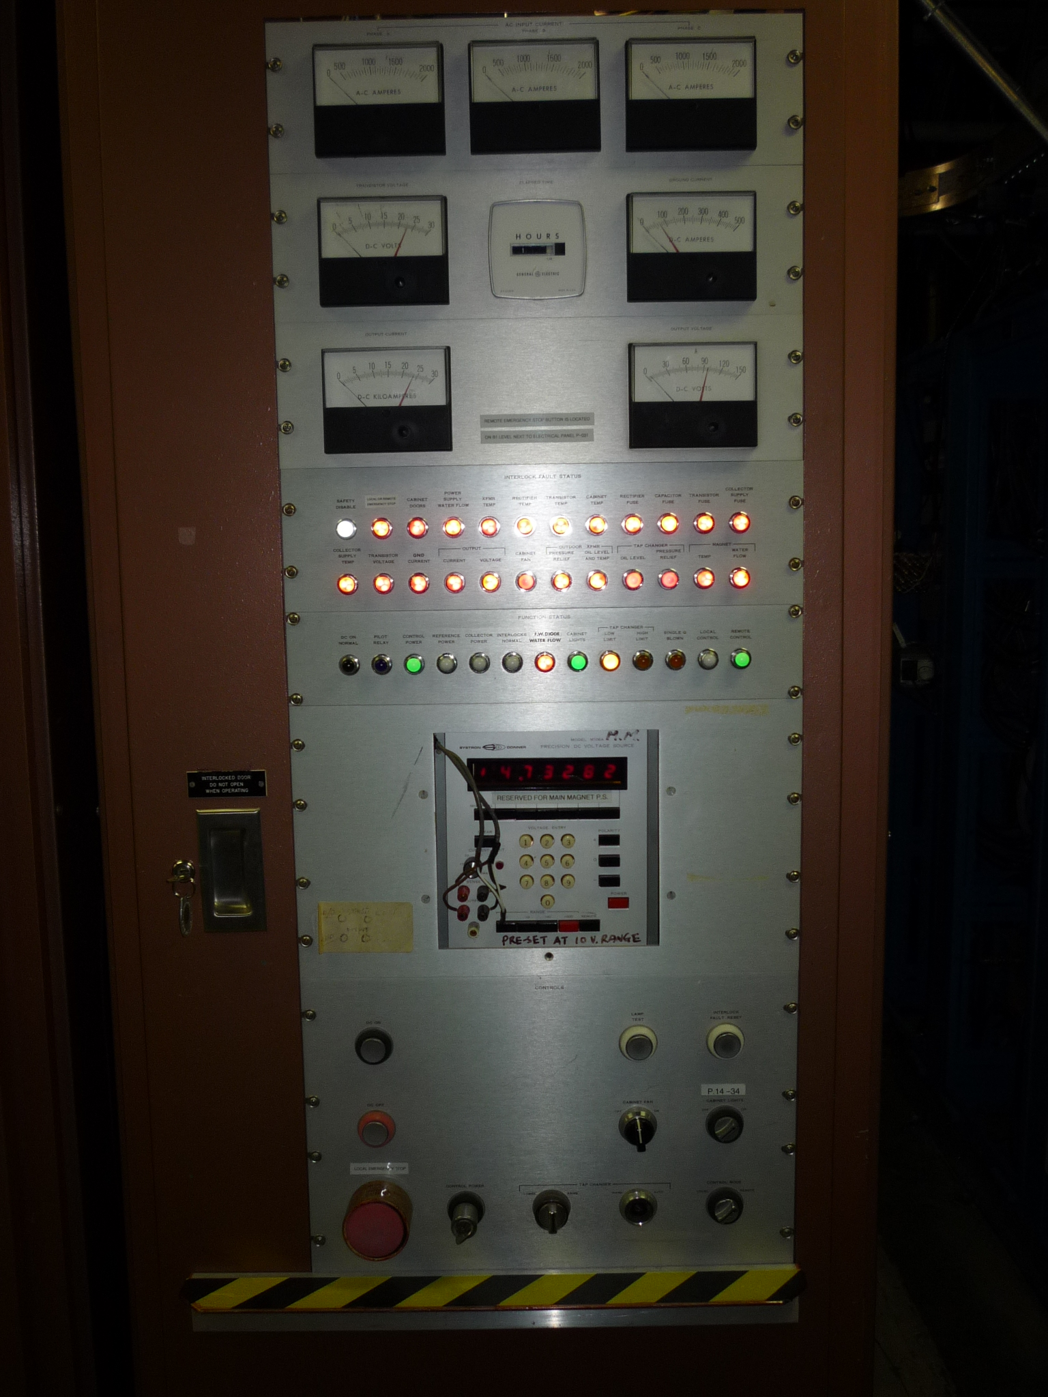
Cyclotron Magnet Power Supply – Control Cabinet
Analog Meter: AC Current, Output Volt, Output Current, Ground Current.
Many Interlock Indicator Lights. Supply has many internal fault protection.
Very stable voltage reference.
Output is set via a 24-bit parallel digital interface.

Slide 14
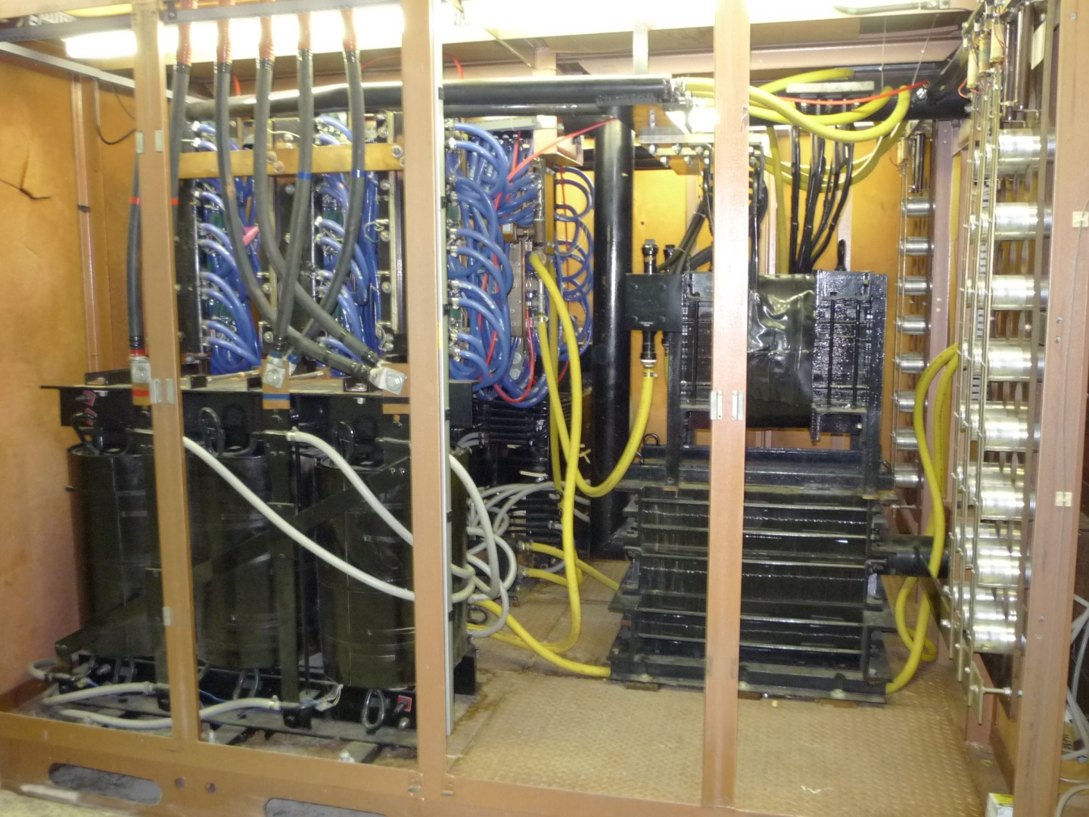
Cyclotron Magnet Power Supply – Rectifier Cabinet
Contains:
Duel AC transformers
Rectifier Diodes
Inter-phase Transformer
Choke Inductor
Capacitor Filter

Slide 15
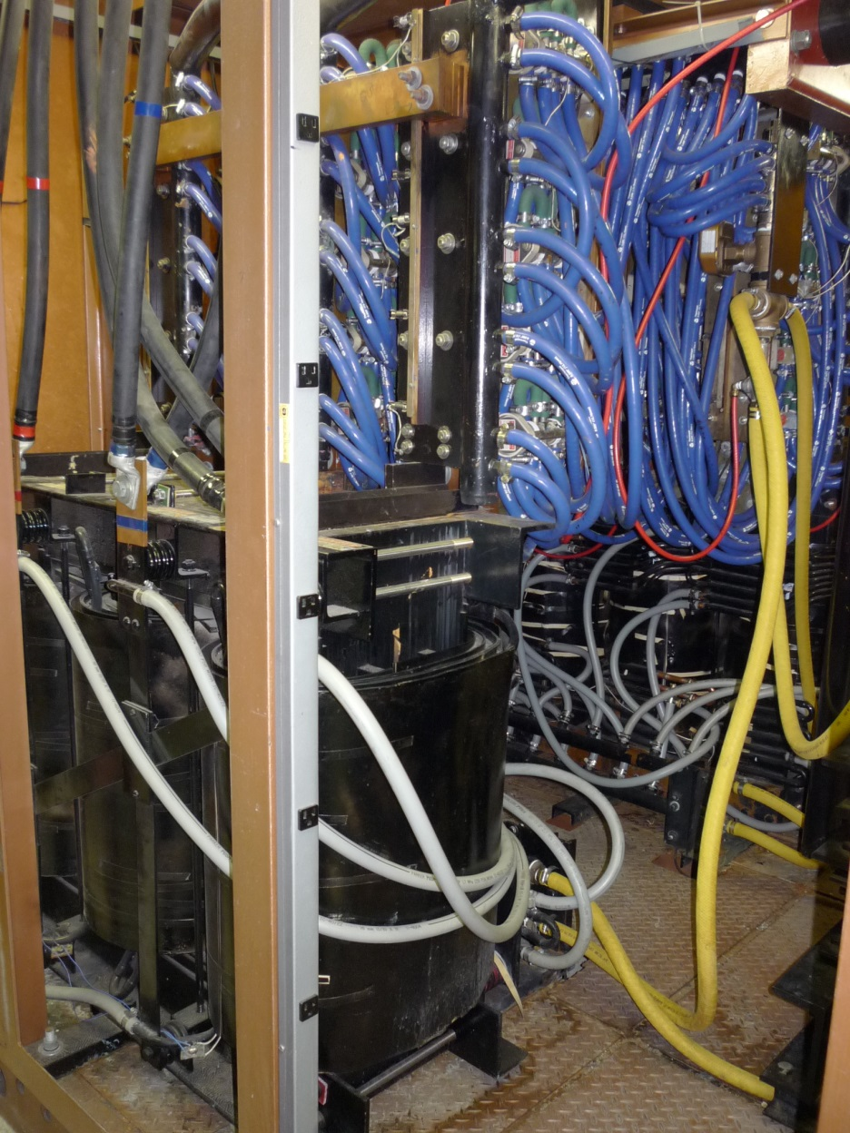
Cyclotron Magnet Power Supply – Duel AC Input Transformers
T1:
Delta – Delta arrangement
2255 kVA, 3 phase, 60 Hz
Primary 1174 V, 1074 A
Secondary 119 V, 10890 A
T2:
Delta – Wye arrangement
2255 kVA, 3 phase, 60 Hz
Primary 1174 V, 1074 A
Secondary 119 V, 10890 A

Slide 16
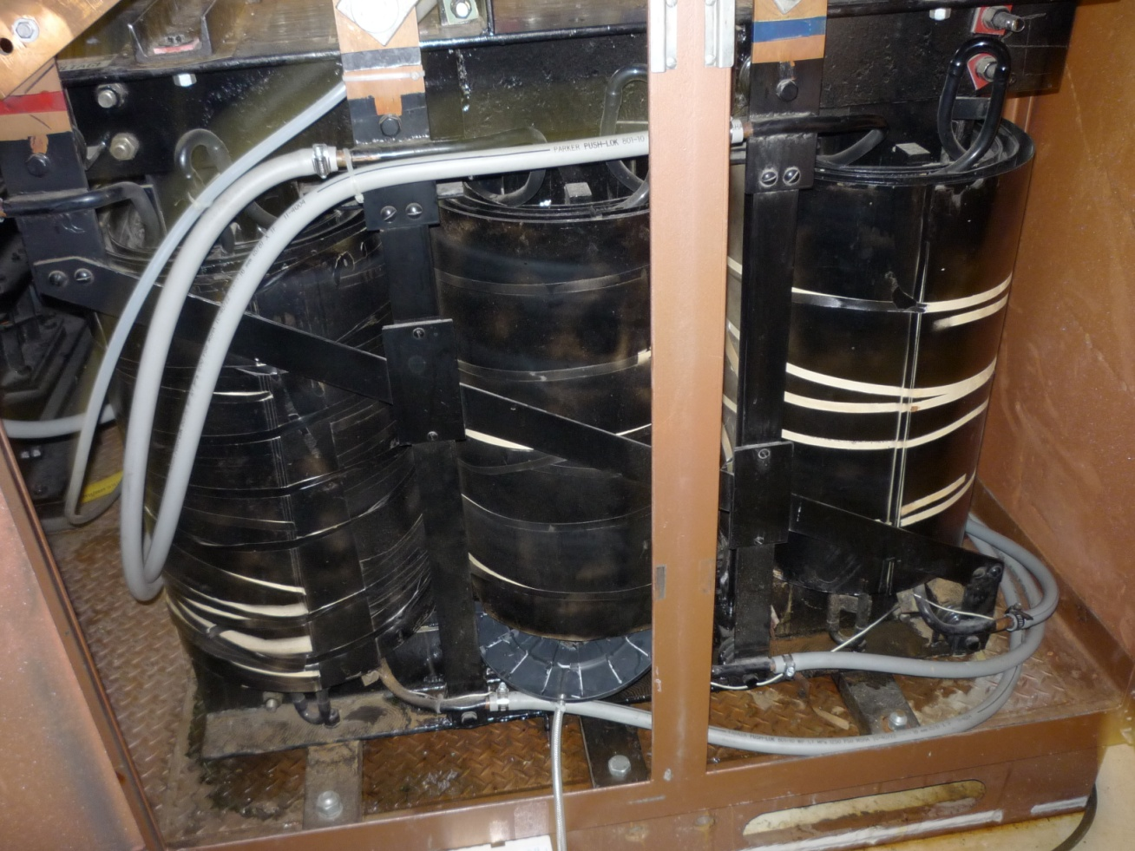
Cyclotron Magnet Power Supply – Transformer Water Leak
Water was found on the floor next to the transformer cabinet on April 15th 2012.
Proton therapy was taken place at the time and scheduled for another 2 days.
Initial assessment on the evening of April 15th indicated the leak was in the power transformer TR1.
Decision was made to leave the power supply ON to complete patient treatment.
The power supply was immediately switched OFF after the final patient treatment on April 17th.

Slide 17
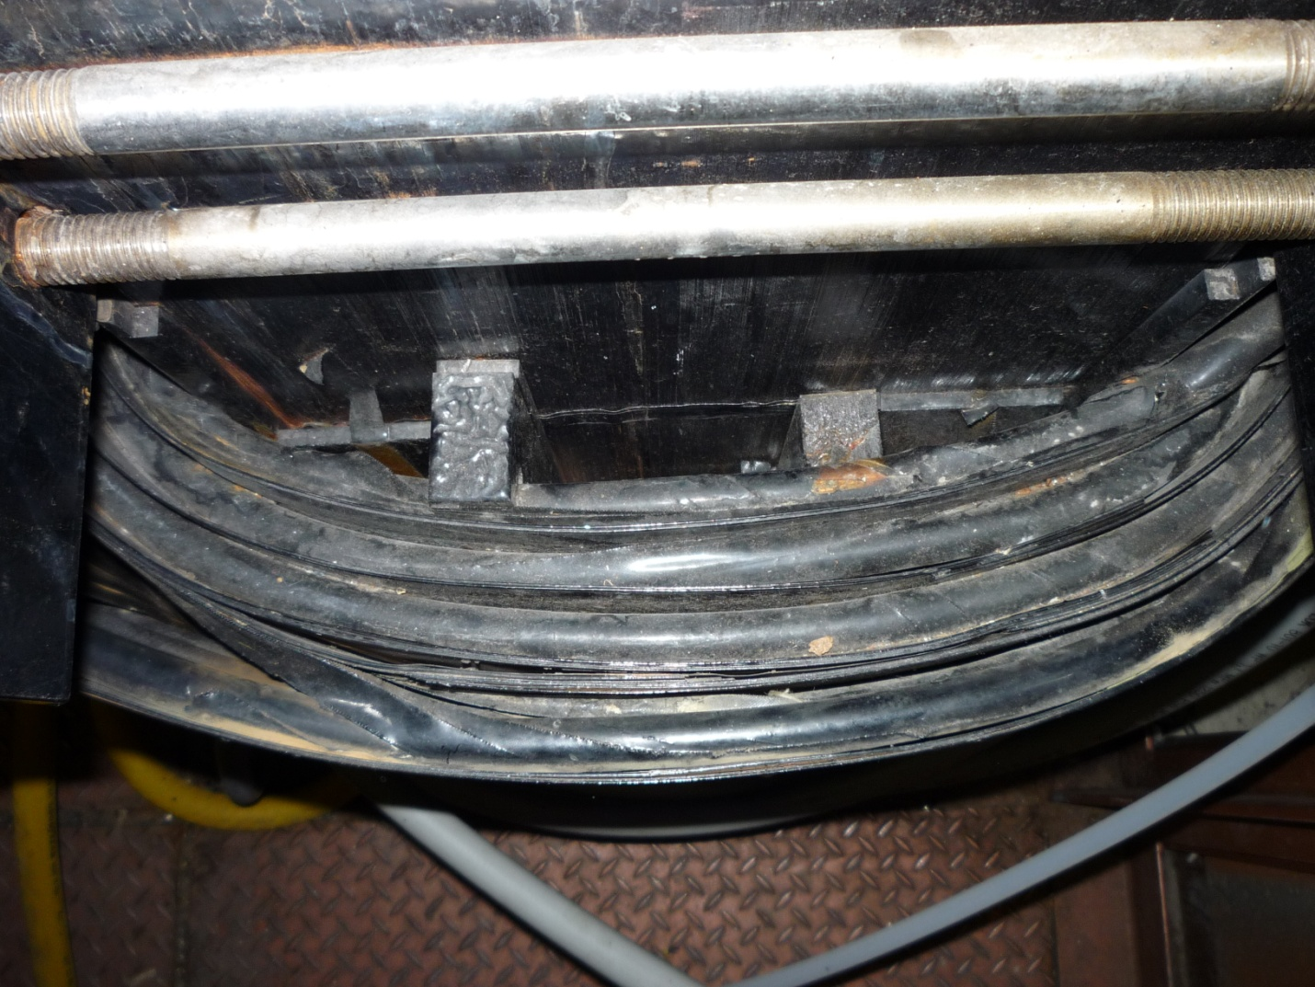
Cyclotron Magnet Power Supply – Transformer Construction
Transformer has 3 layers of primary windings wrapped around the core with the secondary making up the 4th outer most layer.
Both Primary and secondary windings constructed of ½” schedule-40 copper pipe.
Leak was located at the secondary winding of the middle phase.
Leak rate was estimated to be about 5 liters per hour.
Core
Primary Layer
Secondary Layer

Slide 18
Cyclotron Magnet Power Supply – Transformer Water Leak – Actions and Results
Conventional fix of removing and rewinding the transformer would take up to 6 months.
An alternative experimental method of stopping the leak by lining the inner wall of the pipe with epoxy was employed.
The company selected to perform the work is Curaflo.
Calculation was performed to estimate the rise in copper temperature due to the thermo insulating property of the epoxy coating. The increased in temperature was expected to be 5 degrees Celsius.
Two temperature sensors were installed. One to the treated winding, the other to a non-treated winding. After a warm up period, the treated winding temperature was 38 degrees Celsius; the non-treated winding was 34 degrees Celsius.
Reduction in pipe wall thickness due to erosion is relatively minimal.
The contractor also noticed while the epoxy was emitting out of the pipe, the ‘gurgling’ sound made was more due to a small crack rather than a pin-hole.
The speculation is that the crack was cause by a onetime mechanical stress rather than wear and tear.
Treatment started on April 23rd, main magnet supply was turned ON April 25th.
Cost of treatment was about $14,000Can.

Slide 19
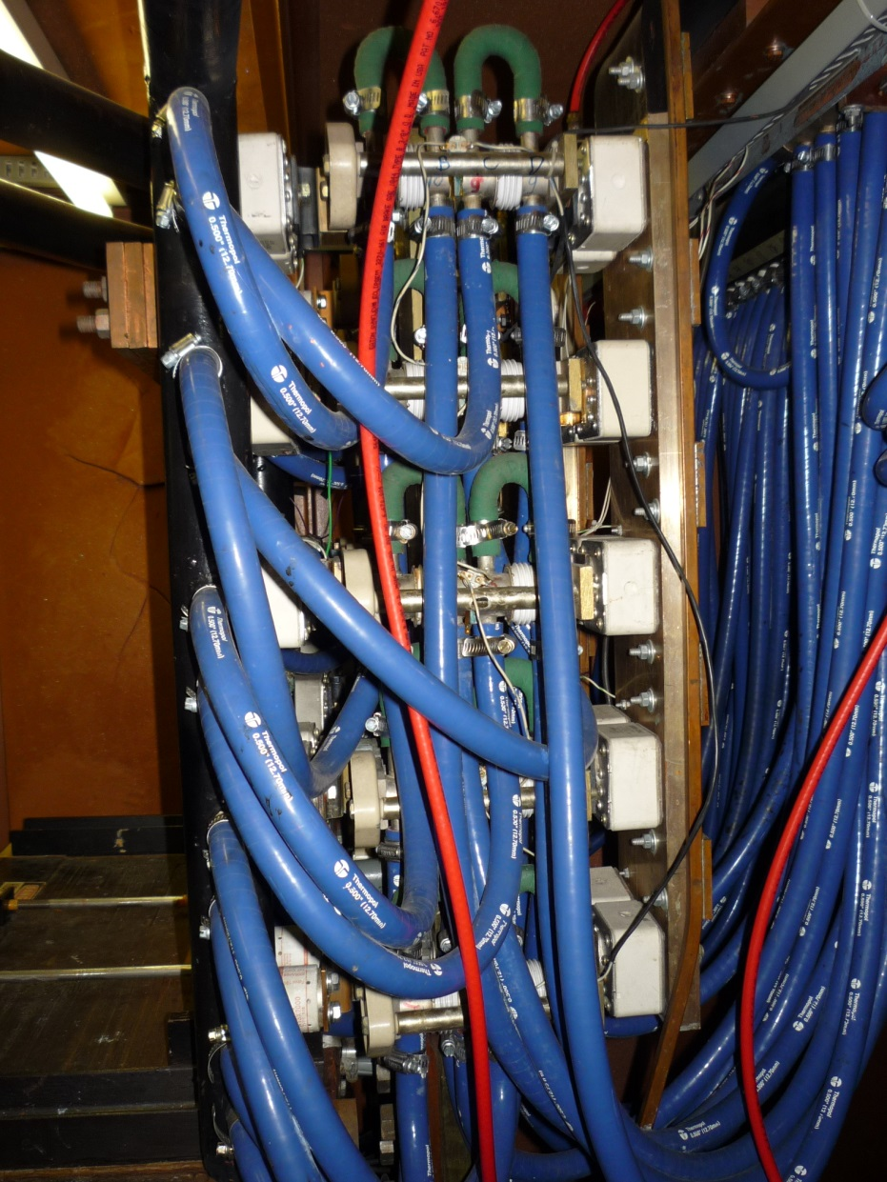
Cyclotron Magnet Power Supply – Rectifier Diodes Assembly
Diode rating: 300 V – 1700 Amp
The outputs of T1 and T2 are rectified by duel six-phase full-wave diode assembly.
The two outputs are connected in parallel to the common load through an interphase transformer.
This combination results in 12-phase rectification with low ripple component.

Slide 20
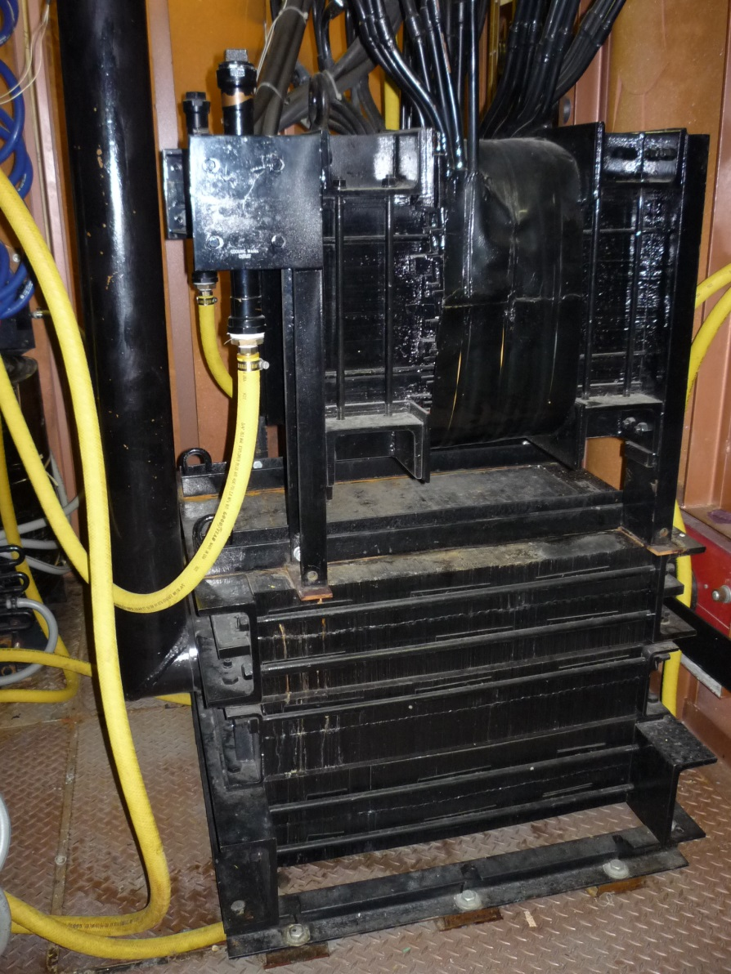
Cyclotron Magnet Power Supply – Interface Transformer and Choke
Inter-phase Transformer:
26700 Amp
160 Vdc Working
Choke Inductor
5 uH
26700 Amp
160 Vdc Working

Slide 21
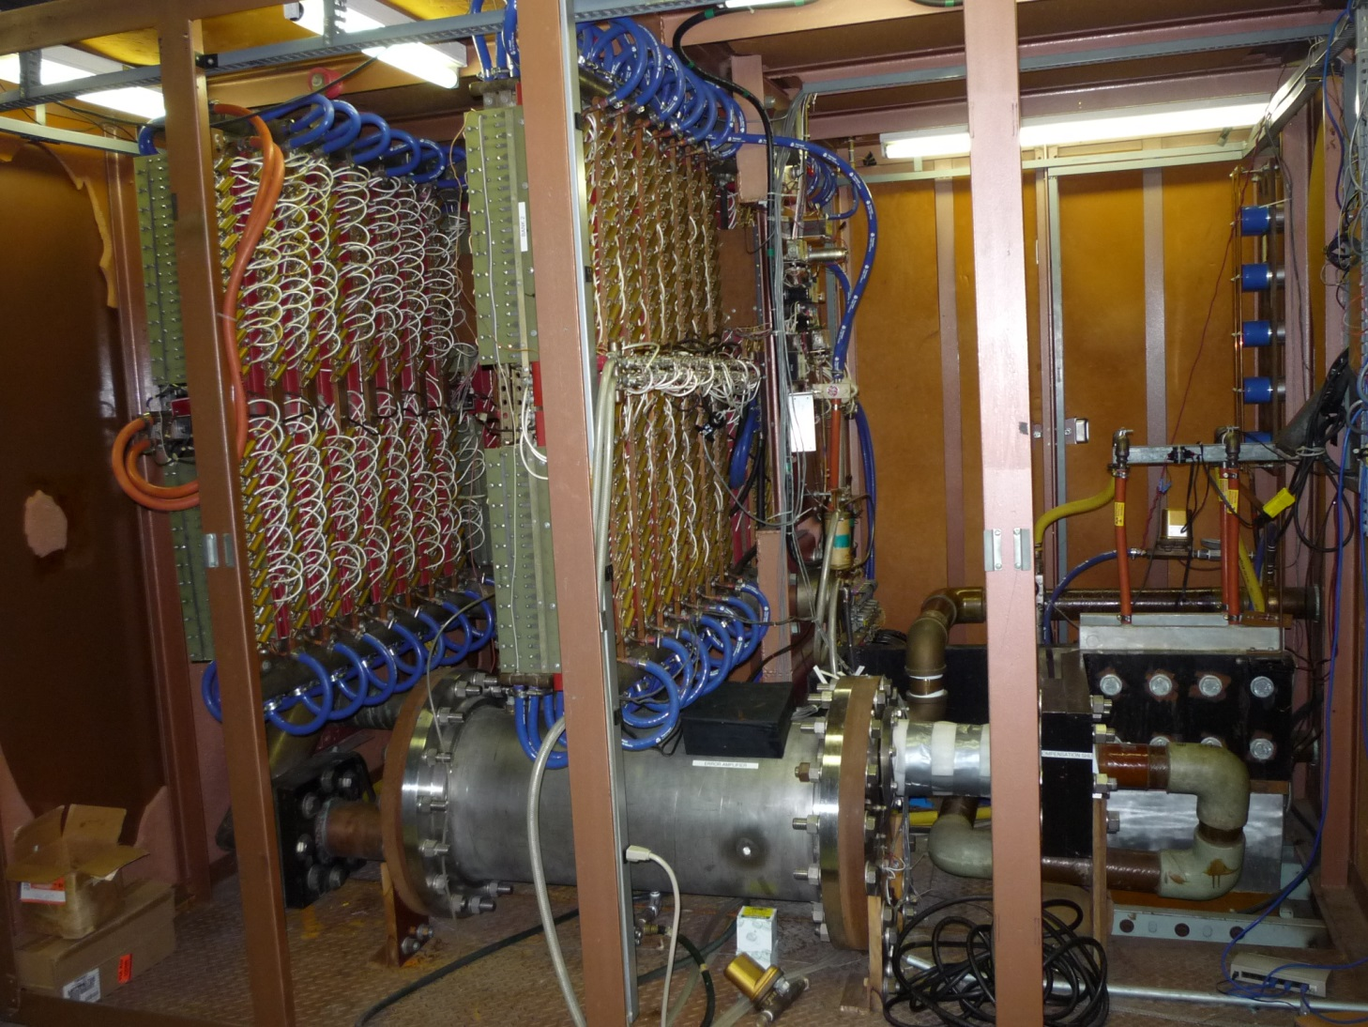
Cyclotron Magnet Power Supply – Regulating Cabinet
Contains:
Four Transistor Banks
Current Shunt
DC Bus Bars
Error Amp PCB

Slide 22
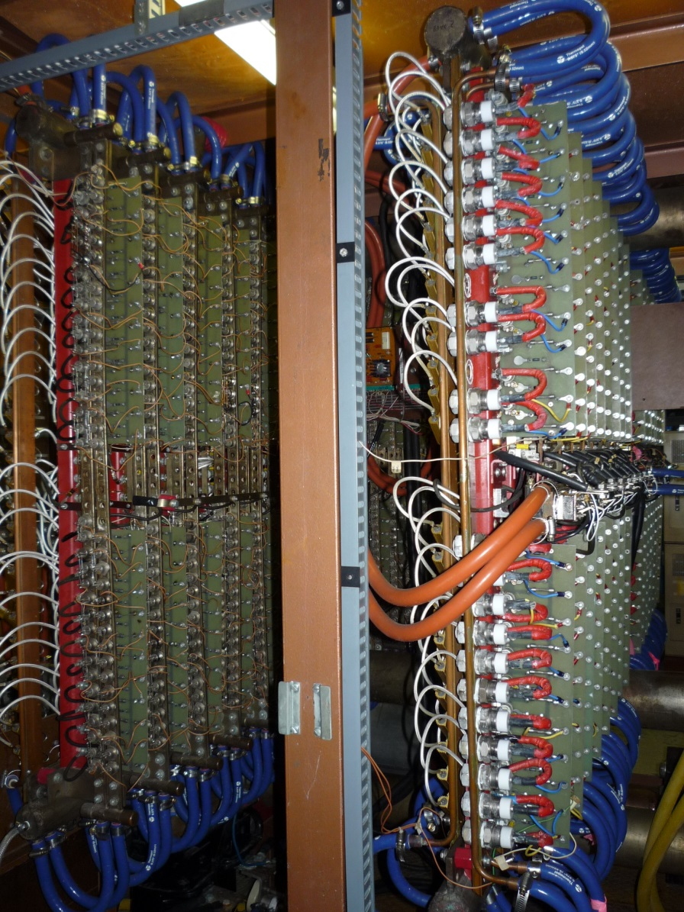
Cyclotron Magnet Power Supply – Transistor Banks
Multiple stages – current gain of more than 1 million from error amp to output.
Four transistor banks running in parallel in final output stage.
2000 transistors make up the four banks.
Supply will trip OFF if more than three transistors have failed.

Slide 23
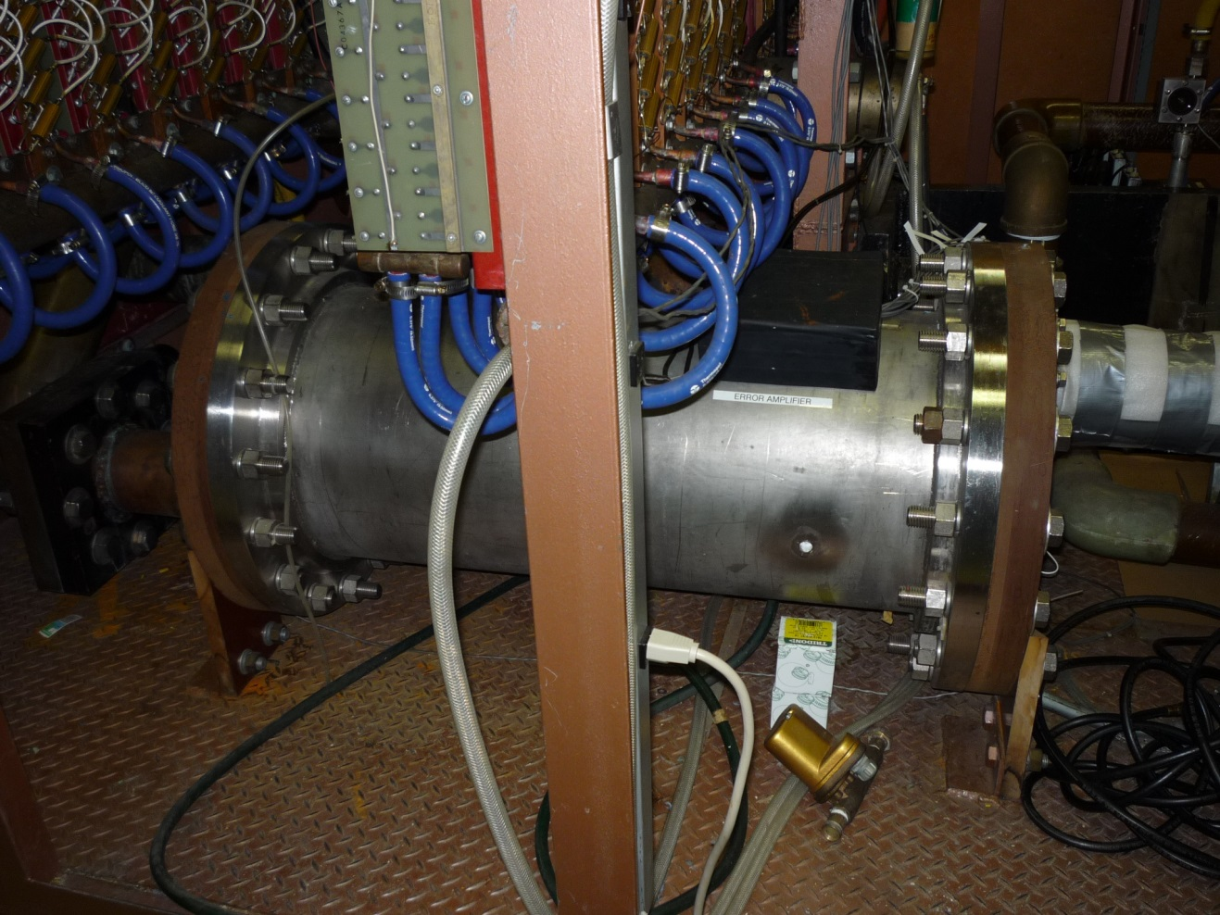
Cyclotron Magnet Power Supply – Precision Shunt
Current Rating: 26700 Amps
Output Signal: 1 Vdc Full Scale
Stability: 1 ppm
Temperature Compensated
Dissipates about 20 kW during normal operation

Slide 24
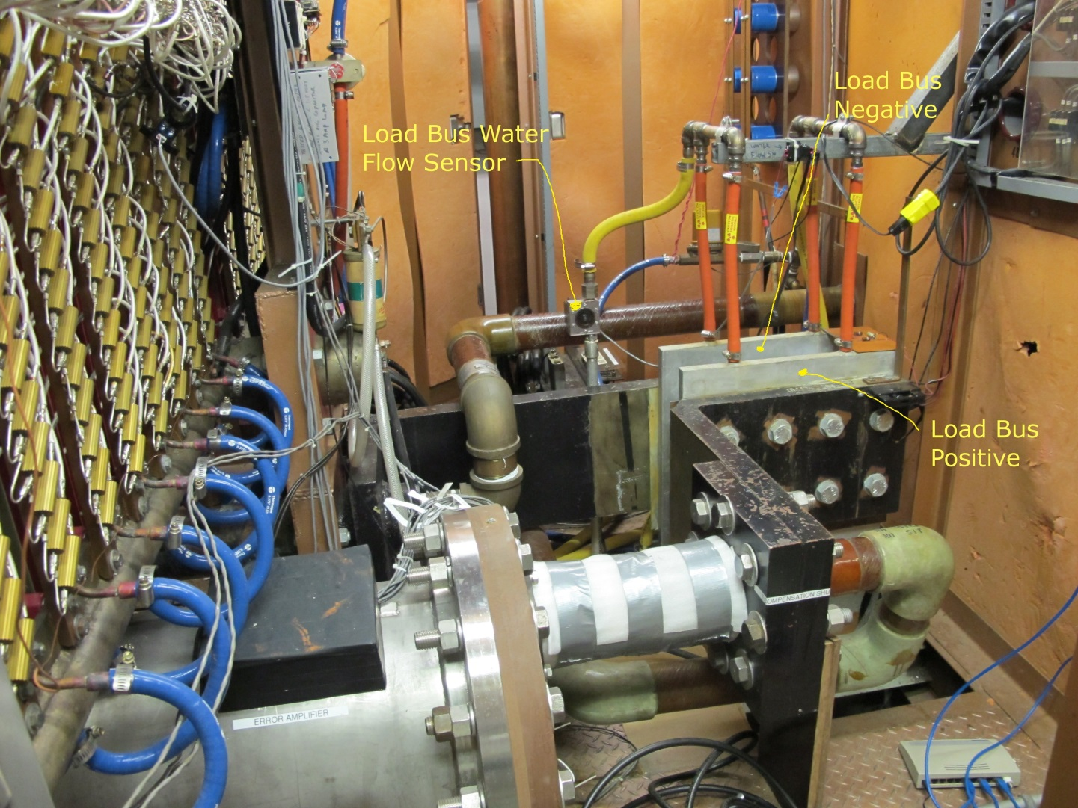
Cyclotron Magnet Power Supply – Cyclotron DC Bus Bars
Aluminum bus bar – cross section 1” X 18”
Cooled by aluminum low conductivity water.

Slide 25
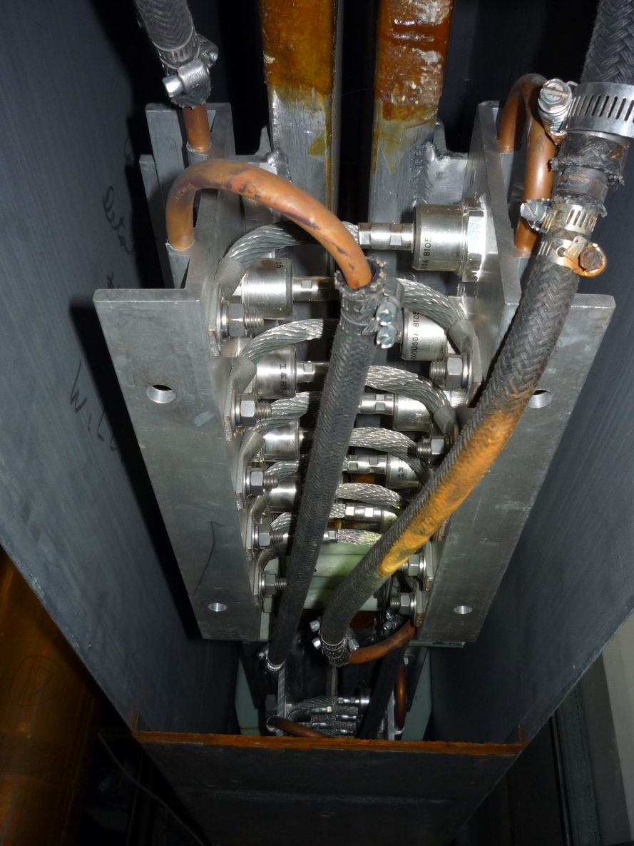
Cyclotron Magnet Power Supply – Free Wheeling Diodes
40 high power diodes connected in parallel to main magnet coils.
20 MJ of stored energy in the magnet during normal operation.

Slide 26
Cyclotron Magnet Power Supply – Magnetic Field Compensation
Stable output from the power supply does not guarantee stable magnetic field.
Physical characteristics of the magnet and environmental factors contribute to long term magnetic field drift.
The signal from a pickup coil is integrated and fed back to the control loop of the supply to counteract external disturbances.

Slide 27
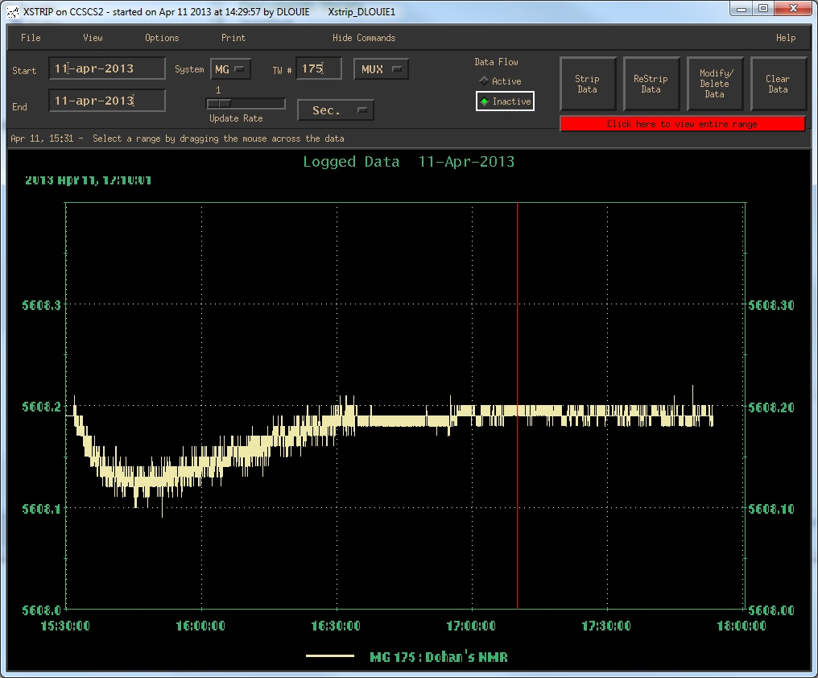
Cyclotron Magnet Power Supply – Pickup Coil compensation
Graph shows Nuclear Magnetic Resonance (NMR ) probe 5608.2 Gauss.
Compensation was disabled for first hour.
Long term drift for cyclotron magnetic field is < 1 ppm.
Compensation is disabled momentarily when adjustment is done on the main magnet or any of the trim and harmonic coils.

Slide 28
Cyclotron Magnet Power Supply - Replacement
Klaus Reinger (former TRIUMF Power Supplies Group Leader) authored the technical specifications for new power supply in March 2015.
Output Requirements:
Maximum Output Power 1.6MW DC continuous
Maximum Output Current 20 000 Amp DC
Maximum Output Voltage 80 Volt DC
Normal Output Current Range 17 000 to 20 000 Amp DC
Overall Stability +/- 2ppm of 20000 Amp for
range of 17 000 to 20 000 Amp

Slide 29
Cyclotron Magnet Power Supply - Replacement
The specifications was part of a Request for Proposal published in April 2015.
The following companies returned proposal:
OCEM (Bologna, Italy)
Danfysik (Taastrup, Denmark)
Alpha Scientific (California, USA)
JEMA (Gipuzkoa, Spain)
EEI (Vicenza, Italy)
TEMES (Warngau, Germany)
Price range $930 000 to $1 900 000 CAN

Slide 30
Cyclotron Magnet Power Supply - Replacement
Joerg Eckoldt, DESY, was member of the proposal assessment committee.
Contract was awarded to OCEM Power Electronics, Bologna, Italy.
Initial design report was accepted by TRIUMF March 2016.
Construction has started.
Testing at OCEM facility in November 2016.
Shipped to TRIUMF December 2016.
Installation begin during scheduled shutdown in January 2017.

Slide 31
Cyclotron Magnet Power Supply
Thank You !
Gracias !

