Slide 1
Powering New Projects at
Brookhaven National Laboratory
Bob Lambiase
5th Workshop on Power Converters for Particle Accelerators
24 – 26 May 2016

Slide 2
Brookhaven Linac Isotope Producer (BLIP) Upgrade
To increase the production of medical isotopes, the average beam current needed to be increased. To prevent overheating and target damage, the beam is scanned over a larger area of the target. This scanning is done by a two axis dipole magnet with a ferrite core.
To efficiently reach the design goals, the magnet was resonated. The resonating capacitors were remotely located from the magnet, which was in a high radiation area, by Kapton insulated litz wire. An impedance matching transformer created the optimum operating point for linear amplifier from the losses in the magnet.
The control system implemented the two amplitude loops, a frequency loop to optimize power factor, and a phase loop to maintain the 90° difference between axes.
Specifications
Nominal Frequency: 4,800 Hz
Peak Magnet Current: 318 Amps
Load Inductance: 68 µHy
Apparent Magnet Power: 106 kVA
Load Losses: 3.18 kW
Resonating Caps: ICAR THY series
Cap Construction: Oil – Metalized Film
Linear Amp: Pacific Power 160AMX
Amplifier Rating: 6 kVA
Controls: NI–PXIe type with LabView
Sensors: 3 independent sets, passive
Protection: 2 independent, Zynq based

Slide 3
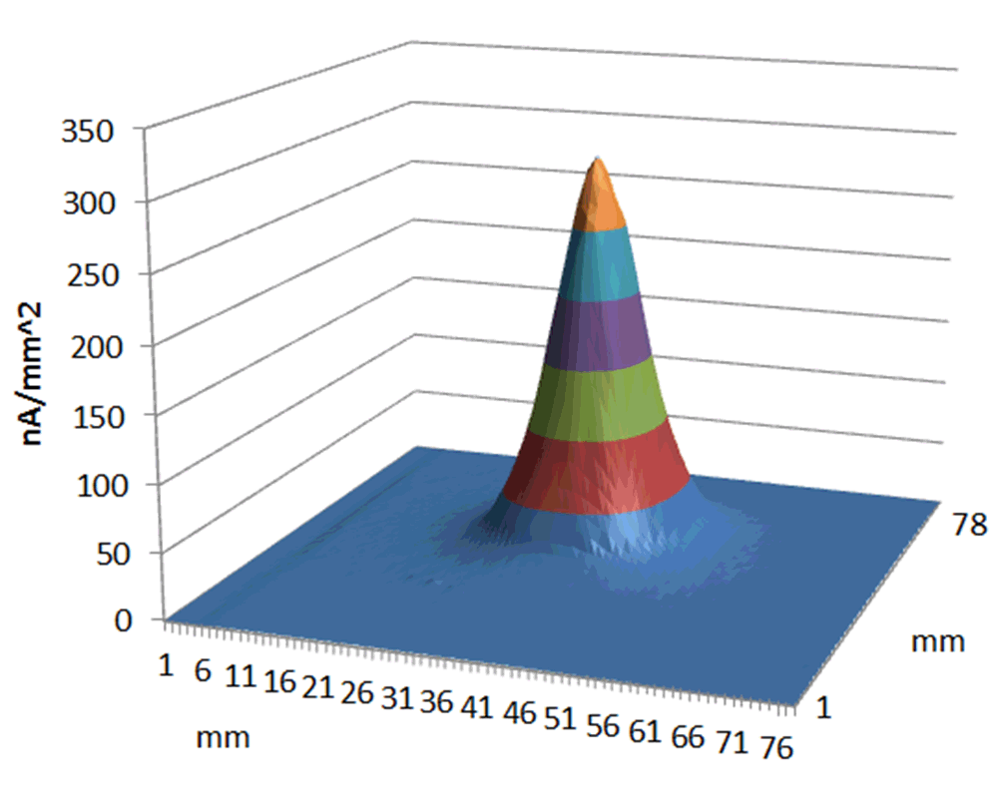
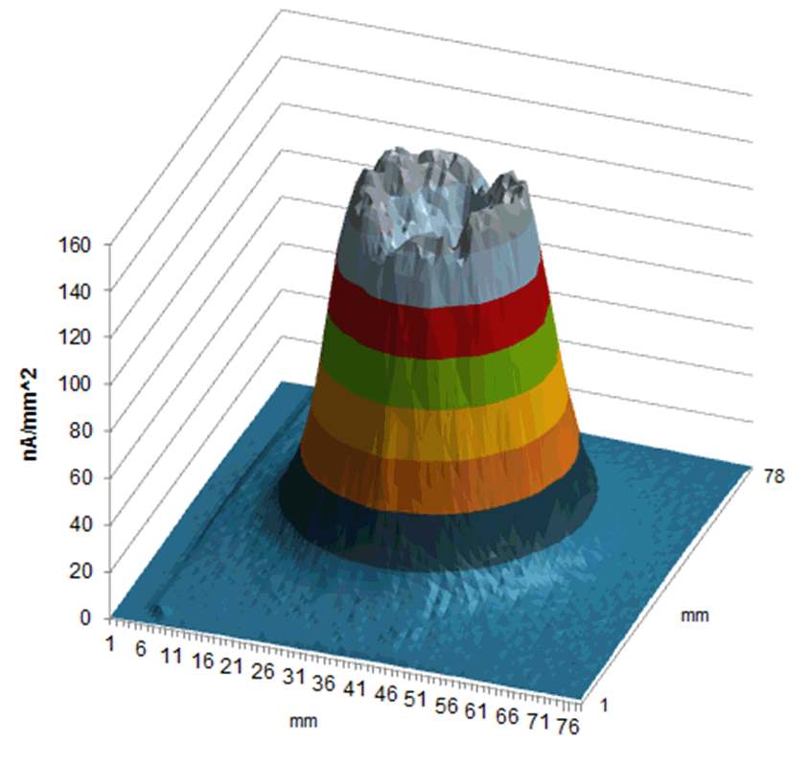
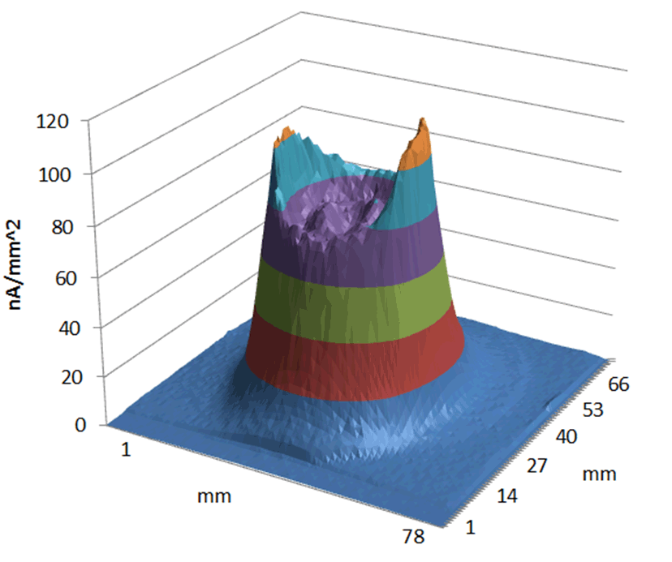
BLIP Upgrade Operational Results
The scanning power supply successfully ran over a weekend at the full 318A peak. After that, a leak was discovered on a ceramic beam pipe seal. The beam pipe was replaced and the current is now limited to 260A and a warm up profile is used to reduce stress.
The charts on the right show current density distribution on the target. The top chart is the pattern for 100µA average current, without scanning. The bottom is the pattern for 155µA average current. This is achieved with four beam pulses at 155A peak magnet current and one pulse at 71A.
The system was also operated at 200 MeV and 140µA average current. The scanning magnet sequence for this mode was four beam pulses at 225A peak and one pulse at 95A peak.
The 200 MeV current density distribution is shown to the left.

Slide 4
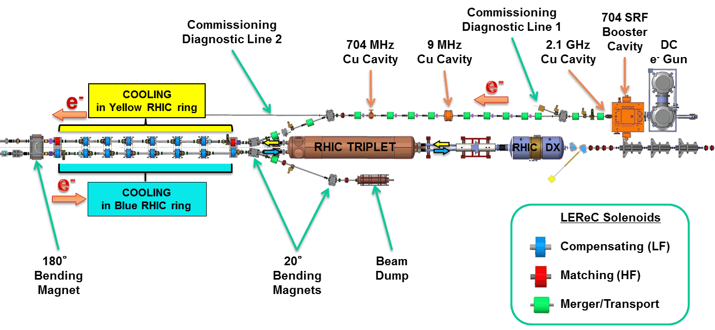
Low Energy RHIC Electron Cooling (LEReC)
An electron cooling section is being installed near the 2:00 interaction region of RHIC. This will permit operation of RHIC at energies lower than is now possible. This opens a new region for research.
This system is currently under construction. It re-uses many of the power supplies and some of the magnets from the BNL R&D ERL, which recently ceased operation.

Slide 5
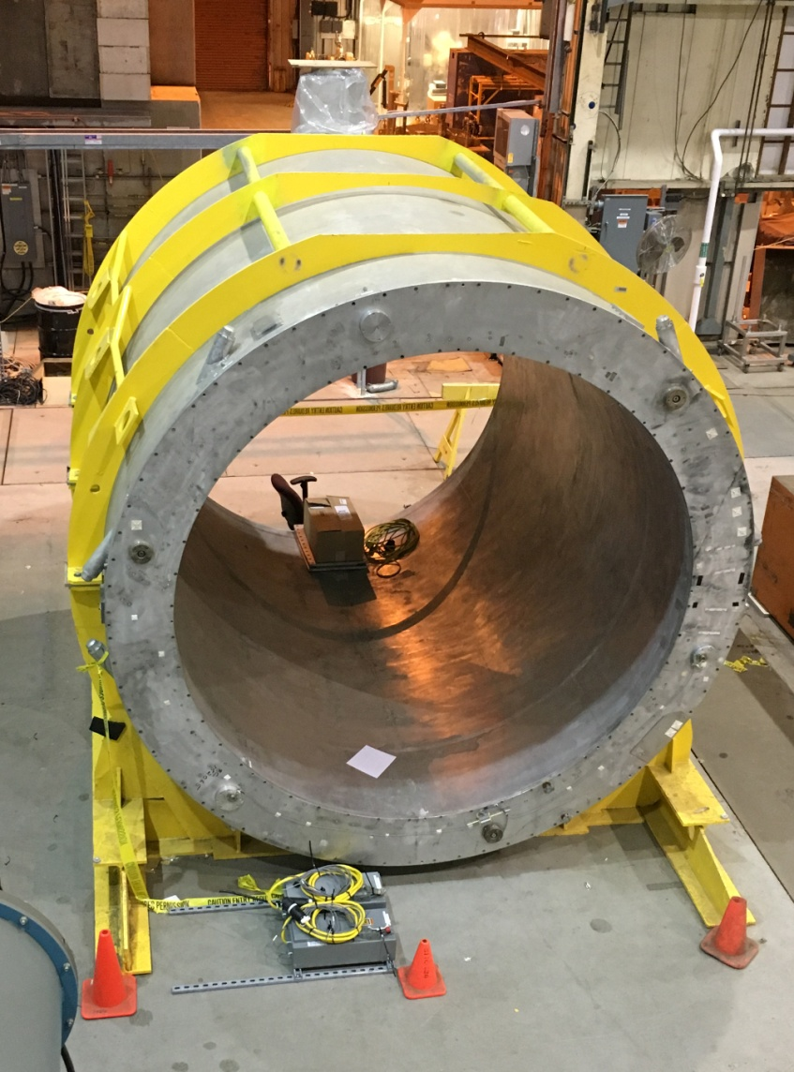
sPhenix
A superconducting solenoid, formerly used as part of SLAC’s BaBar experiment, was available for use as an upgrade to BNL’s Phenix detector. The upgraded magnet was designed to server as the foundation of a future ePhenix, to be compatible with BNL’s proposed electron ion collider (EIC), known as eRHIC.
This massive 40,000 pound magnet was shipped to New York from California by truck. This magnet is 3.5 meters across and 3.9 meters long.
The magnet is designed to create a 1.5T central field at 4,600 Amps. It uses NbTi superconductor stabilized by aluminum and operates at 4.2K. With an incductance of about 2.4 Hy, is stores 25 MJ.
Once the magnet arrived at BNL, it was prepared for low current testing. This past March, the unit was cooled to 4.2K and tested with 100 Amps. This test showed the magnet was viable, and provided key parameters to set up the quench detection system for the high current test. Instrumentation also measured strain gauges to monitor forces, and linear potentiometers for movement during cool-down.
Full current testing is scheduled at 4,600 Amps early in 2017.

Slide 6
eRHIC
eRHIC is the proposed electron ion collider. It will use one of the existing heavy ion rings, which is now part of RHIC with new polarized electron rings.
Some of the features of this electron ring are:
A common Energy Recovery Linac (ERL) for all energies.
Two Fixed Field Alternating Gradient (FFAG) rings made using permanent magnets. The low energy FFAG has beams at 1.7, 3.4, and 5.0 GeV. The high energy FFAG has beams at 6.7, 8.4, 10.0, 11.7, 13.4, 15.0, 16.7, and 18.3 GeV. Because there is no control over permanent magnets, 8,500 correctors are needed.
One high energy transport line at 20GeV
A polarized electron source. The primary source is multiple single cathodes, with beams combined by electrostatic plates driven resonantly. A lower cost Gatling Gun approach is being investigated in parallel.
Coherent Electron Cooling.
Experimental area upgrade. Initially, there will be one detector, ePhenix.

Slide 7
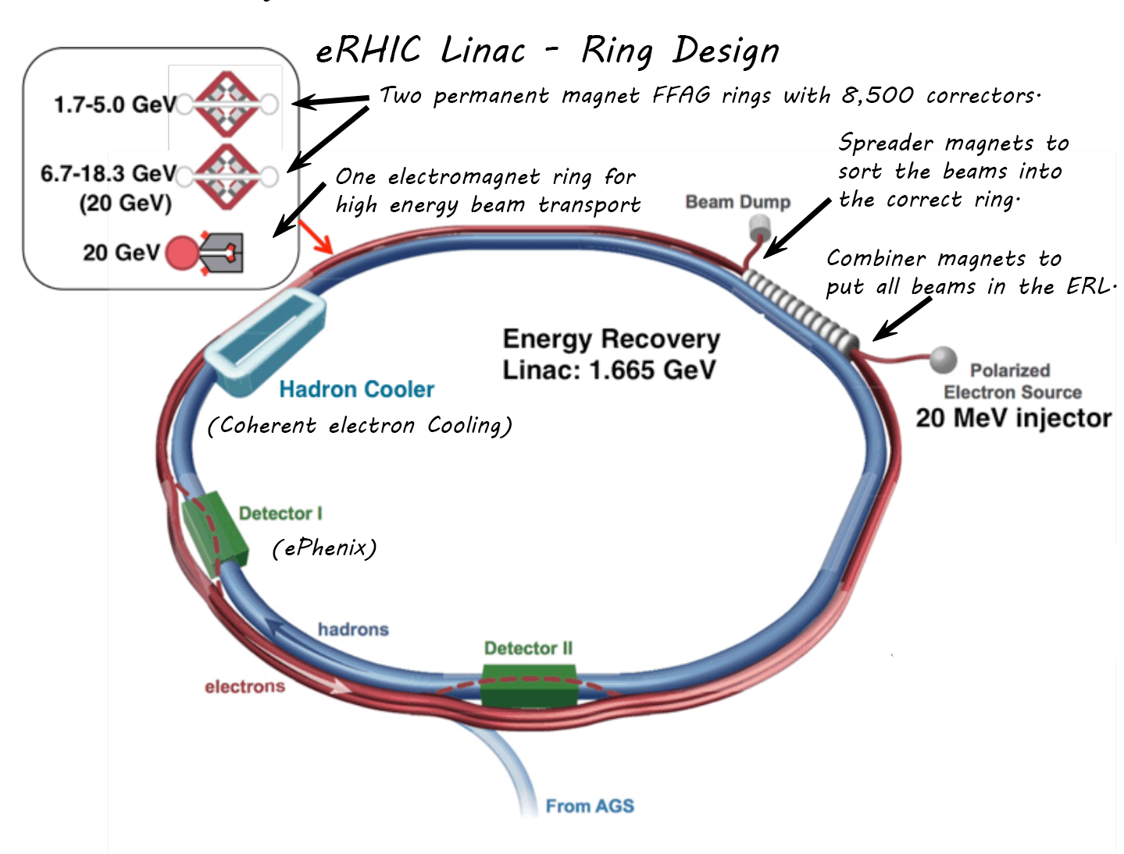

Slide 8
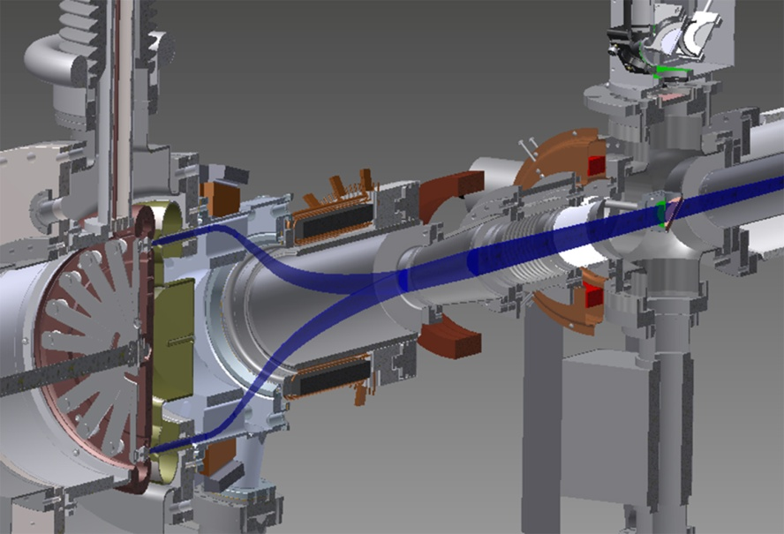
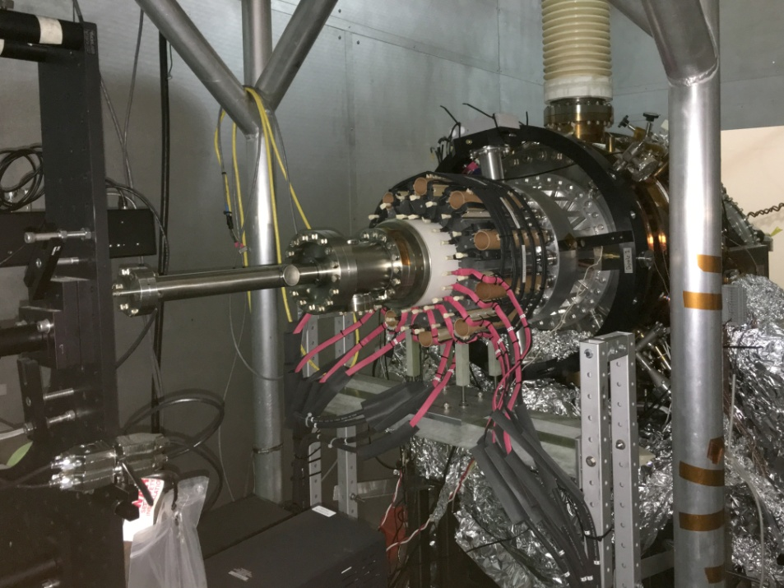
Gatling Gun Polarized Electron Source
While eRHIC is planned to have a more conventional source, a multiple cathode (Gatling Gun) alternative is being developed as a potential lower cost solution.
The electrons from twenty cathodes are to be bent into a dipole / quadrupole field that is designed to rotate at 650kHz
The system has been designed to operate at up to 250kV, but low frequency testing to this point has be done at about 45 kV.
The equipment shown at the left is installed and is being tested at Stony Brook University.

Slide 9
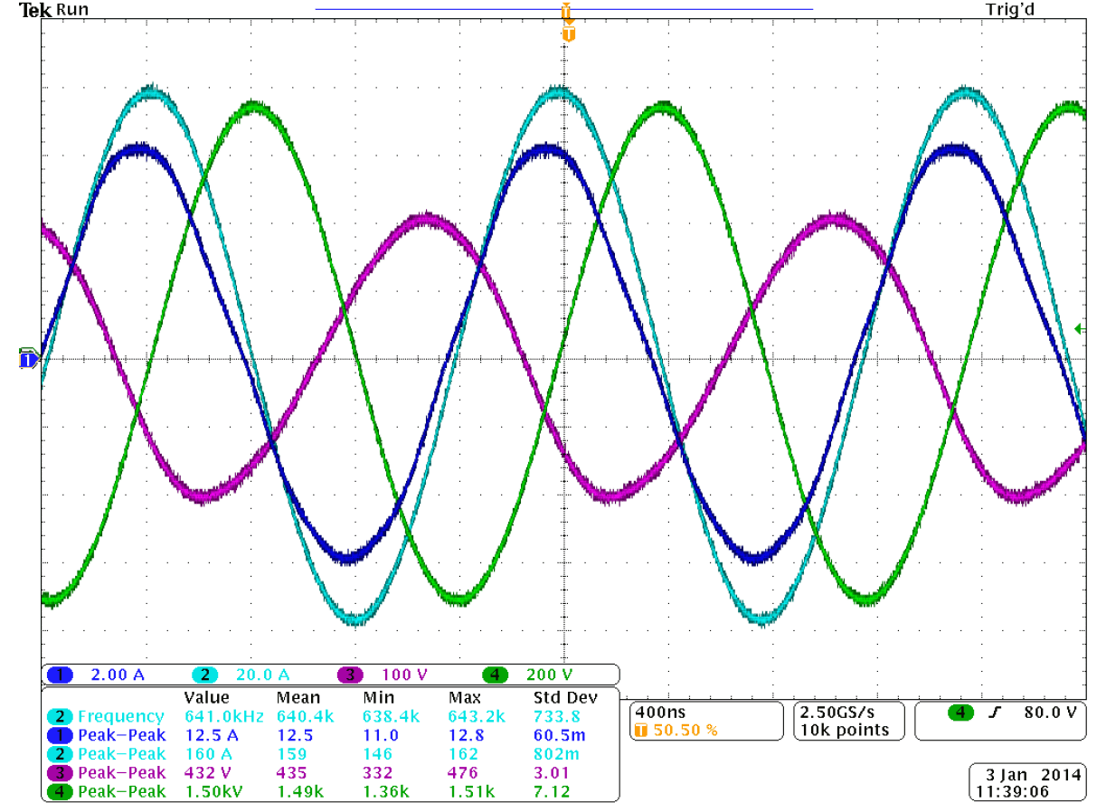
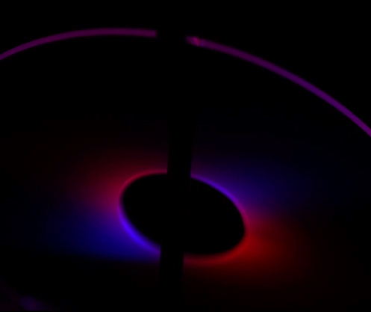
Gatling Gun – Some Test Results
The combination of the beams (1µA, 40kV) from two cathodes can be seen from the Yag crystal picture below. This has been artificially color enhanced to differentiate the two beams.
This test was used to determine what effect one cathode had on the lifetime of the other.
The high frequency characteristics of the combiner magnet circuit were tested. The 2.31µHy dipole circuit was resonated and matched to a lower impedance input with a capacitive transformer.
In the scope trace, Ch 1 (Dk Blue) is input current, Ch 2 (Lt Blue) is magnet current , Ch 3 (Purple) is input voltage, and Ch 4, (Green) is magnet voltage.

Slide 10
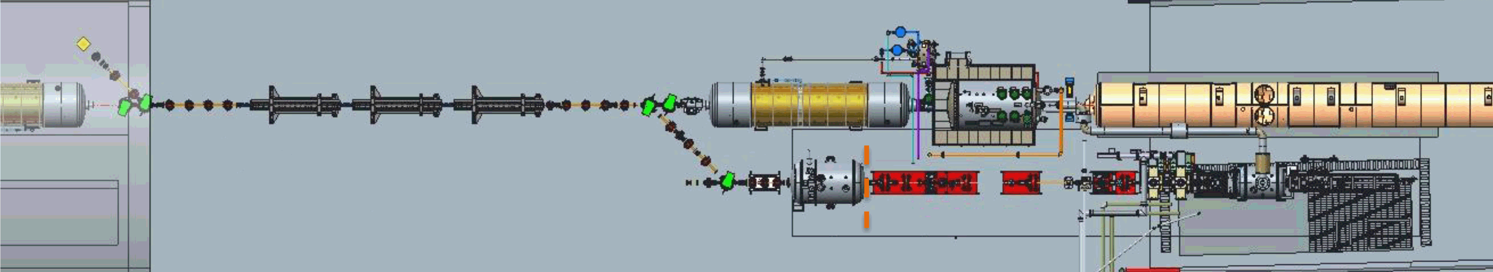
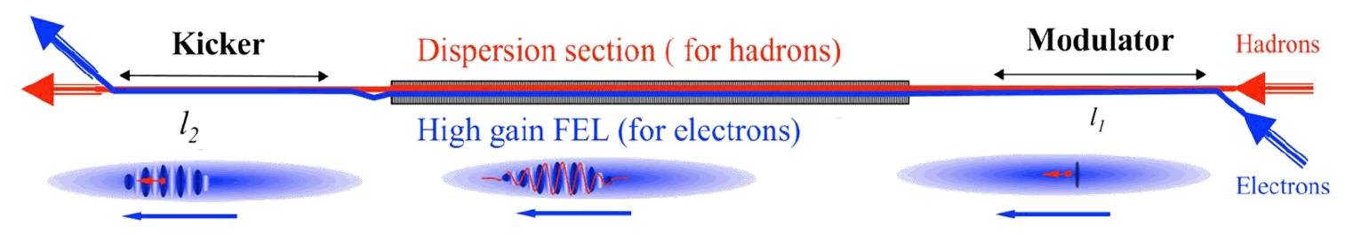
Coherent Electron Cooling - Proof of Principle
Electrons are injected into the modulator section, where they travel at the same speed as the hadrons. The hadrons density modulate the electrons. In the wiggler section, the speed of the electrons along the beamline axis is slowed, but the modulation frequency remains the same. This amplifies the density modulation. In the kicker section, the electrons and hadrons are again at the same velocity, and the electron modulation cools the hadron beam.

Slide 11
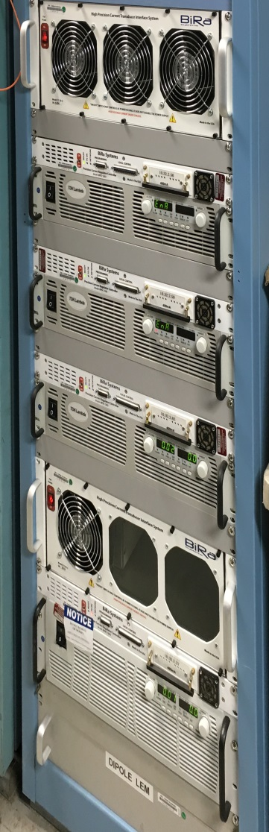
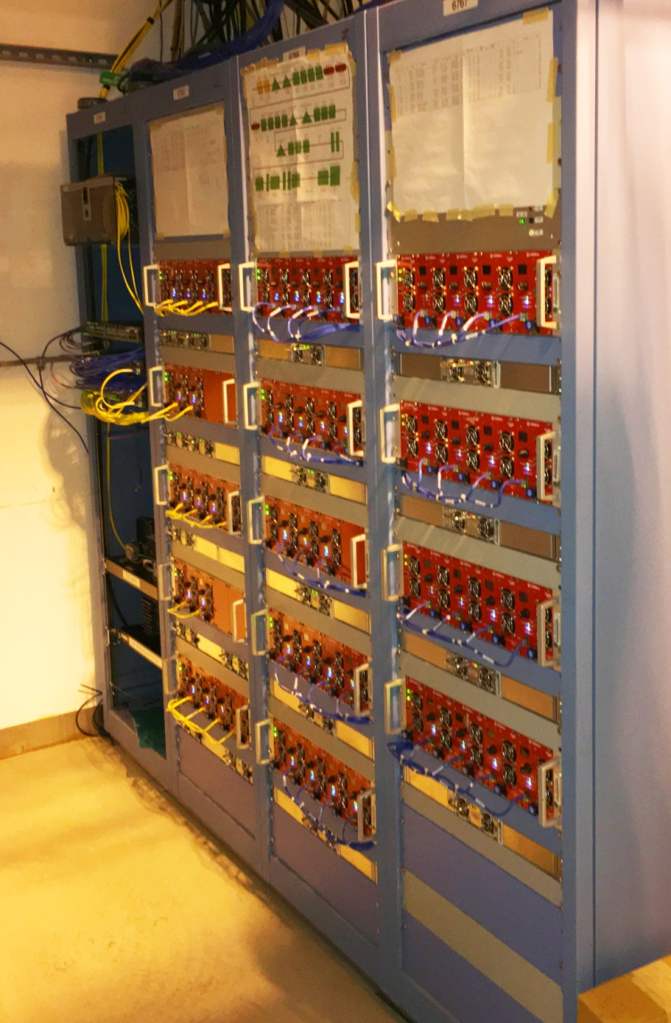
CeC PoP Implementation & Status
The 140A main dipole string and three 75A wiggler phase shifters use BiGen supplies. There are three components: the Genesys PS, the Ethernet Power Controller, and a DCCT / FWD chassis.
The remaining 68 power supplies are implemented with CAENels SY3634 type units with current ratings from 1A to 20A, and either 20V or 40V voltage ratings. The versatility of this system allowed reconfiguration among different stages of development.
All power supplies have been installed and tested. Commissioning has begun with the photocathode electron source and low energy beam transport.

