Slide 1
Automated power supply commissioning
Simon Richner :: Development Engineer :: Paul Scherrer Institut
5th POCPA workshop 24.05.16 – 26.05.16
Notes:
Hello, I’m Simon Richner from PSI and I’m going to talk about our new automated power supply commissioning tool.

Slide 2
Overview
The SwissFEL Project
  Reasons for remote access over Ethernet
  Reasons for automated commissioning
Auto commissioning tool
  Load identification
  Controller parametrization
  Verification
Outlook

Slide 3
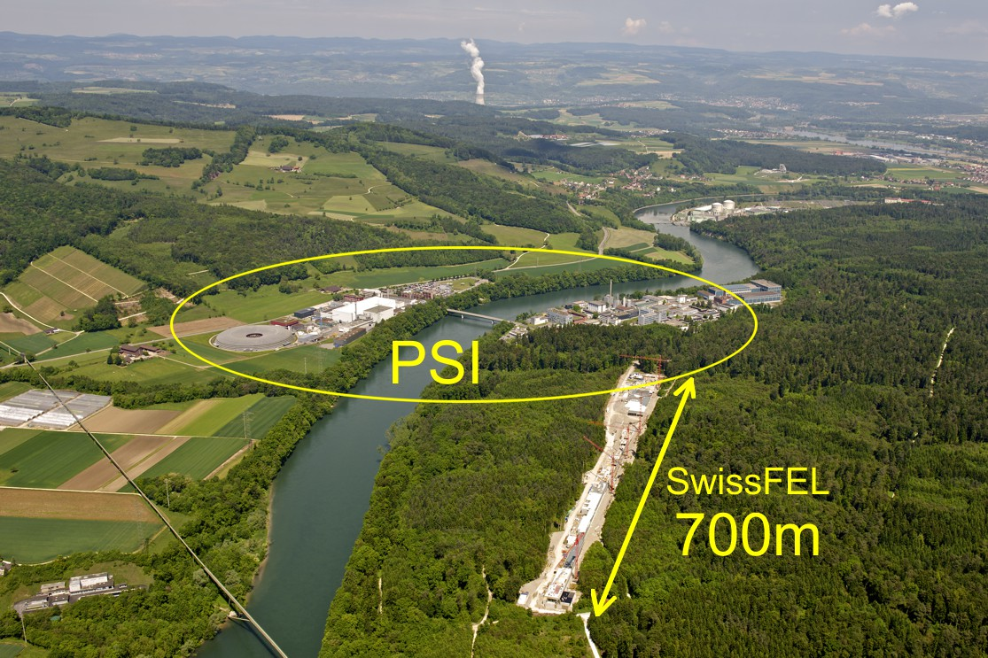
The SwissFEL project
Notes:
… This brings me to the reason, why we descided to connect all of our power supplies over Ethernet.

Slide 4
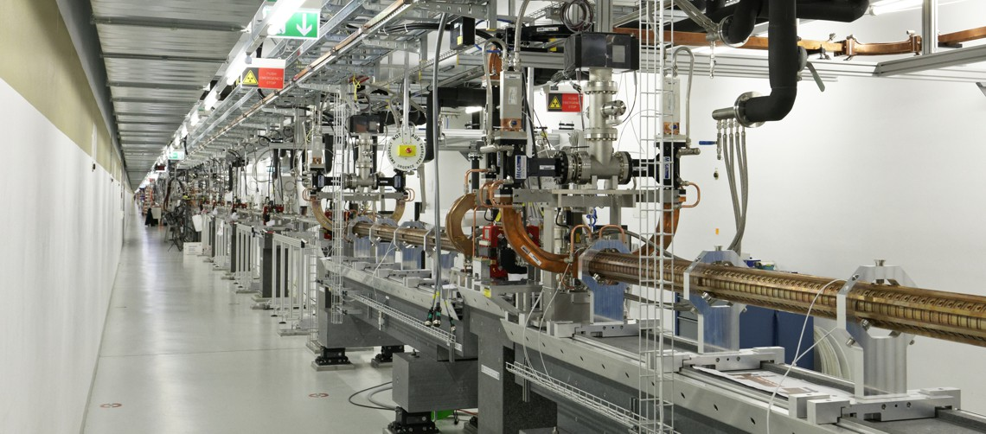
Reasons for remote service access
Facility size and location
  Remote monitoring
  Remote soft-/firmware update
  Access to multiple power supplies at one time
700m beam line
75 converter racks
300 controller cards
800 power supplies
Notes:
Only read acces over EPICS,
Slow connection
Limited data access

Slide 5
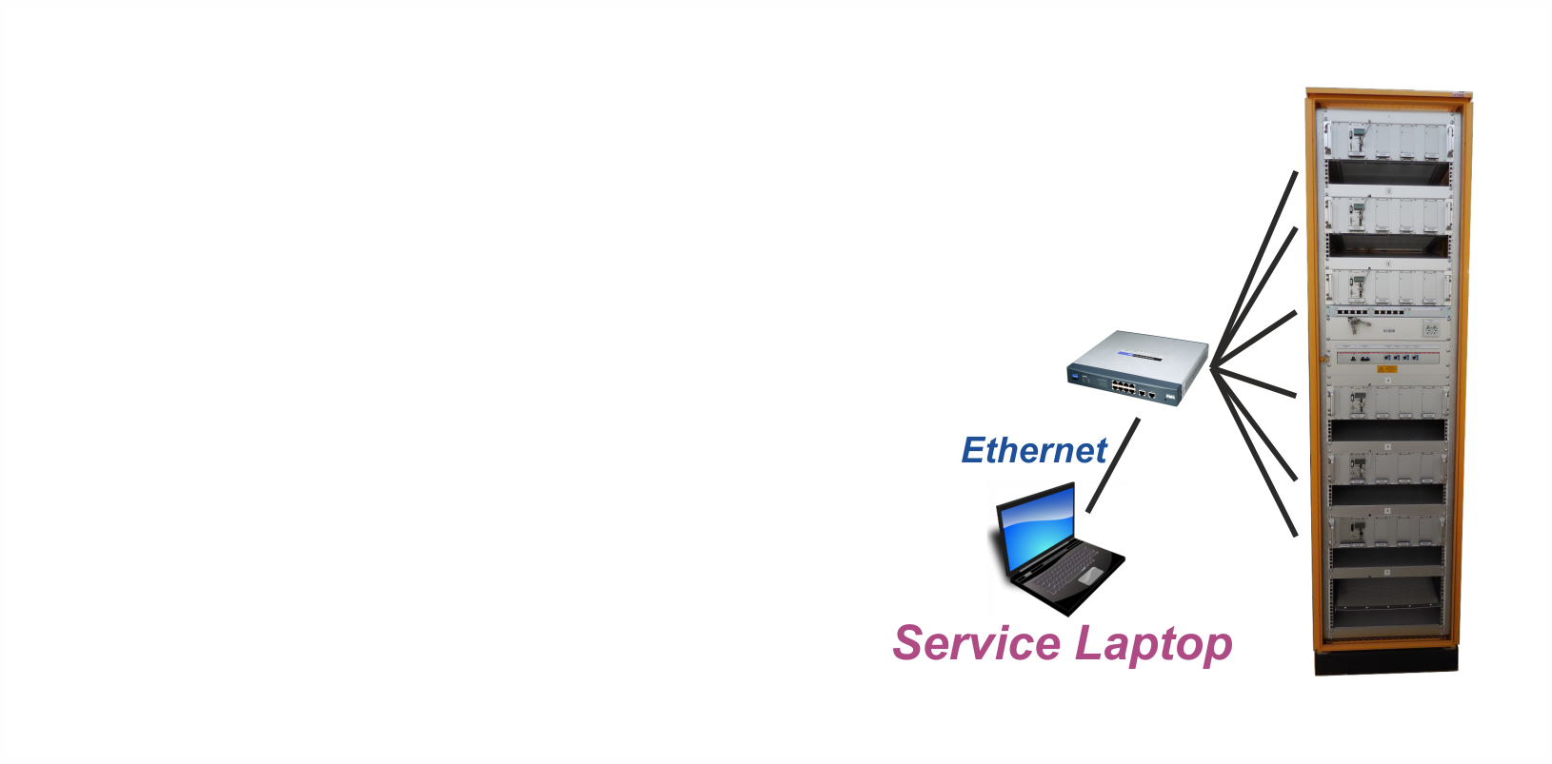
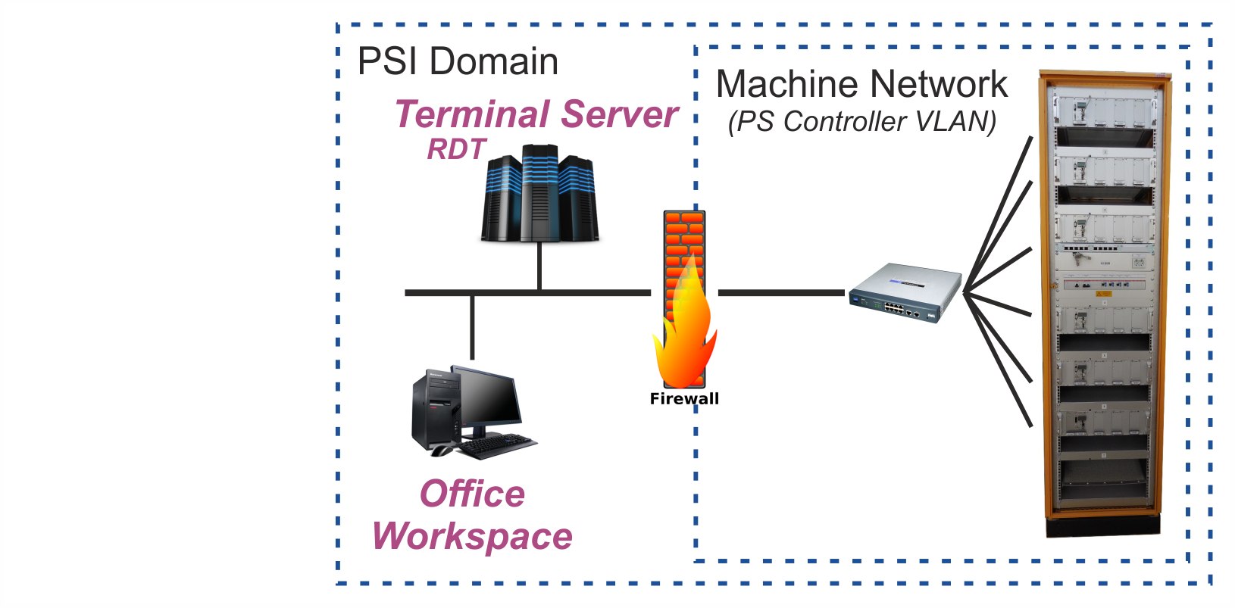
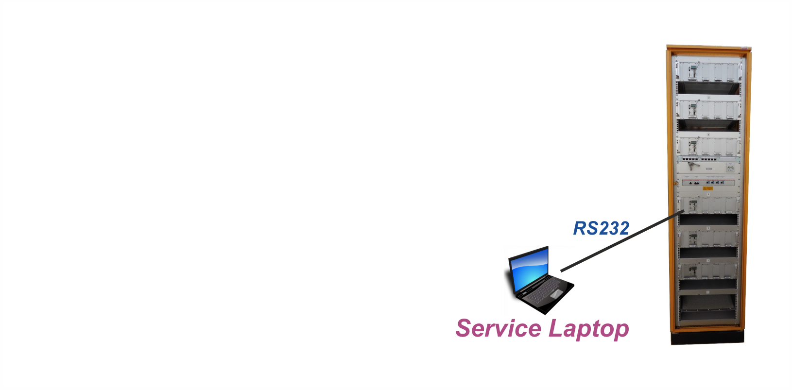
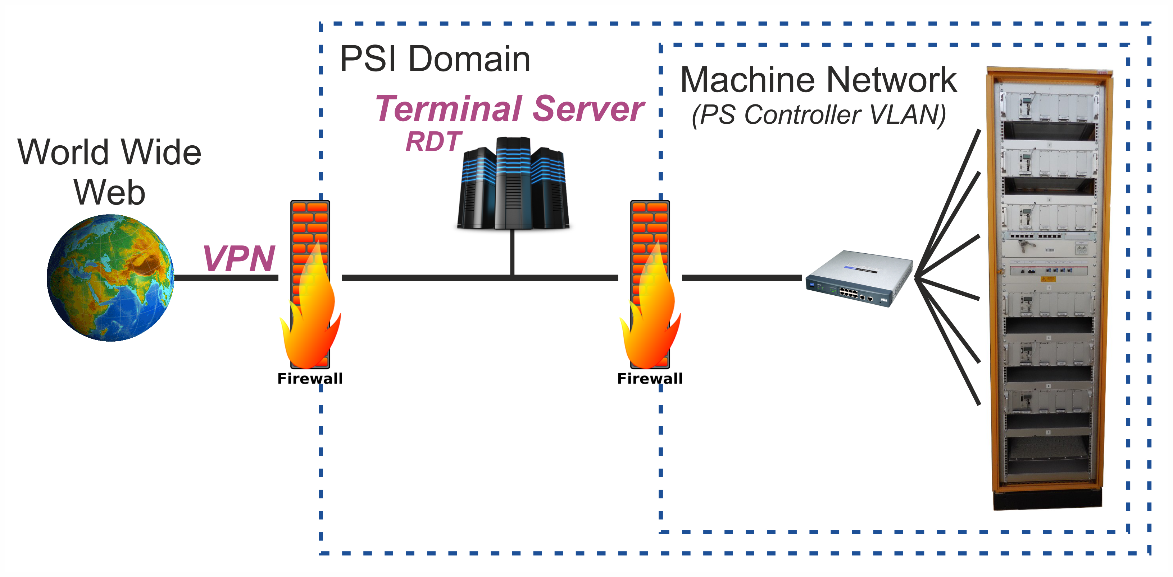
Remote access over Ethernet
Local access (unprotected)
Domain wide access (via Terminal Server)
World wide access (via VPN)
Notes:
Monitor several power supplies at once
But the great benefit is, that we can access the power supplies from the office workspace.

Slide 6
Reasons for auto commissioning
Simplify commissioning process
Reduce commissioning time (10min per power supply)
Eliminate human errors
Document the behavior (reproducibility)
Archive results

Slide 7
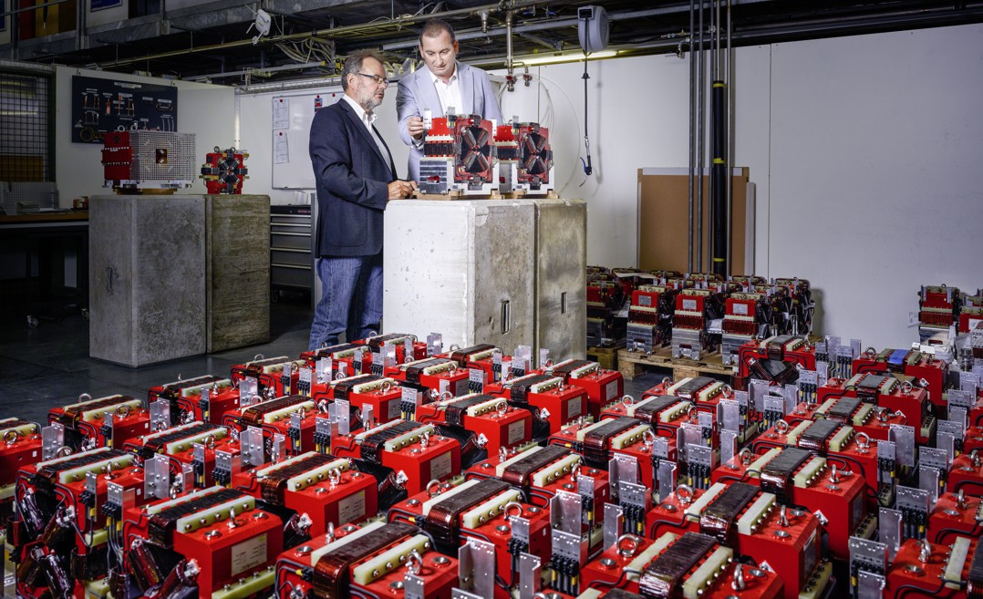
Auto Commissioning – Requirements
Focus on commissioning
  No focus on optimization
  No independent external verification
Focus on small power supplies (97% coverage)
764 small power supplies
  731 x 10A/24V
  20 x 50A/24V
  13 x 20A/10V
  30 magnet types
24 larger power supplies
  10 magnet types

Slide 8



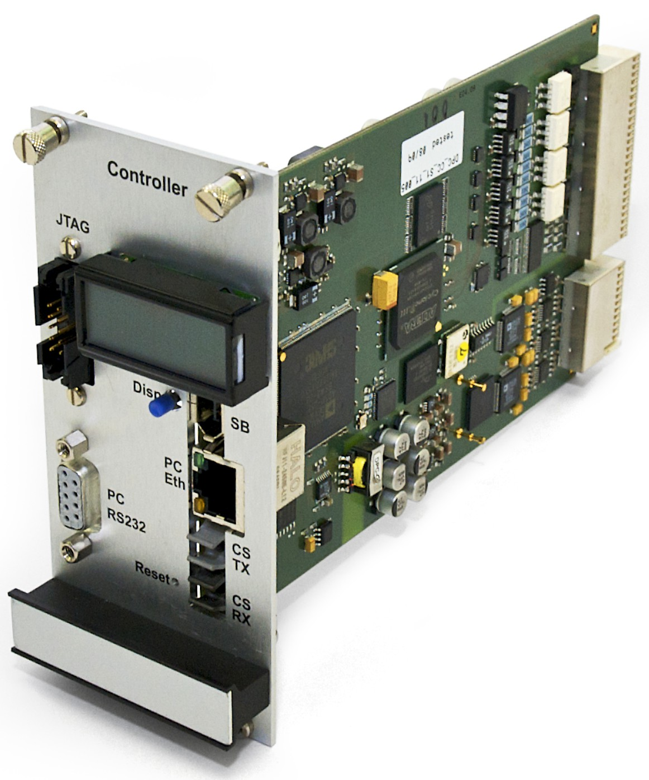
Auto Commissioning – Setup
Magnet-Type specific settings file
  Nominal current
  Target bandwidth
  Tolerance limits
Access to controller via service tool
  Communication over Ethernet
  Consecutive commissioning of multiple power supplies without intervention
Ethernet
100MBit/s
Notes:
Don’t have to be on site.

Slide 9
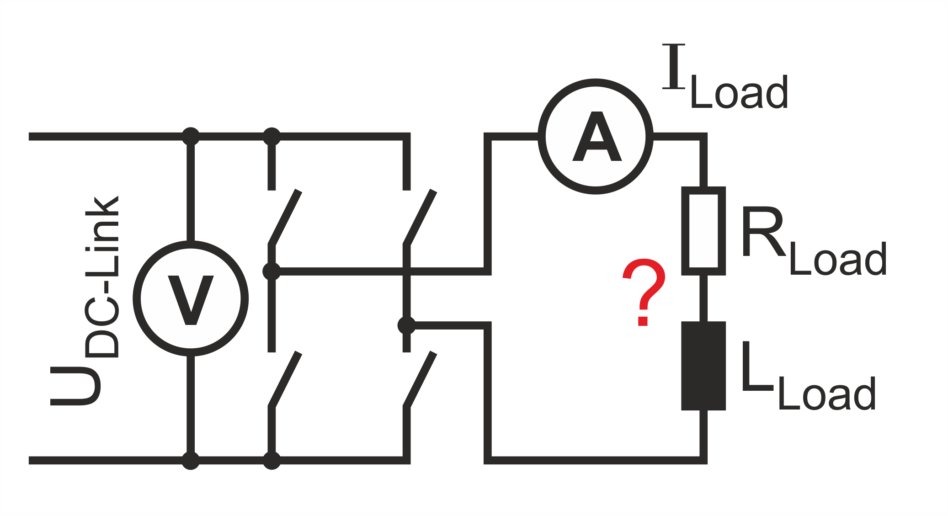
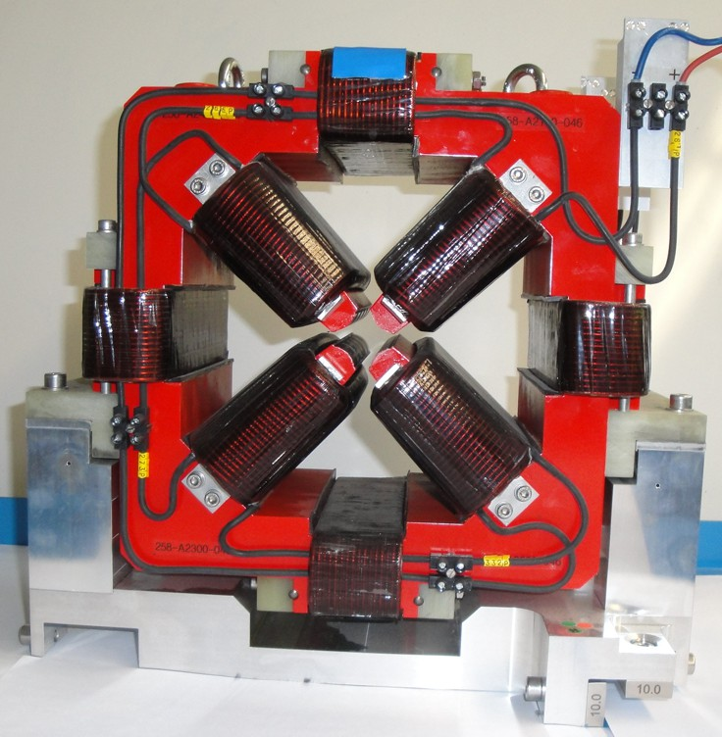
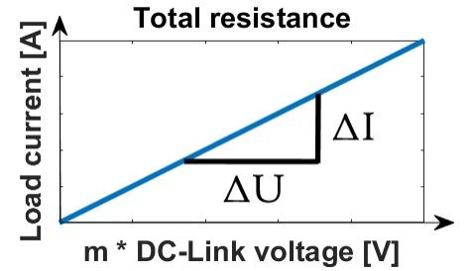
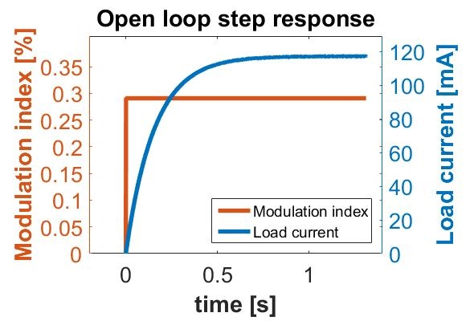

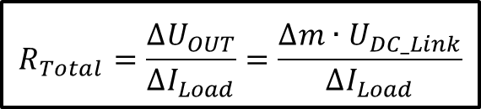
Auto Commissioning – Load Identification
Estimate total resistance
  Small modulation steps
  Monitor input voltage and load current
Record open loop step response
  At 50% of nominal current
  1% step of nominal current
  Sample load current @ 100kHz
$$R_{Total}=\frac{∆U_{OUT}}{∆I_{Load}}=\frac{∆m∙U_{DC_Link}}{∆I_{Load}}$$
$$L_{Total}=τ∙R_{Total}$$
Notes:
Record load current at a sampling rate of 100kHz.

Slide 10

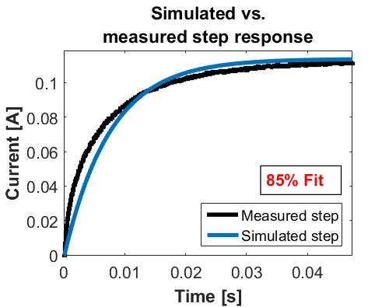
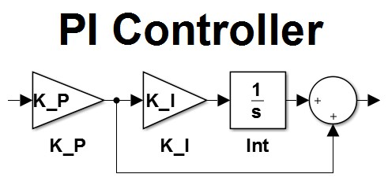
Auto Commissioning – Parametrization
Simulate load behavior
  Correlate step response with a 1st order low pass filter model
Calculate feedback parameters
  Use simple PI-controller
  Calculate K_I / K_P
  Limit dm/dt slope to prevent damage to converter
  Calculate and set further control parameters

Slide 11
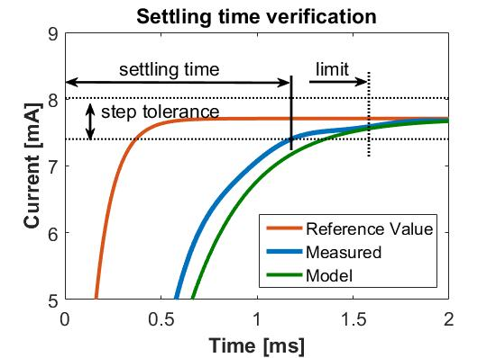
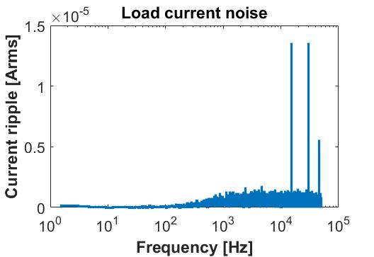


Auto Commissioning – Verification
Verify controller behavior
  Closed loop settling time
  Ramp error
  Load current ripple
  Noise spectrum (purely informative)
Generate and archive report
  Pdf/Html report for manual inspection
  Parameter files for backup
  Raw data for further analysis
+
Notes:
Operate the controller in a linear range.

Slide 12
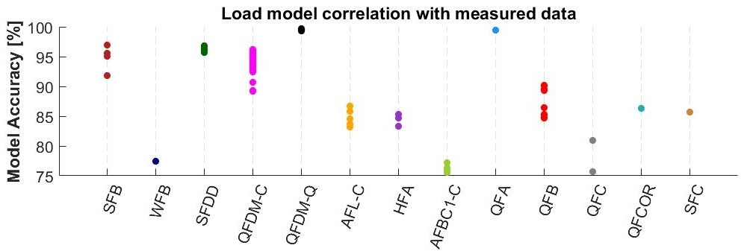
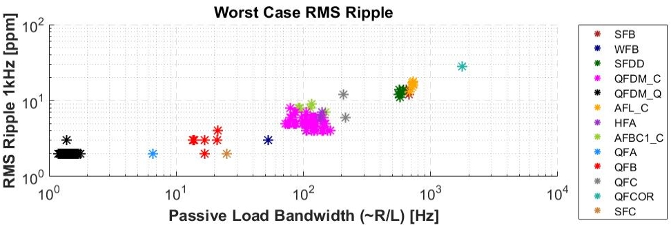
Auto Commissioning – Summary Report

Slide 13
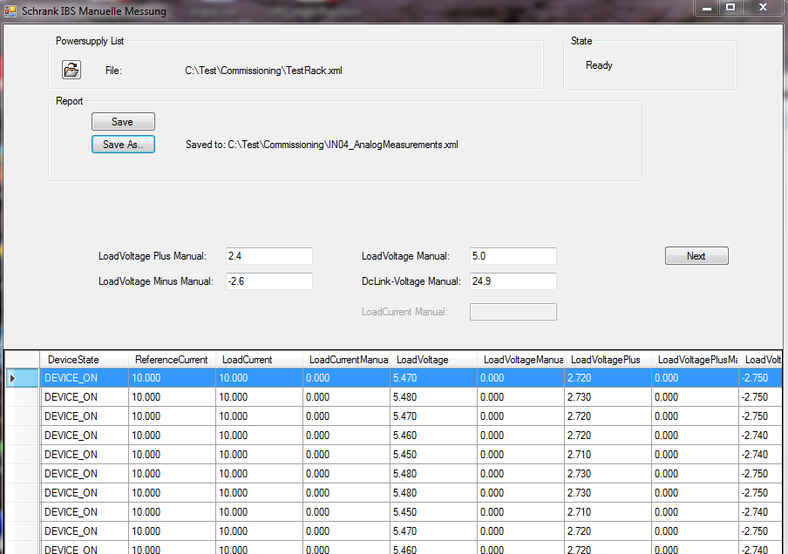
Auto Commissioning – Manual Steps
Manual work steps (half automated)
  Polarity check
  Verify analog measurements

Slide 14
Auto Commissioning – Outlook
Outlook
  Better models for iron core magnets
  More detailed verification?
  Draw conclusions from collected data?
  Further enhancements depend on future projects

Slide 15
Wir schaffen Wissen – heute für morgen
My thanks go to
Hans Jäckle
David Clavier

