Slide 2
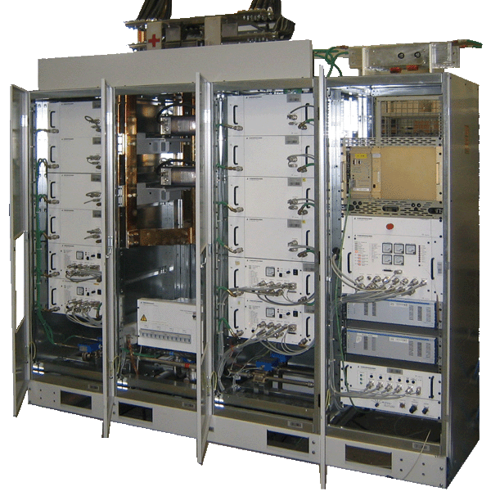
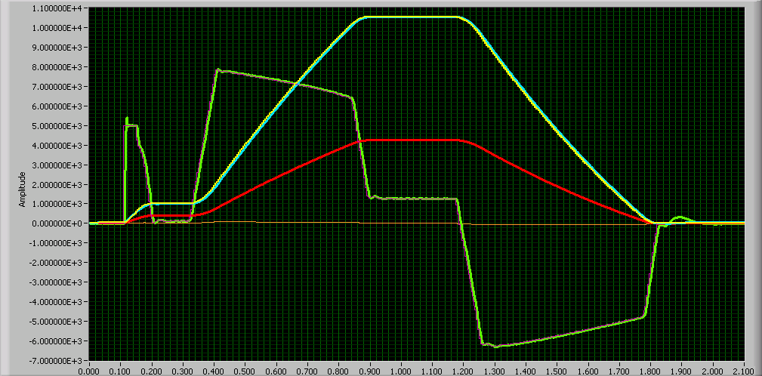
Converter specification : internal or external design, for smooth and efficient contracts
POCPA 2016 – Alba Synchrotron
Gilles Le Godec
Contribution:
Jean-Paul Burnet
Yves Thurel

Slide 3
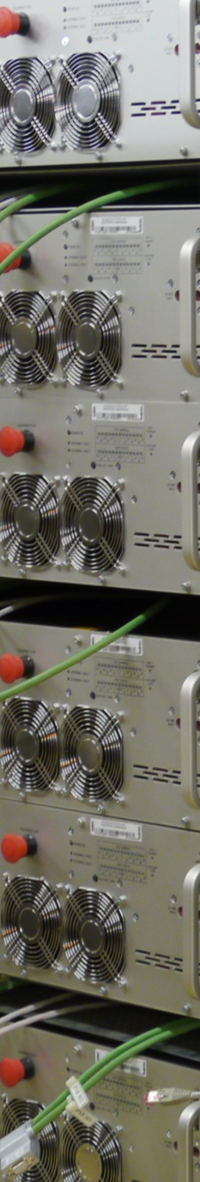
Introduction and strategy for procurement
Off-the-shelf Voltage Source Converter
Voltage Source specified Converter
CERN designed Converter
Conclusions

Slide 4
Introduction and strategy for procurement
Off-the-shelf Voltage Source Converter
Voltage Source specified Converter
CERN designed Converter
Conclusions

Slide 5
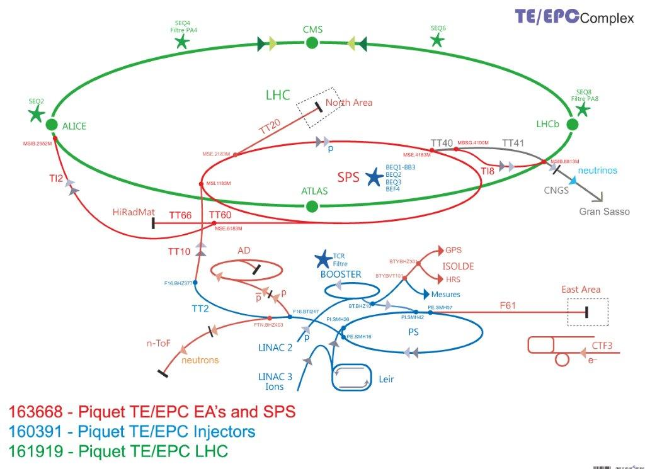
1 Introduction and strategy for procurement
Accelerators at CERN…A complex business

Slide 6
1 Introduction and strategy for procurement
After more than 40 years there is a zoo of different types of converters at CERN:
  More than 5000 equipment used to deliver protons in the LHC machine,
  A Power range from 150W to 150MW,
  Different requirements:
Complex | Mode of operation | Accuracy class | Current loop Bandwidth
LINAC, PSB | Fast cycling (ms range) | 100 ppm | > 1 kHz
PS | Cycling (1.2s) | 100ppm | Up to 1 kHz
SPS | Cycling (up to 20s) | Up to 10 ppm | Up to 100 Hz
LHC | DC | 1 ppm | 1 Hz

Slide 7
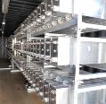
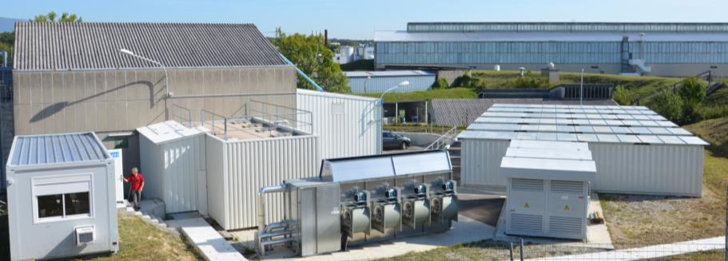
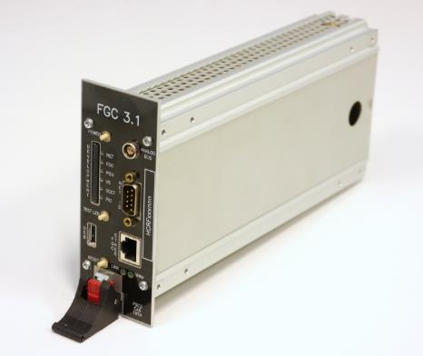
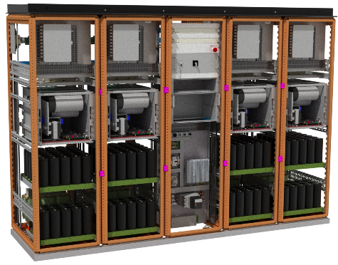
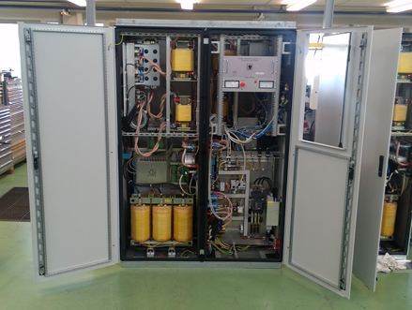
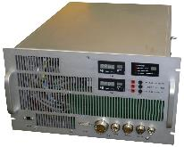

1 Introduction and strategy for procurement
Control room
Electrical room
Cooling tower
Power transformers
Capacitor banks
What is common to all these converters?
POPS – 60 MW
SIRIUS – 200/810 kW
CONTROLLER
High-precision Current loop
COMET – 60 kW
COBALT – 10 kW
CUTE - 180W

Slide 8
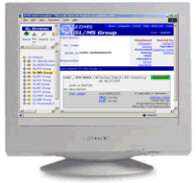
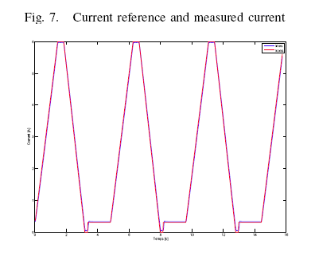
1 Introduction and strategy for procurement
The TE/EPC Group Structure is reflecting the procurement strategy
TE/EPC Group
8 Sections - ~ 70 staff
In charge of the design, development, procurement, construction, installation, operation and maintenance of electrical power systems for all accelerators, transfer lines, experimental areas and tests facilities at CERN
Software development
Electronic
design
Power Converter design
(few kVA to hundreds MVA)
Measurement
design
Maintenance Management Support
Control systems
Analog and digital electronics
Power electronics
High-precision current and voltage measurements
Maintenance management
Section CCS
Converter Control Software - 5 staff
Section CCE
Converter Control Electronics - 5 staff
Sections:
FPC: Fast Pulsed PC - 8 staff
LPC: Low PC - 10 staff
MPC: Medium PC - 10 staff
HPC: High PC - 10 staff
Section HPM
High Precision Measurement
- 5 staff
Section OMS
Operation Maintenance Support - 15 staff
I_{ref}
AC
Reg.
DC
I
Magnet
CONTROLLER
VOLTAGE SOURCE
DCCT
CURRENT SOURCE

Slide 9
1 Introduction and strategy for procurement
CERN Strategy for procurement
A current source is never procured/specified,
The Controller is designed and procured by CERN,
    Function Generator/Controller Version 3 (FGC3).
    1400+ will be installed by the end of 2020.
The high-precision current sensors are specified and procured by CERN,
The Voltage Source is designed/specified and procured by CERN
  Specified Voltage source (external or internal design),
  Off-the-shelf Voltage source,

Slide 10
Introduction and strategy for procurement
Off-the-shelf Voltage Source Converters
Voltage Source specified Converter
CERN designed Converter
Conclusions

Slide 11
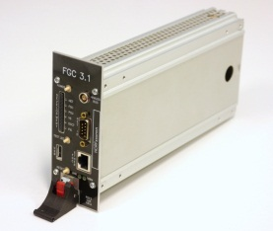
2 Off-the-Shelf Converter
Off-the-shelf Voltage source (e.g.DELTA, TDK)
  Validation of the performances of an existing product,
  Assume system integration responsibility: Voltage Source with FGC3, DCCTs,…
  Validation of current source prototypes,
FGC3
VOLTAGE SOURCE
Func.
Gen.
I _{ref}
Digital
Current
Regulation
V_{ref}
Voltage
Regulation
Power
part
DAC
V _{meas}
I _{meas}
ADC

Slide 12
2 Off-the-Shelf Converter
Benefits:
    Costs and time to market,
    Resources…however it requires a minimum development for interfacing within CERN environment,
Disadvantages:
    Some criteria have to be relaxed: diagnostic, network voltage losses (e.g. 1 phase),…
    No possibility to improve performances (e.g Voltage loop bandwidth),
    Maintenance costs,

Slide 13
Introduction and strategy for procurement
Off-the-shelf Voltage Source Converter
Voltage Source specified Converter
CERN designed Converter
Conclusions

Slide 14
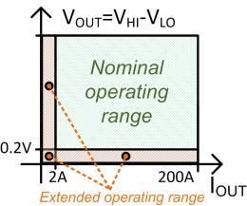
3 Cobalt Converter: Overview
Overview of the context
  49 converters in operation for Hie Isolde machine
          High precision (DCCT), Controller & Power Rack: managed by CERN,
          Need: [200 A; 50 V] Voltage Power Source
  Very short contract with ≈ 2 years given to contract winner
          Design is challenging: very low output noise, 10 kW in 6U module, air cooling, controllability down to [0.2 V; 2 A].

Slide 15
3 Cobalt Converter: Overview
Specification written keeping in mind:
    Well structured chapter & data organized for ensuring:
          Easy to interact between qualification work and specification
          Each technical point = clear criteria + a given method to evaluate it
    Clear milestones = control + progress + real-time re-adjusting.
    Result: Almost no bad surprise encountered
Prototype v.1
10 months – Topology, power range, specific functions in beta.
Prototype v.2
+1 month – Interfaces, stability, output ripple, EMC, thermal.
Pre-Serie v.1
+1 month – Controllability performances with CERN controller.
Pre-Serie v.2
+1 month – Full validation + OK for series production.

Slide 16
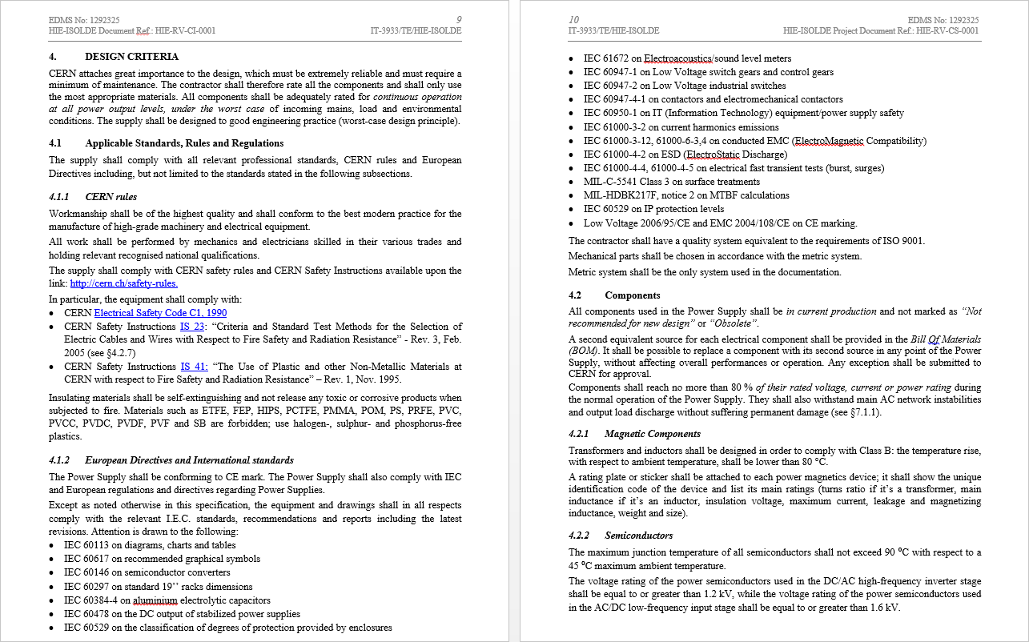
3 Cobalt Converter: Managing standards
Specification written keeping in mind:
    Minimizing grey areas: not relying only on list of standards.
Of course, we keep the list in the specification.
More than 20 standards in total.
1. Imagine the number of pages to read and understand!
2. Remember EMC standards common understanding!
Standards list: a modern nightmare !
Don’t ONLY rely on a list of standards !!!

Slide 17
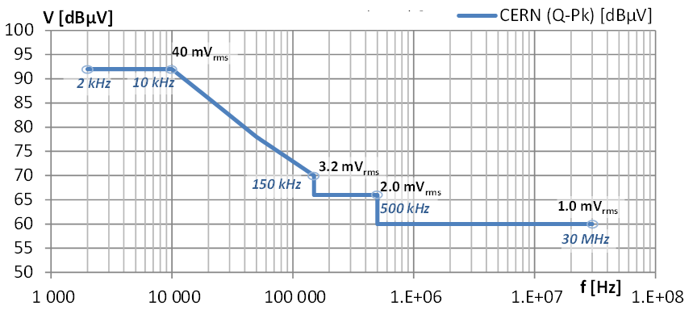
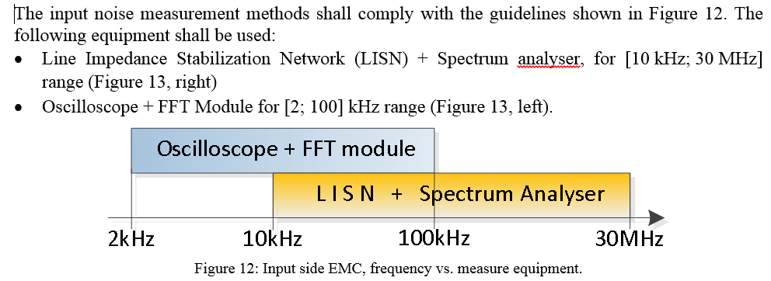
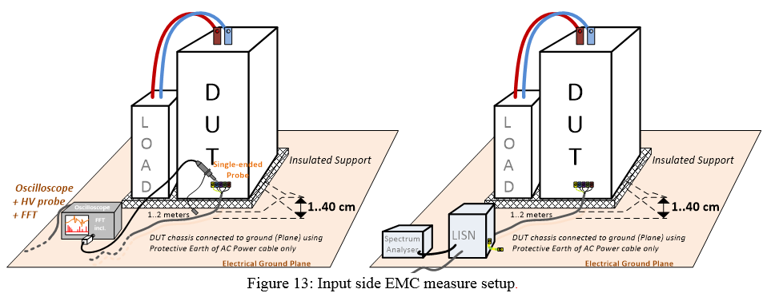
3 Cobalt Converter: Managing standards
Specification written keeping in mind:
    Minimizing grey areas:
          Explaining in detail:
                The ultimate criteria for you
                how to evaluate the criteria
                Defining common ground for
                you AND the manufacturer.
    What do you save?
        You can rely on data from
        manufacturer, reproduce them
        You really control progress and
        milestone state.
        Almost no conflict, and no bad
        surprise for anybody.
The criteria
The method
Even a test set-up

Slide 18
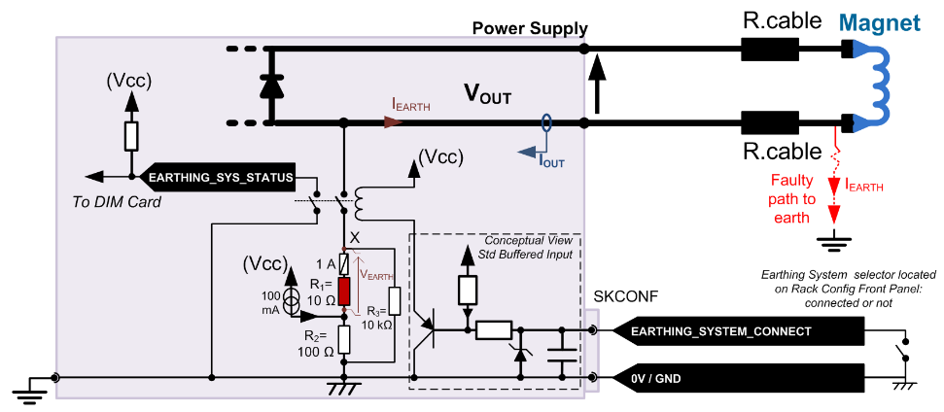
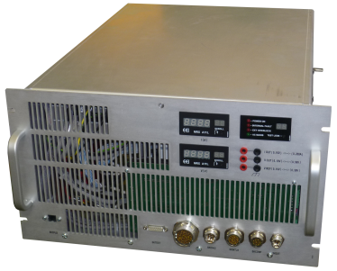
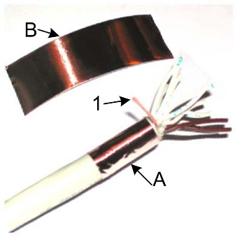
3 Cobalt Converter: Freezing electronics
Specification written keeping in mind:
    Minimizing grey areas:
          Freezing technical points:
                Electrical Design (grounding)
                Systems like Earthing system
                Mechanical layout and cables
                manufacturing
    What do you save?
        Sharing (freezing) known good
        concepts allow you to work on
        other critical points.
        A system you can understand
        easily and operate quickly.
“Grounding”
Earthing syst.
Mechanical

Slide 19
3 Cobalt Converter: Result
Result of a “goal directed specification writing” process:
    Converter fulfilled almost 100 % of the initial specification !!!
    No single point of hard discussion with manufacturer !!!
          Specification was clear and finally found adequate despite 70 pages !
          Manufacturer - EEI (IT) - really played the game:
                Following the given milestones (4 predefined steps for reaching series)
                Following proposed methods for checking criteria limiting conflict.
    Finally, 45 converters were
          put in operation in less than a week in Hie Isolde
          Judged very easy to use and operate from operation screw.

Slide 20
Introduction and strategy for procurement
Off-the-shelf Voltage Source Converter
Voltage Source specified Converter
CERN designed Converter
Conclusions

Slide 21
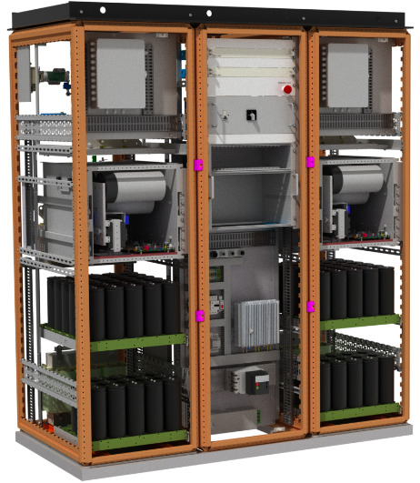

4 SIRIUS family
The SIRIUS family http://section-mpc.web.cern.ch/content/sirius
  ≈ 170 units to build by 2020,
  Accuracy class: 100 ppm,
  Application: transfer lines, correctors for PSB or PS, experimental areas…
Energy recovery bank 30-90kJ
Standardised converter brick
SIRIUS S
SIRIUS 2P
2S
SIRIUS 4P
Or 2P_2S
SIRIUS S 30kJ
SIRIUS S 60kJ
SIRIUS S 90kJ
SIRIUS 2P 60kJ
SIRIUS 2P 120kJ
SIRIUS 2P 180kJ
SIRIUS 4P 120kJ
SIRIUS 4P 240kJ
SIRIUS 4P 360kJ
Extra cabinet for energy storage: SIRIUS 4P 600kJ

Slide 22
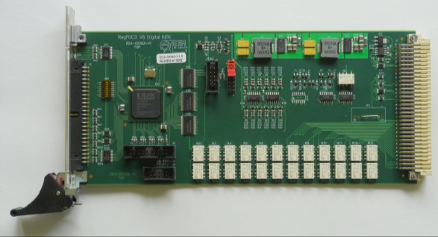
4 SIRIUS family
CERN strategy and responsibility
  Design of the Voltage source: managed by CERN,
  High precision (DCCT), Controller & Power Rack: managed by CERN,
    RegFGC3 crate contains the FGC3 and the other control, interlock and interfacing cards needed to safely manage the power components:
RegFGC3 Digital Interlock Card
RegFGC3 Crate

Slide 23
4 SIRIUS family
CERN strategy and responsibility
  Call for tenders for specific components: magnetics, power stacks, power resistors,
    Strong commitment from CERN on technical choices with suppliers,
    Qualification process at the suppliers premises or in a lab,

Slide 24
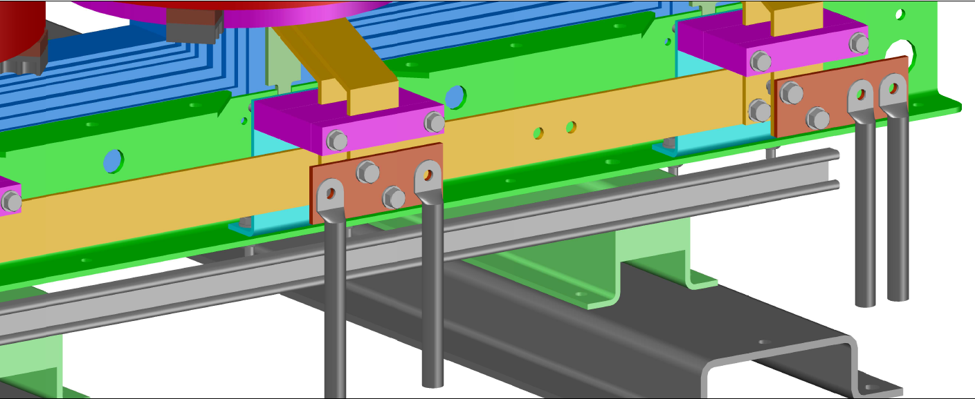
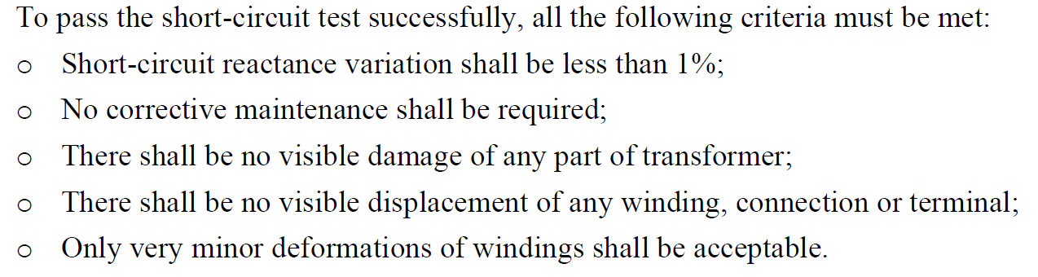
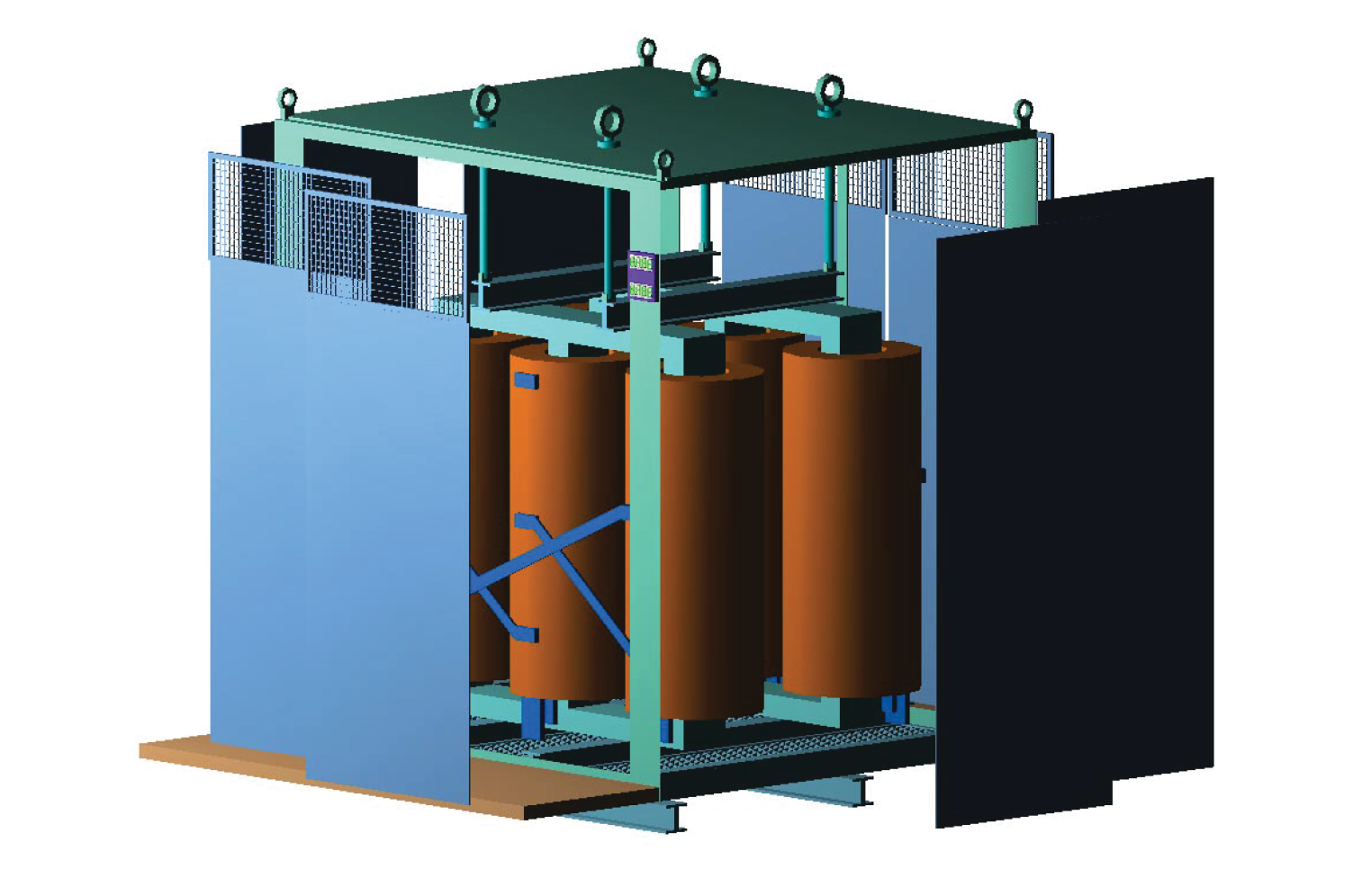
4 SIRIUS Family
Transformer Specification written keeping in mind:
    Minimizing grey areas:
          Freezing technical points:
                LV connections
                Short-circuit tests criteria
                Mechanical layout and cables
                input
    What do you save?
        Sharing (freezing) known good
        concepts allow you to work on
        other critical points.
        You really control progress and
        milestone state.
LV connections
SC test criteria
Mechanical

Slide 25
4 SIRIUS family
CERN strategy and responsibility
    Qualification process at the suppliers premises or in a lab,
Component | Test | Routine | Type | Impact on performances | Impact on reliability
Transformers (IEC-60076 + CERN criteria) | Short-circuit BIL Phase shift Short-circuit impedance Heat run | X X | X X X X X | X X X | X X X
Chokes (IEC-60289 + CERN criteria) | Inductance value (tolerance, deviation, saturation) Heat run | X | X X | X X | X
Power stack | Heatsink thermal impedance Dead time Short-circuit Heat run | X X | X X X X | X X | X X X

Slide 26
4 SIRIUS family
CERN strategy and responsibility
  Assembly/cabling of all components: call for tender,
    Reception and storage of components provided by CERN,
    Purchasing of cables and off-the-shelf components other than the ones provided by CERN,
    Manufacturing of mechanical parts on CERN specifications,
    Integration and cabling of all parts and components,
    Tests:
        Routine test of all cables:
          Continuity;
          Resistance measurement;
          Insulation resistance measurement.
        Functional test of electrical sub-assemblies with a 3phase 400V/32A/50Hz supply,
        Water circuit tightness test (24 bar/20minutes),

Slide 27
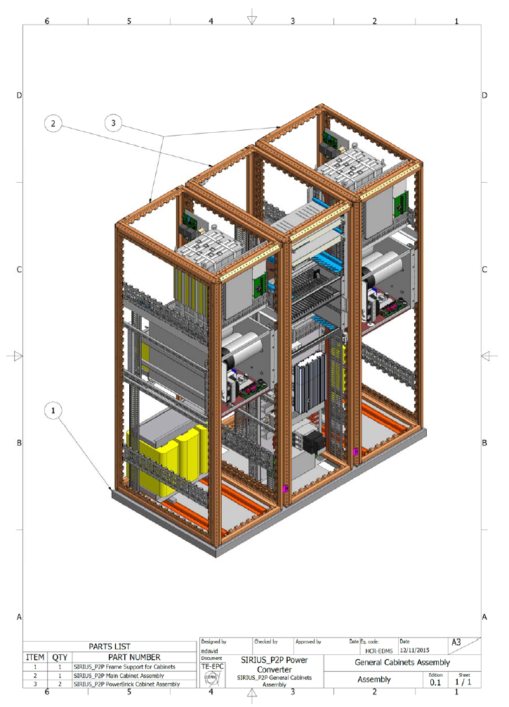
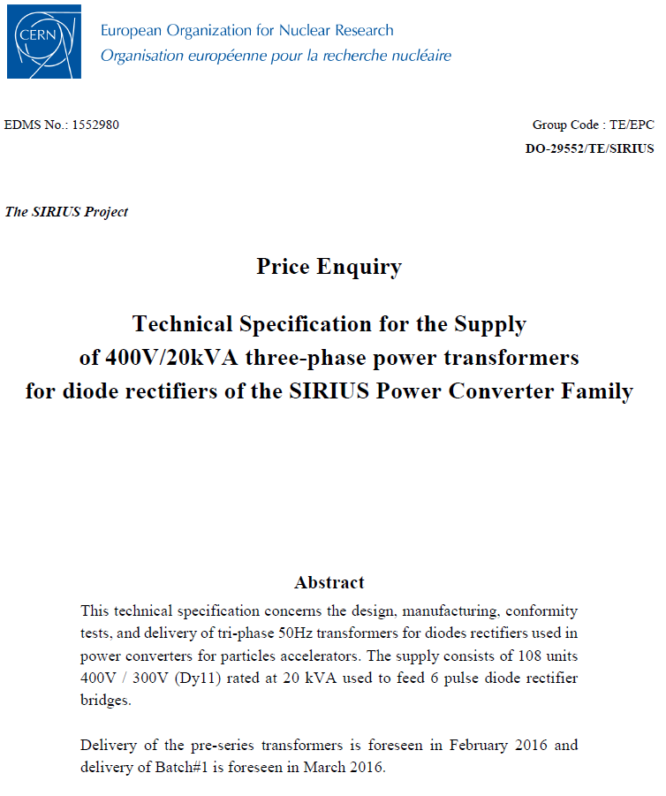
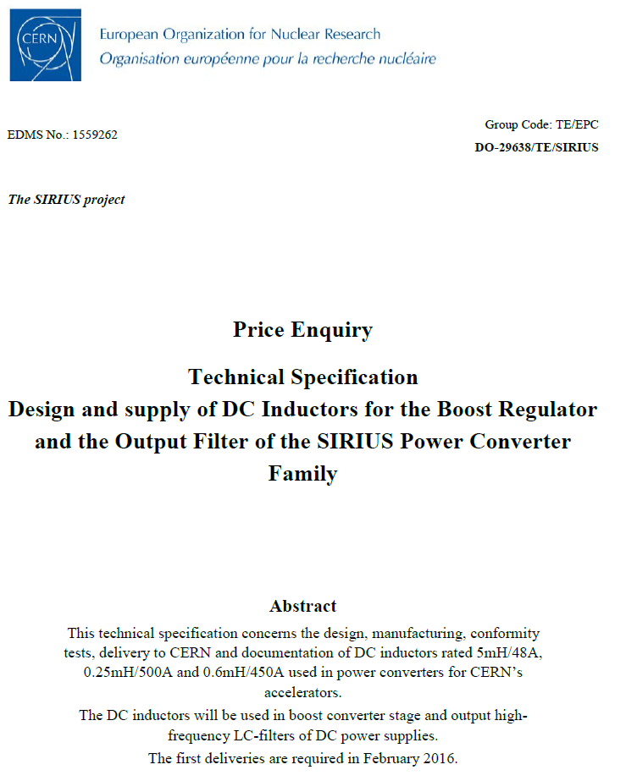
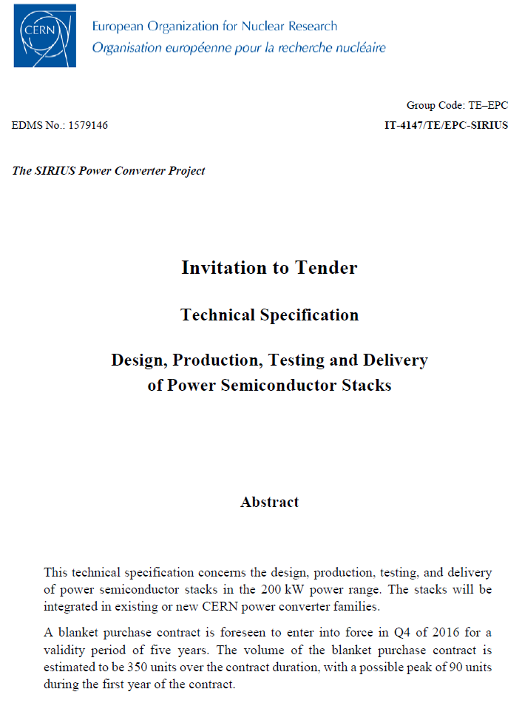
4 SIRIUS family
CERN strategy and responsibility
  Three main components specification,
  One integration/cabling specification,

Slide 28
4 SIRIUS family
Performance tests (current source)
  All converters are tested in the platform @CERN before installation and commissioning,
  A reference DDCT and a DVM (HP3458) are used,
  Main Tests:
    Noise at zero and Imax: the converter is set to 0A (Imax) and the low frequency peak-peak noise is measured.
    Stability at zero and Imax (<0.1Hz): the converter is set to 0A (Imax) and the stability is measured.
    Fast acquisitions at Imax: an acquisition at 1ksps is performed whilst running the converter at Imax,
    Repeatability at Imax: The converter is set to zero and Imax for five times, with 1min duration for each step.
    Linearity: The converter is ran from – Imax to Imax in steps of Imax/10 or Imax/5, with 2 min duration for each step.
Acceptance criteria

Slide 29
Introduction and strategy for procurement
Off-the-shelf Voltage Source Converter
Voltage Source specified Converter
CERN designed Converter
Conclusions

Slide 30
5 Conclusions
The in-house design of the high-precision Controller is a key element for standardisation, build families and reach the performances,
Several strategies possible for the procurement of the Voltage Source,
Whatever the strategy used for the procurement of the voltage source, a strong commitment/implication is required:
  To follow-up closely the project/milestones,
  To make sure that what is delivered is what you expect,

