Slide 2
Miguel Cerqueira Bastos
CERN, for POCPA-2016, Barcelona
High precision specification and test of power converters at CERN

Slide 3
Contents
Accuracy and uncertainty
CERN power converter procurement strategy
Specification of power converter performance
Specification of voltage source performance
Power converter performance testing
Conclusions

Slide 4
Accuracy and uncertainty
  This presentation uses ppm (part per million) of the converter nominal current
“Accuracy” is a qualitative term: closeness of agreement between a test result and the accepted reference value
“Uncertainty” is a non negative parameter that characterizes the dispersion of the quantity values
For power converters
  “Accuracy” can be used to characterize the Performance Class of converters
  “Uncertainty” is the best term to numerically express the dispersion of the values of the current generated by the power converter

Slide 5
CERN procurement strategy
CERN design
External production
CERN or external design
External procurement
CERN specification
External procurement
I_{ref}
V_{ref}
AC
Reg.
DC
I
CONTROLLER
VOLTAGE SOURCE
DCCT
Magnet
CURRENT SOURCE
The Controller is designed and produced by CERN
The Voltage Source is designed/specified and procured by CERN
The high-precision current sensors (DCCTs) are specified and procured by CERN

Slide 6
Specification of current source performance
CERN does not procure current sources, only voltage sources
Specification of current source is for internal CERN use:
  A set of requirements for the magnet current is received from the physicists
  A specification for the power converter (current source) can then be written
  Based on the current source specification specifications for DCCTs, controller and voltage source can be written

Slide 7
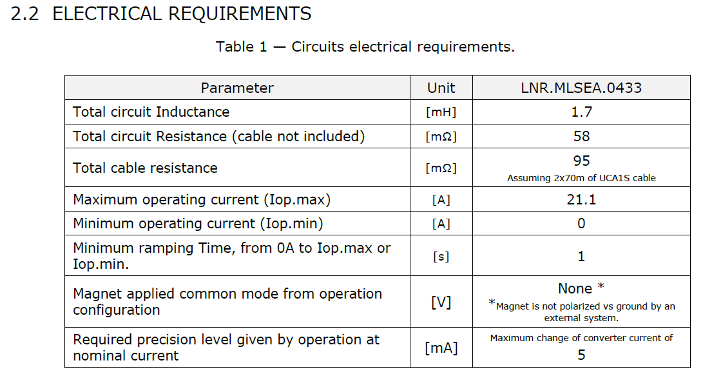
Specification of power converter performance
Often, a single requirement is given for magnet current performance, typically the acuracy class, eg “Precision: 100 ppm”, which can be insufficient
Magnet current requirements are derived from beam performance parameters like tune stability for quadrupoles and orbit variation for correctors.
As a consequence, important performance parameters are, in most cases stability (affected by drift) and repeatibility (affected by noise)

Slide 8
Specification of power converter performance
At least two parameters must be considered in the specification:
  Maximum Noise (ppm pk-pk)
  Stability, which can include:
      Temperature dependant drift
      Time dependant drift
The conditions under which the requirements should be met must be specified:
  Bandwidth
  Range of loads
  Temperature range
  Time frame - often more than one time frame is given: 30min, 24h, 1 year

Slide 9
Specification of power converter performance
Requirements given by the physicists can be assumed to be maximum limits
To ensure compliance to those requirements, maximum values must be used in our specification
When testing many converters, performance distribution will be gaussian, so in order to guarantee compliance, performance of all units must be verified and non compliant units rejected
Performance testing is essential to ensure compliance with requirements
Specification must allow for a good margin with respect to requirements, in order to minimize the number of rejected units
Margins depend on application: cost, feasibility, effort, criticality

Slide 10
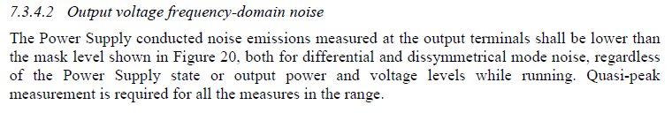
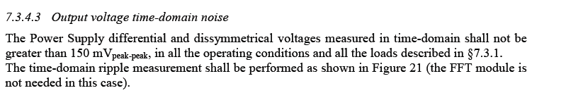
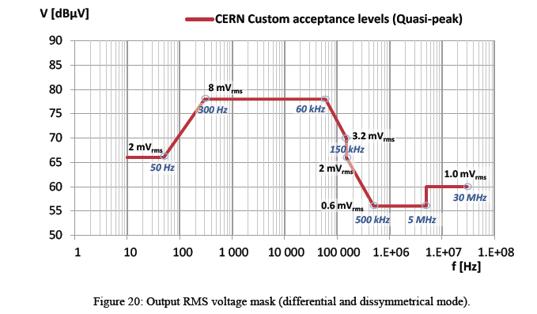
Specification of voltage source performance
Procured in industry: a performance requirement specification must be written
  The Voltage Source must undergo acceptance tests to validate performance!
Important specification parameters:
  Output noise: frequency domain, time domain
More on this
a few slides ahead!

Slide 11
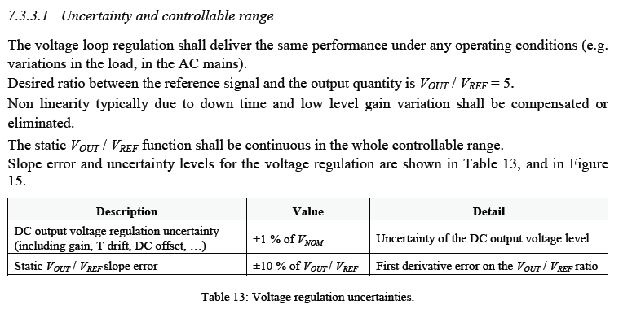
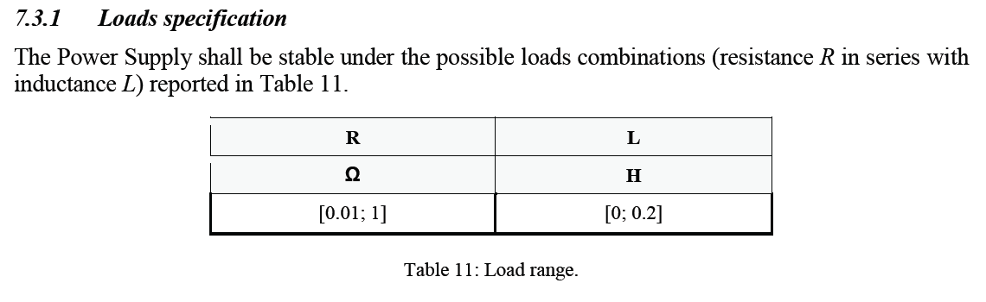
Specification of voltage source performance
  Controllability: Resolution, regulation uncertainty, gain error
  Load: Load range
  Dynamics: Step response, Slew rate, Bandwidth

Slide 12
Specification of voltage source performance
Specification of voltage source must take into account the current loop design and the expected range of loads, because:
  Power converter noise below the current loop bandwidth is mostly determined by the current loop
  Power converter noise above the current loop bandwidth is mostly determined by the load and the voltage source noise
So, two different frequency ranges must be considered for the specification:
  Below the current loop BW
  Above the current loop BW
These two ranges normally overlap but we will ignore the overlap in this presentation, for sake of simplicity

Slide 13
Specification of voltage source performance
Limitations of the present specification
Frequency domain limits are based on existing EMC standard IEC-478-3* extended below 9kHz by CERN: not adapted to load and to performance requirements
Time domain specification intended to cover for occasional spikes but not adapted to the load and to performance requirements
How to adapt the voltage source specification to reach the desired current performance ?
* IEC-478-3 › Stabilized power supplies, d.c. output. Part 3: Reference levels and measurement of conducted EMI

Slide 14
Specification of voltage source performance
Voltage noise specification: A proposal...
Requirement for maximum current noise in time domain (Imax p-p)
Consider the fastest load from specified range of loads: worst case !
Test/Measurement BW based on performance requirements and load:
E.g. FS voltage perturbations (R_{load}*I_{nom}) and < 1ppm current noise
BW should be 6x decades above the load frequency ω₀

Slide 15
Specification of voltage source performance
Calculating the noise limits profile in frequency domain:
Current noise is assumed to be white and gaussian. A flat current noise density in A/ can be calculated over the BW
The current noise density can be scaled to voltage by dividing it by the DC gain of the load transfer function (1/R)
A 20dB/decade shaping must be considered above the current loop BW, as the voltage perturbation attenuation by the load increases with frequency
A -20db/decade shaping is considered below the current loop BW (1 integrator) as the voltage perturbation attenuation decreases with frequency.
Note: A good approximation for the current loop BW is IBW = 10 x ω0

Slide 16
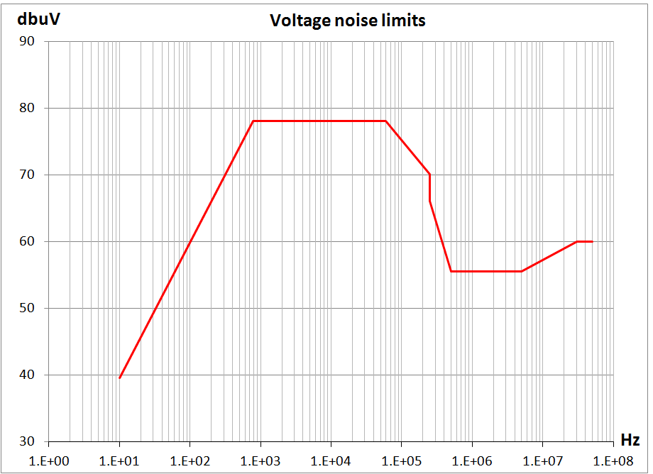
Specification of voltage source performance
Consider fload = 1Hz (L = 0.15H, R = 0.1R), on (200A, 50V) and required Imax noise = 10ppmp-p
Imax noise = 10ppmp-p, white gaussian noise, crest factor = 3 Imax noise = 1.5ppmrms (300µArms)
BW = 100 kHz (5 decades in order to ensure 100dB attenuation 10ppm)
The load considered above is the fastest load for the application: fload = 1Hz
Current noise density: 950 nA/ (300µArms/ )
Voltage noise density: 9.5µA/
6.,7. Response shaped at 20dB/decade below 10Hz and -20dB/decade above and combined with limits from IEC-478-3 extended by CERN
Current loop
Considering
1x integrator
8mVrms
790Hz
60kHz
3.2mVrms
250kHz
2mVrms
1mVrms
0.6mVrms
30MHz
0.5mVrms
500kHz
5MHz
50Hz
0.09mVrms
10Hz

Slide 17
Power converter performance testing
Voltage source performance tests
  In addition to functional and EMC tests, performance tests must be carried out
  Some of these tests can be performed at the factory
Power converter performance tests
  After integration of voltage source + controller + DCCT and tuning of current loop
  Requires a test bed with a test load, reference DCCT, high precision DVM
  Test load must have similar time constant as worst case final load

Slide 18
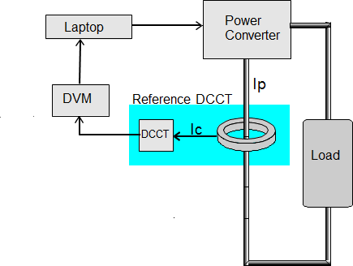
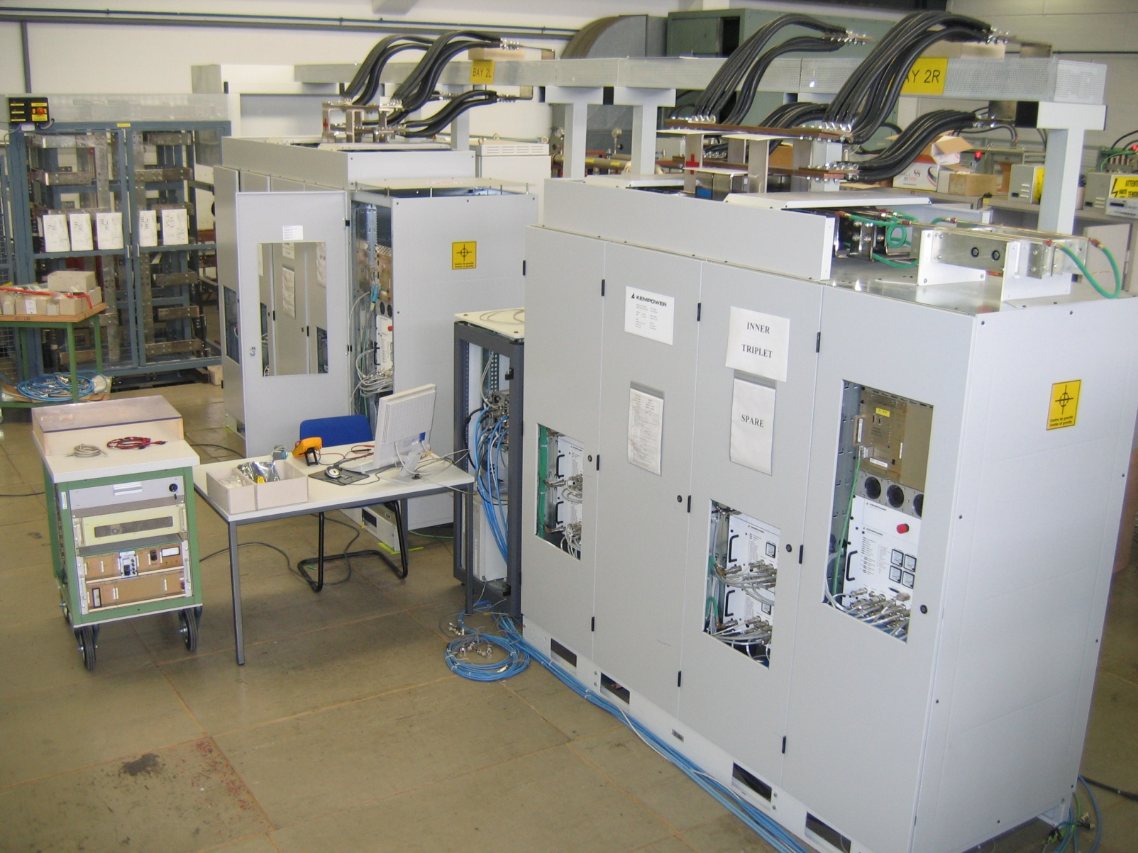
Power converter performance testing
Reference DCCT connected to the output of the converter
Reference DCCT assumed perfect, i.e. uncertainty negligible with respect to the target uncertainty of the converter
Above a certain frequency the reference DCCT noise will be dominant (as PC noise is attenuated by the load) so DCCT baseline noise must be measured

Slide 19
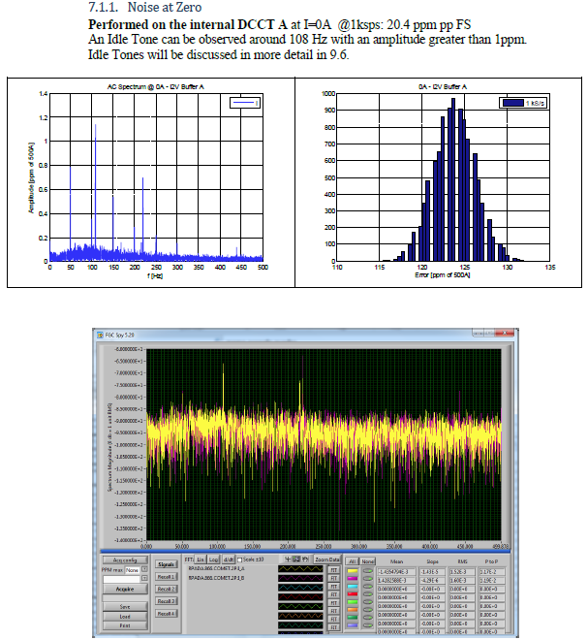
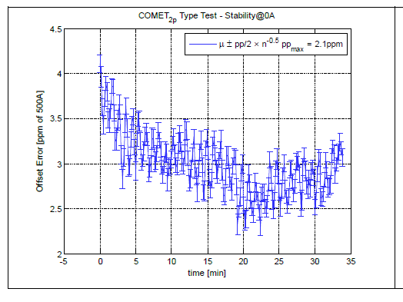
Power converter performance testing
Typical power converter tests performed at CERN are listed below.
BW and time frame for the measurements depend on the application
Noise at zero or Imin
Stability at zero or Imin

Slide 20
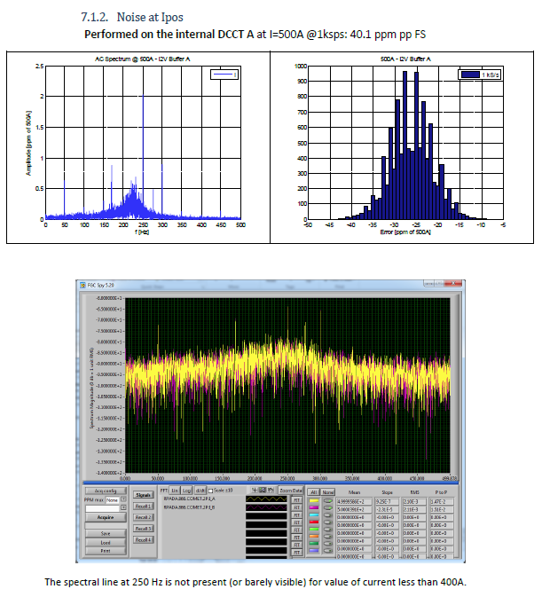
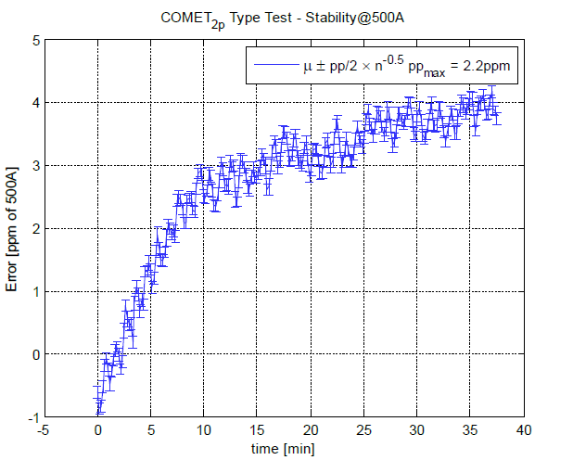
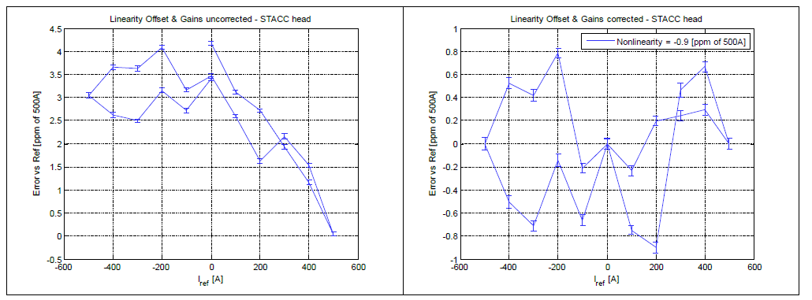
Power converter performance testing
Linearity
Reproducibility at Inom
Noise at Inom
Stability at Inom

Slide 21
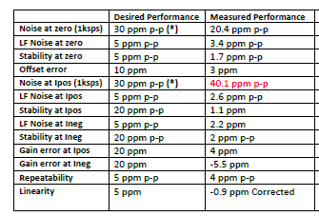
Power converter performance testing
After the tests a performance “datasheet” of the converter can be prepared
The datasheet states the worst case expected performance for each parameter
The table below show the results from a set of performance tests, stability and noise can be used to prepare a datasheet

Slide 22
Conclusions
Magnet current performance requirements are often a single value
A power converter performance requirement specification must contain at least stability and noise requirements for a given BW, load, temperature, time
Based on the power converter specification a DCCT, controller and voltage source performance requirement specification can be written
Performance tests are essential to guarantee performance within requirements
A performance “datasheet” of the converter can be prepared based on the performance test results

