Slide 1

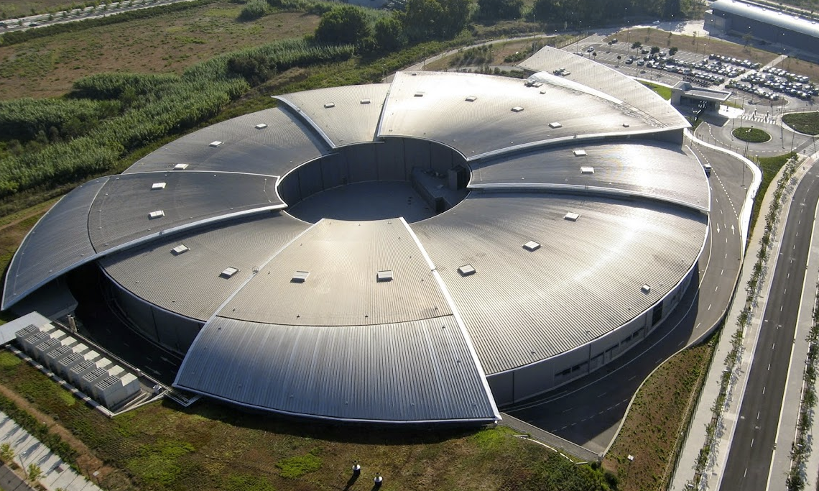

Slide 2
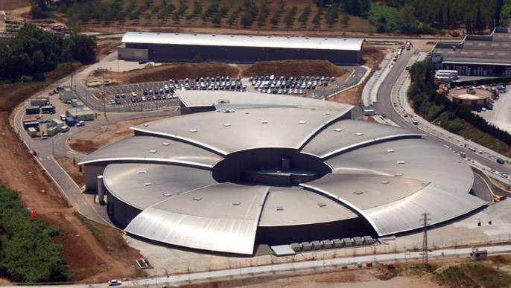
TOP-NOTCH RESEARCH IN:
BIOTECHNOLOGY AND LIFE SCIENCES
CULTURAL HERITAGE
MICROELECTRONICS AND NANOTECHNOLOGY
ENVIRONMENT AND ENERGY
MATERIALS DESIGN, DRUGS AND FOOD
CATALYSIS, HIGH-PRESSURE, etc.
220 M€
PUBLIC INVESTMENT
(2012)
~1000
Users/Researches
per year (2015)
200 staff (December-2015)

Slide 3
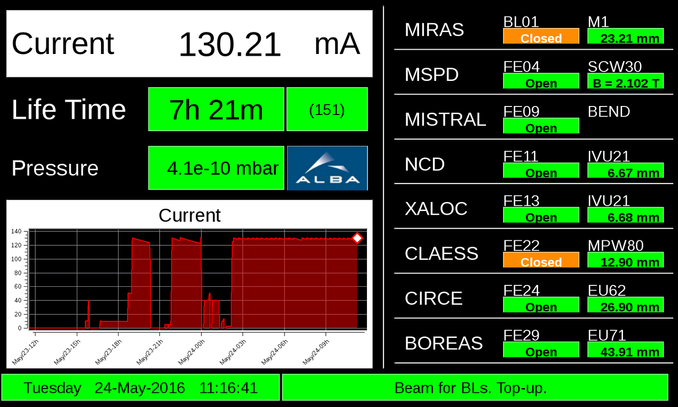
The machine status

Slide 4
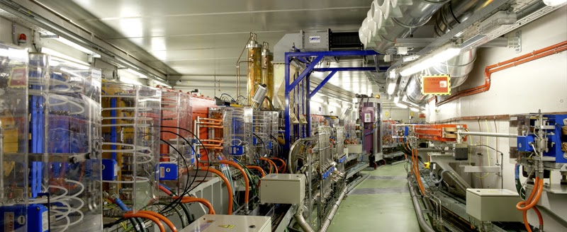
Inside the tunnel
A linear accelerator which accelerates electrons up to 100 MeV;
A booster synchrotron where the electrons are further accelerated up to 3.0 GeV;
The storage ring, where electrons are stored and emit synchrotron radiation, which is used at the Beamlines.

Slide 5
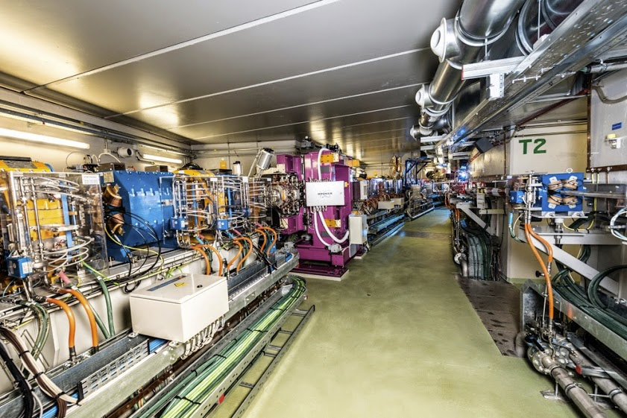

Slide 6
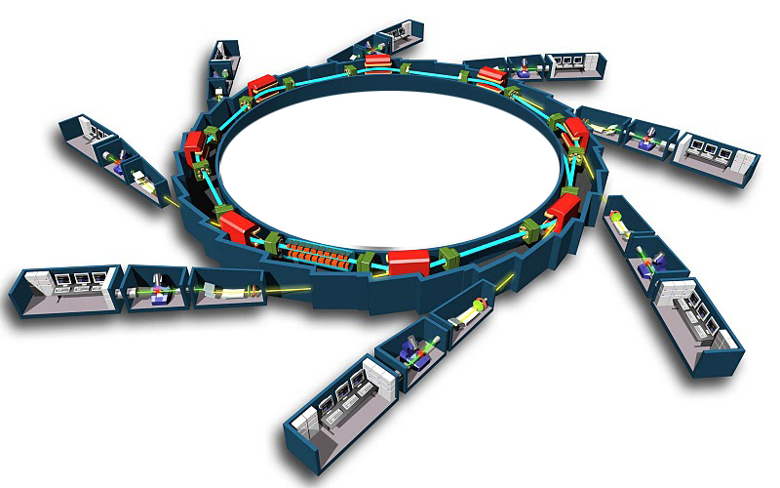


BEAMLINES
6
BL24 - CIRCE
Photoemission Spectroscopy and Microscopy BL
ES1: PEEM ES2: NAPP
BL01 - MIRAS
Infrared micro-spectroscopy BL, expected 11.2016
BL11 - NCD
Non Crystalline Diffraction, SAXS BL
BL29 - BOREAS
BL for Resonant
Absorption & Scattering
ES1: HECTOR ES2: MARES
BL22 - CLAESS
XAS – XES BL
ES1: Absorption ES2: Emission
BL09 - MISTRAL
Soft X-ray microscope BL
BL20 - LOREA
Angular resolved photoelectron spectroscopy BL, expected 12.2018
BL13 - XALOC
Macromolecular Crystallography BL
BL04 - MSPD
Materials Science and Powder Diffraction BL
ES1: HRPD ES2: High Pressure
BLXX – Microfocus-MX
beamsize of ~1 μm; expected 2020
EPSIM 3D/JF Santarelli

Slide 7
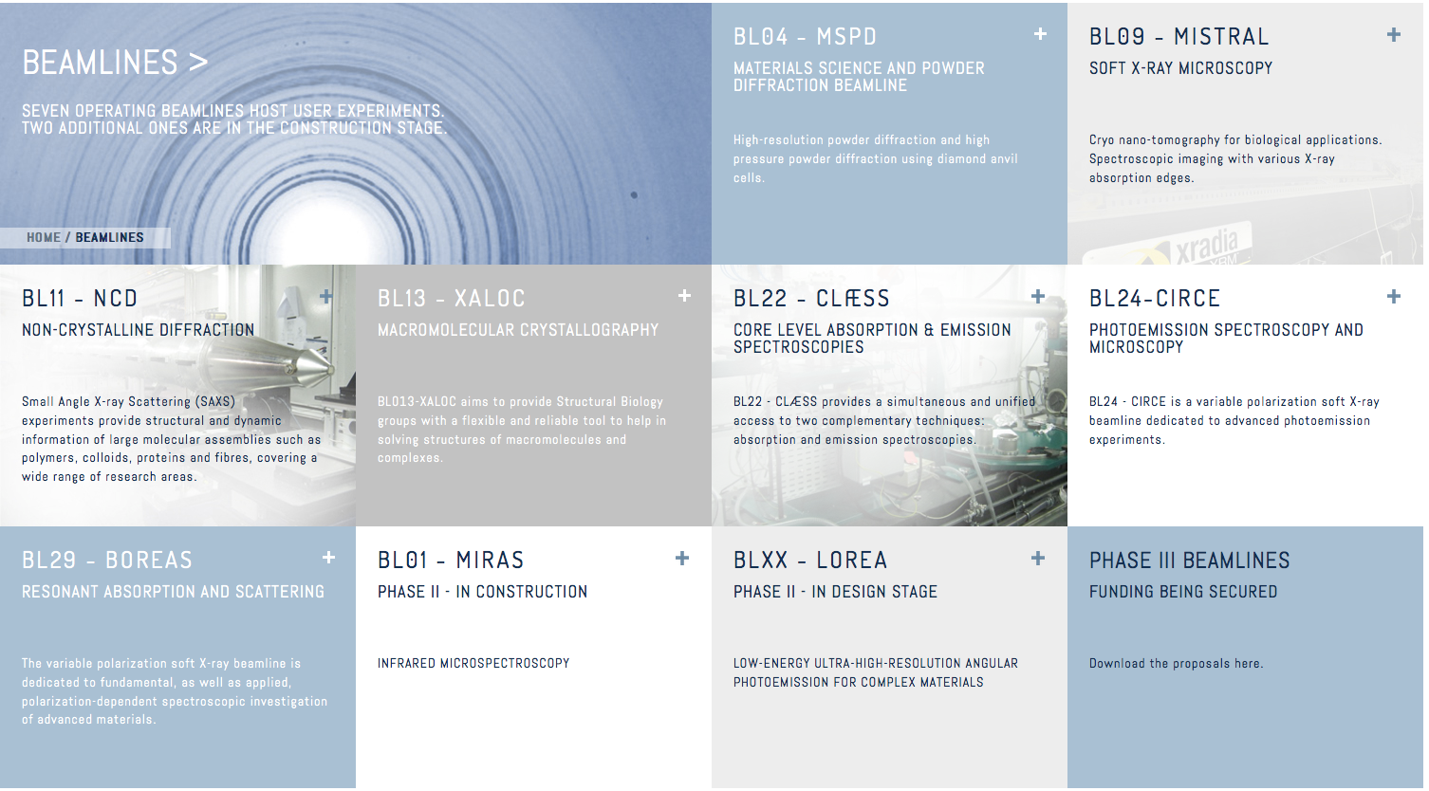
Beamlines
http://www.cells.es/en/beamlines

Slide 8
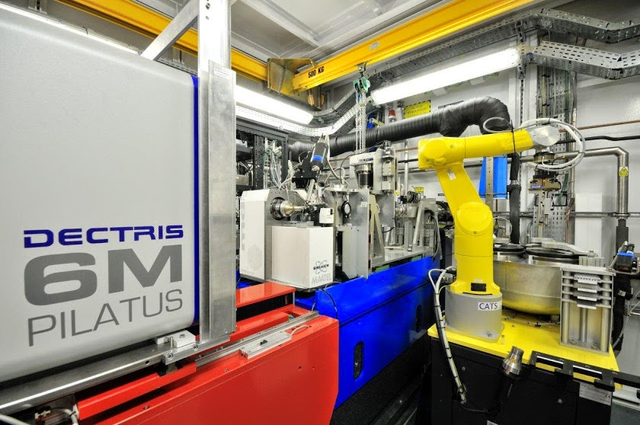
Beamline Experimental hutch

Slide 9
Industrial beamtime
CIRCE
(12h)
BOREAS
(43h)
CLAESS
(39.5h)
XALOC
(102h)
NCD
(66h)

Slide 10
Users

Slide 11
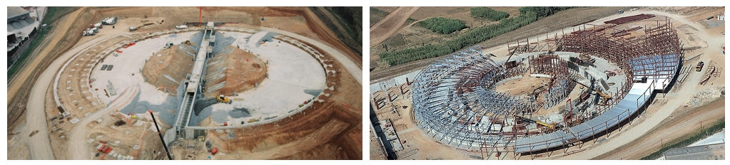
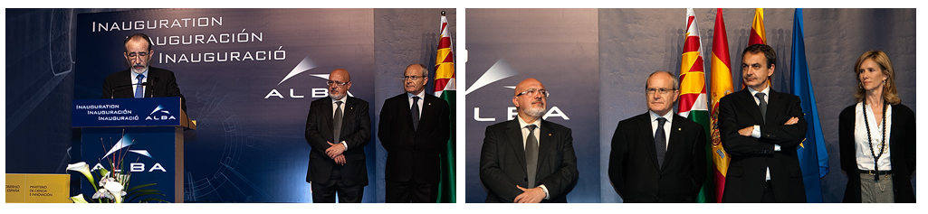
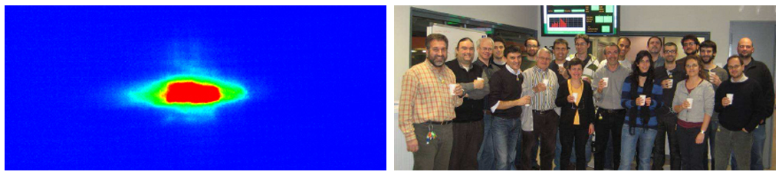
History
2003. Green light
2006: Civil works start
2010: Official Inauguration
2011: Beam in the SR.
First friendly users
2012: Official users in 7 BL
2016: Commissioning of MIRAS

Slide 12
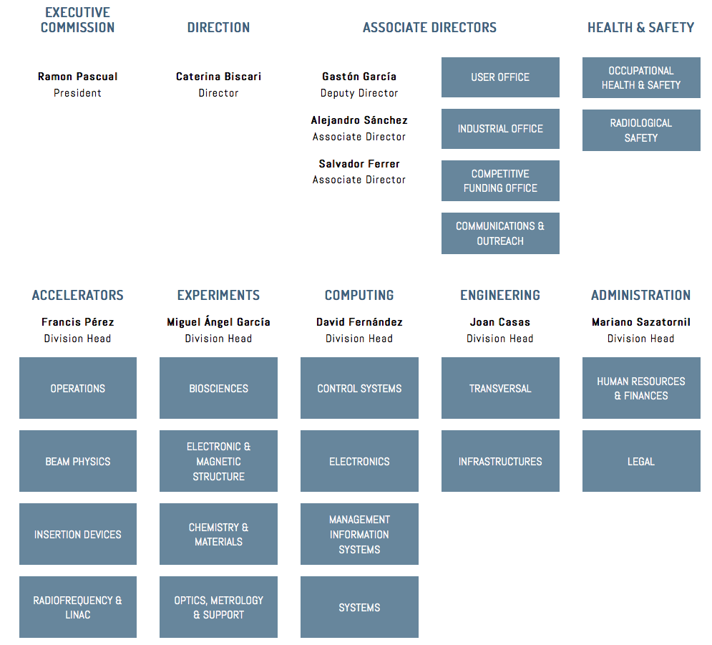

Slide 13
Computing & Controls
COMPUTING
CONTROLS
ELECTRONICS
Oscar Matilla
Management Information Systems
IT SYSTEMS
Beamlines
Control System
Machine
Control system
General
Development
Data Analysis
Service Support
Instrumentation Support
Power Supplies
Roberto Petrocelli
Domingo Alloza
Beamline & User Support
Network & Communication
SW Dev
& Support
Quality
Infrastructure

Slide 14
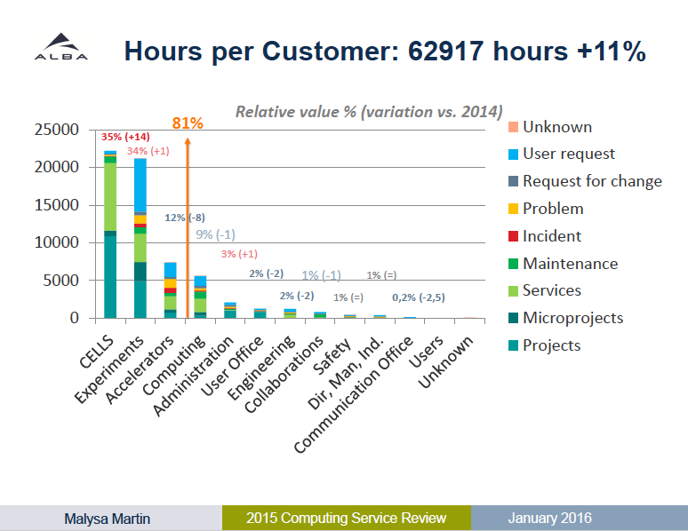

Slide 15
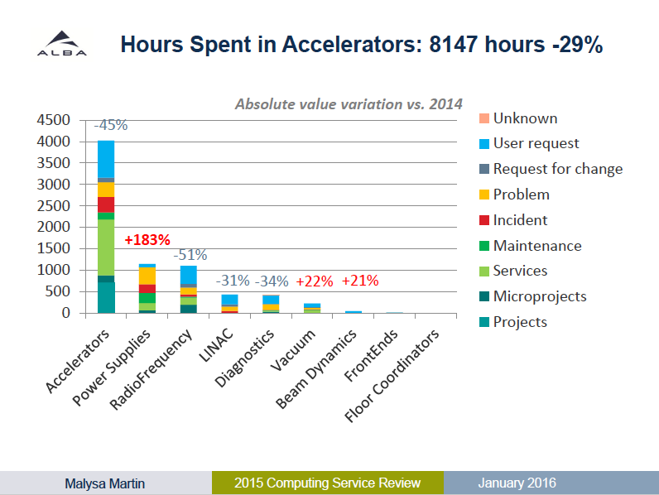

Slide 16
Thank you!

