Slide 2
POCPA5
POwer Converters for Particle Accelerators
Roberto Visintini
Elettra – Sincrotrone Trieste

Slide 3
Previous editions
POCPA1 2008 (Elettra) on “Reliability”
POCPA2 2010 (CERN) on “Safety”
POCPA3 2012 (DESY) on “Digital Regulation and Control”, with tutorials
POCPA4 2014 (BNL) on “Maintenance, best strategies and practices”

Slide 4
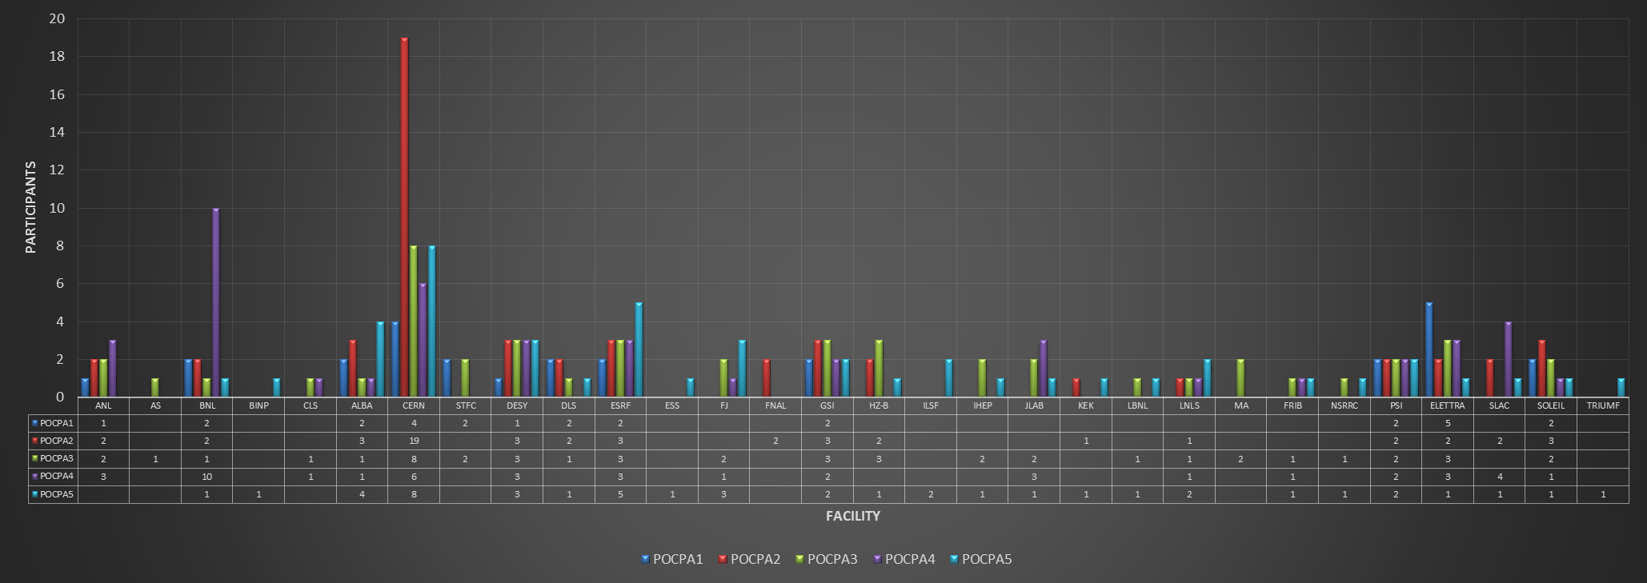
Some Statistics – Facilities
Participants from 30 Facilities
Almost all Continents (besides Africa)

Slide 5
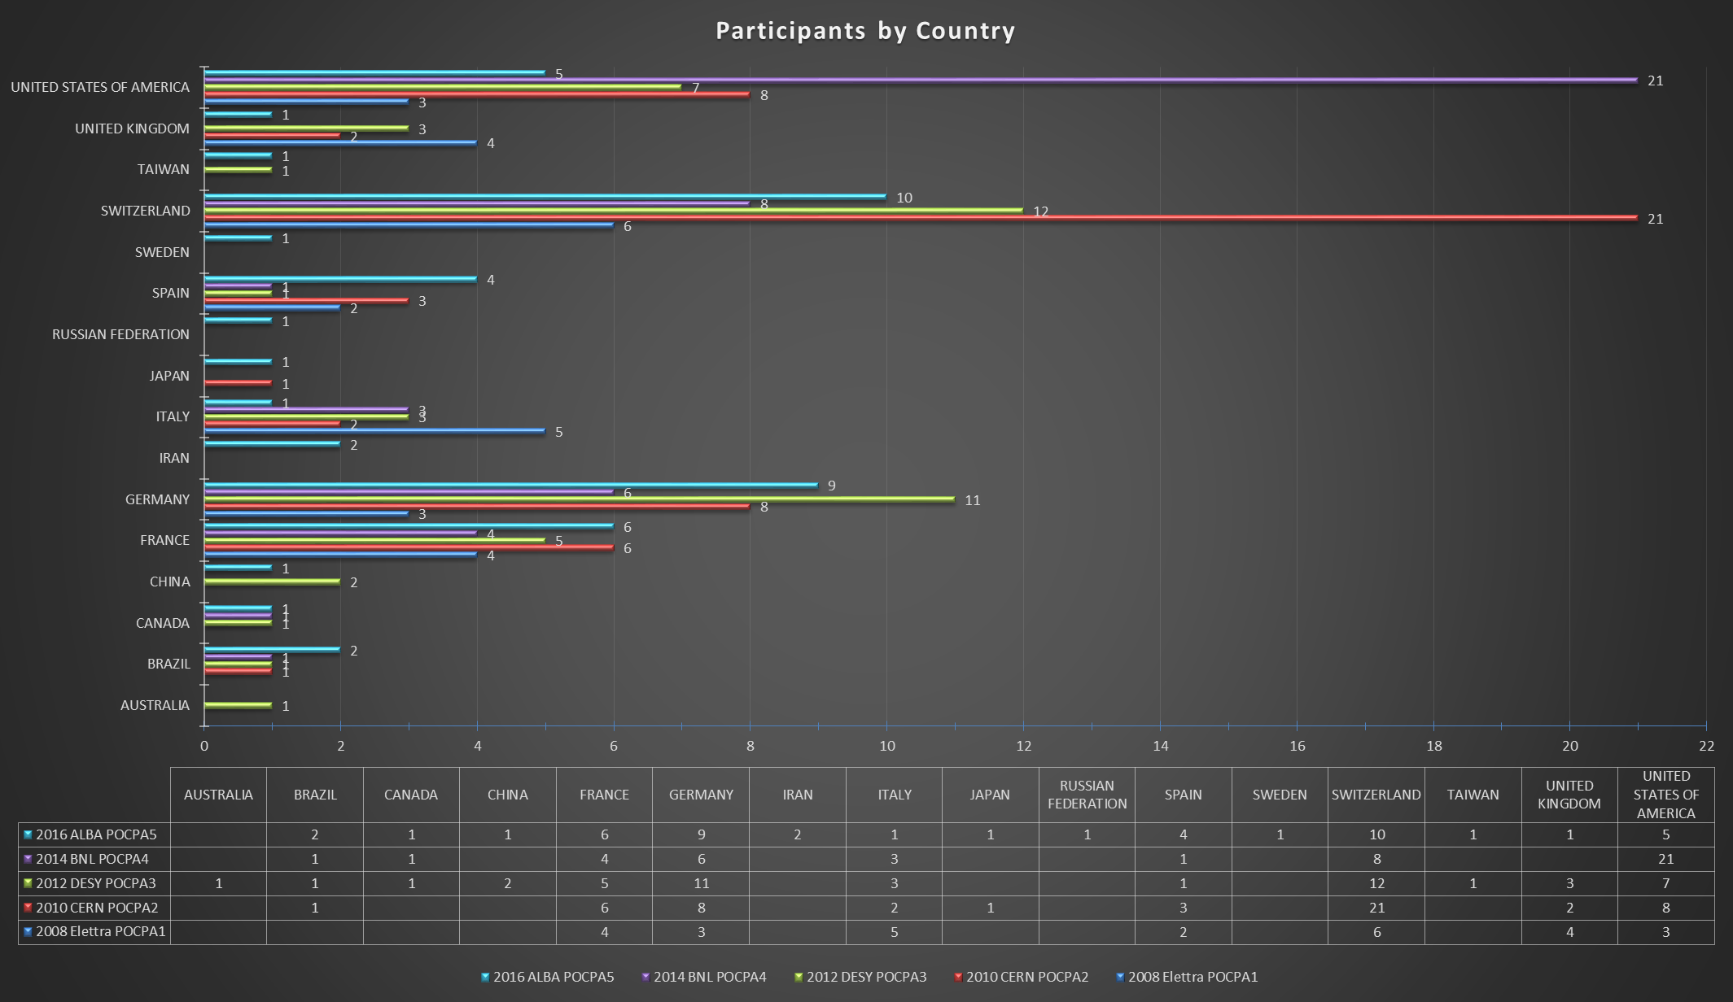
Some Statistics – “Nationality”
16 different Countries

Slide 6
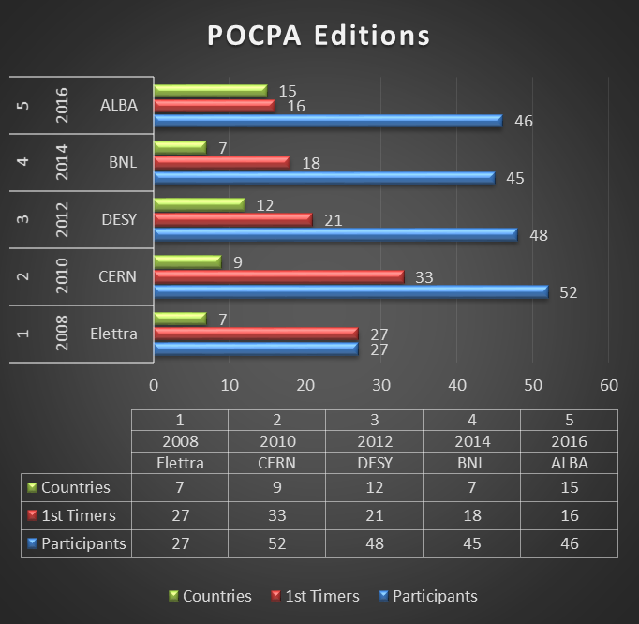
Some Statistics – Participants
Number stabilized ~45
High percentage of “1st Timers”
Edition | Year | Host Lab | Participants | 1st Timers | % of 1stT
1 | 2008 | Elettra | 27 | 27 | 100%
2 | 2010 | CERN | 52 | 33 | 63%
3 | 2012 | DESY | 48 | 21 | 44%
4 | 2014 | BNL | 45 | 18 | 40%
5 | 2016 | ALBA | 46 | 16 | 35%

Slide 7
POCPA «Spirit»
Invitation only, not publicized and informal ⇒ “Community”
Exchange of experiences ⇒ Best Practices, knowledge and TROUBLES
Accelerators’ World only ⇒ no "Fusion” nor Academia
Free speech ⇒ no companies invited nor sponsorship from commercial entities
Minimum fee ⇒ support participation

Slide 8
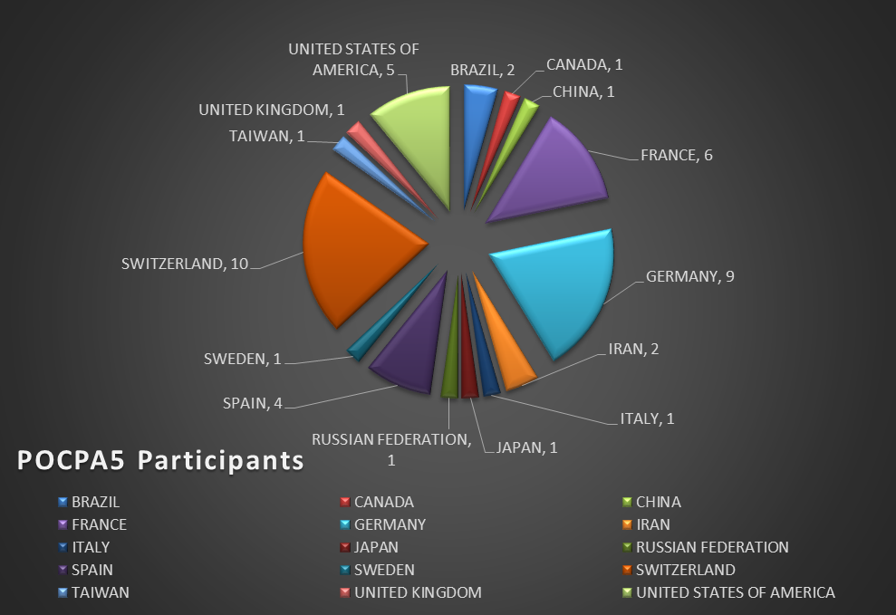
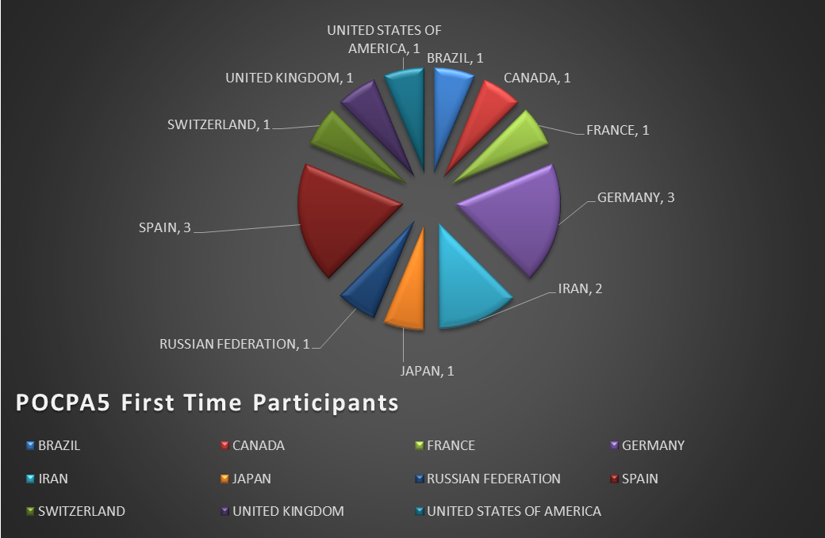
POCPA5 2016 - ALBA
                46 Specialists (4 “internal”)
24 Facilities worldwide
15 Countries of 3 Continents
Main Topic: “Performance Specification, Reviewing and Testing for Power supplies and Subsystems”

Slide 9
POCPA5, in brief:
                Technical
                Performance Specification, Reviewing and Testing for Power supplies and Subsystems (Main Topic)
News from the Labs
17 talks (+ Intro & Closing remarks)
2 Open discussion sessions
1 Visit to ALBA
                Social
Busses from and to Hotels and Restaurants
2 Dinners
3 Lunches
4 Coffee breaks

Slide 10
POCPA5, what else…
                Homework for all:
                start to think about one (or more) possible main topic(s);
                to be discussed and decided by Thursday, before lunch!
                And now…
                …Let’s start and
                Enjoy POCPA5!

Slide 11
Notes:
Last Slide 1: Thanks to the audience

Slide 13
Previous Editions
It’s the FIFTH meeting on
POwer Converters for Particle Accelerators
Troubles in power converters and systems occurs everywhere, share experience and practices
Openly share opinions on devices and, yes, manufacturers
Create a network of experts for consultancies, advice and, when needed, help
Meet “old” friends and make new ones.

