Slide 1
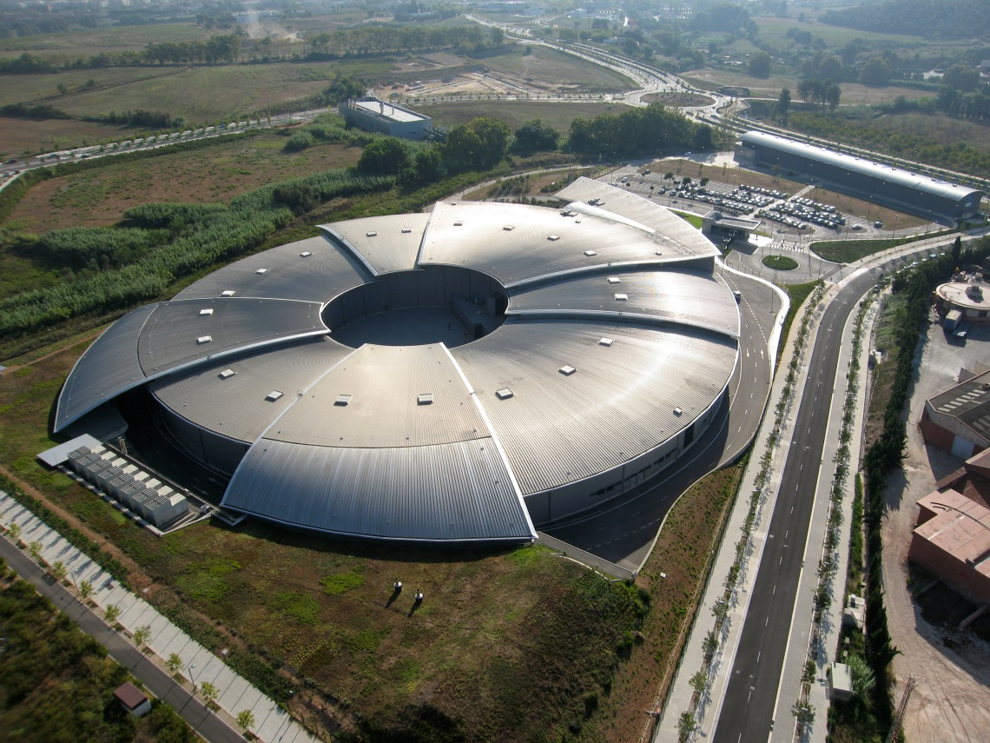
Welcome
POCPA 2016

Slide 2
Useful information
Assistance:
Taxis, boarding cards, etc.
Contact: Mrs Concepción Girbau. cgirbau@cells.es
Roberto Petrocelli : rpetrocelli@cells.es
Wifi access:
Network : albaguest
Password: guest2010

