Slide 1

Diamond Light Source
Power Converters
C Abraham
Snr Power Supply Engineer
1

Slide 2
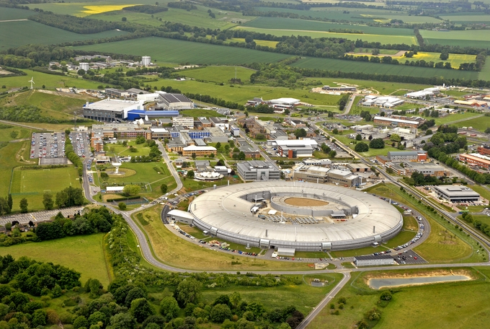
ISIS
(Spallation Neutron Source)
Central Laser Facility
Research Complex (for users of Diamond, ISIS and CLF)
Diamond
Light Source
Located on the Harwell Science and Innovation Campus
2
Notes:
Diamond is located on the Rutherford Appleton Laboratory campus, which also accommodates sever other large research facilities.

Slide 3
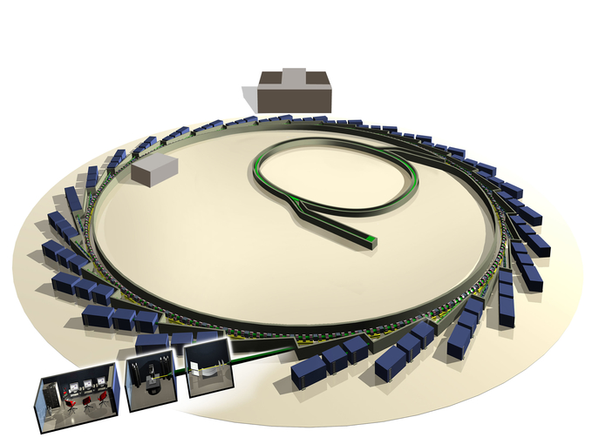
Injector: 100MeV Linac + 3Gev 5Hz Booster
Storage Ring: 24 DBA Cells, 560m, 300mA
30 Beam lines, including
22 I.D. Beam lines
7 Dipole Beam lines
C Abraham – Snr Power Supply Engineer
3
Notes:
Diamond consists of three accelerators,
100Mev Linac identical to SLS?
3Gev 5Hz booster synchrotron, located within the SR
560m circumference SR, with 29 user beam lines

Slide 4
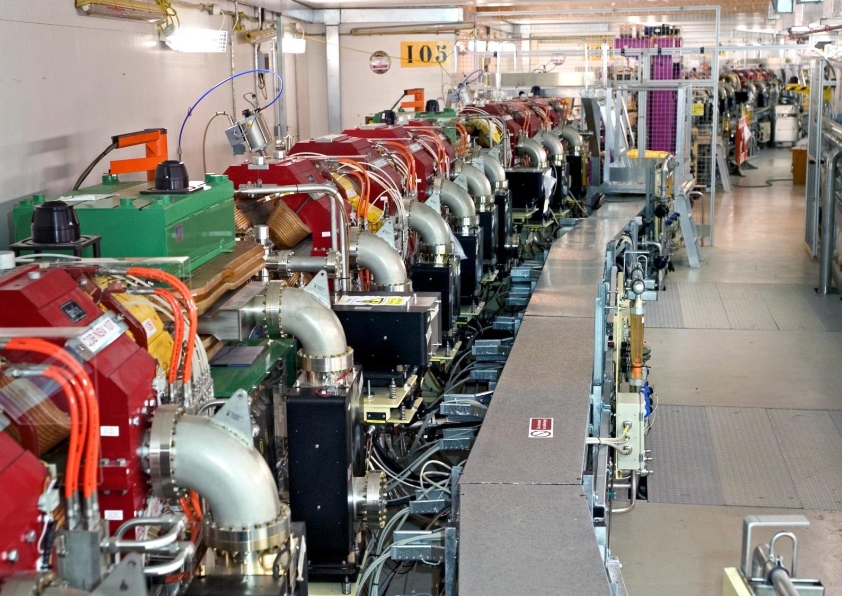
Inside the Storage Ring.
C Abraham – Snr Power Supply Engineer
4

Slide 5
Storage Ring MTBF 2015
Total Faults = 56, in 4650 User Hours
MTBF = 83Hrs (inc RF)
MTBF = 4650Hrs (Power Supplies)
C Abraham – Snr Power Supply Engineer
C Abraham – Snr Power Supply Engineer
5

Slide 6
Power Supply Reliability
User beam trips by Year
C Abraham – Snr Power Supply Engineer
6

Slide 7
Operational Issues.
Booster Dipole regulation.
Booster Dipole, boost converter runaway.
Trips from load resistance inaccuracies
Loss of ADC resolution
ADC Enhancements
DSP - Flex n_pwr trips
C Abraham – Snr Power Supply Engineer
7

Slide 8
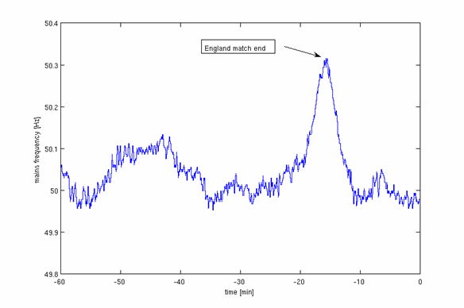
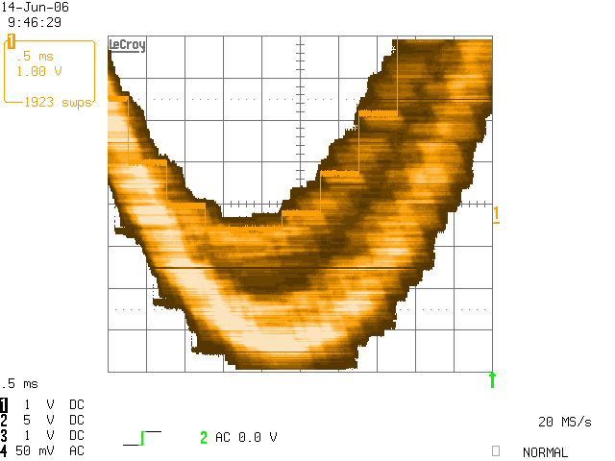
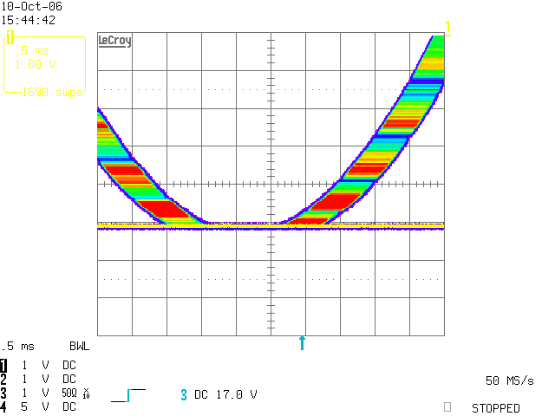
Booster Dipole Jitter
Mains Frequency
Band is due to Dipole clock being asynchronous with timing system clock
Operation Tied to Mains Frequency
Operation at Fixed 5 Hz Frequency
Jitter is blue line
Steps are measurement quantization not real current
C Abraham – Snr Power Supply Engineer
8
Notes:
LH plot, dither caused by 5Hz control loop synchronised to mains 50Hz
RH

Slide 9
Booster Dipole Power Converter Structure
Unit 1
Unit 2
Series Connected Magnets
Unit 3
Output- Filter
Unit 4
Unit switching frequency 4 kHz giving 16 kHz at output.
Input- Filter
Output- Filter
9

Slide 10
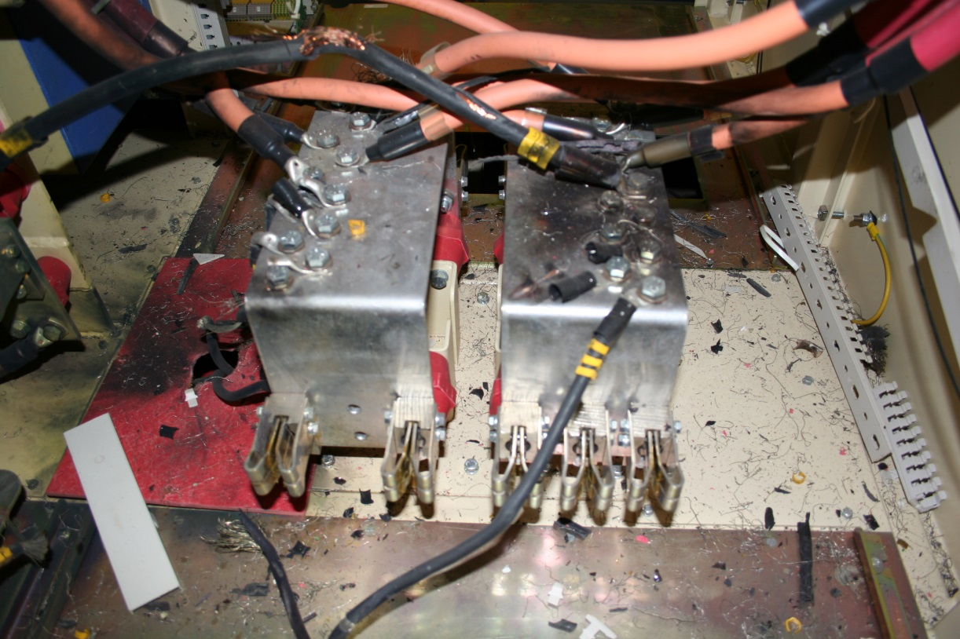
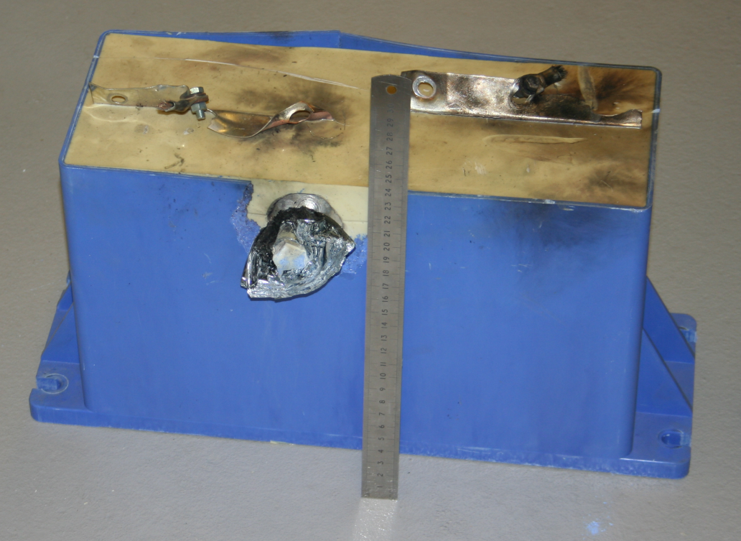
Boost Control Failure
C Abraham – Snr Power Supply Engineer
10

Slide 11
Load resistance monitoring
11

Slide 12
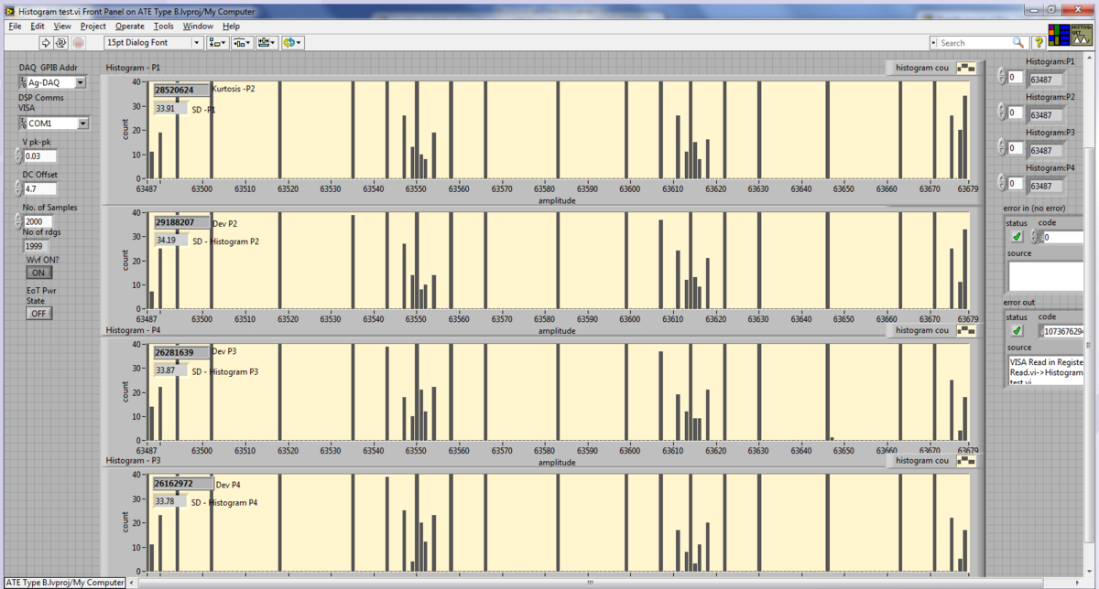
ADC Loss of Resolution
Faulty Card : Histogram of 30mV sawtooth data
12

Slide 13
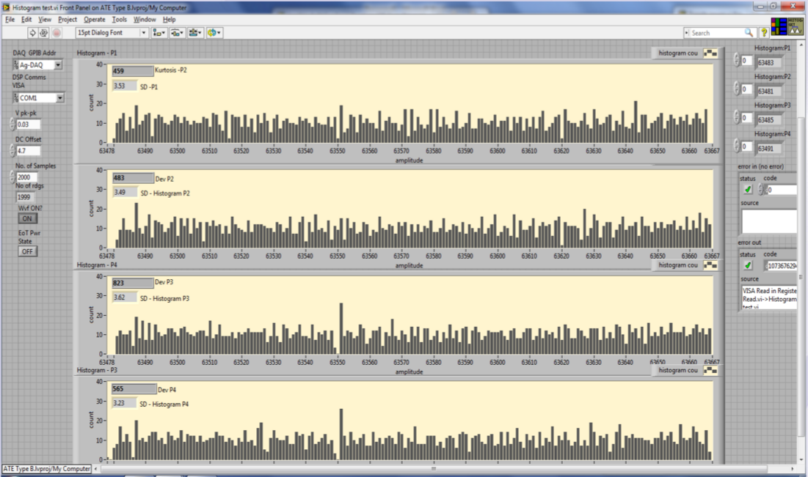
ADC Loss of Resolution
Good Card : Histogram of 30mV sawtooth data
13

Slide 14
ADC Enhancements
IC8, TL431 – prone to resonate.
Replacement of all Al. Electrolytic caps with ceramic.
  Which causes 13.5 to rise to circa 15v. Requires trimming. 13.5v rail reduced to minimum required for acceptable output from resonant converters.
All of the above actions result in improved performance and reliability of the ADC card.
14

Slide 15
DSP - Flex n_pwr trips
Caused 4-5 user beam trips up to 2013
  No error messages
  No hardware faults
  Affected different power supply types.
Discovered by Jackle Hans of PSI. Thank you!
24V supply watchdog spuriously triggering. Stops PWM
Added de-bounce. Fixed. ☺
15

Slide 16
Upgrades and Enhancements
Fast orbit feedback (FOFB)
New 50A power module
EPICS PSC support tools.
Plug in replacement ADC (in progress)
ID10 – Fast Chicane power supplies
DDBA Upgrade
C Abraham – Snr Power Supply Engineer
16

Slide 17
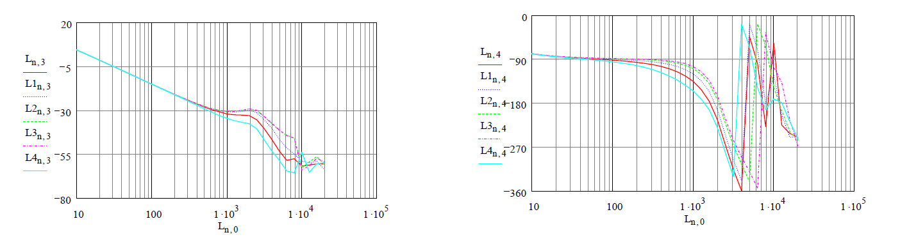
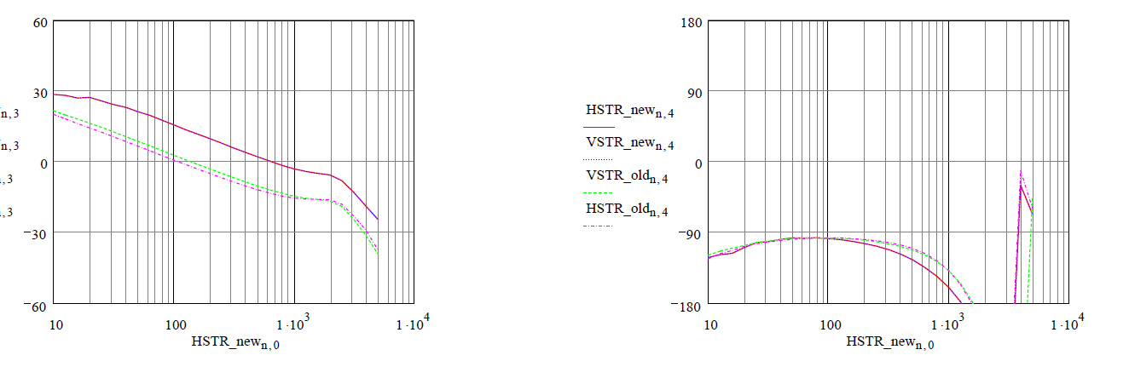
Corrector Performance for FOFB
Standard di/dt rate limiter
Amplitude dependant di/dt rate limiter
C Abraham – Snr Power Supply Engineer
17
C Abraham – Snr Power Supply Engineer

Slide 18
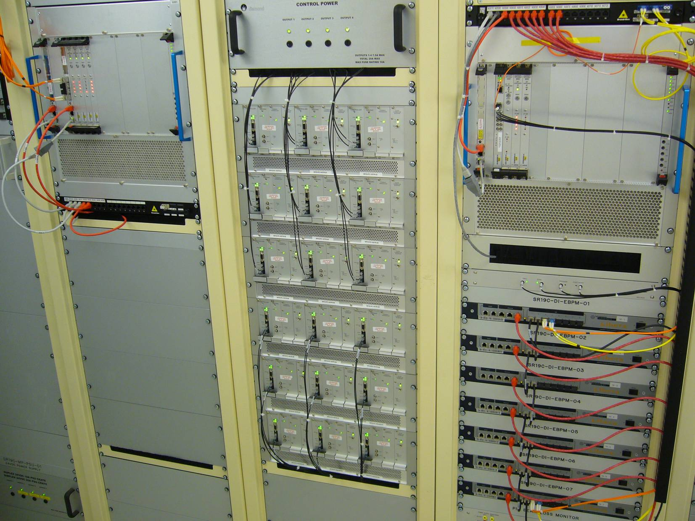
FOFB Installation (one of 24 cells)
Corrector
power supplies
Power supply
& FOFB proc
VME crate
Diagnostics rack
C Abraham – Snr Power Supply Engineer
18

Slide 19
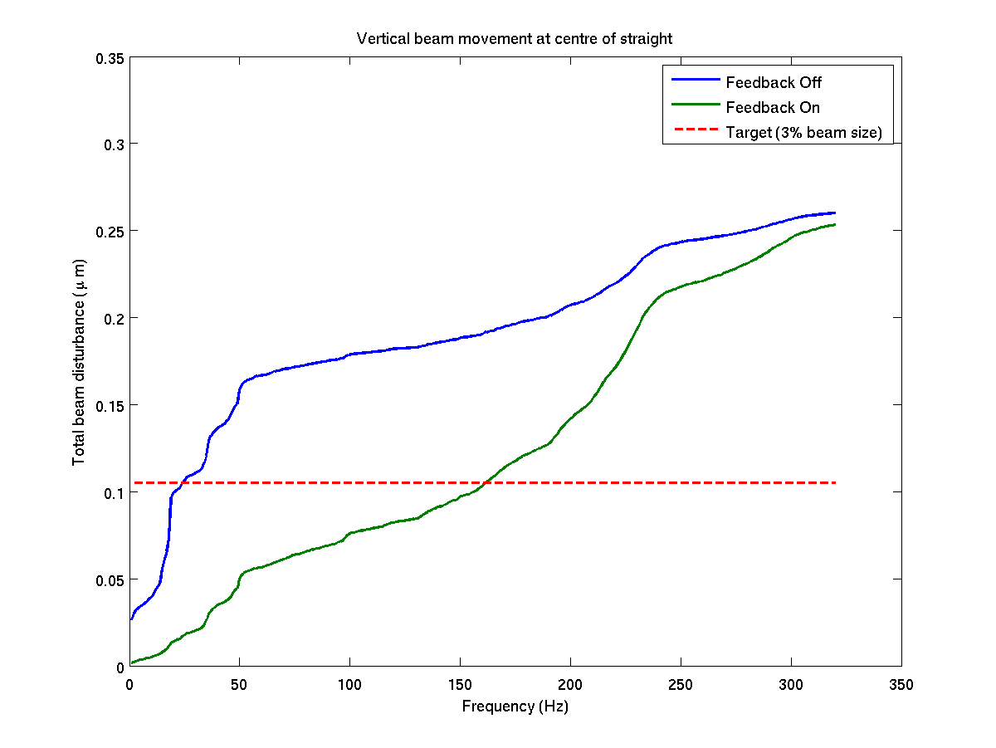
Integrated Impact of Orbit Feedback
C Abraham – Snr Power Supply Engineer
19

Slide 20
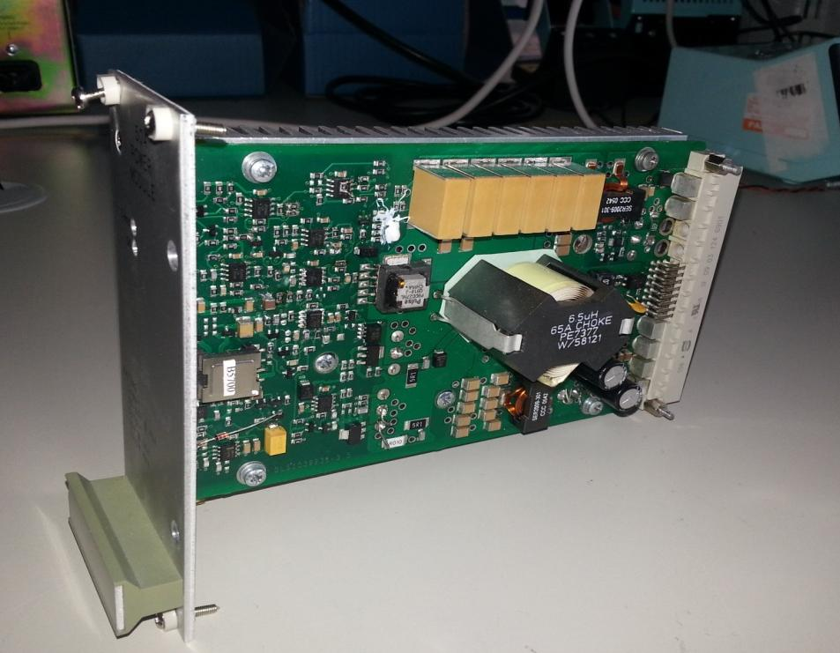
50A Power Module
Smaller form factor
Surface mount technology
More efficient
100kHz switching
Active current share
Wider bandwidth
Pulse by pulse current limit
Hot swappable
C Abraham – Snr Power Supply Engineer
20

Slide 21
EPICS PSC Support tools
Remote maintenance of power supply controllers:
Upload / download and comparison of parameter sets via command line and GUI
Upload / download of binaries via command line
Waveform upload / download in progress
Power Supplies Technical support tools suite.

Slide 22
Replacement ADC Card
Existing ADC Card has ‘issues’
Component obsolescence
Attrition of faulty cards.
Noise floor too high (Unsynchronised flyback)
Design deficiencies
Poor fault reporting
Cause of many power converter faults.
New ADC.
Form, fit and functionally the same
Higher performance ADC devices.
Scope to perform oversampling
Extra functionality could be used on a future DPSC

Slide 23
ID10 - Fast ID Switching
ID Device
ID Device
10Hz Switching between undulators
Usually RH Circ / LH circ polarization.
Careful control needed to change states.
23

Slide 24
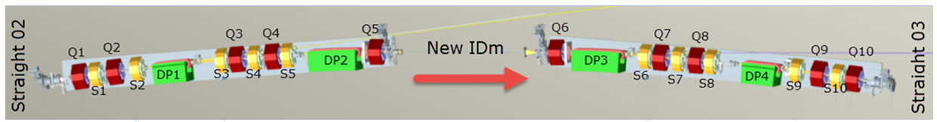
DDBA Upgrade
4 off Dipoles – Each has two circuits.
1300A Main circuit
200A Trim circuit.
10 off Quadrupoles – 200A unipolar
10 off Sextupoles – 100A unipolar (maybe)
16 off Correctors – 5A 4Q.
6 off Sq-Quad – 5A 4Q.
Only six week shutdown to swap from DBA to DDBA sector!
C Abraham – Snr Power Supply Engineer
24

Slide 25
Thank You.
Any Questions?

