Slide 2
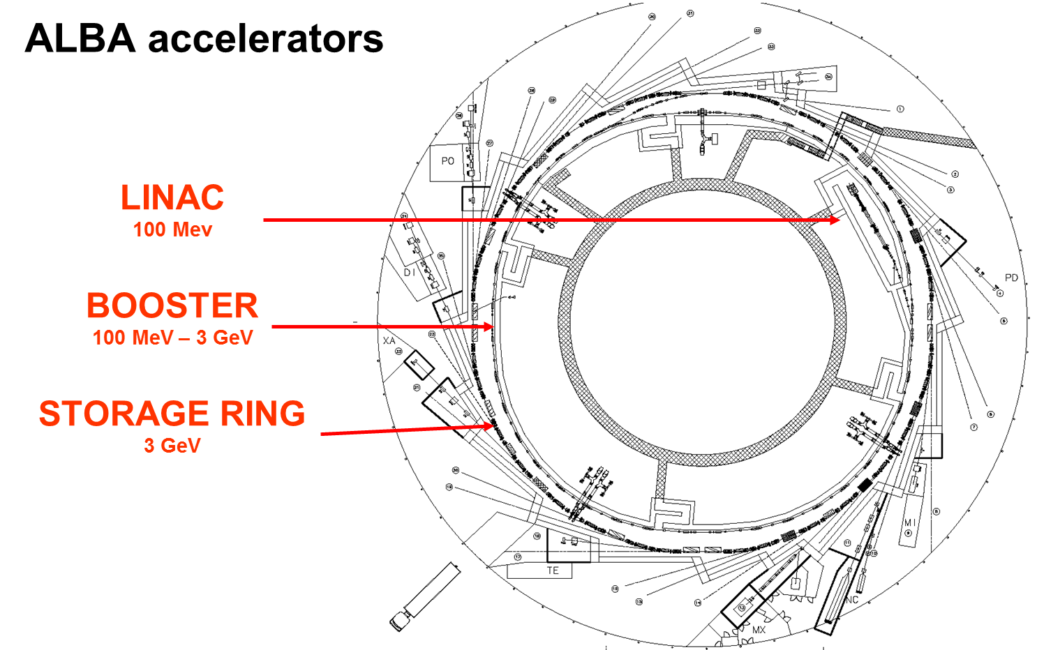
Magnet Power Supply
System Overview
2

Slide 3
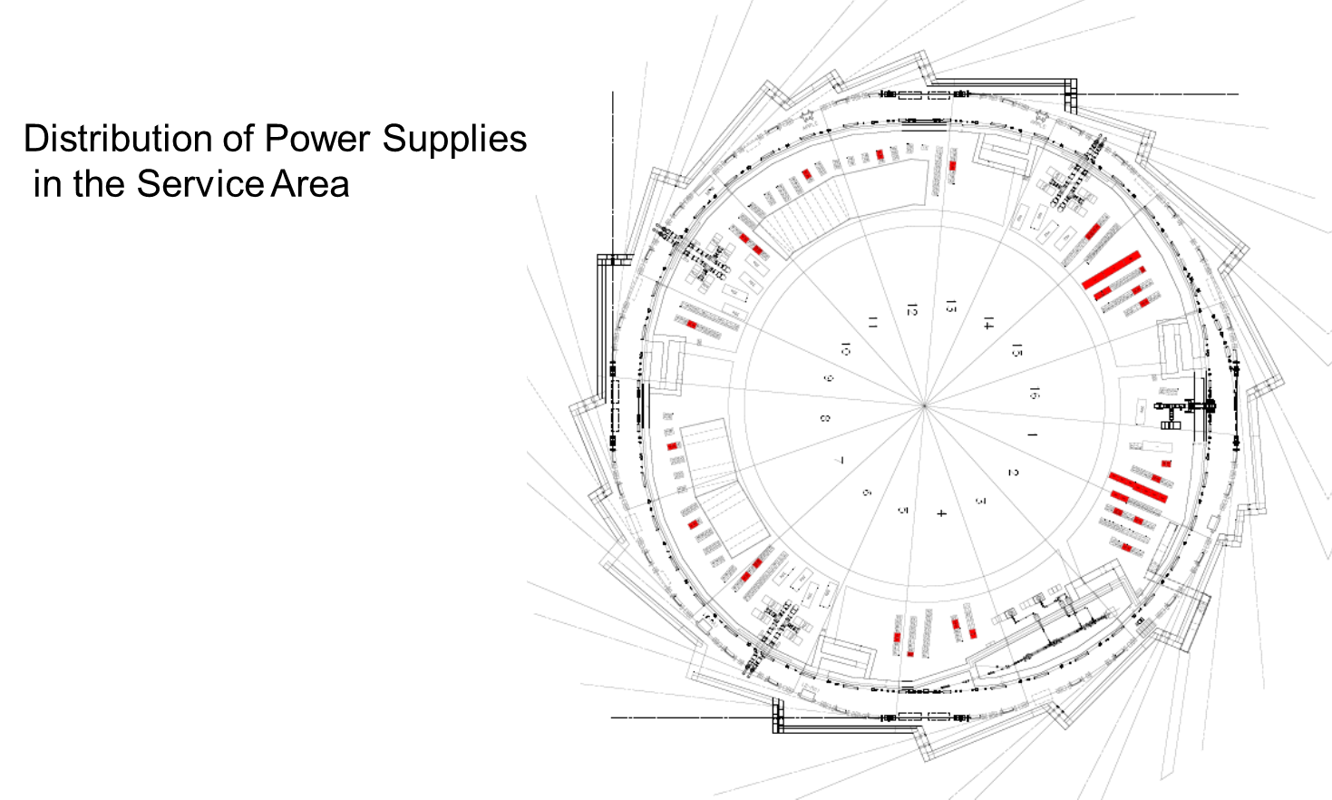
Distribution of Power Supplies in Service Area
3

Slide 4
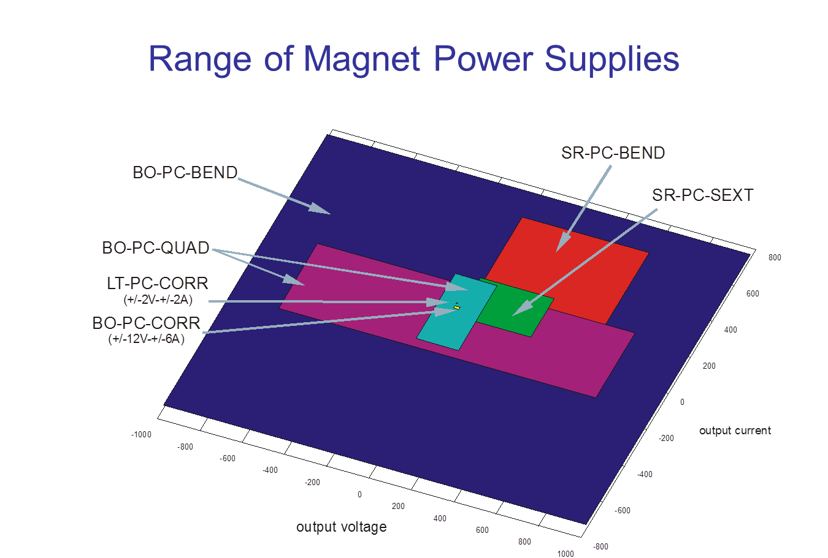
4

Slide 5
OVERVIEW OF STORAGE RING POWER SUPPLIES
5
MAGNET | QUANTITY |  | Nº PS | SPARE | Current (A) | Voltage (V) | OUTPUT POWER (kW)
DIPOLES | 33 |  | 1 | 0 | 600 | 750 | 450
QUADRUPOLES | 112 | 16 (Q200) | 88 | 8 | 200 | 15 | 3
 |  | 48 (Q260)
 |  | 24 (Q280)
 |  | 24 (Q500) | 24 | 2 | 225 | 25 | 5,625
SEXTUPOLES | 120 | 4 families x 8 magnets (S150A) | 4 | 1 | 215 | 100 | 21,5
 |  | 2 families x 16 magnets (S150B) | 2 | 0 | 215 | 190 | 40,85
 |  | 2 families x 24 magnets (S220A) | 2 | 1 | 215 | 350 | 75,25
 |  | 1 family x 8 magnets (S220B) | 1 | 0 | 215 | 125 | 26,875
CORRECTORS | 208 | Horizontal | 88 | 6 | ±12 | ±60 | 200
 |  | Vertical | 88 | 6 | ±12 | ±60 | 200
 |  | Skew | 2 | 0 | ±5 | ±60 | 200

Slide 6
OVERVIEW OF BOOSTER POWER SUPPLIES
MAGNET | QUANTITY |  | Nº PS | SPARE | Current (Apeak) | Voltage (Vpeak) | OUTPUT ACTIVE POWER (kW)
DIPOLES | 40 | 40 coils | 1 | 0 | 750 | ±1000 | 95
 |  | 40 coils | 1 | 0 | 750 | ±1000 | 95
QUADRUPOLES | 60 | 16 (series connection 8+8) | 2 | 0 | 180 | ±100 | 3,5
 |  | 8 | 1 | 0 | 180 | ±200 | 5,6
 |  | 36 | 1 | 0 | 180 | ±750 | 24,5
SEXTUPOLES | 16 (series connection 8+8) |  | 2 | 0 | ±8 | ±60 | 0,45
CORRECTORS | 72 |  | 72 | 4 | ±6 | ±10 | 0,25

Slide 7
OVERVIEW OF TRANSFER LINES POWER SUPPLIES
LINAC to BOOSTER TL
MAGNET | QUANTITY |  | Nº PS | SPARE | Current (A) | Voltage (V) | OUTPUT POWER (W)
DIPOLES | 2 | type 1 | 1 | 0 | 180 | 20 | 3600
 |  | type 2 | 1 | 0 | 12 | 12 | 150
QUADRUPOLES | 9 |  | 9 | 1 | 15 | 20 | 300
CORRECTORS | 8 |  | 8 | 2 | ±2 | ±2 | 4
BOOSTER to STORAGE RING TL
MAGNET | QUANTITY | Nº PS | SPARE | Current (A) | Voltage (V) | OUTPUT POWER (W)
DIPOLES | 2 | 2 | 0 | 180 | 60 | 10800
QUADRUPOLES | 7 | 7 | 1 | 170 | 15 | 2500
CORRECTORS | 8 | 8 | 2 | ±6 | ±10 | 60

Slide 8
Procurement of Power Supplies
Call for tenders for different subsystems (Transfer lines, Booster, Storage Ring)
Turnkey approach.
3 Companies
Bruker (Now Sigmaphi Electronics) for Transfer Lines and Booster
Hazemayer for SR Dipole, Sextupoles and Quadrupoles
OCEM – Storage Ring Correctors

Slide 9
Today’s Solutions are
Tomorrow’s Problems
Yesterday’s Solutions:
Transfer the risk of a new design to an external company
Low Manpower needed, only to follow up the companies
Low delivery time.
Today’s Problems
Risk of out of business of a manufacturer.
Companies may change their business.
The complete know how is in the manufacturer.
Design errors that appear after long term in operation. Not cover by warranties.

Slide 10
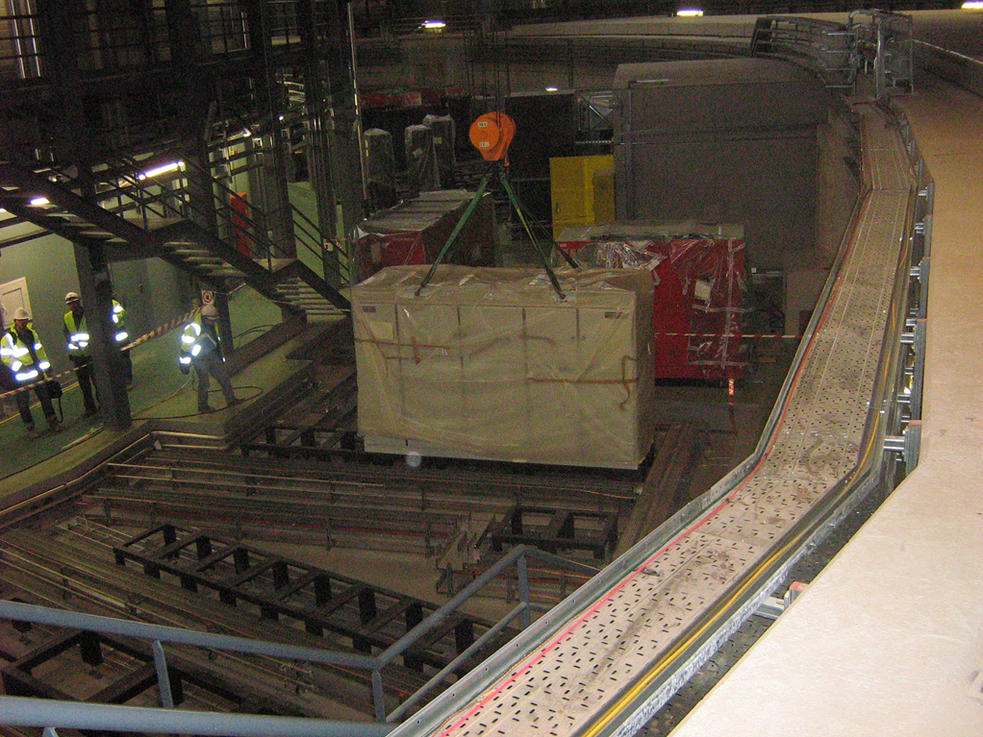
SAT , Installation and Commissioning (2009-10)
All Power were tested before installation in SA
Exception:
Booster Bending and Quadrupoles
Storage Ring Bending Power Supplies
Storage Ring Sextupoles Power Supplies

Slide 11
Stability Test Results

Slide 12
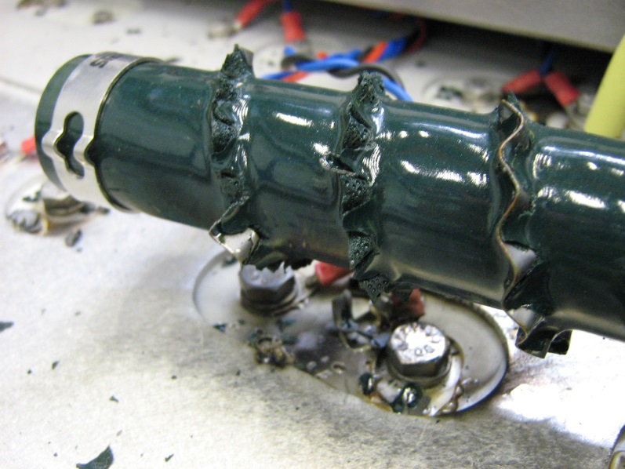
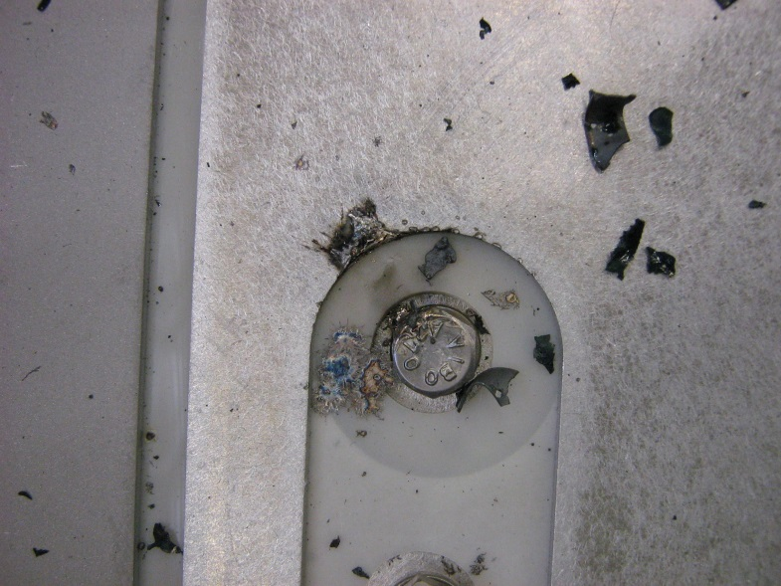
Commissioning
Serious incidents with Booster Dipole Power Supplies During Commissioning
Lesson Learnt: The commissioning of Large Power Supplies could be long and painful. Take time and do not rush into the commissioning of other subsystems.

Slide 13
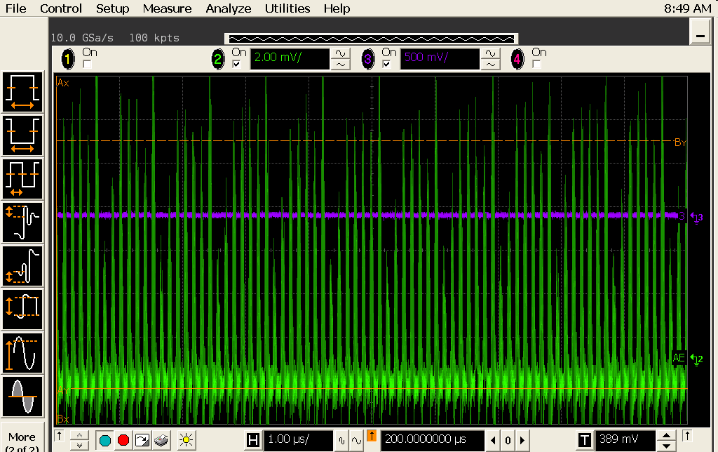
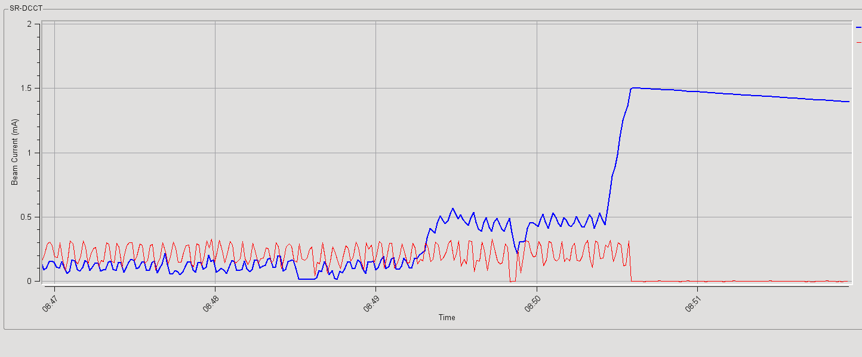
Commissioning of Storage Ring Power Supplies
16 March 2010: Beam Accumulated
Acummulation
1.5 mA stored
111 out of 112 Storage Ring Quadrupoles Connected with the wrong polarity.
Lesson Learn: Polarity meaning may change according to different specialist.

Slide 14
Electronics Section
Composed by
  8 electronics engineers
  6 electronics technicians

Slide 15
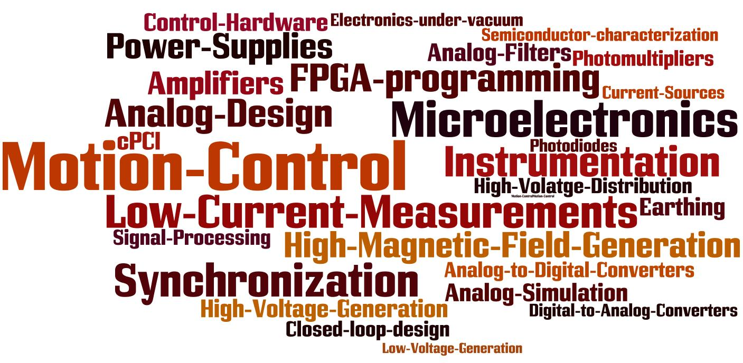
Electronics Section Functions
  Control Hardware (cPCI, DIO cards, NIM...)
  Accelerator Power Supplies
  Instrumentation support (ADCs, DACs, Counters, V2F,...)
  Motion control (ICEPAP project)
  Timing System
  Centralized Hardware Documentation Repository (CableDB)
  Hardware installation
  Electronics design projects

Slide 16
Tools for Operation
Incident Management
On-Call system: 1 Engineer and 1 technician 24 Hs during operation
Incident Register
Cable Database
Request Tracker (RT) migrating to JIRA
Elog
Weekly Power Supply meeting (1 hr)
Weekly Electronics Section Meeting ( 1Hr )

Slide 17
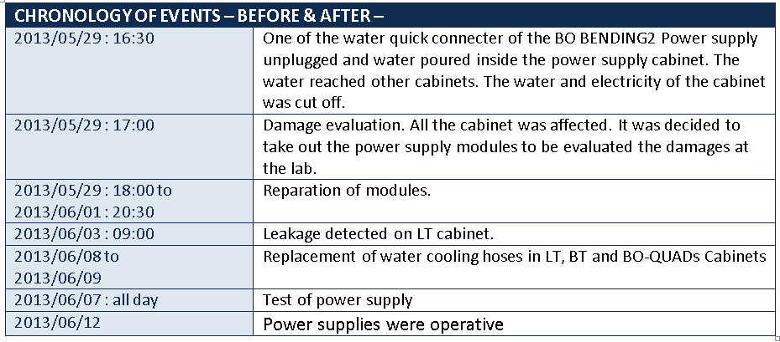
Once in Lifetime Incidents
2013 - Water Leakage in Booster Bending and LT Power Supplies.

Slide 18
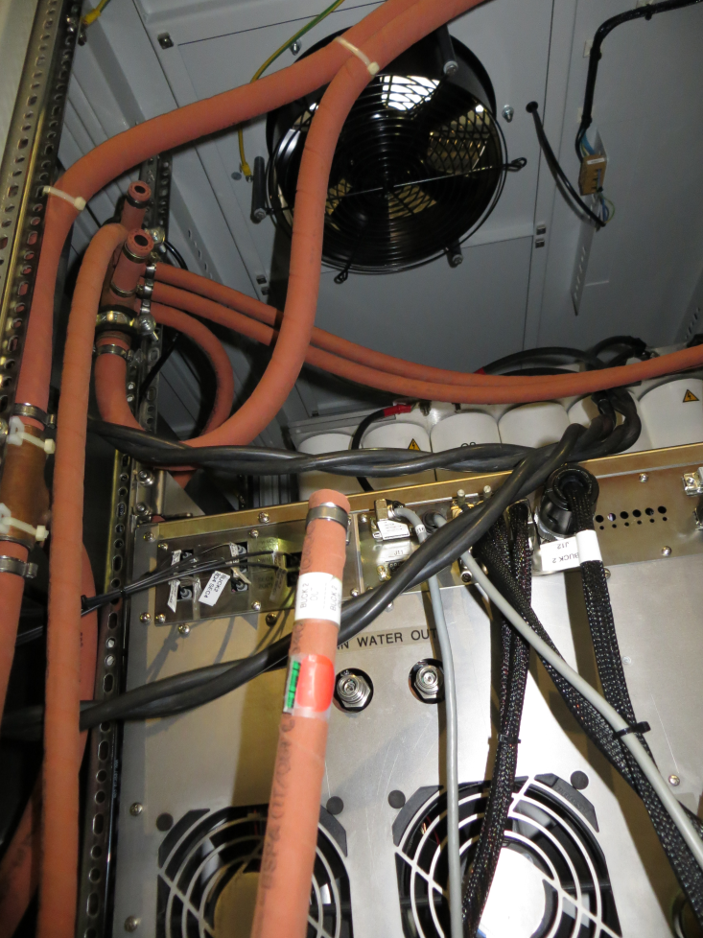
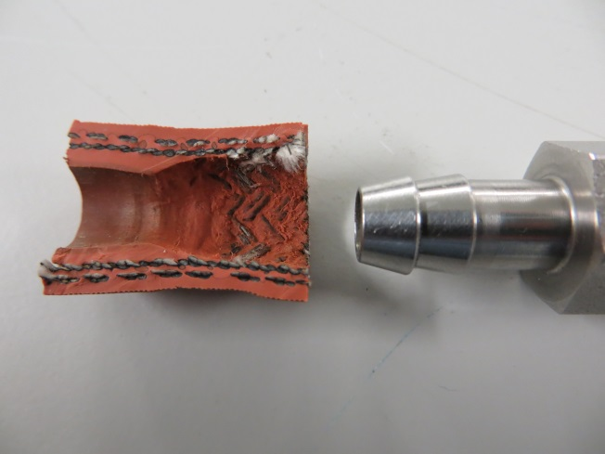
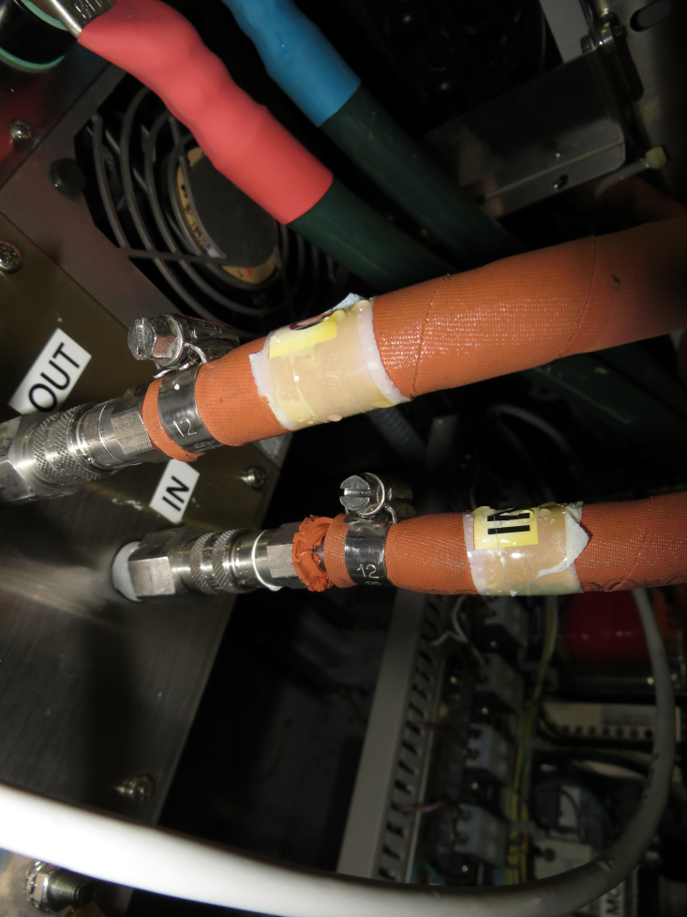
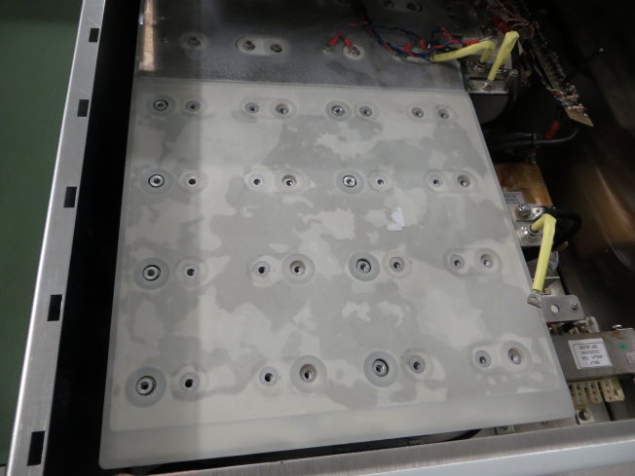
Once in Lifetime Incidents
2013 - Water Leakage in Booster Bending and LT Power Supplies.

Slide 19
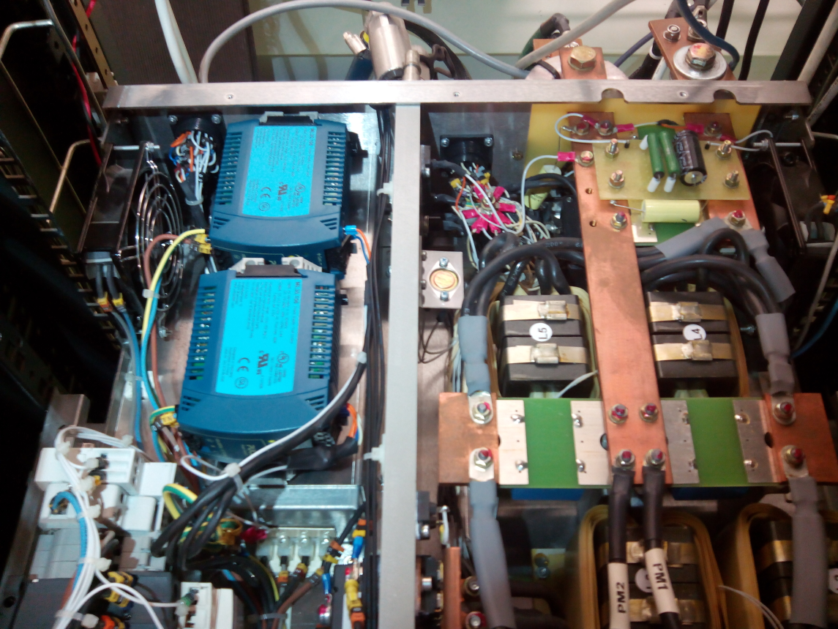
Once in Lifetime Incidents
Auxiliary Power Supplies in SR-QUAD.
Several PS were not operative after shutdown period.

Slide 20
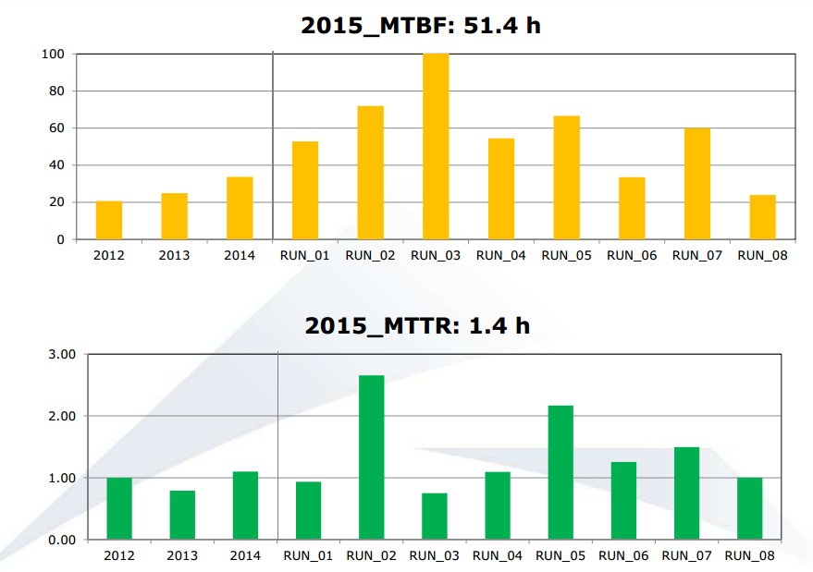
Some Operation Statistics

Slide 21
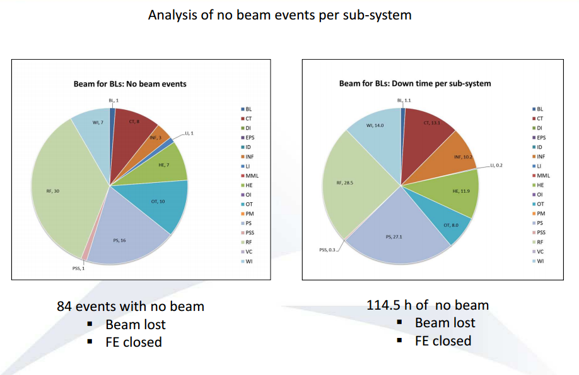

Slide 22
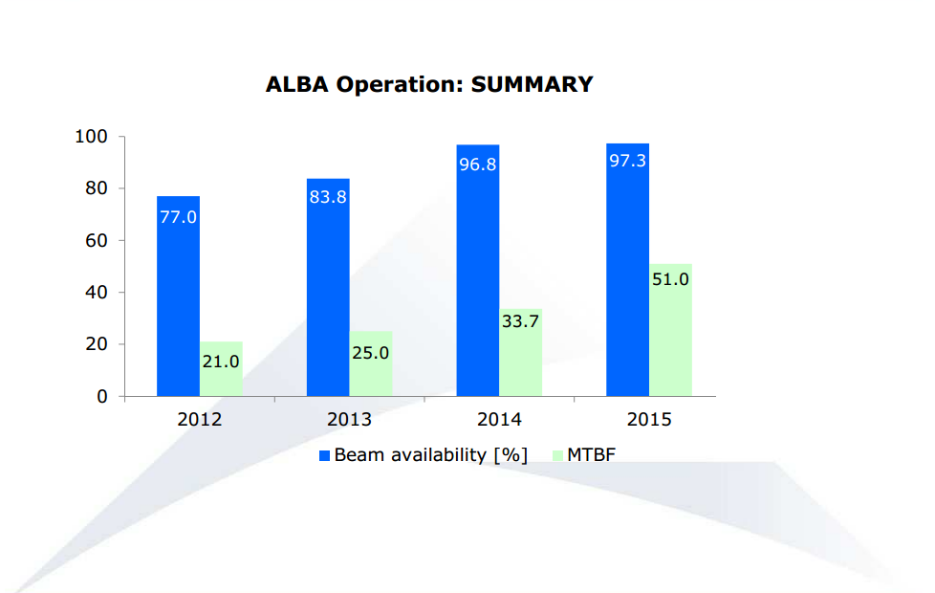

Slide 23
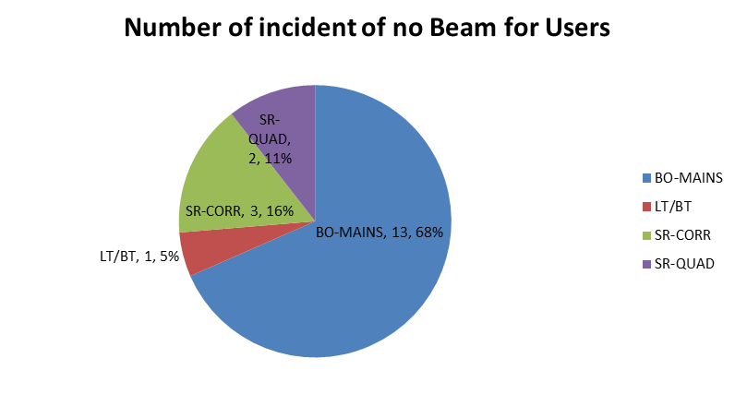

Slide 24
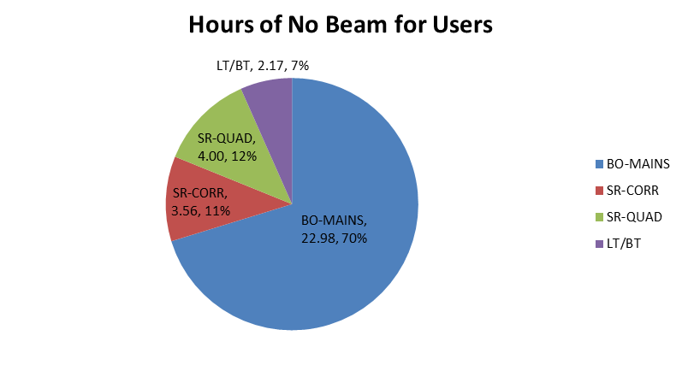

Slide 25
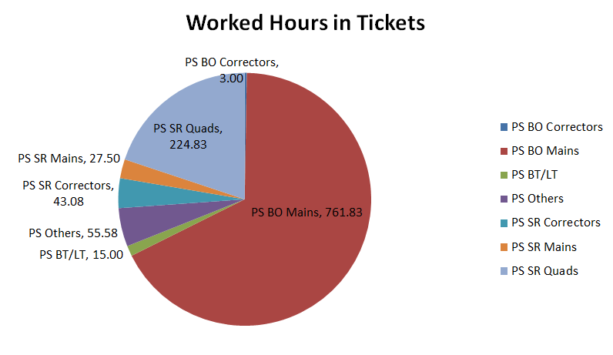

Slide 26
Today’s main concern
Booster Dipole Power Supplies:
Two Main Problems
1) very low lifetime of 2Q modules under the stress of top-up operation.
Power and thermal cycling.
2) Large difficulties to make failure diagnostics when the control/regulation boards are involve.

Slide 27
Problem Solving Approaches:
First step. More spare modules are needed in order to reduce the risks.
Further steps:
Under evaluation.
refurbish the 2Q modules:
over-dimension IGBT
SiC modules
2) We must have a control/regulation boards with a complete access (documentation, firmware, etc)

Slide 28
Thank you
Questions
Suggestions?

