Slide 2
POCPA5
Closing Remarks
Roberto Visintini
Elettra – Sincrotrone Trieste

Slide 3
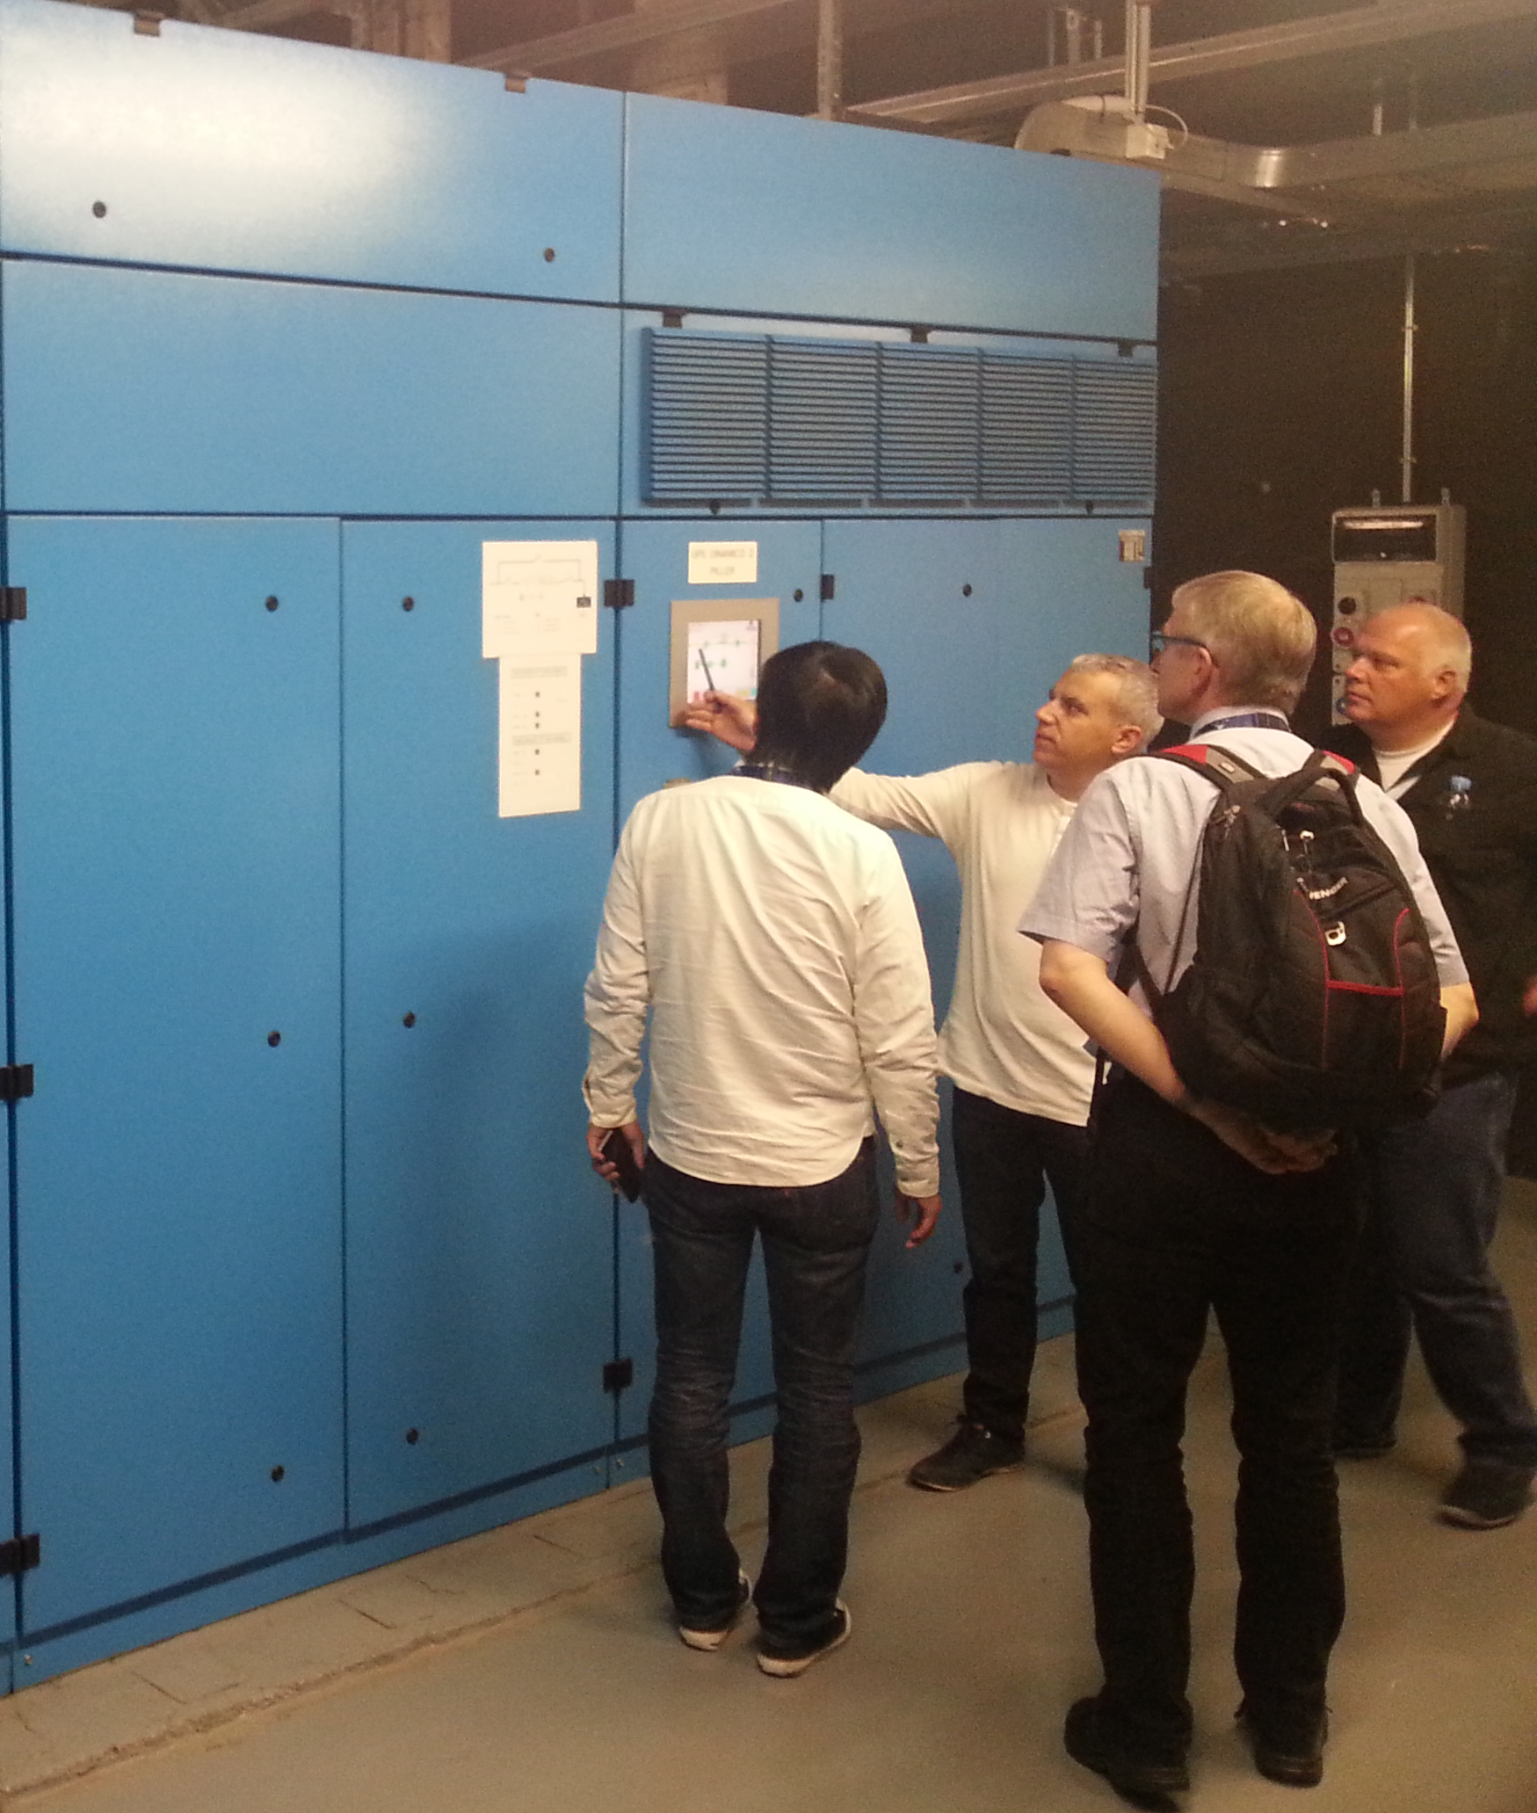
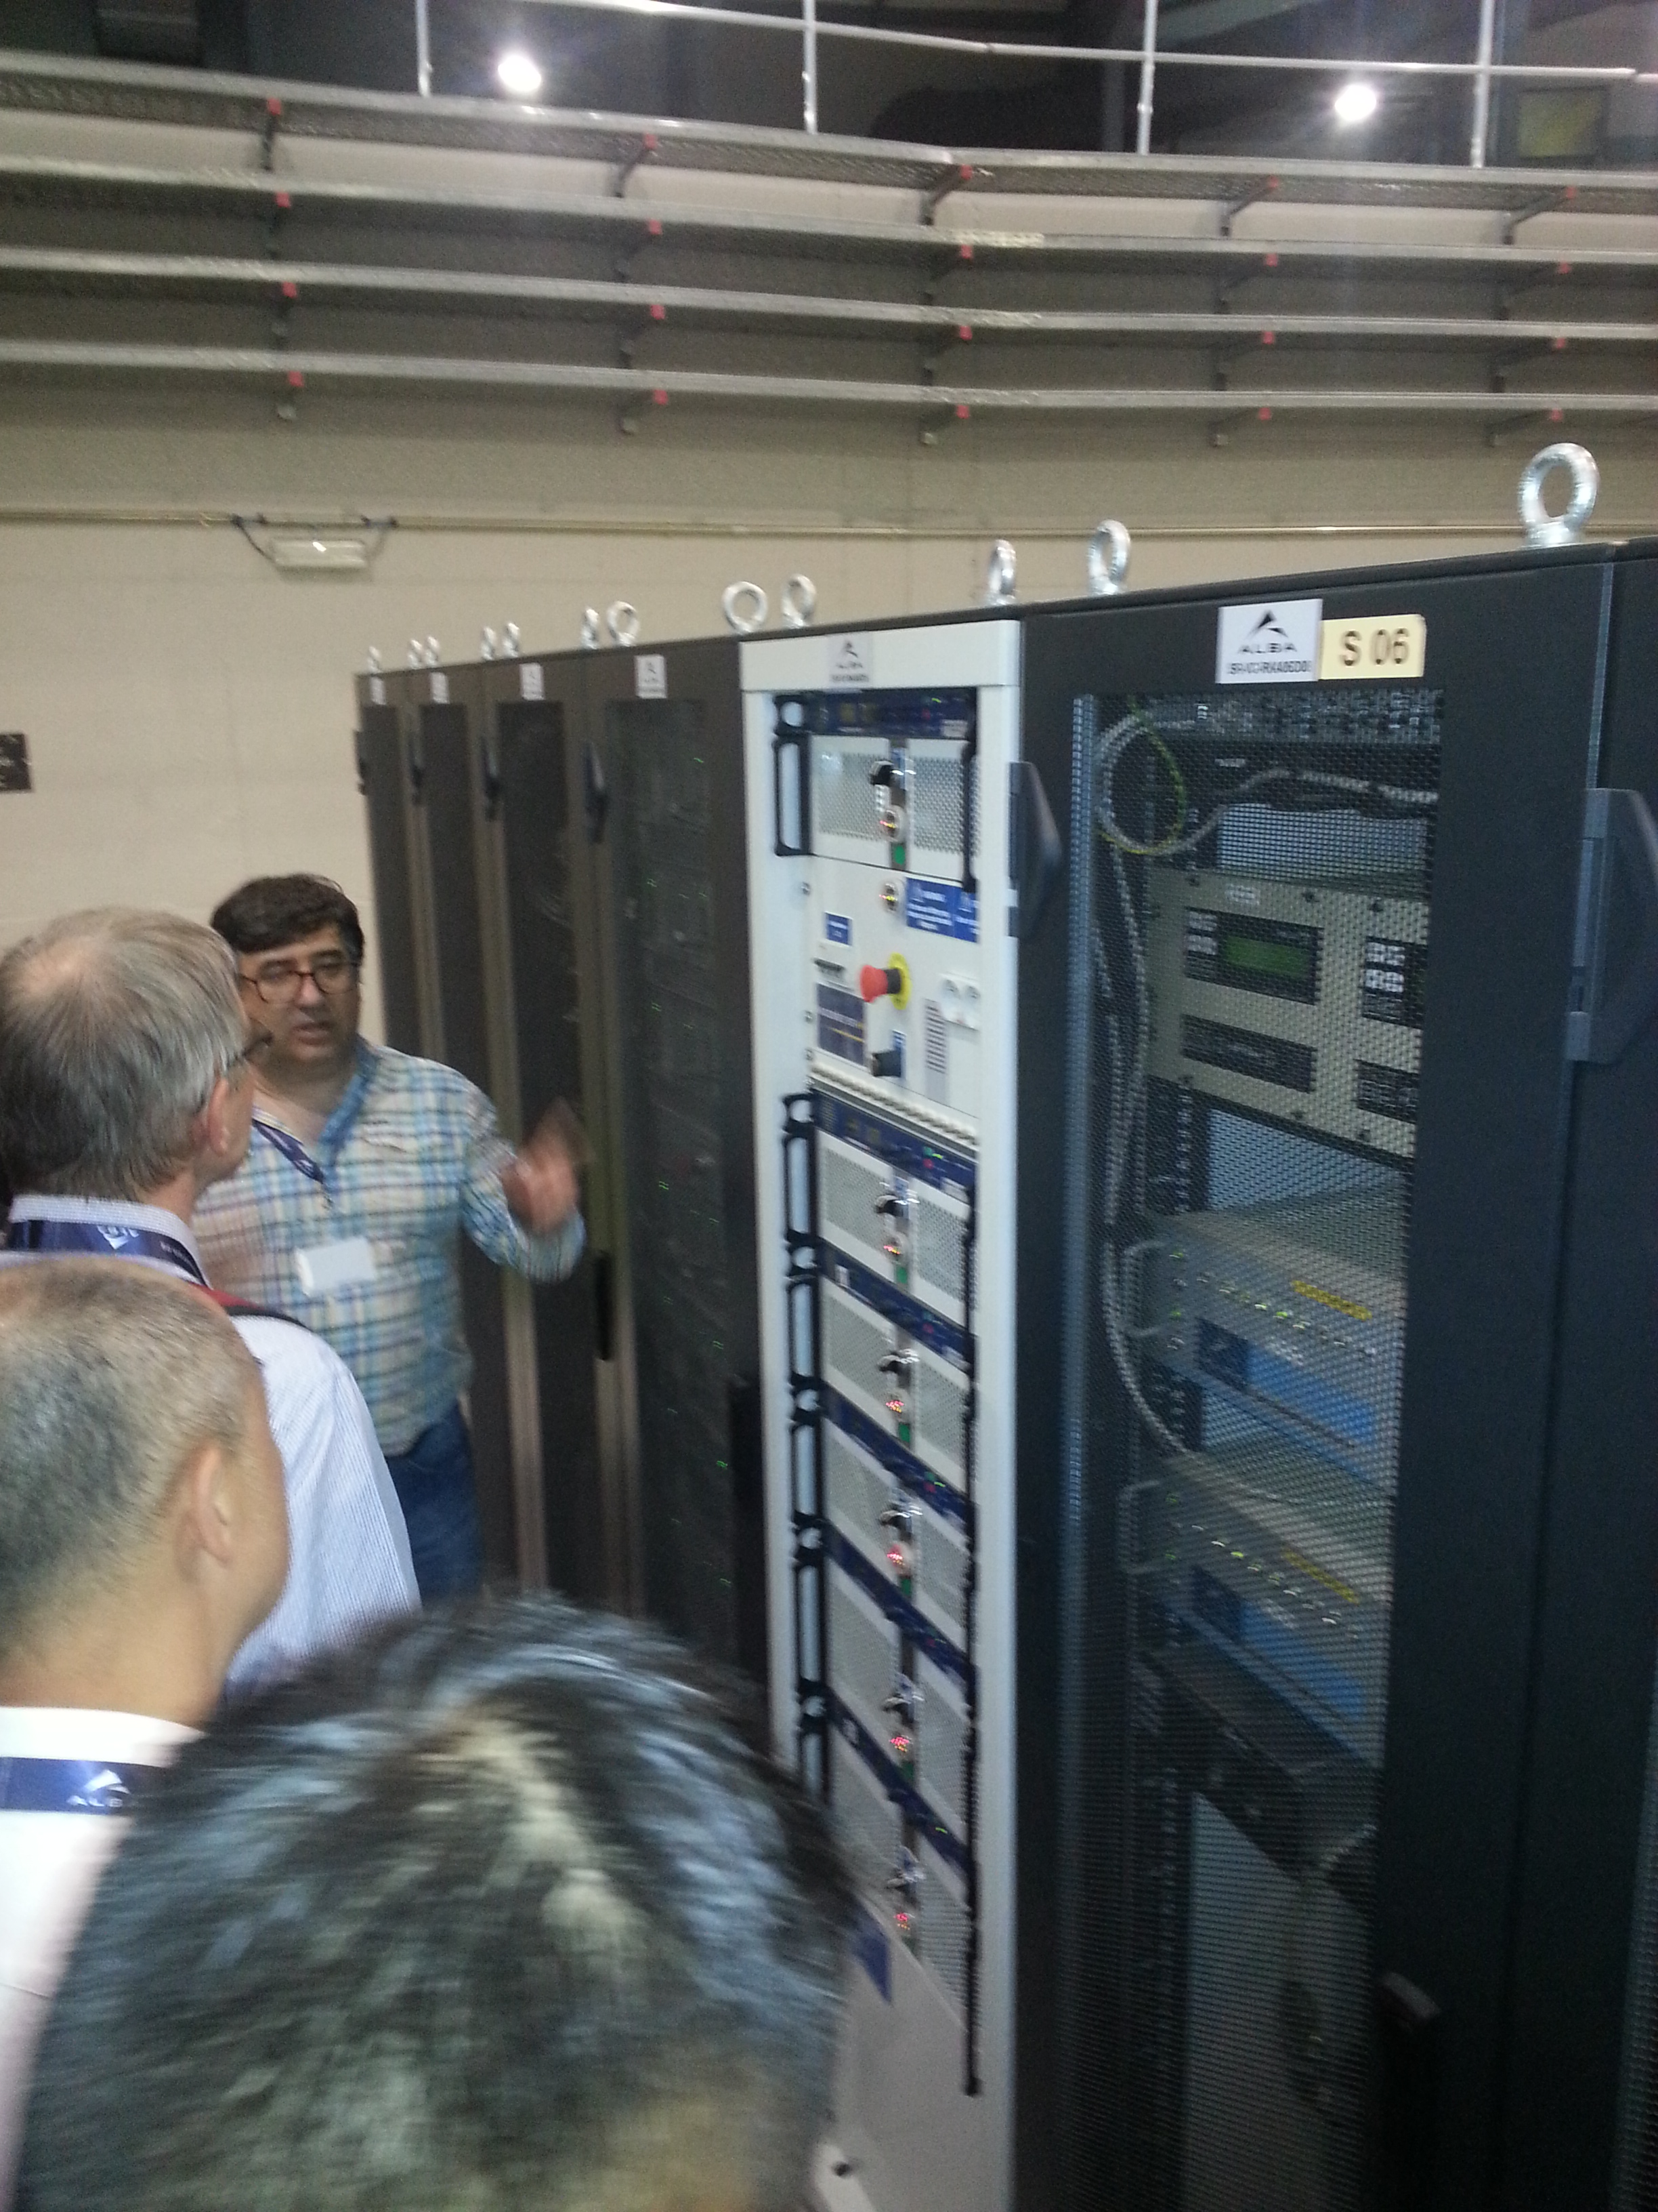
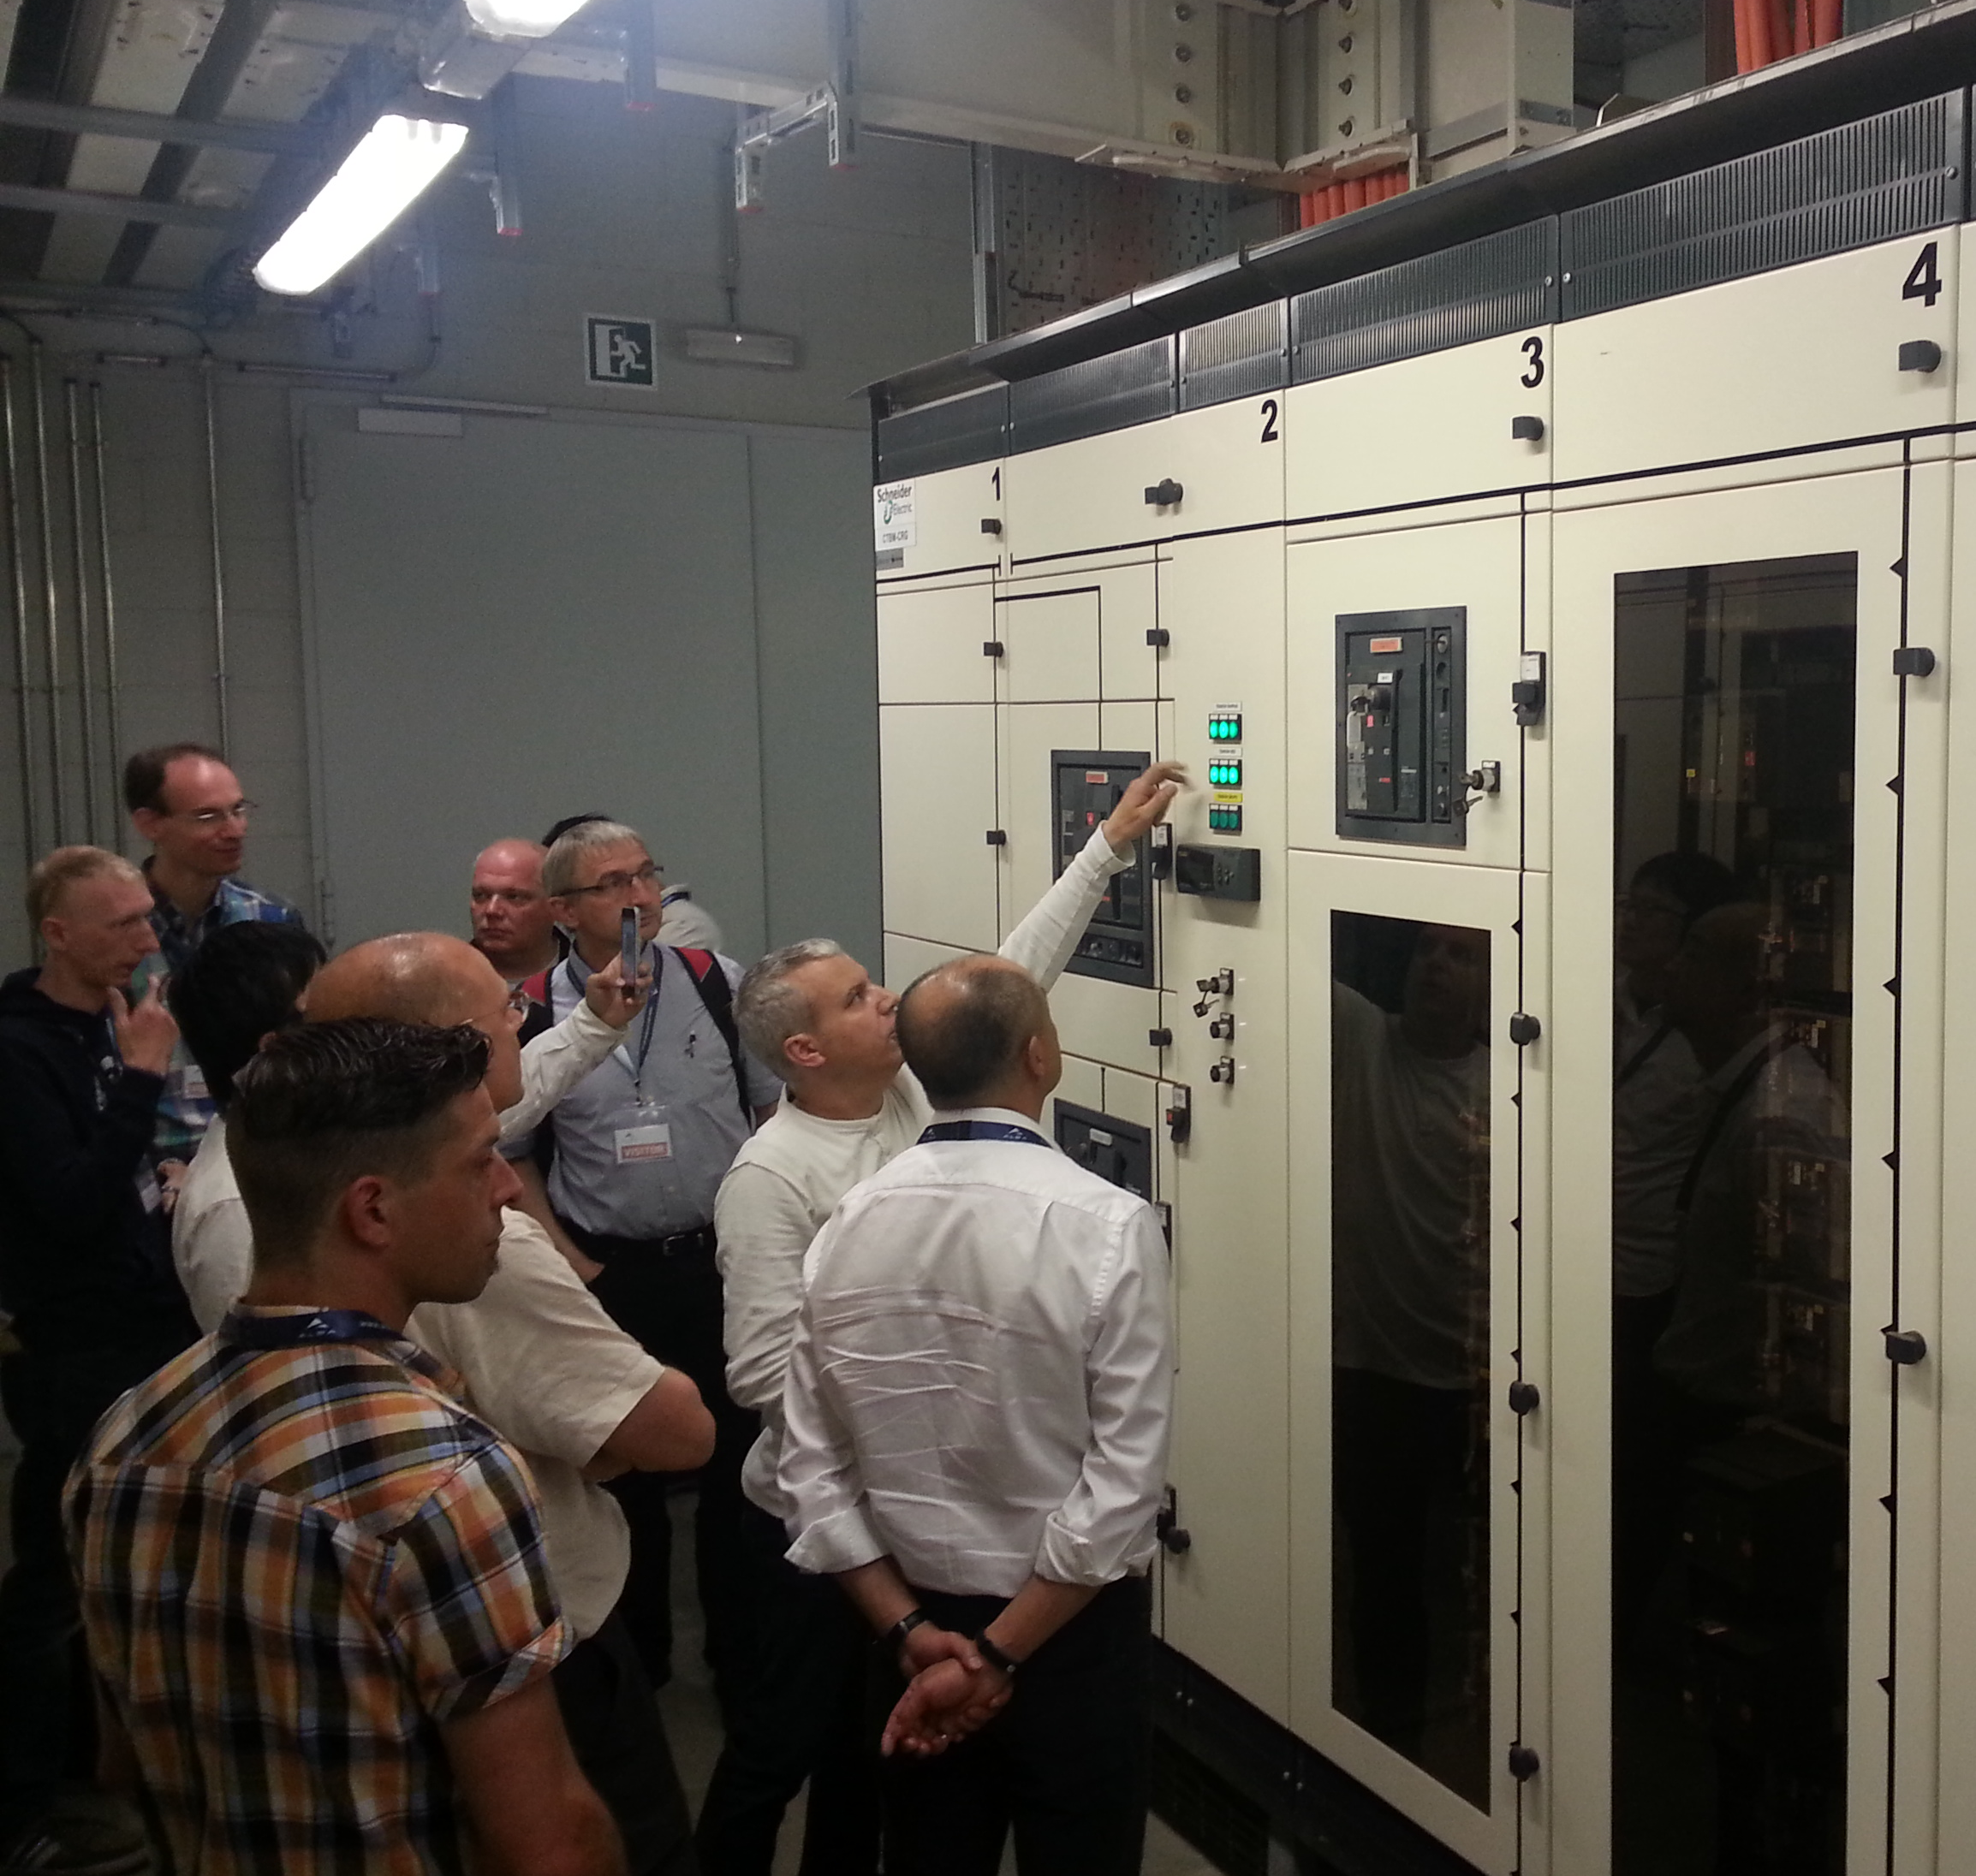
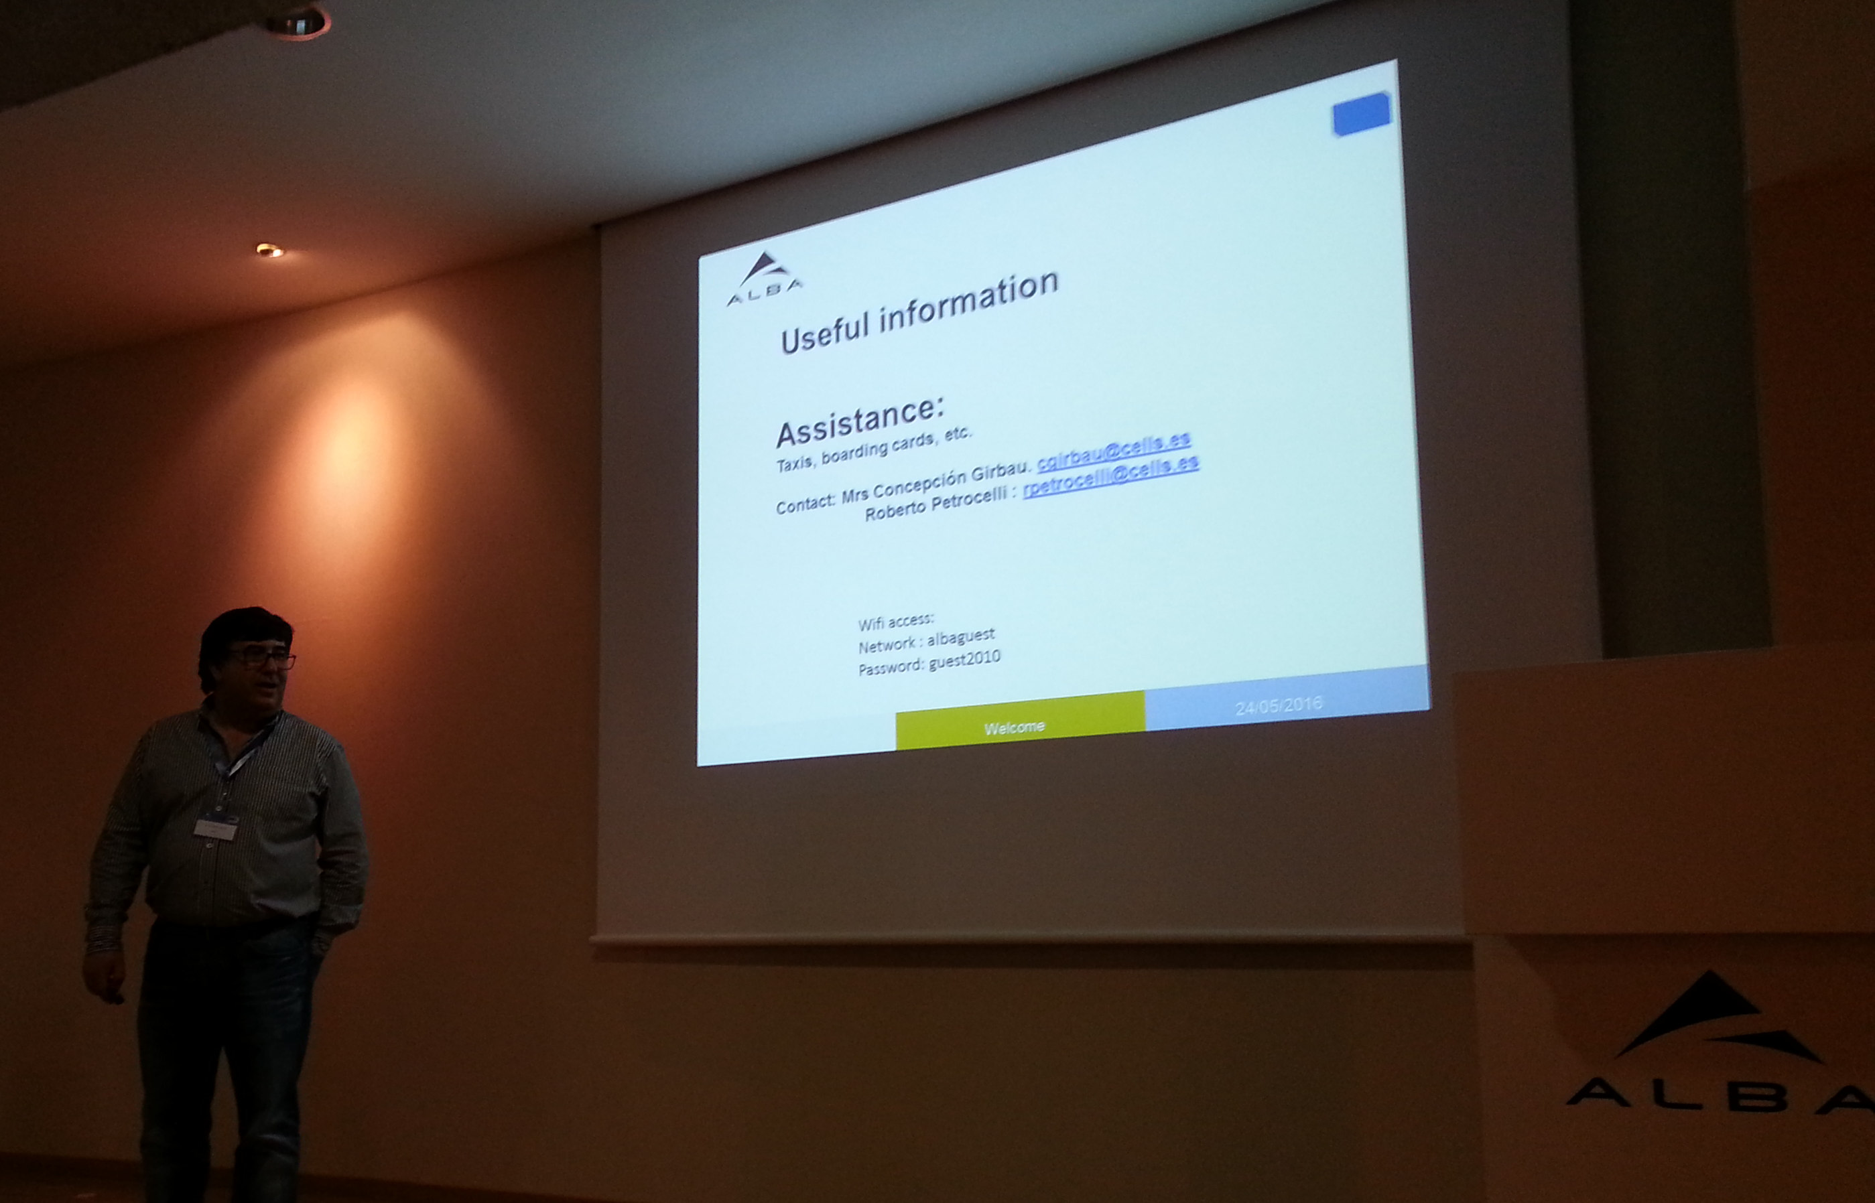
POCPA5, here we are…
                Technical Summary
                Performance Specification, Reviewing and Testing for Power supplies and Subsystems
                News from the Labs
17 talks (+ Intro & Closing remarks)
2 Open discussion sessions
1 Visit to ALBA

Slide 4
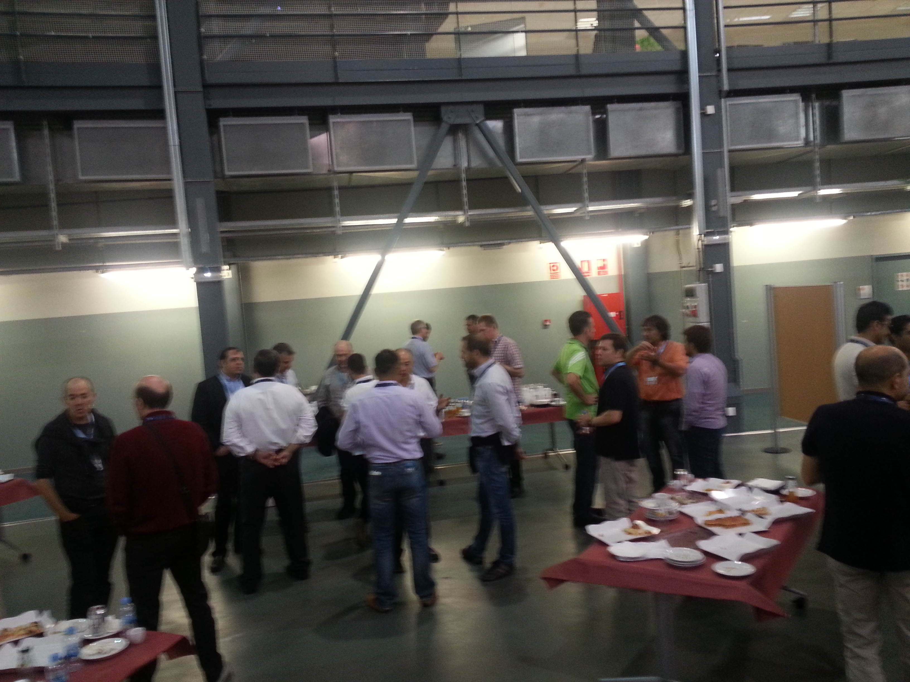
POCPA5, here we are…
                Social Summary
Plenty of talks among us
2 Dinners
3 Lunches
4 Coffee breaks
                Standup Lunch: great source of “Brownian Motion” for interactions!

Slide 5


POCPA5, here we are…
                Some personal considerations
Good examples on how to deal with manufactures in the procurement process
Magnets and Power supplies are the two sides of a “System”
Optimization involves magnets AND power supplies together
Few discussions on interactions with the persons in charge of other systems

Slide 6
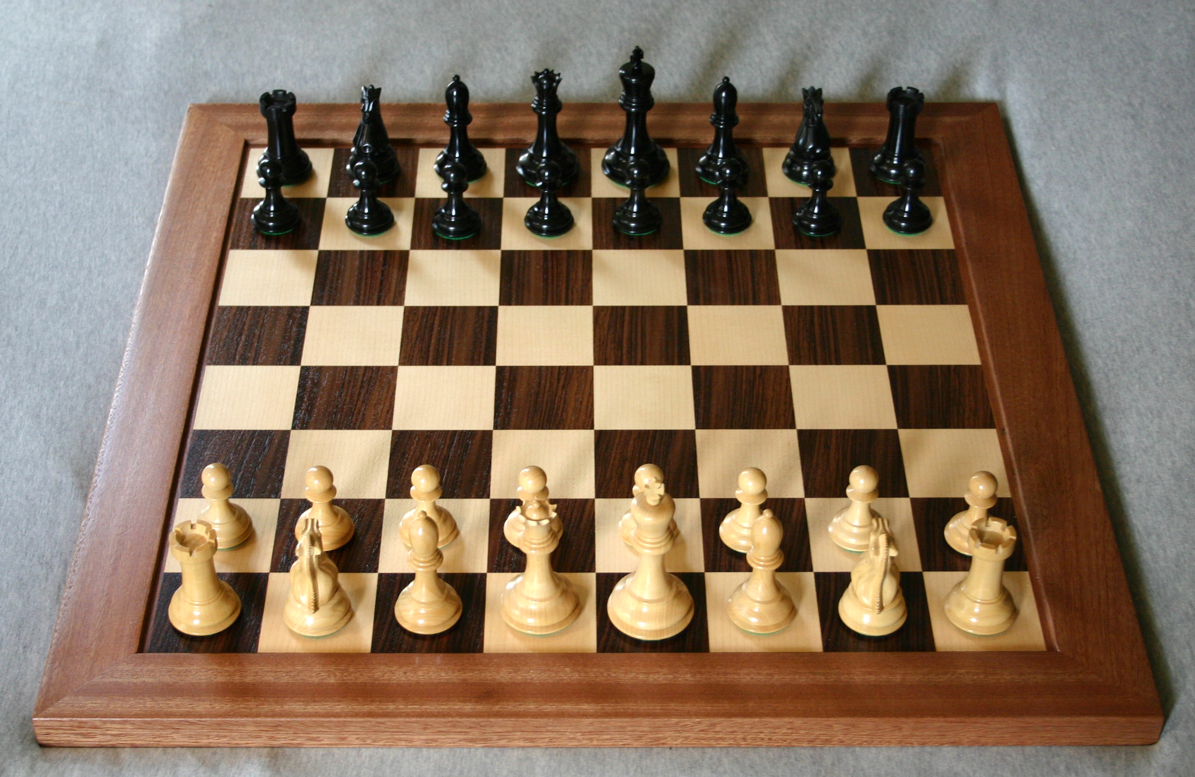
Physics, Magnetics, Power, Control: a System
Magnet Designer
Power Converter Designer
Particle Physicist
Controls Expert
Defining the Parameters of the power converters is not a Chess Tournament where players meet singularly…

Slide 7
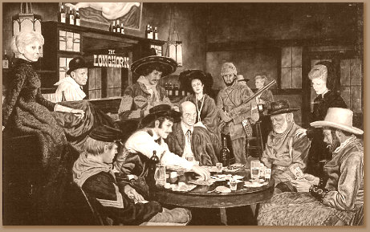
Physics, Magnetics, Power, Control: a System, integrated in the plant!
…it is more a poker game, with spectators waiting for their turn to play!
Electrical Plant Responsible
Cooling Plant Responsible
Particle Physicist
Controls Expert
Magnet Designer
Power Converter Designer

Slide 8

Physics, Magnetics, Power, Control, Plant: “safety margins”…
Electrical System Designer
Cooling System Designer
Power Converter Designer
Magnet Designer
Particle Physicist
Let’s have all player talking together, otherwise anyone adds his own “safety” margin!

Slide 9
Proposal for POCPA6
                Main Topic:
                “Efficiency and integration with other systems”
                Efficiency considered as “Effective Design”
                Integration means focus non only on Procurement but on “interaction” with others, too!

Slide 10
POCPA6 – 2018: WWW
Where
SIRIUS, Campinas, Brazil
When
“Fall” (September - October) 2018
Who…
…wants to candidate for 2020?

Slide 11
Acknowledgments
Our hosting facility, ALBA
The Local Committee and PS staff at ALBA
  Roberto, Conception, and all the collaborators
The members of the Scientific Committee
  Jean-Francois Bouteille, Jean-Paul Burnet, Hans-Joerg Eckoldt, Rene Kuenzi, Cleber Rodrigues, Ju Wang
The Lecturers and …
...YOU, the participants!

Slide 12
See you in 2018!!!
Notes:
Last Slide 1: Thanks to the audience

