Slide 1
POCPA 2016.
Specification of Power supplies at DESY
Hans-Jörg Eckoldt
26.05.2016

Slide 2
Structure.
Overview of Accelerators
  FLASH/ FLASH II
  PETRA III / PETRA III Extension
  XFEL
Specification

Slide 3
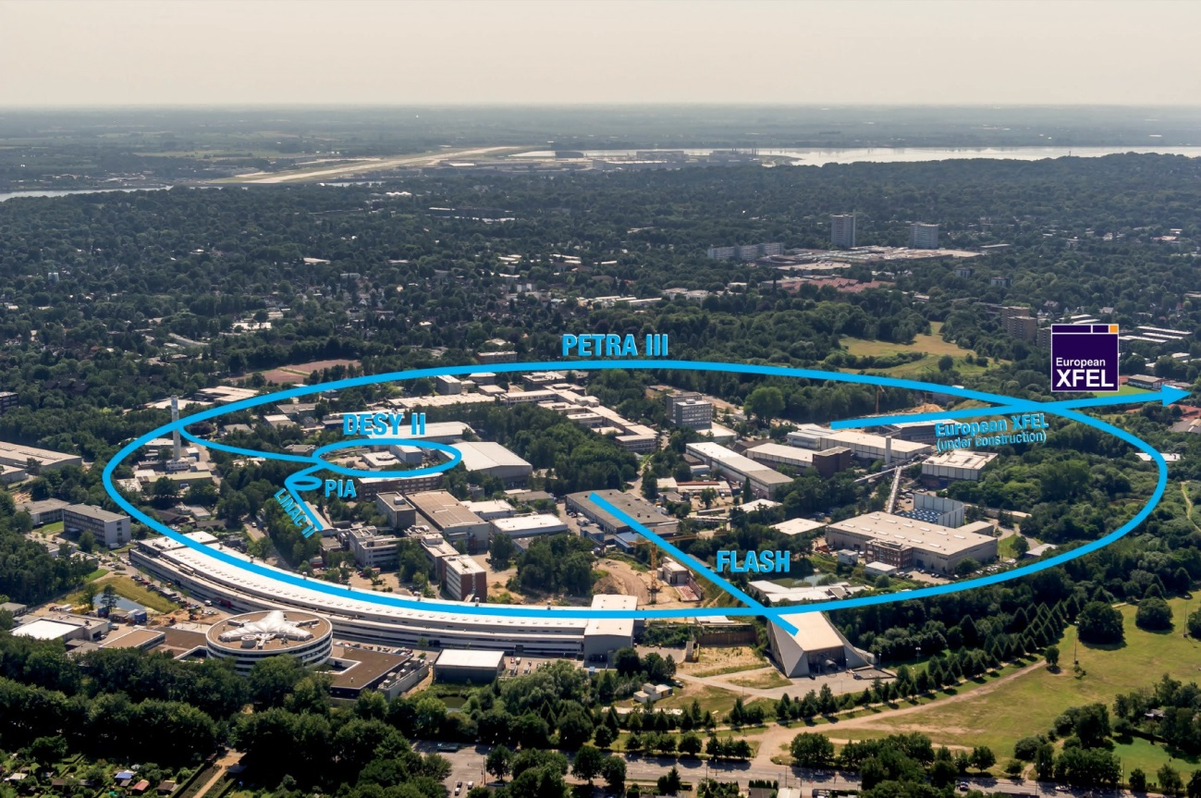
DESY, Hamburg.

Slide 4
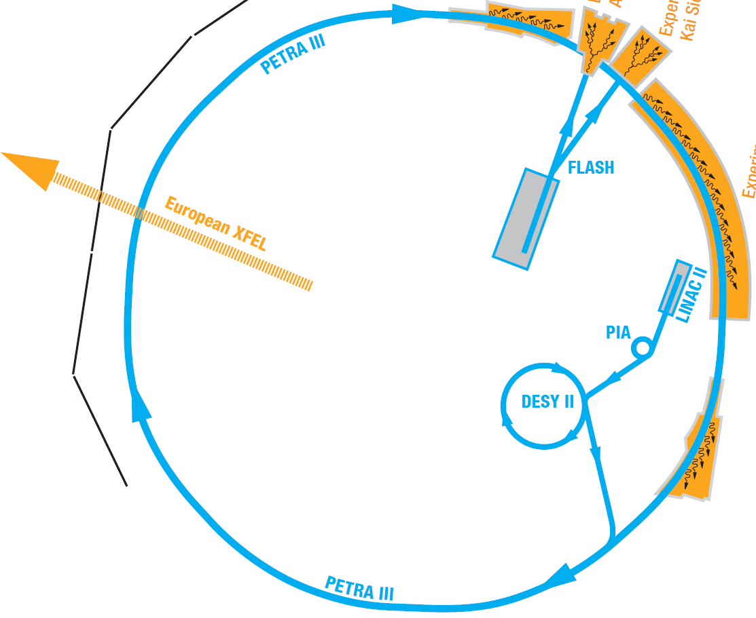
Accelerators.
Linac II 1970
450 MeV e+/e-
PIA 1970
450 MeV e+/e-
DESY II 1990
7 GeV e+/e-
PETRA III 2009/2015
6 GeV e+/e-
FLASH 2003
1.2 GeV e-
FLASH II 2015
1.2 GeV e-
XFEL 2016
20 GeV e-

Slide 5
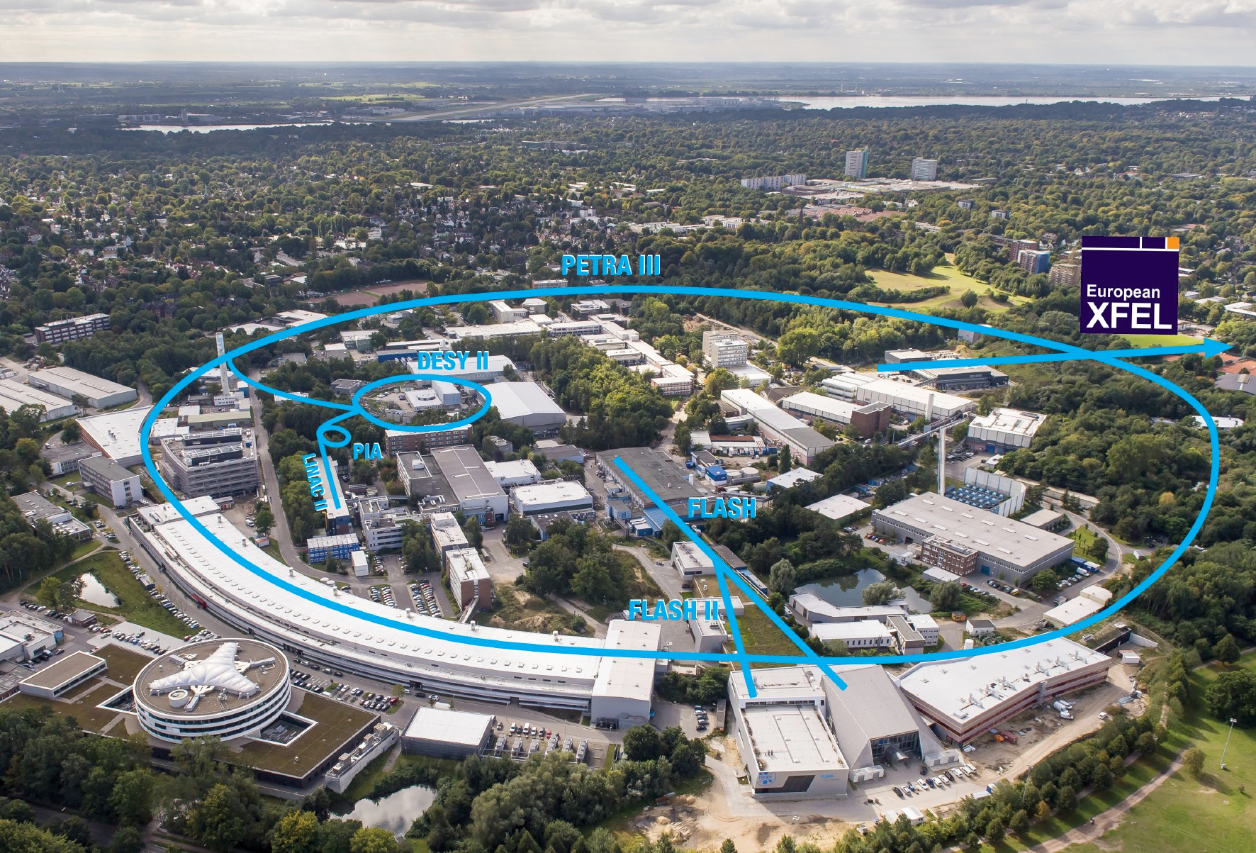
Accelerators, Teststands and Modulators.
XHM
REGAE
(LUX)
CMTB
AMTF
Testhalle für Module
SINBAD
(FORWARD)

Slide 6
FLASH + FLASH II

Slide 7
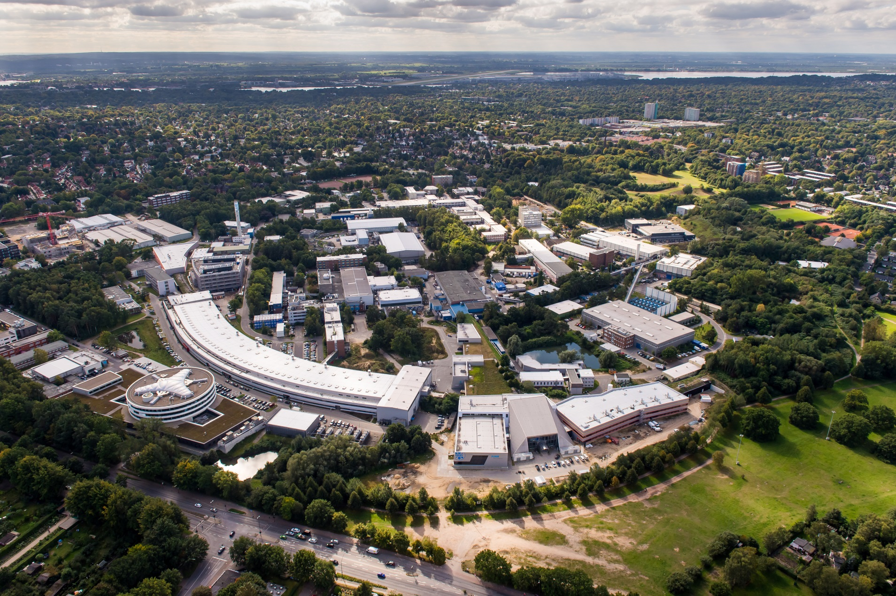
FLASH/FLASH II.

Slide 8
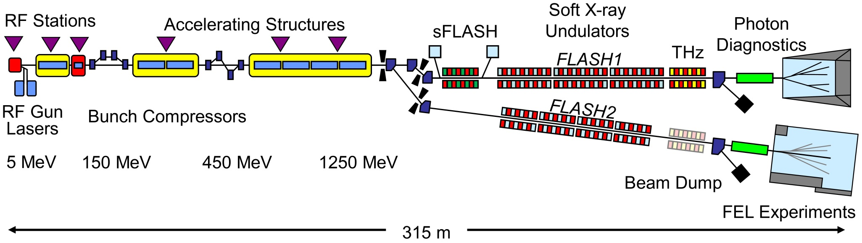
FLASH, FLASH II.
Extraction
FLASH II

Slide 9
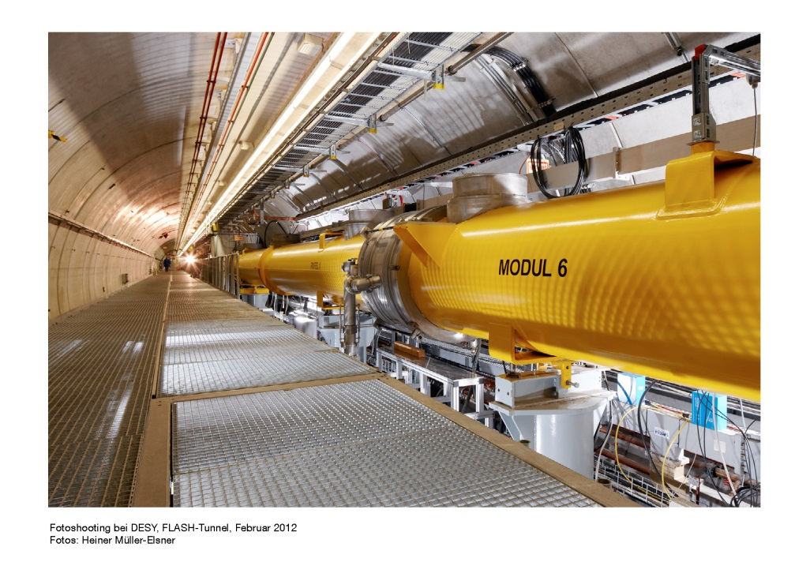
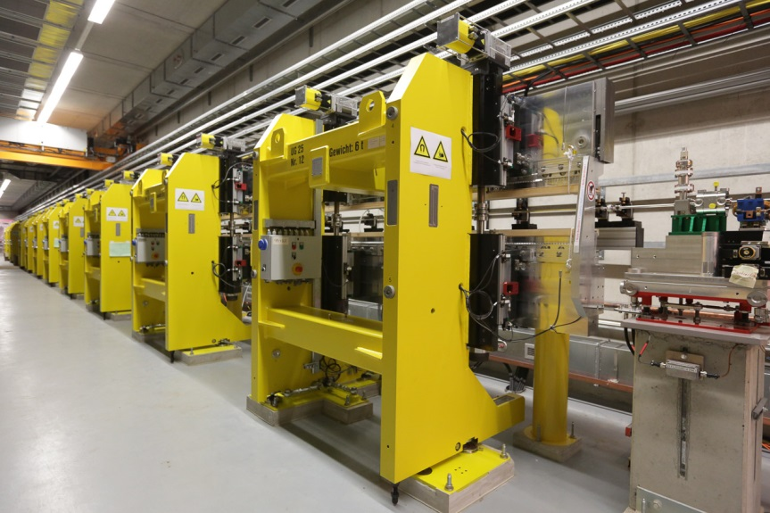
Superconducting modules, Undulators .

Slide 10
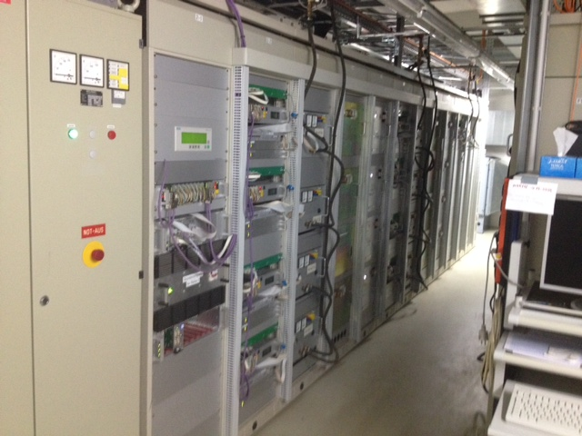
FLASH II power supplies.

Slide 11
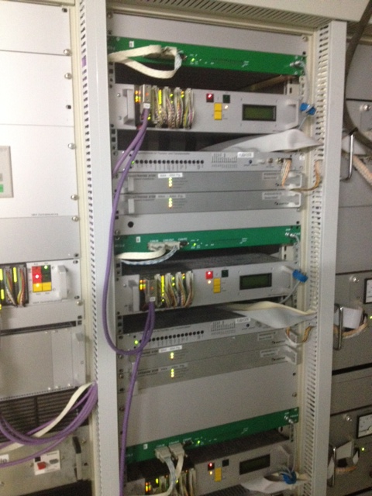
FLASH II Power supplies.
FlashII power supplies are reused from HERA
Analog regulation
DCCT
Power part
Renewed:
PLC master with PROFI-bus slaves per power supply
Power Supply controler
Redundancy switch
Commissioning beginning 2014
First lasing August 2014

Slide 12
Number of supplies Flash.
Normalconducting main magnets
 | Current | Voltage | Quantity
 | 200 | 60/120 | 25
 | 400 | 120 | 48
 | +/-100 | +/-100 | 3
 |  | Sum | 73
Superconducting magnets
 | Current | Voltage | Quantity
 | 100 | 10 | 48
Corrector magnets
 | Current | Voltage | Quantity
 | 30 | 10 | 30
 | 3.5 | 120 | 68
 |  | Sum | 98

Slide 13
Number of supplies Flash II.
Normalconducting main magnets
 | Current | Voltage | Quantity
 | 200 | 60/120 | 25
 | 400 | 120 | 48
 | +/-100 | +/-100 | 3
Flash II | 400 | 90 | 30
 |  | Sum | 103
Superconducting magnets
 | Current | Voltage | Quantity
 | 100 | 10 | 48
Corrector magnets
 | Current | Voltage | Quantity
 | 30 | 10 | 30
 | 3.5 | 120 | 68
Flash II (former DORIS correctors) | 30 | 15 | 30
 |  | Sum | 128

Slide 14
PETRA III + Extension

Slide 15

PETRA III.

Slide 16
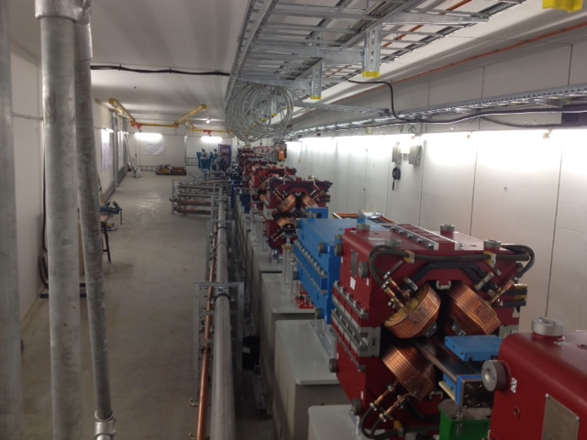
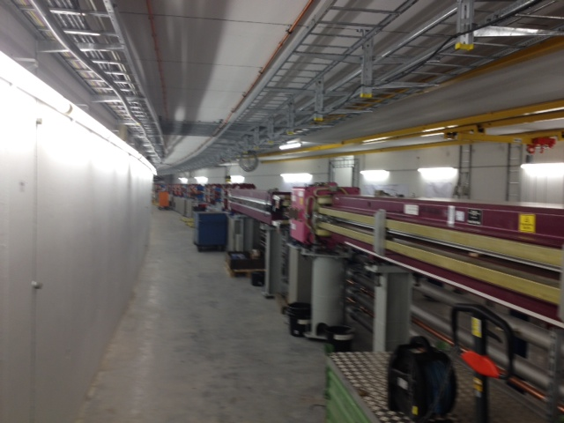
PETRA III Extension hall north.

Slide 17
Number of supplies PETRA III.
Normalconducting main magnets
 | Current | Voltage | Quantity
Switch mode supplies
 | +/- 55 | 50 | 110
 | 200 | 50 | 130
 | 600 | 50 | 58
 | 400 | 100 | 65
 |  | Sum | 363
SCR supplies | 600 | Up to 500 | 10
Corrector magnets
 | Current | Voltage | Quantity
 | 10 | 40 | 300
 | 5 | 60 | 60
 |  | Sum | 360

Slide 18
Number of supplies PETRA III Extention (ordered).
Normalconducting main magnets
 | Current | Voltage | Quantity
Switch mode supplies
 | 200 | 60 | 38
 | 600 | 60 | 38
 |  | Sum | 76
Corrector magnets
 | Current | Voltage | Quantity
 | 10 | 40 | 40
 | 5 | 60 | 10
 |  | Sum | 50

Slide 19
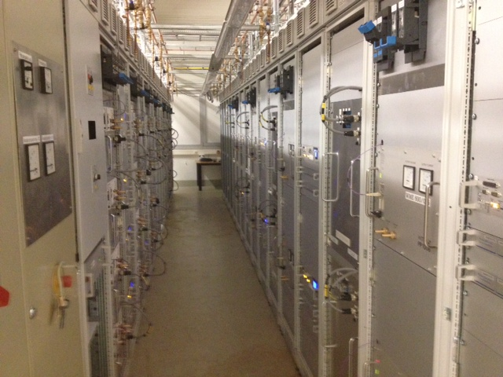
PETRA III Extension power supplies.

Slide 20
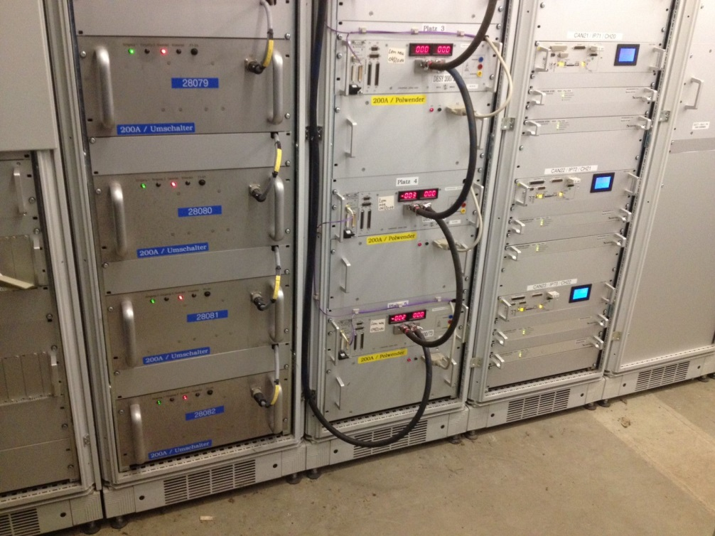
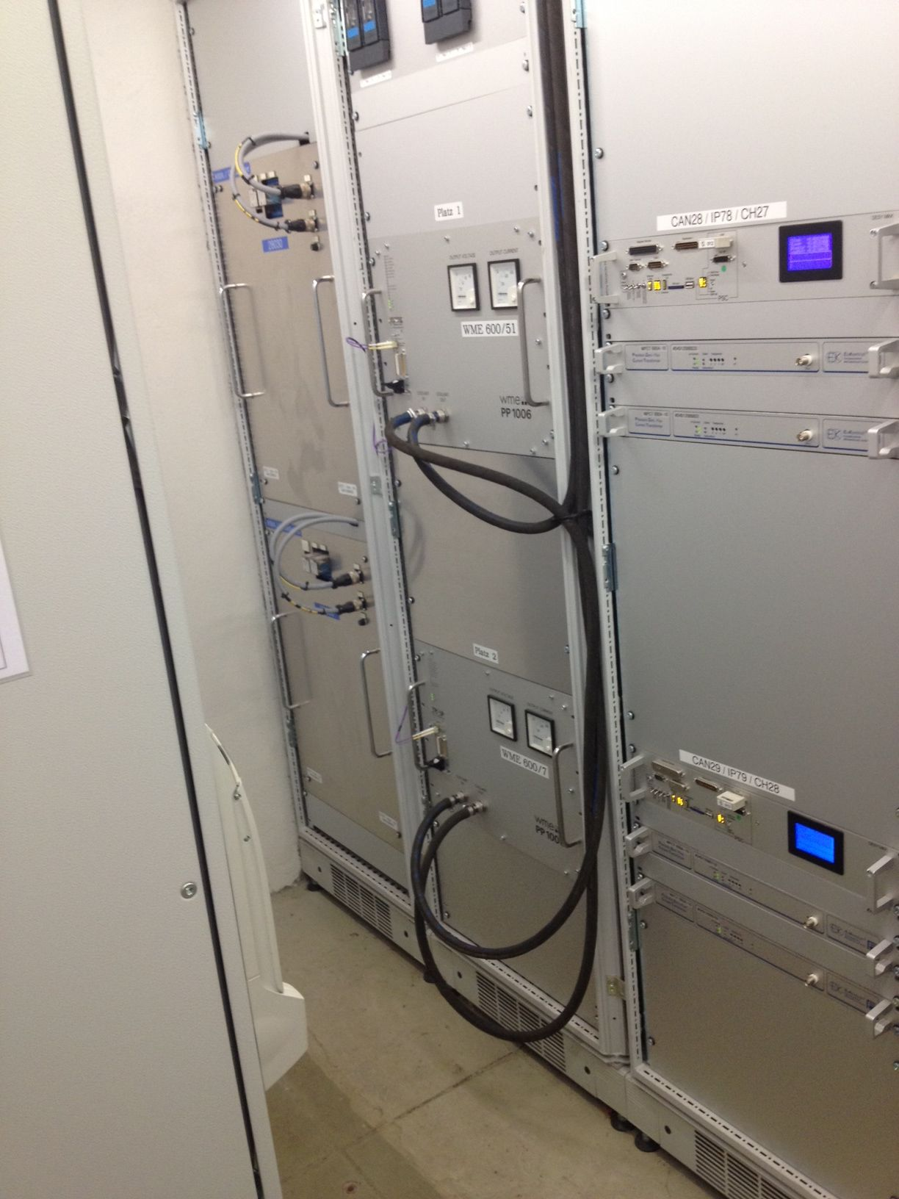
Redundancy system.
For a group of power supplies a spare power supply will be installed.
In case of failure the shift crew detects the failure.
The shift crew tries to reset the power supply. If not successful, switch over to the spare PS.
Within few minutes the machine can restart to operate.

Slide 21
XFEL

Slide 22

XFEL.

Slide 23
Location of magnet power supplies.

Slide 24
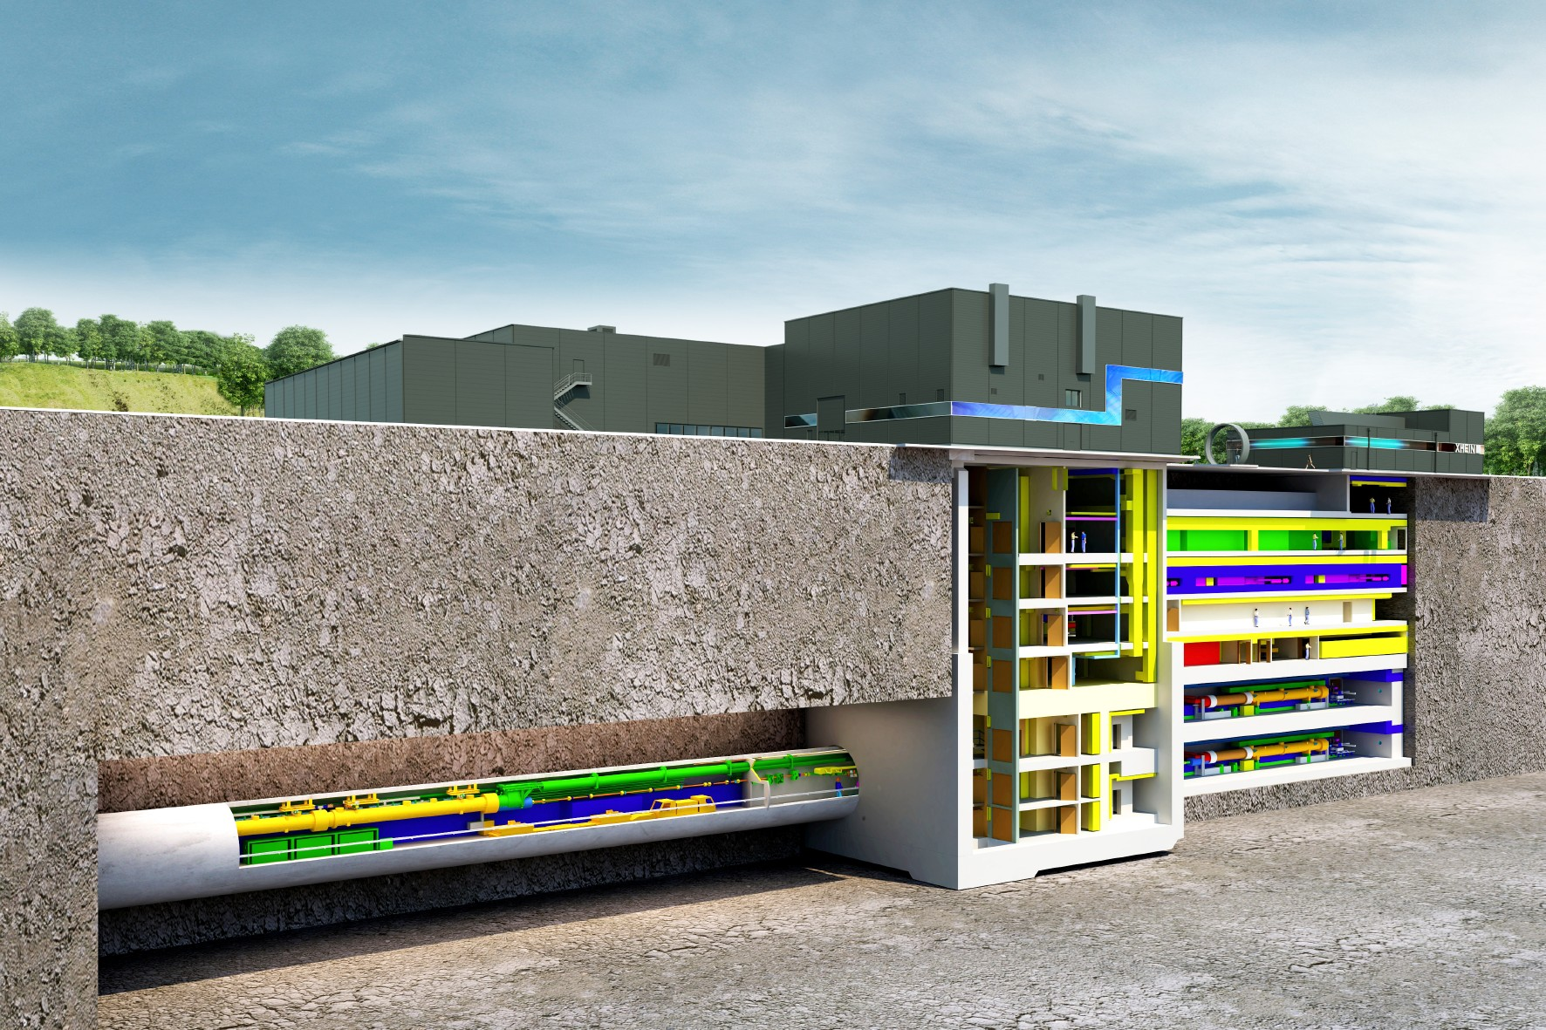
Injector complex.

Slide 25
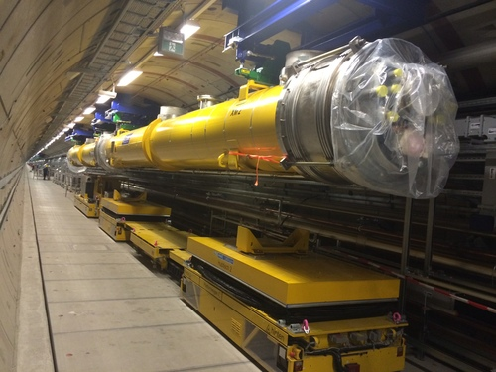
First hanging modules.

Slide 26
Number of supplies XFEL.
Normalconducting main magnets
 | Current | Voltage | Quantity
 | 15 | 40 | 53
 | 200 | 60 | 164
 | 200 | 120 | 48
 | 200 | 400 | 2
 | 600 | 200 | 2
 | 600 | 300 | 6
 | 600 | 400 | 2
 | 600 | 120 | 22
 | 600 | 60 | 12
 |  | Sum | 258
Superconducting magnets
 | Current | Voltage | Quantity
 | 50 | 10 | 222
Corrector magnets
 | Current | Voltage | Quantity
 | 5 | 10/40/60
 | 10 | 40/60
 |  | Sum | 330

Slide 27
Number of supplies.
Normal conducting main magnets
 | Current | Voltage | Quantity
 | 15 | 40 | 53
 | 200 | 60 | 164
 | 200 | 120 | 48
 | 200 | 400 | 2
 | 600 | 200 | 2
 | 600 | 300 | 6
 | 600 | 400 | 2
 | 600 | 120 | 22
 | 600 | 60 | 12
 |  | Sum | 258
Superconducting magnets |  | In kind Spain | University of Madrid
 | Current | Voltage | Quantity
 | 50 | 10 | 222
Corrector magnets |  | In kind Russia | Budker Institute Novosibirsk
 | Current | Voltage | Quantity
 | 5 | 10/40/60
 | 10 | 40/60
 |  | Sum | 330

Slide 28
Number of power supplies.
In the moment more then 1000 power supplies are in operation
With the commissioning of the XFEL DESY will operate more than 1800 power supplies.

Slide 29
  Specification

Slide 30
Specification.
The principle of specifications is derived from the structure of the power supply system
The responsibility of the parameters are in DESY hands
  Accuracy
  Operation
  Maintainability
  Time to repair
  Spares
  Interface to the control system
  Etc.

Slide 31
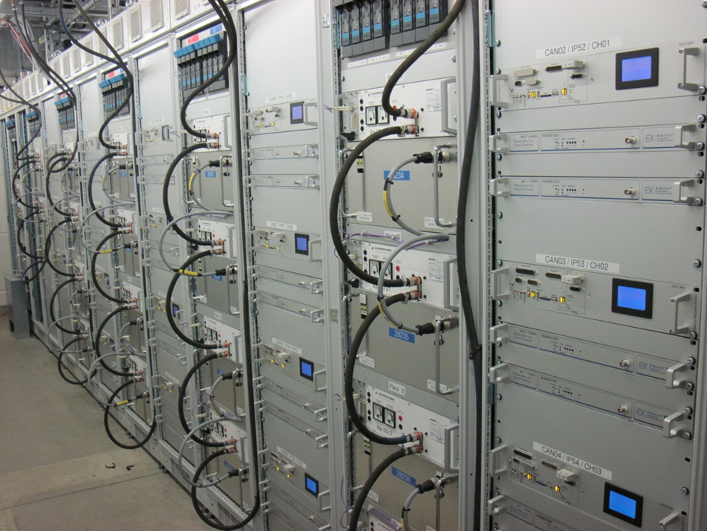
Power supplies in PETRA III.

Slide 32
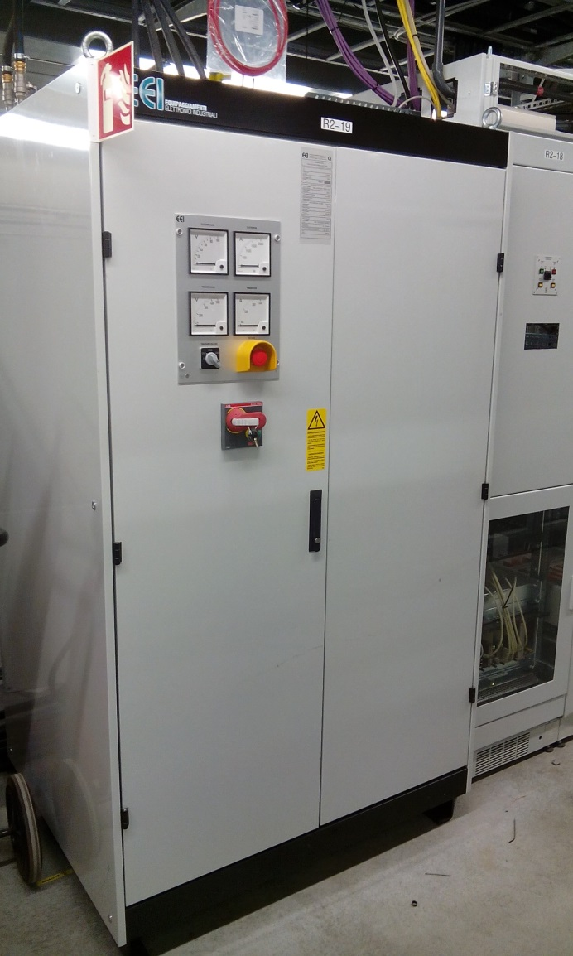
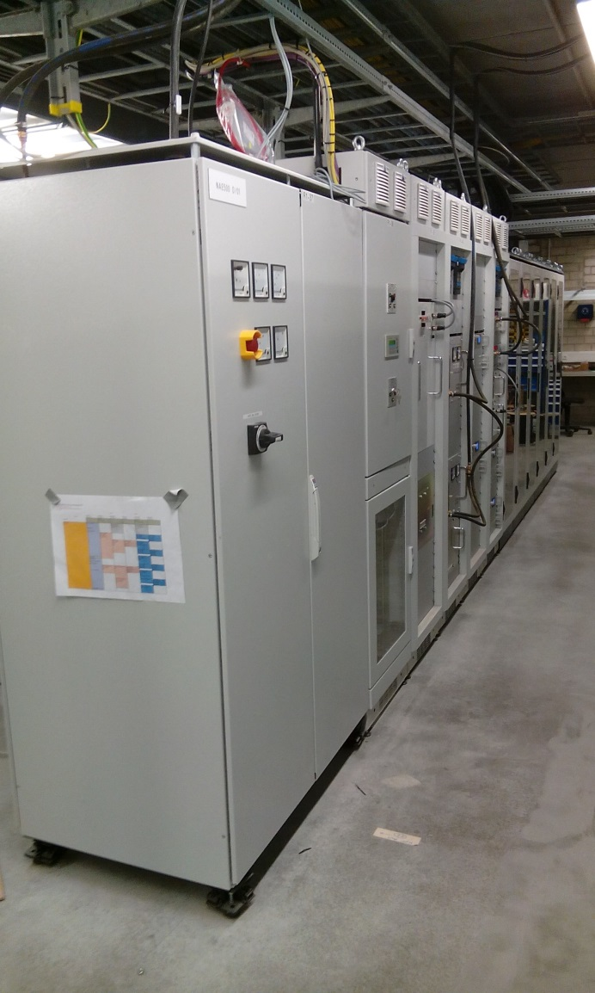
Pictures from XFEL XTIN .

Slide 33
Power supplies larger power .
Bulk diode rectifier
PLC
Power part
  Buck converter
  H-bridge
DCCT
Digital regulation
Polarity switcher
Redundancy switch
Each component group needs a separate specification
  Quantity is large

Slide 34
Many pieces .
DC magnet cabling
AC cabling to power supplies
Copper busbars
Electronic racks
Intermediate cabling
  Ethernet cabling
  CAN cabling
  Power cables

Slide 35
Specification in general .
The market has to be checked for every component.
  This from a sum of 15 000 €
  If more than 200 000 € European call for tender has to be taken
  The specification has to be neutral and independent of the producer
    No possibility to ask for a Mercedes.
    The component has to have 4 tires, a motor, wind screen etc.
    Hopefully everything is mentioned, if not discussions occur
  If ever a defined producer component is needed, additional paperwork is demanded
    PLC has to be Siemens compatible.
    It is not possible to train the programmers on every software

Slide 36
Commercial part .
With the European call for tender procedure long time has to be taken into account.
  The entire process takes a few months
In very seldom cases a direct negotiation procedure is allowed
  Either direct contact with a vendor since he is the only one who is able to do so
    Normally not possible for power supplies
    there are some vendors on the market
  There are a well known number of vendors as e.g. for DCCT, these are working for the scientific community
We usually take the open procedure
  Everybody is able to take part.
  During the evaluation process it has to be found out whether the bidder is capable to handle the job.
We might go for prototyping first, after qualification a larger contract might follow
  Time consuming, we did not have the resources yet

Slide 37
Evaluation criteria for the bidding process .
The general idea for decision is the price
However, there are exceptions to this
  We tried different scenarios
    Technical solution 30%
    Price 60%
    Delivery time 10 %
    References have to be given for the last 3 to 5 years
  If a product is chosen, it has to be documented,
  If you want to exclude someone, you have to prove that this enterprise is not capable to fulfill the contract.
    Easy would be the lack of references
    Harder to do, if you have the impression, that the enterprise will not be able to do it.
  The delivery time is taken out meanwhile.
    Those enterprises who dare to be very optimistic take an advantage from this.
    However some might be right as well
    If the delivery time is exceeded, no punishment is possible

Slide 38
Specification of power supplies .
The power parts we are looking for are not standard from the shelf. So each power part has to be designed and built
As mentioned before in general these are “stupid” power parts.
In very seldom cases a turn-key power supply including regulation is asked for e.g. DESY II power supplies, dump sweeper power supplies

Slide 39
What do we specify? .
The aim of the specification is to fully describe the features.
  Electrical data
  Mechanical data
  Special materials
    Water hoses
    No brass, just bronze, stainless steel, copper
  Standards for construction
  Testing
  Scope of delivery
  Time schedule

Slide 40
Content .
1 General description and topology
2 Technical data:
2.1 Data of the pre-rectifier
2.2 Description of power supply
3 Design
3.1 General description
3.2 Connectors
3.3 Semiconductors
3.4 LC Filter
3.5 Capacitors
3.6 Interface/adapter card
4 Measuring equipment, Signals, Interlocks
5 Water-cooling
5.1 Technical data of the Water cooling system
5.2 Materials
5.3 Hose
5.4 Connections
6 Spare parts
7 Withstand of failure modes
8 Tests
9 Documentation
10 Standards
11 Scope of delivery
12 Required technical data for tender
13 Time schedule of production

Slide 41
Example technical data .
Technical data:
  Nominal output current: 0 - 600 A
  Number of needed supplies: 23 units
  Nominal output current: 0 - 200 A
  Number of needed supplies: 54 units
  Max. output voltage: 140 V according to the primary voltage
  Max. input DC voltage: 150 V
  Auxiliary supply voltage: 230 V+/- 10%, 50 Hz
  Output ripple max: 1.0 V pp
  Output ripple frequency > 25 kHz
  Insulation voltage of the power part to ground: 1.5 kVrms
  Insulation resistance to ground: > 10 MΩ
  Ambient temperature: 10 – 50 °C
  MTBF >70 000 hrs.

Slide 42
Water cooling 1 .
Water-cooling
The power supply has to be water cooled in order not to dissipate the energy into the surrounding. No fans shall be installed in the power part. Up to 4 power parts will be put into the same water circuit. The power supplies will be installed into electronic racks. There will only be natural air flow.
Technical data of the Water cooling system
  Conductivity 1 -2 µS/cm
  Inlet temperature 33 C of the first power part
  Outlet temperature < 50 C
  Max. water flow < 5 l/min
  Max. pressure difference per unit < 1 bar less if favorable
  Test pressure 15 min 16 bar

Slide 43
Water system 2 .
Materials
Deionised water will be used. Therefore the materials that will have contact with the water are specified below.
  Stainless steel
  Bronze (gun metal)
  Copper
  Brass is not allowed
Hose
The hose will be provided by DESY. The inner diameter is 6 mm, 10 mm or 13 mm. During the contract the diameter has to be specified.
Connections
The water connections will be done from the front side of the power supply. A screw connection (hose barbs) will be used. In the mechanical construction this connection has to withstand the mechanical forces for the unscrewing. The water connection shall be far from the interface card.

Slide 44
Spares .
We have started to order spares/spareparts directly with the contract. These are included in the specification
Spare parts
The power supplies have to be maintained, therefore a number of components like circuit boards, main components have to be delivered as well.
  From each installed
  Circuit board 8 units
  Semiconductor 8 sets
  Magnetic devices 8 units
  Main capacitors 8 units

Slide 45
Testing .
Factory test
  Each unit has to be tested after the manufacturing at the factory.
  The contractor has to provide the test equipment (Load, measuring instruments) and the personnel for the testing.
  A test record has to be given with each power part. The protocols have to be agreed with DESY during the design phase. The protocols have to be signed by the responsible person.
Type test
  Isolation test 1500 V_{rms} or 2.12 kV DC for 1 min
    The components as capacitors, semiconductors shall be short circuited for this test.
  Temperature run
    The temperature test shall last until the power supply temperatures reach a stable temperature.
  Voltage over swing at the semiconductors has to be oscillographed
  EMI Test according to the standards mentioned in chapter 10
  Test of grounding according to EN 61010

Slide 46
Tests 2 .
Series test
  Check of the measuring devices, Signals
  Wiring
  Check of the over current trip
  Full power test for 1 hour
  A test load can be provided by DESY.
  Isolation test according to BGV A3
  Test of grounding according to EN 61010
A final acceptance test will be done at DESY with the magnet load and a 24 hour burn in test.

Slide 47
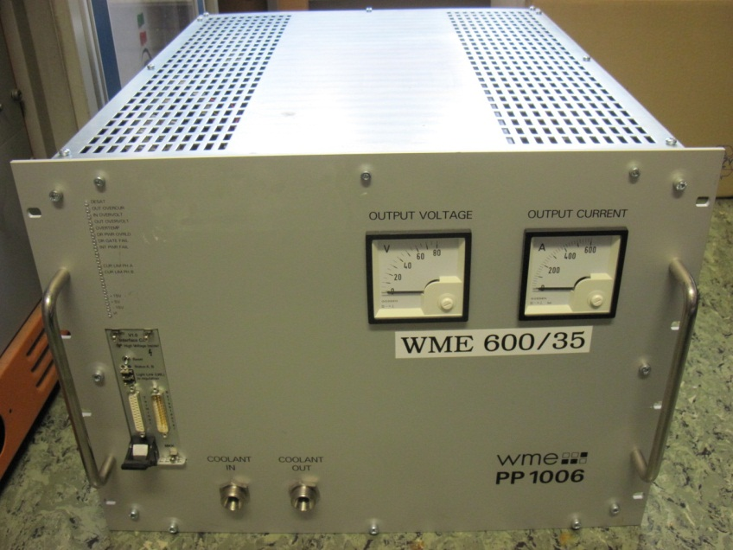
That is what we get at the end .

