Slide 2
Managing and reporting on any project size using only two comprehensive A4 documents, based on Goal Directed Project Management concepts https://edms.cern.ch/document/1687394
Thurel Yves
CERN, for POCPA-2016 in Alba, Barcelona, 24-26th May 2016

Slide 3
This presentation motivation and purpose
Do you remember the “1 month task” which ended finally in a “1-year project”?
Foundations, context and real purpose were not clear enough !!!
I need a simple document describing sufficiently well the project.
This is covered by the 1st part of this presentation: “Project Mandate”.

Slide 4
This presentation motivation and purpose
Do you share easily the documents you create and use for managing your project with others?
No, they are too complex. People don’t see interest in them. Presenting status of the project only is not trivial !
I need a simple document I can share and people would easily understand.
This is covered by 2nd part of this presentation: “Project Milestone Plan”.

Slide 5

Important note: give to Caesar…
The proposed approach is based on “Goal Directed Project Management” concepts.
    These concepts were developed more than 30 years ago (Norway).
    Please read this book if interested, so that you get the correct foundations of the concepts.
    What is proposed in this ppt is
          Certainly not correct with regards to the concepts, we accommodated.
          Our implementation of the concepts through templates we created.

Slide 6
Step 0: How to recognize a project?, or…
… what makes a task a project? and how to recognize it, to apply the adequate method.

Slide 7
Recognizing a project
How to recognize a project?
    When several entities (people) interact / impact each others.
    When manpower, budget & time constraints impact the work.
    When a large or complex task is subdivided in linked subtasks.
    Personally, my main criteria is:
    When considering the task as a project makes life easier to involved people, with limited additional work (balance).

Slide 8
Step 1: Formalize the “project mandate”…
… creating a document which must be:
[simple + detailed + accessible + extremely clear ]

Slide 9
Project Mandate
Goal of a Project Mandate
    It helps to understand the project foundations, not losing its initial reason, why it exists, the pre-history / current situation.
    It defines the true purpose of the project, which stays unchanged during the project execution.
    It clarifies the scope of the project, what is included and excluded from it.
    It clearly defines the limitations/constraints on the project: time, budget, acceptable actions or unacceptable solutions.

Slide 10
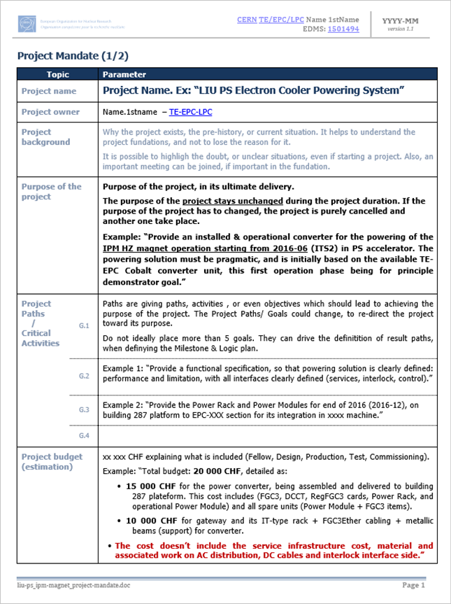
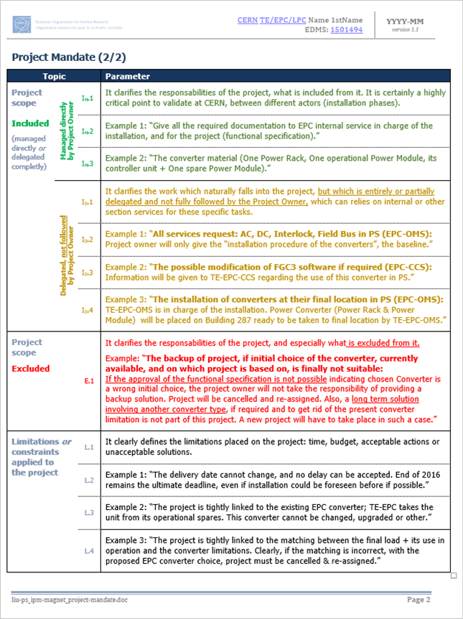
A project mandate: overview
A short document divided in clear sub-sections.
The most important document in the project definition

Slide 11
A project mandate, in details
Project Name: A short sentence or group of words, describing well the project. Its impact can be high on the whole project, compare for ex.:
“Booster Injection BI.BVT Powering”
“Principle Demo Magnet Pragmatic Powering”
The name is ideally used for folder structure, and email title, and of course document naming.
Project Name
Project Owner
Project Owner: The official responsible of the project for client, and for hierarchy.
Usually in charge of the reporting
Following the milestone plan.
Not obviously in charge of the main tasks. A Project Owner can rely on a Project Leader.
Project Background: Gives the current situation, and explains usually why the project is required.
It can be used to re-focus the project, if diverging, not losing the initial why, requiring the project.
It can also highlight level of information gathered, or even doubts on project basis.
Project Background
Project Purpose: The purpose is the ultimate goal of the project. It must not be restricted to the delivery of the project, but must highlight the true purpose of all the work being accomplished towards the goal. Compare for ex.:
“Deliver the 30 units of ref:12A34 converters to an experience[…]. ”
“Propose and deliver the adequate powering to the experience.”
The second formulation is closer to the ultimate goal, and will require validating the converter choice for achieving the powering will work.
Project Purpose
Project Paths
Project Paths: It describes project domains or activities. Project paths (5.max) can be:
Design, Production, Test, Commissioning
Documentation: writing a functional specif.
Purchase, Order, Deliver plan, Organize
Several complex different paths already identified at the level of the project mandate is a tip of a challenging project to come.
Project Budget
Project Budget: The best estimation, at t₀. It is ideally divided into sub-sets to cost origin. It is mandatory to indicate what is or not included.
It is possible to review this budget without changing the specific project nature or viability.

Slide 12
A project mandate, in details
Project Scope - Included: This part clearly indicates what is IN the project, like its deliveries. A large part of the document is devoted to this part, to be crystal clear on this topic, since considered as a natural critical topic.
It is possible to identify:
“What is directly driven by the project itself”
“What is IN, but considered as external”
Project Scope - Included
Project Scope - Excluded
Project Scope - Excluded: What is excluded must be crystal clear & must not allow any false interpretation. What is excluded is definitively out of project scope, and cannot be endorsed by it, reason being clearly given why.
Limitations on Project: All severe constraints or limitations are detailed. Example:
“Strong time or budget constraints”
“A milestone strongly depending on external condition, or an initial assumption”
Less than 5 limitations, not to dilute their weight.
Limitations on Project

Slide 13
A project mandate

Slide 14
Step 2: Following project status and reporting on it…
… creating a document which must be:
[simple + detailed + accessible + maintainable]

Slide 15
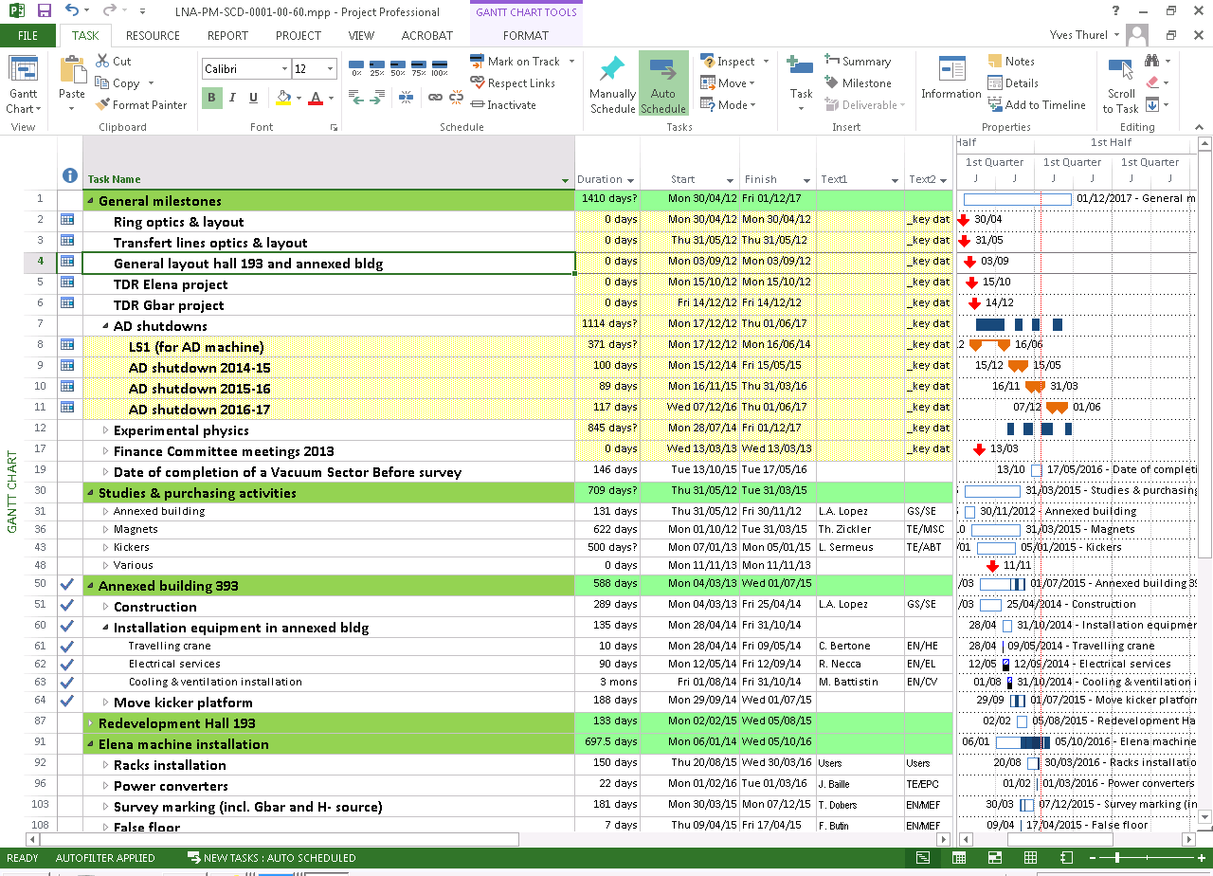
« Standard » Project planning format
This Gantt representation is a list of tasks or activities, which is often not the optimum* format for checking the status of a project:
It indeed represents the work being done or not, what is late or not, but does not give a quick answer on where is the project.
*this representation can be required for managing coactivities, or even for listing all the activities in the project.

Slide 16
Milestone Plan: overview
This format is called a Milestone Plan. Let’s try to understand this format, switching from usual Gantt diagram towards this Milestone Plan format.

Slide 17
Switching for Gantt view to milestone plan
…
a due date …
Step-1: Remove the indication of an activity during a period, and replace time line information by …

Slide 18
Switching for Gantt view to milestone plan
… representing now a predefined …

Slide 19
Switching for Gantt view to milestone plan
Step-2: Classify domains or “paths” involved in each milestone,
and re-assign them.
… milestone formulated in a formal and very precise way:
“when a state is reached, under x condition, with y performed”.

Slide 20
Switching for Gantt view to milestone plan
Step-2 result: group of activities are now visible, and describe better the project and its specificity.

Slide 21
Switching for Gantt view to milestone plan
Step-3: place adequate links between states to better visualize impacting states.

Slide 22
Switching for Gantt view to milestone plan
Step-4: Place this “responsibility matrix” you will refer to …
Step-5: Place every actor in the column referring to their impact on each milestone, using the “responsibility matrix”.
X eXecutes work
P manages Progress
D takes Decisions solely/ultimately
d take decisions jointly/partly
C must be Consulted
A Available to advise
I must be be Informed
T provides Tuition (Teach) on job

Slide 23
Switching for Gantt view to milestone plan

Slide 24
Switching for Gantt view to milestone plan
Information is now focusing on predefined states, defining the path to the project end. “Where are we in the project?” is easy to answer: (milestone combination).
Every member knows what is exactly expected from him, and how & with who to work.
It is true that 6 steps are reached (“ok”), over 7 in total considered at meeting date.
A glimpse on the A4 document gives the real status through a basic color code applied to milestone icons:
  - Not late
  - Late
  - Done
But, even with 85 % (6/7) of success, project is stopped, and required action since one step not achieved is blocking it.

Slide 25
Some real examples: try to evaluate project state in one glimpse.

Slide 27
How to maintain and when to share the milestone plan?

Slide 28
Maintaining the milestone plan
Updating it?
    Color painting only to stay updated !
Updating: yes, but modifying it with which freedom?
    Modifying it = requires adaptation from people to new version.
          Often better to keep the same document during the whole project.
    “Should I update/modify the initial date of completion of milestone during project life?”
          I personally never do it, if final date is let unchanged.
                The due date are initially fixed regarding the project needs and are not contextual. If dates are updated, everything seems ok even if deviating.
What to do if the project mandate is modified?
    The best and wisest thing to do: restart a new milestone plan.
A1
A1
A1

Slide 29
Sharing the milestone plan
Sharing it:
    When launching the project with all the actors invited, and after having presented the project mandate to the audience
          Validate line by line the “what” & the “who”, with everyone present.
          Obtain “formal ok” from people in the responsibility matrix (X, P, C…), or, even better, build the responsibility matrix with people.
    During periodic meetings, showing clearly the project status
          Presenting milestone plan only if things progress well
          Presenting Milestone plan + more info on critical milestones (only)
              Note: People follow easily the progress since same document is used from project start to end, with only milestone color being updated.

Slide 30
Conclusion

Slide 31

Conclusion
  The result: two A4 document, as promised;-), which are
          Defining the what, the how, the path & giving the current situation.
          Easy to read, easy to access and easy to understand.
          Written for sharing them, and being useful for all project actors.
The original concept (the bible) | Project Mandate (public access) | Project Milestone Plan (public access)
www.gdpm.com | EDMS N° 1501494 | EDMS N°1517380

Slide 32
And finally
Hope you enjoyed!
Thank you for your attention !
This presentation : EDMS N° 1687394

Slide 34
Responsibility matrix
    Responsibility matrix: a real must to describe the manpower context of a milestone to achieve. Experience these cases:

Slide 35
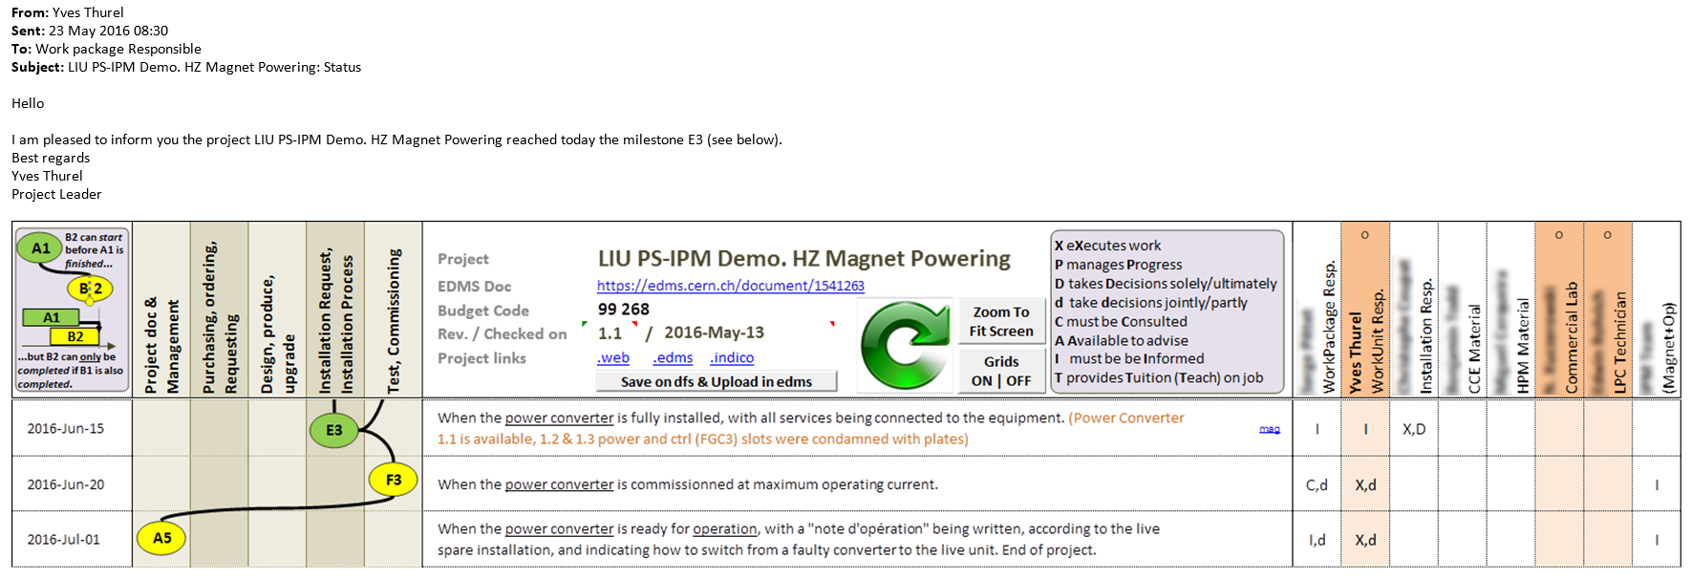
Communicating using milestone plan
Emailing people with a simple copy / paste*
          Using the milestone plan template provided: copy first line (actors), and paste it as a “picture enhanced metafile”
          Repeat with interesting lines.

Slide 36
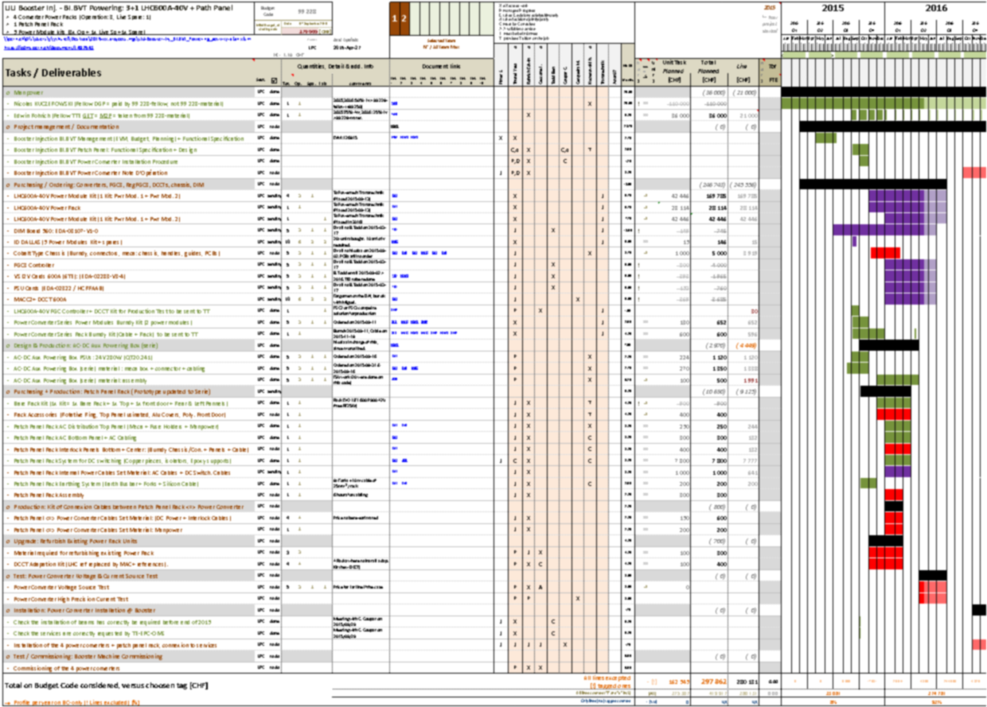
Activity Plan supporting the milestone plan

