Slide 1



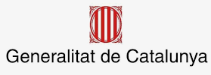


Call for Beamline/Instrument
Pre-Proposal (Concept-Proposal)
Klaus Attenkofer
30-06-2021
Foto Sergio Ruiz

Slide 2
The Context: ALBA’s Mission
ALBA is currently providing robust highly productive user operation with a focus on:
  Health.
  Energy.
  Information technology.
ALBA’s mission is to support all national and international user communities but specifically provide the full service package in the three focus areas:
  To provide all synchrotron characterization tools to study structure and electronic states and their roles in the functions of materials and devices.
  Add additional characterization tools (mainly microscopic tools like Electron Microscopy) to reach atomic and subatomic resolution or add additional contrast mechanisms.
  Provide all sample preparation and computational tools necessary to enable the user to answer key questions and grand challenges of the field.
  And develop methodologies using multimodal approaches.

Slide 3
The Context: ALBA II
ALBA upgrade decision to a 4th generation synchrotron was granted in December 2021; the goal of the upgrade is:
  Bringing all facilities of ALBA to a modern, state-of-the-art standard guaranteeing stable and effective operation for the next 20-25 years.
  Significantly strengthening the microscopic capabilities.
  Providing high throughput capabilities and integrating big data approaches in the research portfolio.
  Strengthening the operando and in-situ capabilities.
Preliminary ALBA II timeline:
  Providing a scientific case and defining key parameters for the upgrade (including first additional instruments): January 2022.
  Preliminary design of accelerator complex and instrumentation: Mid 2022.
  Operation until 2028; large shutdown is currently planned for 2029 with commissioning and start of operation in 2030.

Slide 4
The Context: ALBA II at a Glance
Beamlines at ALBA II:
13 ID BLs
8 BM BLs
1 IR BL
2 Straights for RF
1 Straight for injection

Slide 5
The Planning Process at a Glance
The Section
Reviews
Workshops &
Colloquium
Call for
New Instruments
Goal:
  Mission verification.
  Strategy review.
  Gap Analysis.
  Service review.
Stakeholders:
  International experts.
  National user community representatives.
  SAC expert.
Goal:
  Identification of grand challenges.
  Identification of needs.
  Creating awareness in community.
  Organizing community.
Stakeholders:
  Spanish community.
  International experts.
  ALBA employees.
  AUSE.
Goal:
  Identification of instruments and services
  Grouping key-players around proposed instruments.
Stakeholders:
  Spanish and international community.
  ALBA employees.
  AUSE.

Slide 6
ALBA II process during 2021
Scientific case
ON GOING
Workshops
ALBA II Colloquia
PLANNED
- 3 Section Reviews
BL proposals
ON GOING
From ALBA staff
PLANNED
ALBA II Day (30.6.21)
From ALBA Users
Workshops in preparation:
PEEM
Catalysis I (grand challenges)
Catalysis II (current status)
Catalysis III (NAPP and related techniques)
Battery
SAC
Mai
June
July
August
September
October
November
December
January
February
2D Materials
WS
Spintronics
WS
Time resolved
WS
First version
of science case
With gap analysis
Macromolecular
stractural biology
Review
SructuralCellular
and Tissue Biology
Review
Material Science
and Chemistry
Review
Magnetism and
Electronic Material
and Device
Review
Science case
SAC evaluation of
Science case and beamline
selection
Start of Beamline 14
ALBA II Day
(workshop)
Definition of proposal
and preselection for
projects compatible with BL14
Selected proposal
development
External review
and rating
Internal Call for
BL Concepts
Internal presentation
of call results
User Community Call for
BL Concepts
User Community Call for
BL Concepts Deadline
BL proposal

Slide 7
ALBA II process during 2022
Scientific case
PLANNED
Workshops
ALBA II Colloquia
BL proposals
PLANNED
- From ALBA Users
SAC
March
April
May
June
July
August
September
October
November
December
Science case
SAC evaluation of
Science case and beamline
selection
External review
and rating
Definition of ALBA II BLs
Analysis of BL concepts
(by ALBA) –
choice of # of them
User Community Call for
BL Proposals
ALBA II Day
(workshop)
Definition of proposal
and preselection for
Projects for ALBA II BLs
Selected proposal
development
BL proposal

Slide 8
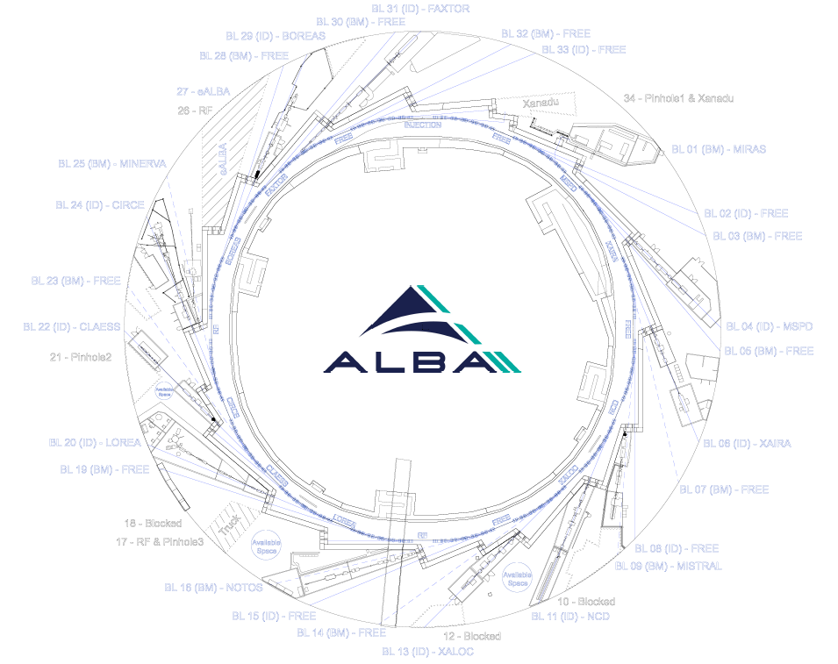
The 2021 Call: Deliverables
Selection of beamline 14
Selection of beamline 15
Creating a “pool” of instrument and beamline ideas, which
  are pre-reviewed
  can be developed fast to full proposals.
  or may motivate upgrade of exising BL.
“Pool” will be added to selected results of second call following in 2022.

Slide 9
The 2021 Call: The Process
(see also breakout sessions)
Pre-proposal call:
  Simple PPT-template with information about proposers, and 11 simple questions.
  Information needed: field of research, technique(s) provided, basic beam parameters, which grand challenge is addressing the beamline, and potential user community.
  Pre-proposals will be reviewed by Proposal Committee (international experts, SAC members, ALBA management members); selected number of proposals (either full or parts) (3-4) will be encouraged for full proposal submission.
Full proposal:
  Only selected proposals will be developed to full proposals.
  Proposer team will be supported by ALBA expert team.
  Full proposal will include science case, cost, impact- and risk analysis based on a first preliminary design including a first budget estimation.
  Proposal Committee will suggest beamline 14 and 15.
  Final decision by ALBA management is expected in January 2022 (after SAC).

Slide 10
The 2021 Call: Who can contribute
Any member of the community is encuouraged to participate on the call.
  Spanish users of synchrotron sources.
  European and international users of synchrotron sources.
  ALBA employees.
Spokesperson of the proposal has to be an employee of a Spanish institution (not ALBA).

Slide 11
The 2021 Call: Time Lines and Deadlines
Call for beamline/instrument ideas | 1th of July, 21
Pre-Proposal deadline | COB 6th of September, 21
Encouragement to full-proposal (including providing support team) | End of September, 21
Full-Proposal | COB 6th of December, 21
Final decision for beamline 14 and 15 | Beginning of February 22

Slide 12
The 2021 Call: Review Criteria
The review criteria will be:
how much does the beamline program benefit from ALBA II but also is usable at ALBA.
does the instrument solve a scientific and a community need which is consistent with ALBA’s scientific branding.
is there a potential or existing community in Spain.
how the instrument fits in the international competition.
and is the concept feasible and can be built with realistic resources.
Not all criteria need to be fulfilled.

Slide 13
Thank you for the attention!
Any questions?
Foto Sergio Ruiz

