Slide 1
Sustainable Information Technology at ALBA II: New Opportunities
Presented by:
Manuel Valvidares
(Section Head)
30.6.2021

Slide 2
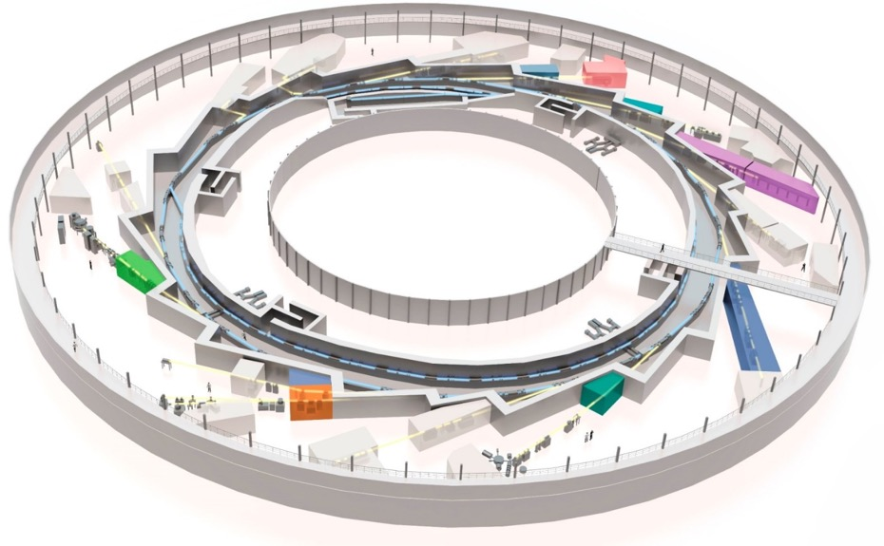
Existing tools E&MS at ALBA
Current facilities for Sustainable Inf. Tech.&QMs:
2+2 BLs
Materials Science lab & Surf. Sci Lab
TEM
MISTRAL
(TXM magnetic
microscopy/tomography)
Fully
dedicated
(S)TEM
Partially
dedicated
BOREAS
(XAS/XMCD, XRMS/
coherent imaging)
In
construction
CIRCE
(X-PEEM
electronic and magnetic
microscopy)
LOREA (ARPES,SP-ARPES)
Electronic band structure mapping
MSLab
(sample prep, 2D+GB, MOKE,..)
Surf.Sci. Lab (STM,AFM,ALD)
Notes:
Add as many slides as you have topics within the branding area:
For example material sciences: Catalysis and Batteries
Don’t forget the TEM resources to be.

Slide 3
Branding: Information Technology & Quantum Materials
Resolving and Manipulating the Electronic and Magnetic States, and its Spatial and Dynamic Characteristics in Quantum Materials.
      using a suite of techniques and services enabling the catalytic role of ALBA
Focused on scientific fields
Techniques
Services
Materials growth and device fabrication
XAS, XMCD, XMLD, XLD XRMS
ARPES (including spin-resolved)
X-ray microscopy and coherent imaging with chemical, magnetic contrast
High-resolution TEM
Lab characterization (LEED, LEEM, SPMs, MOKE, Raman)
Sample preparation tools allowing off-line and in-situ sample preparation prior and during experiments +efficient approaches such as automatized structure preparation, wedges, combinatorial approaches
multi-modal pipelines and access modes for providing solutions for main focus area applications
Computational modeling tools
Materials discover
Device physics
Spintronics and Spin-Orbitronics
2D VdW Materials
Topological states and other emerging states in quantum materials (Dirac/Weyl,...)
3
Notes:
This slide would be great if you can create. I suggest that you make a first go and we can iterate next week together.
Perhaps this will be the last slide which you should make.

Slide 4
Correlation between (soon-to-come) program tools
Information technology
Quantum materials
UHV/air sensitive materials
Spectroscopy of electronic and magnetic states
LOREA
(S)TEM EELS , ...
(atomically resolved spectroscopy)
surface probe
Materials/Surf. Science Lab
& off-line
beamline instrumentation
STM MFM
MOKE
BOREAS-XMCD
“bulk” probe
spectro-microscopy of electronic states
microscopy of magnetic states
BOREAS-scatt/
coherent imaging
(S)TEM DPC / e- holography
(E&M imaging)
FIB
MISTRAL-TXM
(magnetic microscopy/tomography)
CIRCE-XPEEM/LEEM
Section instruments have an integrated program with well defined roles, complementarity scope & capabilities
Section program to be correlated with TEM additional structural characterization capabilities, explore opportunities for TEM-imaging of electronic and magnetic states in solids
Enhancement of MSLab and Surf Science equipment (Raman, ARPES/XPS), FIB capability
Notes:
Make here a diagram in which all instruments and resources appear.
I can see here in general the difference between assemble averaging techniques with microscopic onece.
I would leave in a first iteration the correlations (errors) out. We may want to work these out in discussion.
In the boxes you should indicate the role of each instrument. This could be done a bid better.
The text should give you the key messages perhaps already a message what you may want to correct. But this message should be very carefully worded.

Slide 5
The Roles/Flows of all Tools
Computing
Resources
Ab-initio
Multiplet
Holo/CDI-
ptychography
Data analytics
magnetic
tomography
𝝁-magnetics
m-s modelling
BOREAS
users
Beamlines
LOREA
MISTRAL-mag
CIRCE-PEEM
Sample shipment, UHV suitcase
UHV suitcase
Air/capping
UHV/in-situ
sample/device prep.
MBE, ALD, sputt., CVD...
@offline bl instrumentation
external visitors, users
2D VdW foundry, air sensitive materials Glove box
@MSLab
TEM
FIB
Notes:
This is a slide which needs to be made for all areas. So you will need one for catalysis and one for batteries.
You can think in a way that you need first to define a few main trusts where each trust corresponds to a specific grand challenge of the field. For example catalysis: 1.) catalyst-substrate interaction 2.) combinatorial optimization of catalysts. 3.) design of highly selective catalysts. 4.)rational design of single atom catalysts. You could use for each challenge an own color and indicate the importance of the instruments by width. It would be important to understand how much of these activities are based on fully onsite users and how much (especially high throughput) would benefit from local sample prep so that the experiments can be done remotely.
This slide can also indicate external dependencies like databases which are hosted by others like the Battery 2030+
In other words, this slide can have lots of content or nearly nothing. This depends how far you are with you review planning.

Slide 6
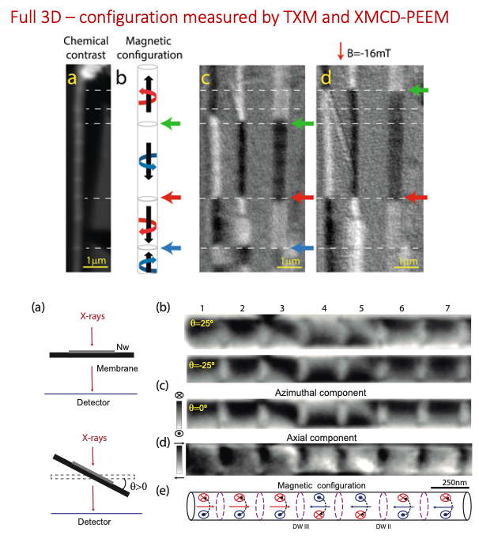
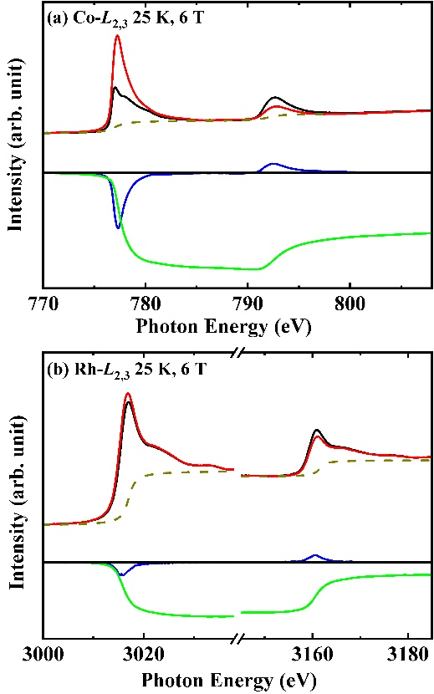
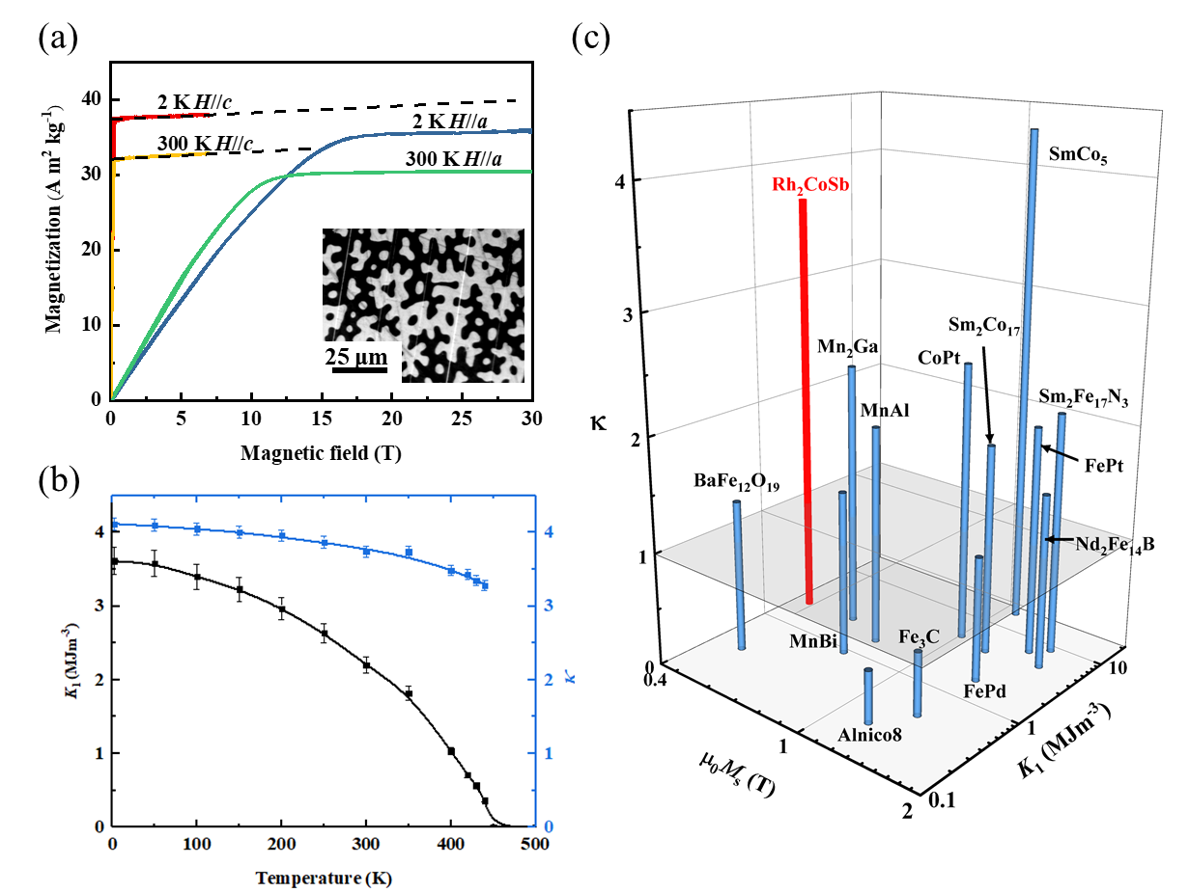
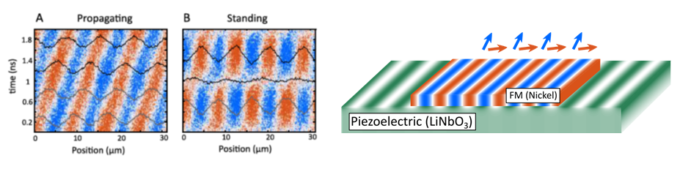
Multi-modal opportunities at ALBA: novel materials, characterization techniques and in-operando environments for imaging and manipulating states in IT materials
New Highly-anisotropic Rh-based Heusler Compound for Magnetic Recording @Boreas
Helical Magnetic Domain Configurations In Nanowires @Peem+mistral
Rh2CoSb
MPI Halle,
Trinity College,
...
Adv. Mater.
2020
IMDEA, ALBA,
...
Nanoscale,
2020
Manipulating magnetic domains via surface accoustic wave @CIRCE-PEEM
ALBA, ICMAB-CSIC, PDI Berlin, Phys Rev. Lett. 2021
Notes:
Here I would make one example in which I show how a collaboration/IHR has alread. pushed in a direction and it is showing how things can work together. In this case you have 2 slides. In no cases longer.

Slide 7
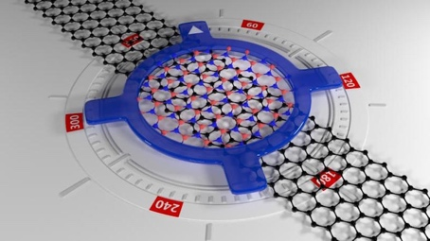
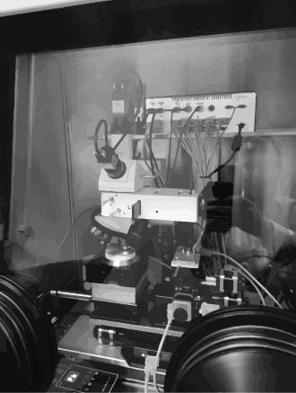
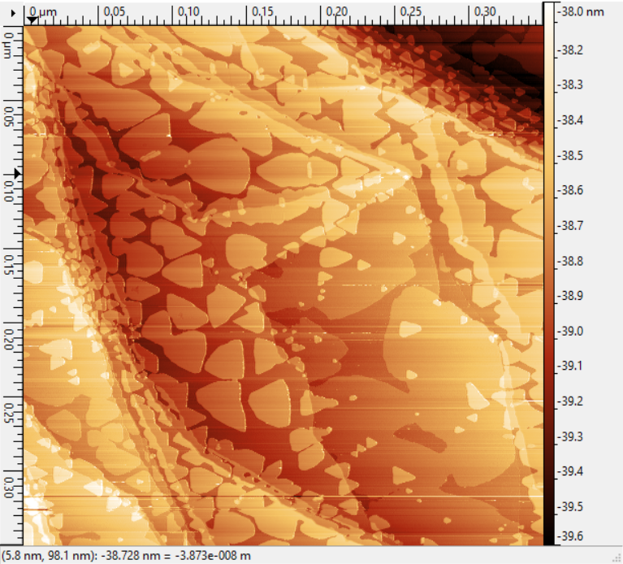
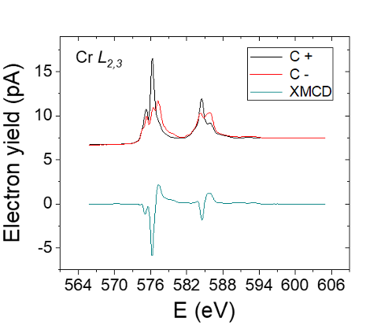
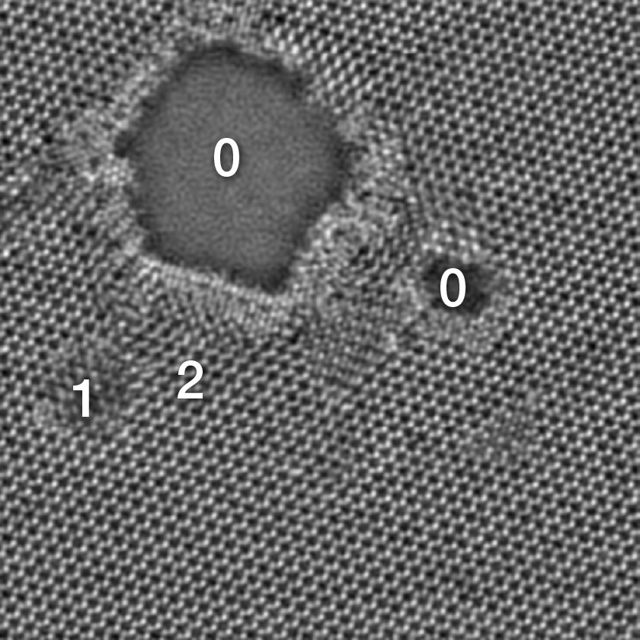
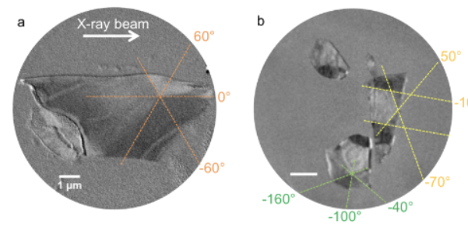
Our Goal at a Glance
example: 2D-VdW materials
MBE, 2D Materials and VdW Foundry at MS Lab, offline bl equipment, as a complement & bridge to user facilities
Challenges addressed and advantages:
air sensitive / short duration
repeatibility / efficiency / on-the-go experiment adjustments
Deeper partnership (projects, shared PhDs, short and mid term stays related to experiments and projects)
Raman
twistronics
VdW transfer setup
STM
Microscale* averaged electronic & magnetic properties
Micro to nanoscale imaging
Atomic imaging
-ALBA to provide the X-ray & electron- tools, enhanced sample preparation capabilities enabling pre-experiment preparation, mid-term visitor /missions and stronger collaborations and partnerships
-Aiming at a multi-modal approach from meso to nanoscale, from surface to bulk-like
LOREA: ARPES
BOREAS - XMCD
CIRCE, MISTRAL & BOREAS
HR-(S)TEM
ARPES in twisted BLG,
Soleil, Sci Reports 2016
*Sub-micron to nano scale if a nano-focusing upgrade is considered
Defects in a MoS2
imaged with
high-resolution STEM
Spectra, ThermoFischer
Cr XMCD in CrCl3 sl,
ArXiv 2020
PEEM, Multilayer flakes of
CrTe2 VdW, ACS AMI 2020
 | Resolution | complementary x-ray + SPM, TEM imaging capabilities
XTM MISTRAL | 20-30 nm | fast ; 2D imaging ; 3D tomo ; bulk (only C+ BM)
PEEM CIRCE | 20-30 nm (<10nm possible) | fast; 2D; part 3D (shadow tech.) ; surface, mod. Field & LN temp
Coh. Imag. BOREAS | 25 nm (3-5 nm possible) | slow (reconst. or scanning) 2D ; 3D possible; LHe ; Hig field
Notes:
It would be great if you can conclude this with a slide which graphically explains what is your branding and how the different tools contribute to this.
This is a very difficult slide but I think you really know what you want to say if you can make this one.

Slide 8
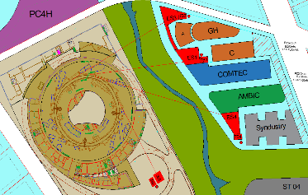

ASTIP: Examples for Strategic Partnerships
(in Pre-Proposal Stage)
Large partnership with local institutions and opening to other national institutions to form a hub of 4 pillars, being ALBA II in the center. The other three pillars will be:
  AMBIC (life sciences)
  COMTEC (material sciences)
  SYNDUSTRY (Innovation hub for industry)
The materials science center COMTEC could boost :
  2D, spintronic and spin-orbitronic systems
  Multifunctional materials
  Quantum informatics
  Computational Materials Science
  Sample Preparation and Support Facility
COMTEC provides full service building on the strength and expertise of local groups and provides them the full network.
ASTIP is in the preproposal stage
Notes:
Here one should say something about strategig partnerships and what you do now and could be done with partnerships (like the battery lab).

Slide 9
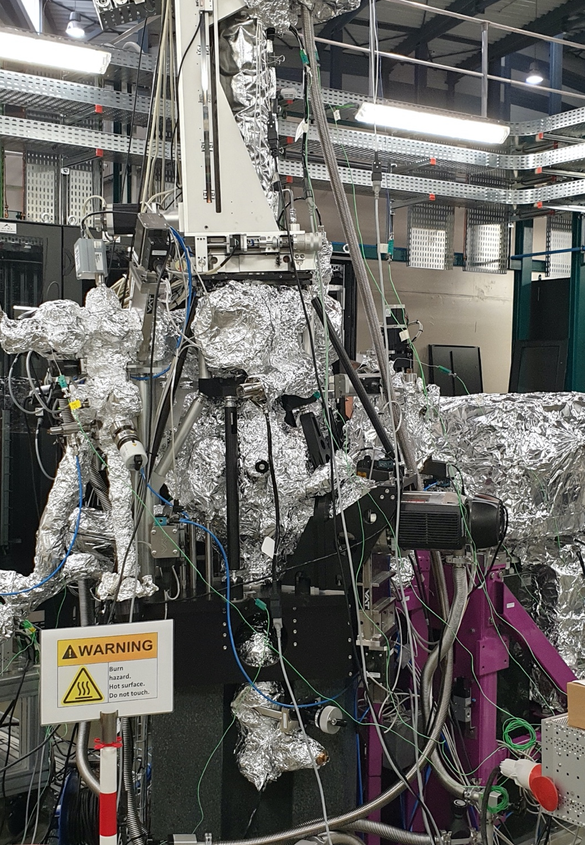
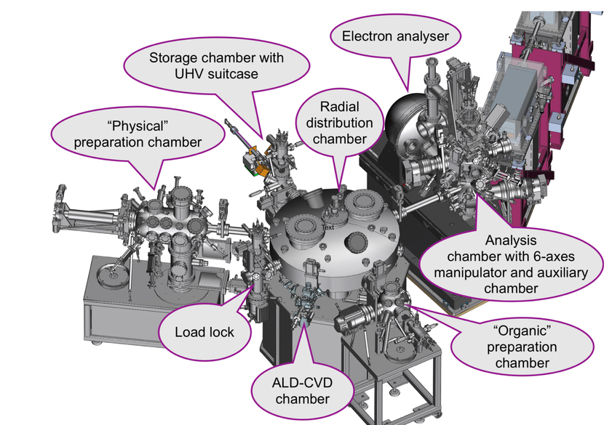
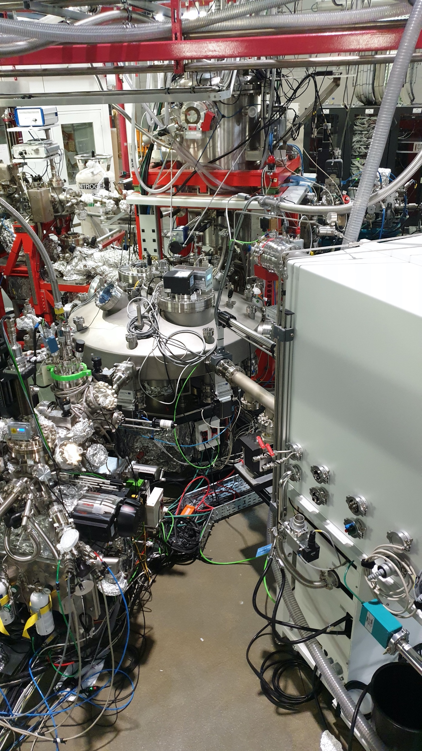
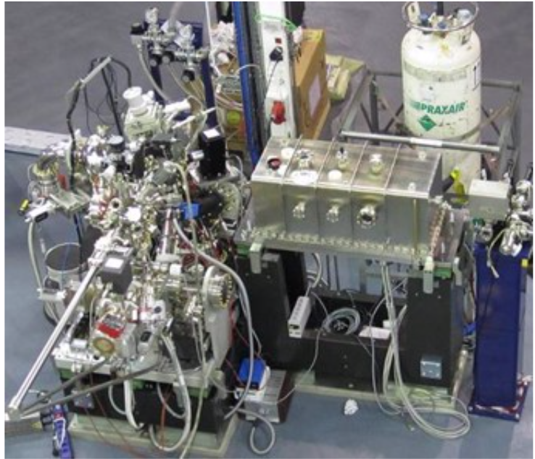
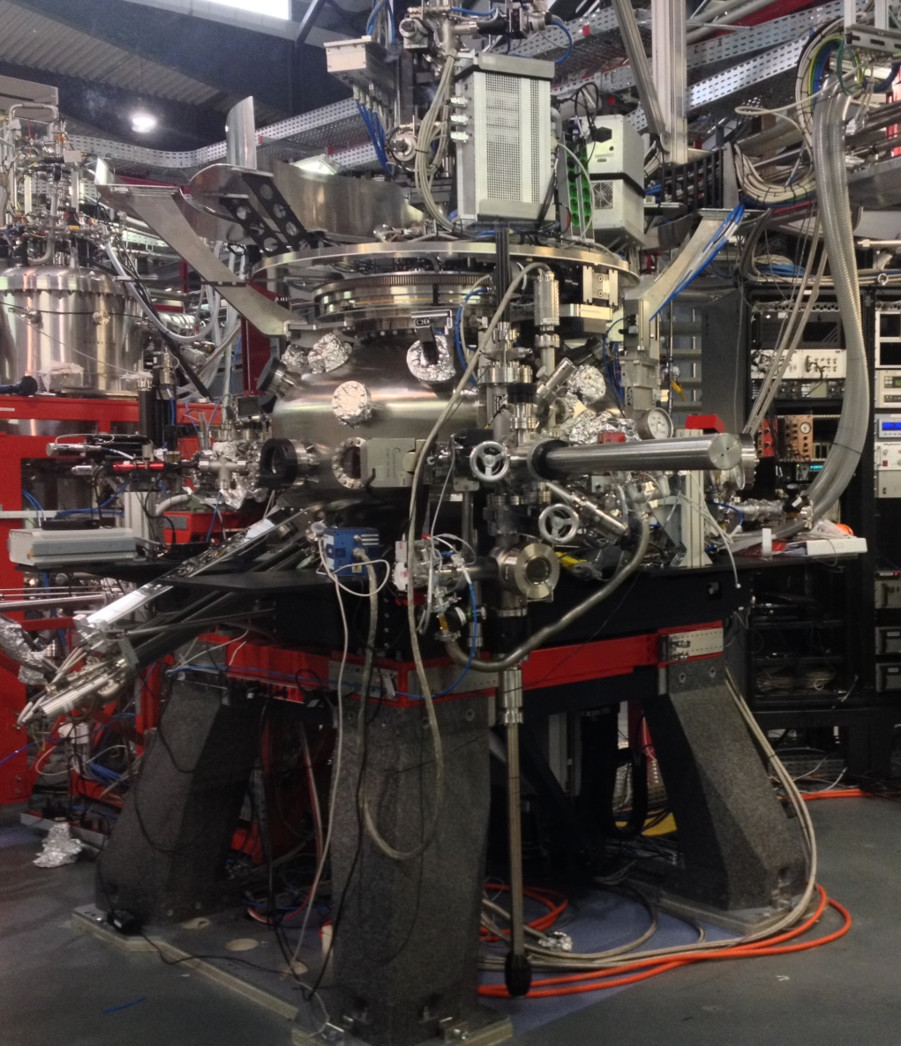
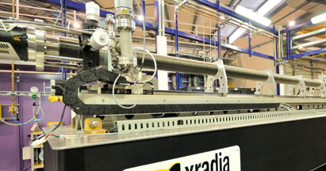
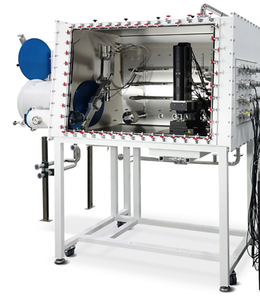
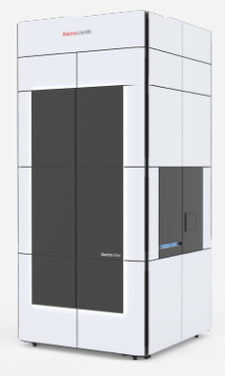
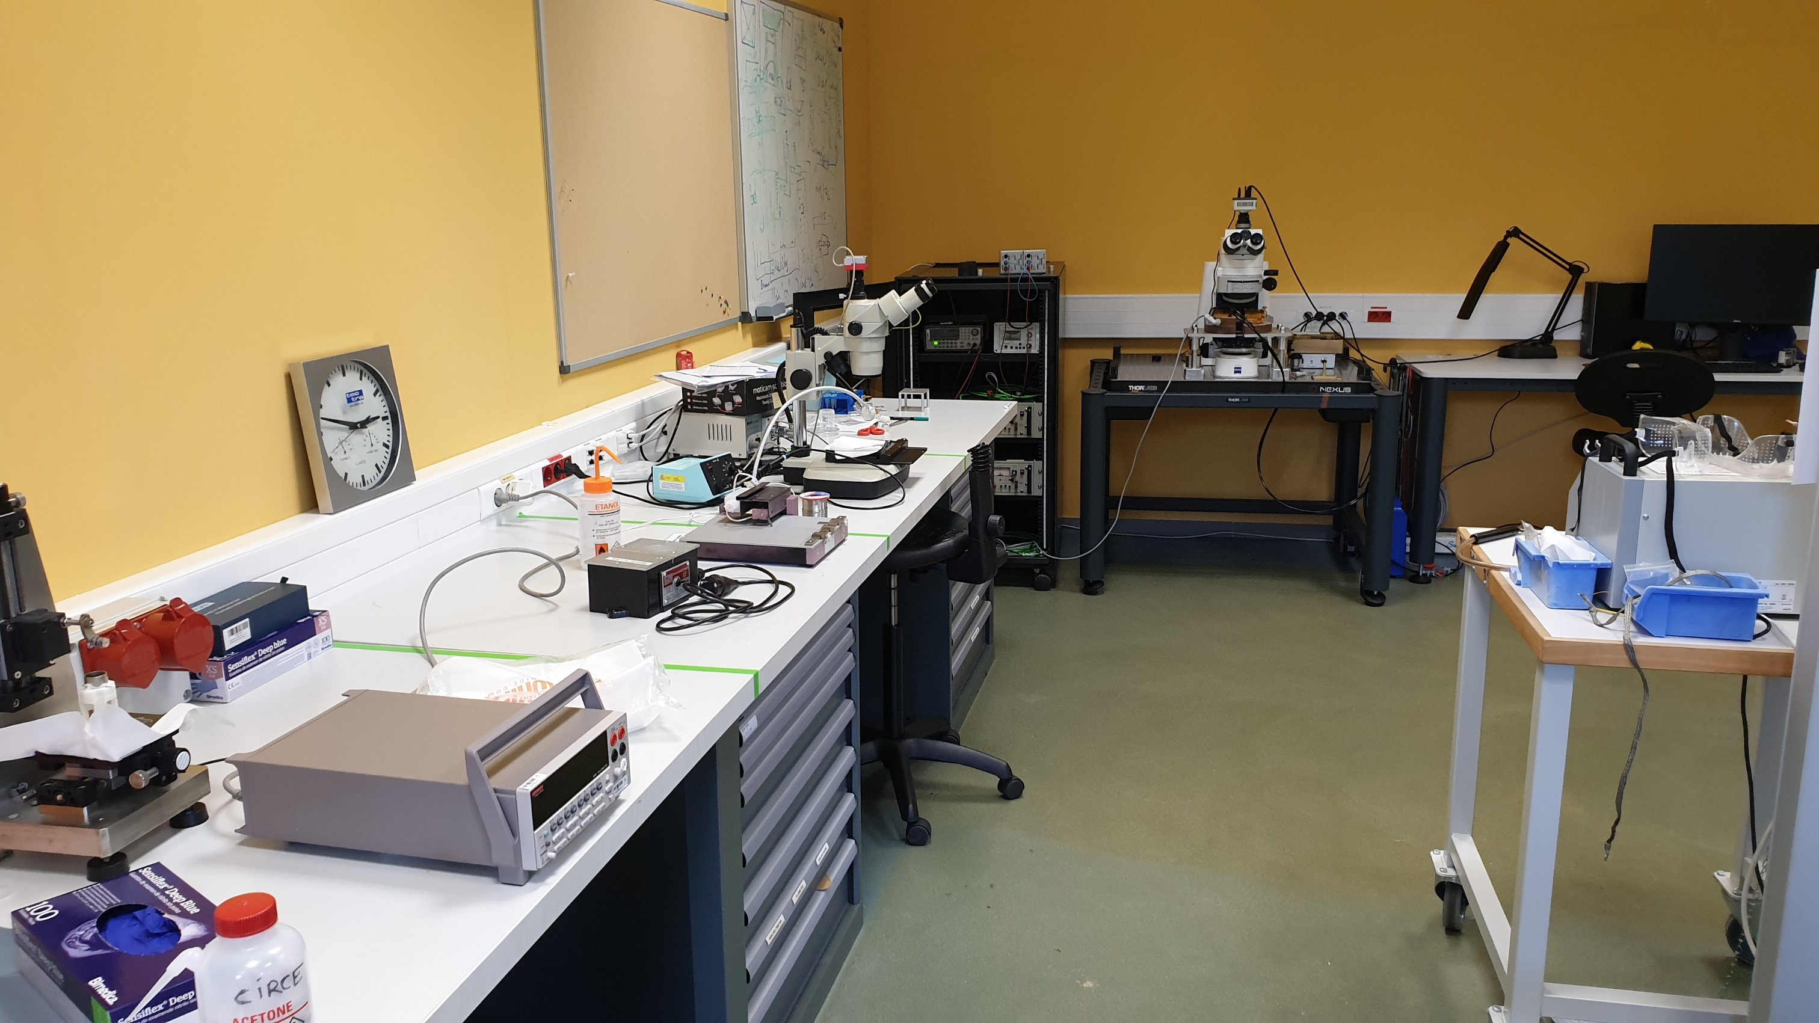
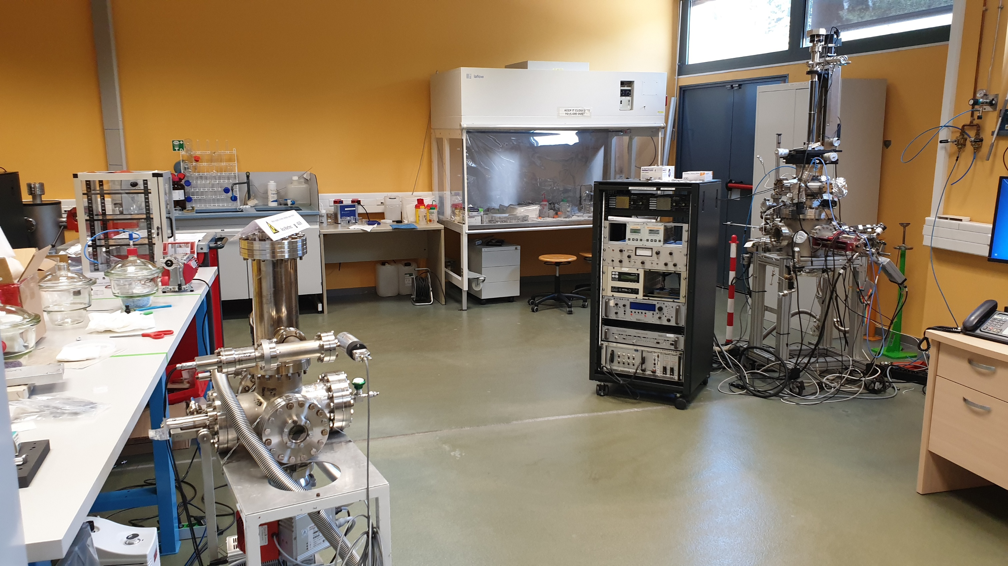
ALBA II a 4th Generation Source
Computational resources
Ab-initio
Multiplet
magnetic
tomography
Data analytics
Holo/CDI-
ptychography
Micromagnetics
Multi-scale modelling
XPCS
  ALBA II will provide complete characterization solutions for the 2 branding areas (2D/QMs, Information Technology) by combining:
Enhanced spectroscopic and imaging tools allowing multi-modal approaches.
Optimized high-throughput instrumentation.
Data handling facilities consistent with big data (including theory, simulation and data analytics for branding areas).
Development and implementation of new methodologies.
ALBA II will form strategic partnerships** and will be embedded into research supporting infrastructure which provides all non X-ray support to the users (example of the ASTIP proposal). **ALBA II will still provide all current services to all (Spanish) other users.
LOREA-ARPES
BOREAS-XMCD
ALBA Core-Business
CIRCE-PEEM
BOREAS-SCATT
MISTRAL TXM–(MAG)
HR-(S)TEM
*
Materials&Surf Science Lab
not yet
approved
Notes:
I would follow this concept for the summarry: Blue box all core instruments which you think you will need (indicate to be approved if not yet in the process of being built). Red boxes are services for which we will do best effort but cannot guarantee to make it without partners.

Slide 10

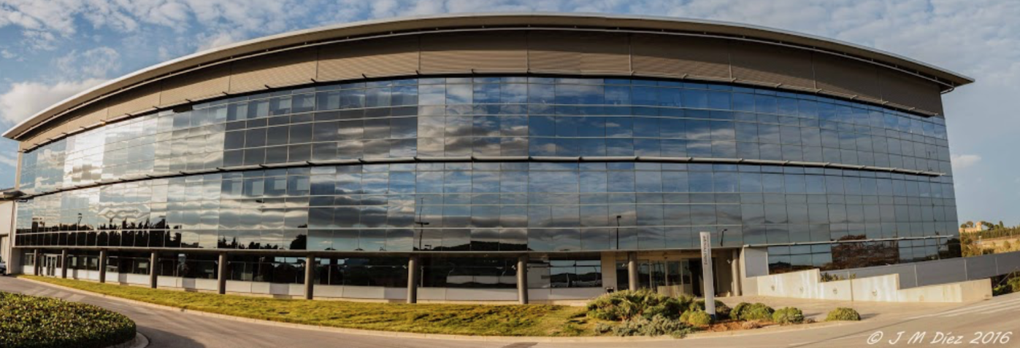
ALBA II
a 4th Generation Source
Questions welcome

