Slide 1
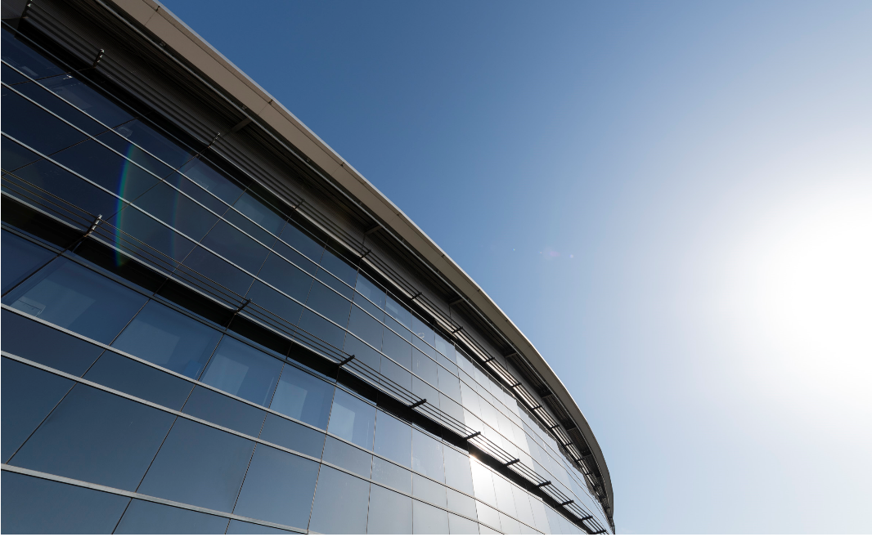


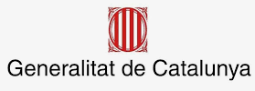


ALBA towards ALBA II
Introduction and
Institutional Background
Caterina Biscari
30-06-2021
Foto Sergio Ruiz

Slide 2
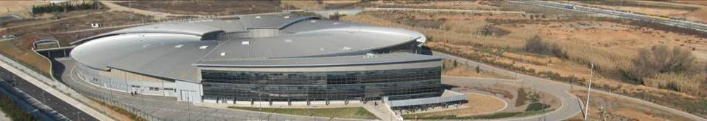
ALBA is the Spanish Synchrotron Radiation Facility
National public institution with 50% national + 50% regional funding (Ministerio de Ciencia e Innovación) and GenCat (Department de Recerca i Universitats)
National and international (28%) staff
National and international (35%) users
National and international collaborations

Slide 3
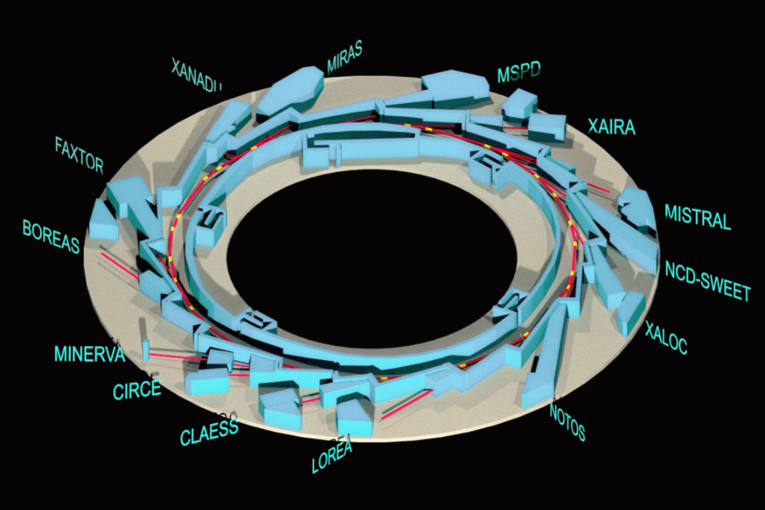
ALBA key parameters
Synchrotron:
e- Energy = 3 GeV
C = 270 m
Emittance = 4.4 nmrad
8 operating BLs
2 in commissioning
3 in construction
1 for acc. Diagnostics
Advanced Microscope Platform based on partnership in construction
ALBA

Slide 4
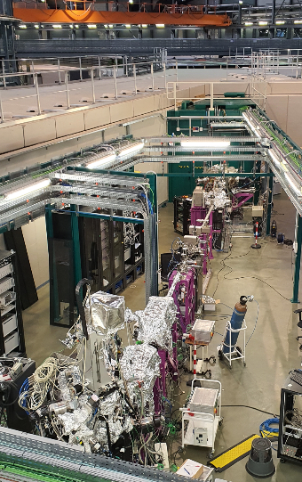
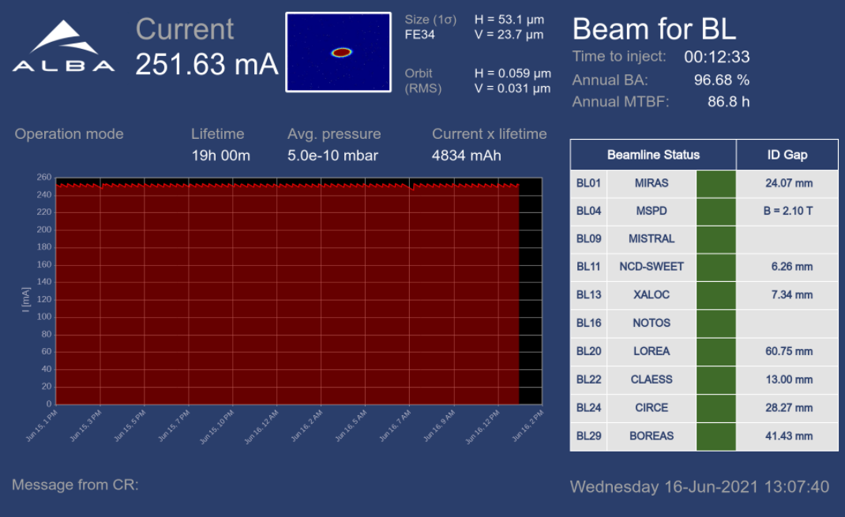
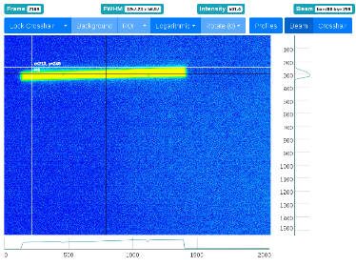
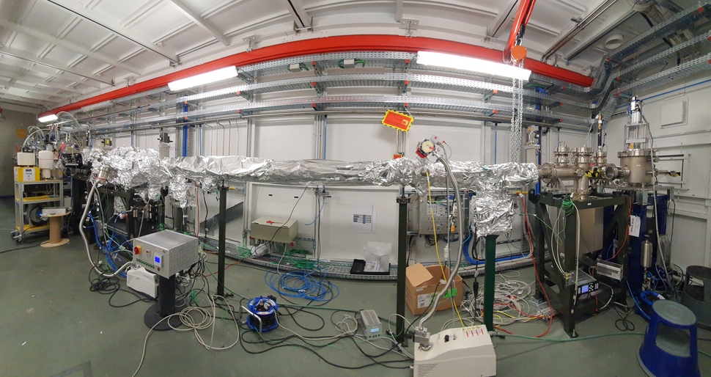
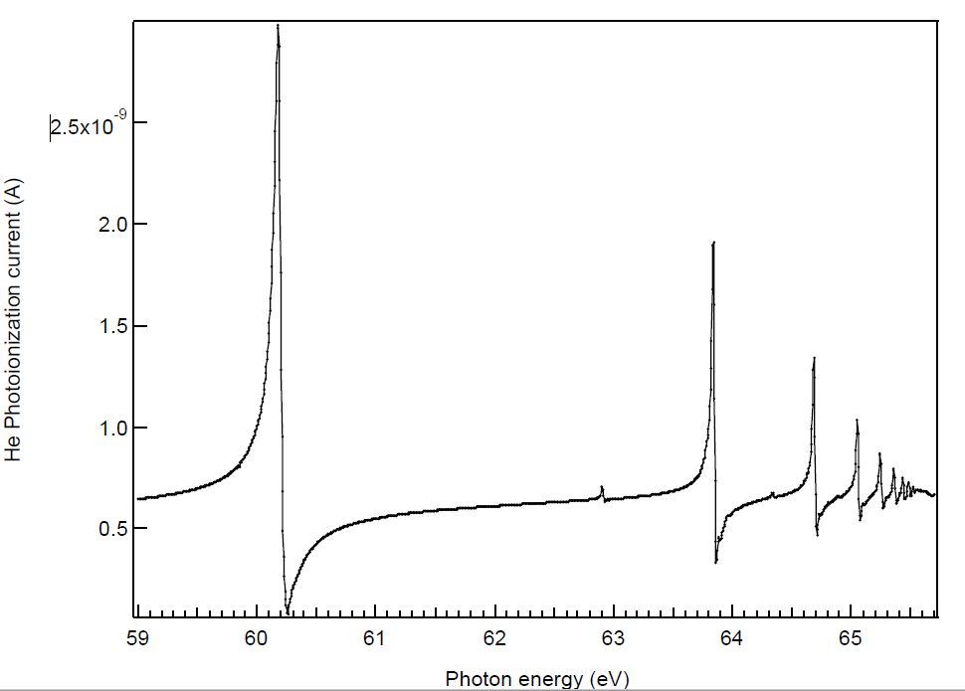
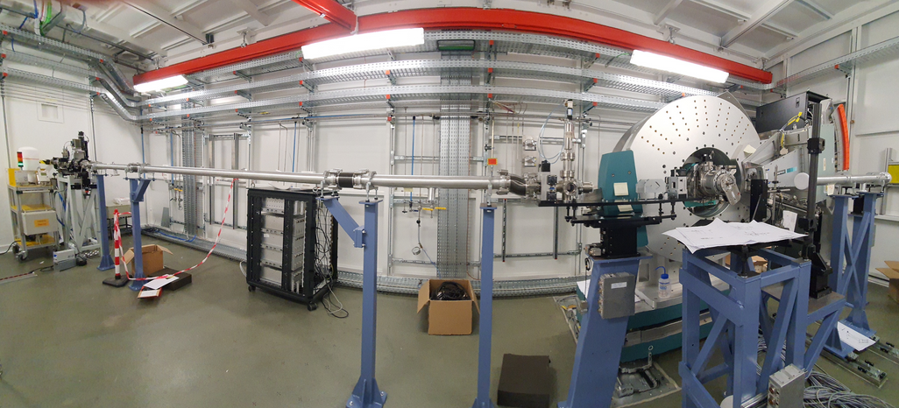
LOREA and NOTOS in commissioning
Official users after summer shutdown
LOREA layout and first spectrum (22/06/21)
NOTOS opt&exp hutches and first beam after the monochromator (22/06/21)

Slide 5

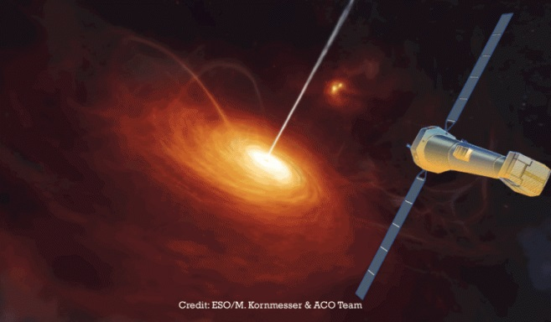
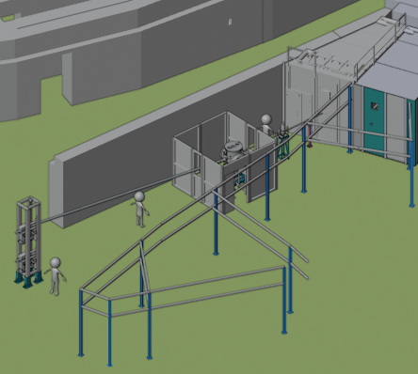
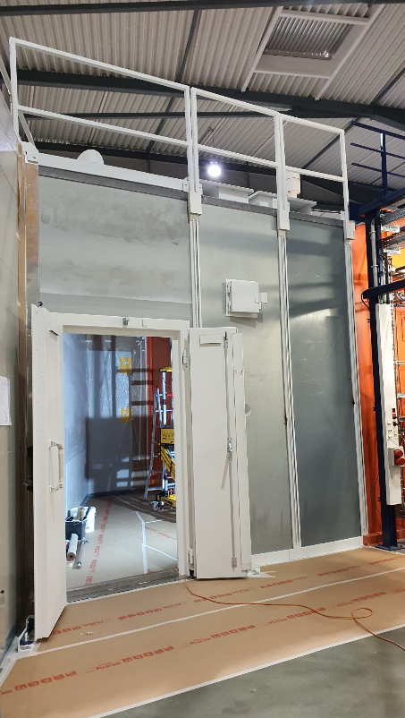
We participate in exploring the universe:
ALBA - European Space Agency collaboration
13th BL
In construction. Starts operation in 2022
ATHENA Mission (2032)
Advanced Telescope for High-ENergy Astrophysics
Will study the high energy universe, including black holes
MINERVA, 13th ALBA BL: BL to test hundreds of mirrors to be mounted in ATHENA satellite

Slide 6
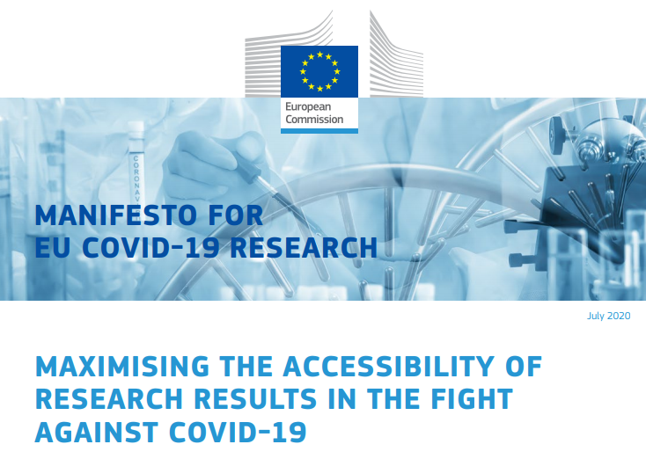

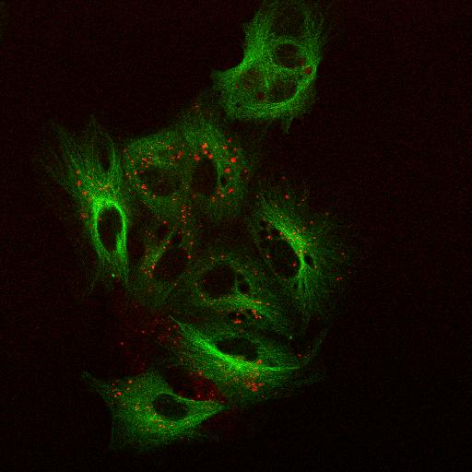
Offered since April ‘20 our instruments to the scientific community with quick access for COVID-19 related experiments
So far:
+ 15 public experiments
2 private experiments
Inhibition of COVID-19 viral replication using microtubule modulators
CIB Margarita Salas, INIA, ALBA.
Mebendazole (a in clinical use antiparasite) blocks the activation conformational switch of tubulin precluding the use of microtubules for viral infection (Data adquired at XALOC)
The inhibition of the viral replication is caused by the blockage of the movement of viral particles over the infected cell microtubules. Microtubules labelled in green, viral particles over dynein in red (Data obtained at CIB).
Few examples:
Blocking SARS-Cov-2 cellular processes: microtubules mediated trafficking of viral particles
Análisis estructural de las proteinas de membrana del SARS-CoV-2 para el diseño de nuevos inhibidores del ensamblaje viral.
STRUCTURAL CHARACTERIZATION OF SARS-COV-2-INDUCED DOUBLE MEMBRANE VESICLES IN INFECTED CELLS USING CRYO SOFT X-RAY TOMOGRAPHY
Viral proteins and their interactions with host components.
Towards the structure determination of 3D structures using viscous jets at XALOC beamline.
Data collection for drug-target complexes
Structural studies of macromolecular interactions relevant to infectious and metabolic diseases.
Towards determination of crystal structures of proteins involved in infectious diseases.

Slide 7
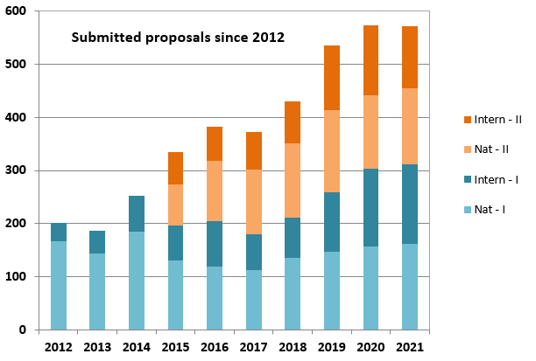
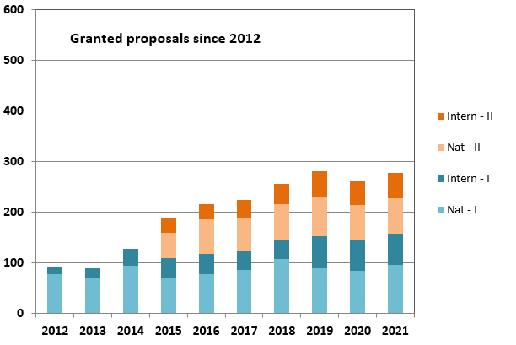
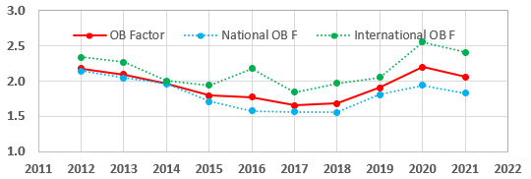
Our USERS
Joint academic and industrial
Private
Academic
Academic proposals (submitted/granted)
+50 companies using our instruments
Direct access covering operational costs
Results can be confidential
Competitive and free access
Public results

Slide 8
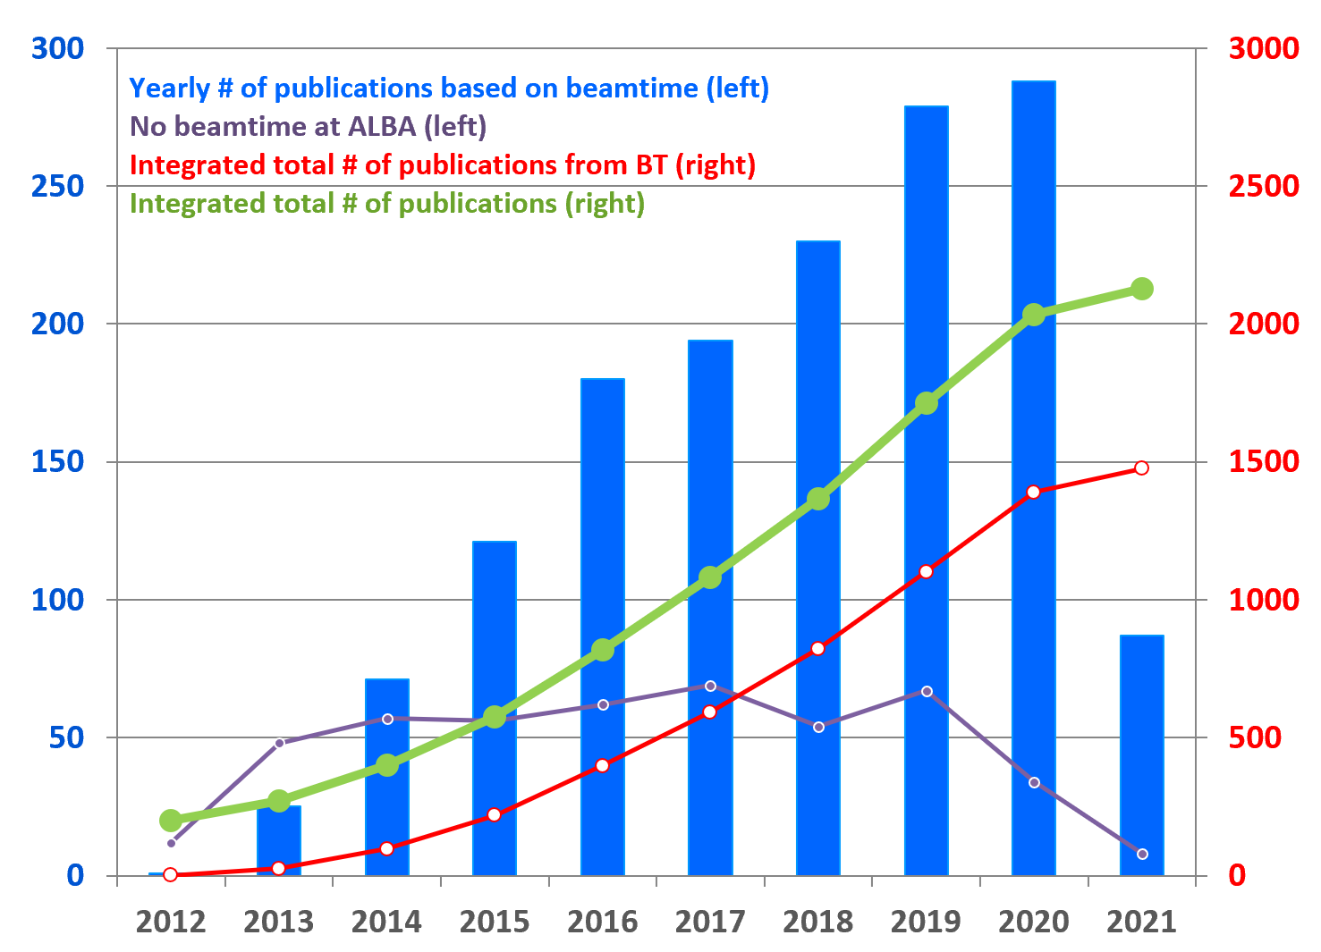
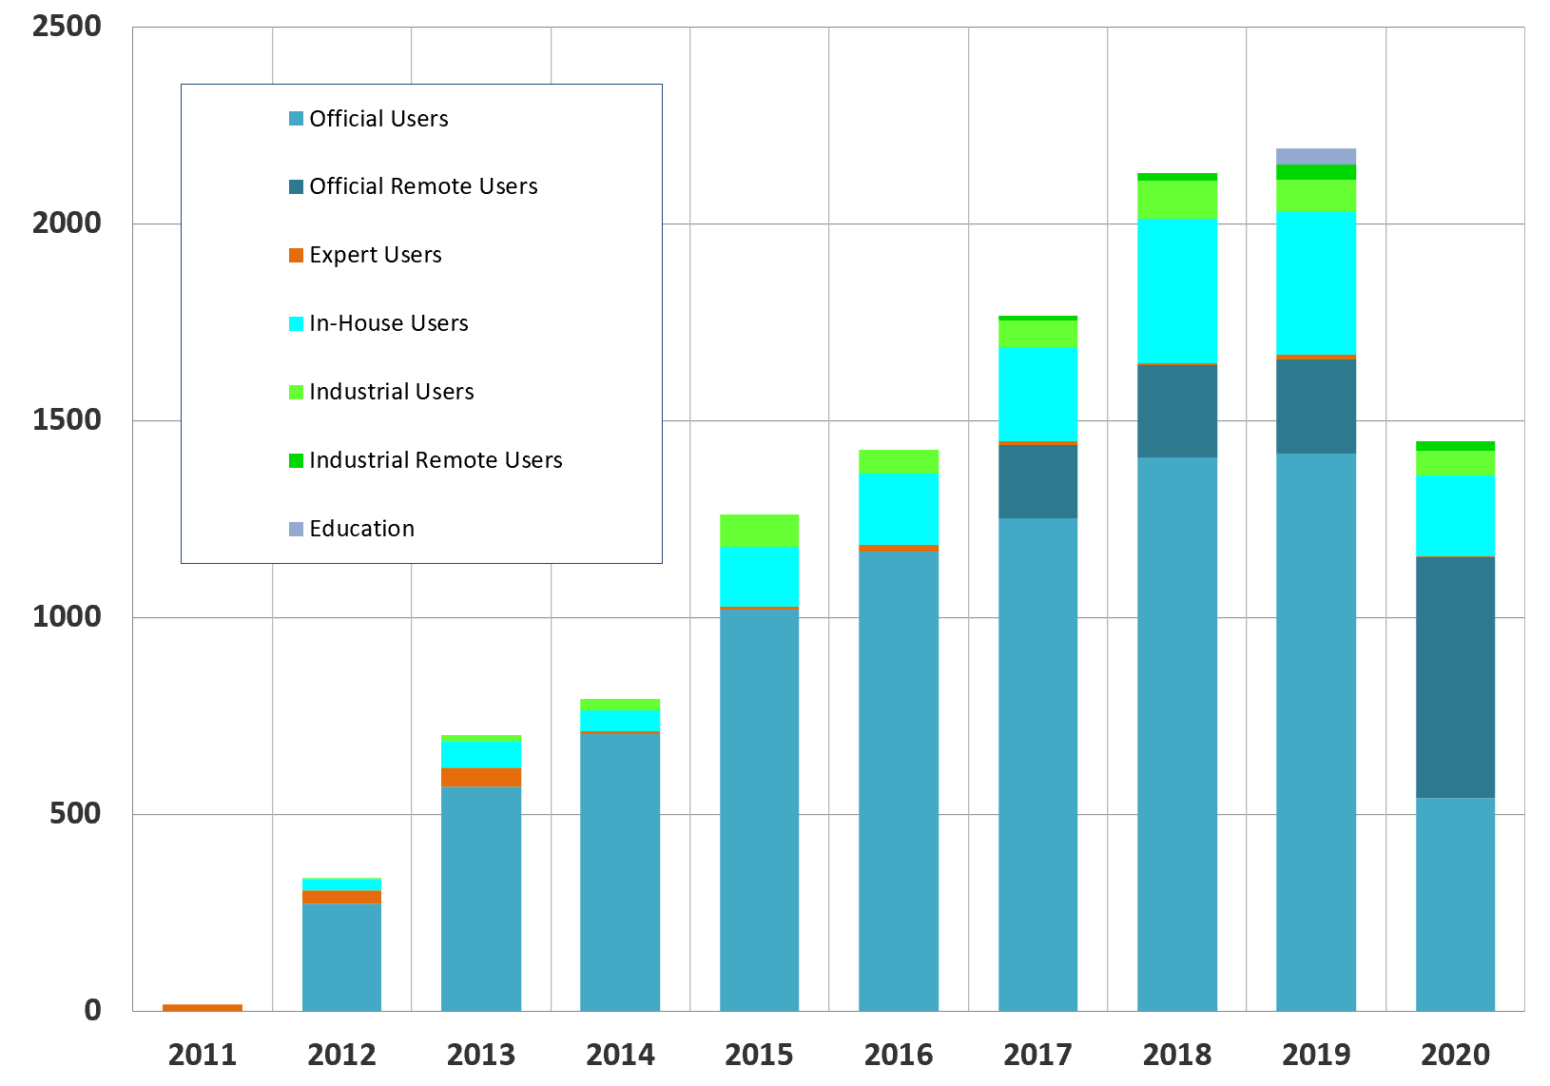
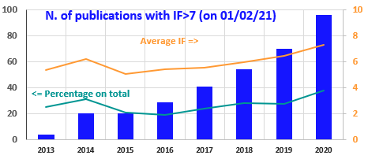
Today
+ 2000 user visits/normal year
+300 yearly experiments
ALBA science KPIs
+2100 publications
<+35> pub/BL/year
300 experiments also during 2020 in spite of decreased beamtime and # of users!!
User database:
3000 national
2700 international users
Remote users
Continuous increase of proposals #
2/3 from Spain

Slide 9
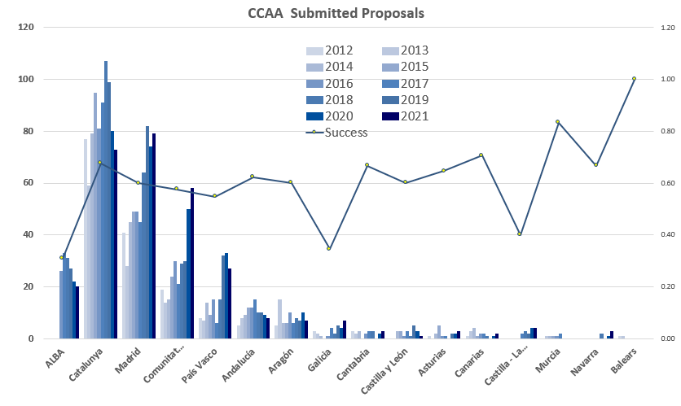
National users

Slide 10
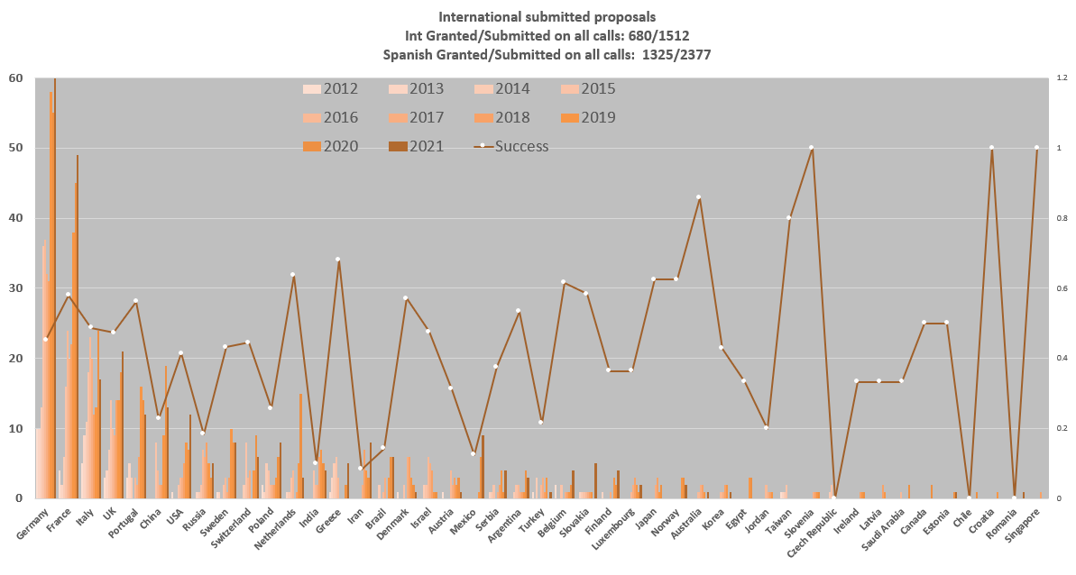
International users

Slide 11
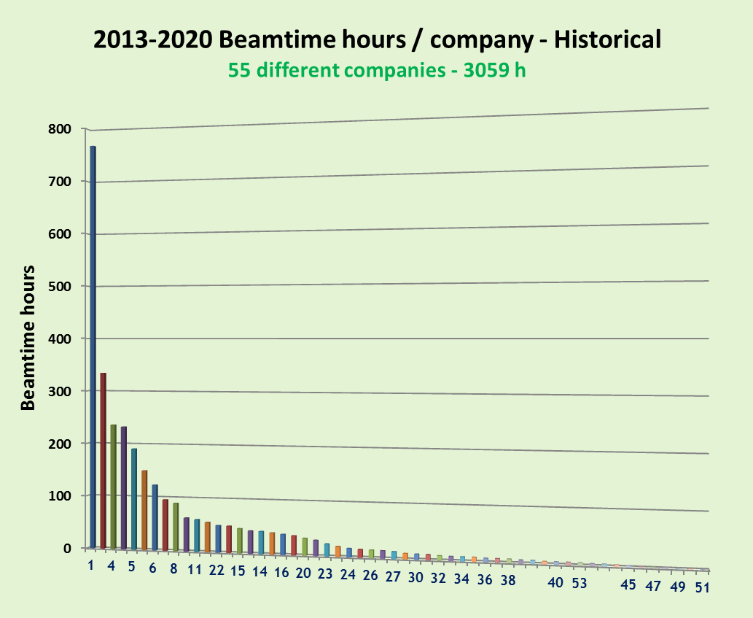
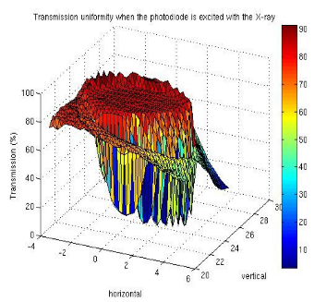
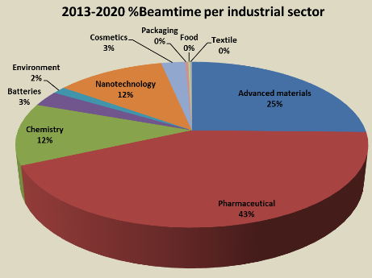
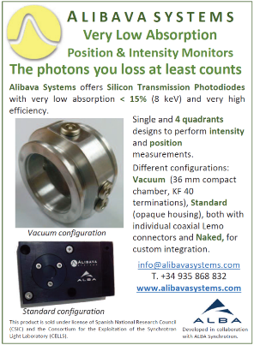
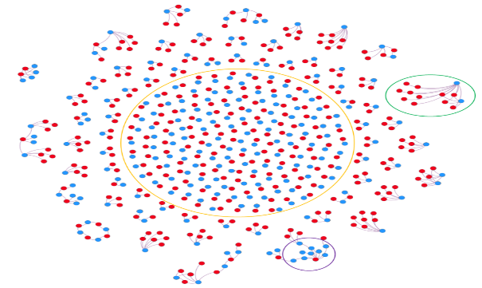
Today
Industrial beamtime in all BLs
Technological transfer
Dedicated staff
ALBA innovation
Photodiode detector: Collaborations with industries to commercialize in-house developments: license contract with ALIBAVA an spin-off company of the CSIC.
+ EU projects granting free access for SME
Industrial relevance of academic experiments
Patents citing publications
Industrial participation in BL funding
243 ALBA P1 publications (blue dots) out of a total of 9974 are directly cited by 337 patents (red dots)
15 patents + 337 citing ALBA (done on 2018)

Slide 12


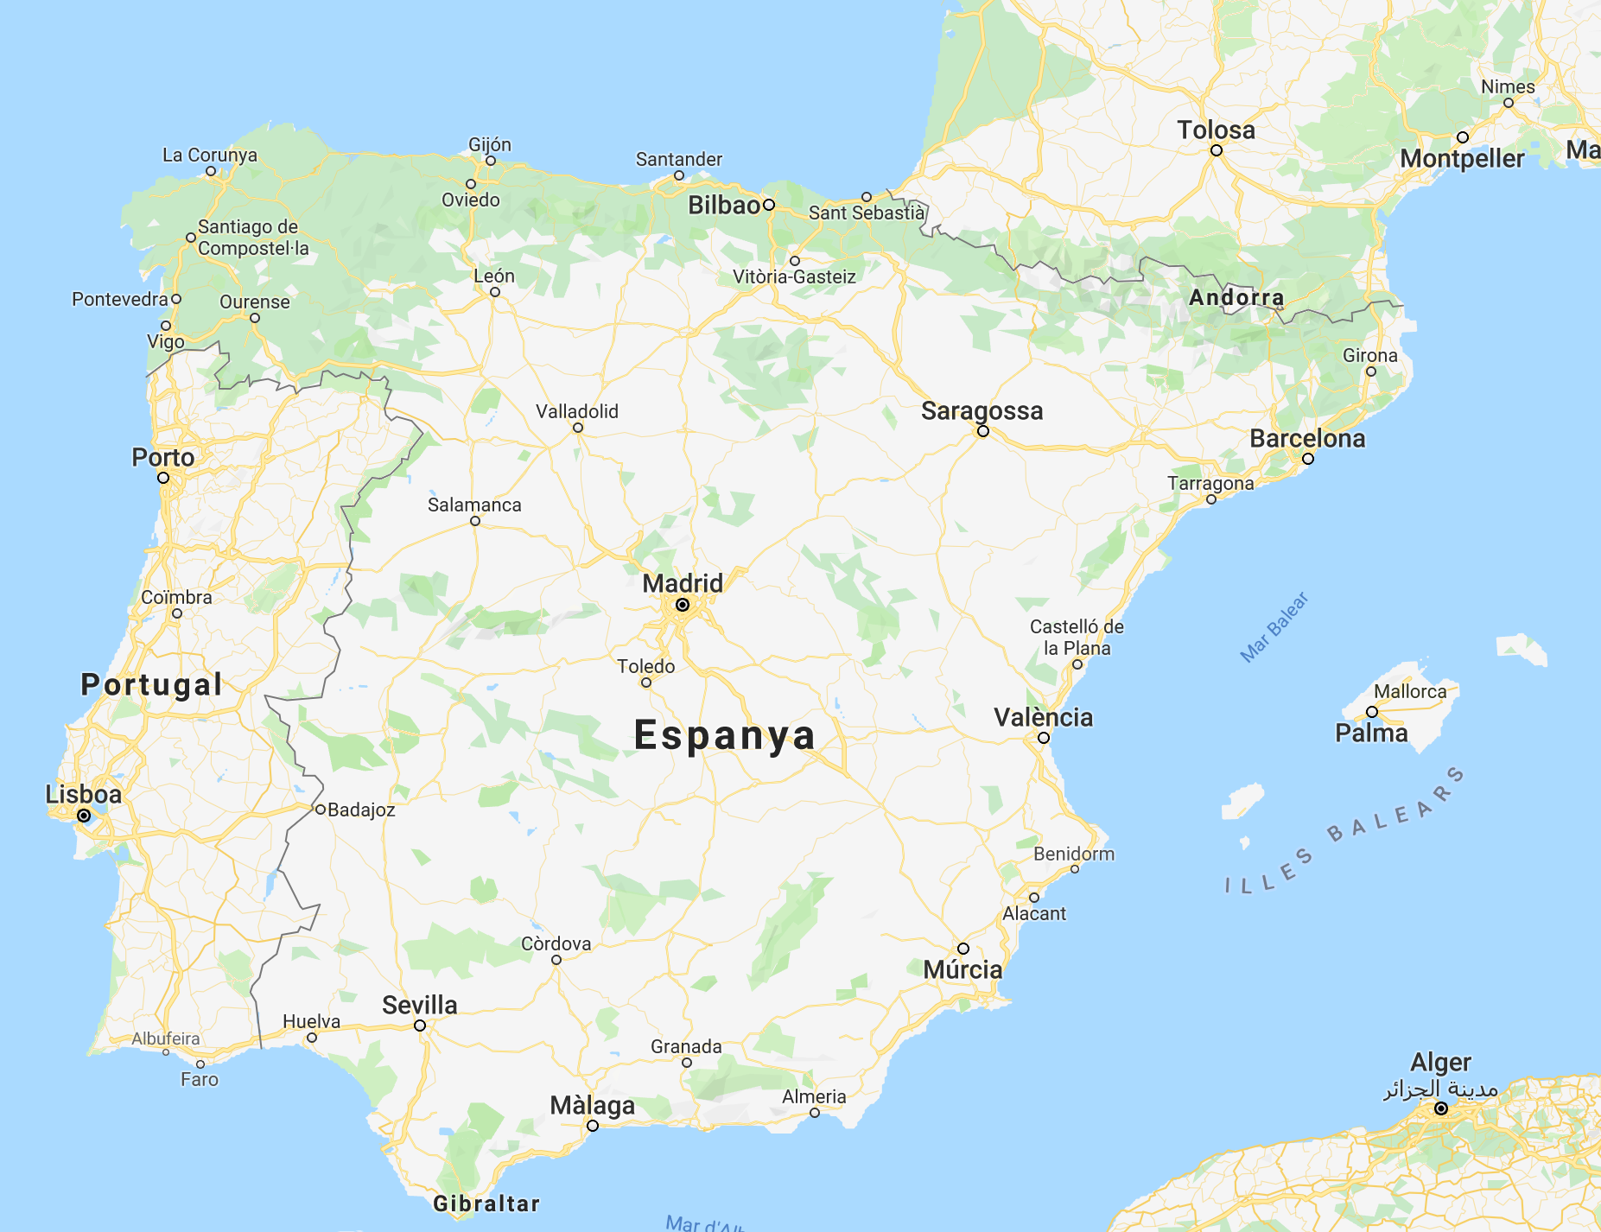
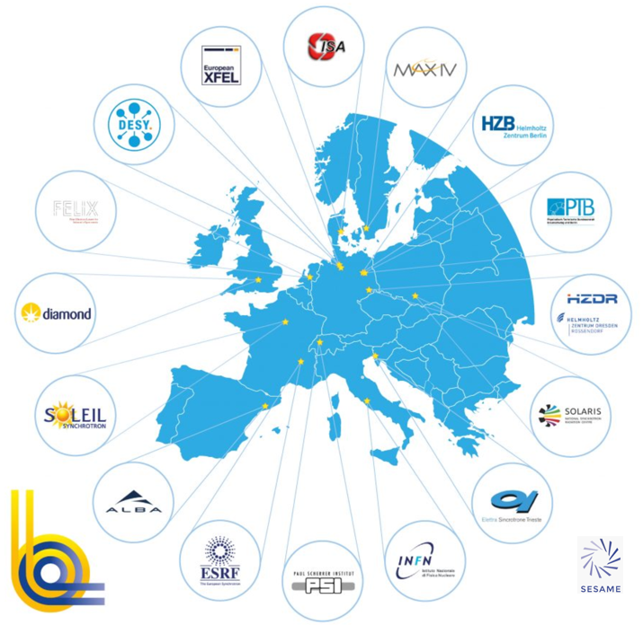

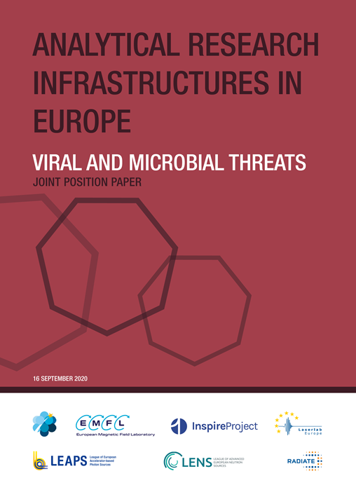
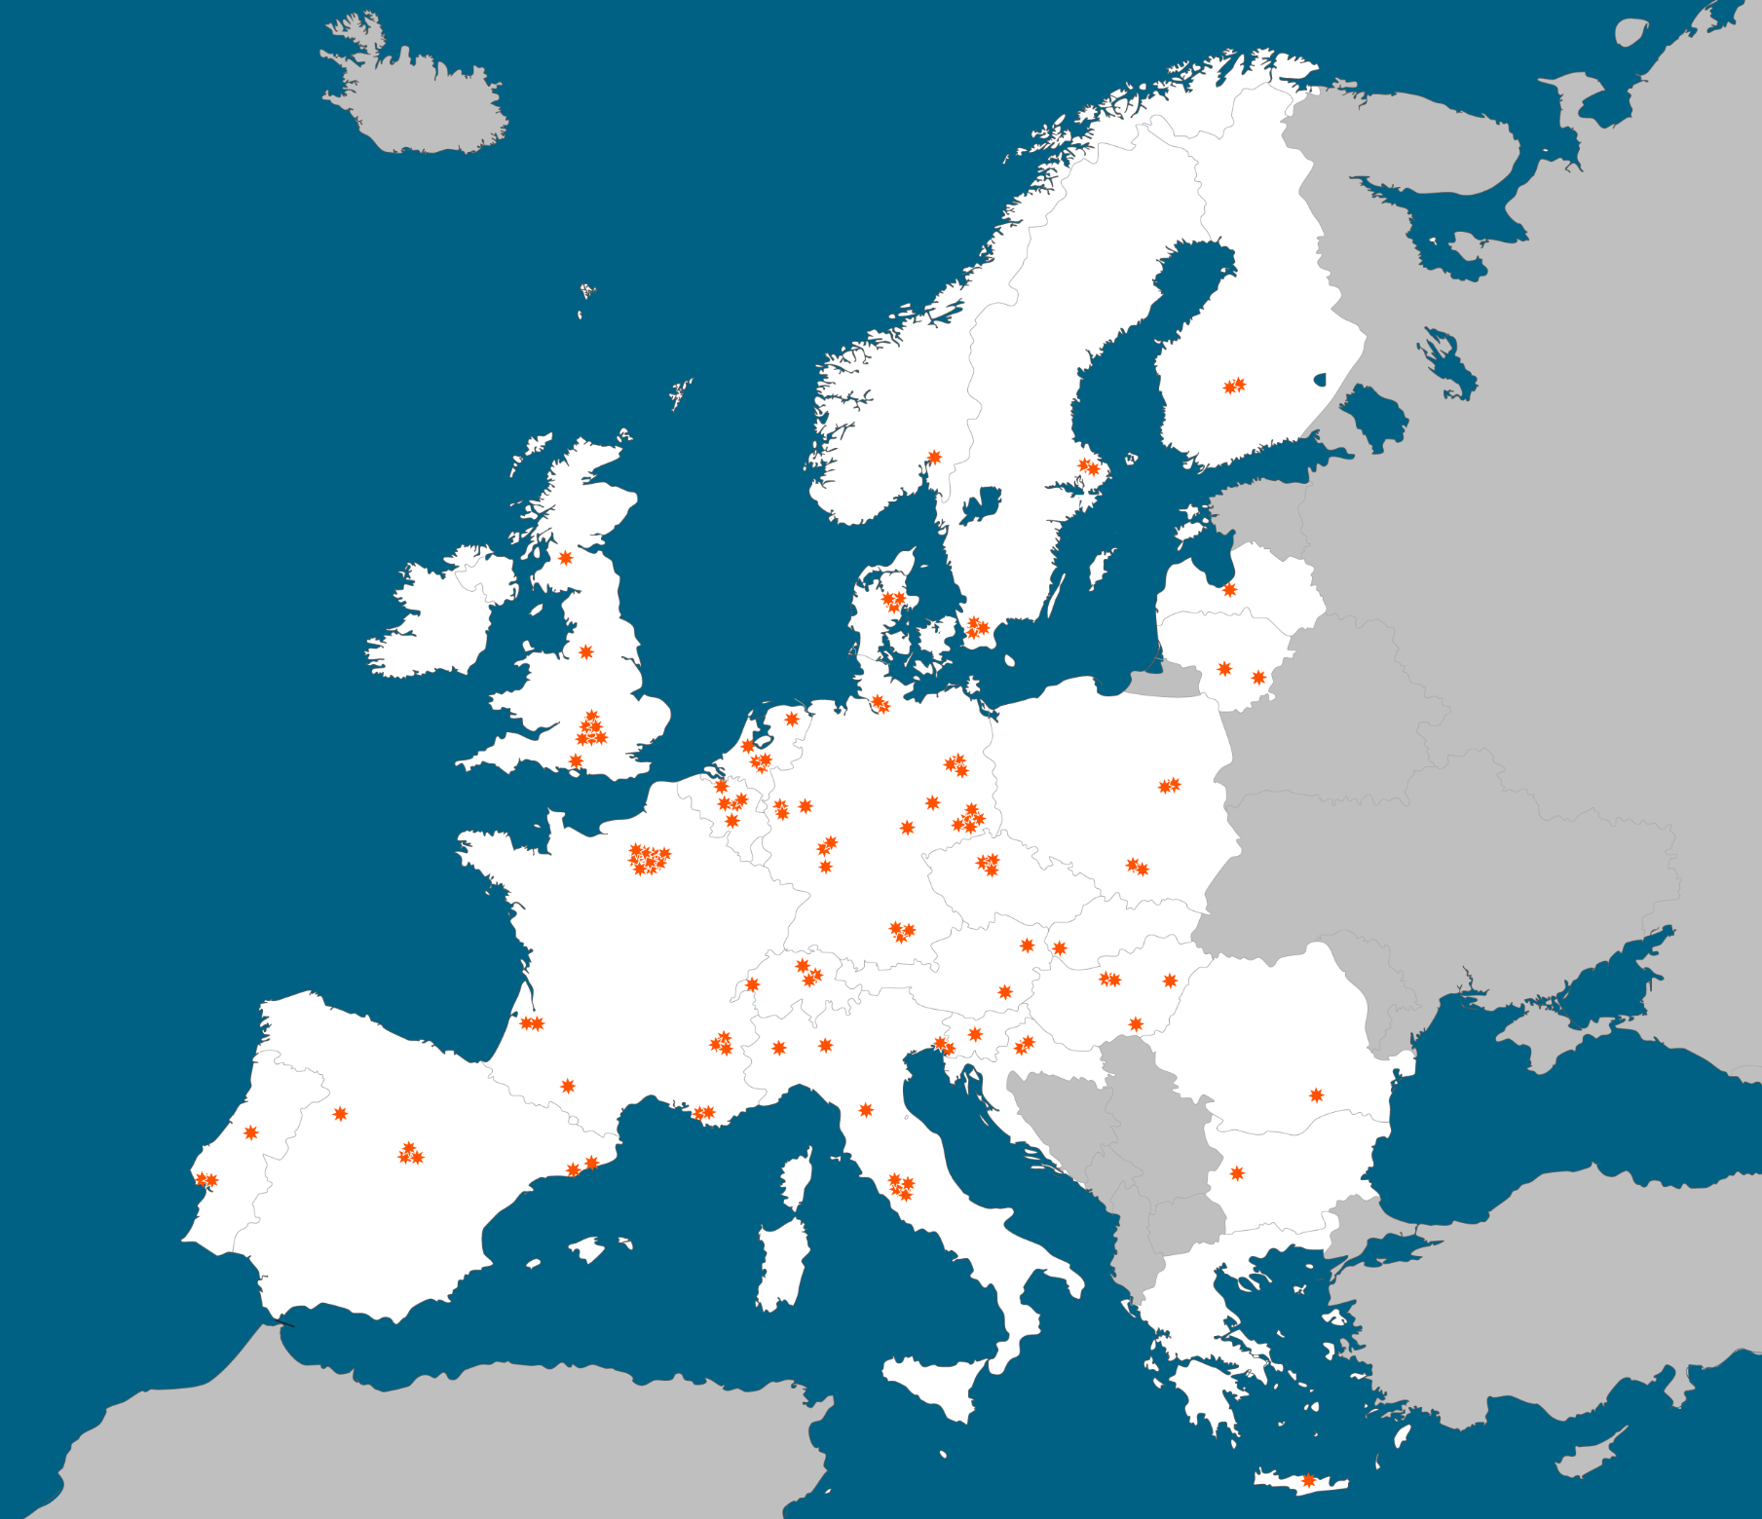
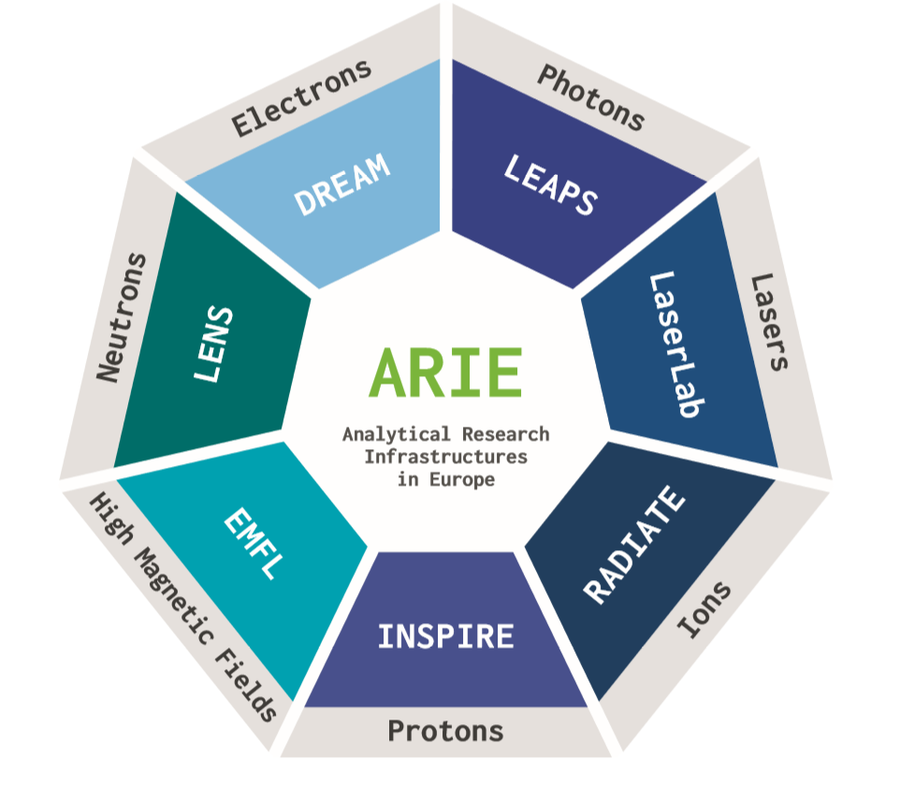
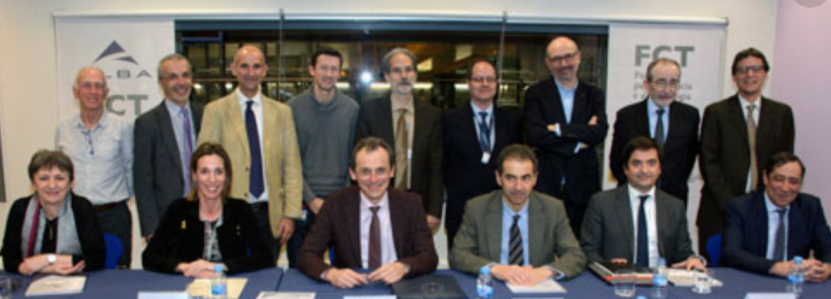
Today
Chairing LEAPS on 2020 and 2021
19 facilities - 16 institutions - 10 countries
European Commission
ALBA collaborations
Increasing # of National collaboration projects
ARIE spokesperson for start-up the collaboration
Minerva: BL in collaboration with ESA
Agreement with Portugal

Slide 13


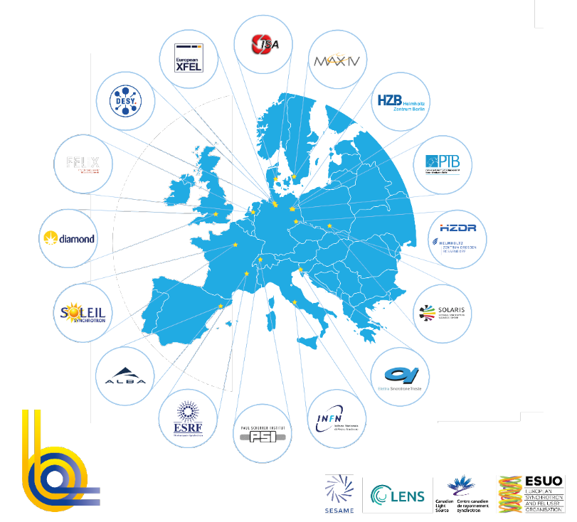
19 facilities - 16 institutions - 10 countries
+35000 users from all EU & beyond
+300 operating End Stations
+25000 publications
In last 5 years
offering +800000 h/year
2 international facilities
17 national facilities
Funded by national governments
Offering free access to ALL public researchers, based on competitive excellence
Offering advanced and cost effective instruments to ALL industrial world
Associate: SESAME
Partners: ESUO, LENS, CLS

Slide 14


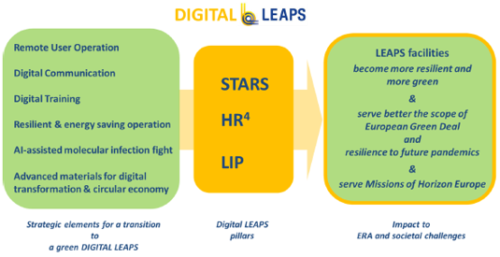
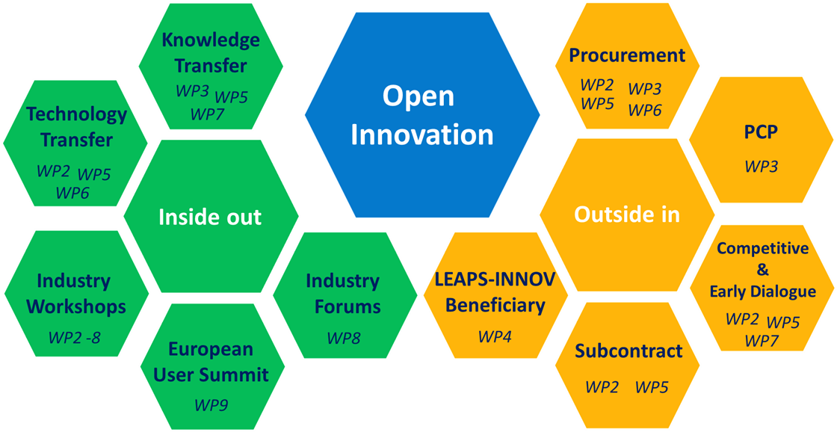
Some examples of on-going programs
Developing a LEAPS strategy for
sustainable industry partnership

Slide 15
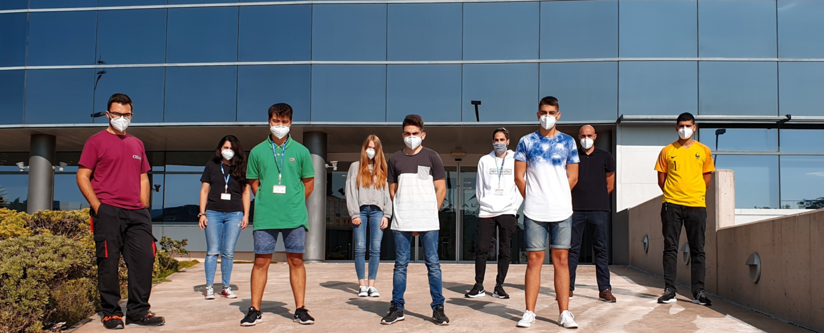

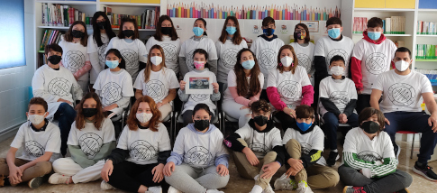
Today
High-qualified job offers
Positive Economic return of investments
+200 students trained
Involvement in educational programs from schools to universities
ALBA & society
+7500 outreach visits per year
220 staff
Organization of scientific and industrial workshops for pharma, chemistry,…
Contributing to
health, clean energy, advanced technologies, climate change, environment, food, agriculture, transport & mobility, security, cultural heritage,…
Academic and Industrial PhDs
Outreach projects for schools, reached more than 25000 children in 3 years

Slide 16
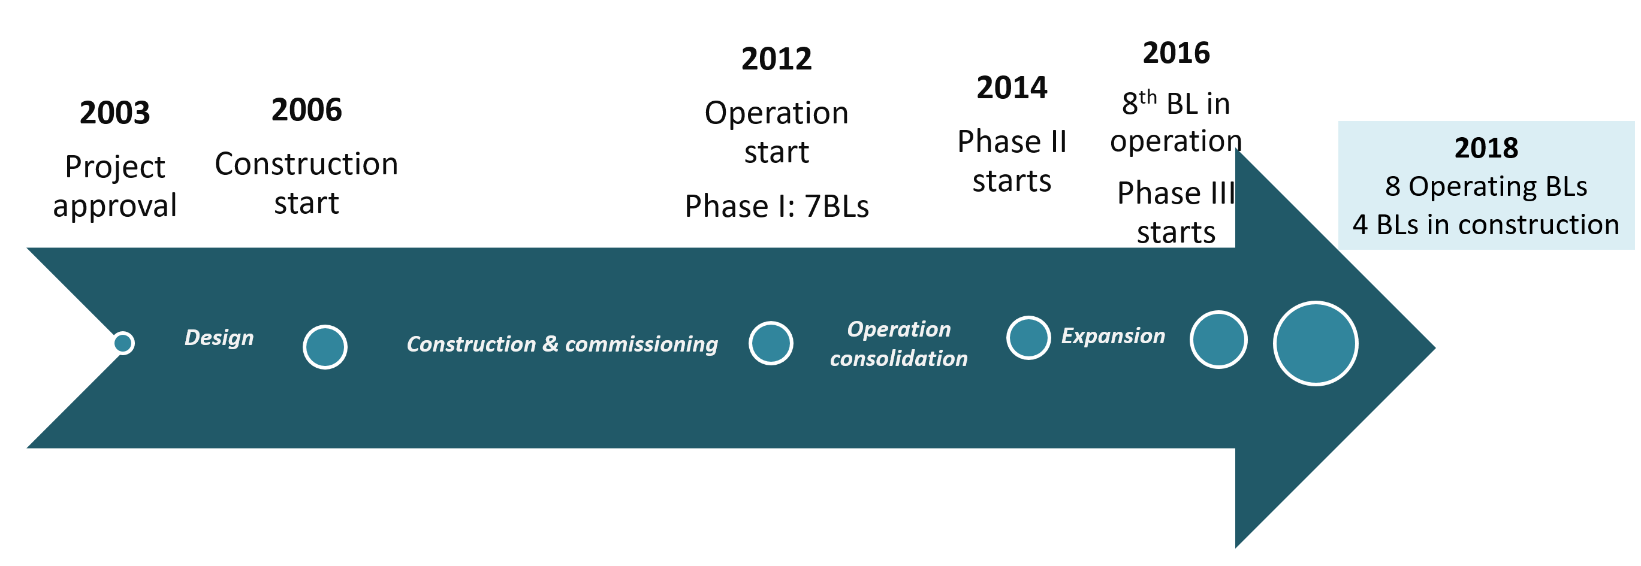
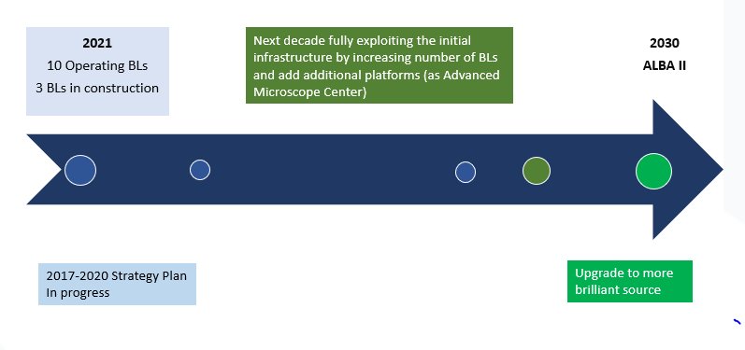
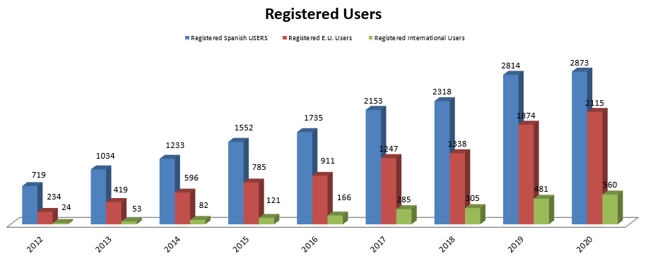
ALBA History and Future
2021
10 Operating BLs
3 BLs in construction
First proposal for building a synchrotron in Spain: in the ’90s
10 Years for the approval - 10 Years for the operation

Slide 17
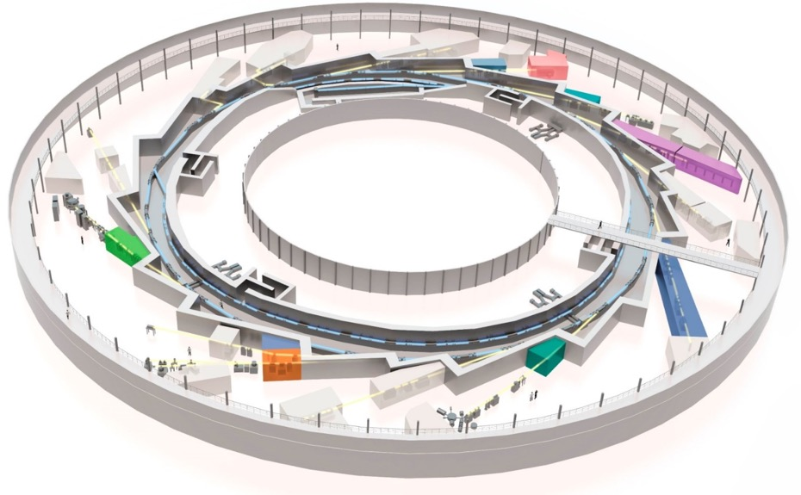
Beamline portfolio at ALBA
2012:
Phase I
MSPD
MISTRAL
BOREAS
NCD
XALOC
CIRCE
CLAESS

Slide 18
Beamline portfolio at ALBA
2012:
Phase I
2014-16:
Phase II
MIRAS
MSPD
MISTRAL
BOREAS
NCD
XALOC
CIRCE
CLAESS
LOREA

Slide 19
Beamline portfolio at ALBA
2012:
Phase I
CryoEM (Glacios)
Faxtor
TEM
2014-16:
Phase II
MIRAS
MSPD
Xaira
CorrelativeTEM
MISTRAL
2017 - 20:
Phase III
BOREAS
NCD-SWEET
2021 - ESA
Partnership
Minerva
XALOC
CIRCE
NOTOS
In
construction
CLAESS
LOREA

Slide 20
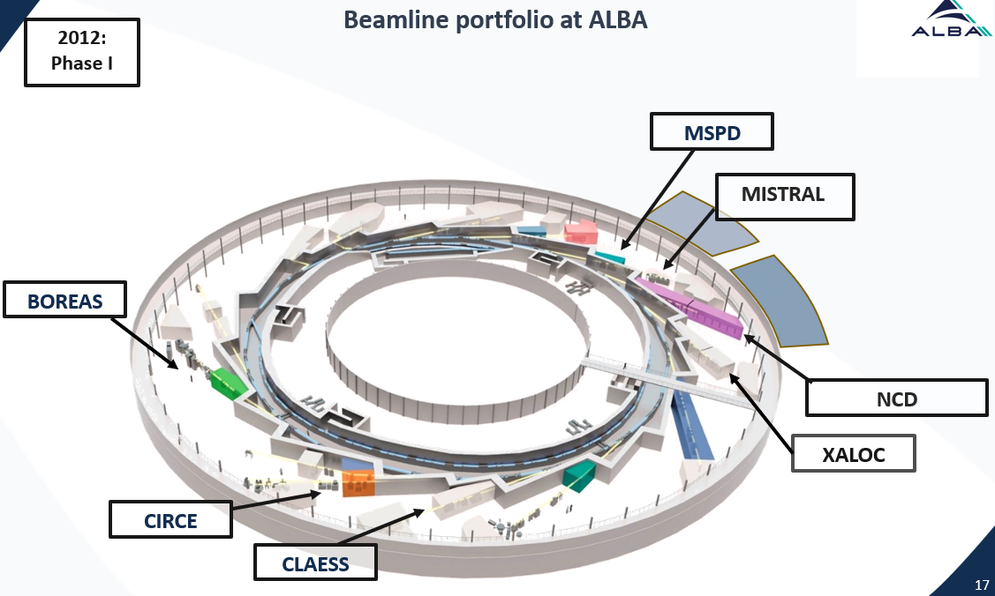
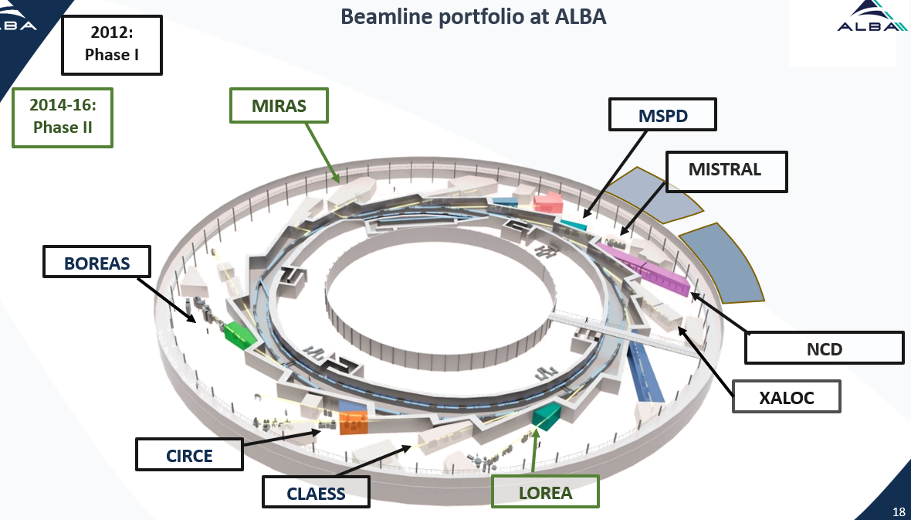
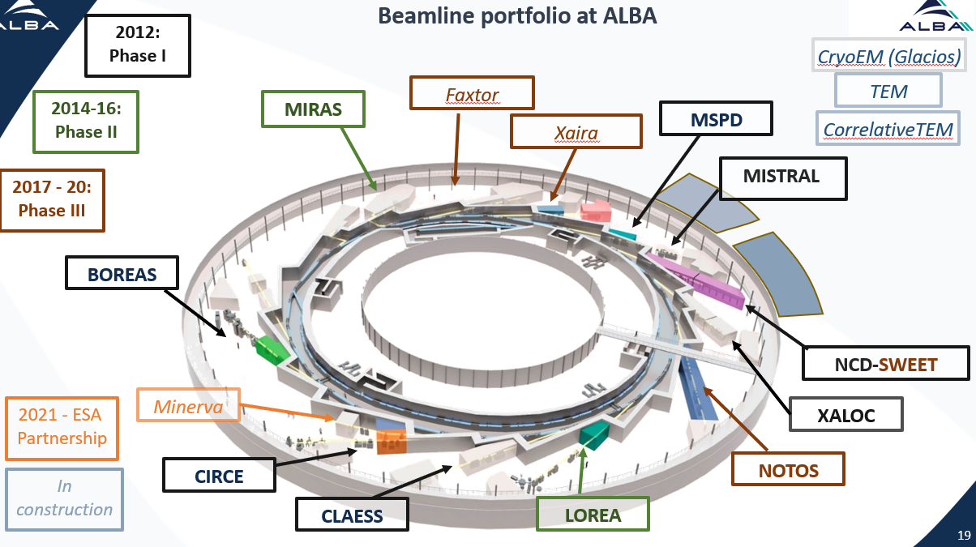
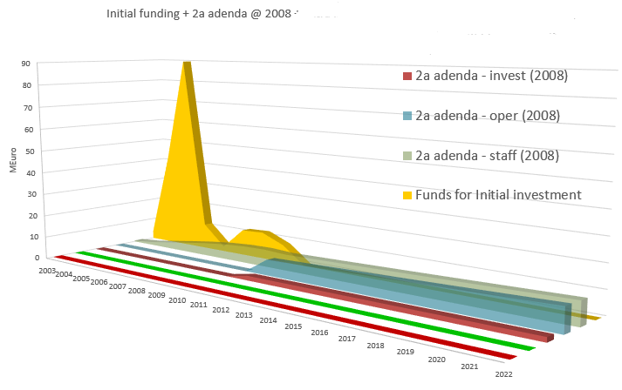
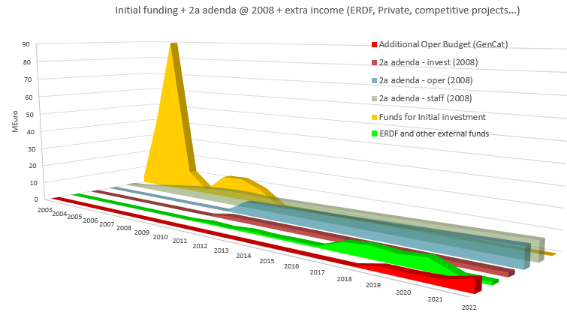
Phase I + start Phase II: initial funding (2003 = addenda 2008)
Phase II + start Phase III: + ERDF + additional Operational Budget

Slide 21
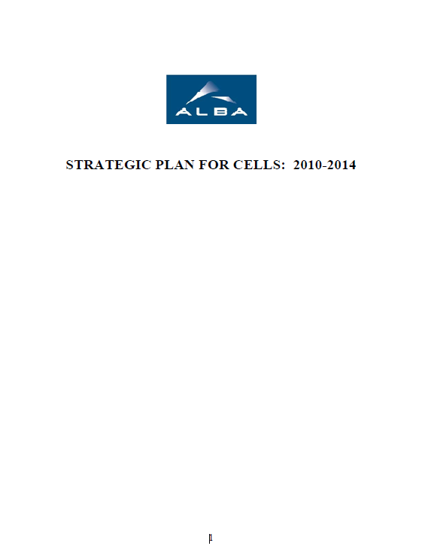
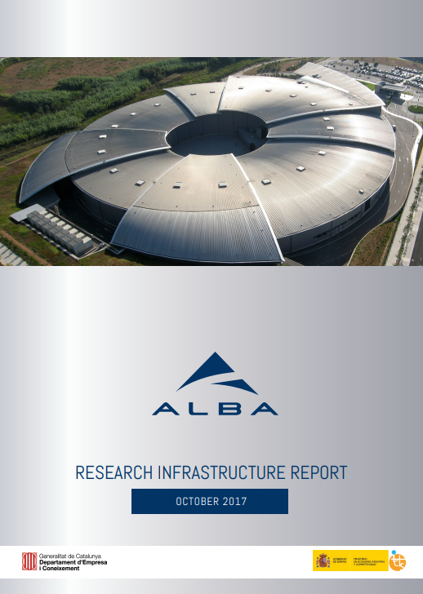


ALBA past Strategy Plans
2010-2014
2017-2020
2013-2016
https://www.cells.es/en/about/strategic-plans/

Slide 22
Evolution of the strategy
To research in, deliver and maintain methods and techniques with which to conduct cutting edge Synchrotron Light based research and development
Plan to increase # of BLs at the rhythm of 1.5/year – Not done due to lack of new investment funds
20 BLs in 2020 - based on new investments, ALBA to be refurbished in 2035
2010-2014
2013-2016
Enhance expertise and promote the utilization of Synchrotron Light by working with the Spanish and international scientific communities;
20 BLs in 2020 – based on new investments
2017-2020
Be a center of excellence in synchrotron radiation (SR) science and technology at European level and consolidate the status of CELLS as a recognized world class facility in its field.
16 BLs in 2020 – based on new investments and ERDF funds
Starting planning ALBA II

Slide 23




Evolution of Synchrotron Radiation Sources
Increase in Brilliance
Increase in Resolution Power
Increase in Coherence
Increase in Data Analytics capacity
Representation of photon beam on sample

Slide 24




Synchrotron Radiation Facilities today
Details on Francis’ talk
Any new SR since 2020 is 4th generation (see MAX IV, SIRIUS, Chinese and Russian projects)
Almost all 3rd generation ones are upgrading to 4th generation (see ESRF, SLS, Elettra, Diamond,….)
3rd generation beam
4th generation beam

Slide 25


Timing for ALBA Upgrade is now:
Technological Developments
ALBA
New Funding Period Definition
Societal challenges urgencies
MaX IV, the first 4th gen Synchrotron (2018)
ESRF-EBS, the first upgraded from 3rd to 4th (2020)
Health
Energy
Environment
IT Technology
Agreement valid until 2022
Period 2023-2037 under design
DATA Management
+ possibility of using Recovery Funds

Slide 26






ALBA II Project brief history
Spring 2020 – First preliminary design of low emittance lattice for ALBA II
September/October 2020 – Preliminary plan for ALBA II Project and informal presentation to funding agencies
December 2020 – Approval from Consejo Rector to start the design
March-April 2021 – Preparation of Strategy Plan 2021-24 including ALBA II Plan
in evaluation – not yet public

Slide 27
Evolution of the strategy
To research in, deliver and maintain methods and techniques with which to conduct cutting edge Synchrotron Light based research and development
Plan to increase # of BLs at the rhythm of 1.5/year – Not done due to lack of new investment funds
20 BLs in 2020 - based on new investments, ALBA to be refurbished in 2035
2010-2014
2013-2016
Enhance expertise and promote the utilization of Synchrotron Light by working with the Spanish and international scientific communities;
20 BLs in 2020 – based on new investments
2017-2020
Be a center of excellence in synchrotron radiation (SR) science and technology at European level and consolidate the status of CELLS as a recognized world class facility in its field.
16 BLs in 2020 – based on new investments and ERDF funds
Starting planning ALBA II
2021-2024
Contribute to the improvement of well-being and progress of society as a whole through provision of scientific instruments dedicated to solving societal challenges such as health, environment, energy and communication.
Act as a catalyst for regional and national collaborations addressing overarching societal challenges
Start ALBA II project

Slide 28

ALBA II in a nutshell
4th generation light source
Emittance 150 pm (30 times smaller than ALBA)
Current 300 mA (+ 20% with respect to ALBA)
Increase of brilliance by orders of magnitude
Increase of coherence
Same footprint of ALBA (C = 270m, same injector)
Present 13 BLs will be maintained and refurbished as needed
New BLs will be fully designed in view of ALBA II
Space for long BLs is available (three front ends + plots nearby ALBA)
Advanced Microscope Platform
Partnership with other institutions is welcome

Slide 29


Advancing in the accelerator systems of ALBA II
(more on Francis’ talk)

Slide 30

Advancing in the beamline technical possibilities of ALBA II
(more on Nico’s talk)

Slide 31



based on new investments based on new investments
1st project of ALBA II: Enabling ALBA II Technologies
ALBA01 (as in SP21-24):
prototyping of the main components of the ALBA II accelerators, namely prototypes of the magnets for the storage ring, of the vacuum chambers and of the girders for building a full mock-up of a section that will provide essential information prior to tendering the series.
Prototyping of one of the new Insertion Devices, in particular a superconducting undulator, fundamental to develop the new technology.
The present optics and instrumentation laboratory will be expanded to include a nano-positioning laboratory section which is of fundamental interest for the new beamlines for ALBA II.
APS design

Slide 32

Advancing in the preparation for the DATA challenge at ALBA & ALBA II
(more on Nicolas’s talk)

Slide 33

Preparing the Science case of ALBA II
(more on Klaus’ talk)
Since beginning of 2021, there have been several events with user and ALBA community involvement
About 20 colloquia, most of them with video available
See https://www.cells.es/en/science-at-alba/alba-ii-colloquium
+ ALBA II Workshops
ALBA II Workshop "2D Materials and synchrotron radiation“ 12 April
ALBA II Workshop “Spintronics”, 17 May
ALBA II Workshop “Coherence and Time-resolved X-ray Science”, 31 May

Slide 34
Starting to choose the new ALBA II Instruments
Input for new Beamline Concepts
and then new BL Proposals
This is today meeting main reason
BL concepts input started at ALBA, by ALBA scientists, in collaboration with external collaborators (April/May 2021)
Resulting in 6 draft proposals (Klaus will show), plus other 10 preliminary concepts
These will be added to the input we will get from you
Details on the call will be in Klaus talk
Open the call this week
Deadline for concepts: beginning of September 2021
Selection of few BL proposals for first short beamlines to be fully developed: September 2021
Presentation of these BL proposals deadline: beginning of December 2021
Evaluation of BL proposals: January 2022
Decision on the first two ALBA II BLs: February 2022
Possibility for funding one/two BLs in 2022 being pursued

Slide 35

Tentative ALBA II timeline
Today

Slide 36

Tentative ALBA II cost:
120 M€ to be added to ALBA budget in 10 years
From our Strategy Plan 2021-2024:
This includes an increase of the total staff by 40% by 2030

Slide 37
Thank you for the attention
Foto Sergio Ruiz

