Slide 1
LOREA: the new ARPES beamline at ALBA for investigating spintronics materials
Massimo Tallarida
17.05.2021

Slide 2
LOREA for band structure of complex materials
Quantum materials for spin-charge conversion
Surface vs bulk states
e-ph interaction
correlations
Dirac cones
Fermi arcs
Rashba effect
Band gap
Band alignment

Slide 3

ARPES
ARPES: Angle Resolved-PhotoEmission-Spectroscopy
take photoemission spectra at different angles and find the energy of peaks → energy of electrons with certain k//
from Photoemission peaks to Band structure
Band structure of Bi₂Se₃ calculated without and with S-O
From:

Slide 4
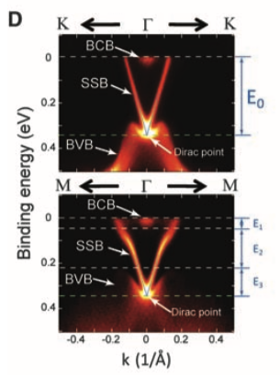
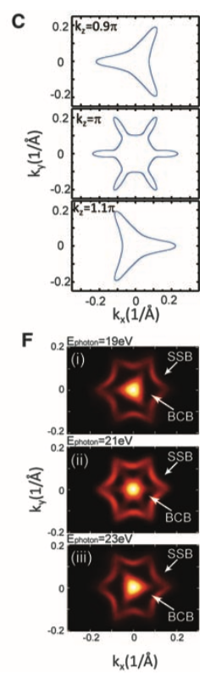
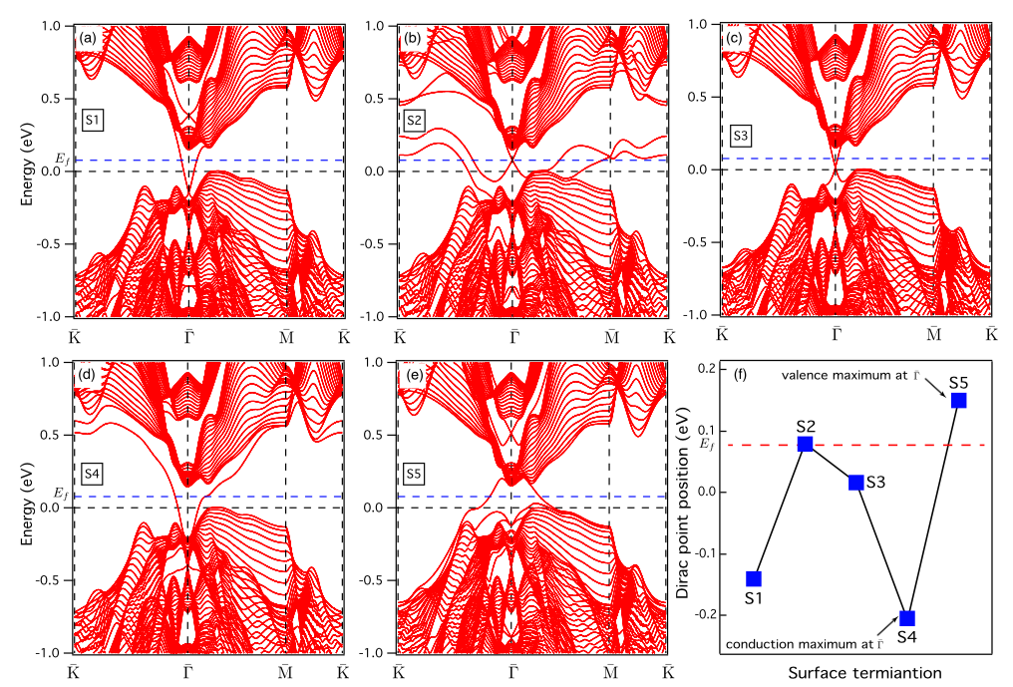
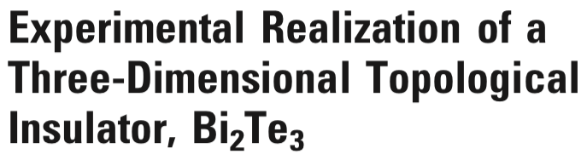
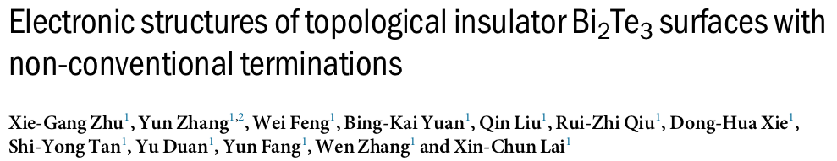
ARPES
ARPES: Angle Resolved-PhotoEmission-Spectroscopy
take photoemission spectra at different angles and find the energy of peaks → energy of electrons with certain k//
from Photoemission peaks to Band structure
Band structure and Fermi surface of Bi₂Te₃ measured with ARPES
From:
Band structure of Bi₂Te₃ calculated with surface states for various surface terminations
From:

Slide 5
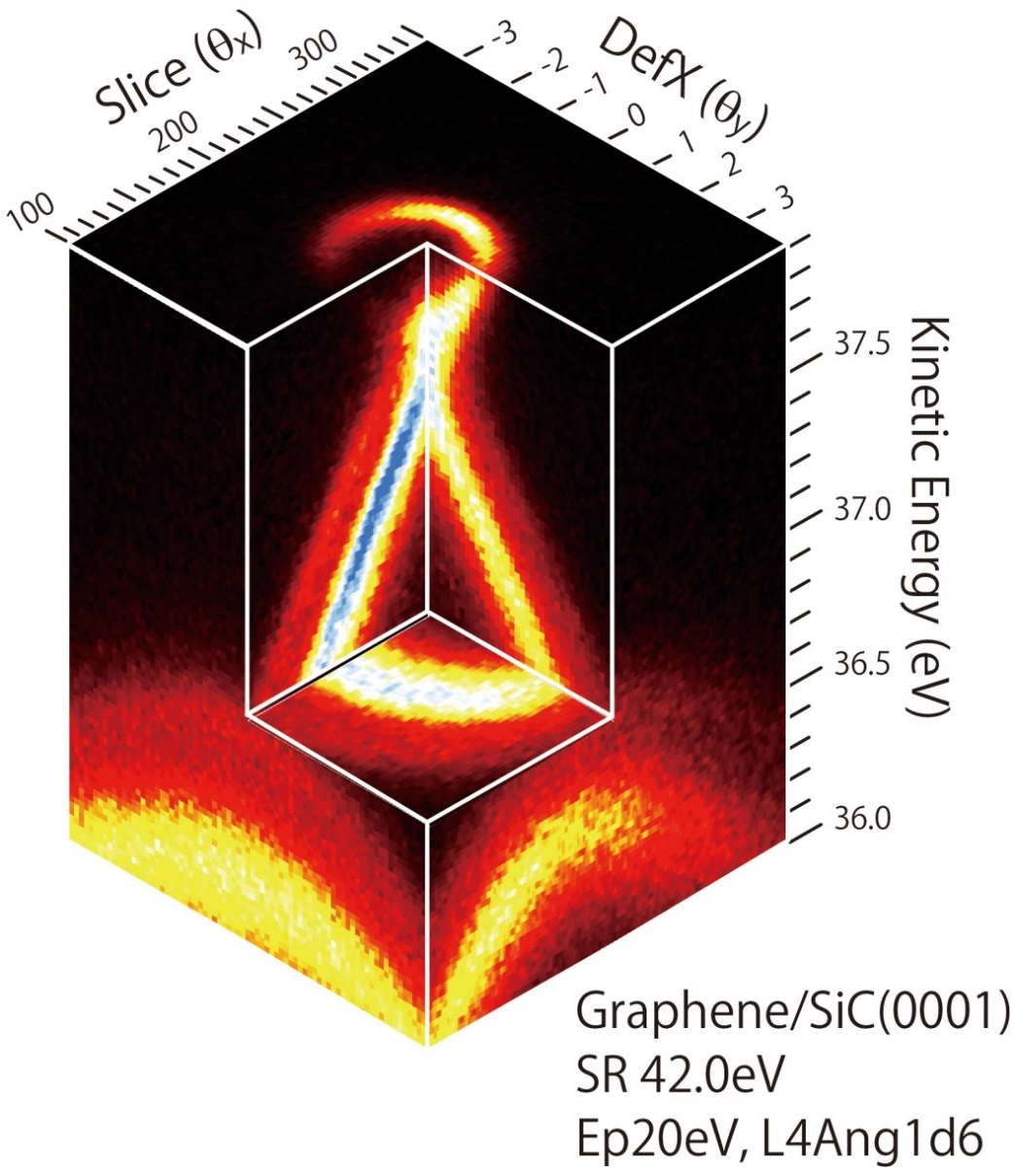
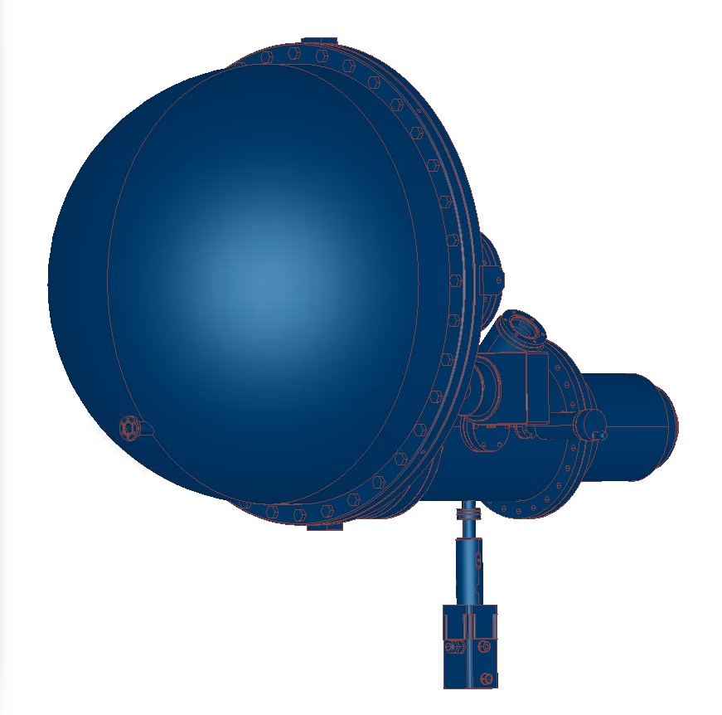
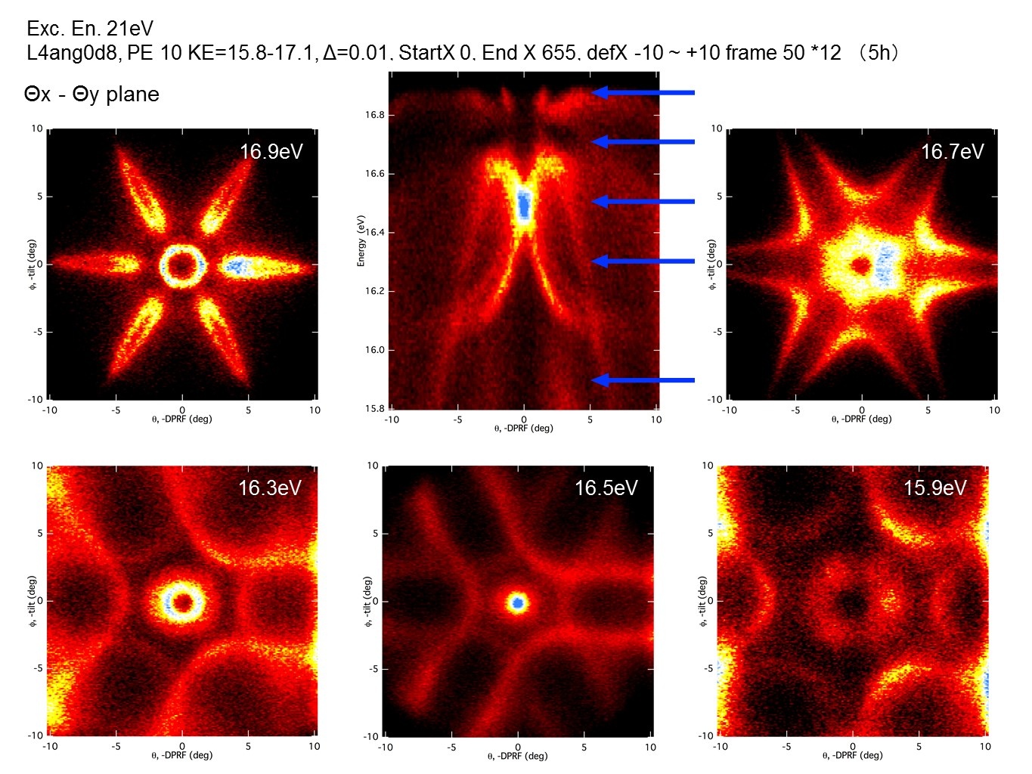
ARPES
ARPES: Angle Resolved-PhotoEmission-Spectroscopy
Detector (MCP)
e⁻
Sample
hν
Entrance Slit
from F. Bisti

Slide 6
The optical design of LOREA
Flux ~ 10¹² ph. @max resolution
Energy Range 10-1000eV with resolution > 10⁴
Beam spot of the order of 10µm

Slide 7

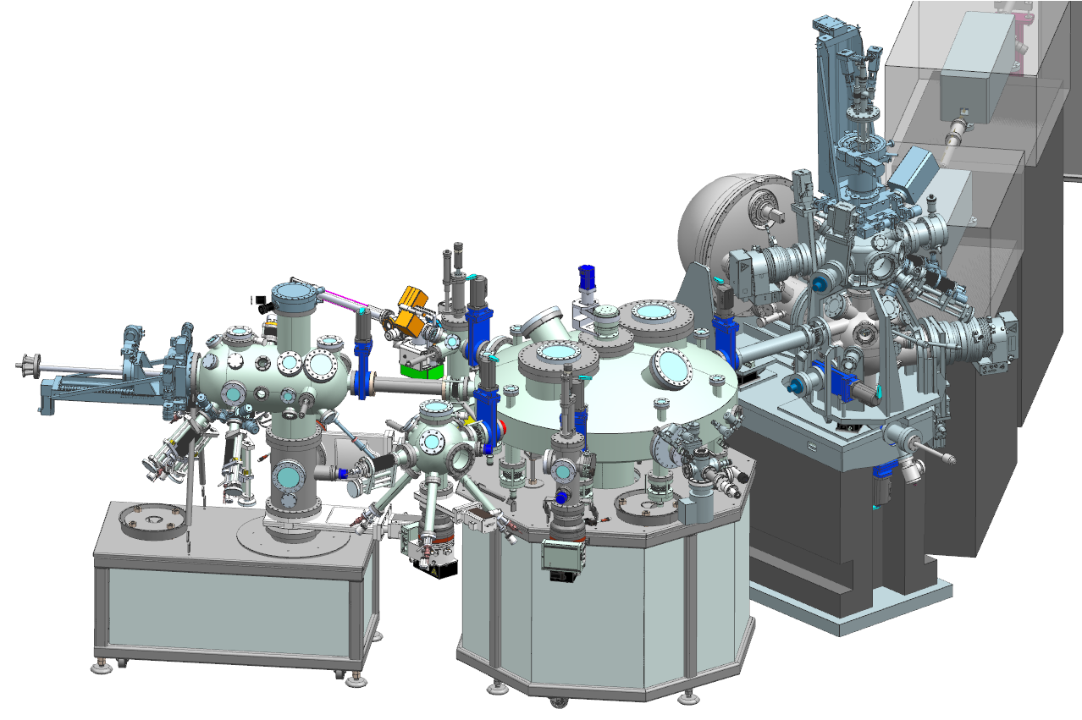
The end-station for LOREA
Specifications
Analyzer:
ΔE ~1 meV @ 20 eV.
Δθ < 0.1°
±3.5° ±7° ±15° 2D modes
MBS A-1_#0004@Saga University Synchrotron Light Application Centre
Bi (111) Data taken by Dr. M.Imamura, Prof. K. Takahashi

Slide 8
The end-station for LOREA
Aperture for spin detection
Magnetizing coil
O/Fe(100)
MCP
Sample
E_{kin}=6 eV
hν
Spin down
e⁻
Spin up
Upgrade to spin-resolved ARPES: VLEED seems the best option
Entrance Slit
MBS A-1_#0004@Saga University Synchrotron Light Application Centre
Bi (111) Data taken by Dr. M.Imamura, Prof. K. Takahashi
from F. Bisti

Slide 9
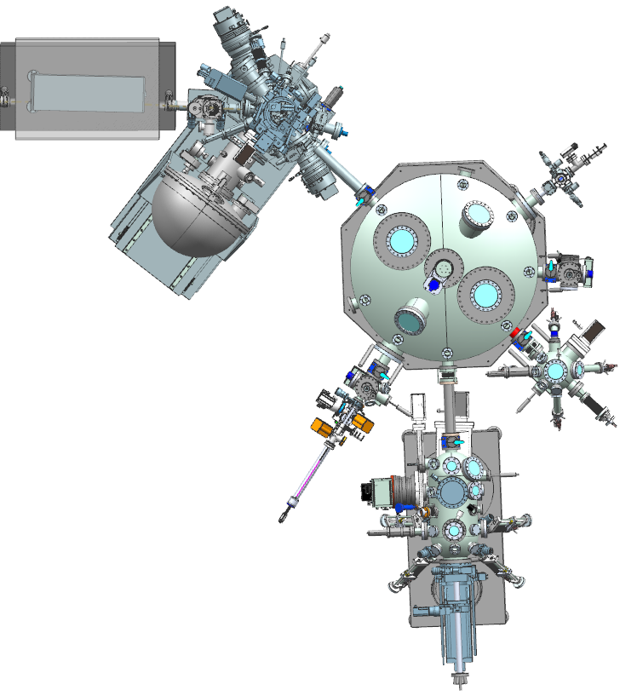
The end-station for LOREA
Photon beam
Atomic Layer Deposition
Load lock
Samples storage + UHV suitcase
Organic Molecules Chamber
Specifications
Analyzer: Manipulator:
ΔE ~1 meV @ 20 eV. 6-axes fully motorized
Δθ < 0.1° T < 10 K
±3.5° ±7° ±15° 2D modes Up to 4 electrical contacts
Preparation Chamber

Slide 10
Conclusions and acknowledgments
The new ARPES beamline at ALBA is on the way
A good opportunity for the Spanish ARPES community to grow and improve the technical capabilities
Low T, High resolution, wide energy range, 2D measurements, automatization, wide variety of sample preparation tools,…
This project is co-funded by the European Regional Development Fund (ERDF) within the Framework of the Smart Growth Operative Programme 2014-2020

Slide 11
Conclusions and acknowledgments
All ALBA staff for the technical support
Engineering Division: Alejandro Crisol (mechanical design of LOREA and Monochromator); Llibert Ribó (monochromator mirrors), Nahikari Gonzalez, and Joaquín González (NanoBender); Raquel Monge (Vacuum group), Marta Llonch (Alignment), Nuria Martí and Cristina Orozco (Infrastructures), Carles Colldelram, José Ferrer
Computing Division: Bernat Molas (Electronics), Fulvio Becheri (Control System), Jorge Villanueva (Protection Systems), Sergi Pusó (IT), Guifré Cuní, Toni Pérez, Oscar Matilla
Accelerator Division: Pep Campmany (ID), Jordi Marcos (FE), Montse Pont (installations), Francis Pérez
Administration: Vanesa Faro, Edgar Aigner
Jordi Prat, Debora Pierucci and Federico Bisti
Josep Nicolás (Optical design and Project Executive)
This project is co-funded by the European Regional Development Fund (ERDF) within the Framework of the Smart Growth Operative Programme 2014-2020

