Slide 1

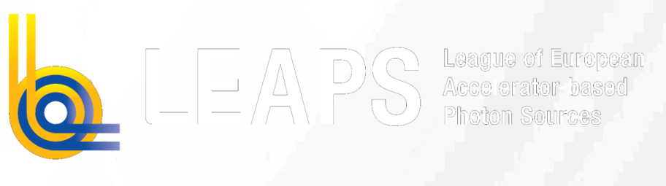
Report on
LEAPS Integrated Platform
Marco Calvi
LEAPS Plenary
21 Oct 2021

Slide 2

The LEAPS Integrated Platform
DiTARI
HORIZON-INFRA-2021-TECH-01-01
Digital Twinning:
  WP1: Technology Platform (EUXFEL, L. Gelisio)
  WP2: Source and Beams (PSI, M. Calvi)
  WP3: Modules for Photonic Instruments (ILL, P. Mutti)
Design activities and networking:
  WP4: Androids for Remote Access (DESY, R. Wanzenberg)
  WP5: Permanent Magnets, PerMaLIC (ALBA, F. Perez)
  WP6: The Fully Automated Beamline, FAB (DESY, H. Graafsma)
LEAPS Internal Project
HORIZON-INFRA-2021-TECH-01-01

Slide 3
The LEAPS Integrated Platform
DiTARI
HORIZON-INFRA-2021-TECH-01-01
Digital Twinning:
  WP1: Technology Platform (EUXFEL, L. Gelisio)
  WP2: Source and Beams (PSI, M. Calvi)
  WP3: Modules for Photonic Instruments (ILL, P. Mutti)
Design activities and networking:
  WP4: Androids for Remote Access (DESY, R. Wanzenberg)
  WP5: Permanent Magnets, PerMaLIC (ALBA, F. Perez)
  WP6: The Fully Automated Beamline, FAB (DESY, H. Graafsma)
LEAPS Internal Project

Slide 4
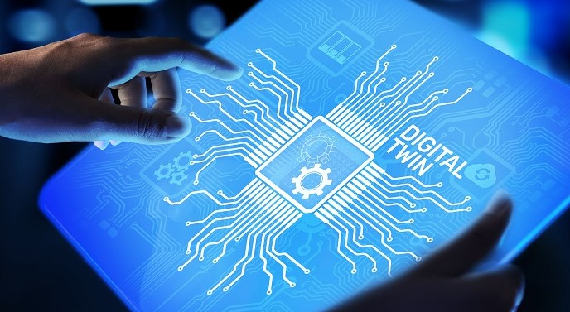
Digital Twinning
WP1. The Technology Platform
shall enable digital twinning to make preparation, execution and analysis of the experiments more effective leading to higher success rates

Slide 5
Digital Twinning
WP1. The Technology Platform
shall enable digital twinning to make preparation, execution and analysis of the experiments more effective leading to higher success rates:
It should be facility independent, i.e. easily portable to increase synergies among LEAPS members
Enhance robust operation of ARI facilities
Integrate AI to allow swift comparison of observational and simulated data during experiments in “real-time”
Establish it as a service in EOSC
Address and include new communities (expert & learning) by training and tutorial capability

Slide 6
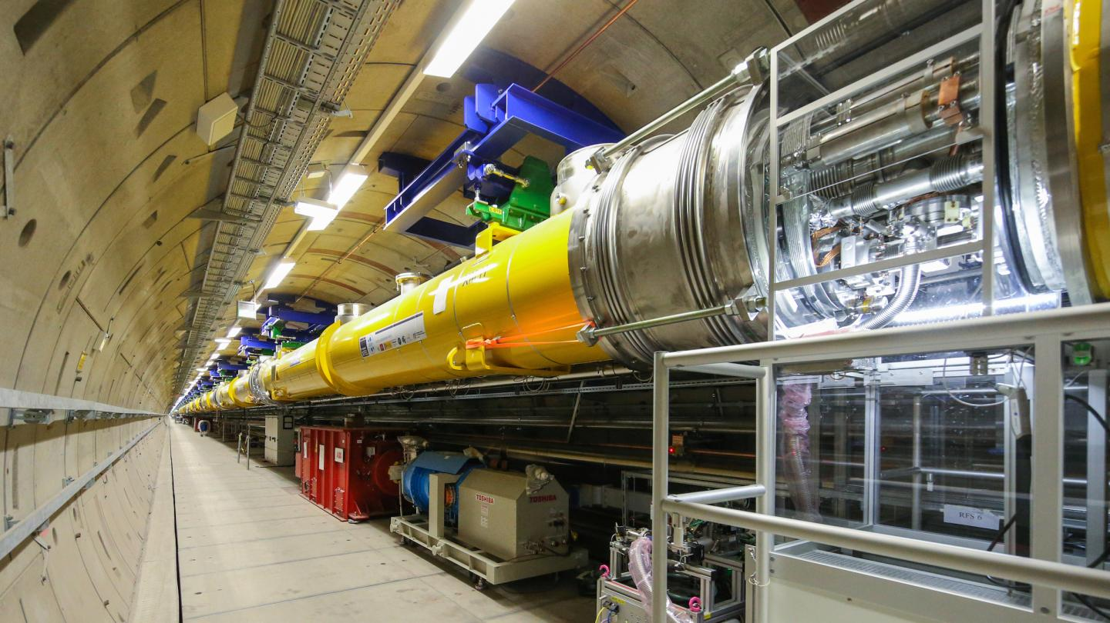
Courtesy of EuXFEL
Digital Twinning
WP2. Source and Beam Modules
will be integrated into the new Platform:
Simulation modules for charged particle beam dynamics (OCELOT, pyAT, Genesis 1.3)
Integration of ray-tracing and wavefront propagation software simulation of incoherent, resp. coherent probe beams (OASYS, WPG)
Machine Learning methods and optimisers
Virtual diagnostics ML based will extract and enhance information from conventional diagnostics to run specific experiments

Slide 7
Courtesy of PSI
Digital Twinning
WP2. Source and Beam Modules
will be integrated into the new Platform:
Simulation modules for charged particle beam dynamics (OCELOT, pyAT, Genesis 1.3)
Integration of ray-tracing and wavefront propagation software simulation of incoherent, resp. coherent probe beams (OASYS, WPG)
Machine Learning methods and optimisers
Virtual diagnostics ML based will extract and enhance information from conventional diagnostics to run specific experiments

Slide 8
Hanuka, Nature Scientific Reports 11, 2945 (2021)
Virtual Diagnostic: Machine-learning based diagnostics
Improve accelerator or more general beam diagnostics by using scalars or spectra to retrieve beam properties non-destructively and with higher resolution
Once trained such a system allows for quasi real-time feedback
much faster than a re-construction of real data.

Slide 9
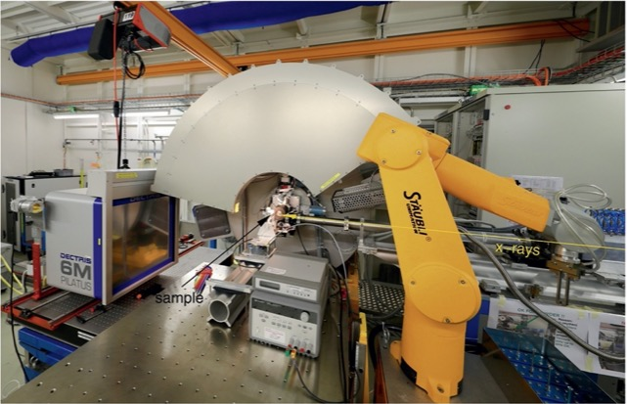
Digital Twinning
WP3. Modules for Photonic Instruments
Provide software modules for experiment simulations including instrument, beam-sample-interaction, scattering process and detector response
GUI to enhance researcher experience
Predict collisions between instrument moving parts during automatic data acquisition procedures
Improve data collection strategies: use ML to optimize data collection time, sample conditions, measurement directions, etc.

Slide 10
DiTARI Modules just a starting point
Digital Twinning

Slide 11
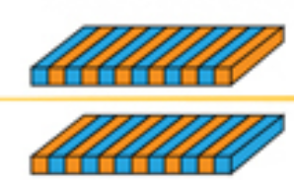
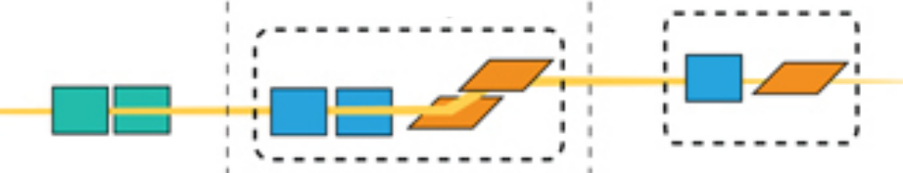

Digital Twinning
DiTARI Platform
EOSC
Cloud computing
Access to DiTARI as a service
Co-design/-creation of
DiTARI platform and
specific applications
Definitions
Interfaces
Data formats
AI methods /
ML tools
integration
Interface to EOSC services
Source
modules
Beam
modules
Instrument
modules
Sample
modules
Detector
modules
DiTARI Library
Executing communities
Experts in various science domains
Facility operators
Users of facilities
Contribution of existing
tools & know-how
DiT Examples
Modules
Documentation
DiT for experiment EXP
Training DiT
Perform
virtual experiments
Physical instrumentation
Control system 1
Control system 2
Operate facilities/instruments and perform experiments

Slide 12
Digital Twinning
The architecture and communication protocols of the DiTARI technology platform will be defined to implement and execute DiTs at various facilities with different underlying computing and experimental control infrastructures
The platform orchestrates software modules and channels data and metadata both among modules and bi-directionally with the control system
State-of-the-art event streaming platforms like Apache Kafka or time-series databases like InfluxDB will be employed
Through a clear and standardized definition of a DiTARI module, any existing software can become a module via interfaces based on existing APIs or from scratch with high-level I/O tools like openPMD-API
DiTARI data models will be built on standards based on already widely-adopted definitions such as openPMD and NeXus
Web-based graphical interface will be provided which permits a user-friendly interaction with the platform
Modern virtualization technologies, such as Singularity and Docker, will be used, thus ensuring smooth integration and exploitation of EOSC resources

Slide 13
The LEAPS Integrated Platform
Digital Twinning:
  WP1: Technology Platform (EUXFEL, L. Gelisio)
  WP2: Source and Beams (PSI, M. Calvi)
  WP3: Modules for Photonic Instruments (ILL, P. Mutti)
Design activities and networking:
  WP4: Androids for Remote Access (DESY, R. Wanzenberg)
  WP5: Permanent Magnets, PerMaLIC (ALBA, F. Perez)
  WP6: The Fully Automated Beamline, FAB (DESY, H. Graafsma)
LEAPS Internal Project

Slide 14
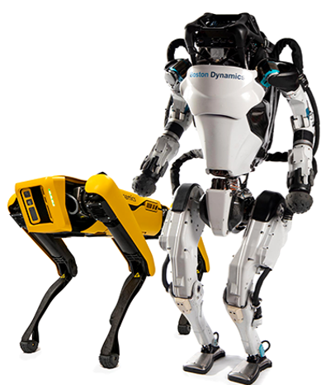
Design activities and networking
WP4. Androids for Remote Access
As androids can access parts of the facility normally forbidden to people due, e.g., to radiation hazards in accelerator bunkers, they can become the eyes and the hands of a human operator
Assessment of a commercially available androids within the accelerator environment
The performance of androids should be compared to less advanced robots
Example of commercially available androids from Boston Dynamics

Slide 15
Design activities and networking
WP4. Androids for Remote Access
As androids can access parts of the facility normally forbidden to people due, e.g., to radiation hazards in accelerator bunkers, they can become the eyes and the hands of a human operator
Assessment of a commercially available androids within the accelerator environment
The performance of androids should be compared to less advanced robots
MARWIN
Courtesy of André Dehne

Slide 16
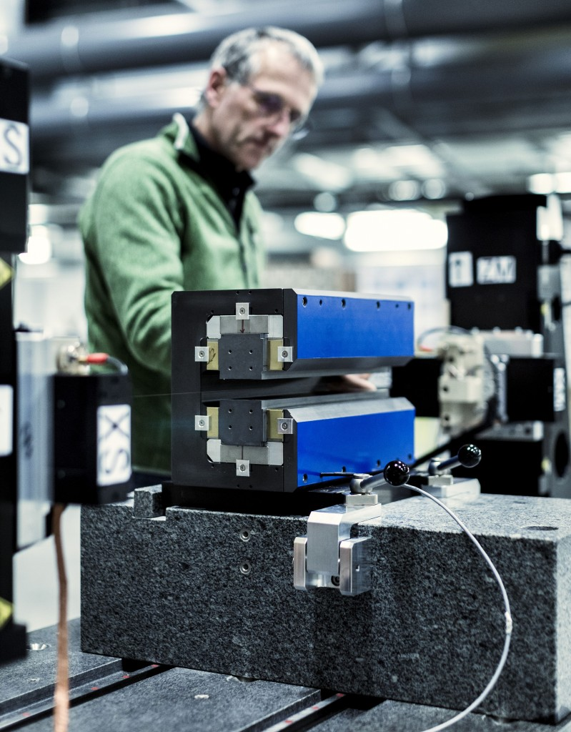
Courtesy of ESRF
Design activities and networking
WP5. Permanent Magnets LEAPS Internal Collaboration, PerMaLIC
The main goal is to help the transition of our SR based facilities to low consumption DLSR. Organization of annual face to face workshop and virtual seminars every two months. Research topics:
Tunability
Radiation damage
Temperature stability
M-Measurements of small aperture magnets
Recycling / Reusing *
*PM Market was USD 20 billion in 2015 expected to grow up to 50 billion in 2024, Report ID: GMI1113, Jan 2017

Slide 17
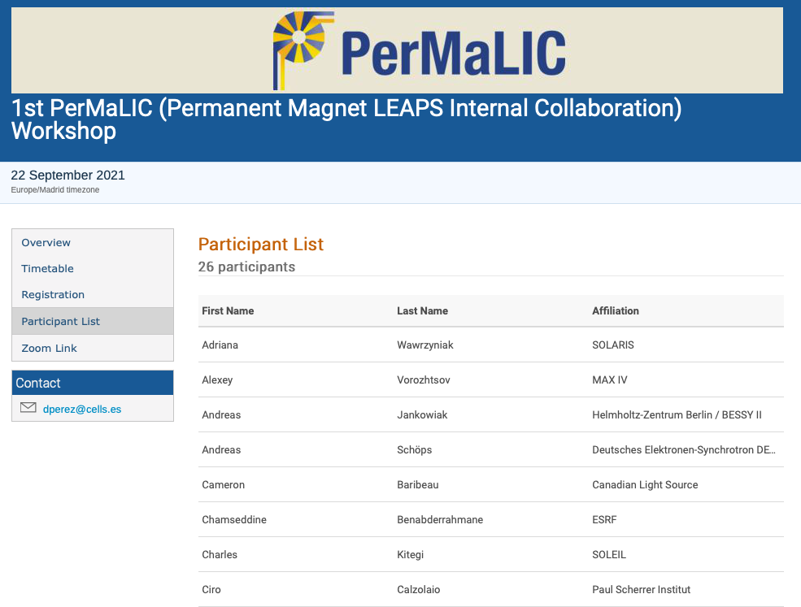
Design activities and networking

Slide 18
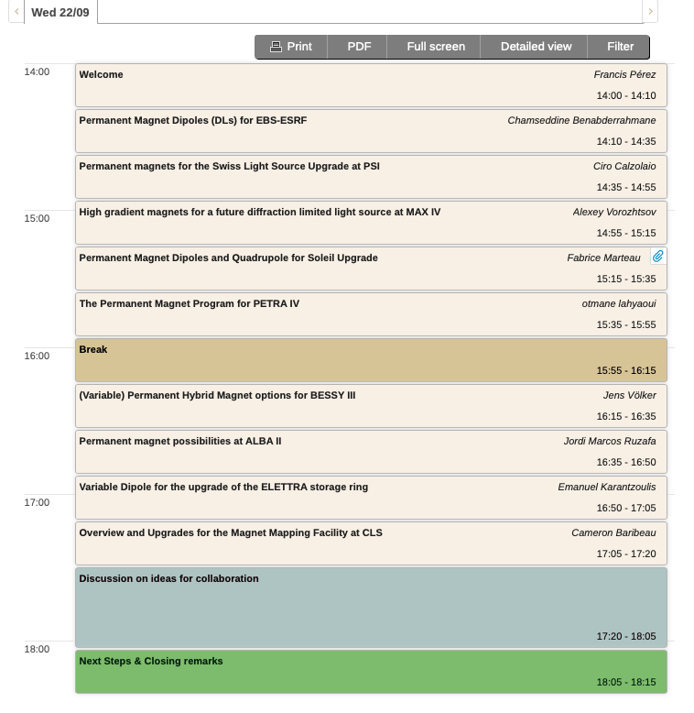

ESRF EBS Project realised
SLS2.0 Project approved
MAX IV Project under design
SOLEIL Project with CDR
PETRA IV Project with CDR
BESSY III Project under design
ALBA II Project under design
ELETTRA Project approved
CLS Project under design

Slide 19
Design activities and networking
WP6. The Fully Automated Beamline
A technical blueprint of a fully automated beamline will be developed
A series of workshops will be organised inviting LEAPS experts from different working groups
Focus on automation and fault tolerance of repetitive tasks like:
  beamline alignment, focus, sample alignment, fault tolerance, maintaining safe operation
  detector calibration, software configuration, parameter selection

Slide 20
Thanks for your attention!!
DiTARI
HORIZON-INFRA-2021-TECH-01-01
Digital Twinning:
  WP1: Technology Platform (EUXFEL, L. Gelisio)
  WP2: Source and Beams (PSI, M. Calvi)
  WP3: Modules for Photonic Instruments (ILL, P. Mutti)
Design activities and networking:
  WP4: Androids for Remote Access (DESY, R. Wanzenberg)
  WP5: Permanent Magnets, PerMaLIC (ALBA, F. Perez)
  WP6: The Fully Automated Beamline, FAB (DESY, H. Graafsma)
LEAPS Internal Project
HORIZON-INFRA-2021-TECH-01-01

