Slide 1
Welcome & Introduction to:
2D Materials and Synchrotron Radiation
By Klaus Attenkofer
12.4.2021

Slide 2
The Context: ALBA’s Mission
ALBA is currently providing robust highly productive user operation with a focus on:
  Health.
  Energy.
  Information technology.
ALBA’s mission is to support all national and international user communities but specifically provide the full service package in the three focus areas:
  To provide all synchrotron characterization tools to study structure and electronic states and their roles in the functions of materials and devices.
  Add additional characterization tools (mainly microscopic tools like Electron Microscopy) to reach atomic and subatomic resolution or add additional contrast mechanisms.
  Provide all sample preparation and computational tools necessary to enable the user to answer key questions and grand challenges of the field.
  And develop methodologies using multimodal approaches.

Slide 3
The Context: ALBA II
ALBA upgrade decision to a 4th generation synchrotron was granted in December 2021; the goal of the upgrade is:
  Bringing all facilities of ALBA to a modern, state-of-the-art standard guaranteeing stable and effective operation for the next 20-25 years.
  Significantly strengthening the microscopic capabilities.
  Providing high throughput capabilities and integrating big data approaches in the research portfolio.
  Strengthening the operando and in-situ capabilities.
Preliminary ALBA II timeline:
  Providing a scientific case and defining key parameters for the upgrade (including first additional instruments): January 2022.
  Preliminary design of accelerator complex and instrumentation: Mid 2022.
  Operation until 2028; large shutdown is currently planned for 2029 with commissioning and start of operation in 2030.

Slide 4
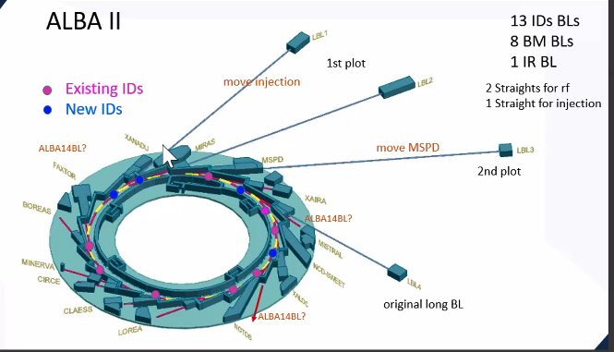
The Context: ALBA II at a Glance

Slide 5
The Context of the Workshops
The Section
Reviews
Workshops &
Colloquium
Call for
New Instruments
Goal:
  Mission verification.
  Strategy review.
  Gap Analysis.
  Service review.
Stakeholders:
  International experts.
  National user community representatives.
  SAC expert.
Goal:
  Identification of grand challenges.
  Identification of needs.
  Creating awareness in community.
  Organizing community.
Stakeholders:
  Spanish community.
  International experts.
  ALBA employees.
  AUSE.
Goal:
  Identification of instruments and services
  Grouping key-players around proposed instruments.
Stakeholders:
  Spanish and international community.
  ALBA employees.
  AUSE.

Slide 6
The Timeline

Slide 7
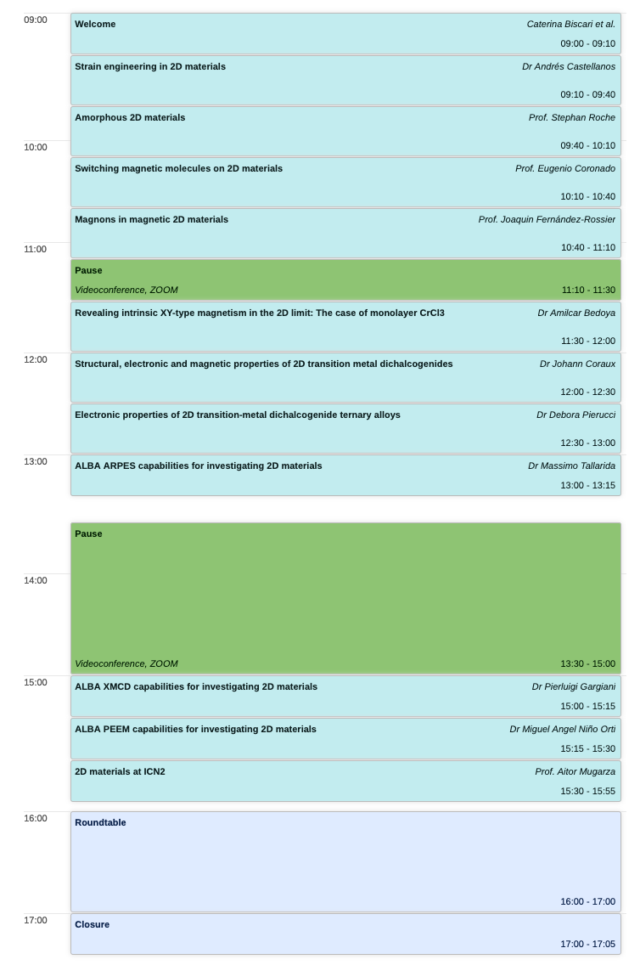
Our First Workshop:
2D Materials and Synchrotron Radiation
Structure of the workshop:
  Morning is dedicated to Grant Challenges.
  Afternoon will provide overview of existing tools and
  Giving everybody a voice in a round table discussion.
Goal of Round Table Discussion:
  Giving every participant a voice.
  Agreeing on grant challenges and
  Collecting first characterization(and other) needs.
  Defining final workshop report topics which will be used for the science case of ALBA II.

Slide 8
Questions and Answers
Any Questions or Suggestions?

