Slide 1
Life Sciences at ALBA
By Judith Juanhuix
17.12.2019
SAC29

Slide 2
Life Sciences: overview
XAIRA
MISTRAL
Molecular level
  XALOC – MX
  NCD-SWEET – SAXS/WAXS
  (XAIRA) – MX
  (CryoEM)
MIRAS
NCD-SWEET
Biolabs
FAXTOR
XALOC
Cellular level
  MISTRAL – soft X-ray microscopy
Tissue level
  MIRAS – IR
  (FAXTOR) – Hard X-ray microscopy
2
Notes:
Mention all external funding: Call, PI and Co-PI from Alba, funding period, what are we getting. On the side use a nice picture to show results from the work (highlight or from publication)
In the case of life science: use a second slide to explain the staffing and funding if applicable

Slide 3
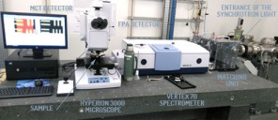
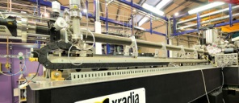
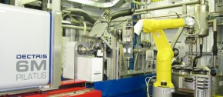
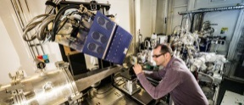
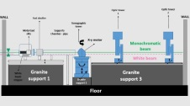
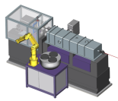
The people
Instruments:
Staff & Associate Staff:
Operating beamlines:
LBl Sci
Bl Sci
Bl Sci
PostD
PostD
Stud
BL Eng
Techn
Elec
Ctrl
FC
MIRAS:
Yousef, I. Kreuzer, M.
Ducic, T.
TBA
Ribó, L.
Prieto, F.
Alloza, D. Falcón, C.
Martínez, F.
MISTRAL:
Pereiro, E.
Pérez-Berná, A.
Sorrentino, A.
TBA
Groen, J.
Crisol, A. Valcárcel, R.
Ávila, J.
(TBA)
Oliete, R.
XALOC:
Boer, R.
Gil, F.
Carpena, X.
TBA
Crespo, I.
Álvarez, J.M.
Valcárcel, R.
Ávila, J.
Andreu, J.
De Diego, I
NCD:
Malfois, M.
Martínez, J.C.
Solano, E.
TBA
Prieto, M.
Farré, F.
Serra, X.
Jové, G.
Martínez, F.
MIRAS
MISTRAL
IR spectroscopy
and microscopy-BL
Soft X-ray
microscopy-BL
XALOC
NCD
MX-BL
WAXS/(GI)SAXS-BL
Under construction:
Lab infrastructure:
LBS
BS
BL Eng
Techn
Elec
Ctrl
FAXTOR:
Mittone, A.
Ribó, L.
XAIRA:
Juanhuix, J.
Garriga, D.
TBA
González, N.
(Valcárcel, R.)
Molas, B.
Andreu, J.
FAXTOR
XAIRA
Bio lab (Sacristán, A)
Mammalian cell lab
P2 level lab
Tomography-BL
Microfocus MX-BL
Notes:
Explain all resources you have:
Instruments:
Operating beamlines, beamlines in construction, labs
Staff and Associate staff:
List to all beamlines the full staff.
Lead beamline scientist is in cursive labeled (LBS)
Beamline scientist (BS)
Postdoc (PD), black if fully funded by Alba, purple if partially or fully funded by others
Students also in purple
All matrixed people in blue
You may also mention collaborators if they play a big role; use red for them
Mention all external funding: Call, PI and Co-PI from Alba, funding period, what are we getting
In the case of life science: use a second slide tho explain the staffing and funding if applicable

Slide 4
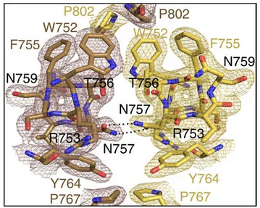
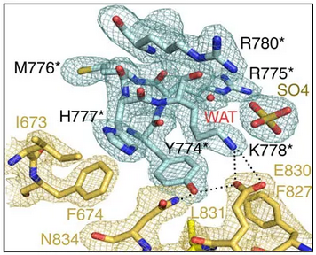
XALOC – Macromolecular crystallography:
A new key target for the treatment of prostate cancer
Androgen receptor (AR) plays a crucial role in development and metabolism as well as in diverse pathologies such as androgen insensitivity syndromes, male infertility and prostate cancer.
Dimerization through Ligand Binding Domain was controversial
The structure of the human AR-LBD homodimer bound to dihydrotestosterone explains dimerization
Also AR-LBD dimer has been solved by FRET in vivo.
Explains 40 point mutations responsible of either androgen insensitivity syndromes and/or prostate cancer
Small molecules that may interfere with AR dimerization could be potentially useful for PCa treatment
Details of interdomain interactions
M Nadal et al. Structure of the homodimeric androgen receptor ligand-binding domain. Nat. Comm. 8:14388 (2017)
Notes:
Depending on the size of the section you may choose more; however, I would only use the picture and a few main bullets;
I would say only life science should have 2 slides.
Remember that most of the people don’t care about the details but they want to get an overview and understand for what your section stands.

Slide 5
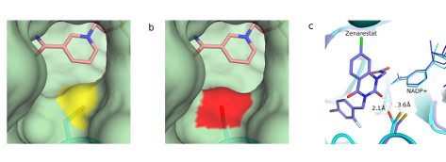
XALOC – Macromolecular crystallography:
Why some diabetes drugs are not effective
Aldose reductase (hAR) is key in diabetes complications and has been explored as a drug target since the 1980. But drugs were not effective
Irradiation simulating oxidative stress showed that there is one conformational change (mutation) in hAR (Cys298Ser)
New drugs must be designed using the irradiated form and not the native form, as done in recombinant techniques
A.Castellví et al. Efficacy of aldose reductase inhibitors is affected by oxidative stress induced under X-ray irradiation.. Scientific Reports (2019) 9, 3177
Notes:
Depending on the size of the section you may choose more; however, I would only use the picture and a few main bullets;
I would say only life science should have 2 slides.
Remember that most of the people don’t care about the details but they want to get an overview and understand for what your section stands.

Slide 6
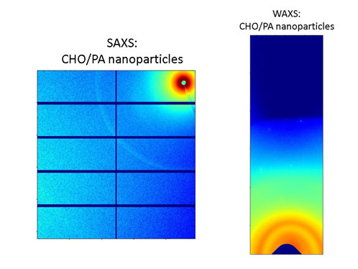
NCD-SWEET:
New biocompatible nanoparticles for breast cancer theraphy
Dasatinibhas is an excellent potential candidate for breast cancer therapy, but solubility is extremely low
A polymeric nanoparticle is being developed for a sustained and controlled delivery of the drug
The polymer maintains its properties when forming the nanoparticles and is biodegradable, non-toxic and blood compatible.
Enrique Niza et al. Poly(Cyclohexene Phthalate) Nanoparticles for Controlled Dasatinib Delivery in Breast Cancer Therapy. Nanomaterials 2019, 9, 1208. DOI: 10.3390/nano9091208.
Notes:
Depending on the size of the section you may choose more; however, I would only use the picture and a few main bullets;
I would say only life science should have 2 slides.
Remember that most of the people don’t care about the details but they want to get an overview and understand for what your section stands.

Slide 7
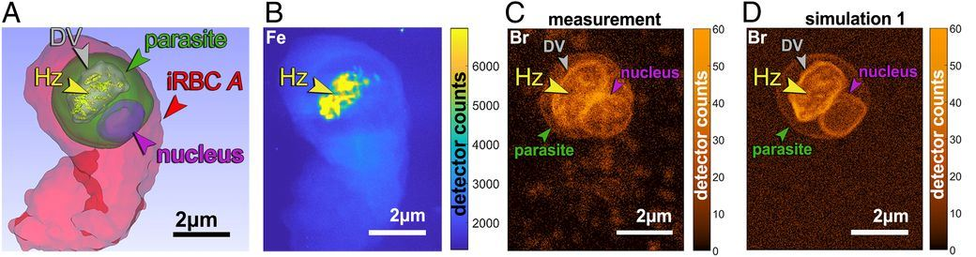
MISTRAL - Full-field transmission X-ray microscopy
Unveiling the mechanism of most commonly used antimalarial drugs in near-native conditions
Quinoline-family anti-malarian drugs are effective, but mechanism was unknown
MISTRAL imaged whole cell samples in their native state, locating active centers of the drug.
By μ-fluorescence the bromoquine was located, so mechanism was found
These results show a model that can be generalized to all quinoline drugs, such as quinine.
Sergey Kapishnikov, et al. Mode of action of quinoline antimalarial drugs in red blood cells infected by Plasmodium falciparum revealed in vivo. PNAS (2019). DOI: 1910123116.
Notes:
Depending on the size of the section you may choose more; however, I would only use the picture and a few main bullets;
I would say only life science should have 2 slides.
Remember that most of the people don’t care about the details but they want to get an overview and understand for what your section stands.

Slide 8
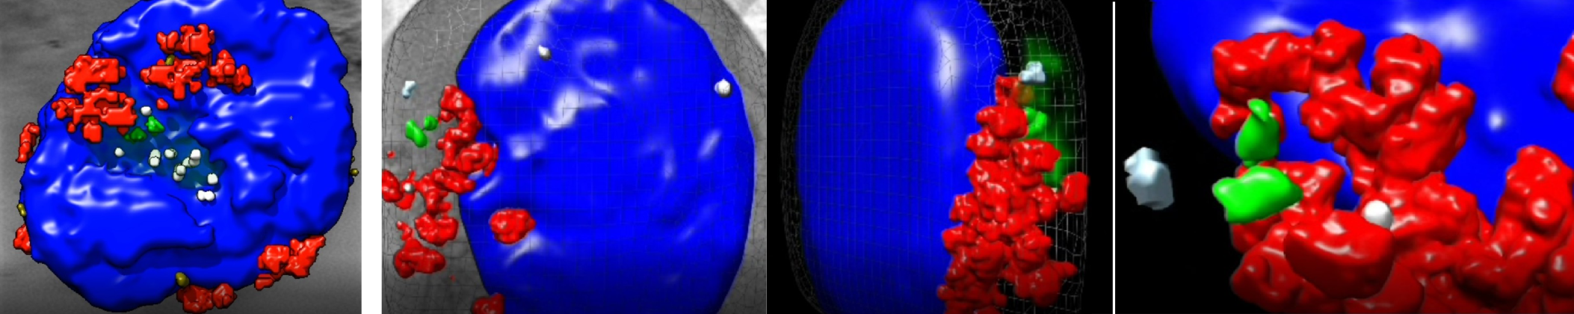
MISTRAL - Full-field transmission X-ray microscopy
Key factor of the immune response intensity identified
The antigen-presenting cells activate T-lymphocites via a structure called immune synapse, which determines the intensity of the inmune response
The immune response requires the reorganization of the cytoskeleton and the centrosome.
The cytosolic chaperonin CCT is found to control the changes involved in the centrosome and mitochondria distribution through the regulation of production of cytoskeletal elements such as α - and β-tubulin
The door is open to design of new strategies aimed at blocking CCT as a therapy against autoimmune processes that occur with hyperactivation of lymphoid cells.
3D reconstruction of an unstimulated lymphocyte. Blue, reconstructed volume of the nucleus; red, mitochondria; green, the two centrioles of the centrosome surrounded by many proteins and, among them, the chaperonin CCT. Right: reconstruction of a lymphocyte forming an immune synapse
N.B. Martín-Cofreces et al. The chaperonin CCT controls T cell receptor-driven 3D configuration of centrioles. Science Advances (6), 49.
Notes:
Depending on the size of the section you may choose more; however, I would only use the picture and a few main bullets;
I would say only life science should have 2 slides.
Remember that most of the people don’t care about the details but they want to get an overview and understand for what your section stands.

Slide 9
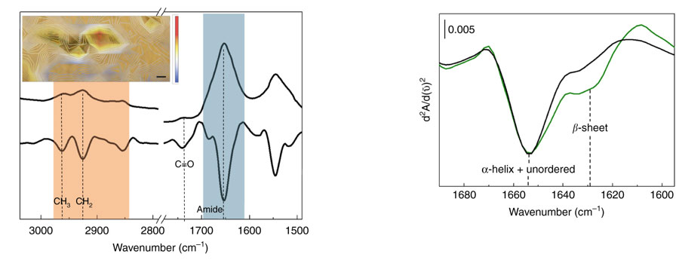
MIRAS - IR spectroscopy and microscopy
A new muscular disease: Myoglobinopathy
New muscular disease caused by a mutation in the myoglobin gene discovered
It has been observed that sarcoplasmic bodies correspond to oxidized lipids and misfolded proteins
Causes a progressive weakness of the axial and limb muscles, later affects the respiratory musculature and the heart
Allows the diagnosis for some patients after many years and will allow researchers to focus on finding a cure.
Optical image of a tissue section with sarcoplasmic bodies. The color bar represents intensity of the ratio: blue and red mean low and high lipid content, respectively
4 μm
Protein aggregation
Olivé M et al. Myoglobinopathy is an adult-onset autosomal dominant myopathy with characteristic sarcoplasmic inclusions. Nature Comm, 2019.
Notes:
Depending on the size of the section you may choose more; however, I would only use the picture and a few main bullets;
I would say only life science should have 2 slides.
Remember that most of the people don’t care about the details but they want to get an overview and understand for what your section stands.

Slide 10
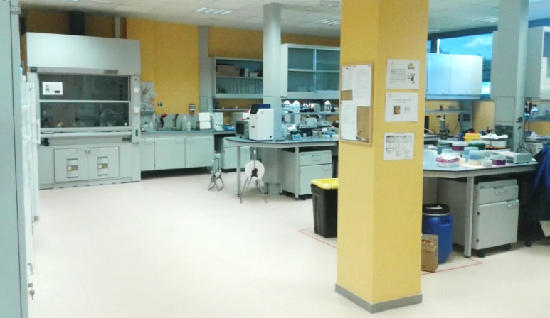
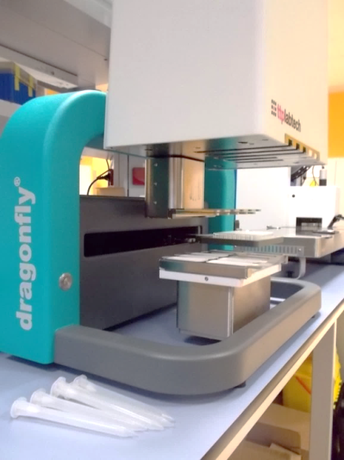
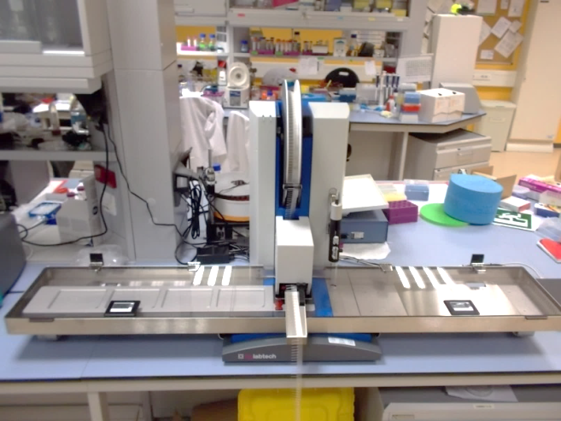
Facilities:
Close-by labs for in-situ preparation
225 m2 of biolab space
Mammalian cell lab
Biosafety level 2 lab
Large cold room @4C
Crystallization service available
In-situ preparation on demand
Dragonfly for setting up optimizations
Mosquito LCP for general screening
Notes:
Mention all external funding: Call, PI and Co-PI from Alba, funding period, what are we getting. On the side use a nice picture to show results from the work (highlight or from publication)
In the case of life science: use a second slide to explain the staffing and funding if applicable

Slide 11
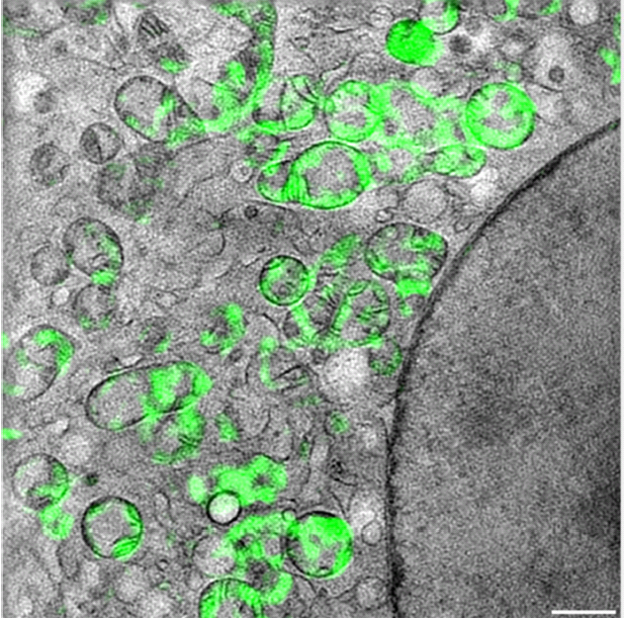
Next to come:
Correlative microscopy to couple with MISTRAL
Cryo EM
New BEAMLINES
Development a SIM working at cryogenic temperatures (E Pereiro)
Allows 3D correlation between cryo-SIM and cryo-SXT on the same cell to locate specific structures, molecules or events in the cellular landscape
CryoEM microscope to be installed in 2021
Thermofisher Glacios 200kV, with Falcon 4 detector
Sample preparation
1 µm
cryo-SIM: 120nm lateral res & 240nm in depth
cryo-SXT: 40-50 nm in 3D volumes
New biosciences beamlines in construction
XAIRA: micro-MX, serial-MX
FAXTOR: Hard x-ray microscopy
Notes:
Mention all external funding: Call, PI and Co-PI from Alba, funding period, what are we getting. On the side use a nice picture to show results from the work (highlight or from publication)
In the case of life science: use a second slide to explain the staffing and funding if applicable

Slide 12
Life Sciences: overview
XAIRA
MISTRAL
Molecular level
  XALOC – MX
  NCD-SWEET – SAXS/WAXS
  (XAIRA) – MX
  (CryoEM)
MIRAS
NCD-SWEET
Biolabs
FAXTOR
XALOC
Cellular level
  MISTRAL – soft X-ray microscopy
Tissue level
  MIRAS – IR
  (FAXTOR) – Hard X-ray microscopy
12
Notes:
Mention all external funding: Call, PI and Co-PI from Alba, funding period, what are we getting. On the side use a nice picture to show results from the work (highlight or from publication)
In the case of life science: use a second slide to explain the staffing and funding if applicable

