Slide 1


Status Report and Planned Activities for 2021
SGs and WGs spokespersons
24 November 2020

Slide 2
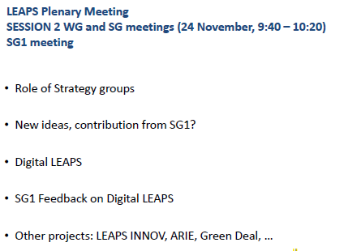
SG1 Storage Rings/ Synchrotron
SG1
Notes:
RIPATHS pilot: arising from experiments carried out at ALBA and the pathways by which these impacts materialise

Slide 3
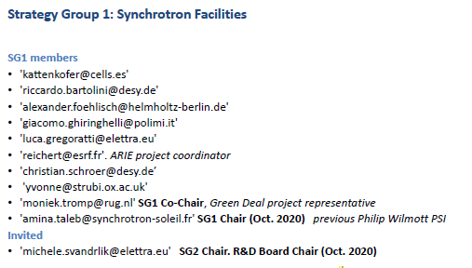
SG1 Storage Rings/ Synchrotron
SG1
Notes:
RIPATHS pilot: arising from experiments carried out at ALBA and the pathways by which these impacts materialise

Slide 4
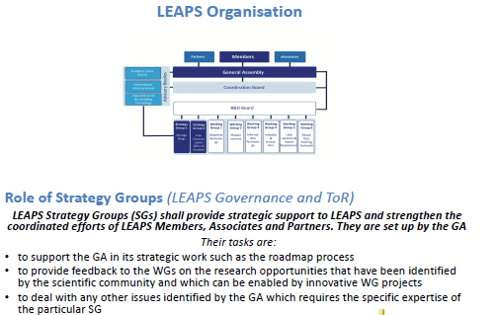
SG1 Storage Rings/ Synchrotron
SG1
Notes:
RIPATHS pilot: arising from experiments carried out at ALBA and the pathways by which these impacts materialise

Slide 5
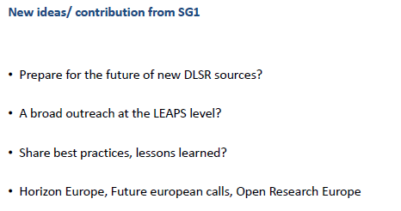
SG1 Storage Rings/ Synchrotron
SG1
Notes:
RIPATHS pilot: arising from experiments carried out at ALBA and the pathways by which these impacts materialise

Slide 6
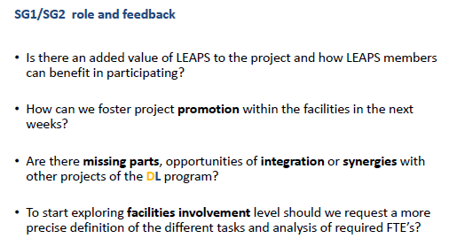
SG1 Storage Rings/ Synchrotron
SG1
Notes:
RIPATHS pilot: arising from experiments carried out at ALBA and the pathways by which these impacts materialise

Slide 7
SG2 Free Electron Lasers - STATUS
SG2
Contribution to LEAPS Position Paper on HE Missions
Involvement in the Green Deal Task Force
e.g. suggestion of beamlines at LEAPS FEL facilities that could be part of the project
Involvement in the R&D Board
(with spokesperson and 2 co-spokespersons)
Ideas for Internal Projects proposed to R&D Board
included in DL document section 2
Proposal for a Photonic Diagnostics WG
aiming at initiating joint activities between the FELs and SR sources in the areas of photon diagnostics and machine learning application focusing on the special requirements of non-invasive diagnostics tools.
Regular interaction with SG1
Notes:
RIPATHS pilot: arising from experiments carried out at ALBA and the pathways by which these impacts materialise

Slide 8
SG2 Free Electron Lasers – PERSPECTIVES 2021
SG2
Further elaborate ideas for strategic internal projects, starting from DL section 2, but not limiting ourselves to them
  Studies and developments towards full coherent FEL radiation, e.g. jointly explore the ideas and benchmark possibilities given by seeding and self-seeding to achieve a strong development of the techniques
  Further developments for X-ray FELs towards shorter pulses and harder photon energies
  could be relevant for the Advanced Materials DL strategic Element
Contribute to discussion on support base for (internal) LEAPS projects
  dissemination, promotion, concepts of implementation
Notes:
RIPATHS pilot: arising from experiments carried out at ALBA and the pathways by which these impacts materialise

Slide 9
SG2 Free Electron Lasers – PERSPECTIVES 2021
SG2
Scientific Webinars
  Starting from the positive feedback received for the tutorials at the Science@FELs conference 2020, we intend to organize in 2021, together with FELs OF EUROPE, a series of Webinars on Scientific Highlights from the FEL community.
Document repository for SG2
  central point of information (useful for all WGs/SGs?)
  via the official LEAPS cloud?
The community starts to find SG2
  Visibility of SGs on the official LEAPS website
Notes:
RIPATHS pilot: arising from experiments carried out at ALBA and the pathways by which these impacts materialise

Slide 10
WG1.1 – Beamline Technologies - Detectors
WG1.1
Notes:
RIPATHS pilot: arising from experiments carried out at ALBA and the pathways by which these impacts materialise

Slide 11
WG1.2 Optics and Beamline Instrumentation
WG1.2
COVID epidemic has significantly affected the general activities of the WG this year – no face-to-face meetings and few meetings of whole group.
Joint Activities 2020
  Inventory of existing collaborations relevant to WG activities
  DIGITAL LEAPS discussion
  Execution of ongoing projects
    CALIPSOplus: JRA1 - MooNpics (Metrology developments for nanometre scale optics)
    NFFA: JRA1,2,4 – X-ray Optics related activities
  LEAPS Innov Proposal Preparation
    Superflat – Driving improvements in production of high performance X-ray mirrors
    NeXtgrating – Exploring new methods for X-ray diffraction grating fabrication
  NEP Proposal Preparation
    X-Ray Wavefront Metrology, Correction and Manipulation for Nanoscience
Notes:
RIPATHS pilot: arising from experiments carried out at ALBA and the pathways by which these impacts materialise

Slide 12
WG1.2 Optics and Beamline Instrumentation
WG1.2
Plans for 2021
  Execution phase of LEAPS Innov WPs (NeXtgrating and Superflat) and NEP WP will mobilise significant in-kind resources
  Pre-kick off meetings for both projects in early 2021
  More regular WG1.2 meetings in video-conferencing.
Digital Leaps
  Reference Design for a Fully Automated Beamline:
    Particular role for WG1.2 in design and implementation of automatic beamline alignment/beam-stabilisation. Builds upon existing initiatives at several facilities
Notes:
RIPATHS pilot: arising from experiments carried out at ALBA and the pathways by which these impacts materialise

Slide 13
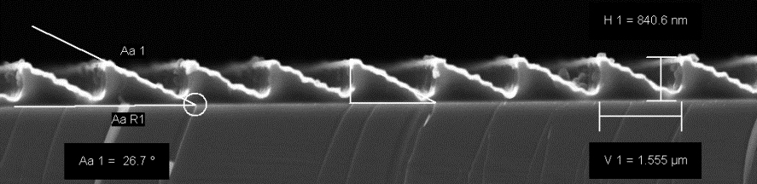
WG1.3 Experiment Environment
WG1.3
LEAPS-INNOV
Finalization of the WP5 “New positioning and scanning systems for speed and accuracy”
Tasks 5.1 and 5.2 closer communication and collaboration with industrial partners
Preparation of the project phase
Database for Experiment Environment Information
Several virtual meetings
Feedbacks from the different facilities on the database structure
Now resources needed (digital LEAPS / STARS ?)
SEM micrographs of an e-beam exposed blazed PMMA grating structure.
Notes:
RIPATHS pilot: arising from experiments carried out at ALBA and the pathways by which these impacts materialise

Slide 14
WG1.3 Experiment Environment
WG1.3
LEAPS-INNOV
Pre-project phase starting January 2021
Establish mechanisms for regular exchange
Kick-off April 2021
Workshops for tasks 5.3, 5.4
Work on deliverables
Milestone MS5.1 (M6) „Target specification for magnetic levitation stage and online metrology system“
Database for Experiment Environment Information
Refinement of the concept
Changes to WayForLight database? Resources? STARS?
Digital LEAPS
STARS, fully automated user beamline
Notes:
RIPATHS pilot: arising from experiments carried out at ALBA and the pathways by which these impacts materialise

Slide 15
WG2 Photon Sources
WG2
Notes:
RIPATHS pilot: arising from experiments carried out at ALBA and the pathways by which these impacts materialise

Slide 16
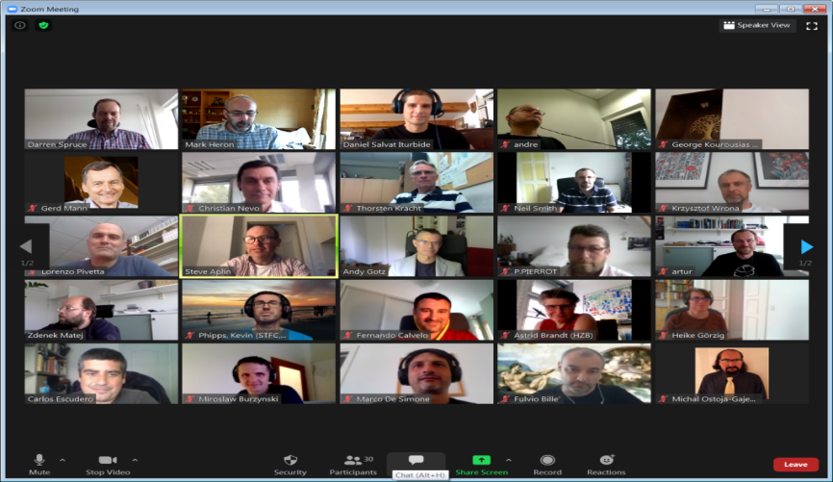


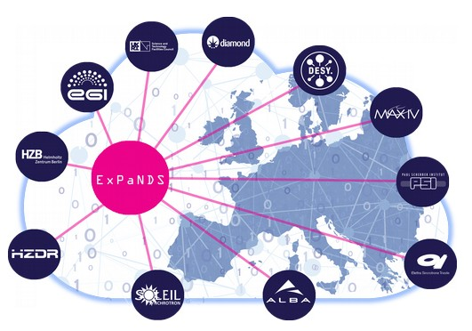
WG3 – Data management and software- STATUS
WG3
LEAPS IT WG3 Executive
  Mark Heron – Diamond
  Daniel Salvat – Alba
  Darren Spruce – MaxIV
  Gerd Mann – PSI
  Lorenzo Pivetta – Elettra
Work Group activities
  Technical meeting June “IT Solutions to address Operational Challenges during COVID-19”
  CALIPSO+ JRA2
  PaNOSC
  ExPaNDS
Up and running
Delivering developments
Successful Collaborations
Notes:
RIPATHS pilot: arising from experiments carried out at ALBA and the pathways by which these impacts materialise

Slide 17
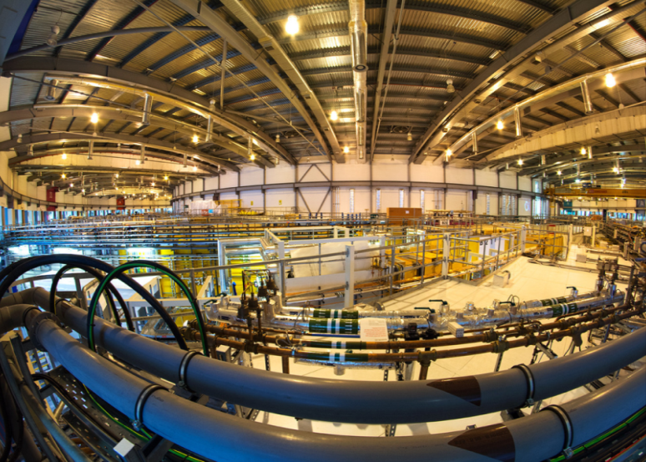
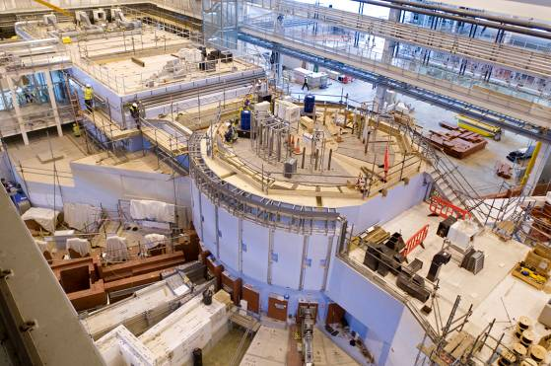
WG3 – Data management and software – FUTURE ACTIVITIES
Diamond Light Source
WG3
Continue current activities
  Technical meetings, and CALIPSO+ JRA2, PaNOSC, ExPaNDS
Innovation WP7 Data Compression
Digital LEAPS
  Involved in nearly all the proposals
Data tsunami has not gone away
  Upgrade of facilities: ESRF, Petra, Soleil, SLS, Diamond, Elettra
  Increase brightness and coherence
  New detectors coming online
  Drive data rates, volumes and complexity
  Data processing is more and more demanding in terms of computing and software
  There is no, or little, new money
  We need to work together
We will explore establishing a LEAPS IT “Collaboration Forum”
  Move from “Talking Together” to “Working Together”
  Objective is to stimulate interest for new self funded collaborations
  Establish LENS-LEAPS partnership on Software and Computing
  Build on the history of Photon and Neutron facilities working together in software and computing
ISIS Neutron Source
Notes:
RIPATHS pilot: arising from experiments carried out at ALBA and the pathways by which these impacts materialise

Slide 18


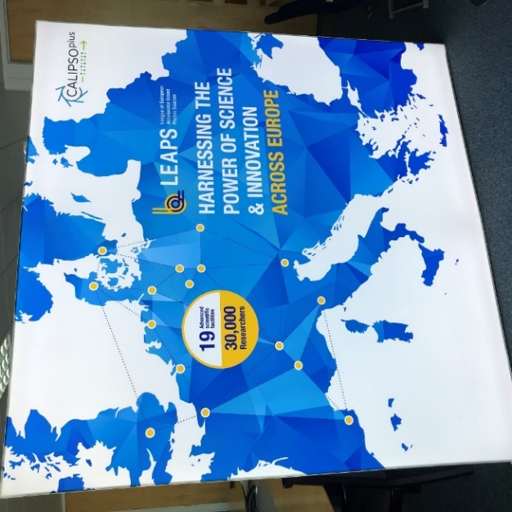
WG4 – Industry and Innovation
WG4
LEAPS WG4 2021 activities: CALIPSOplus final 12 months
WP22: SME Access Tamata
  Focus to foster SME applications
WP4: ELSIIplus industry networking
  Task 4.1: Virtual industry office network meeting Spring 2021
  Task 4.4.1: Position paper or policy brief on how governments and stakeholders could support access to and structuring of light sources for industry
  Task 4.4.2: “High level” industry event. Focus the final year activities upon BSBF2021 (28 Sept - 1 Oct 2021:
    Task 4.1: Final CALIPSOplus light sources industry office networking face-to-face
    Task 4.4.2: CALIPSOplus funded booth at BSBF2021 (branded CALIPSOplus/LEAPS)
    Task 4.4.2: Potential CALIPSOplus sponsored activity (e.g. Market Place) at BSBF2021 (branded CALIPSOplus/LEAPS)
Notes:
RIPATHS pilot: arising from experiments carried out at ALBA and the pathways by which these impacts materialise

Slide 19
WG4 – Industry and Innovation
WG4
LEAPS WG4 2021 Activities: LEAPS INNOV Pilot Activities
8.1
8. 2
8. 3
Light Source Exploitation
Boost Innovation in European SMEs
Bridging Towards Industry as Technology Collaborators
Call for IPR training launched
Industry engagement teams established in collaboration with technology WPs
Extension and widening of the TAMATA activity which ran under CALIPSOplus
SME selection panel established
First call issued
Joint presentation at BSBF 2021 with CALIPSOplus
Innovation Mall (Digital LEAPS) could be discussed with other innovation pilots (AIDA & IFAST)
Survey of European industry to be drafted
Notes:
RIPATHS pilot: arising from experiments carried out at ALBA and the pathways by which these impacts materialise

Slide 20
WG5 – User service and impact -1
WG5
Status report
Impact assessment and LEAPS metrics
Workshops organised within the RI-PATHS H2020 project
Pilot on the innovation impacts → shared through the Coordination Board
Metrics for LEAPS - last survey in 2019, completed early 2020
Sample Environment database - work together with WG1.3
170 environment setups from 11 facilities
List of required changes to the database
Notes:
RIPATHS pilot: arising from experiments carried out at ALBA and the pathways by which these impacts materialise

Slide 21
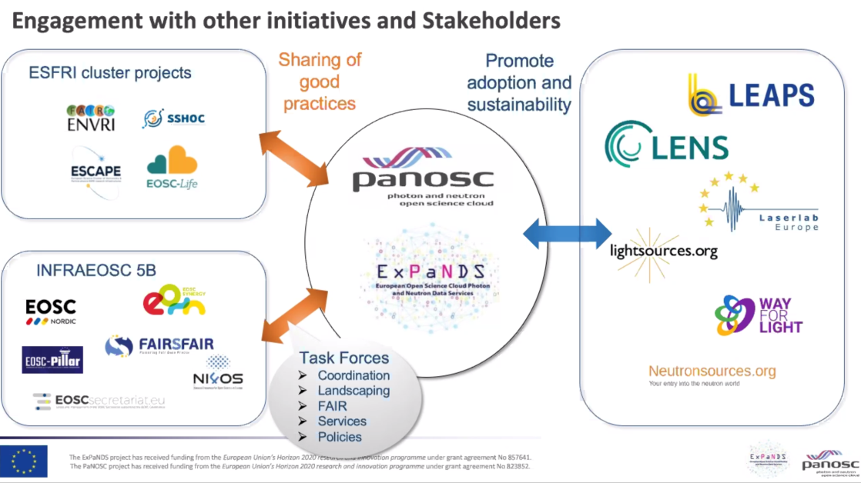
WG5 – User service and impact - 2
WG5
Status report
Wayforlight: looking for sustainability
Bridge from CALIPSOplus to LEASP…to ARIE
Exploring compatibility with
  CatRIS catalogue – PANOSC & ExPaNDS
Internal project: Smart User Network
upgrade of digital repositories
attempt to share and standardize remote / mail-in facility procedures
Links with users through ESUO
Interaction between Industrial Liasion Offices
→ Most but not all activities now included in the ”STARS” proposal
Notes:
ExPaNDS & PANOSC symposium Nov 9
Fast-track for industrial users
Network of experts → Green Deal call

Slide 22
WG5 – User service and impact - 3
WG5
Planned Activities for 2021
Further discuss Impact Assessment & Metrics for LEAPS
User involvement: LEAPS-ESUO partnership, LEAPS-INNOV WP9 co-creation
STARS proposal:
  Evaluate superposition / integration with other Digital LEAPS parts
  Refine the concept with prioritisation and commitment
Notes:
No better acronym proposed

Slide 23
WG6 - Education, Training & Outreach
WG6
“The strength of LEAPS lies in its staff and users, hailing from all European countries, beyond those which host the facilities.”
Notes:
No better acronym proposed

Slide 24
WG6 - Education, Training & Outreach - STATUS
WG6
WG6 aimed a restart of activities in 2020
The pandemic has made this more difficult
WG6 has more attendance and clear interest from many facilities but individual abilities to support activities are mostly rather limited
LEAPS-INNOV WP9 exists more or less outside WG6
Notes:
No better acronym proposed

Slide 25
WG6 - Education, Training & Outreach – GOING FURTHER
WG6
IDEA task force represents many of the values that guide WG6 work
WG6 internal proposal MOON (small but specific) directly addressing challenges and opportunities of outreach during and after the pandemic (hybrid meetings)
Some aspects still exist in STARS and LIP
Unclear how WG6 members can support expected remote education activities for STARS and LIP, will need resource commitments from facilities
Further clarifying role and expectations on WG6 will strengthen LEAPS; “Soft skill activities” need increased support from across LEAPS beyond expecting in-kind contributions only.
Notes:
No better acronym proposed

