Slide 1
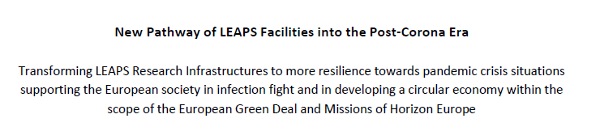

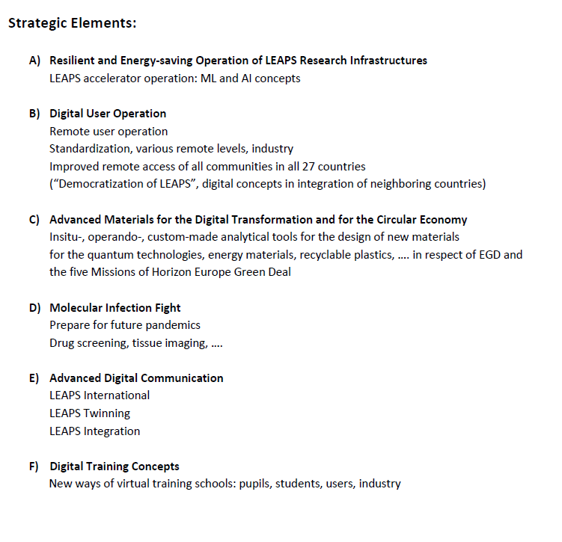
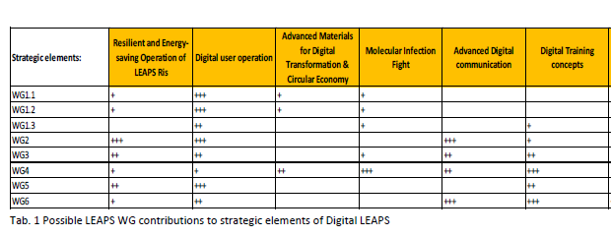
Bottom up brainstorming → synergies → transversal projects
DIGITAL LEAPS framework program with 4 transversal project proposals (conceptual level)
While some of the ideas presented are agnostic with respect to the source and wavelength range, others focus in on specific parameters to yield tangible goals.

Slide 2
DIGITAL LEAPS (DL): a new Pathway of LEAPS Facilities into the Post-Corona Era
The DL proposal is made up by four projects, transversal to the WGs:
STAndardisation for Remote Sample handling (STARS)
LEAPS Integrated Platform (LIP)
Reference Design for a Fully Automated User Beamline
Collaboration Platform for LEAPS Members: From Technology News to “Innovation Mall”
Proposed internal projects related to Developments of Facilities and to Platforms and Networks are listed separately in section 2 of DL document, for they do not fit within DL or they could fit on a different time scale.

Slide 3
SESSION 2 WG and SG meetings (24 November, 9:40 – 10:20)
Within these meetings, foresee at least a brief moment dedicated to DIGITAL LEAPS
Make sure the content of the DIGITAL LEAPS document is known (section 1 and section 2)
Collect any comment and/or new ideas
Discuss how to promote the proposal within the own facilities

Slide 4
SESSION 2 Joint WG and SG meeting dedicated to the DIGITAL LEAPS program projects (24 November, 10:40 – 11:25)
STARS, LIP, Reference Design for Fully Automated Beamline, Innovation Mall
Brief presentation of the project. Highlight the added value of LEAPS to the project and how LEAPS members can benefit in participating.
Foster project promotion within the facilities in the coming weeks.
Analyse missing parts, opportunities of integration or synergies with other projects of the DIGITAL LEAPS program.
Explore synergies with EU funded projects running from the LEAPS community, e.g. CALIPSOplus, EXPANDS/PANOSc and LEAPS-INNOV.
Start exploring facilities involvement level and confirm or refine existing analysis of in-kind contributions (if appropriate and time allows).

