Slide 1


Overview of LEAPS status and perspectives
Caterina Biscari
ALBA Synchrotron
LEAPS Chair
24 November 2020

Slide 2
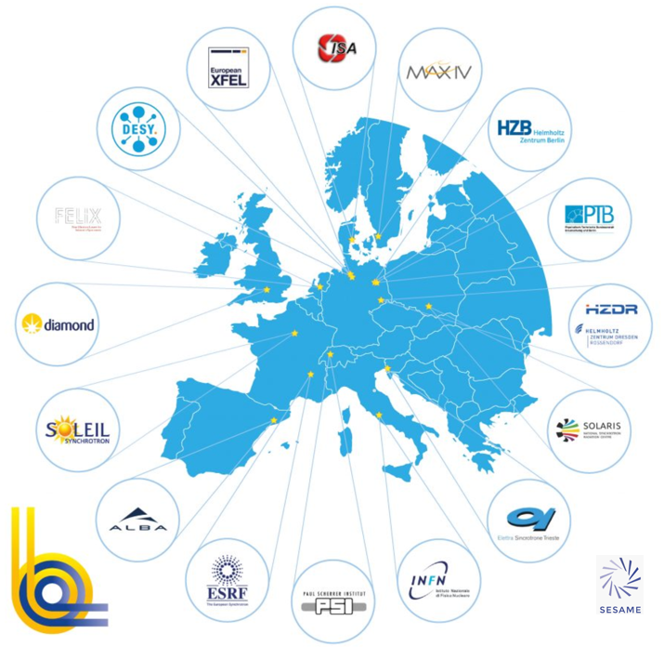
19 facilities - 16 institutions - 10 countries
+35000 users from all EU & beyond
+300 operating End Stations
+25000 publications
In last 5 years
offering +800000 h/year
Associate: SESAME (Jordan)
Partners: ESUO, LENS, CLS

Slide 3
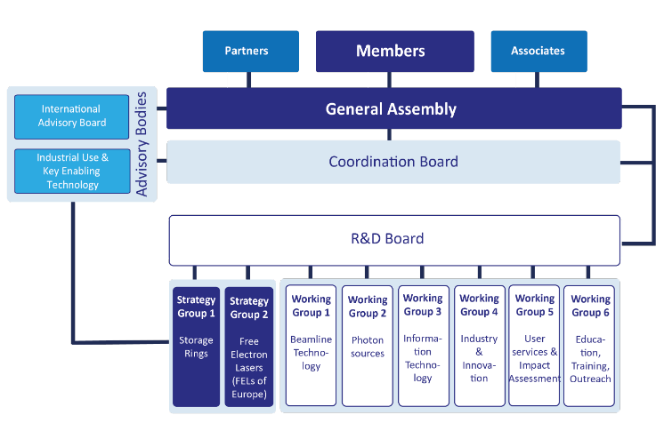
LEAPS Organization
LEAPS chairs
General Assembly Coordination Board
Present chair: Caterina Biscari (ALBA) Gaston Garcia
Past chair: Helmut Dosch (DESY) Ute Krell
Incoming chair: Lenny Rivkin (PSI) Mirjam van Daalen

Slide 4
Strategy and Working Groups
Strategy Group 1 – SR
Strategy Group 2 – FELs
WG1 – BL technology
WG2 – Photon Sources
WG3 – IT
WG4 – Industry & innovation
WG5 – Users & Impact
WG6 – Education, training, outreach
Amina Taleb (SOLEIL)
Michele Svandrlik (Elettra)
Graafsma (DESY), Barrett (ESRF), Kiefer (HZB)
Marco Calvi (PSI)
Mark Heron (Diamond)
Mitchell (ESRF), Sanchez (ALBA), Shotton (Diamond)
Blasetti (Elettra)
Hennies (MaxIV)
Please review your participation and contact spokespersons if update is needed

Slide 5



Partnerships reviewed this year
Partners support the goals and acknowledge the Terms of Reference of LEAPS. Partners contribute to LEAPS activities either by collaborating on joint technological projects or cooperate on joint activities of strategic nature
The status of Partner is granted by the GA for the time of active collaboration, usually for a period of three years. Multiple extensions of this status are possible upon request by the Partner
1. Regular partners collaborate on joint technological projects of specific WGs or in the framework of EU projects
2. Strategic partners cooperate on activities of strategic nature
3. Twinning partners are new or non-European light sources for which LEAPS facilities act as mentor

Slide 6
RDB Board established this year
Chair: Michele Svandrlik
The LEAPS R&D Board is composed of representatives nominated by each of the WGs and SGs, and one of the CB Chairs. It provides a platform for discussion and exchange on cross-cutting issues and strategic decisions, and establishes a link between the WGs and SGs and the LEAPS management (GA and CB).
The RDB shall meet at least twice per year. One of these meetings shall be a face-to-face meeting e.g. during the annual LEAPS plenary meeting; the other meetings may be held by video or telephone conference. The tasks of the RDB are:
to coordinate the LEAPS Roadmap process;
to be responsible for developing a plan for LEAPS internal projects to GA;
to coordinate LEAPS internal projects and report on outcome to CB and GA;
to report to CB and GA on the outcomes of WGs & SGs;
The RDB Chair or Vice Chair shall attend the GA meetings (without voting rights) and be a permanent guest in the CB meetings, and should attend the face to face CB meetings. After these meetings, she or he will report the relevant outcomes of these meetings to the all R&D Board members.

Slide 7
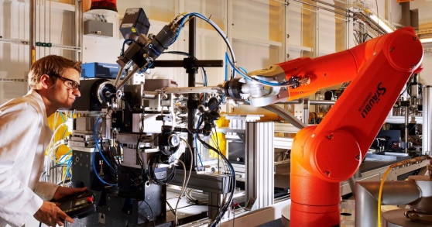
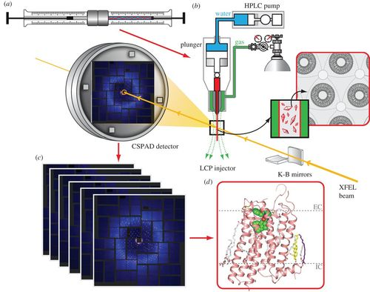
Learning from present challenges
Digital LEAPS
AI-assisted resilient and energy-saving operation
of LEAPS Research Infrastructures
Autonomous operation of complex accelerators
Remote operation
Digital user operation modes
Remote user experiments
Real-time analysis of data and
real-time (exascale) simulations
Advanced digital communication
Lessons Learnt: new digital forms of communication
between labs and between labs and users
Digital training concepts
New forms of training exploiting Virtual Reality
(from schools to universities)
AI-assisted molecular infection fight
LEAPS facilities prepare for future infection fight
(virus, bacteria, parasites)
Advanced materials for the digital transformation
and circular economy
RDB chair will present the status of the work and the perspectives as the result of the work done during the last few months

Slide 8
Task Forces: Valuable contribution to LEAPS dynamics
Teams of few people (~5-10) for proposing actions/finding solutions/enquiring on possibilities/reporting to GA for informed decisions
Triggered by CB, based on volunteering
Examples of 2020 task forces:
Connection to ESUO (=> driving the decision on ESUO as strategic partner)
Information on pros and cons of becoming a legal entity (still being debated)
Preparation for the Green Deal European calls
On going:
IDEA (Inclusion, Diversity, Equity and Anti-discrimination)
Organizing funding mechanism for internal projects

Slide 9
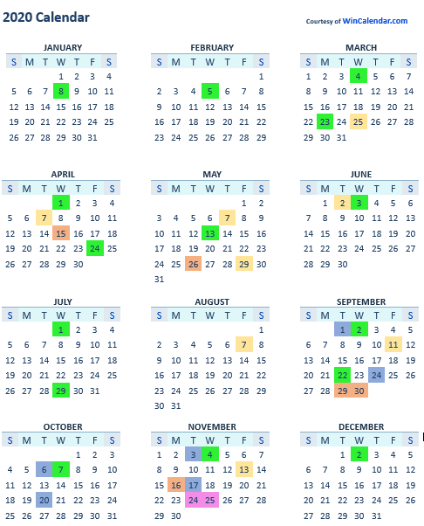
Some of the LEAPS activities during 2020
Coordination Board
Plenary Meeting
General Assembly
LEAPS Chairs
RDB
All of them on video
For the future:
Maintain video meetings
Do only selected one f2f

Slide 10
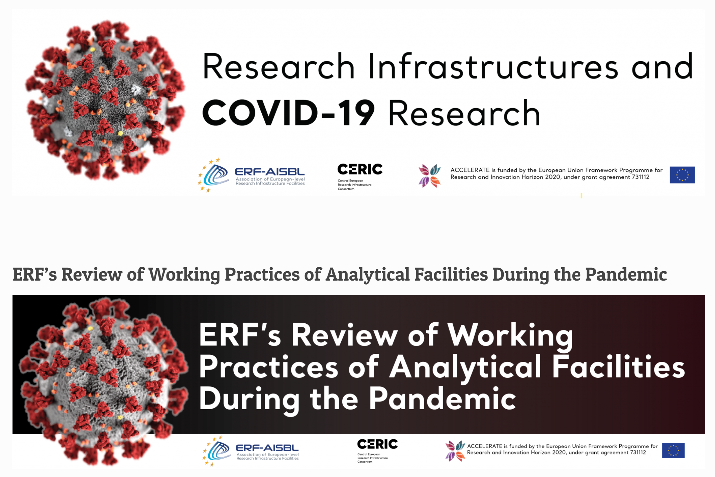
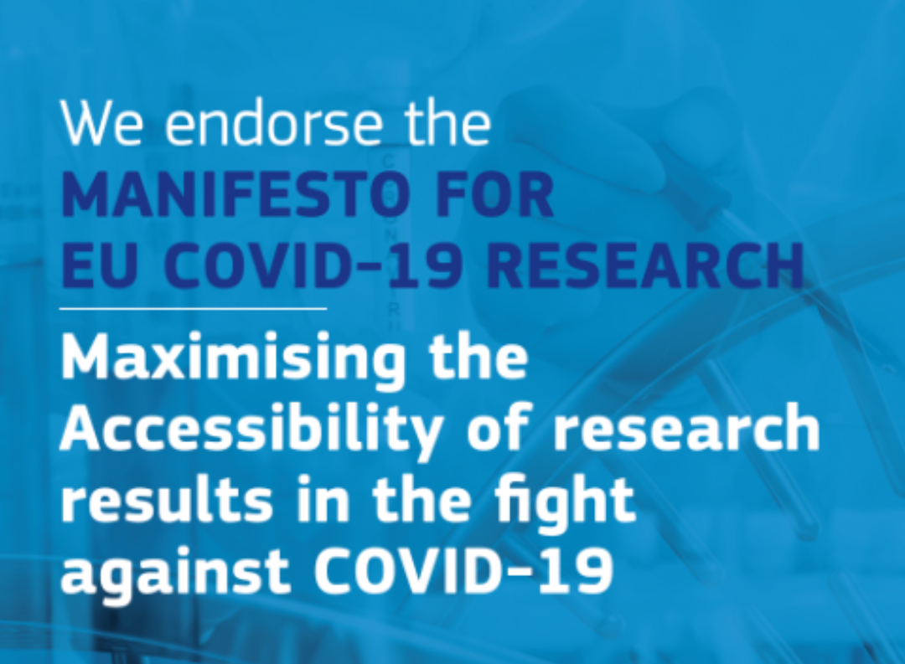

Answering to COVID-19 Pandemic
Reaction
to
Pandemic
Dedicated fast track access mode on almost all LEAPS facilities, addressed to Academy and Industry from the very first moment, compatibly with each country pandemic conditions.
LEAPS Position Paper on COVID-19 – May 2020
Sharing experiences and solutions through webinars
Operation during and after the pandemic
Scientific contribution to fight the pandemic

Slide 11
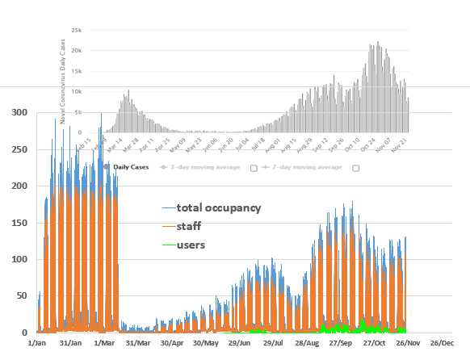
Combining safe conditions/operation/user services
LEAPS and its users have
Reaffirmed safety is the priority
Maintained alive scientific activity and technological developments
Optimized the available tools and developed new ones
Planned for the future learning from the present
Flexibly react to pandemic indicators and travel restrictions in each country
Example of ALBA occupancy and Spanish pandemic indicators
(https://www.worldometers.info/coronavirus/country/spain/)

Slide 12
LEAPS facilities operation during the COVID19 pandemic
MARCH-MAY Operation was drastically reduced at LEAPS facilities
APRIL-MAY The majority of sites quickly opened to COVID19-related experiments using
specific fast access and operation modes
From JUNE Mail-in service was settled also in the majority of facilities
From JULY Most facilities were operating under normal user operation but having a
reduced number of users on-site (down to 20-50%), in particular a reduced
number of foreign users.
From OCTOBER Most facilities keep the normal user operation but on-site access was again reduced to
national/regional users and with smaller team sizes or users are obliged to test
negative for Covid-19 to be granted access.
* Experiments that had to be cancelled are being re-scheduled ASAP
* Mail-in together with fully remote access has developed further in most facilities going up to 20%
increment for instance at PSI.
* External on-site visits (schools, meetings and conferences) have been stopped in almost all facilities

Slide 13
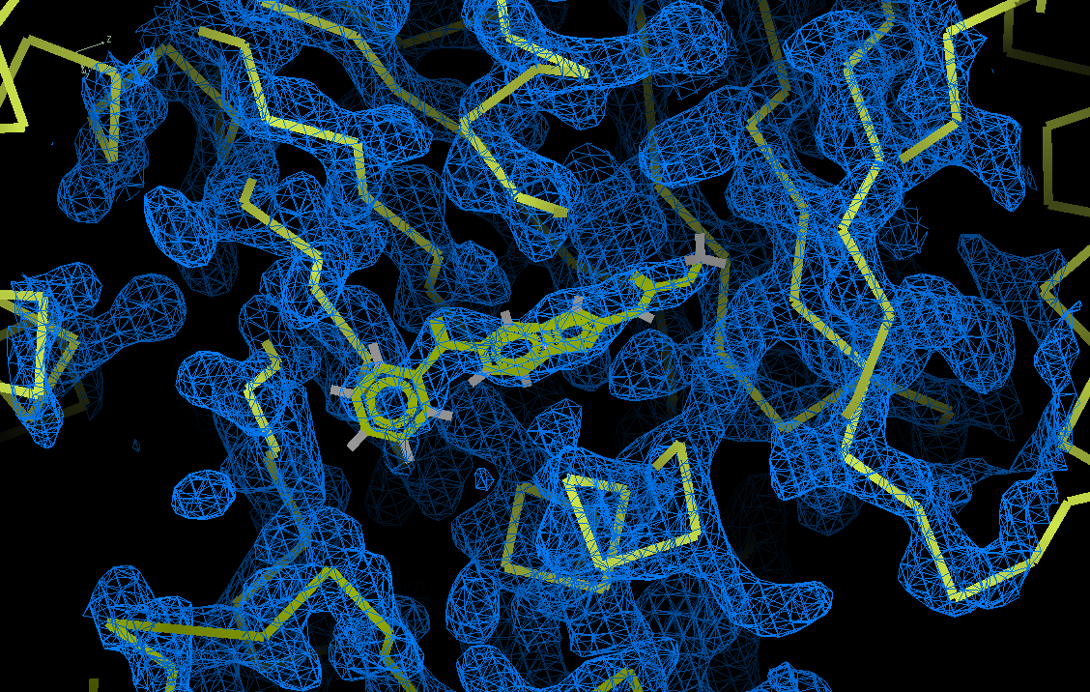
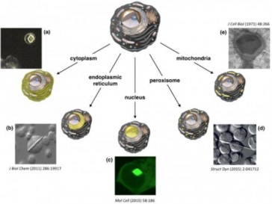
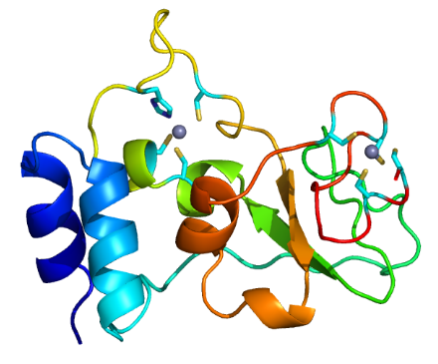
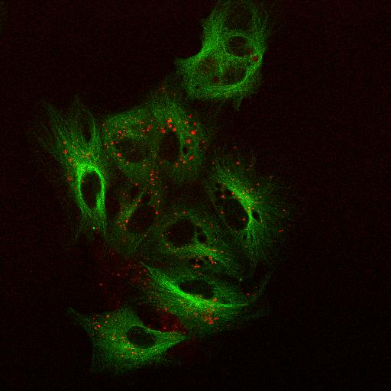
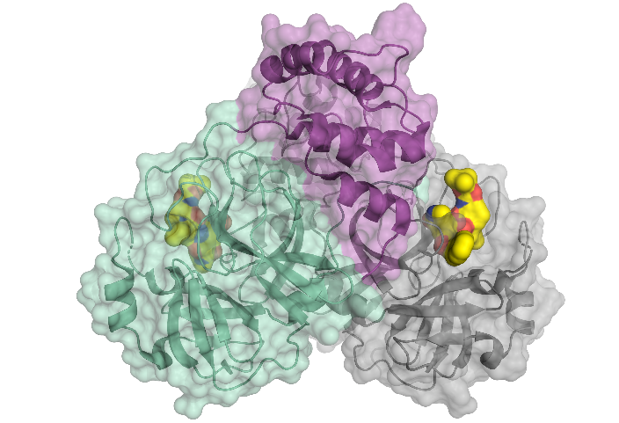
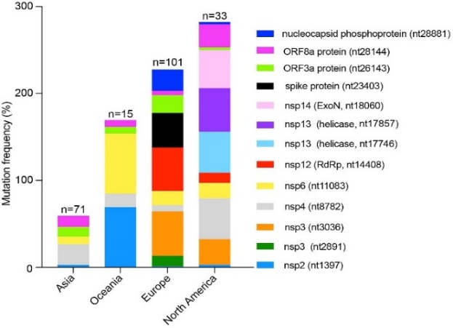
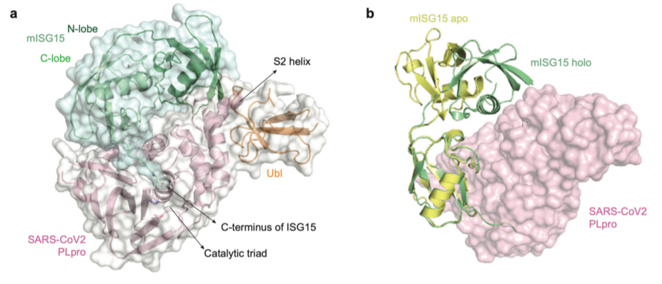
COVID-19 related research at LEAPS
COVID-19
Research at LEAPS
At ALBA (INIA) Investigating inhibition of viral replication with mebendazole, combining MX (ALBA) and fluorescence microscopy (CIB)
At SOLEIL (with INRAe and SANOFI) to express and crystallize in-vivo all SARS-CoV2 proteins and screen them against industrial fragment library
At MaxIV
Structure of SARS-CoV-2 Nsp10, important roles in viral replication and transcription in its unbound form
doi: 10.3390/ijms21197375. PMID: 33036230
Not exhaustive list
https://www.synchrotron-soleil.fr/
en/beamlines/proxima-1/acces-ge-covid-19
CIB Margarita Salas, INIA, ALBA
At BESSY II
Decoded the 3D architecture of the main protease of SARS-CoV-2, involved in the reproduction of the virus
At Elettra - Studying how the virus is evolving revealing that EU, North American and Asian strains might coexist, each of them characterized by a different mutation pattern.
At SLS
studying how the inhibition of papain-like protease PLpro blocks SARS-CoV-2 spread and promotion of anti-viral immunity
https://doi.org/10.1038/s41586-020-2601-5
https://science.sciencemag.org/content/368/6489/409 (doi: 10.1126/science.abb3405)
https://doi.org/10.1186/s12967-020-02344-6).

Slide 14
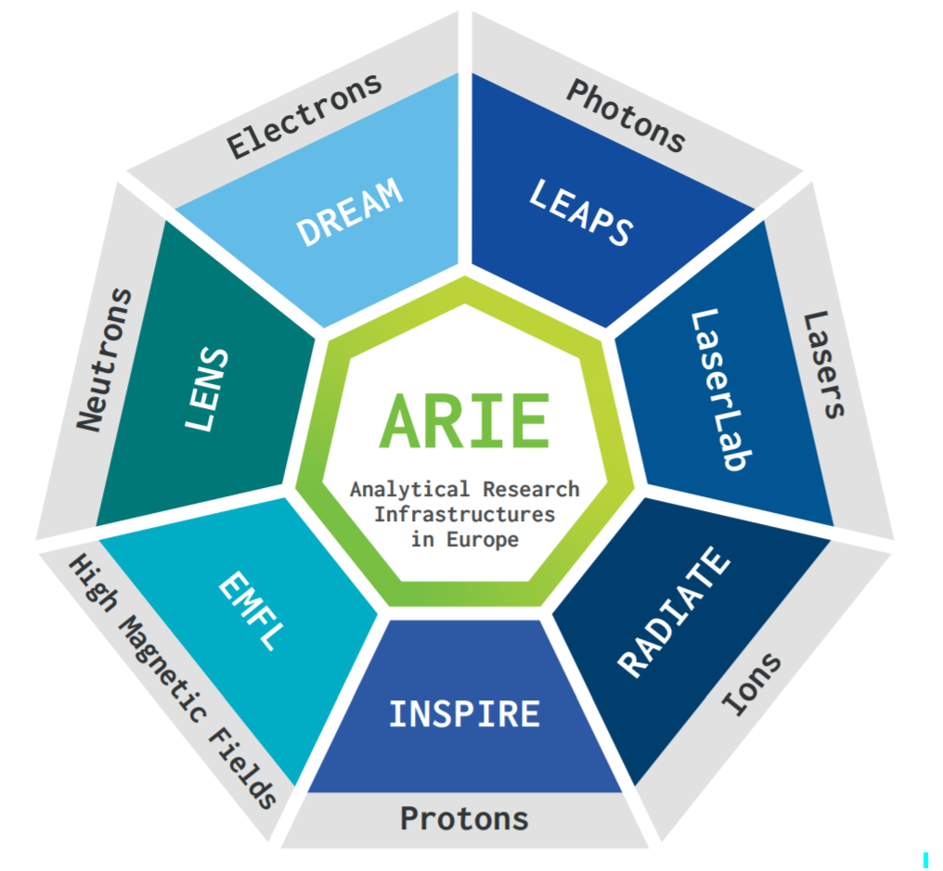
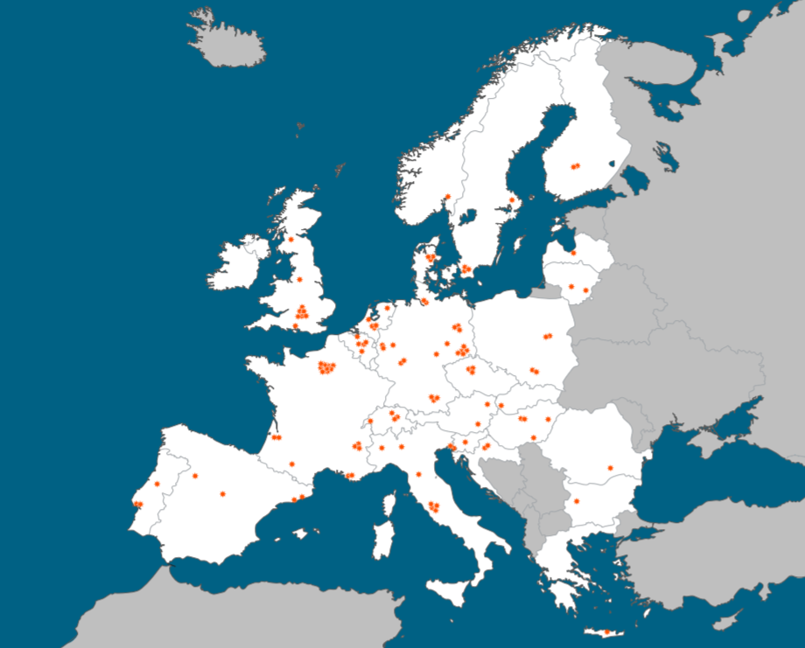
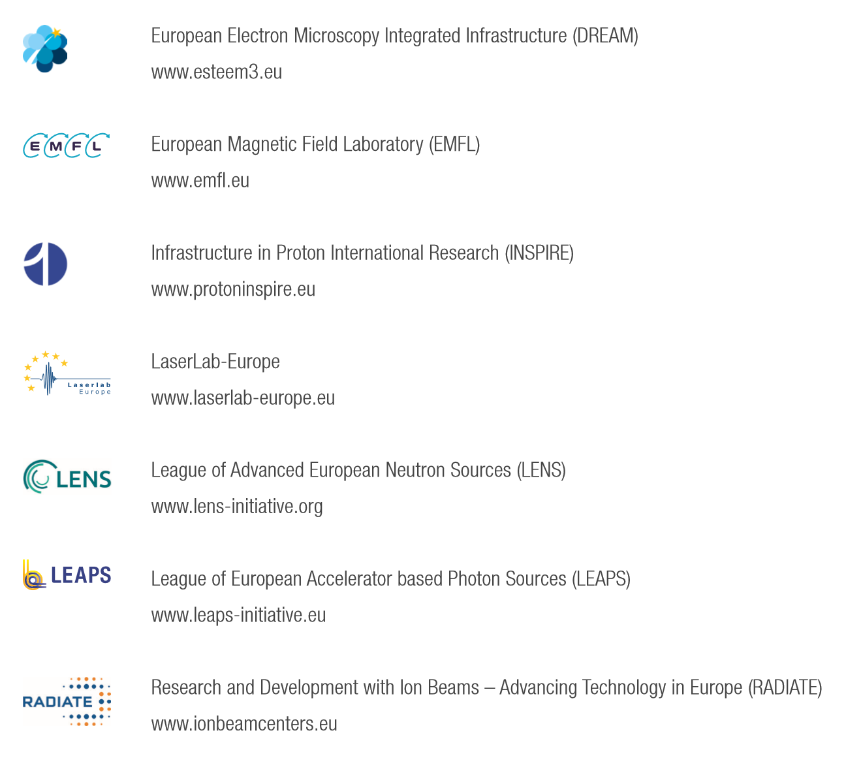
Cooperation with other European Analytical RIs:
ARIE, a powerful tool for solving societal challenges
More than 120 European RIs
Seven networks
ARIE Board
Caterina Biscari (LEAPS)
Rafal Dunin-Borkowski (eDREAM – 2021 chair)
Stefan Facsko (RADIATE)
Karen Kirkby (INSPIRE)
Helmut Schober (LENS)
Claes-Göran Wahlstrom (Laserlab-Europe)
Jochen Wosnitza (EMFL )
Complementary
Multi-scale
Multi-modal

Slide 15
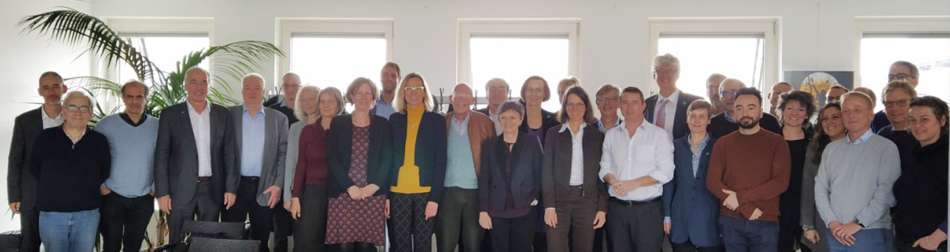
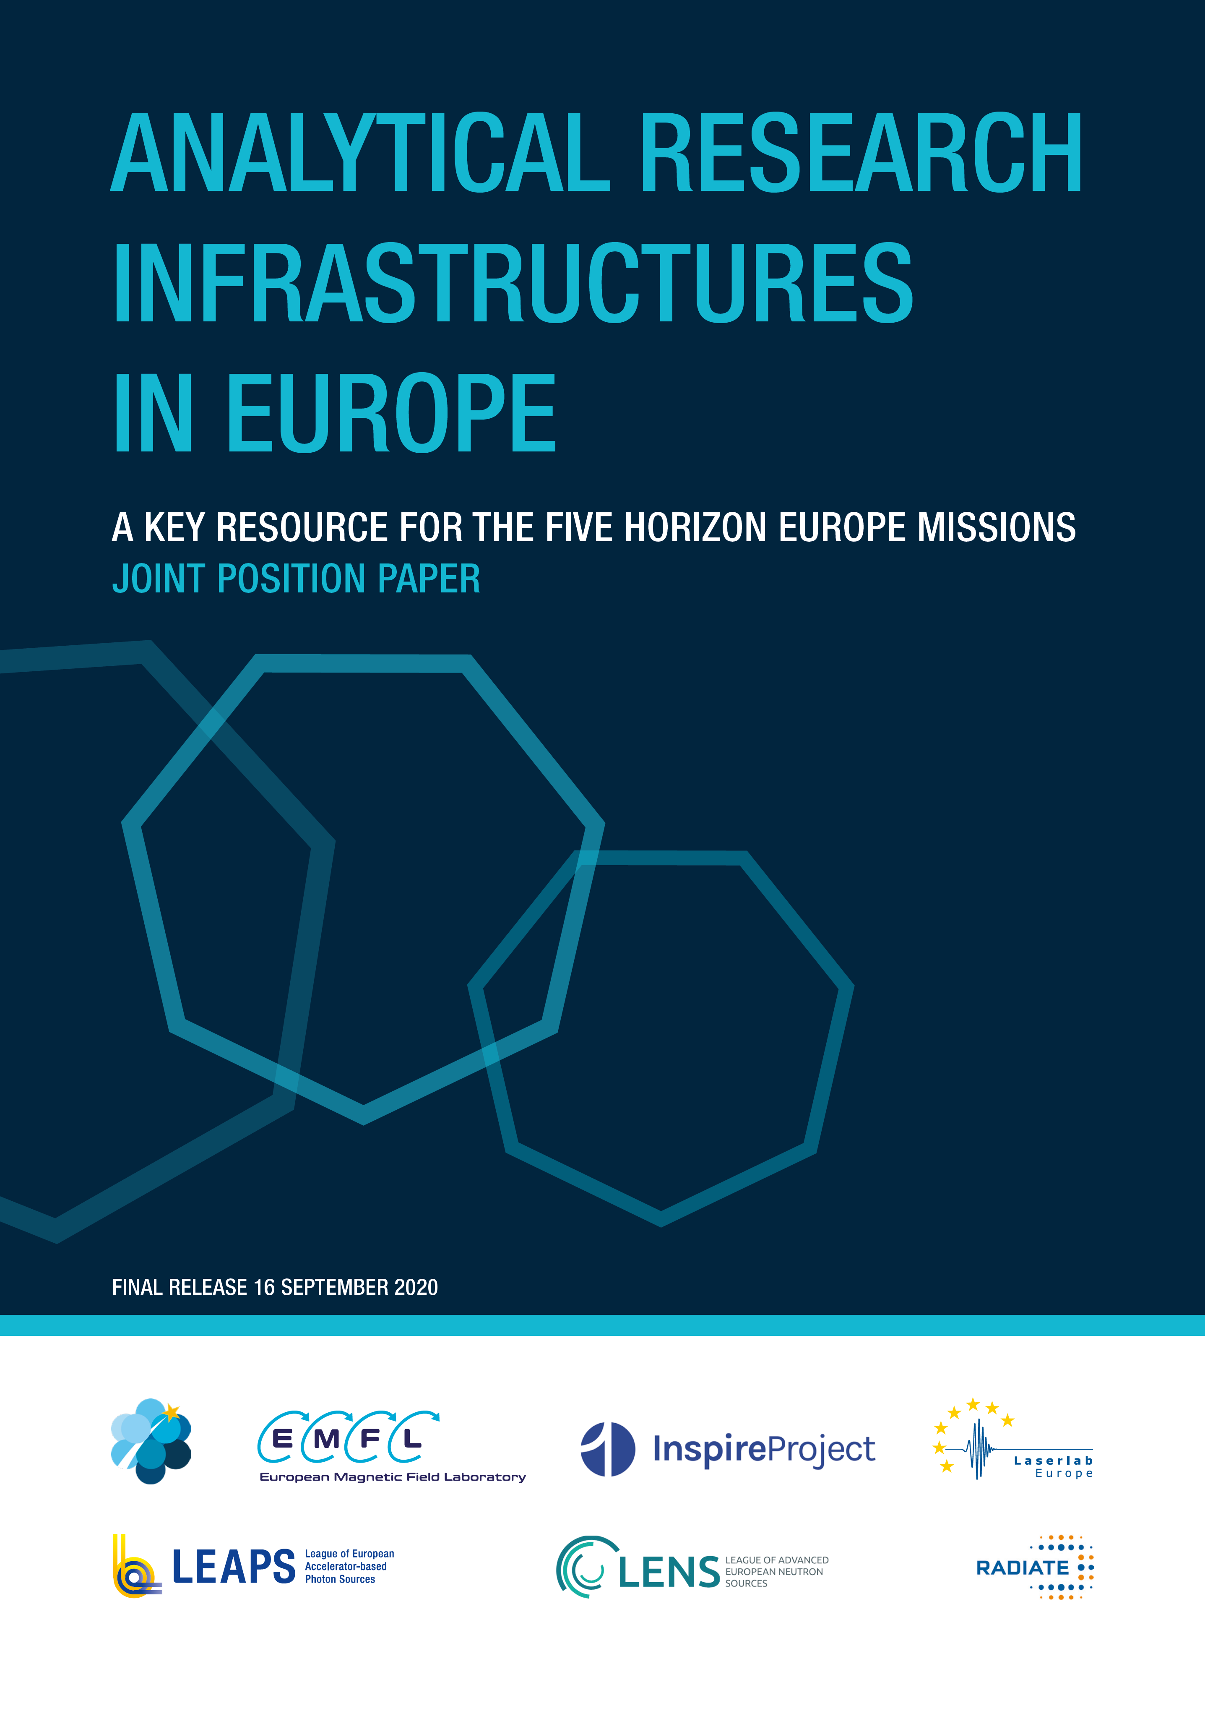

ARIEs are an European asset
1st informal meeting in Feb 21 in Brussels
Organized by LEAPS
Aiming at showing how each network can answer to HE
ARIE Position Papers
ARIE organization:
Board + Coordination Team (vicechairs + one person/network)
- Working groups (for specific position papers – coordinated so far by Mirjam van Daalen, PSI)
- Working team (for Green Deal Proposal – coordinated by Jakub Drnec, ESRF)
Preparing to answer to future HE calls
Preparing a webpage – on going
https://leaps-initiative.eu/wp-content/uploads/2020/09/ARIE-MISSIONS-PosPaper-FINAL-RELEASE_09.2020.pdf
https://leaps-initiative.eu/wp-content/uploads/2020/09/Viral-Threats-Paper-09.2020-FINAL.pdf

Slide 16
Preparing the participation to H2020 Green Deal Call: ARIE Green Deal Advanced Service Platform
Green Deal Areas 1-8 Communities
Distributed Research Infrastructures and Open Innovation Test Beds for scientific questions on energy technologies.
Full range of TRL and whole value chain of possible industrial applications.
Complex technological orscientific questions on energy storage technologies
e.g. Battery, Hydrogen Fuel, Super Caps….
Green Deal Service Counter
Advice
Proposal
Work plan
ARIE EXPERT NETWORK
Facility
Facility
Facility
Facility
Data analysis
(Data modelling)
Data repository respecting facility data policy
OBJECTIVE 1: energy tech R&D (translation, experiment design & execution, data analysis and reporting)
OBJECTIVE 2: ARIEs working together to achieve a comprehensive support in a time limited framework for specific and urgent challenges
OBJECTIVE 3: create a working governance and operational structure for ARIE transversal support platforms
Green Deal

Slide 17
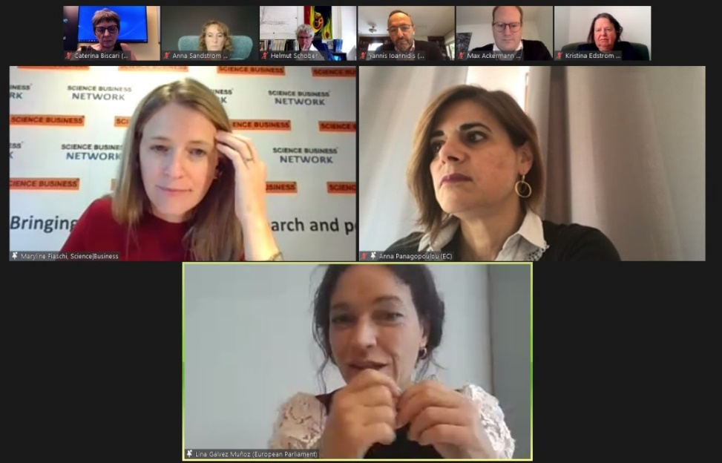

LEAPS relations with European Parliament
Event on 28 October hosted by Lina Galvez (MEP and ITRE vicechair) and LEAPS
EU RIs as engines for science and innovation
The key to tackle societal challenges
Anna Panagopoulou (EC)
´What we (EC) can do in the future relates with the recovery and resilience funds where we have as priorities: the climate transition, the digital transition and the accessibility to RIs though digital procedures.´
´Missions are not only for Horizon Europe but are key areas where different policies and different domains could consolidate their efforts to deliver concrete results.´
´EC has recognized the role of RIs over the years by funding RIs and access of researchers to RIs but now this is the moment where we should have a more strategic approach in collaboration with various stakeholders for RIs to identify those areas where the role of RIs would be further recognized´
‘RI and IT essential pillars of ERA’
Aiming at 3% of GDP in Research for all Europe. Still far from there, both from private and public investments
Most important messages: Green/Digital/Resilience/Competitiveness
Lina Gálvez (EP)
´The negotiation at the EP to increase the budget will be difficult because of national interests however, especially for RIs, there is a very clear need for international programs and cooperation.´ ´There is still a small possibility for having an increase in budget for RIs but we still need to put our focus on own resources in order to assure extra funding.´
´Horizon Europe is the first program on our (EP) list to receive more funds.´
‘Europe should do what is possible not to loose any more talent’
‘Priorities: Digital transition & Health’
No funding for construction of new RIs, except for structural national budgets
Tool for European inclusiveness
Participants | 90

Slide 18
LEAPS relations with European Commission
European Commission has gone through restructuring
Our interlocutors have changed during 2019-2020, modifying also the perspectives for the HE funding
Several meetings
Johannes Klumpers several times – will participate tomorrow in the open session
Jean Enric Paquet (18 September, with ARIE network, LEAPS as spokesperson)
Anna Panagopoulou (28 October, EP event)
LEAPS is well understood and the model much appreciated by EC
EC is now well aware of the RI world beyond ESFRI, based on national fundings, with free access to everybody, including all countries with no facilities
LEAPS has a good visibility with respect to others RIs, LENS and ARIE are closely following
The ARIE position papers on Missions on Viral Threats were very much appreciated
Key messages from EC: show complementarity, work with industry for boosting innovation
Transnational access could be again supported by EC future calls – Model of ARIE GD call or LEAPS-INNOV following Tamata are much in line with EC interests

Slide 19
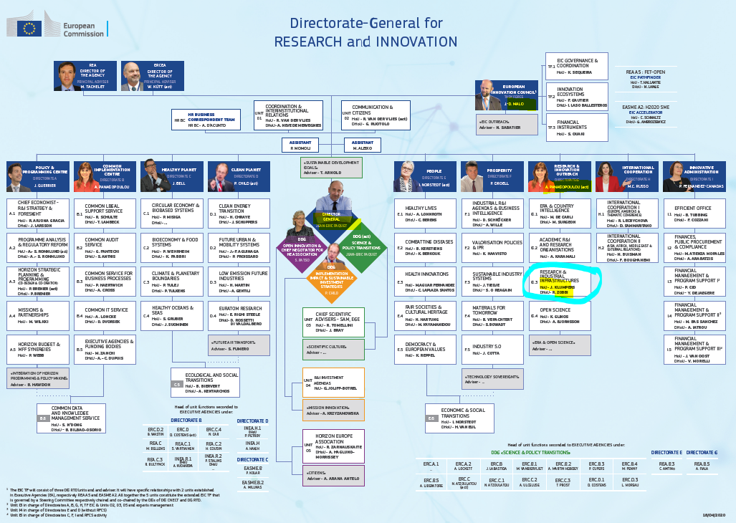
Our interlocutors
RIs

Slide 20

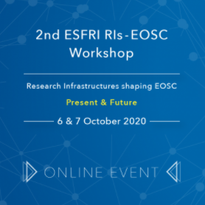

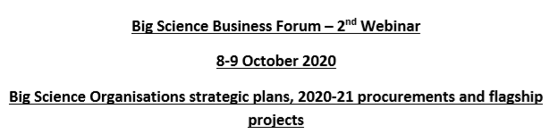


Participation to other events – science, innovation, outreach
LEAPS as
Affiliated Big Science Organizations

Slide 21

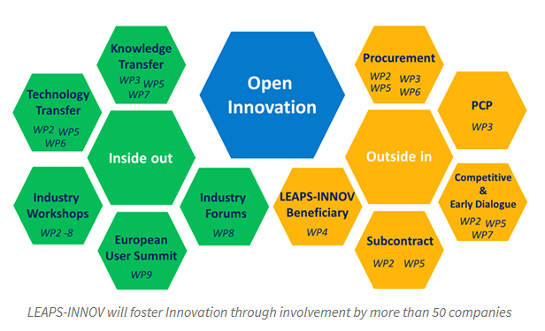
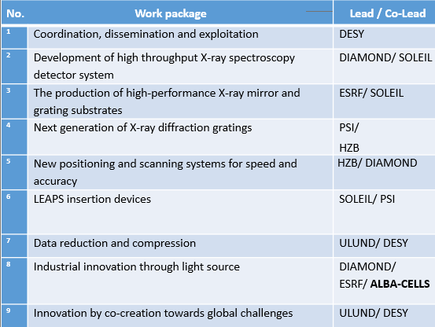
1st LEAPS Proposal granted from EC
(November 2020)
10 M€ distributed in 9 work packages
Many thanks to all participants, and specially to DESY people coordinating the proposal

Slide 22

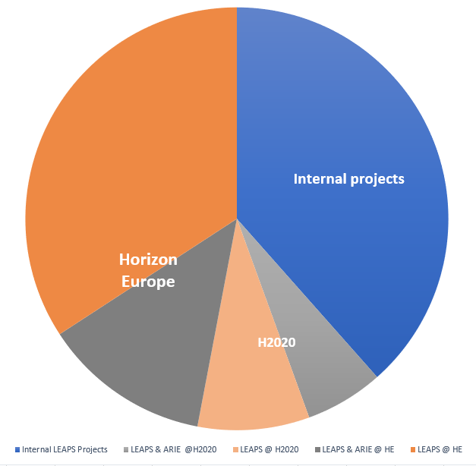
First call from Helmut
Collaborating teams – Strategy 2030 – Launch in Brussels
Structure for proposing common developments
Contacts with EC and useful feedbacks
Start-up of LENS
LEAPS INNOV preparation
Answer to Pandemic = stronger links
DIGITAL Leaps as strategic program
LEAPS INNOV granted – on going until 2023
ARIE start-up – preparing for GD H2020 call just open
Internal projects
EC Programs – only LEAPS
EC Programs – with other networks
Co-creating HE programs 2023 on
2015 2018 2020 2021-2027
Start-up
Organization
Clear visibility in ERA
1st common projects
Preparing for the future

Slide 23

Tool for European inclusiveness
Tak
Tack
“The strength of LEAPS lies in its staff and users, hailing from all European countries, beyond those which host the facilities.”
Thanks
Bedankt
Dziękuję
Danke
Merci
Grazie
Gracias
https://leaps-initiative.eu
شك

