Slide 1


ARIE Position Papers
Mirjam van Daalen
Vice-chair LEAPS Coordination Board
Paul Scherrer Institute
LEAPS Plenary Meeting / Zoom Webinar
25th of November 2020

Slide 2
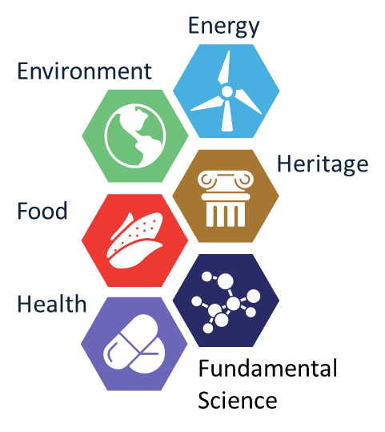
Why ARIEs?
RIs co-creation of HE
A year ago at the LEAPS plenary meeting at PSI Nov 2019, RI networks were asked by the EC to respond to the evolving landscape of the European research and innovation policy.
How can the various RIs can contribute to the societal priorities in HE in a collaborative way?
How to connect to societal challenges? Closer to the EU citizens, be able to demonstrate the impact much better.
RI networks collaborate

Slide 3


Evolution from Technology-Centered to Scientific-Priorities-Centered activities
perez@centell-folch.com

Slide 4
Analytical Research Infrastructures in Europe ARIE
The five missions are cemented in Pillar II of Horizon Europe, Global Challenges and European Industrial Competitiveness.

Slide 5


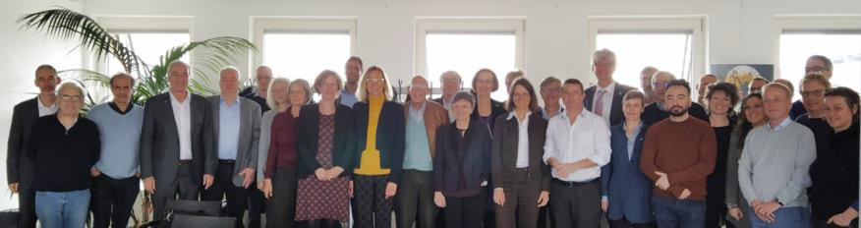



ARIEs are an European asset
1st informal meeting in Feb 21 in Brussels Organised by LEAPS
Aiming at showing how each network can answer to HE
Representatives of the seven research infrastructure networks met to discuss how they could best serve the Missions.
15

Slide 6





Analytical Research Infrastructures as key resources for the five horizon Europe missions
Transversal working groups were formed to assess the opportunities, and how the specific strengths, capabilities and core skills of the ARIEs are relevant.
LENS
LEAPS
eDREAM
RADIATE
LEAPS
ERIC-Forum
LENS
eDREAM
EMFL
RADIATE
LaserLabEurope
INSPIRE
LEAPS
ERIC-Forum
LENS
eDREAM
EMFL
RADIATE
LaserLabEurope
LEAPS
eDREAM
RADIATE
LaserLabEurope
LEAPS
eDREAM
RADIATE
LaserLabEurope

Slide 7
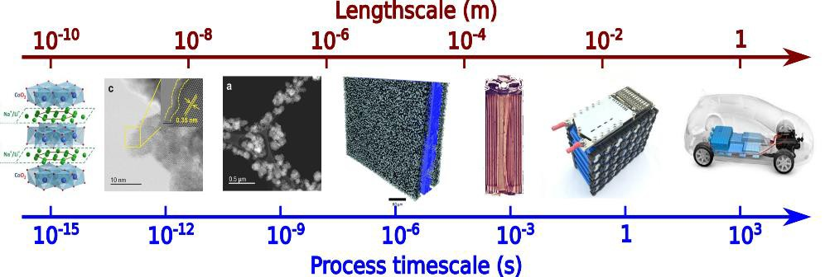

SMART CITIES MISSION:
One key example of complementarity
◆ BETTER BATTERIES AND FUEL CELLS
Length scale challenge in future battery research (courtesy: ESRF)
Bridging spatial, temporal and chemical information – from X-ray, neutron and
electron-beam analytics

Slide 8

ARIEs reaction to COVID-19 and beyond
ANALYTICAL RESEARCH INFRASTRUCTURES OF EUROPE (ARIEs) JOIN FORCES TO FACE THREATS SUCH AS COVID-19 AND OTHER POSSIBLE FUTURE CRISES
Key example of complementarity
Complementary use of X-ray/neutron crystallography, X-ray/neutron scattering techniques and cryo-electron microscopy/tomography, uniquely available at the ARIEs, provide the structural details of processes at the molecular and atomic levels needed to understand the interaction of the virus with host cells – details that could lead to the identification of new therapeutic targets.
LEAPS
LaserLabEurope
LENS
RADIATE
eDREAM

Slide 9
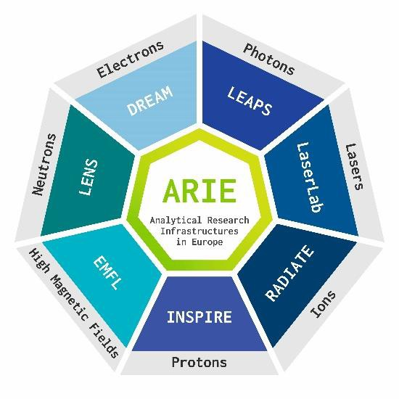


Top 5 Update on relations with ARIE
EC-ARIE meeting (18th of September)
ARIE HE Mission paper https://zenodo.org/record/4049769
ARIE Viral and Microbial Threats paper https://doi.org/10.5281/zenodo.404
9720
‘I am very happy to see such a large group of research infrastructures pooling their resources and expertise to work together on addressing the Missions. This is what the European Research Area is all about - actors teaming up to create a critical mass.’
Jean-Eric Paquet DG EC Research and Innovation

Slide 10
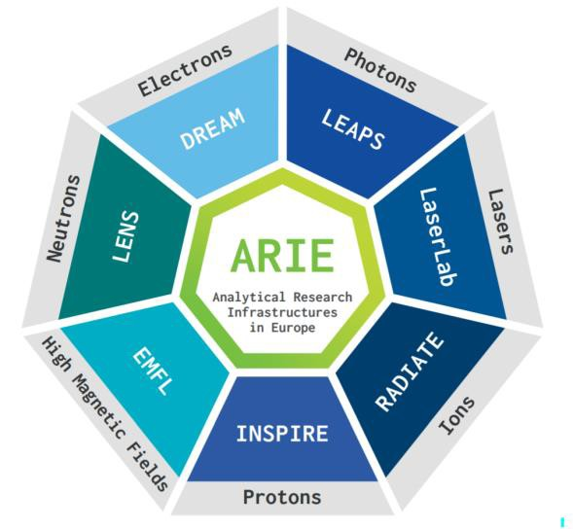
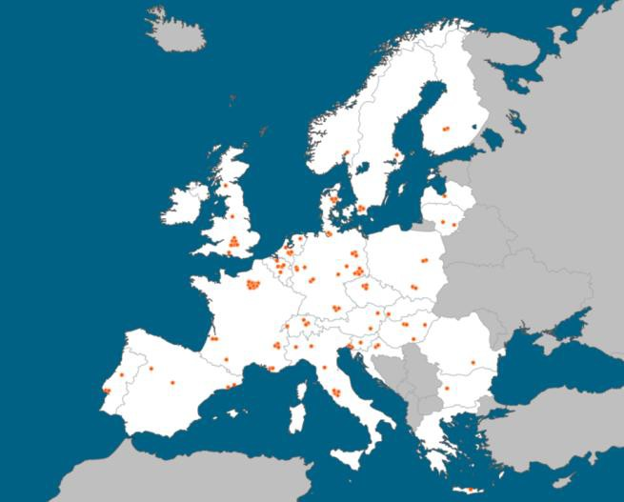
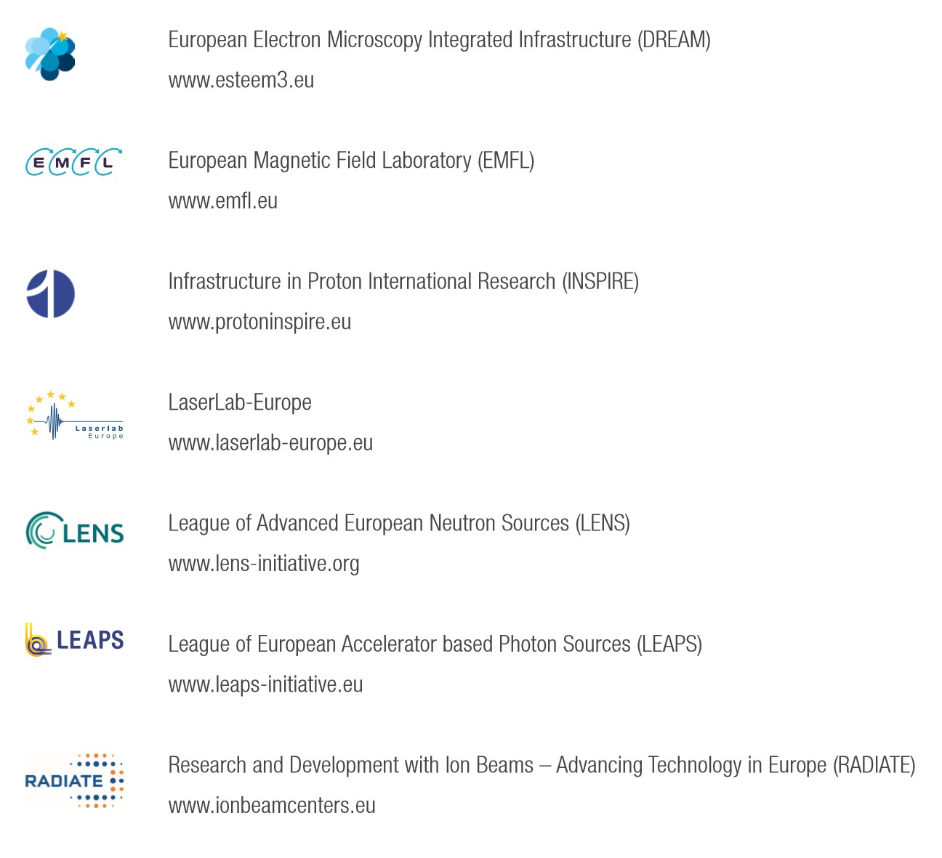
Cooperation with other European Analytical RIs:
ARIE, a powerful tool for solving societal challenges
More than 120 European RIs
Seven networks
◆ ARIE Board
◆ Caterina Biscari (LEAPS)
◆ Rafal Dunin-Borkowski (eDREAM – 2021 chair)
◆ Stefan Facsko (RADIATE)
◆ Karen Kirkby (INSPIRE)
◆ Helmut Schober (LENS)
◆ Claes-Göran Wahlstrom (Laserlab-Europe)
◆ Jochen Wosnitza (EMFL )
Complementary Multi-scale Multi-modal

Slide 11
ARIEs are an European asset
ARIE organisation:
Board + Coordination Team
(vicechairs + one person/network)
Working groups (for specific position papers – coordinated PSI)
Working team (for Green Deal Proposal –
coordinated by ESRF)
Working team react on health topic 3 With 4 ARIE and life science ERICs (coordinated by ESS)
Tool to answer to future HE calls, where ARIEs complementarity is needed
15

Slide 12


Tak
Tack
“The strength of LEAPS lies in its staff and users, hailing from all European countries, beyond those which host the facilities.”
Thanks
Bedankt
Dziękuję
Danke
Merci
Grazie
Gracias
https://leaps-initiative.eu
شك

