Slide 1



LEAPS-INNOV
LEAPS pilot to foster open innovation for accelerator-based light sources in Europe
Elke Plönjes
Scientific Coordinator
Julia Hauk, Ute Krell
DESY
LEAPS Plenary
November 25, 2020

Slide 2
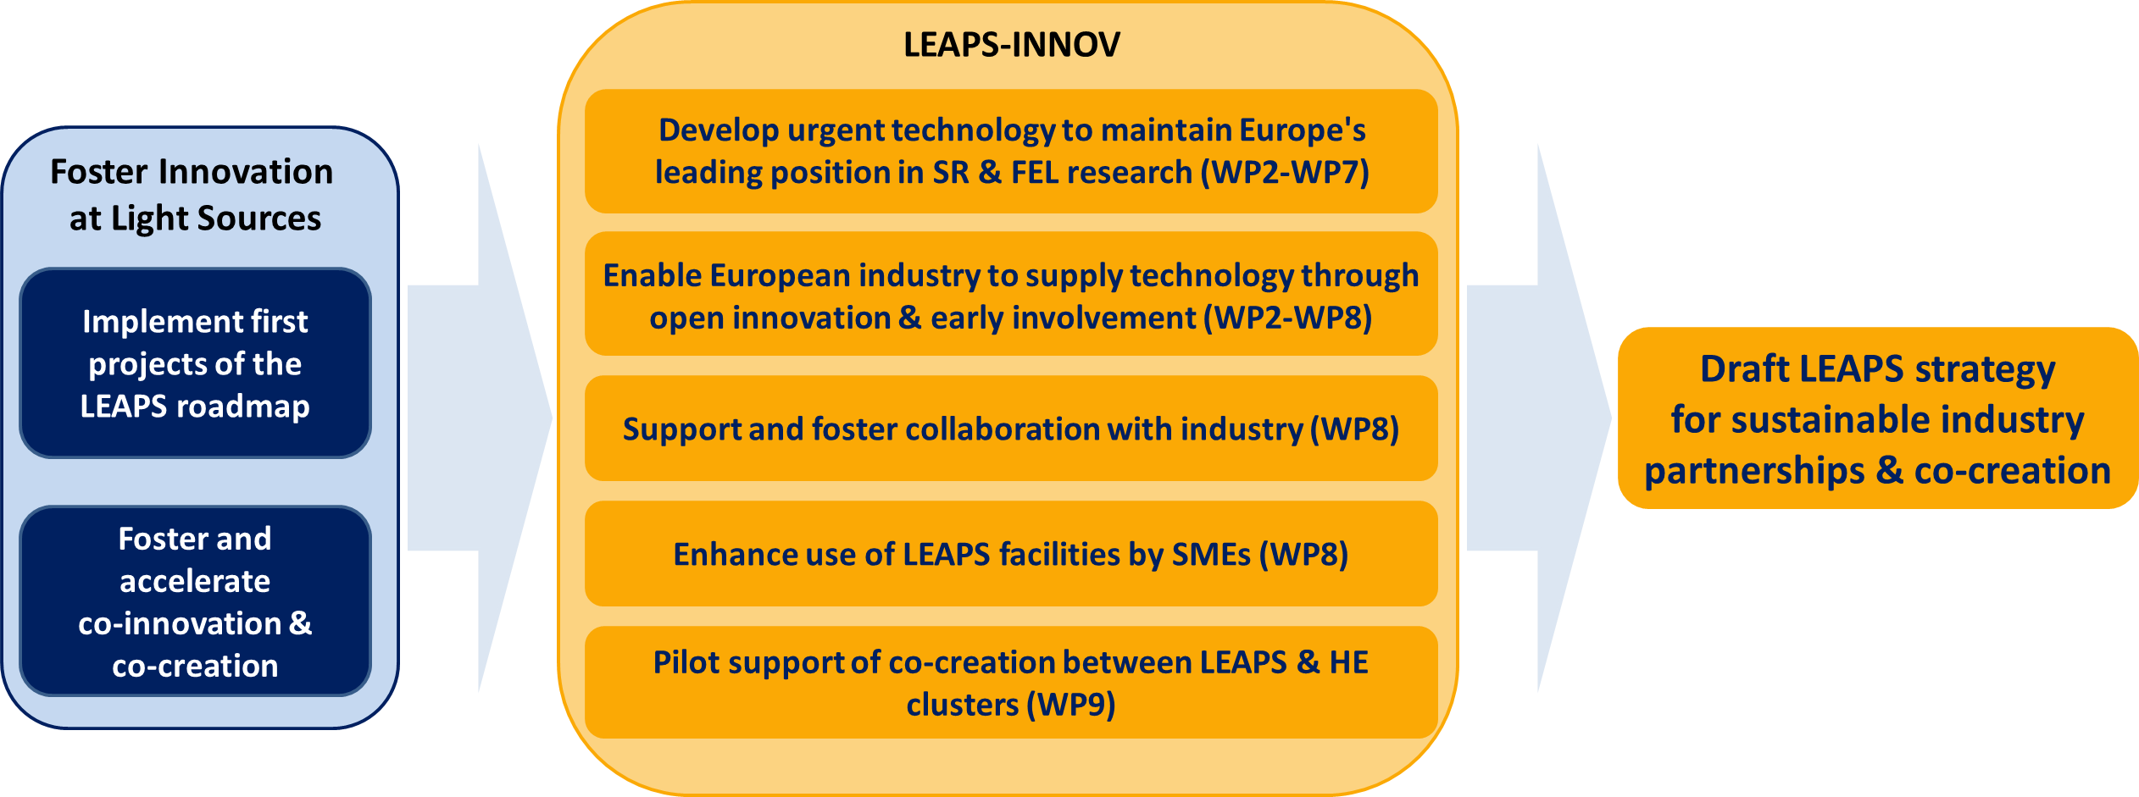
LEAPS-INNOV strategy and objectives
H2020 call INFRAINNOV-04-2020: Innovation Pilots for Research Infrastructures

Slide 3
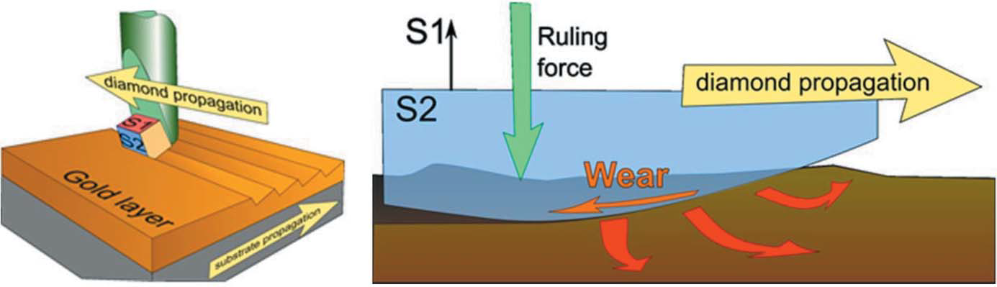
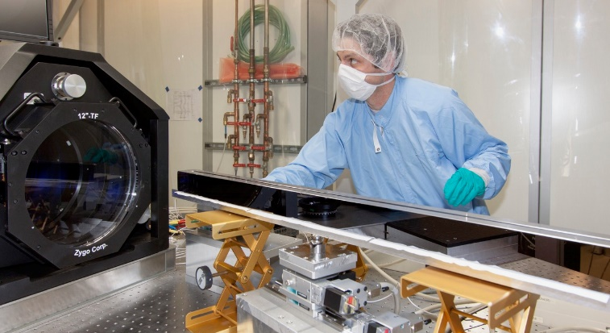
Technology-driven work packages
WP2 XAFS-DET
Development of high throughput X-ray spectroscopy detector system
WP3 SuperFlat
Production of high-performance X-ray mirror and grating substrates
WP4 NeXtgrating
Next generation of X-ray diffraction gratings
Alleviate dependence on non-European suppliers
Pre-commercial procurement (PCP) for process development for higher performance flat silicon mirrors
New metrology methods and measurement protocols suitable for production environments
Deterministic corrective figuring techniques for freeform surfaces
Design of blazed silicon gratings made by e-beam lithography
Development of EBL fabrication process together with SME partners
Mitigate dependence on small number of suppliers and very long lead times
New generation of Germanium detectors for X-ray spectroscopy applications
Foundation for higher performance detector systems in the future
Distribution of results and technologies among LEAPS partners
Preparation of procurement path and production plan for European light sources through early industry involvement
Mechanical ruling of a
blazed grating
F. Siewert et al
European XFEL
V.A. Guzenko & C. David, PSI

Slide 4
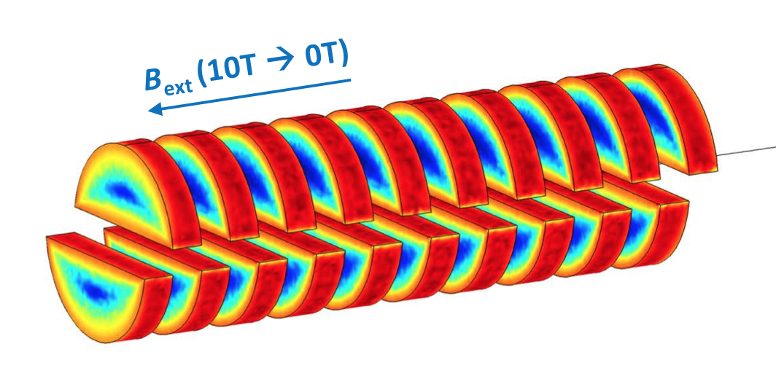
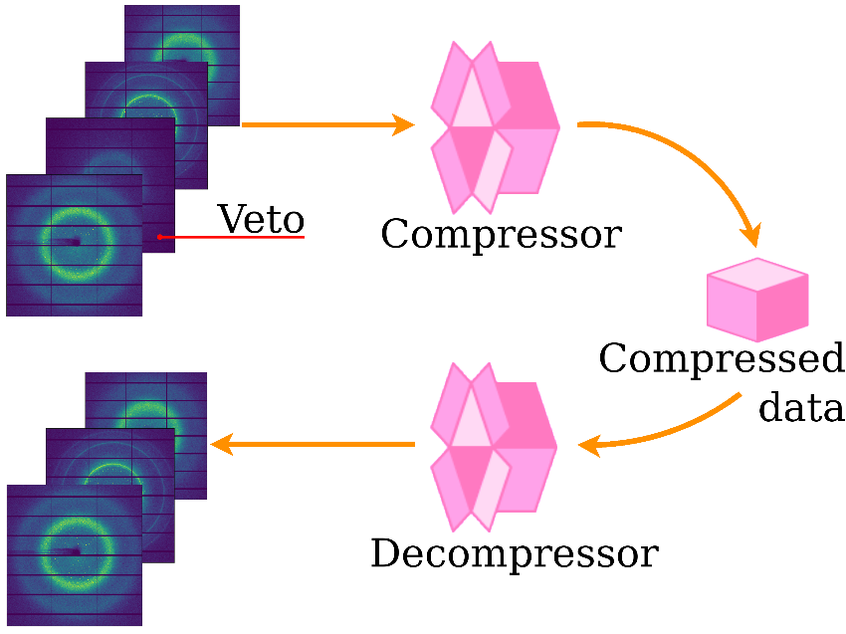
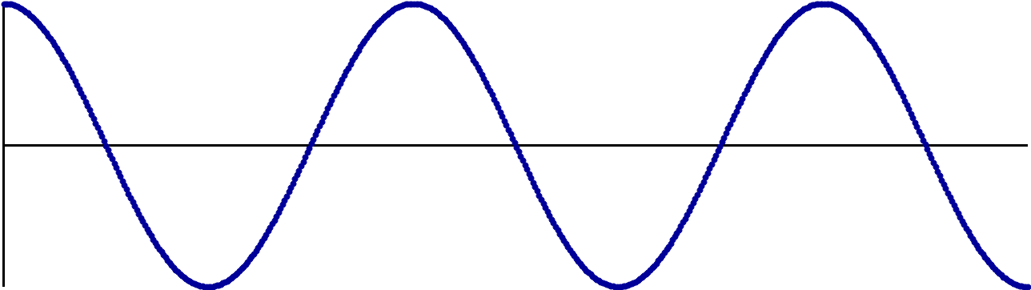
Technology-driven work packages
WP5 POSIT
New positioning and scanning systems for speed and accuracy
WP6 LIDs
LEAPS insertion devices
WP7 DATA
Data reduction and compression
Science limited by data rates and volumes
Reduced cost and ecological footprint for networking and storage
Open source
Tight coordination with experts of detector suppliers towards building compatible interfaces
Translation and rotation on the nanometer scale
High-accuracy online metrology based on interferometry sensors
Synchronisation between beamline components
Standards for room temperature structural research with microcrystals
Involve industry in development of standards and protocols
Push the limits of ID technology:
  Short period , high field, planar undulators for hard X-rays
  Short period, high field, elliptically polarizing APPLE-type undulators
Prototype measurement benches for undulator characterisation
Early and continuous involvement of industry to prepare concepts for technology transfer to European industry
+
-
+
-
+
-
Contactless sample manipulation system
X-ray
Notes:
short period , high field, planar undulators for hard X-rays:
a high temperature superconducting (HTS)
a cryogenic permanent magnet undulator (CPMU)
short period, high field elliptically polarising undulators
a cryogenic APPLE III undulator
a cost-effective compact APPLE X undulator
Two prototype measurement benches to characterise the undulators:
a small aperture, low temperature Hall probe measurement bench
a pulsed wire measurement bench

Slide 5
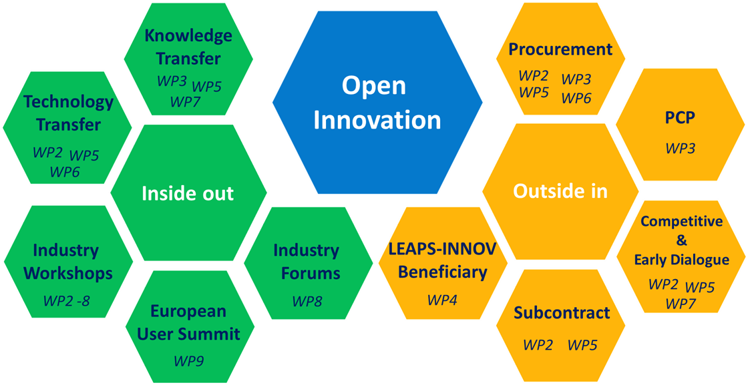
Foster technological development through open innovation
WP8 INDUSTRY
Industrial innovation through light sources
  Boost trans-LEAPS links towards industry
  Support WPs in IPR, industrial collaboration and exploitation of results
  Support “RI Co-Innovation Platform” towards industry
  Provide SME access system for LEAPS facilities
  Build bridges to industry as user, collaborator and supplier
WP9 CO-CREATION
Innovation by co-creation towards global
challenges
  European User Summit
  Round-tables and forums between LEAPS and large research initiatives in Europe (e.g. European Partnerships) towards solving global challenges
  First implementation studies
  developing scientific instruments

Slide 6
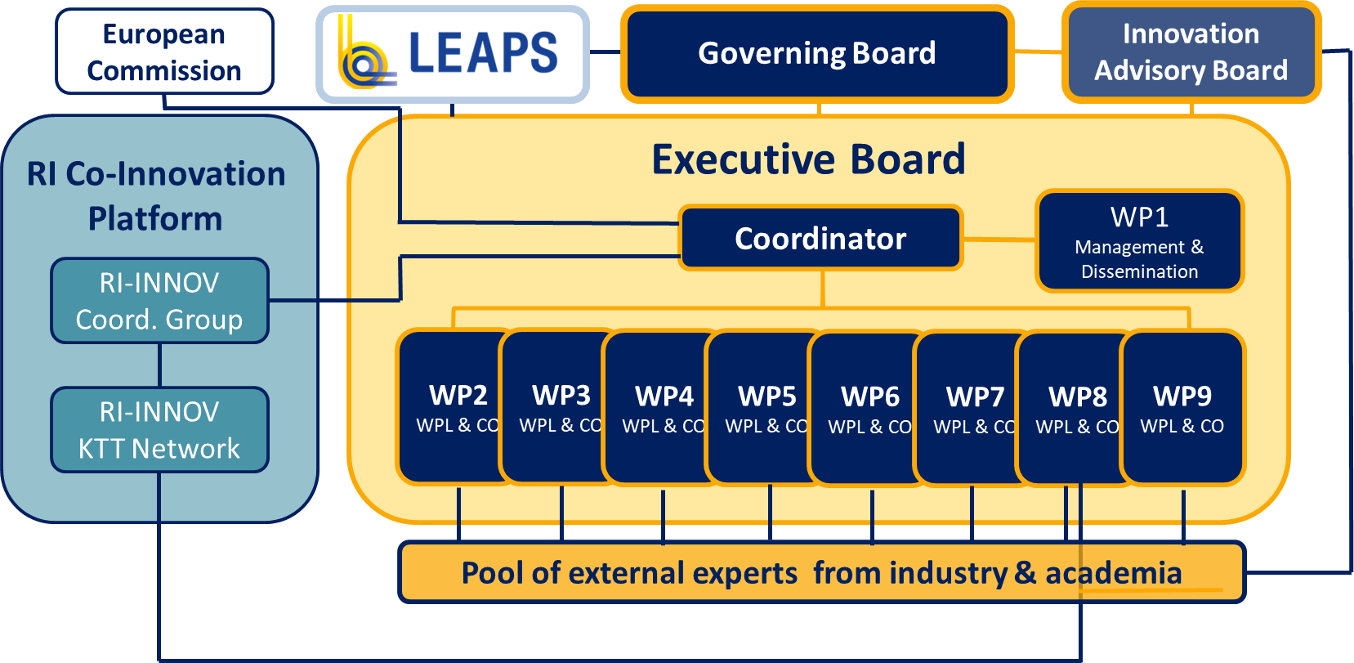
LEAPS-INNOV governance
direct interaction with LEAPS
Jointly with other
Innovation- Pilots
I.FAST
(accelerator)
AIDAinnova
(detector)

Slide 7
LEAPS-INNOV summary
Key technology WPs (6)
WP Outreach towards industry
WP Outreach towards user community
Consortium
All 16 LEAPS members, 3 SMEs, 3 technology partners (ENEA, KIT, STFC)
and > 50 European industrial partners (> 77% are SMEs)
Budget
10 million EUR, with own contribution of 8.3 million EUR
Timeline
4 years, starting April 1, 2021
Kick-off meeting: April 20/21, 2021
To develop a
LEAPS strategy
for sustainable
industry partnership

Slide 8


Tak
Tack
“The strength of LEAPS lies in its staff and users, hailing from all European countries, beyond those which host the facilities.”
Thanks
Bedankt
Dziękuję
Danke
Merci
Grazie
Gracias
https://leaps-initiative.eu
شك

