Slide 1
Em# Collaboration Meeting
July 20-21, 2020

Slide 2
Acquisition w/ 2.0.00 – Current mode
HW trigger – rising edge: using delay generator Stanford Research Systems DG645
Integration time: 5ms down to 1ms
Aiming at reaching 60000 samples.
Int. time (ms) | Freq. (Hz) | #samples | Note
5 | 200 | 1541
5 | 200 | 0 | Reboot!
5 | 200 | 60000
3 | 333 | 60000
2.5 | 400 | 60000
2 | 500 | 60000
1 | 1000 | 3288 | Different attempts – similar results

Slide 3
Acquisition w/ 2.0.04 – Fast buffer &
Autotrigger
#triggers | Int. time (ms) | Wait time (ms) | Duration (sec) | Size of file
1000 | 10 | 10 | 20.294 | 22.18 kB
 | 10 | 1 | 11.309 | 22.15 kB
 | 0.9 | 0.1 | 1.339 | 18.50 kB
 | 0.5 | 0.1 | 0.885 | 15.46 kB
 | 0.3 | 0.1 | 0.694 | 15.33 kB
 | 0.1 | 0.1 | 0.486 | 14.85 kB
100 000 | 10 | 10 | 2000.5 | 2.30 MB
 | 10 | 1 | 1100.4 | 2.29 MB
 | 0.9 | 0.1 | 100.3 | 1.91 MB
 | 0.5 | 0.1 | 60.296 | 1.62 MB
 | 0.3 | 0.1 | 40.287 | 1.58 MB
 | 0.1 | 0.1 | 20.292 | 1.47 MB
17*10^6 | 0.1 | 0.1 | 3401 | 248 MB

Slide 4
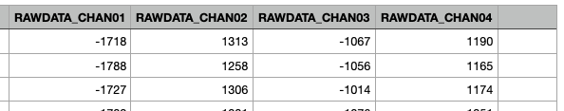
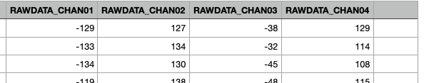
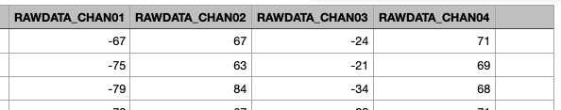
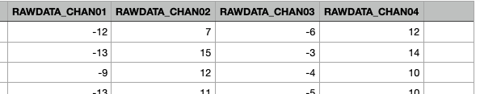
Acquisition w/ 2.0.04 – Fast buffer &
Autotrigger Cont.
Int. time 10 ms, Wait time 10 ms
Int. time 0.9 ms, Wait time 0.1 ms
Int. time 0.5 ms, Wait time 0.1 ms
Int. time 0.1 ms, Wait time 0.1 ms

Slide 5
SW 2.0.0x – Issues & Notes
*SHT command
  The display is turned off, connection to the Web server is dropped, but the light of the power button is still on. Hard reset is required.
  connected to *RAP below?
*RAP command
  The display is turned off, but the NUC is still running! Login is possible, when connected through the USB-port or by SSH!! The connection to the Web interface remains lost. Failure in stopping main application Alin (seen on external screen).
  Equal to pressing button “Restart App”
Model command
  Listed when *hlp? is used.
  Model? returns NOT_SET
  Unable to set it!!
  Not described in the User Manual

Slide 6
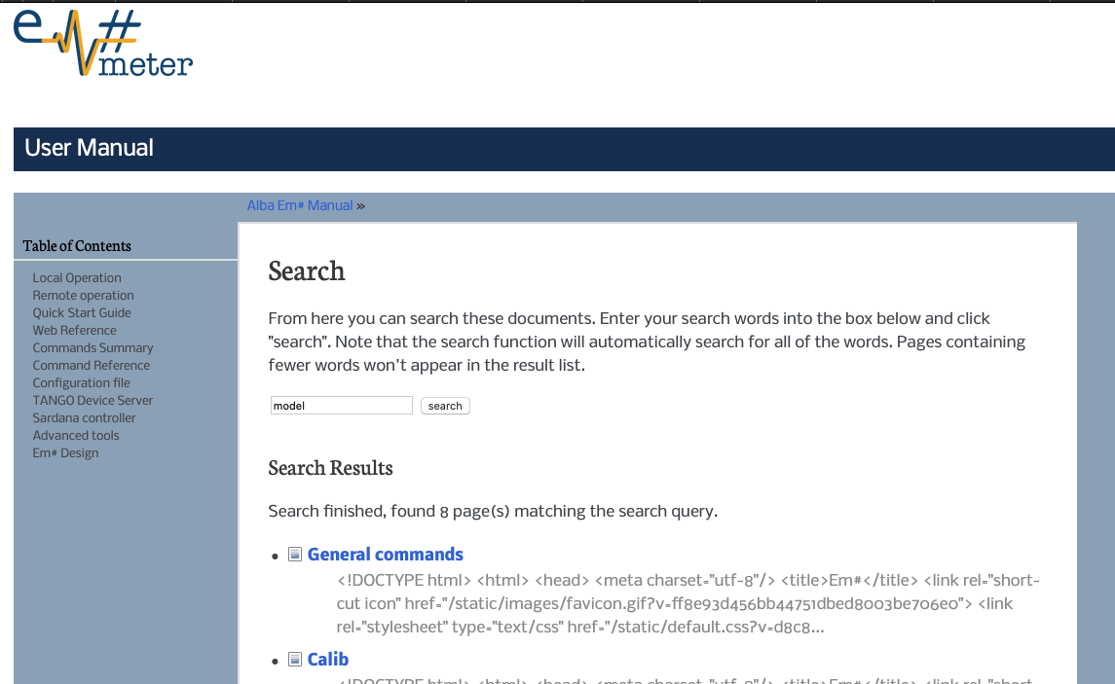
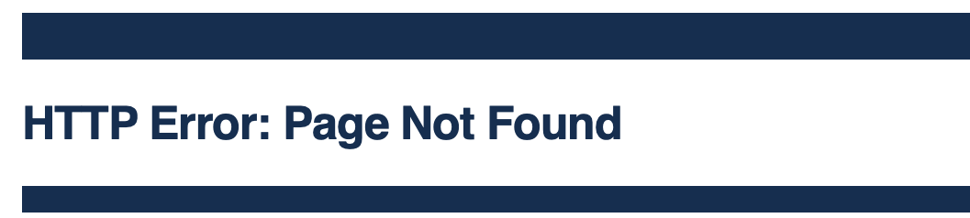
SW 2.0.0x – Issues & Notes Cont.
Documentation
  Links in the User Manual Search not populated!
  Information found in the user manual is not included when pdf-document is generated.

Slide 7
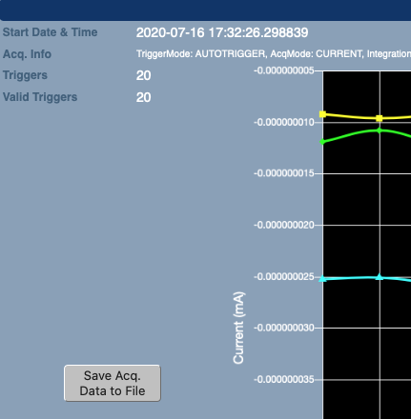
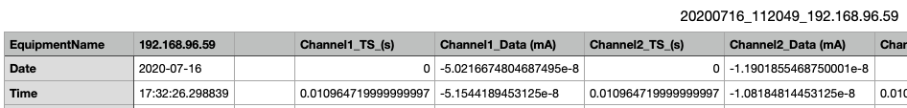
SW 2.0.0x – Issues & Notes Cont.
Minor issue.
Data file – Time tag in v 2.0.0x
  Time tag saved in the file (and shown on the web interface as well) is incorrect, while the timestamp added to the name of the CSV file is correct!!
  Using UTC-time that is default in Yocto
Terminal commands “timedatectl” and “ls –l /etc/localtime” don’t work
Used:
  date --set
  hwclock --set
Changing the default to localtime instead of UTC? Add support for NTP (Network Time Protocol)?

