Slide 1
Em# Collaboration Meeting
July 20-21, 2020

Slide 2
Multiplexer
Total in facility 55 produced in two batches
2nd batch
  Schematics 2016
  PCB 1804
  Bias current 80 pA expected
  Testing:
    Channels 0-6: 110 uA
    Channel 7: OK!
  20 units showing same behavior

Slide 3
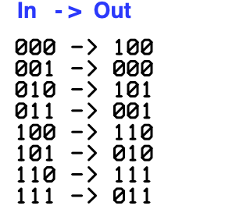
Schematics
Probing
  MUX/DEMUX (ADG708)
  Quad Comparator (LP339)
    Conversion
  Our case
    Output 011 for all selections!
    Always channel 7 was active!
    Comparator is broken?

Slide 4
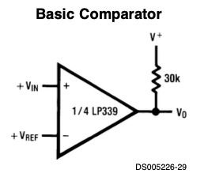
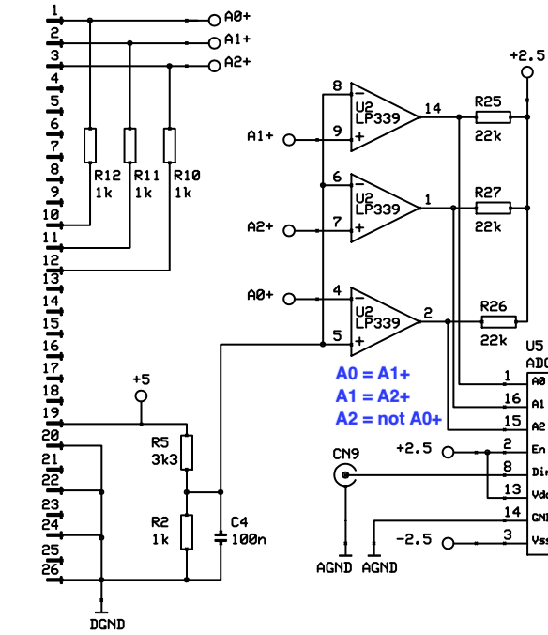
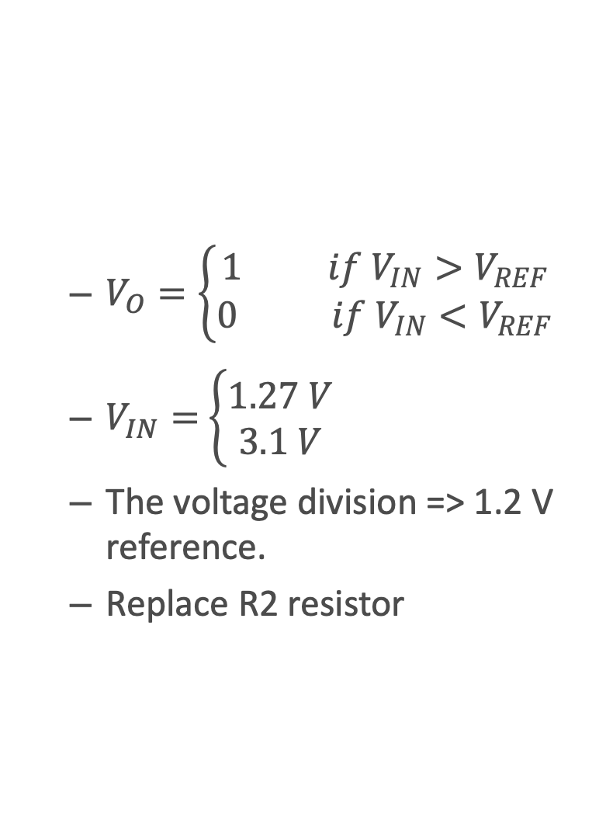
Comparator
  $V_{O}=\left\{\begin{matrix}1 if V_{IN}>V_{REF} \\ 0 if V_{IN}<V_{REF}\end{matrix}\right.$
  $V_{IN}=$ $\left\{\begin{matrix}1.27 V \\ 3.1 V\end{matrix}\right.$
  The voltage division => 1.2 V reference.
  Replace R2 resistor

Slide 5
Controlling Multiplexer
Currently from Em#
  DIO_5 set to 5V using Web interface
  DIFF_IO_1, DIFF_IO_2 and DIFF_IO_3 using SCPI commands.
Future:
  Dedicated (one-click) functionality for selecting channels in the Web interface (?)
  Selection on the Sardana/Tango level.

