Slide 1
Em# Collaboration Meeting
July 20-21, 2020

Slide 2
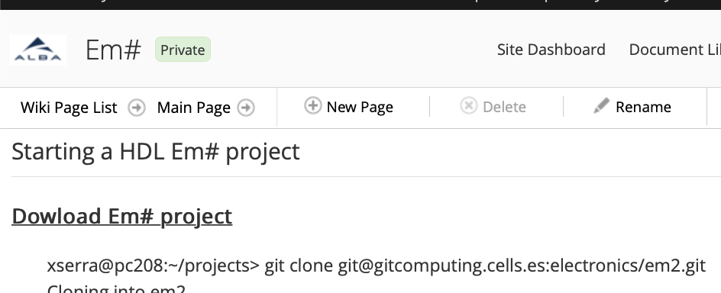
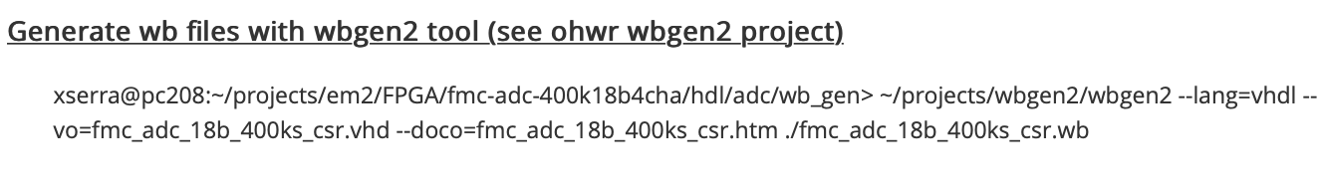

Starting HDL Em# project
Intuitively, one would start from Em# project at ALBA’s Alfresco

Slide 3
SPEC
OHWR provides guide to get started with SPEC
  wbgen2: Wishbone Slave Generator is a tool for generating VHDL/Verilog cores which implement Wishbone bus slaves.
  hdlmake: generates multi-purpose Makefiles for FPGA projects and supports synthesis, simulation and creation of ISE project files.
wbgen2 (cloned from ohwr)
  Written in lua language. Lua 5.1 is required.
  “sudo apt install lua” on Ubuntu 18.04 will install lua-5.3.4
    Deprecation problems, e.g., function module() that is crucial for wbgen2. Unpack lua-5-1 and install locally.
    Missing modules, e.g. md5.
  Configuration file must be changed to use lua 5.1!
Notes:
MD5 Message Digest algrorim, hashing function.

Slide 4
Wishbone files
Each WB file contains a description of a single Peripheral
General syntax:
  <code class="C">
  block {
  attribute1 = "string";
  attribute2 = 1234;
  block {
  attribute3 = ....;
  block { ... };
  };
  };
  </code>
Notes:
MD5 Message Digest algrorim, hashing function.

Slide 5
Wishbone files – Register
A Register block describes a single memory-mapped register.
A Register block can contains multiple Fields, each with number of attributes
  total size of all fields in a single register must not exceed the data bus width, of which each contain attributes
Align attribute
  Optional
  Specifies the alignment of the register's address to the nearest multiple of num
  Default value 1 means that the register is placed right after the previously defined register
Notes:
MD5 Message Digest algrorim, hashing function.

Slide 6
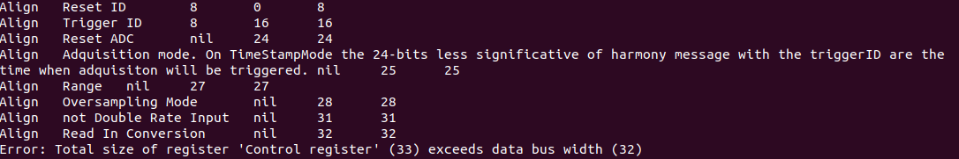
Wishbone files – Register cont.
% wbgen2 --lang=vhdl --vo=fmc_adc_18b_400ks_csr.vhd fmc_adc_18b_400ks_csr.wb
Miss-alignment of address space for field “Reset ID” in register “Control Register” leads to exceeding the data bus width, 32 bits.
Notes:
MD5 Message Digest algrorim, hashing function.

Slide 7
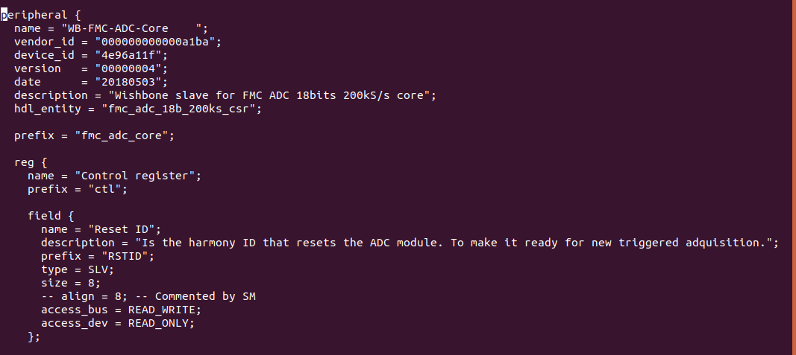
Wishbone files – Register cont. 2
Commenting the align-attribute solves the problem!
Notes:
MD5 Message Digest algrorim, hashing function.

Slide 8
Wishbone files – Register align cont. 2
wbgen2 versions
  ALBA: version 0.6.1-alpha (received from Xavier by email)
  MAX IV: version 0.7.1-epics (cloned late 2019 from Cern)
Alpha version seems to ignore the first alignment attribute, i.e. considering it as default 1. The register is always placed at address 0.
Epics version fixes this “bug”, which leads to the behavior seen here!
List of Wb files that need to be modified:
  /adc/wb_gen/fmc_adc_18b_FV_Ctrl_csr.wb
  /adc/wb_gen/fmc_adc_18b_400ks_csr.wb
  /em2/wb_gen/em2_digital_io_csr.wb
  /em2/wb_gen/em2_DAC_csr.wb
  /Harmony/wb_gen/AVERAGE_block.wb
  /Harmony/wb_gen/﻿em2_FIFO_block.wb
  /Harmony/wb_gen/﻿hrmy_counter_block.wb
  /Harmony/wb_gen/﻿hrmy_crossbar_block.wb
  ﻿/Harmony/wb_gen/hrmy_idgen_csr.wb
  ﻿/Harmony/wb_gen/hrmy_mem_block.wb
Notes:
MD5 Message Digest algrorim, hashing function.

