Slide 1
Em# Collaboration Meeting
July 20-21, 2020

Slide 2

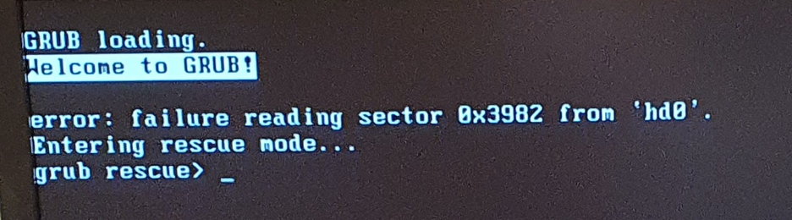
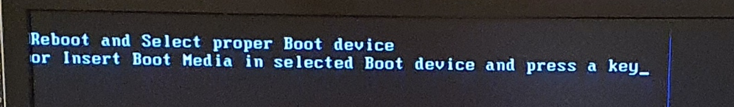
Problems & incidents at MAX IV
NanoMAX and KITSLAB – acquiring data at integration time 2ms, with HW trigger:
  Acquistion State Fault is obtained.
  Reboot while ssh-ed (restart Alin)
  HW-triggered acquisition won’t work.
  Solution: first acquiring with SW trigger. Then acquiring with HW trigger!
  The problem is observed with 1.3.03 and 2.0.00.
SoftiMAX – a device with software ver. 1.3.03
  When acquiring data over Sardana using HW trigger, the acquired values are listed as NaN, while the Web interface shows (on tab Acquisition) that the buffer actually contains real numbers!
  Once the unit is turned off, it doesn’t launch when turned on! Blue screen! Connecting an HDMI screen to the device reveals that the SBC doesn’t boot. Two messages are obtain, alternating after each boot-try. Waiting 10-15 minutes before switching on the unit will solve the booting problem

Slide 3
Problems & incidents at MAX IV – cont.
Turn off/on several times
  The unit was test at the lab.
  After switching off/on (to mimic the behavior from SoftiMAX unit), a blue screen is obtained!
  Ping & SSH are OK, but telnet and web server are not accessible.
  Ports 5025 and 8888 are not listed as Listening when terminal command
  netstat –tulpn is used.
  Kept the unit turned off for some time and turned on again. Everything is OK!
MMC problem (addressed in previous meeting, 2019)
  Unit connected to external display through HDMI port.
  Unable to launch.
  Error message
    mmc0: tried to reset card, got error -110
    mmcblk0: retrying using simple block read
    mmcblk0: error -110 sending status command, retrying
    mmcblk0: error -110 sending status command, retrying
    mmcblk0: error -110 sending status command, aborting

Slide 4
New requirement – Test Protocol
Basic functionality (SW)
  Connectivity
    Ping, SSH, Telnet and Web interface.
  Reboot/restart
    Problems with *RAP-command & Restart App-button
  Stop Web/Display
    crucial to achieve higher frequency.
Core functionality (HW)
  Amplifiers
  Filtering
  Ranges

Slide 5
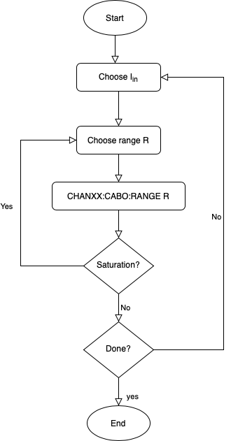
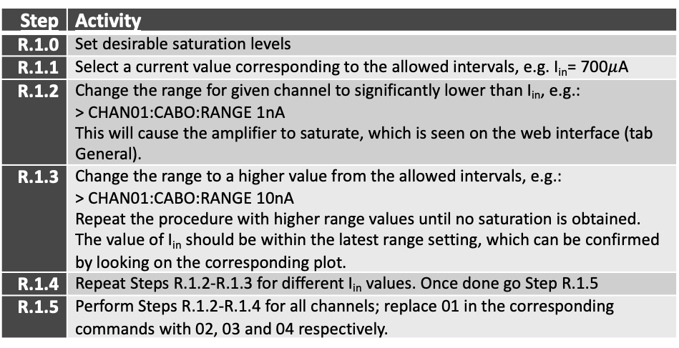
New requirement – Test Protocol cont.
Step | Activity
R.1.0 | Set desirable saturation levels
R.1.1 | Select a current value corresponding to the allowed intervals, e.g. I_{in}= 700$μ$A
R.1.2 | Change the range for given channel to significantly lower than I_{in}, e.g.: > CHAN01:CABO:RANGE 1nA This will cause the amplifier to saturate, which is seen on the web interface (tab General).
R.1.3 | Change the range to a higher value from the allowed intervals, e.g.: > CHAN01:CABO:RANGE 10nA Repeat the procedure with higher range values until no saturation is obtained. The value of I_{in} should be within the latest range setting, which can be confirmed by looking on the corresponding plot.
R.1.4 | Repeat Steps R.1.2-R.1.3 for different I_{in} values. Once done go Step R.1.5
R.1.5 | Perform Steps R.1.2-R.1.4 for all channels; replace 01 in the corresponding commands with 02, 03 and 04 respectively.
Fully automated testing
  Telnet port (no Tango/Sardana)
  Different input currents
  All triggering modes
  All acquisition modes.

