Slide 1
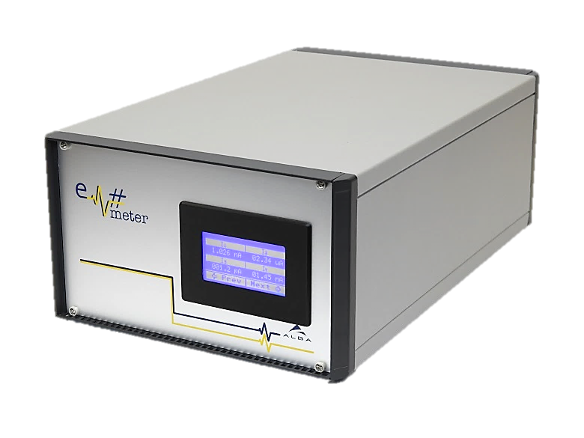


Em#
Collaboration meeting
Components Obsolescence
21. 07. 2020

Slide 2

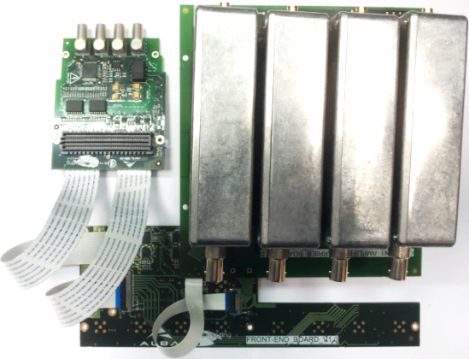
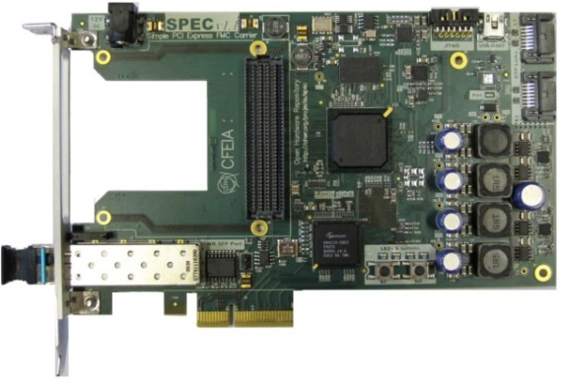
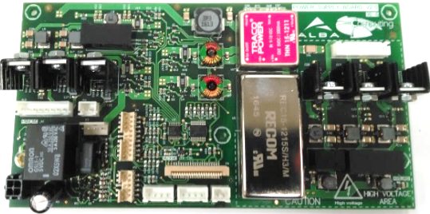
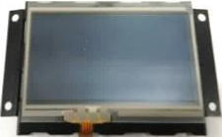
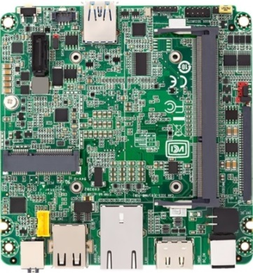
Em# block diagram
FMC_ADC, FEB, CACB, 4xCA
FMC
FPGA
PCIe
DISPLAY
ETH
I2C
SBC
PSB
USB
Front Panel Hader

Slide 3
Obsolete Components in Em# (2020)
Single Board Computer: Intel NUC DE3815TYBE
PCIe FMC Carrier: OHWR SPEC V4
    Component: Gennum GN4124 PCI-Express bridge
ALBA Em Current Amplifier
  Component: OPA128LM Electrometer-Grade operational amplifier

Slide 4
Obsolete Components in Em# (2020)
FMC_ADC, FEB, CACB, 4xCA
FMC
FPGA
PCIe
DISPLAY
ETH
I2C
SBC
PSB
USB
Front Panel Hader

Slide 5
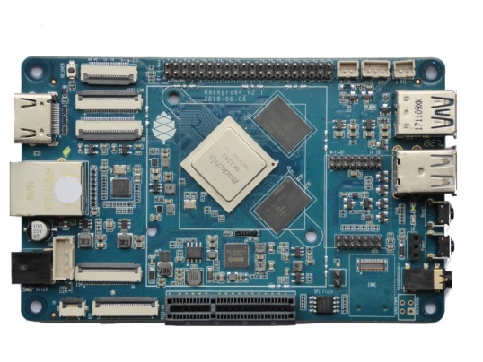
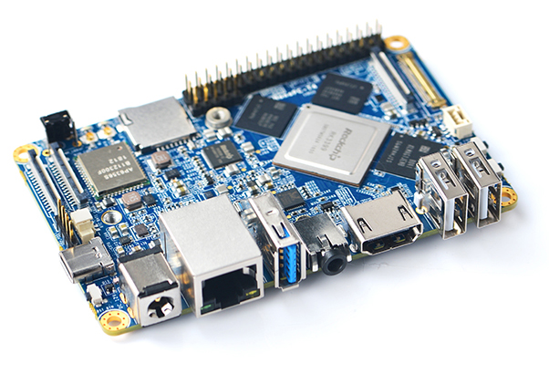
Single Board Computer: Replacement?
Basic Features:
  Fanless
  PCIe 4-lane interface
  I2C bus
  USB
  ETH
ROCKPro64 from PINE64 for 80$ ARM LTS(2023)
NanoPC-T4 from FRIENDLYELEC for 133eur

Slide 6
Single Board Computer : Risks and Opportunities
OPPORTUNITIES
RISKS
More than 2 core can improve the response times and speed with FPGA
Wider PCIe bus from actual PCIe 1x to PCIe 4x could do four times faster data transmission with FPGA
Solve problems with MMC memories
New Linux Driver
New YOCTO project for new CPU
ARM core are very popular and may do heavier the migration
I2C that controls Display and PSB maybe not compatible
PCIe code in FPGA is different

Slide 7
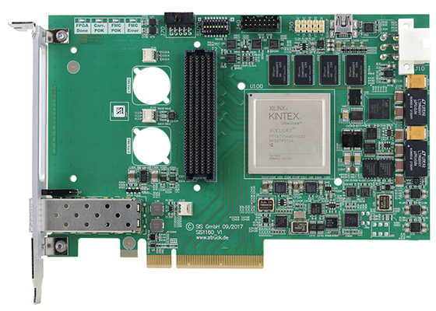
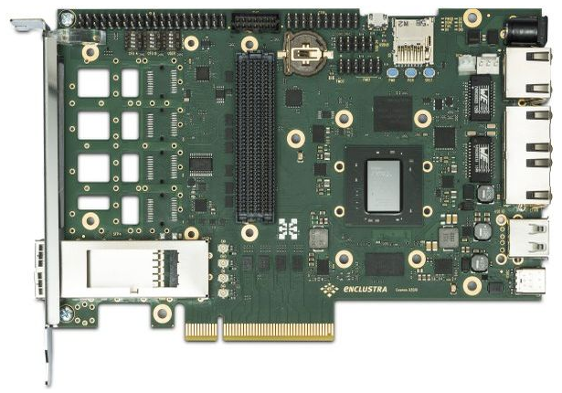
PCIe FMC Carrier: Replacement?
Basic Features:
    PCIe
  FMC LPC (minimum)
  12V External Input
SIS1160 from Struck Innovative Systeme GmbH
CO-XZQ10-111-I from enclustra ~750€

Slide 8
PCIe FMC Carrier: Risks and Opportunities
OPPORTUNITIES
RISKS
New FPGA with more resources
Change of control scheme by using a module with an FPGA with embedded microprocessor (i.e. SPEC7)
Project must be moved to new FPGA.
Clocks maybe different frequencies
Comunication with SBC: PCIe IP must be adapted

Slide 9
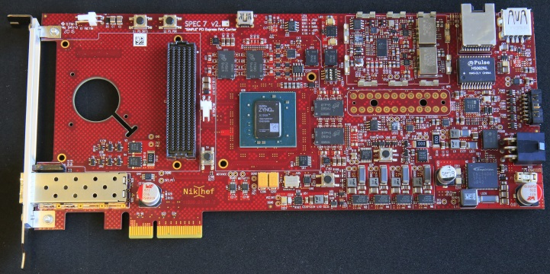
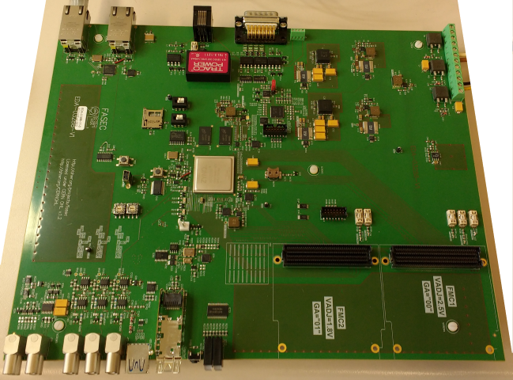
FMC Carrier
SPEC 7 (OHWR):
        Xilinx Zynq FPGA with Dual-Core ARM processor integrated (XC7Z030)
FASEC (OHWR):
  2x LPC FMC
  Xilinx Zynq FPGA with Dual-Core ARM processor integrated (XC7Z030)

Slide 10
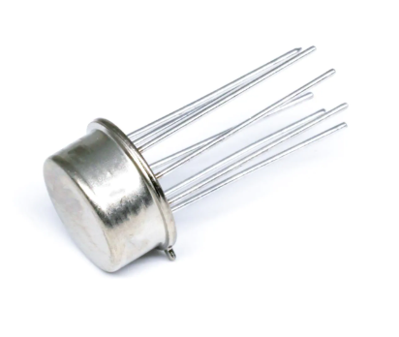
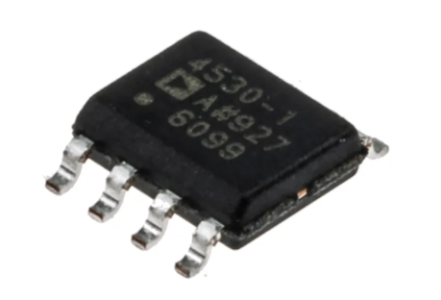
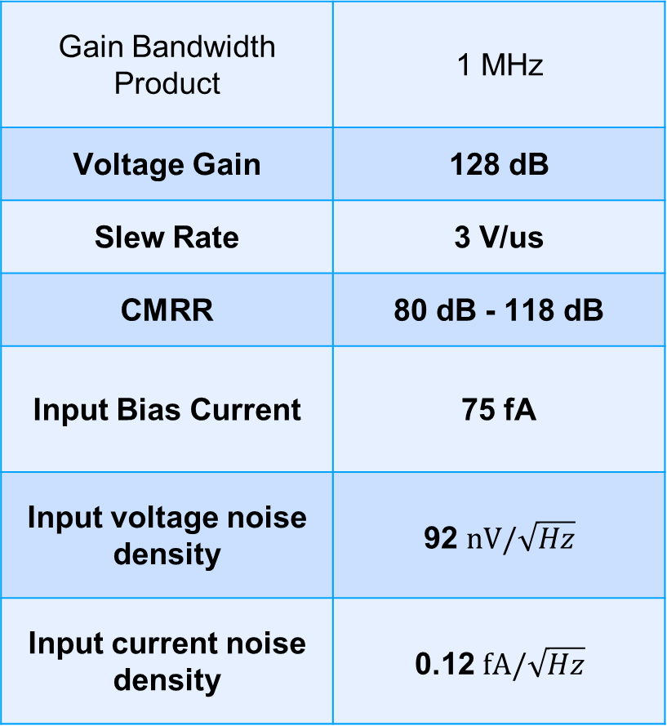
Current Amplifier
Gain Bandwidth Product | 1 MHz
Voltage Gain | 128 dB
Slew Rate | 3 V/us
CMRR | 80 dB - 118 dB
Input Bias Current | 75 fA
Input voltage noise density | 92 $nV/\sqrt{Hz}$
Input current noise density | 0.12 $fA/\sqrt{Hz}$
OPA128LM (obsolete)
Test possible replacements
ADA4530 from Analog Devices ~20

Slide 11
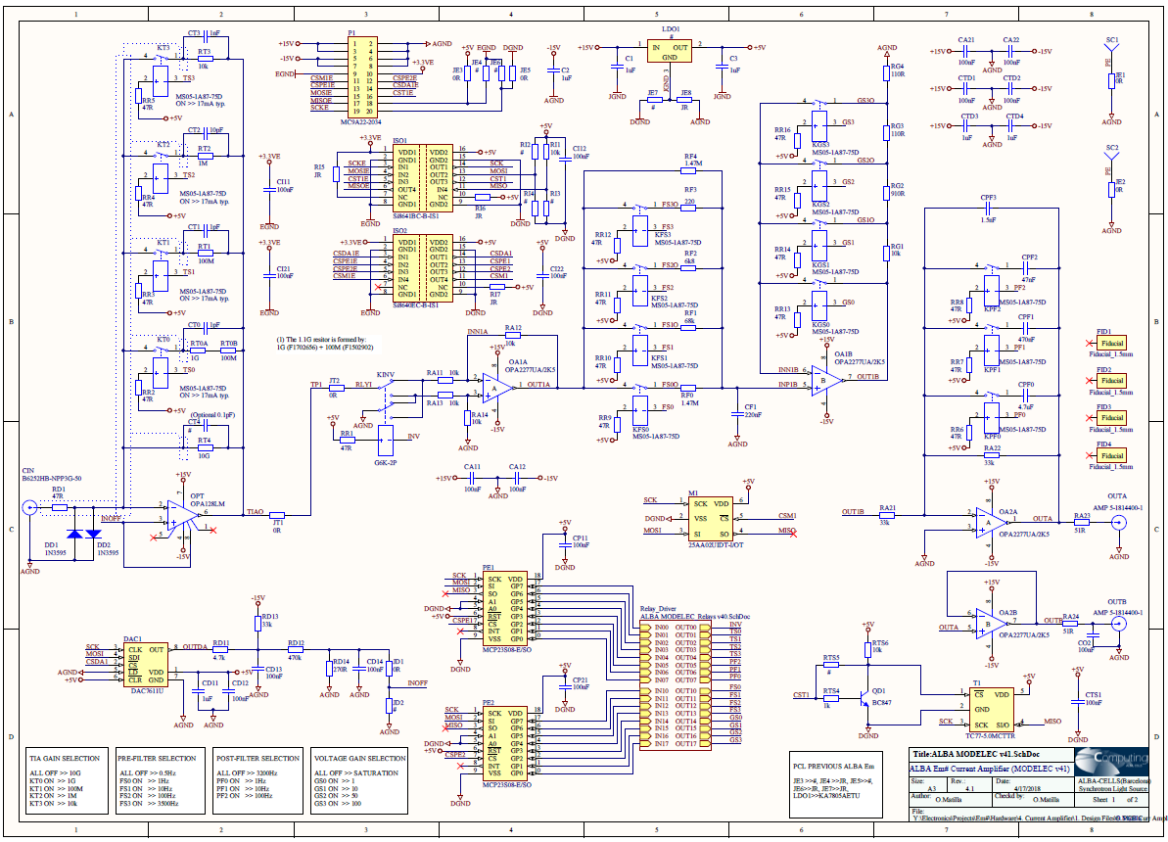
Current Amplifier
Improvement of Bandwidth: reach 200 kHz
New CA design
Improvement in Gain: reach 100G or higher
Study configurations and limits. Noise reduction

Slide 12
www.albasynchrotron.es
Carrer de la Llum 2-26
08290 Cerdanyola del Vallès, Barcelona, Spain
Tel: +34 93 592 43 00
@albasynchrotron

