Slide 1


Calibrating the Calibrator
Xevi Serra
20. 07. 2020
Notes:
Note: Please After adding your picture to “Image Place Holder” by “Drag & Drop”, right click on it and “Send it Back”.

Slide 2

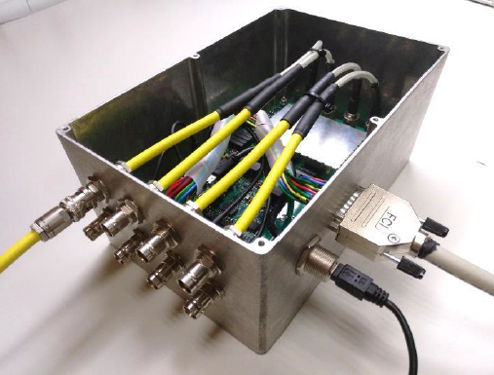
Calibrator
<number>

Slide 3
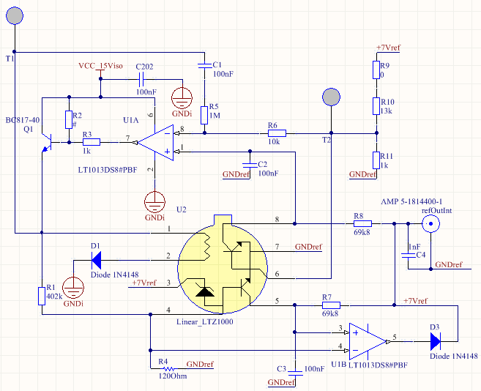
Voltage Reference
<number>

Slide 4
Elements to calibrate
EEPROM
7V Voltage reference
Resistors
<number>
EEPROM is used to identify the Calibrator and store the calibration values
The voltage reference is based on LTZ1000.
It has an amazing temperature stability, but tolerance is around 10%
Ageing has never studied
Some of Resistors are the same used in the CA, some other are selected with better temperature stability.
They must be calibrated and compensated against temperature

Slide 5
Voltage Reference
High stability low noise
Sensibility to Load
Surprises
<number>
0.05ppm/ºC
1.2μVp-p
The voltage reference is sensitive to the load
Depending on the resistor the voltage changes
So a buffer was used to isolate the reference from load
So it is mounted R40 instead of R45
When we start to test the calibrator, we discovered that a output capacity could create a oscillation on voltage reference
So C4 can not be mounted

Slide 6
Voltage Reference Calibration
Keysight 34470
Voltmeter setup
Voltmeter setup
<number>
The voltmeter is connected to refOut1 connector
Measurement type: DCV, range Manual 10V, aperture 20PLC, autoZero ON, InputZ Auto, DCV Ratio Off
Trigger Settings: Single, Delay Auto, Samples/Trigger 10, Sample Immediate
Null: Set with a shortcut in the input
Statistics ON
Triaxial cable connected to an Em# calibrator output (i.e. OUTPUT1) with a triax-coax adaptor and a 50Hom load connected.

Slide 7
Voltage Reference Calibration Procedure
Termal stabilization
Zero set
Dependency with load
<number>
After first switching ON of Keysight 34470A, wait for 90 minutes for thermal stabilization.
Apply a shortcut to the input (with a banana cable), wait for 2 minutes, and set the NULL value. The reading value should be 0.
Each range of 8 current ranges had a different calibration, due to the load dependency

Slide 8
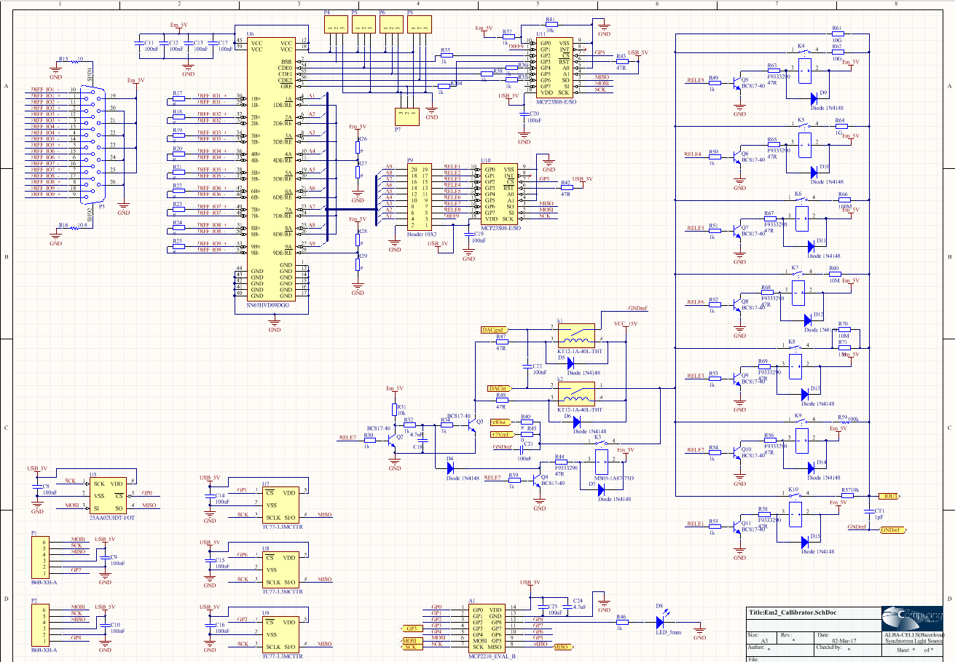
Calibrator Resistors
<number>

Slide 9
Resistors Calibration
Keythley 6517B
Setup
Used Keythley Volt source
<number>
wait for 2 hours for thermal stabilization.
Measurement type: Resistance, Vsource 7V, 10V or 100V, Speed Normal, Range Auto, Filter ON (moving average 100rds)
Each range of 8 current ranges had a different calibration, due to the load dependency

Slide 10
Store Calibration
Voltage reference
Current
.
<number>
Stored a value for each range
Stored a Value for each range and also a linear correction with temperature
.

Slide 11
www.albasynchrotron.es
Carrer de la Llum 2-26
08290 Cerdanyola del Vallès, Barcelona, Spain
Tel: +34 93 592 43 00
@albasynchrotron
Notes:
Note: Please After adding your picture to “Image Place Holder” by “Drag & Drop”, right click on it and “Send it Back”.

